Slide 1


Practice

Slide 2


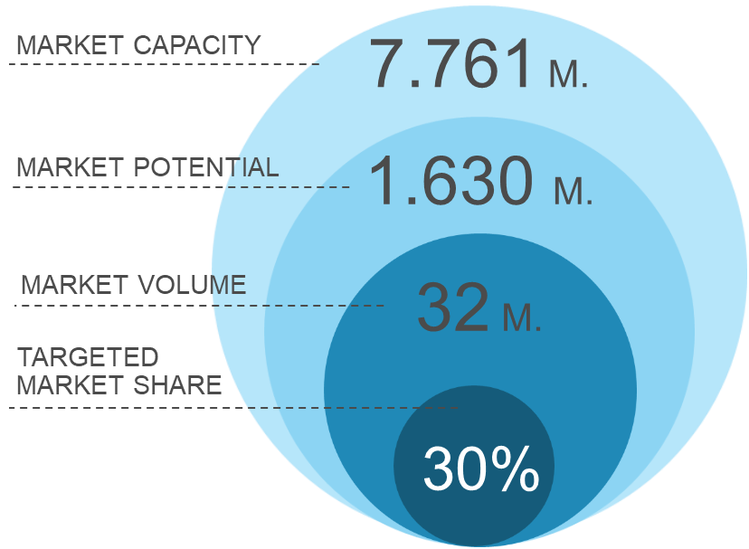

Secondary research collects the initial market information; keep it simple for success! Calculate your market size
Practice
1
Define your transaction
Me
Target group
Delivery of a Product / Service
Supplier of a
product or service
Constituted by customers and interested parties
Transaction
Payment
2
Calculate market volume / market potential (2 methods)
Reports
Company presentations
Statistics
Graphs
Start with “[my solution] market (statista)”
Market Reports and Estimates
Top-down

Slide 3
Product Name: ___
1
2
4
Product explanation:
…
Market estimation
Sources found/used
Assumptions made
…
Result: xy € per year
3
Market definition and segmentation:
Total market
Total addressable market
Possible market segments
Selected market segment

