Slide 1
Filter coffee.
Not people.
Dr Robbie Francis Watene
The Lucy Foundation
Aotearoa New Zealand
Small organizations as inclusion champions
Wednesday 5th March 14:00

Slide 2
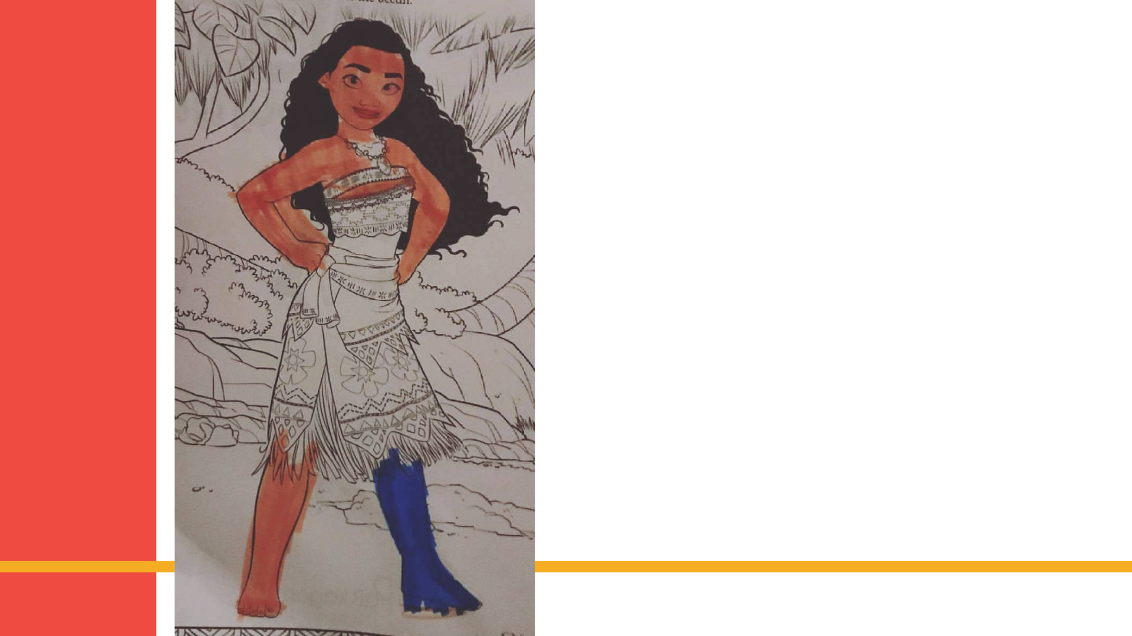
Pxt and text message from a friend.
"So my beautiful daughter was colouring in and she said 'I've made Moana just like Robbie and given her a Lucy Leg xx”

Slide 3
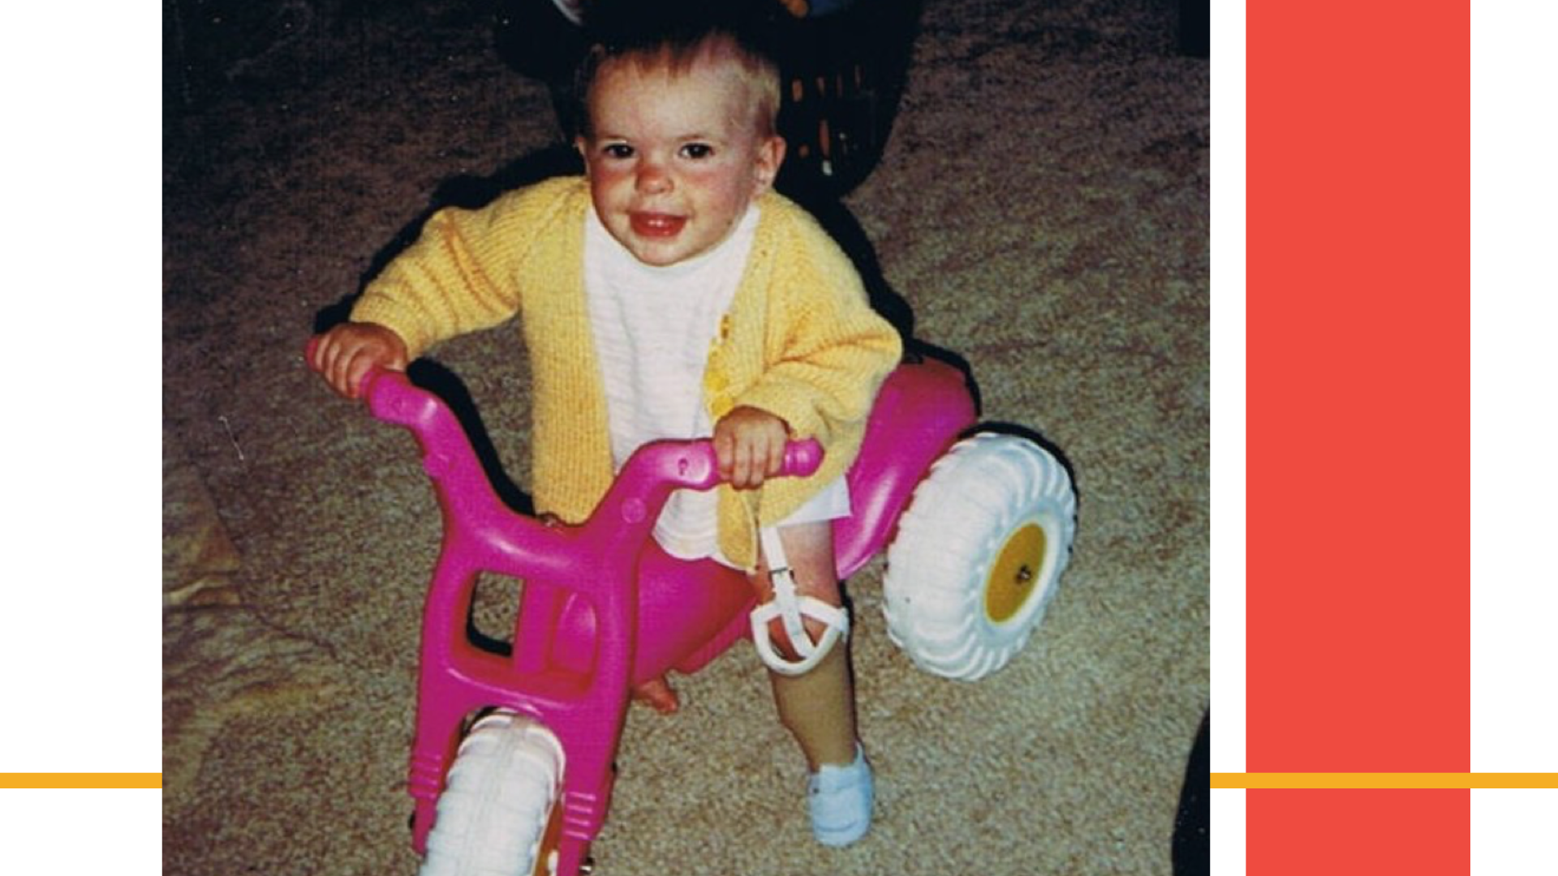
Robbie as a toddler.

Slide 4
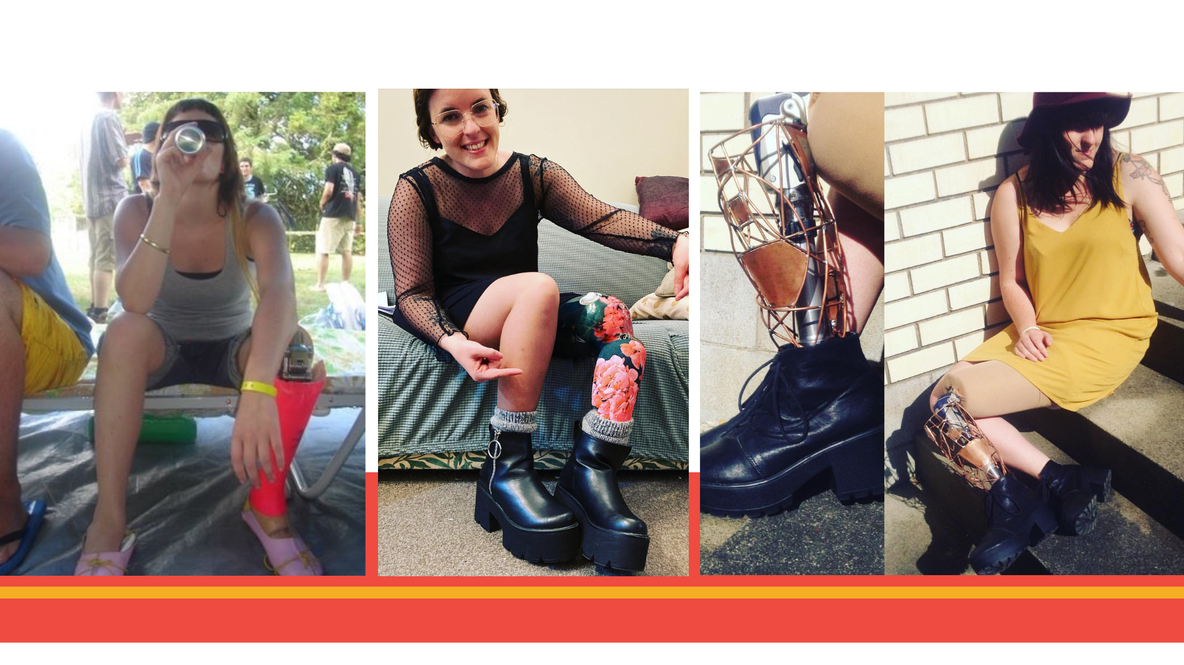
Photos of Robbie as a young adult.

Slide 5
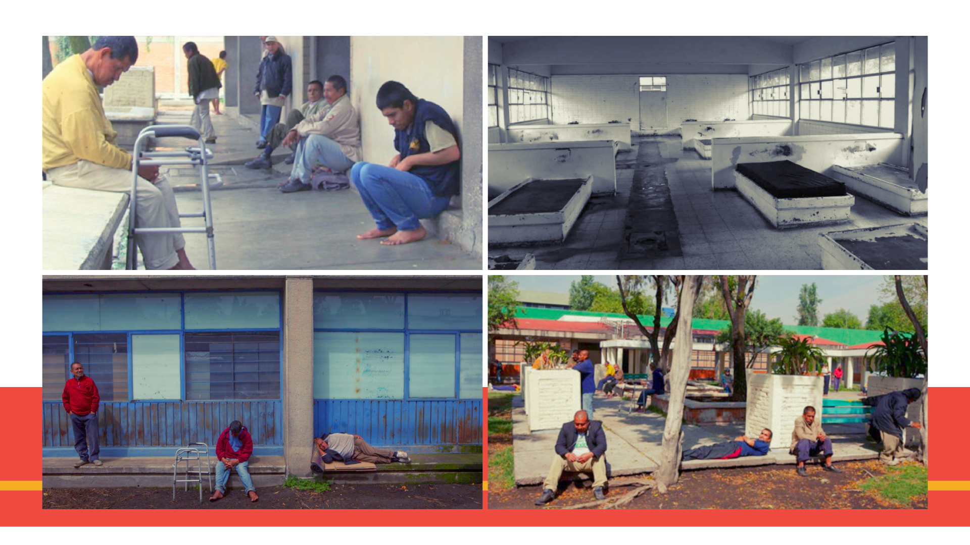
Photos inside an institution for persons with disabilities.

Slide 6

Line from a Brooke Fraser song.
“Now that I have seen,
I am responsible.”
- Brooke Fraser

Slide 7

The Lucy Foundation logo.

Slide 8
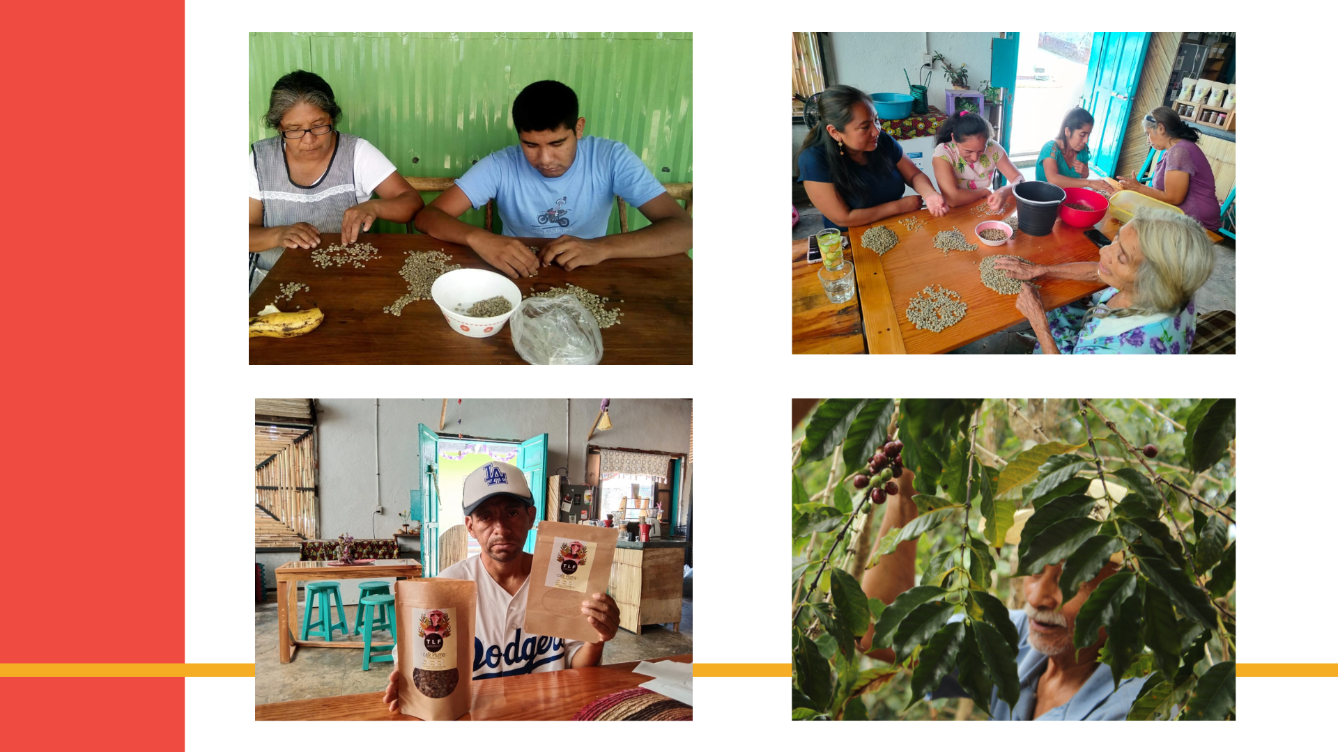
Photos from The Lucy Foundation Mexico.

Slide 9
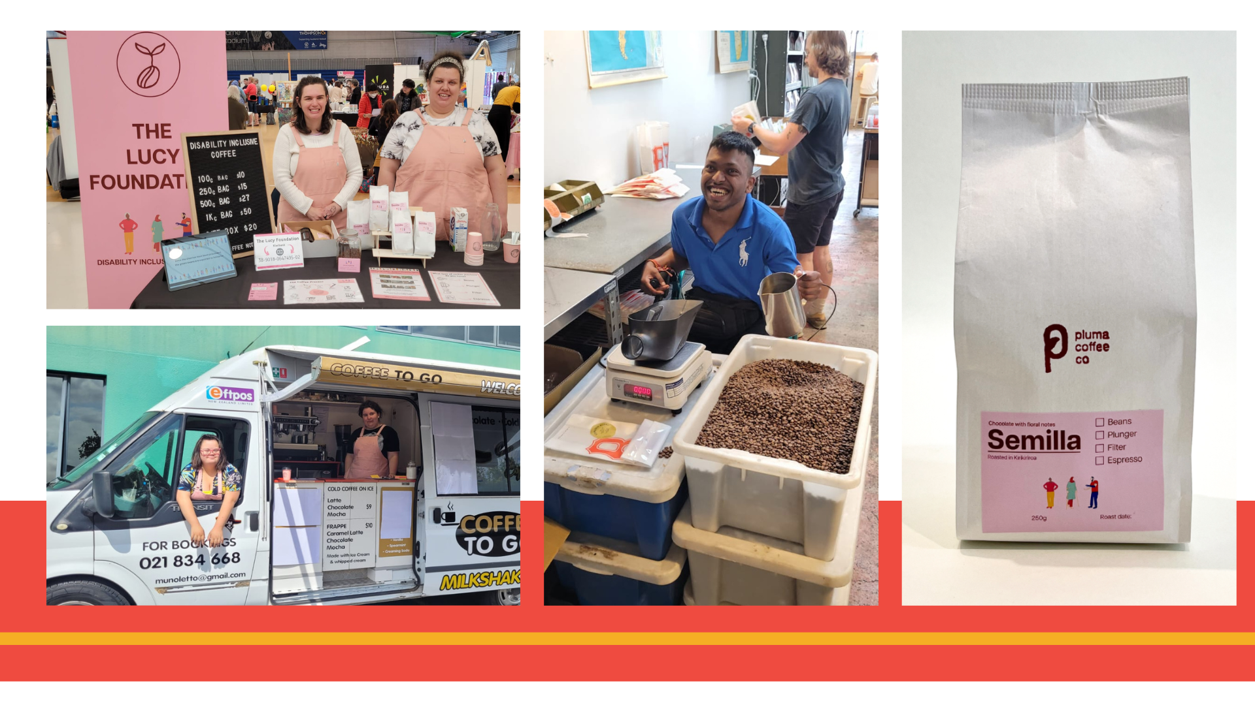
Photos from The Lucy Foundation Aotearoa New Zealand.

Slide 10
Pxt from a friend.

