Slide 1
INDUSTRIAL BIOTECHNOLOGY
MEETS
GLOBAL CHALLENGES
Dr. Martin Trinker
Director Business Development & Fundraising

Slide 2





We are acib
ACBT
2002-2010
30+ years of experience
SFB
Biocatalysis
1993-2003
Applied
Biocatalysis
2002-2010

Slide 3
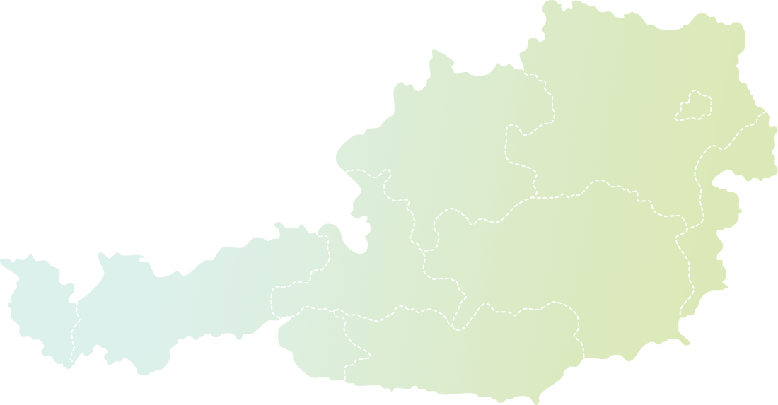

Bundling Academia in Austria
Additional locations of
Key researchers:
Tulln
• Belgium
• Germany
• Italy
• Poland
• Portugal
• Slovenia
• Spain
• Sweden
• Thailand
Vienna
Innsbruck
Graz
Strong academic core formed by shareholder Universities
Personnel embedded in academic working groups

Slide 4









Our identity
ACADEMIA
ACADEMIA
Break scientific ground
SCIENTIFIC
VALUE
Generate industrial value
ECONOMIC
VALUE
Fill industrial gaps
Train next generations
Austrian Centre
of Industrial
Biotechnology
Create regional impact
SOCIETAL
VALUE
Live international community
INDUSTRY
INDUSTRY
SOCIETY
SOCIETY

Slide 5




What makes us different:
One stop shop for industry
Industrial research
in academic environment
Great expertise:
top technical skills in
biotech & biomedical research
Excellent service:
Processing of contracts
(IP, confidentiality …) only with acib
Scientific partner
Associated partner

Slide 6
acib IP-Transfer
Foreground IP in company projects belongs to our industrial partner
Flexible ways on how to use generated IP:
Non-exclusive licence (basic fee of EUR 8,000-20,000 + 25% of patent costs + royalties/milestone payments)
Exclusive licence (basic fee of EUR 8,000-20,000 + 25% of patent costs + royalties/milestone payments with minimum annual payments)
Full IP Transfer (EUR 15,000-50,000 + highflyer or royalties or milestones)
Trade Secret (EUR 20,000-80,0000 + highflyer or royalties or milestones)
Later negotiation

Slide 7
Our areas of expertise
Biocatalysis
This research field describes the use of biocatalysts for the conversion and synthesis of molecules and replacing traditional chemical processes by efficient and environmentally friendly approaches.
Microbial Biotechnology
The research field includes the biotechnological utilization of microorganisms (bacteria, yeasts, fungi) and their compartments for the production of proteins or important metabolites.
Prof. Robert Kourist
Prof. Diethard Mattanovich
Enzyme Technologies
In this research field we are dealing with new enzymatic conversions in synthetic approaches in order to close current gaps of enzymatic process applications, as well as the immobilization of enzymes.
Protein Engineering
We combine direct laboratory evolution with structure-based rational design to optimize the activity, stability, affinity, solubility or expression of proteins from enzymes to biotherapeutics.
Prof. Bernd Nidetzky
Prof. Bernd Nidetzky

Slide 8
Our areas of expertise
Cell line Development & Epigenetic
The projects carried out in this area deal with a detailed, molecular understanding of the properties of production
cell lines (e.g. CHO) that are used for the manufacture of biopharmaceutical products.
Bioinformatic & Simulations
Genes, RNA, proteins and metabolites are the key players in biological systems. The sum of these parts is less than the whole, because these actors never act alone, but are integrated into complex and multi-layered networks.
Prof. Nicole Borth
Prof. Jürgen Zanghellini
Bioprocess technologies
The research area Bioprocess Technologies deals with the development of improved or new biotechnological (continuous) processes, flexible production and process intensification, as well as process analytical technologies.
Environmental Biotechnology
& Bioeconomy
Optimizing recycling and the valorization of waste is an important topic at acib. From degradation of natural to synthetic polymers to bioleaching and valorization of waste streams, acib is in the driving seat of the new bioeconomy.
Prof. Alois Jungbauer
Prof. Georg Gübitz

Slide 9
acib – Cooperation Opportunities
acib offers:
+ contract research in all areas (from R&D to production and analysis)
+ extensive literature studies
+ consulting for funded research
+ professional project management for (funded) projects
+ professional dissemination activities
+ innovative and reliable partnership in (inter)national funding calls´
+ organization of events and conferences
+ training courses (theoretical and 'hands-on‘)
+ partner search
+ looking for technologies
+ 'acib task force' => solving challenging problems at your R&D Facility

Slide 10
acib – Cooperation Opportunities
acib works with...
Company partners for on new products and processes
Scientific partners on competitive funding proposals
Investors for maturing technologies and start-up building
Foundations and donors on making the world a better place

Slide 11
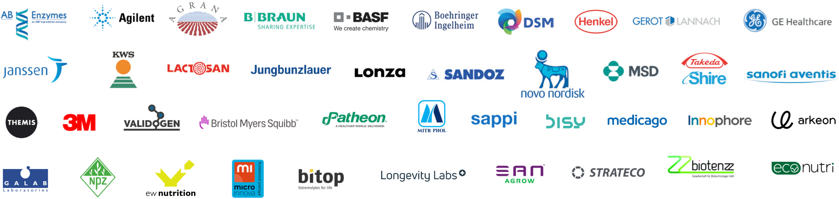
Some of our company partner

Slide 12
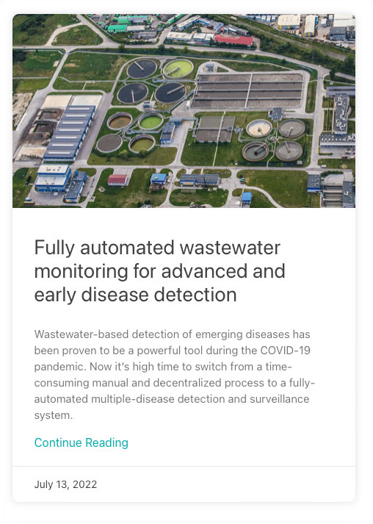
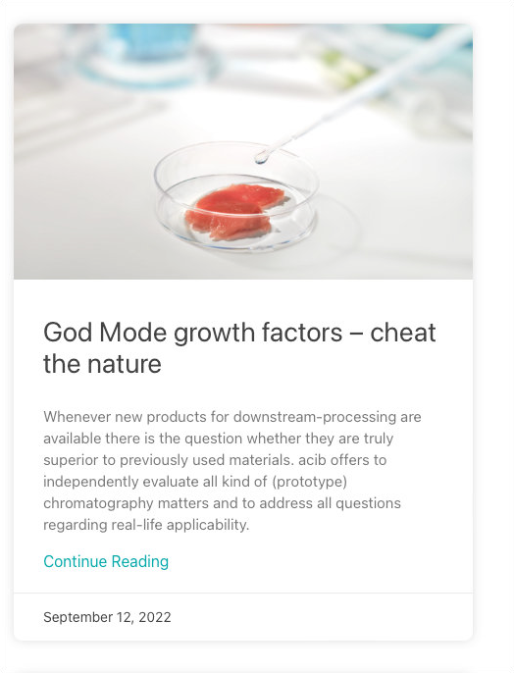
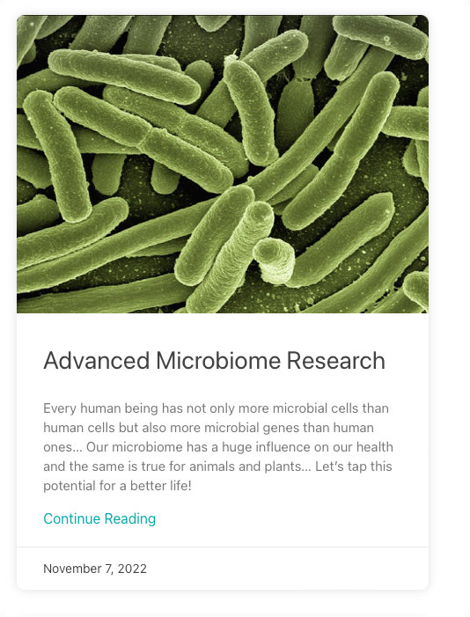
Research market place
New Innovations from Nature …
Project Offers:
Ideas with a solid background for an industrial project, e.g. feasibility or proof-of-concept studies.
Technology Offers:
Mature technologies for licensing, transferring IP or new research project.
Service Offers:
Service provided to others, e.g. Dissemination & Communication offers.
sent with Directmail to 12,500+ e-mail adresses,
also available at https://acib.at/offers

Slide 13
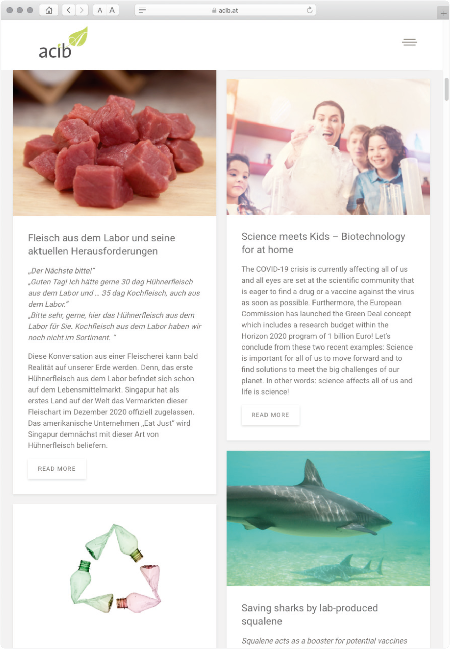
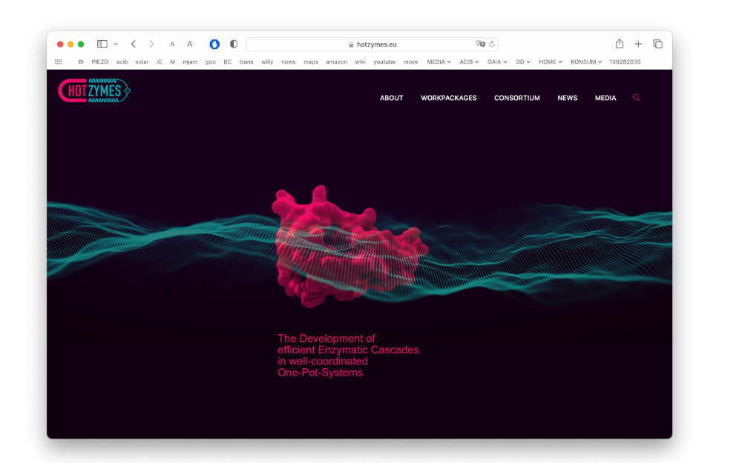

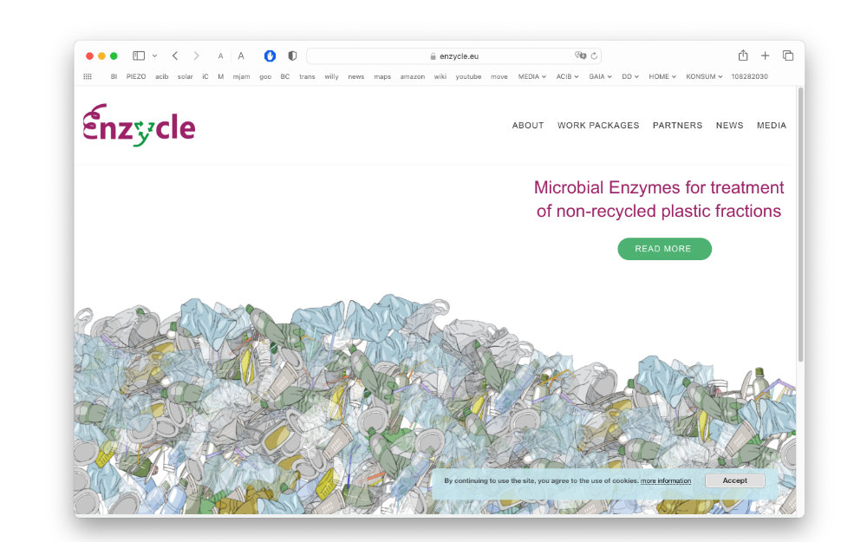



Holistic valorization approach
Open Multichannel Communication
Find out more about our projects,
and visit our project homepages
Watch our Explanatory videos
on our Youtube-Channel
Connect with us on Social Media,
and visit us on Facebook, Instagram
and LinkedIn
Watch our Blog
www.acib.at/blog

Slide 14
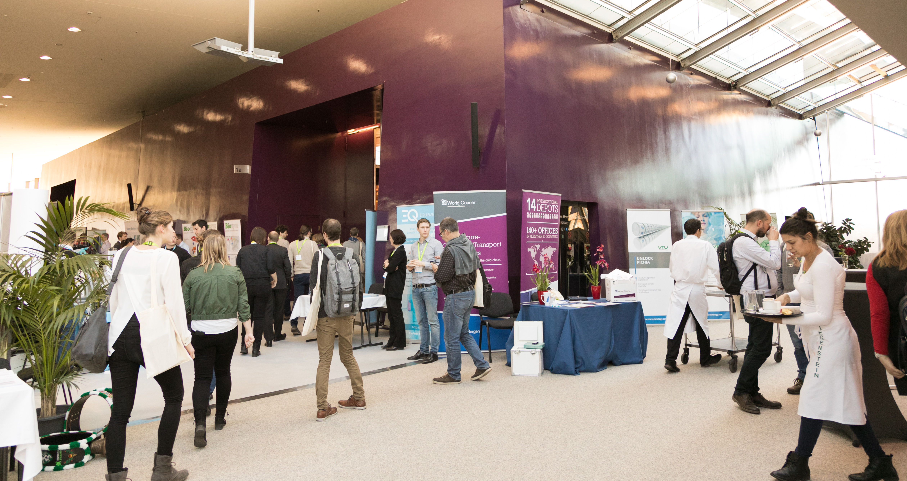


European
Summit
of Industrial
Biotechnology
November 10th to 12^{th,} 2026
https://www.esib.at
14

Slide 15
Dr. MARTIN TRINKER
Director Business
Development & Fundraising
Krenngasse 37/2
8010 Graz, Austria
P: +43 720 270664 17 martin.trinker@acib.at
Thank you
For your attention
© 2026 by acib
AUSTRIAN CENTRE
OF INDUSTRIAL BIOTECHNOLOGY
acib GmbH
Krenngasse 37/2
8010 Graz, Austria
https://acib.at

