Slide 1
Entrepreneurship and leadership development for young people with disabilities
Kriszta, Zsiday
Salva Vita Foundation
Hungary
Thursday, February 22, 2024
14:40 – 16:00 CET
Notes:
Kriszta, Zsiday
Salva Vita Foundation
Hungary
Entrepreneurship and leadership development for young people with disabilities
Thursday, February 22, 2024
14:40 – 16:00 CET

Slide 2
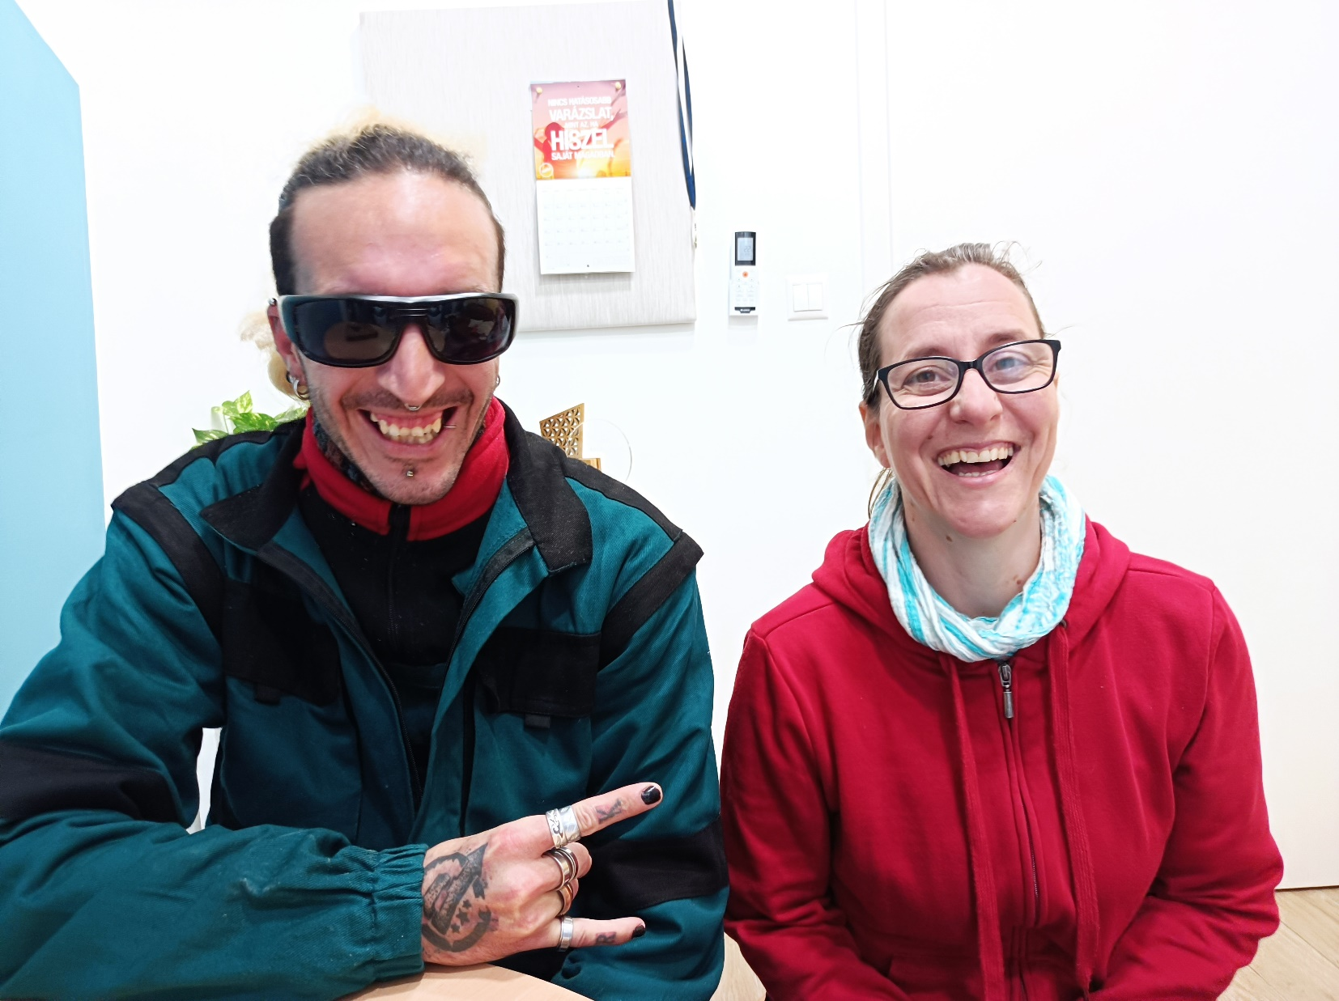
Youth House: Empowering vulnerable young people with disabilities
Salva Vita Foundation: “We are building a world where everyone has a place, a role, a task, and everyone is valuable.”
30 years of experience
Support to find and keep jobs
Services for employers
Youth House: "Empowering Futures,
Embracing Differences: where every journey
finds its unique path"
Practical skills
Soft skills
Psychological support
Notes:
The Salva Vita Foundation, with 30 years of experience, is dedicated to creating an inclusive world. Their Youth House focuses on empowering individuals through job support, practical and soft skills development, and psychological support. They envision a world where everyone has value and a unique path towards success.
Photo: one of our youngsters with his job coach. They had great relationship during the work which is essential for successful cooperation.

Slide 3
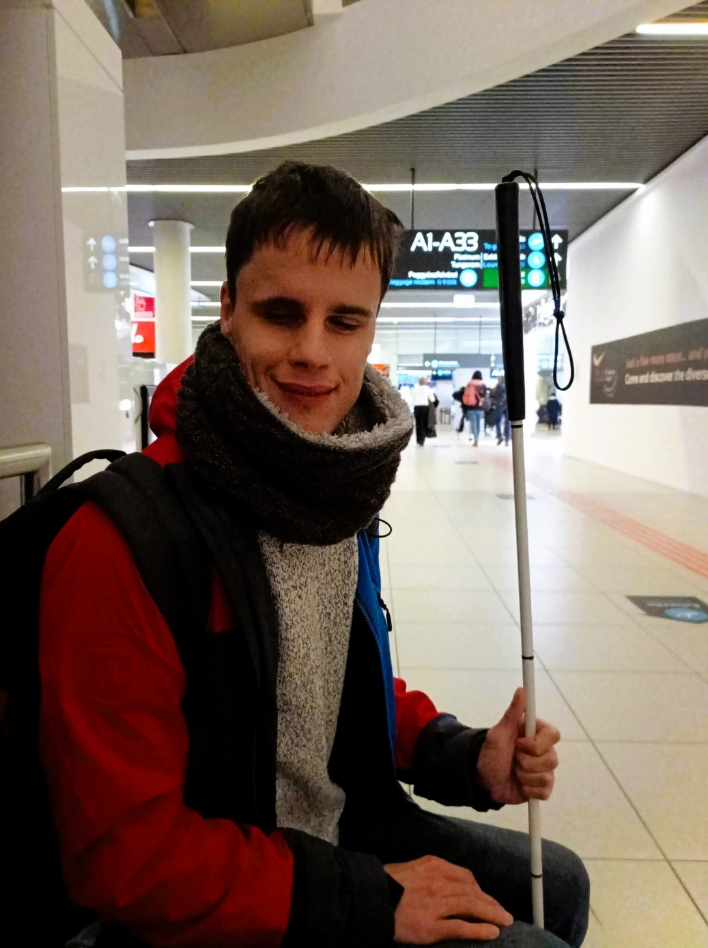
"Discovering my strengths, connecting with others, and charting my own course"
Youth House
2019 - 2020 Research: young people, family members, relatives, employers
2020 - 2021 Developing a methodology
2021 – Adapting method to the specific clientele and circumstances
Goals and objectives
NEET (Not in education, employment, or training) youth
Support the social and labour market integration of youth aged 15-29
Results
30% found employments/school
Skill development: communication, social skills, realistic self image, mental health improvement
Notes:
The Youth House project, conducted extensive research in 2019-2020, developed a methodology in 2020-2021, and adapted it to specific needs. Focused on NEET youth aged 15-29, it aimed to integrate them into the social and labor market. Results include a 30% success rate in finding employment or returning to school, along with skill development in communication, social skills, fostering realistic self-image, and enhancing mental health.
Photo: One of our visually impaired young clients represented the program in Brussels. It was the first flight of his life, he was very excited. He was accompanied by a volunteer, a university student.

Slide 4
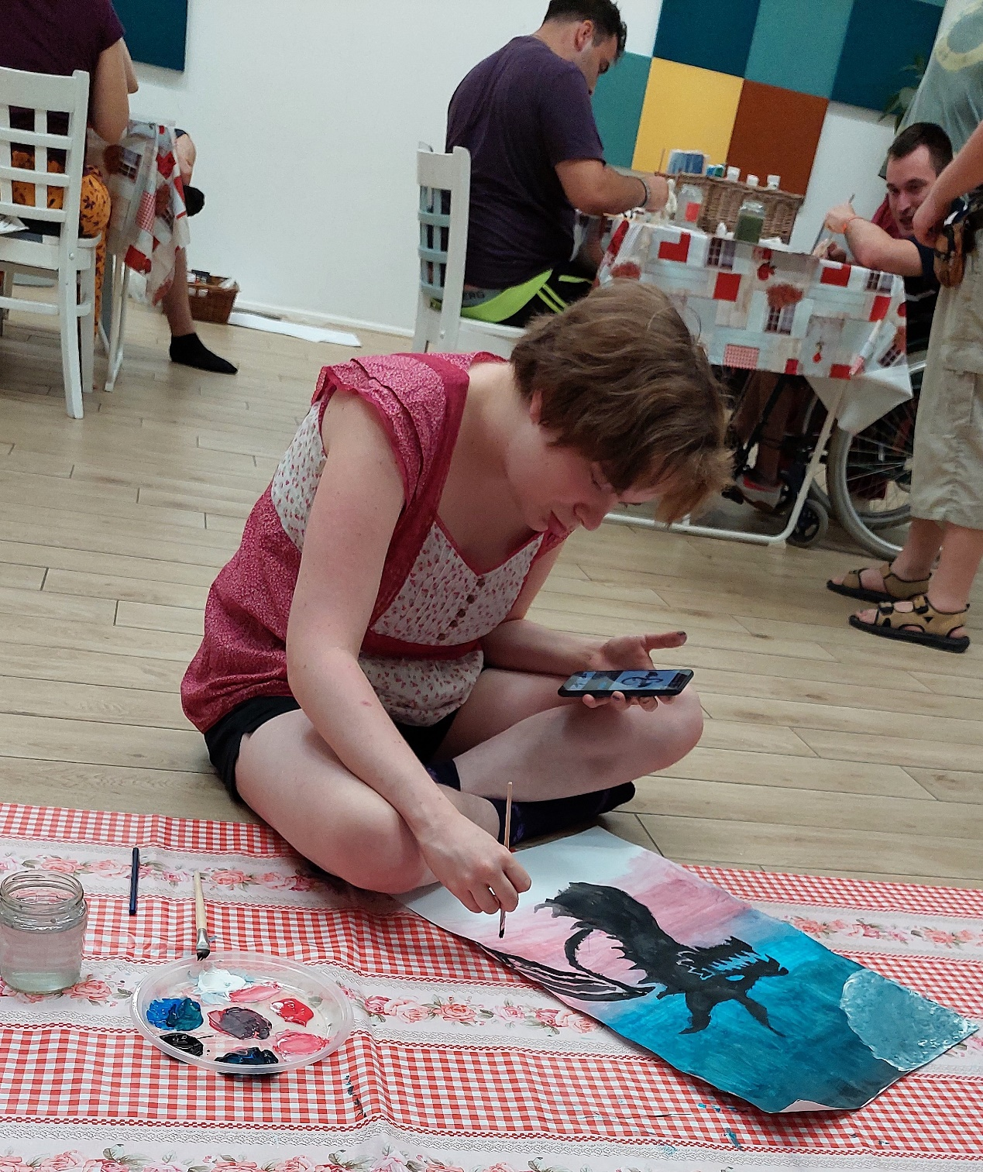
„Innovation is the compass that guides us through uncharted territories”
Revolutionizing Youth Support
Complex methodology
Holistic approach
Multi-disciplinary cooperation in one place
Adaptation of existing practices
Individualized, person-centered approach
Inclusion of youth to design services
Self-directed participation
Mixed abilities groups
Awareness-raising (peers, employers, environment)
Notes:
The Youth House revolutionizes youth support with a complex, holistic methodology. Its multidisciplinary cooperation, blending existing practices, emphasizes individualized, person-centered approaches. The inclusion of youth in service design, self-directed participation, and mixed-ability groups fosters awareness among peers, employers, and the community.
Photo: A hearing impaired young woman in an art class drew a beautiful picture. Dóri is now a member of one of our clubs.

Slide 5
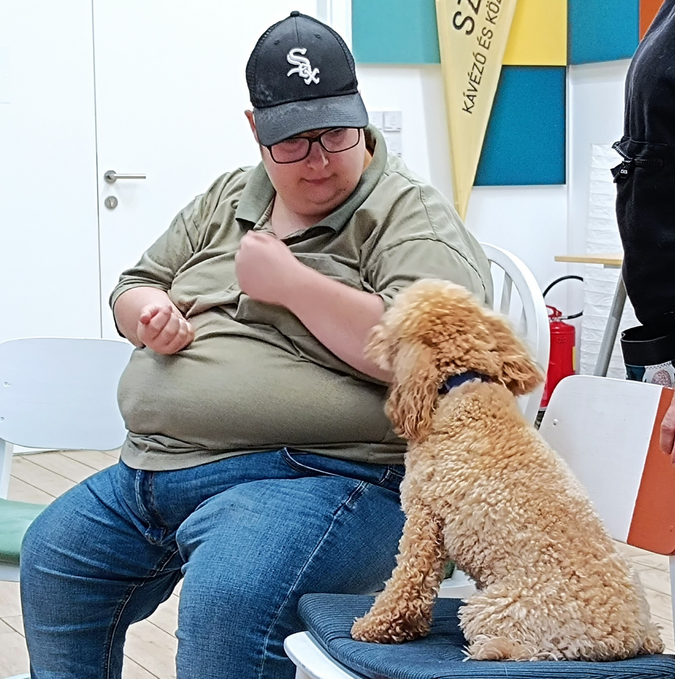
Multi-disciplinary cooperation
Psychologist
Psychiatrist
Mental health professional
Therapist
Youth worker
Social worker
Motivation specialist
Mentor: Community worker
Special needs teacher
Teacher
Vocational trainer
Life skills counsellor
Job counsellor
Human Resource (HR) Specialist
Financial adviser, accountant
Notes:
The Youth House boasts a dynamic, multidisciplinary team including psychologists, psychiatrists, mental health professionals, therapists, youth workers, social workers, motivation specialists, mentors, special needs teachers, regular teachers, vocational trainers, life skills counselors, job counselors, HR specialists, and financial advisers, providing comprehensive support for the youth.
Photo: One of their favorite activities was the dog therapy. We still love dogs.

Slide 6
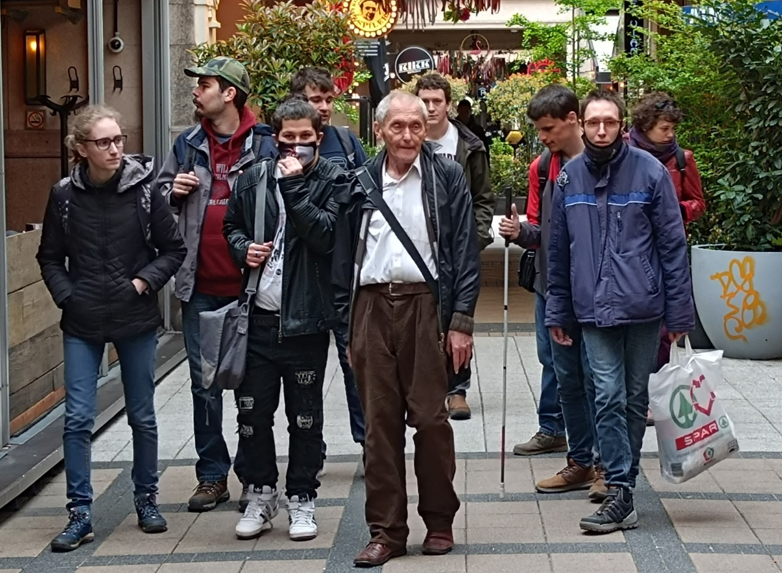
„not just numbers, but transformative stories of individuals who dared to dream and, with our support, turned it into reality"
More than words
200 youth interested/year
70 employed/back to school
150 youth took part in services
30 companies involved
personal, individual development
Social skills
Reduction of anxiety
Dealing with quarter-life crisis
technical, practical steps
Realistic skills assessment
matching desires and possibilities
skills development
Notes:
The Youth House transcends numbers, embodying transformative stories of individuals who, with support, turn dreams into reality. Engaging 200 youth annually, with 70 securing employment or returning to school, 150 participating in services, and 30 companies involved, it fosters personal and social development, addresses anxiety, and guides practical, realistic skills development.
Photo: Involving seniors meant a lot to all of us: youngsters and trainers.

Slide 7
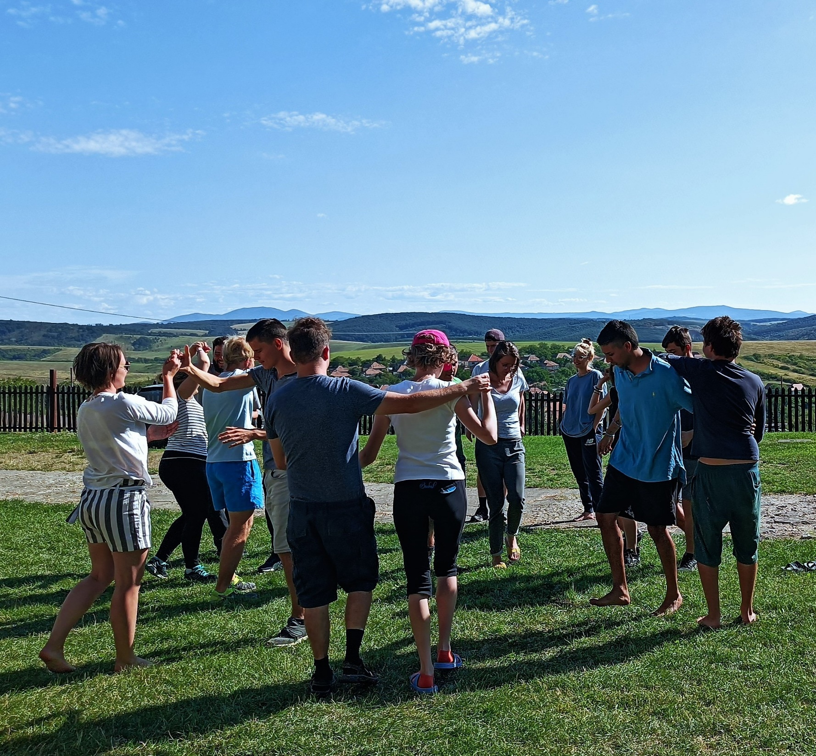
Keys to Success
Complex solutions to the complex problems of youth with disabilities
Assist youth to make their decisions
30 years experience and targeted research
Application of Carl Rogers' principles
Holistic approach
Networking, multi-disciplinary cooperation
Personal encounters of different abilities, stories, ages
Role model, peer support
International experiences, involving foreigners
Learning self-management, autonomy, decisions
Balance between emotional and practical matters
Intergenerational programs
Notes:
Success lies in complex solutions for youth with disabilities, emphasizing decision-making empowerment, guided by 30 years of experience and targeted research. Applying Carl Rogers' principles, the program adopts a holistic approach, fostering networking, multi-disciplinary collaboration, and diverse, intergenerational personal encounters. It integrates role models, peer support, and international experiences, promoting self-management, autonomy, and balanced emotional and practical development.
Photo: A week away from the family: summer camp in the countryside. Nature, relaxation, foreign volunteers, developmental activities.

Slide 8
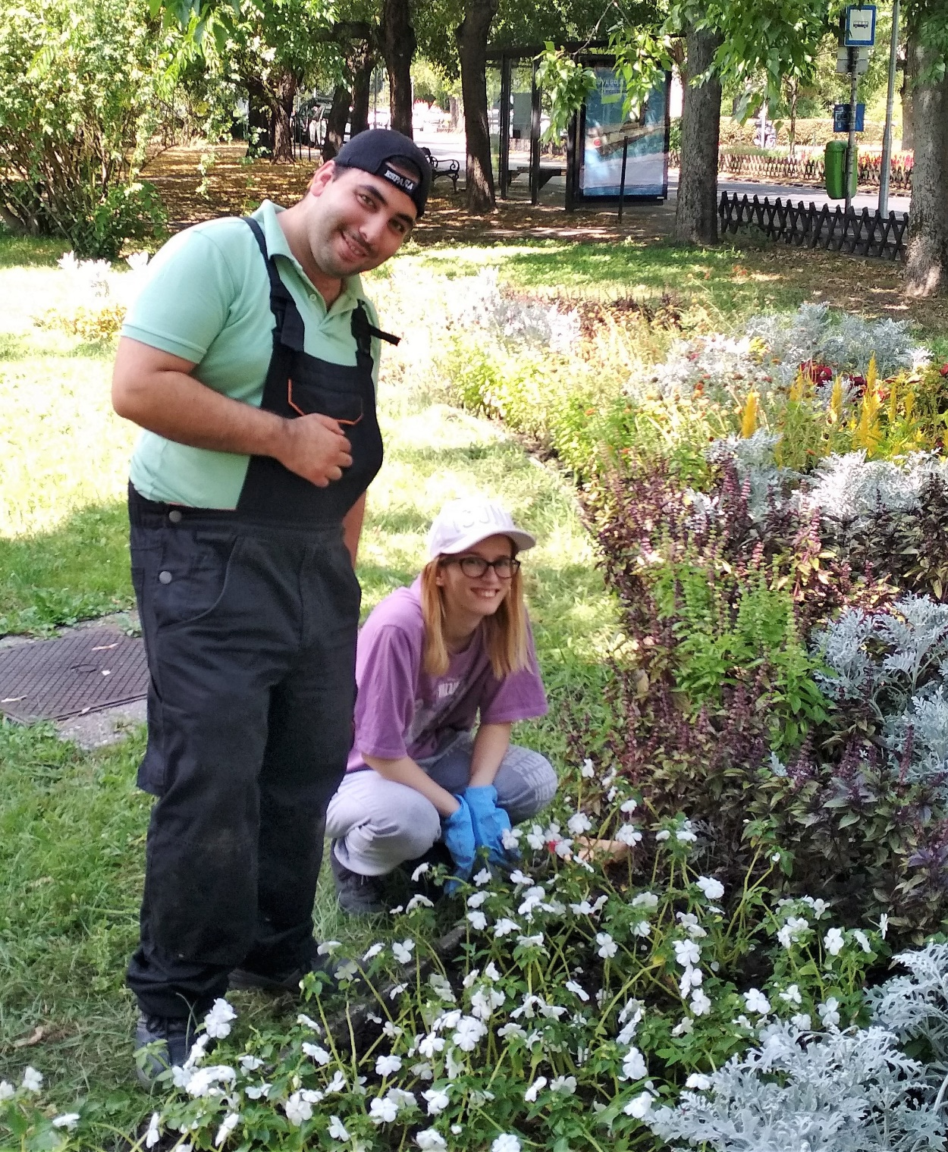
Financing, sustainability
Primary funding from the EEA and Norway in 2021-2023
Erasmus+ programme 2023-2026
Corporate supporting:
MOL New Europe Foundation
DXC Technology
London Stock Exchange
Morgan Stanley
Individual & parental donations
Voluntary & material contributions (regular volunteers (peer, senior), university students,
foreign youth, seniors)
Notes:
Securing primary funding from the EEA and Norway (2021-2023) and the Erasmus+ program (2023-2026), the Youth House extends its support with corporate backing from entities like MOL New Europe Foundation, DXC Technology, London Stock Exchange, and Morgan Stanley. It further sustains through individual, parental donations, and voluntary contributions, involving regular volunteers, university students, foreign youth, and seniors.
Photo: As part of the cooperation with employers, young people had opportunity to work trials in several places.

Slide 9
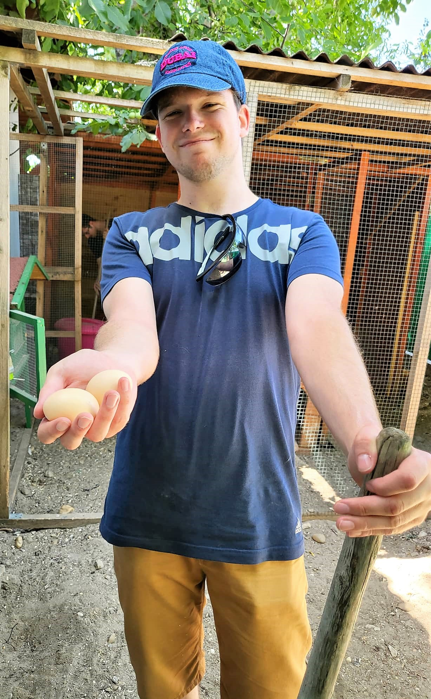
The road ahead
Expansion of services and outreach
Developing impact measurement tools
International mobility
Preparing families
Social enterprises
Independent, supported housing
We invite partners for collaboration,
partnerships, or support!
https://youtu.be/T4LULgY_5ZA
Notes:
The Youth House aims to expand services, enhance outreach, develop impact measurement tools, facilitate international mobility, prepare families, and promote social enterprises and independent supported housing. The organization invites partners for collaboration, partnerships, and support in these initiatives.
Photo: A great experience: on the farm, among the animals. And a couple of eggs, a symbol of new life and rebirth.

