Slide 1
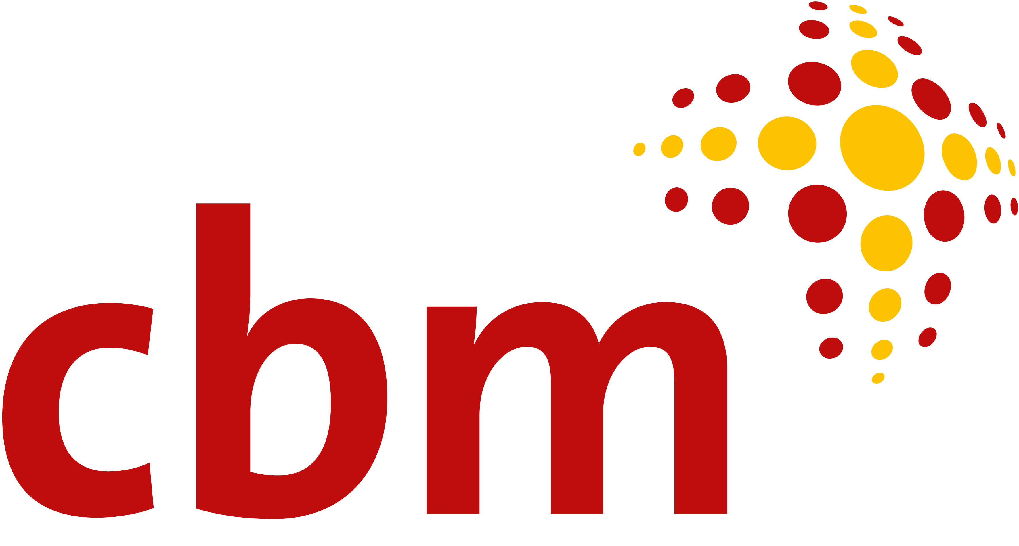
Integration strategies for mainstream schools and youth services
Carmen Lucía Guerrero / Mauricio Mogollon
Christian Blind Mission / Adisa Guatemala
Guatemala
Thursday, 22nd Feb 2024, 12:20
Notes:
•CBM is an international Christian development organization, committed to improving the quality of life of persons with disabilities in the poorest communities of the world.
•ADISA is an organization implementing activities since 25 years in rural Mayan communities from Guatemala. Our aim is to empower people with disabilities, their families and their communities, so they can live and fulfill their rights. ADISA is implementing activities with Community Based inclusive development and human rights approach.

Slide 2
Project Details
Project title: Promoting inclusive education in Guatemala through the development of a Universal Design for Learning (UDL)
Funding: The project receives 75% of its funds from the German Federal Ministry for Economic Cooperation and Development (BMZ), with 25% from CBM.
Implementation partner: Association of Parents and Friends of People with Disability (ADISA) and other local partner organisations.
Governmental involvement: Ministry of Education and Programs
Location: Sololá, Quetzaltenango y Chiquimula Guatemala
Volume: €600,000
Duration: 01.01.2021 – 31.12.2024 (36 months)
Overall objective: To achieve the inclusion of children with disabilities and other learning challenges in the educational system under equity opportunities and conditions so they can fully participate and exercise their right to education.
#ZeroCon24

Slide 3
The Essence of the Project
Situation On Ground | The Project
Children with disabilities and learning challenges, and their specific learning needs often face barriers in accessing inclusive and quality formal education because of several limitations of the education system in rural areas. | Promotes inclusive education using the principles of Universal Design for Learning (UDL). The program supports students with and without disabilities in preschool and elementary school in the Mayan communities of five districts in Guatemala.
#ZeroCon24
Notes:
Guatemala including lack of appropriate learning method, pedagogical skills of the teachers and unavailability of resources including digital technology

Slide 4
The Innovative Aspects
The goal is to embed UDL principles within the country's educational practices by running this pilot project.
UDL was implemented in the Mayan communities of five districts in Guatemala to support students in pre-school and elementary school who face barriers to learning, whether these are explicitly due to disability or other factors.
Technical assistants were trained to support students, teachers and parents. Three resource centers were equipped with appropriate digital media. A network of educators was created to mentorship and share experiences and resources to other teachers and staff from Education Ministry programmes.
#ZeroCon24
Notes:
The project intends to achieve:
26 educational institutions have made adaptations on accessibility and have been equipped with necessary resources to deliver improved inclusive education
860 children with disabilities were successfully referred to health facilities for rehabilitation and psychosocial care.
124 teachers have been trained and coached on inclusive education
1,230 parents and care givers of children with disabilities have been sensitized and report an increased understanding of their child's right to access inclusive education.
A strategy for strengthening inclusive education has been developed by the Ministry of Education at Turkana county level
Strengthening of existing OPDs
1,850 students were be supported with one hot lunch per day during drought season

Slide 5
The Impact of the Universal Design for Learning
Addresses cultural diversity, economic, geographic and attitudinal barriers
These barriers have been addressed from the concepts of accessibility, flexibility, respect for cultures and languages and community participation
Teachers are better prepared to meet diverse learning needs and they experience professional growth
The flexibility of UDL fosters student autonomy and self-regulation skills
This translates into a more equitable and relevant education that empowers students to face local and global challenges and promotes inclusion
Notes:
The impact of the Universal Design for Learning
Is especially significant since cultural diversity, economic, geographic, attitudinal barriers often hinder access to quality education; these barriers have been addressed from the concepts of accessibility, flexibility, respect for cultures and languages and community participation.
Teachers who have adopted the UDL are better prepared to meet diverse learning needs; they also experience professional growth by learning new ways of teaching and assessing, promoting student motivation and engagement. The flexibility of UDL fosters student autonomy, developing self-regulation skills.
This translates into a more equitable and relevant education that empowers students to face local and global challenges and promotes inclusion.

Slide 6
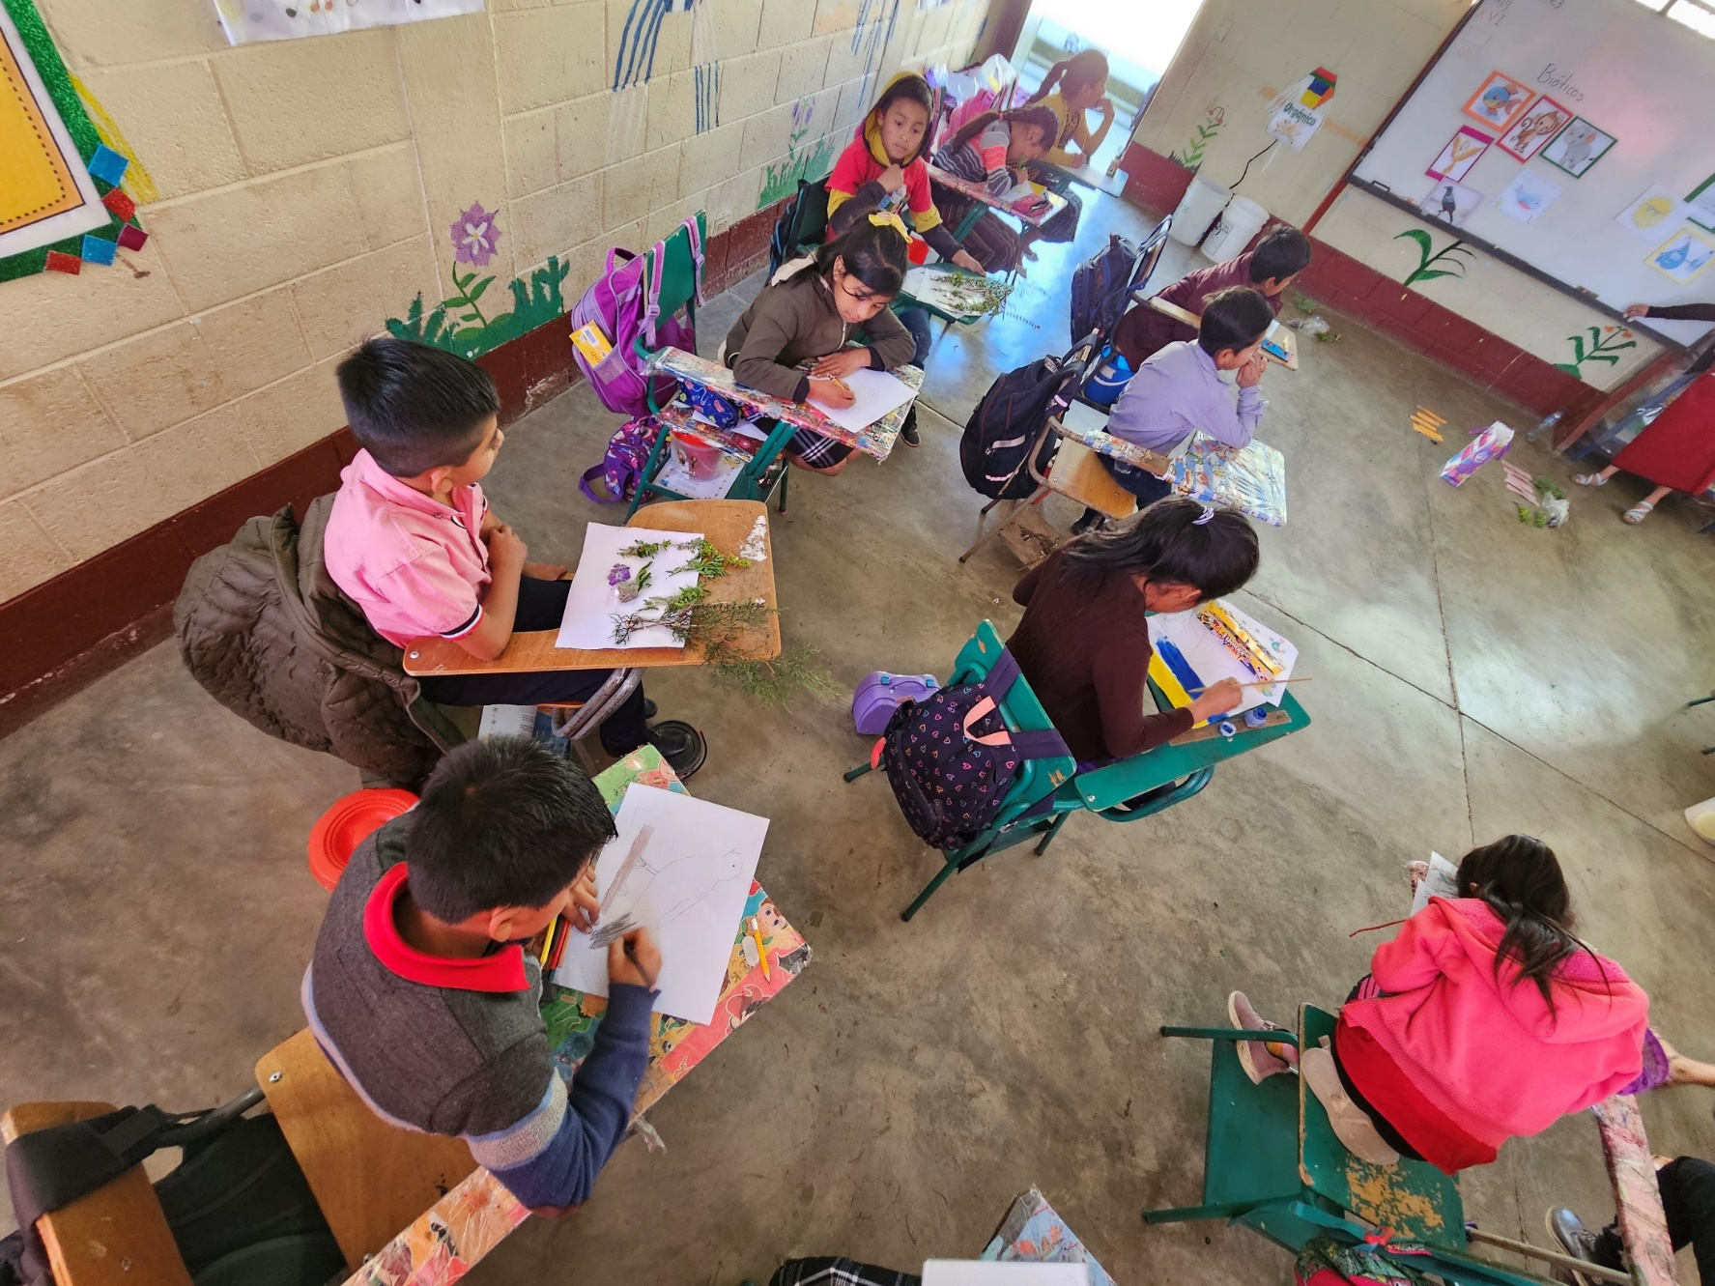
The Success Factors
In 2022 and 2023, 800 children in 10 schools were supported
400 parents and guardians were provided with knowledge and guidance
A cross-regional training programme for 500 teachers and a training for 35 staff of Ministry of Education was organized
The Ministry of Education recognised UDL as an opportunity for the transformation of the education system
#ZeroCon24

Slide 7
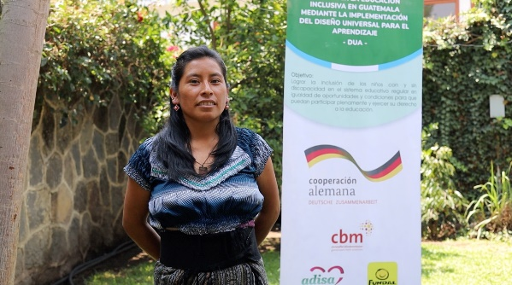
Paula’s Story
“I work as a literacy teacher, a job opportunity that I got thanks to ADISA and the UDL Guatemala project, in this new process of my life I have the opportunity to teach literacy to mothers whose children benefit from the UDL Project; in this process I feel happy because mothers begin to read and write, especially they can support their children in their learning process.”
Paula, mother of a child with disability.

Slide 8
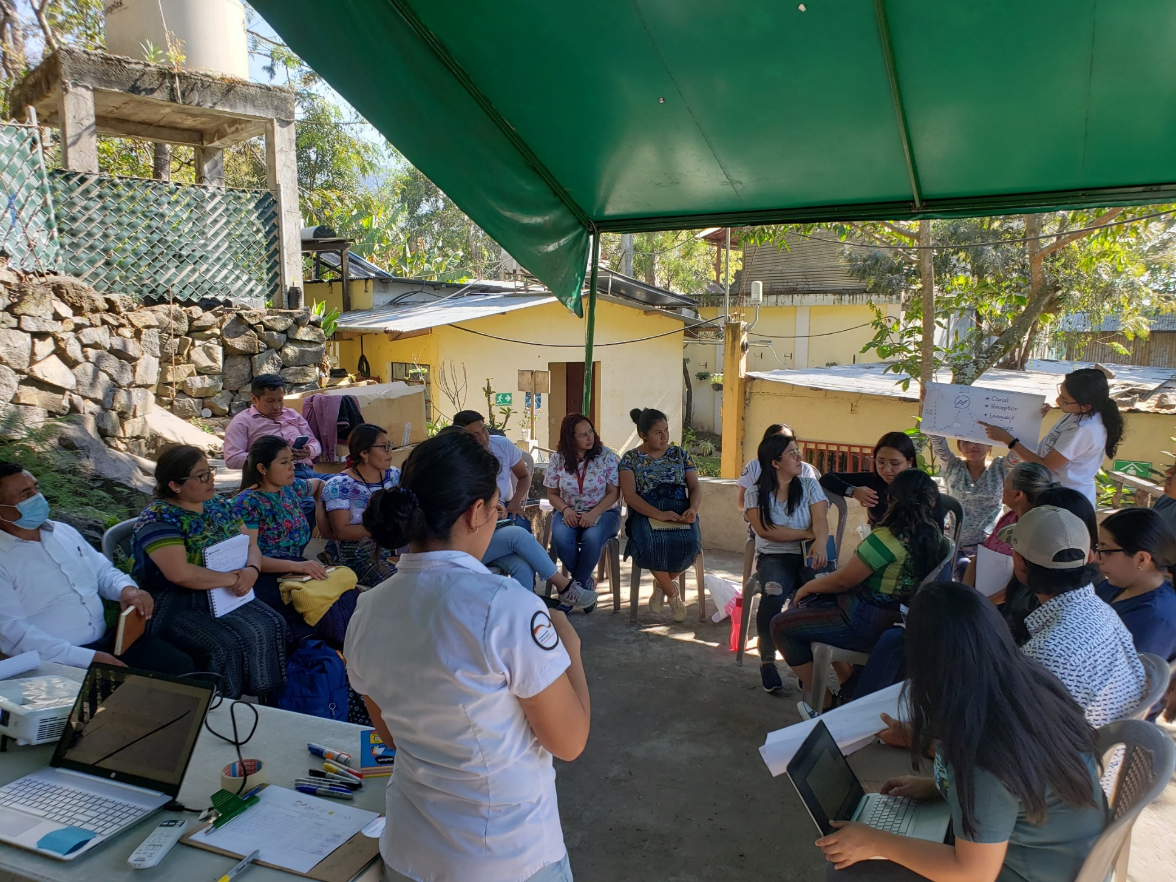
Lessons learned, challenges
Lessons Learned:
Online, in-person and ongoing support is key for success.
For UDL to work:
Teachers need to share their resources
Have technical support from an expert
The enrolment and commitment of Ministry of Education and districts is important for upscaling
Challenges:
Requires political will
Flagship project
Document and systematize the experience
Notes:
Requires political will on the part of the governing public entity in order to generate consistent guidelines for personnel.
Flagship project, which has to break new ground and propose guidelines, elaborate didactic proposals/guides and create contextualized contents.

Slide 9
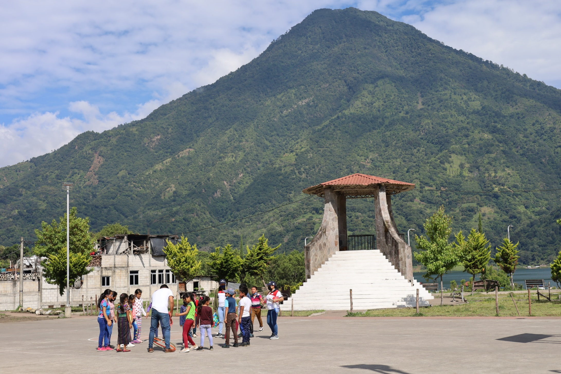
Sustainability and next steps
Sustainability
We hope The Ministry of Education adopt the model to be expanded to other districts.
The joint work with the CSO as ADISA and the consortia to support as expertise in the process.
Next steps
Advocacy, awareness, and capacity building with key actors and decision makers to ensure the implementation of the UDL in the National Education System.

Slide 10
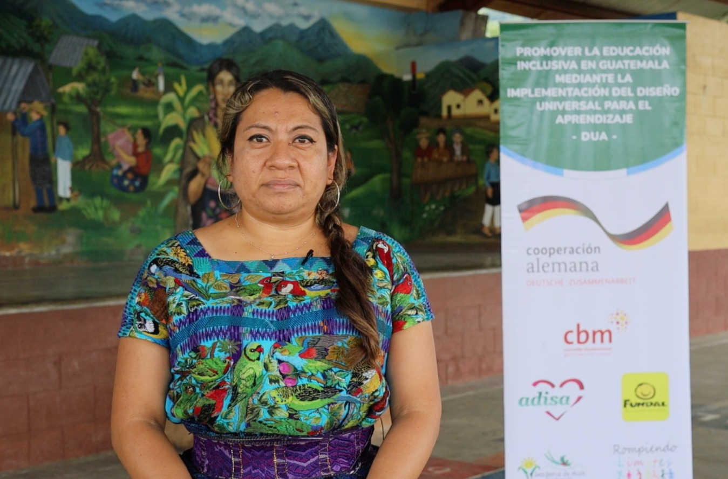
María’s Story
“The UDL has changed my way of teaching and has allowed me to see in my students their abilities, their way of learning and has placed me in a position of guide to achieve the children's metacognition.” María, 6th grade teacher.
#ZeroCon24

