Slide 1
Troy Otillio
CEO of Aira
USA
Session: “ICT solutions supporting the blind and the visually impaired“
5 pm on Wednesday March 5, 2025

Slide 2
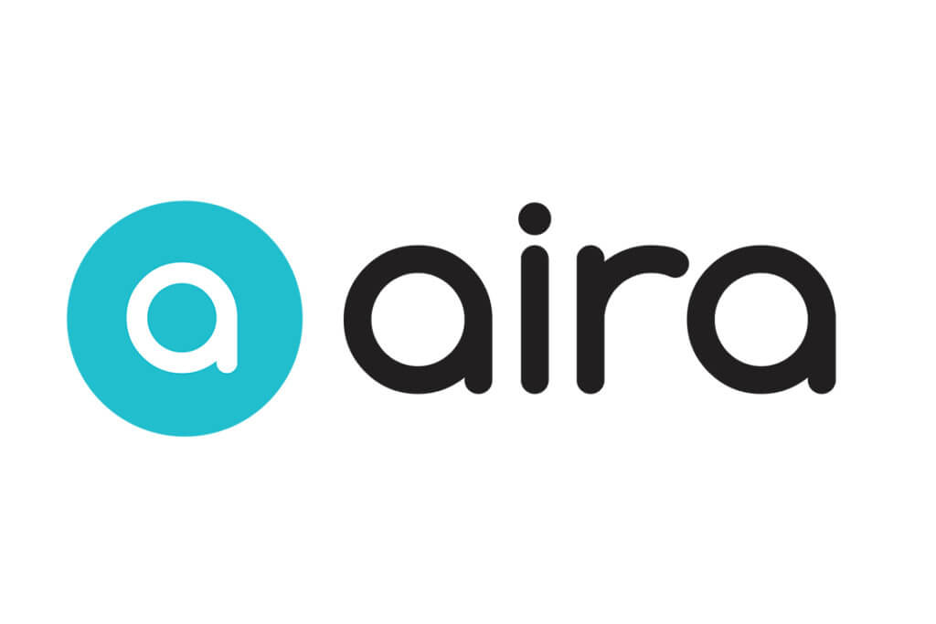



Partnering Together to Offer Video Remote Interpreting

Slide 3

Hi, we’re Aira! We’re a video remote interpreting (VRI) service.
Say “Yes” To Accessibility.
Aira breaks down accessibility barriers with on-demand VRI for both the blind and low-vision community, and the Deaf and hard-of-hearing community.
Our Company

Slide 4
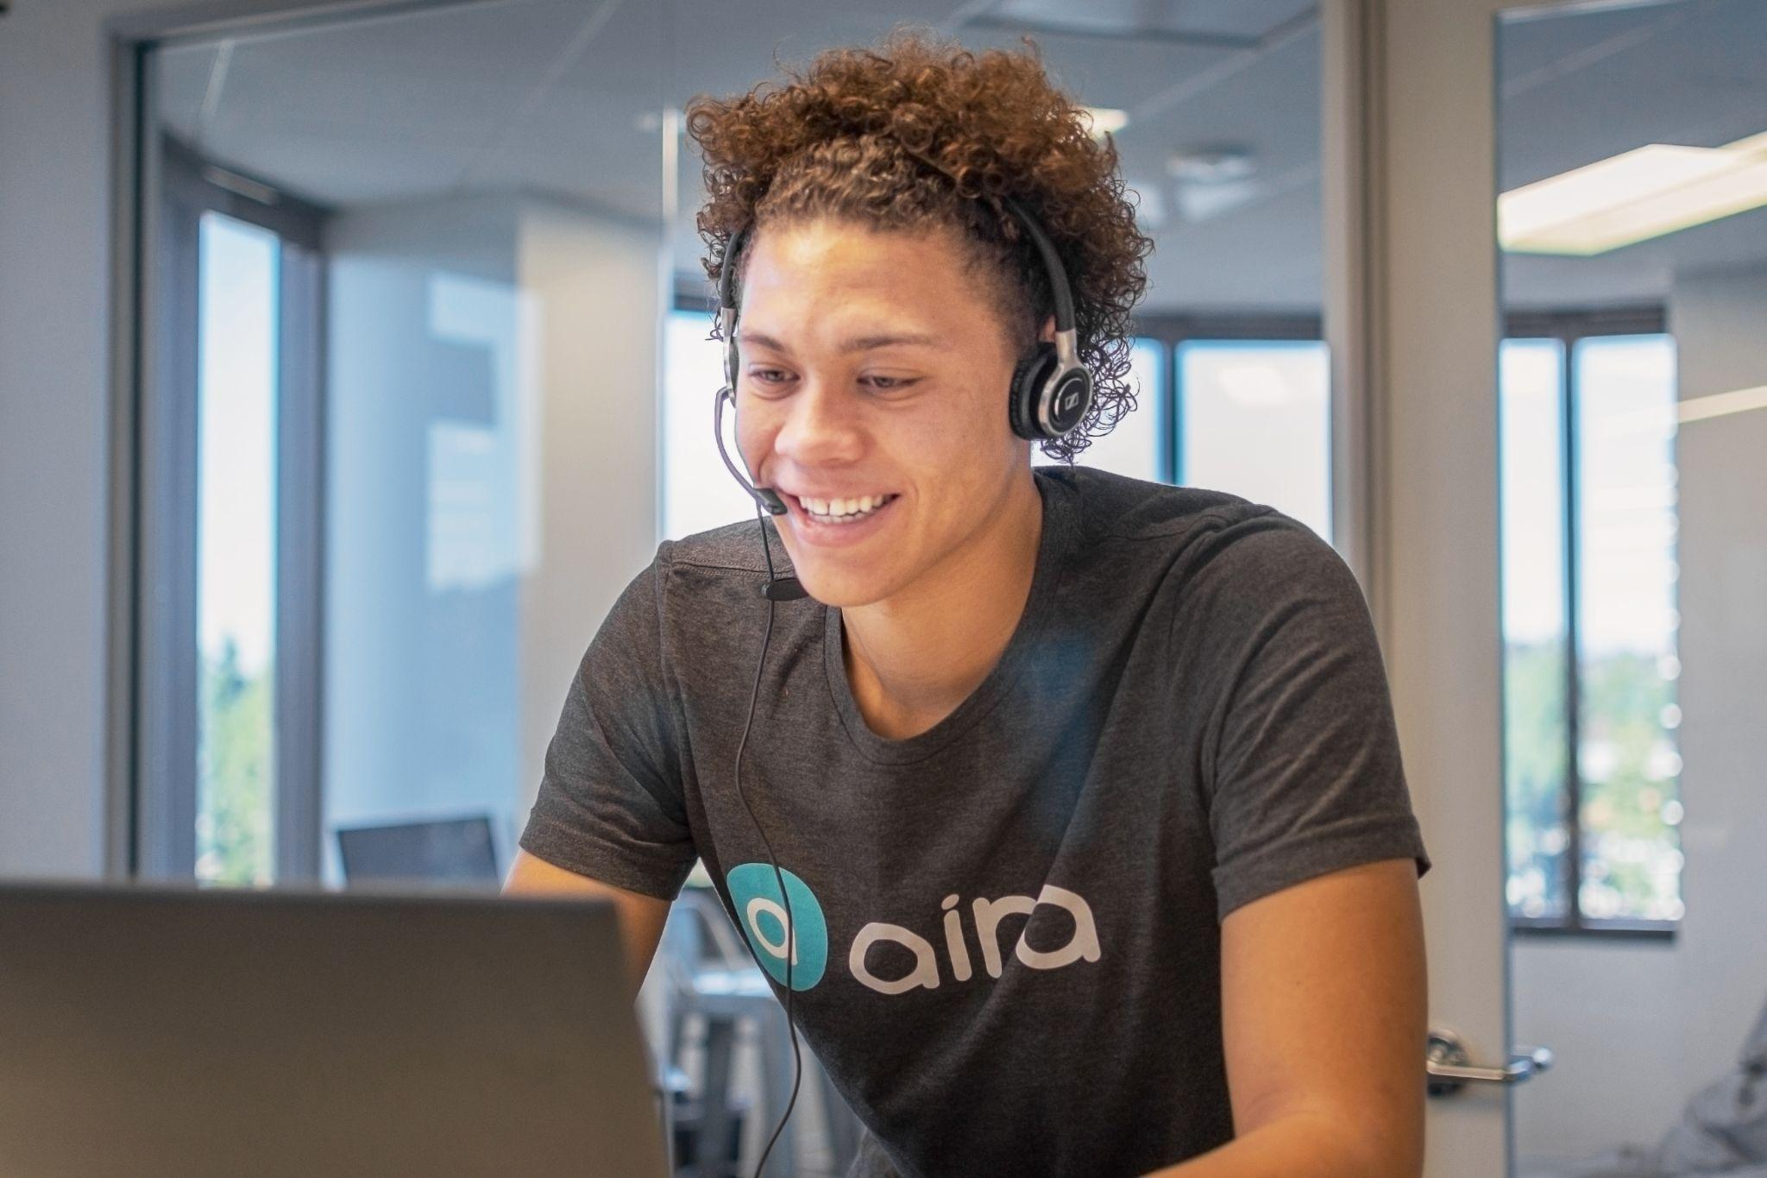
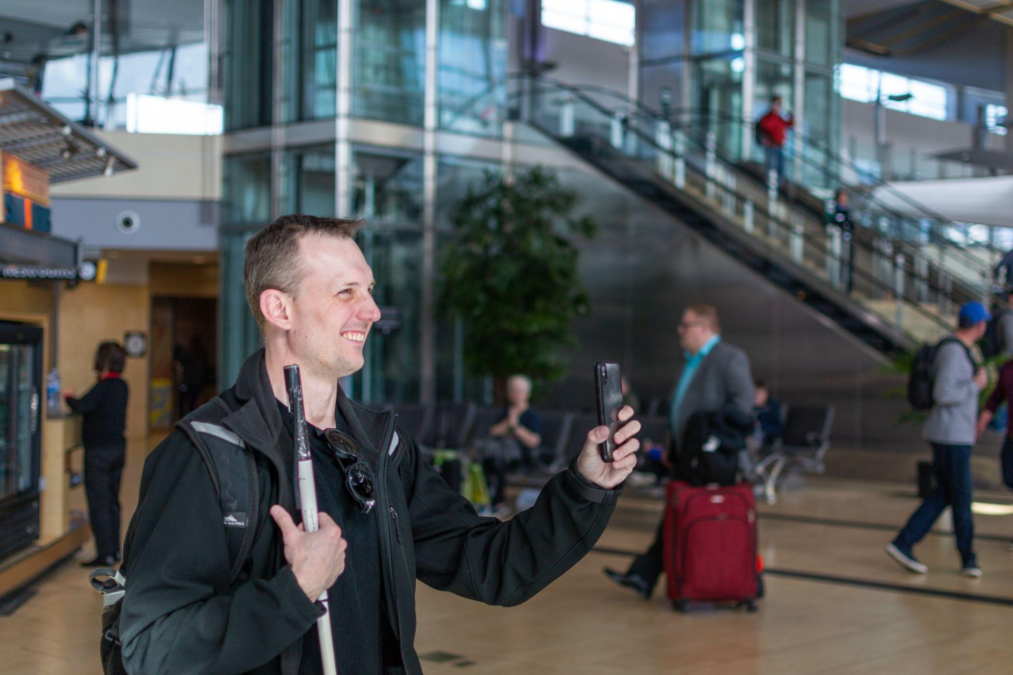
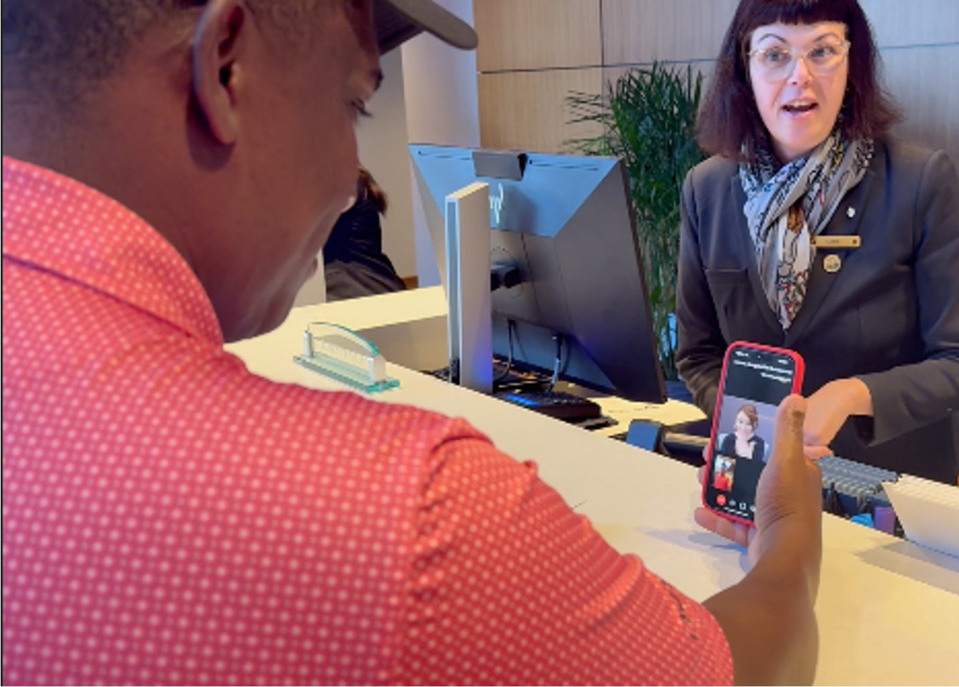
What is VRI?
Professional interpreter and caller are connected via mobile device
Interpreter uses caller’s mobile phone camera and microphone to communicate information
Our Services

Slide 5



Two Solutions for Wide-Reaching Accessibility
Aira Explorer
Aira ASL
Our Services
Blind & low-vision community
On-demand, 24/7/365
Accessed via mobile device
iOS, Android, web app, Smart Glasses
Geofencing technology
Assists with wide range of tasks
Deaf & hard-of-hearing community
On-demand, 24/7/365
Accessed via mobile device
iOS, Android, web app
Geofencing technology
Facilitates better communication

Slide 6
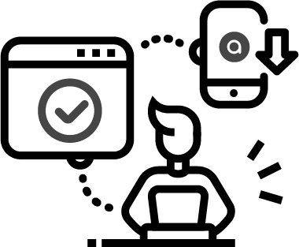

Frictionless Support Anytime, Anywhere.
Using Aira is easy & on-demand
Download
Aira App
Connect with a professional interpreter
Get real-time assistance and communication support
How it works

Slide 7

Aira Explorer
In Action

Slide 8
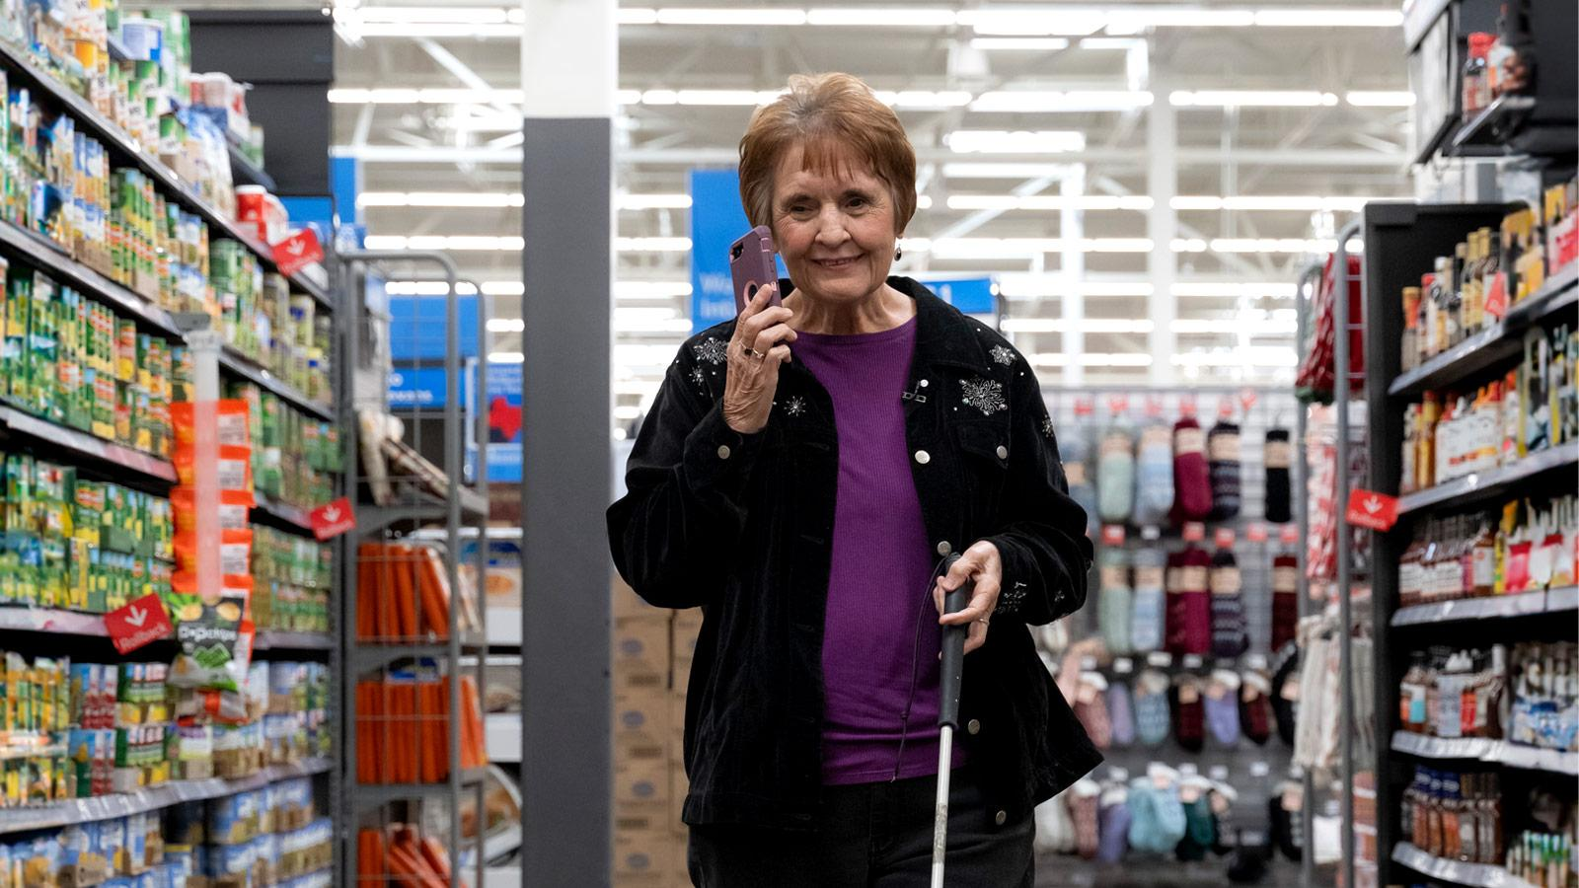
Becoming an Access Partner
Aira Access Partners provide our services free of charge to their communities.
Your employee or customer signs up through your provided plan and downloads the app.
They are then connected with a highly-trained Aira Agent through their smartphone.
Access Partners
Easy to set up
Increased inclusivity
Supports DEI initiatives
Competitive differentiator
No operational/technical lift
Notes:
Make sure to add alt text to everything

Slide 9
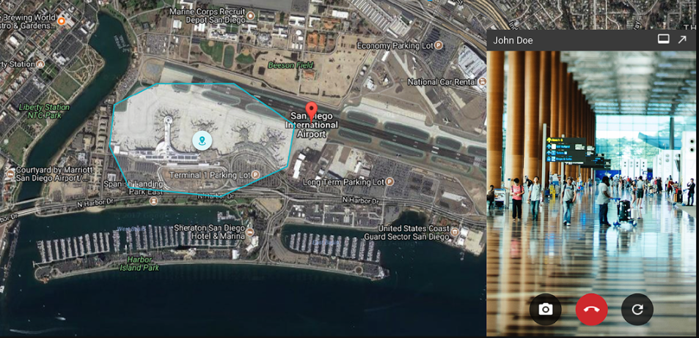
Geofencing
Invisible digital perimeter around where you’d like to offer our services
We simply turn on this geofence
Anyone within can connect with an interpreter at the tap of a button
Notes:
Make sure to add alt text to everything

Slide 10
A Foundation of Trust, Security & Confidentiality
Your employee or customer signs up through your provided plan and downloads the app.
They are then connected with a highly-trained Aira Agent through their smartphone.
Security
Aira has passed hundreds of stringent global security reviews
Strict and industry-leading security standards
All Explorer information confidential
Access Partners include organizations like Amazon, Google, state governments, Chase Bank, & Bank of America

Slide 11















Become an Access Partner. Join the Movement.
Over 275+ organizations already offer Aira’s services to create inclusive environments
Public Sector & Private Sector Transportation | Education | Government | Entertainment | Financial Services | Healthcare | Manufacturing | Consumer Goods
Access Partners

Slide 12
Connect
ACCESS IS A
HUMAN RIGHT
Get started with Aira today
access@aira.io
www.aira.io

