Slide 1

Exposure assessment along life cycle of nanocomposites
Project Idea | Exposure assessment along Life Cycle of (SWCNT)-nanocomposites, supported by own initiated case studies, downstream users need to start collaborating.
Organization name, town and country | OCSiAl Europe S.a.r.l, Leudelange, Luxembourg
Addressed topic(s) | [Insert here the number and the title of topic from the list provided at the tab Calls in scope or put Expertise relevant to multiple topics]

Slide 2

OCSiAl Europe S.a.r.l.

Slide 3

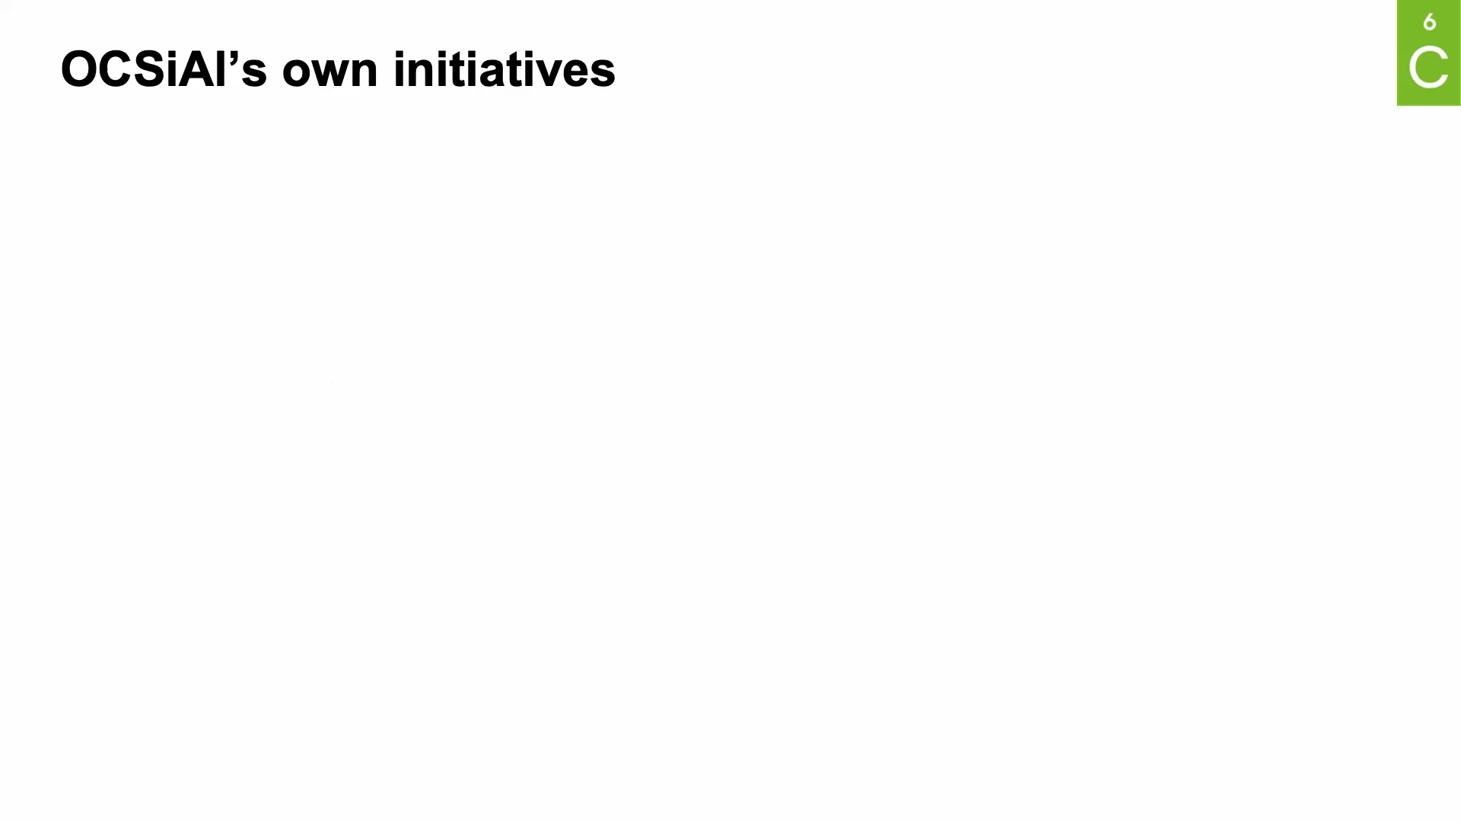
Exploring the SSbD of SWCNT nanocomposites

Slide 4
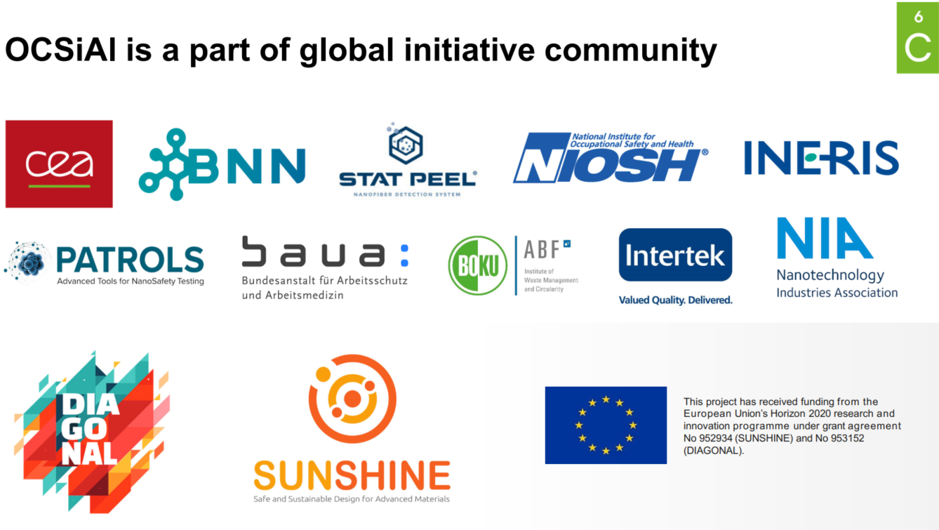
Competences / type of partners sought
Notes:
We have a open science-based dialogue with various stakeholders
We adopt a very open and collaborative attitude:
Academics and research centers: scientific experts which often work like these 2 EC funded projects DIAGONAL SUNSHINE which are still on going.
Federal institutes : like BAuA, Canadian CEPA, US NIOSH …
Industrial Associations: like CEFIC, NIA, BNN, …
Service suppliers: INTERTEK, Eurofins, BOKU, Laus, CEA, …
And ...→ who i often meet during different funded projects!

Slide 5
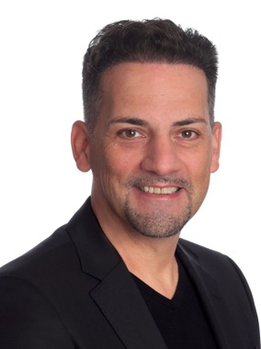
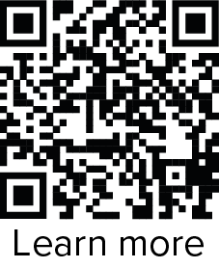

Contact details
Contact person | Van Kerckhove Gunther
Organisation: | OCSiAl Europe S.a.r.l.
Address: | Leudelange, Luxembourg
Phone: | +352 661 183 429 / +41 77 259 56 61
E-mail | gunther.van.kerckhove@ocsial.com
B2Match profile | Van Kerckhove Gunther
LinkedIn/Twitter | www.linkedin.com/in/gunther-van-kerckhove-62aa99a6
[Your photo]

