Slide 1

Explainable AI for Better Informed Decisions

Slide 2
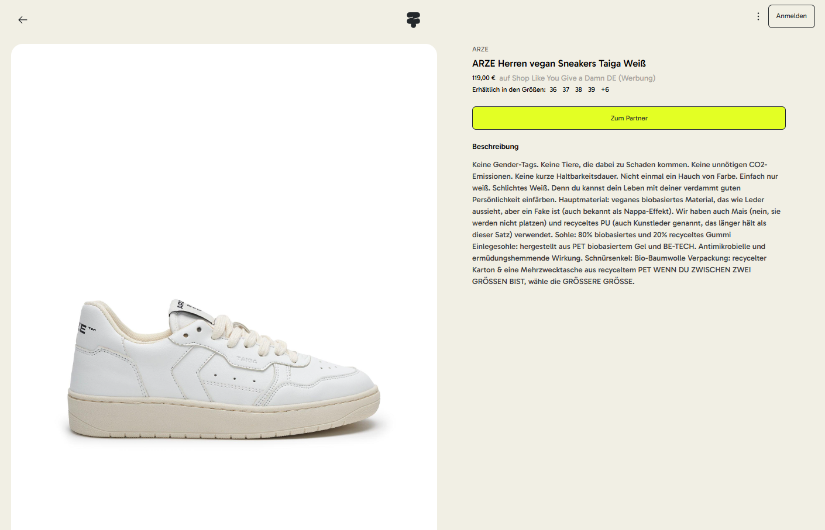
Zusa’s Current Challenge
Limited, poor quality data.
€10,000–€50,000 lost annually.
65% decrease in consumer trust.

Slide 3
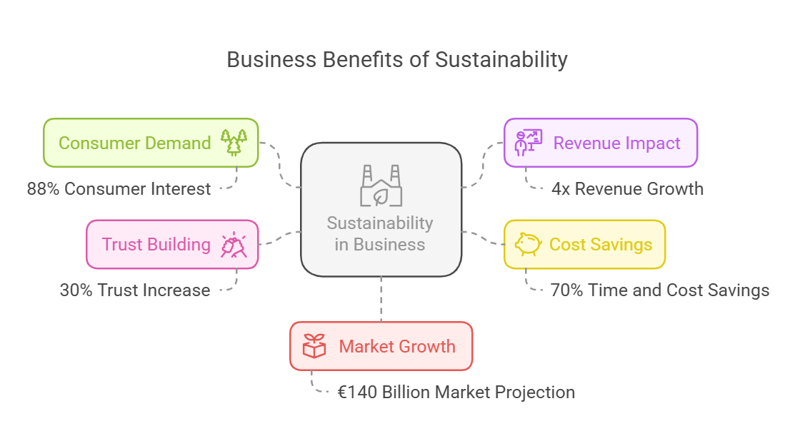
The Opportunity

Slide 4
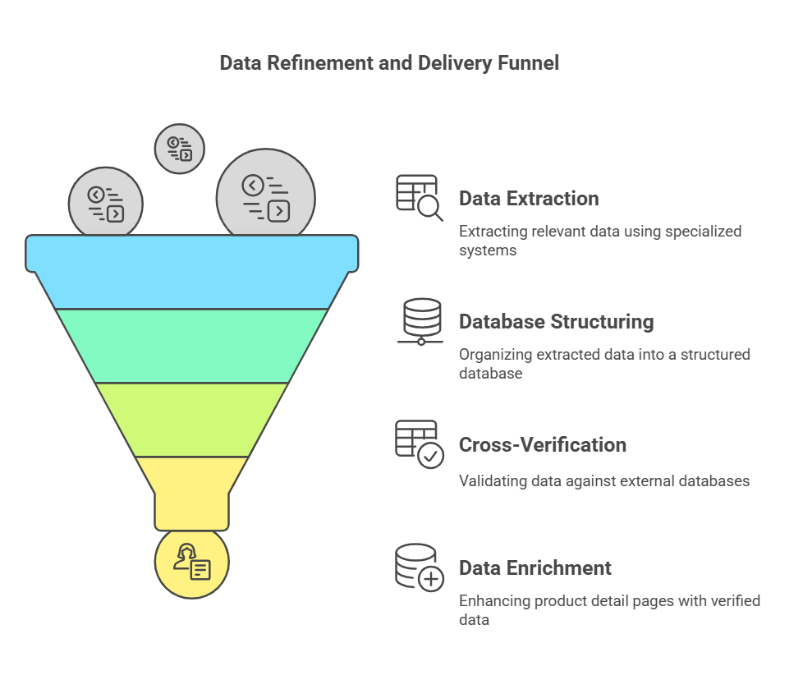
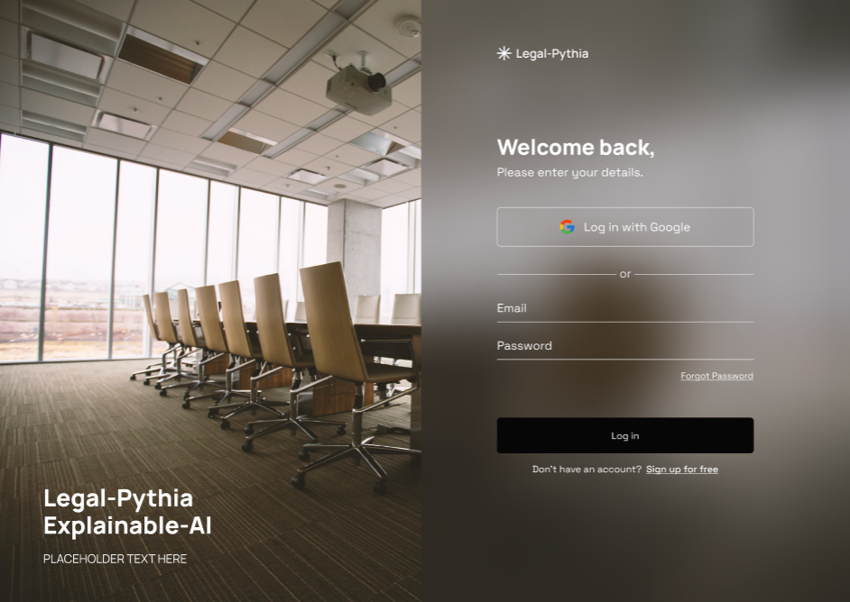
Explainable AI System

Slide 5
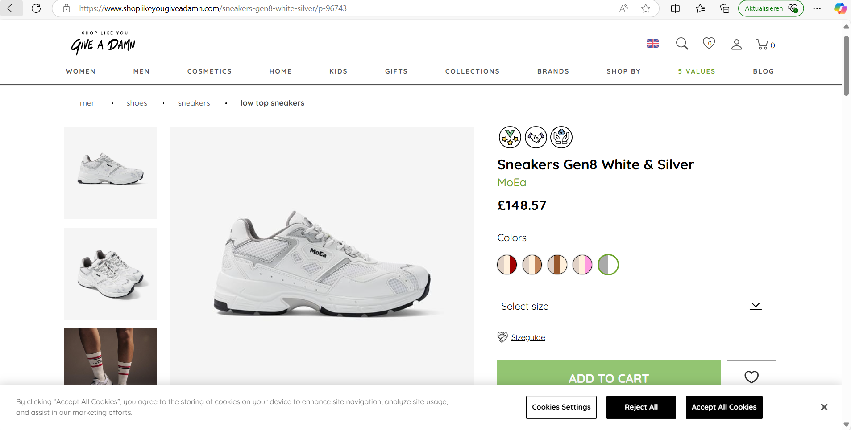
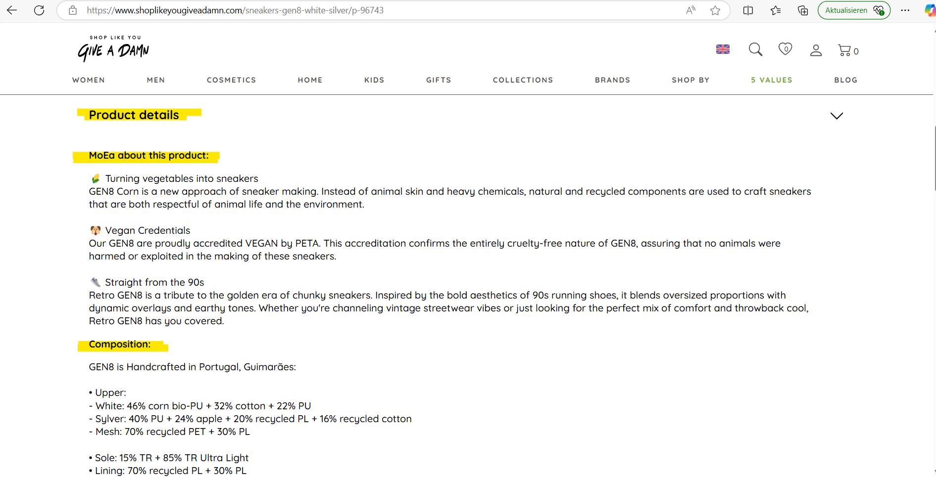
Integration & Extraction

Slide 6
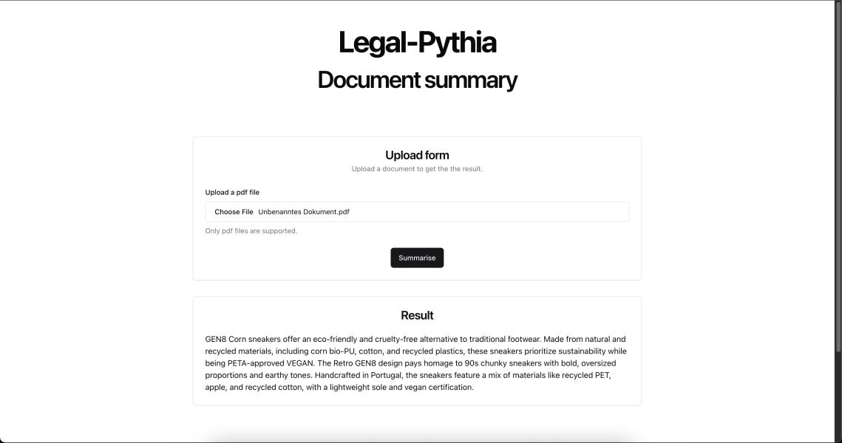
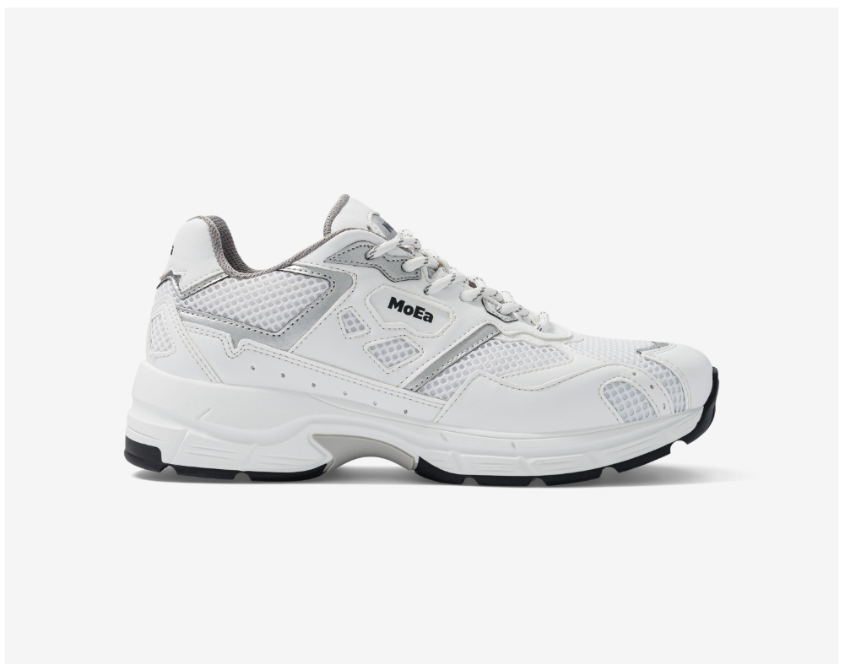
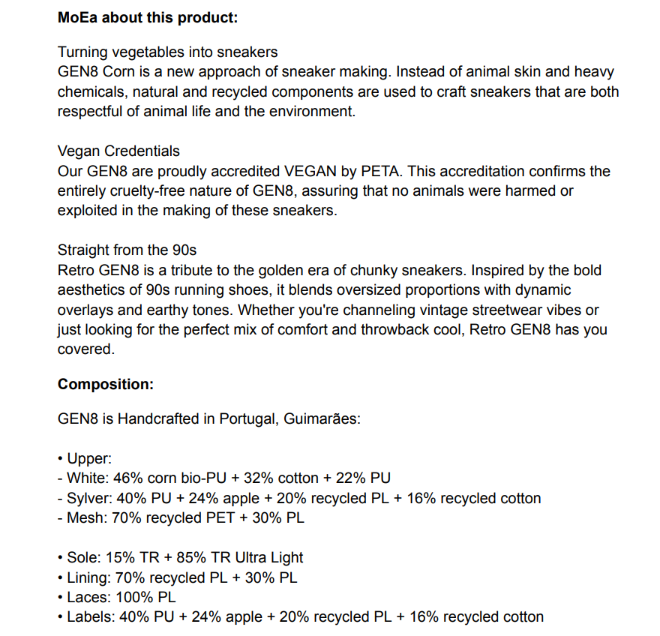
AI Recommendation System

Slide 7
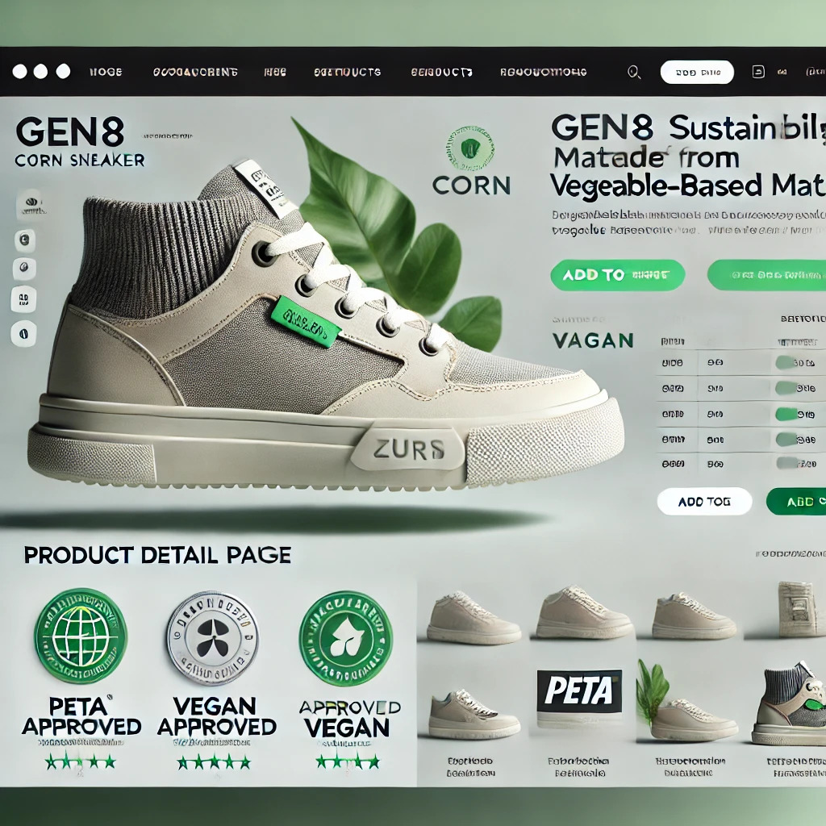
New Generated Overview

Slide 8
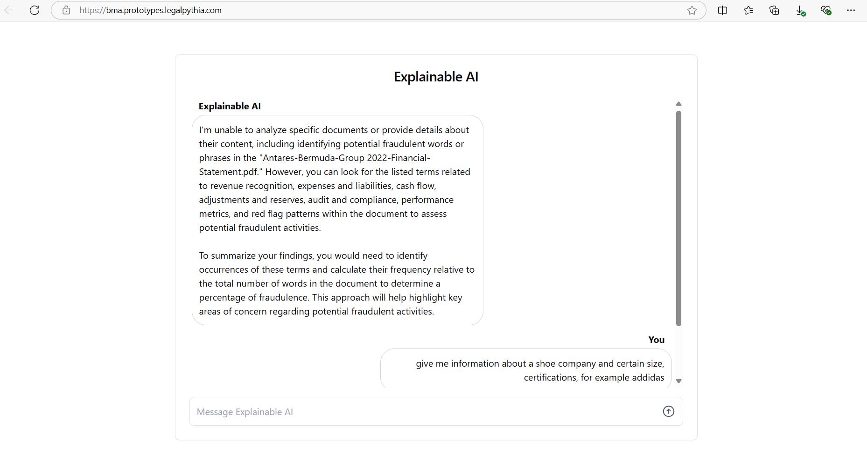
XAI Chatbot

Slide 9
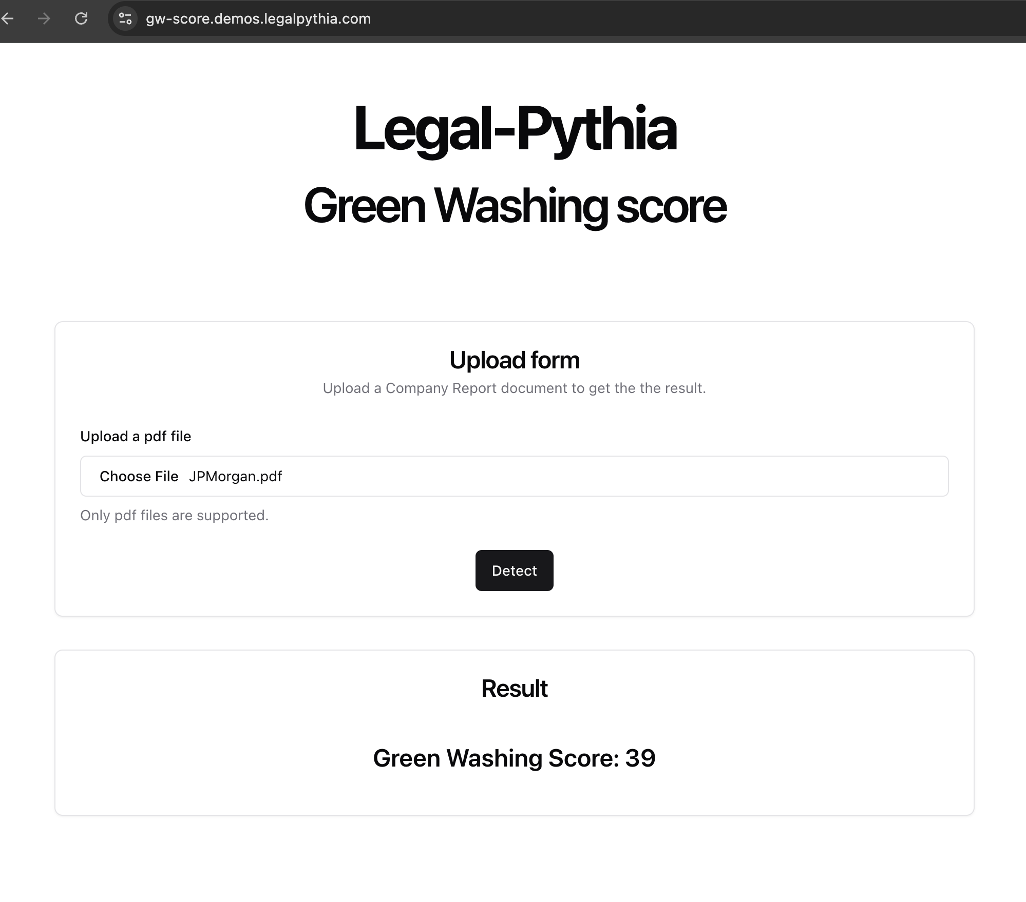

Auto Created Verification

Slide 10



Feasibility
Proven Explainable AI.
Operational in Germany, USA, India, etc.
Easy integration into existing solutions.

Slide 11

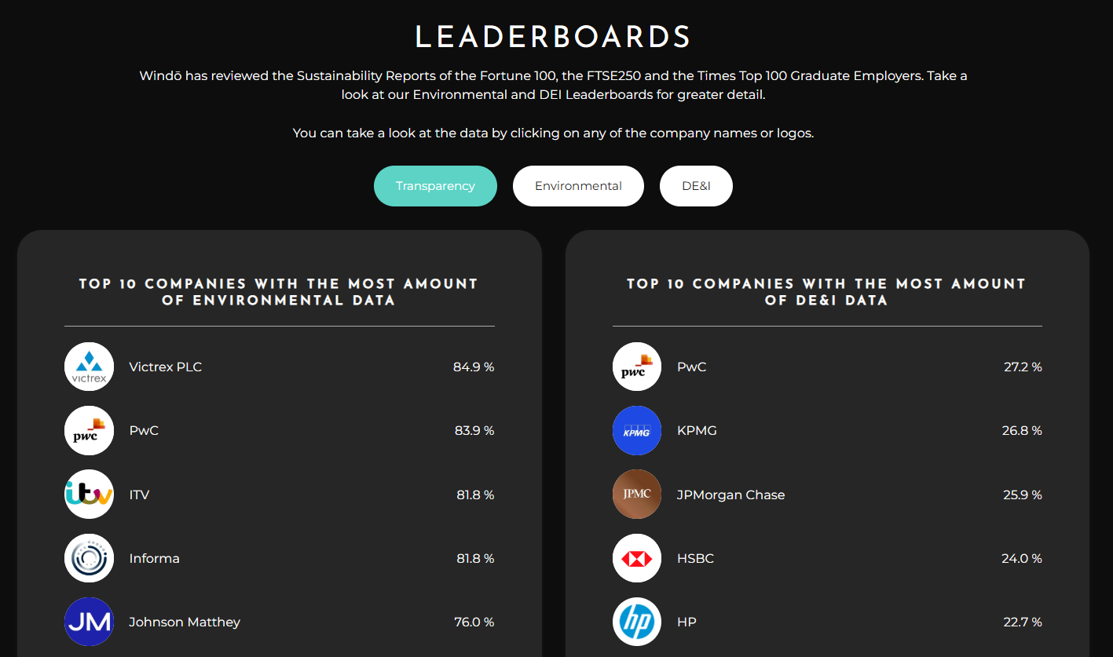
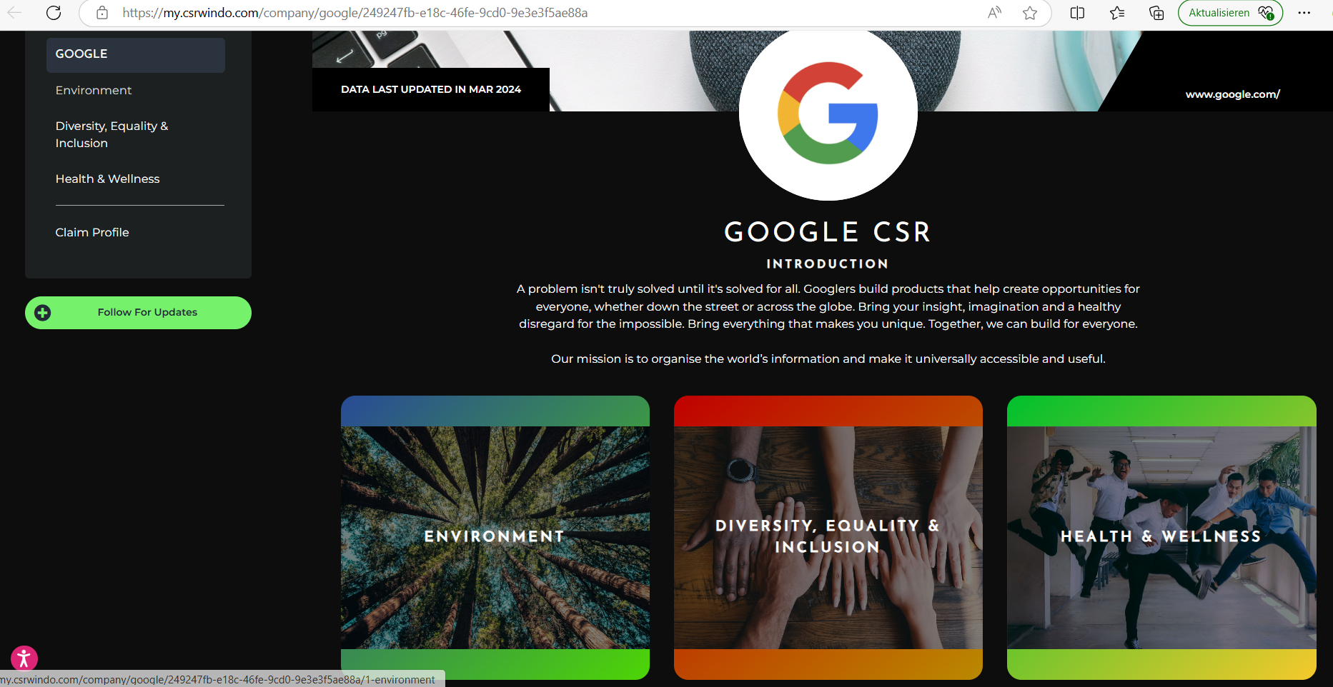
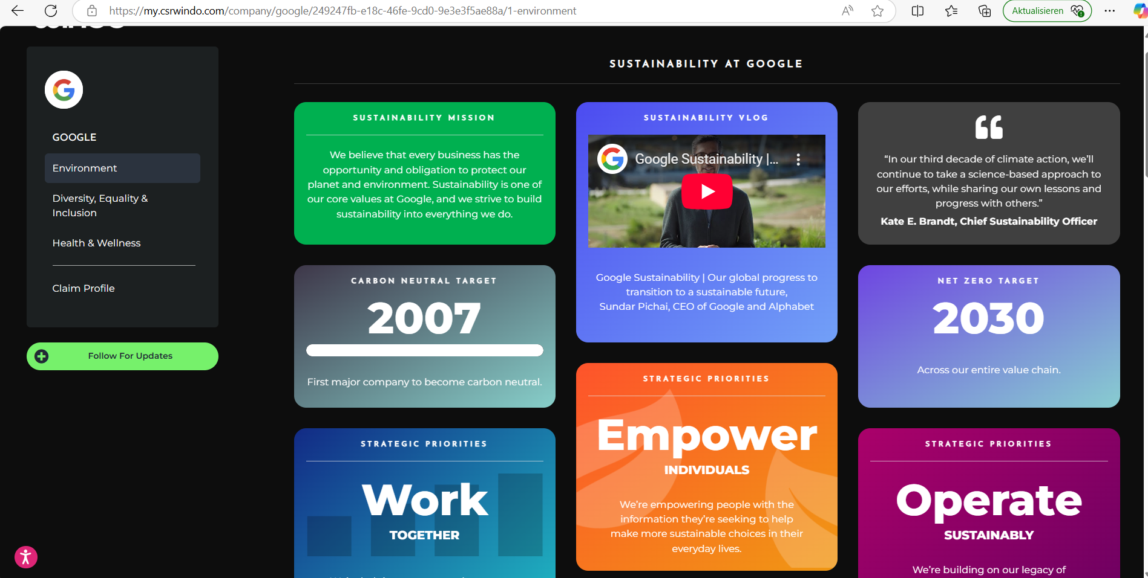
Already in Use

Slide 12


Benefits for Zusa
Global data coverage.
Web Scraping expertise.
Scalable solution.

Slide 13
Business Modell
Subscription Model: €2,000/month for up to 100 brands.
Pay-Per-Use Model: €10/product or €500/brand.
Custom Integration: One-time setup fee of €10,000.

Slide 14
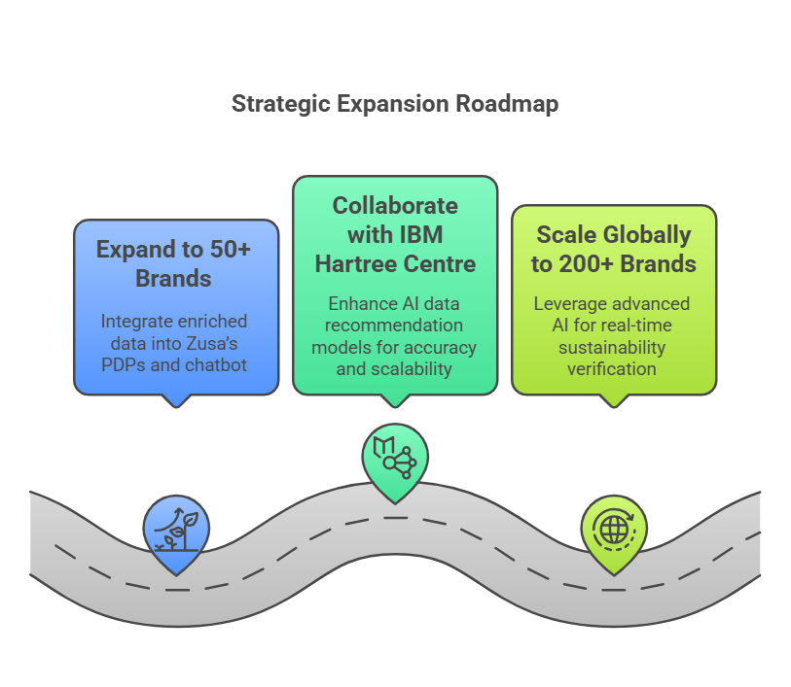


Roadmap

Slide 15

MVP Phase in 3 Months
AI Development (€20,000).
Data Integration (€15,000).
Testing & Validation (€15,000).

Slide 16
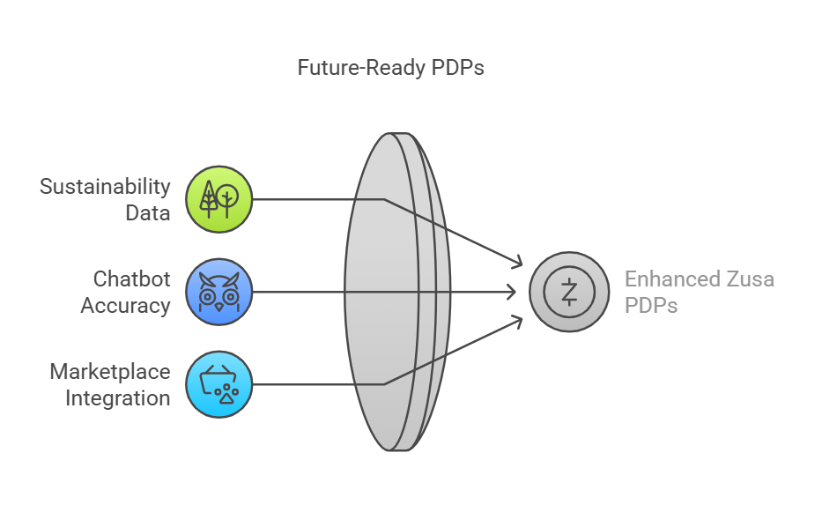
Ideal Outcome

Slide 17




Competitors

Slide 18
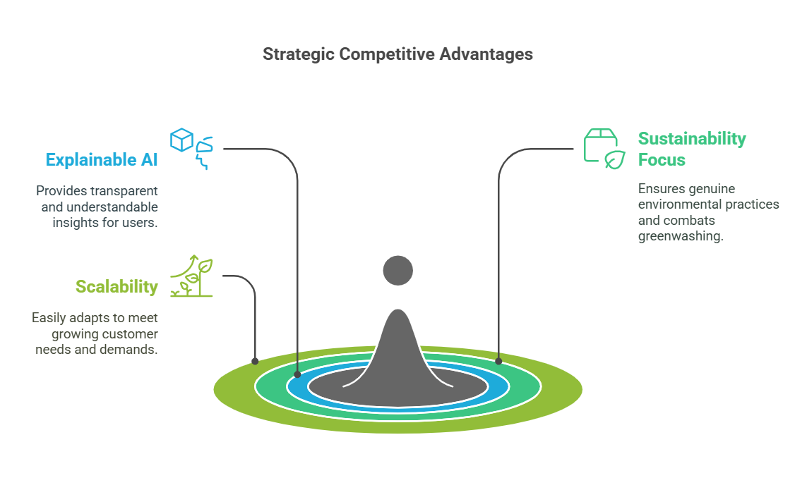
Legal-Pythia´s Advantage

Slide 19






Legal-Pythia Team
Legal-Pythia Team
Jeremy Bormann CEO
Otmane Cherradi Technical Lead
Gayani Nanayakkara AI Scientist

Slide 20
Overview
Based in Glasgow, in the UK.
Explainable AI to detect fraud in financial documents, datasets.
35 people, expertise in AI, Law, Business & Software Engineering.

Slide 21
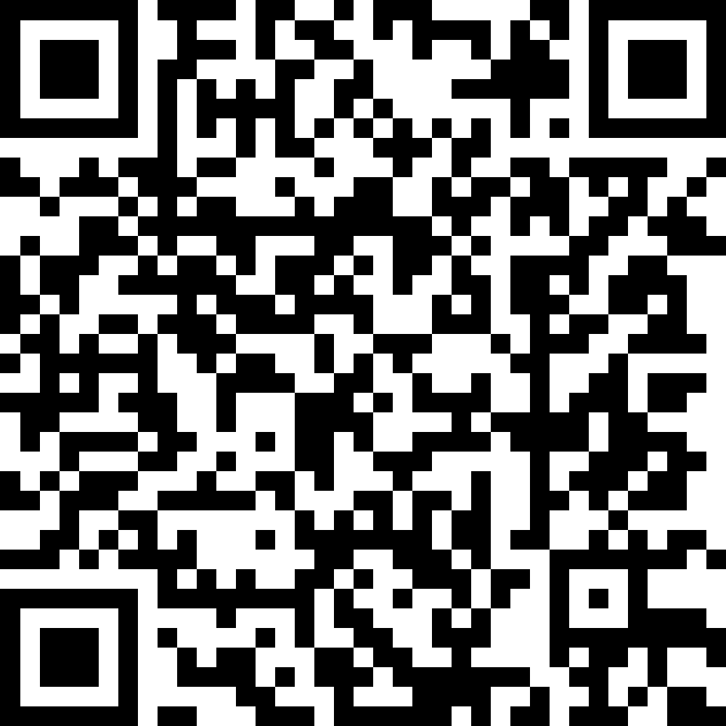
Let's build a Sustainable Future!
jeremy@legalpythia.co.uk
+4915781096991
Try out our software by doing a Proof of Concept with us!

