Slide 1

Summary Information of the Game
mindSTEMgame
Hüseyin Vatansever

Slide 2
Name symbol
Mind +x
Heart +x-
Straight +
Diagonal x
Fork y
Slow l
The number on the game piece in the center; The mathematical power arising from the way it moves.
Heart stone;
1 or 2 rooms can go in every direction. Its power becomes 6. Optionally, its power can be made 10 or 20.
The aim of the game;
Collect points

Slide 3
Decentralized Starting position;
Level 1 - 2 different stones
Level 2 - 3 different stones
3......
4......
Level 5 - 6 different stones
White slow stones,
in the 2nd and 3rd rows,
‘’other’’ white stones,
can be found in the rooms they want at the beginning in the 1st and 2nd rows.
In front of every 'other' stone, there must be a slow stone.
The number of slow stones can increase optionally.
Colored stones are placed symmetrically to the whites.

Slide 4
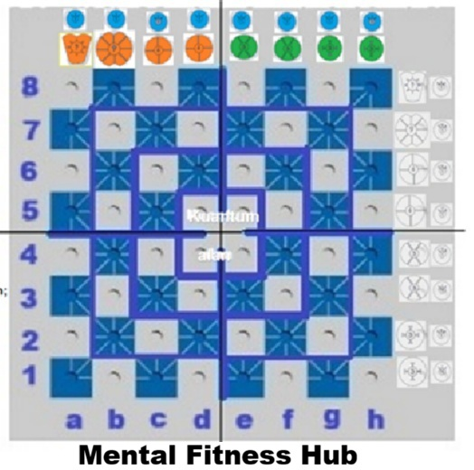
Quantum Aan Innovation; The d4, d5, e4, e5 squares (rooms) in the center are the Quantum Field.
Game pieces can enter these rooms with their normal movement. A game piece that is inside the room can exit from any of these four rooms when its normal turn comes.
In the quantum field, teams can have at most two game pieces.

Slide 5
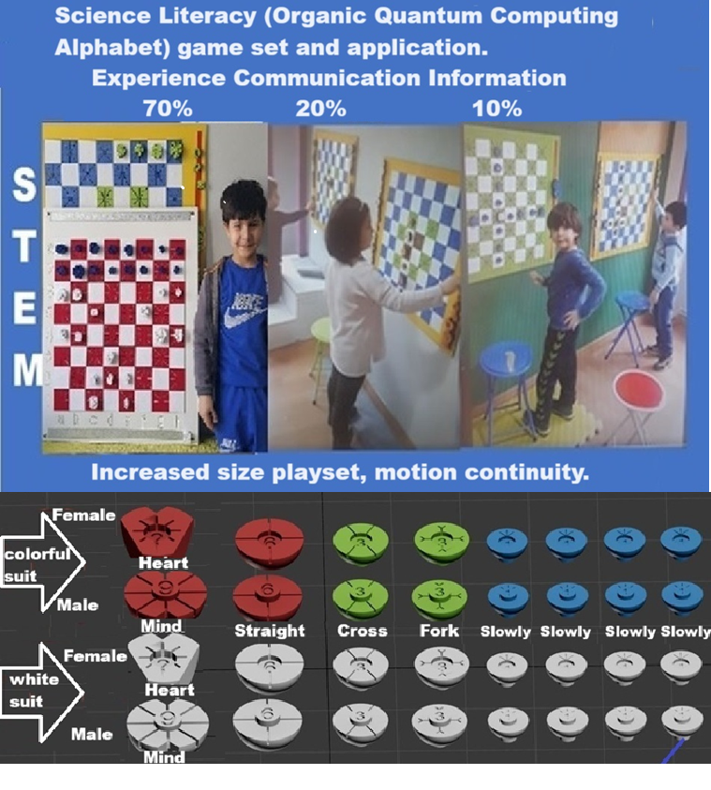
Vertical Game Set applications
https://youtu.be/urTcgLWIhtY

Slide 6
Technical Flow and Data Schema
1. Voice-Only AI Architectural Flow
This section defines the screenless, voice-driven interaction loops between the human players and the AI Referee/Coach.
Phase 1: Decentralized Initialization
- Players verbally dictate their custom, symmetric, or asymmetric starting positions using the mindSTEMgame chess-like coordinate notation (e.g., "White Suit: Mind to a1, Heart to b1...").
- AI validates the starting layout based on the level-specific constraints (Level 1 to Level 5) and confirms via voice: "Starting configuration accepted. Match timer initiated."
Phase 2: The Turn & Clock Loop
- Player A makes a physical move on the 1m² vertical board and immediately dictates the move verbally (e.g., "Straight to c4").
- Rule Validation Engine: AI processes the command. If the move is legal, AI instantly stops Player A’s thinking timer, logs the timestamps, and verbally announces: "Move accepted. Player B, your time starts now."
- Quantum Field Transition: If a piece enters or exits the Quantum Field (d4, d5, e4, e5), the AI flags this state in the system backend to track non-linear positioning rules.

Slide 7
Phase 3: Illegal Move Exception Handling
If a player dictates an illegal move (violating the mathematical power or path of the specific piece), the AI interrupts immediately via voice.
Instead of just saying "Error", the AI explicitly explains the mathematical/logical violation (e.g., "Invalid Move. Fork piece cannot move diagonally. Reset position and try again."). The player's clock continues to run as a penalty.
Phase 4: Digital Mode Cognitive Feedback (Evaluation)
In Digital/Hybrid tournament modes, the AI acts as an active analytical commentator.
While the AI never reveals or suggests the best moves during active gameplay, it evaluates and scores the player's cognitive selection immediately after the turn based on a 1-to-5 metric: 1 (Very Poor), 2 (Poor), 3 (Average), 4 (Good), 5 (Very Excellent).

Slide 8
2. "Crystal Data" Schema Architecture
This schema defines how mindSTEMgame extracts high-fidelity human reasoning metadata, turning human gameplay into valuable training data for Embodied AI frontier models.
{ "Metadata": {
"Tournament_ID": "String (Pre-loaded match parameters)",
"Match_Type": "String (Individual / Team / Cross-Generational Karma Team)"
},
"Player_Profile_Registered_ID": {
"Age_Group": "String (Child / Youth / Adult)",
"Gender": "String (Female / Male)",
"Cognitive_Baseline_Score": "Float"
},
"RealTime_Telemetry_Data": [
{
"Turn_Number": "Integer",
"Piece_Type_Used": "String (Mind / Heart / Straight / Cross / Fork / Slowly)",
"Mathematical_Power_Delta": "Integer (Calculation of move complexity)",
"Quantum_Field_State": "Boolean (Inside/Outside the Superposition Zone)",
"Thinking_Duration_Seconds": "Float (Exact time taken before verbal command)",
"Verbal_Command_Latency": "Float (Time between physical action and voice notation)",
"AI_Quality_Score": "Integer (1 to 5 Cognitive Evaluation Rating)"
}
],
"Tournament_Outcomes": {
"Total_Points_Collected": "Integer",
"Illegal_Move_Frequency": "Integer (Measures cognitive fatigue/stress limits)",
"On_Chain_Verification_Hash": "String (SHA-256 Blockhain Immutable Stamp)"
}
}

Slide 9
