Slide 1

Deadpoint
The Strategy Operating System for Hedge Funds
Humans Build → AI Classifies → System Learns
Seed · $4.5M Raise · March 2026
Munjal Subodh · munjal@deadpoint.ai · +1 781-600-9694
Detailed speaker notes accompany each slide
CONFIDENTIAL
1
Notes:
Deadpoint is building the Strategy Operating System for hedge funds managing $50M–$1B in AUM. The platform industrializes the full trading strategy lifecycle — from strategy generation and backtesting through regime-aware classification and execution — giving funds a system of record for every deployment decision.
Core value proposition: quants build strategies, Deadpoint's AI classifies current market conditions and scores each strategy's fit to the regime, and the system learns from every outcome.
We are raising $4.5M on a post-money SAFE at a $25M valuation cap, targeting 36 months of runway to cash-flow positive.
The full data room is available upon request: 25+ documents across three progressive tiers including financial model, cap table, investment memo, competitive analysis, market sizing, product roadmap, regulatory analysis memo, SOC 2 readiness roadmap, information security policy, and more. All numbers trace to a bottom-up financial model with 36 months of monthly granularity.

Slide 2



Three Tailwinds Are Reshaping How Hedge Funds Operate
41.7%³
18.3%²
95%⁴
of Seed Capital Goes to AI
CAGR for Multi-Manager Platform Funds
of Hedge Fund Managers Now Use Gen AI
AI-native startups dominate venture funding. Hedge funds are accelerating their integration of AI-driven approaches (AIMA, 2025).
Multi-manager platform funds are the fastest-growing segment in hedge funds — growing 8× faster than the rest of the industry.
Technology adoption has crossed from early majority to near-universal. Compliance automation and audit trails are now table stakes. The window for new infrastructure is open.
Carta State of Seed 2025
Goldman Sachs AM
AIMA “Charting the Course”, 2025
2
² GS AM, "Mapping the Evolution," March 2025. Multi-manager platforms only (~40 firms), 2018–2024. · ³ Carta, State of Seed, Winter 2025. ~1,494 priced seed rounds (~$8.1B); 41.7% of capital to AI. · ⁴ AIMA, "Charting the Course," September 2025. Survey of 150 fund managers globally, ~$788B AUM.
Notes:
Three structural shifts define why this is the right moment for a Strategy OS.
AI ADOPTION IS ACCELERATING: AI-native startups captured 41.7% of all seed capital in 2025 (Carta State of Seed 2025). Hedge funds are accelerating integration of AI-driven approaches (AIMA 2025). Demand for AI infrastructure in finance is real and growing — but the governance layer to manage AI-driven strategy deployment does not yet exist as a commercial product.
THE FASTEST-GROWING SEGMENT NEEDS SYSTEMATIC TOOLING: Multi-manager platform funds (Millennium, Citadel, Balyasny) grew AUM at 18.3% CAGR from 2018–2024, eight times faster than the rest of the industry (Goldman Sachs AM, "Mapping the Evolution," March 2025). The broader multi-strategy universe reached $748.2B at end-2024 (HFR Q4 2024). These funds run hundreds of simultaneous strategies and are the most natural buyers of strategy lifecycle infrastructure.
TECHNOLOGY ADOPTION IS NEAR-UNIVERSAL: 95% of hedge fund managers now use generative AI tools (AIMA "Charting the Course," September 2025 — 150 fund managers, avg AUM ~$5.3B; adoption at smaller ICP funds is likely lower but directionally consistent). Funds have the tools — what they lack is the system governing how those tools inform deployment decisions.

Slide 3



A $5 Trillion Industry Deploying Strategies Without Intelligence
No System of Record
$5.15T¹
The SEC’s $2B+ off-channel enforcement sweep (2021–2025) shows investment decisions routinely occur on unarchived platforms.ᴬ The FCA found governance bodies lacked detailed record-keeping of how decisions were reached.ᴮ No audit trail exists for which strategies are eligible, or why.
No Regime Intelligence
Total Hedge Fund
Industry AUM
~75-80% of managers use discretionary approaches (Harvey et al., JPM, 2017).ᴰ Regime-unaware strategies sacrifice ~200-340 bps risk-adjusted return annually (Ang & Bekaert, 2004).ᶜ Alpha is left on the table.
HFR Q4 2025
~1,827 SEC-registered hedge fund advisory firms in the US⁵
No Governance Layer
Larger managers tend to build in-house.
Most funds need to buy.
Only 27% of alt fund managers have fully integrated systems; 36% rely on manual processes (EY, 2024).ᴱ Research and production remain disconnected even at quant-oriented firms (Coalition Greenwich, 2026).ᶠ
3
¹ HFR Global Hedge Fund Industry Report, Q4 2025. · ⁵ SEC Private Fund Statistics, Q4 2024. · ᴬ SEC PR 2024-44, 2025-6 ($2B+ off-channel enforcement). · ᴮ FCA Private Markets Valuations Review, 2024. · ᶜ Ang & Bekaert, "How Do Regimes Affect Asset Allocation?" NBER WP 10080, 2004. · ᴰ Harvey, Rattray et al., "Man vs. Machine," Journal of Portfolio Management, 2017. SSRN 2880641. · ᴱ EY Global Alternative Fund Survey, December 2024. · ᶠ Coalition Greenwich, "Top Market Structure Trends to Watch in 2026," January 2026.
Notes:
The hedge fund industry manages $5.15 trillion in assets (HFR Q4 2025). There are approximately 1,827 registered hedge fund advisory firms in the US alone (SEC Private Fund Statistics Q4 2024). The largest managers build proprietary technology costing tens of millions per year. The approximately 700–840 funds in our ICP ($50M–$1B AUM, US + UK) cannot afford to build and have nothing institutional to buy.
NO SYSTEM OF RECORD: The SEC's $2B+ off-channel enforcement sweep (2021–2025) demonstrates that investment decision communications routinely occur on unarchived personal platforms (SEC press releases 2024-44 and 2025-6). The FCA found governance bodies "lacked detailed record-keeping of how decisions were reached" (FCA Private Markets Valuations Review, 2024). No audit trail exists for which strategies are eligible, or why.
NO REGIME INTELLIGENCE: Approximately 75–80% of hedge fund managers use discretionary, judgment-based approaches (Harvey, Rattray et al., Journal of Portfolio Management, 2017). Even among systematic funds, CAIA (2020) found "little evidence" that ML has enabled effective regime adaptation. Ang & Bekaert (2004) established that ignoring regime shifts costs approximately 200–340 basis points of risk-adjusted return annually — a directional finding whose specific magnitude may vary.
NO GOVERNANCE LAYER: Only 27% of alternative fund managers have fully integrated technology systems; 36% rely on largely manual processes (EY Global Alternative Fund Survey, December 2024 — 224 managers). Even at quant-oriented firms, "actual trading is still generally handled via more deterministic technology" separate from ML research (Coalition Greenwich, January 2026).
ANCHOR CASE: Two Sigma Securities paid $255M in total penalties (January 2025, SEC Press Release 2025-15) for failing to govern algorithmic model parameter changes. This was a systems-level governance failure at one of the most sophisticated quant firms in the world — exactly the kind of failure a Strategy OS prevents.
ALTERNATIVE DATA IS USED, BUT NOT SYSTEMATICALLY: Funds are increasingly adopting alternative data — news sentiment, foot traffic, geopolitical signals — but use it for analysis rather than systematically for execution decisions. A senior quant with 20 years of experience knows what happens every time China devalues its currency. But what about the junior who just joined? That institutional knowledge is not documented, not transferable, and not consistently applied. Even funds that invest heavily in alternative data leave value on the table because the data does not flow into the strategy deployment decision.

Slide 4


The Right Strategy, in the Right Regime, Every Time
Label & Compare
Classify by Regime
Govern & Audit
Standardized metadata makes every strategy comparable across teams, tools, and time periods — regardless of where it was built.
AI classifies current market conditions and matches eligible strategies systematically — not by intuition.
Every selection decision carries a regime classification, a reason code, and a full audit trail. COO-ready from day one.
We don’t replace Bloomberg or QuantConnect. We sit above them — the regime intelligence and decisioning layer.
The platform supports human-approval mode and fund-configured automation. We advise starting with manual approval — customers never lose control. Customers enabling automation retain full fiduciary control; Deadpoint is decisioning infrastructure, not an investment adviser.
4
Notes:
The Strategy OS addresses all three gaps — no system of record, no regime intelligence, no governance — with an integration-first architecture that sits above existing tools.
LABEL & COMPARE: Standardized metadata makes every strategy comparable across teams, tools, and time — regardless of where it was built. This is the foundation that enables systematic selection. Without standardized labels, strategies remain siloed in individual notebooks and backtesting environments.
CLASSIFY BY REGIME: A global regime classifier trained on our alternative data layer continuously classifies the current market environment. Each strategy is mapped to the regime states in which it historically performs well. The dashboard provides an assessment: given current conditions, which strategies score highest for the current regime and which score lowest.
The classifier does not need to understand any strategy's internal logic — it maps regime states to strategy performance profiles based on observed outcomes. The platform acts as a tighter filter: if a strategy would have activated 15 times historically, the regime classifier narrows that to higher-quality activations — never adding exposure beyond what the strategy itself would generate. Per-strategy fine-tuning adds precision in Phase 2 once real outcome data accumulates.
GOVERN & AUDIT: Every activation carries a regime classification, a reason code, and a full audit trail. COO-ready from day one.
POSITIONING: Deadpoint sits above Bloomberg, QuantConnect, and FlexTrade as the decisioning and governance layer. Integration-first — existing infrastructure investments are preserved, not replaced.
KEY DESIGN PRINCIPLES: The system has no priors about which alternative data inputs affect which strategies. Foot traffic, sentiment, macro indicators, geopolitical signals — the AI discovers correlations empirically, per strategy. We don't go in with opinions. We don't say foot traffic affects Apple stock. The model learns whether it does or not. Quants build the strategies — that doesn't change. We provide the intelligence layer that classifies market conditions so the fund knows which regime it is in. We augment judgment, we don't replace it.
HUMAN CONTROL — ACTIVATION vs. OPENING: The platform draws a precise line. Activation is Deadpoint's assessment — should this strategy be eligible to trade right now? Opening is the strategy's own trigger — when its logic fires (e.g., a moving average crossover), a trade opens, but only if activated. We control activation. The strategy controls trade entry. The fund manager decides whether to accept our assessments. Manual approval is the default — because fund managers want to push that button themselves. Automation is earned progressively. Customers enabling fund-configured automation retain full fiduciary control; Deadpoint is decisioning infrastructure, not an investment adviser.

Slide 5




Eight Steps, One Platform, Full Lifecycle
01
02
03
04
DIFFERENTIATOR
Generate
/ Ingest
Backtest
Stress
Test
Label /
Metadata
05
DIFFERENTIATOR
06
07
DIFFERENTIATOR
08
DIFFERENTIATOR
Classify
(Regime)
Route to
Execution
Monitor
Feedback
5
Notes:
The platform covers the full trading strategy lifecycle in eight steps. Steps 4, 5, 7, and 8 are Deadpoint differentiators — capabilities that no existing platform provides.
01 GENERATE/INGEST — Create new strategies or ingest existing ones (Python, LEAN, or any format). Bring-your-own strategies.
02 BACKTEST — Historical validation integrating with existing quant infrastructure.
03 STRESS TEST — Scenario analysis and tail risk assessment. Phase 2 adds an NLP scenario engine: natural language queries ("What if oil prices double?") propagated through the alternative data correlation layer across all strategies.
04 LABEL/METADATA [DIFFERENTIATOR] — Standardized taxonomy makes every strategy comparable across teams and tools. This is the prerequisite for systematic selection.
05 CLASSIFY (REGIME-AWARE) [DIFFERENTIATOR] — Global regime classifier trained on alternative data. Classifies current market conditions and surfaces which strategies are best positioned to run. Does not need access to a strategy's internal logic. Tighter filter: reduces activations to higher-quality opportunities. Per-strategy fine-tuning adds precision in Phase 2.
06 EXECUTE — FIX/API routing. Supports human-approval mode and fund-configured automation.
07 MONITOR [DIFFERENTIATOR] — Real-time dashboards with regime-aware alerting. A standalone sellable capability even without the rest of the platform.
08 FEEDBACK [DIFFERENTIATOR] — Outcomes feed back into regime models. The system learns from every deployment decision.
Steps 4+5 form the Decision Pair. Steps 7+8 form the Learning Pair. The feedback loop from step 8 back to step 5 is what makes the moat compound over time — every deployment outcome improves the next classification.

Slide 6
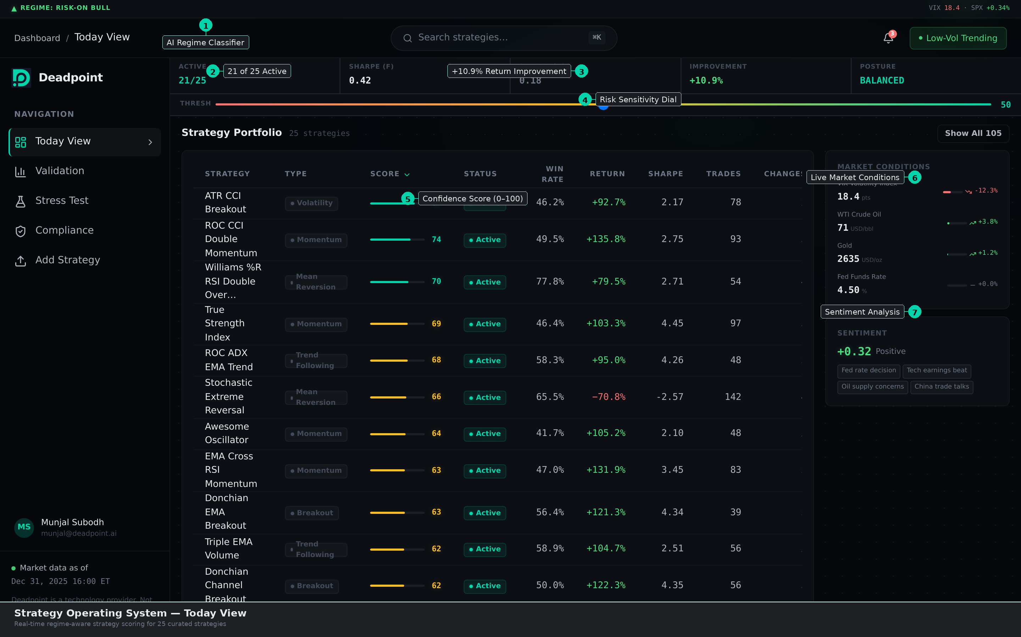
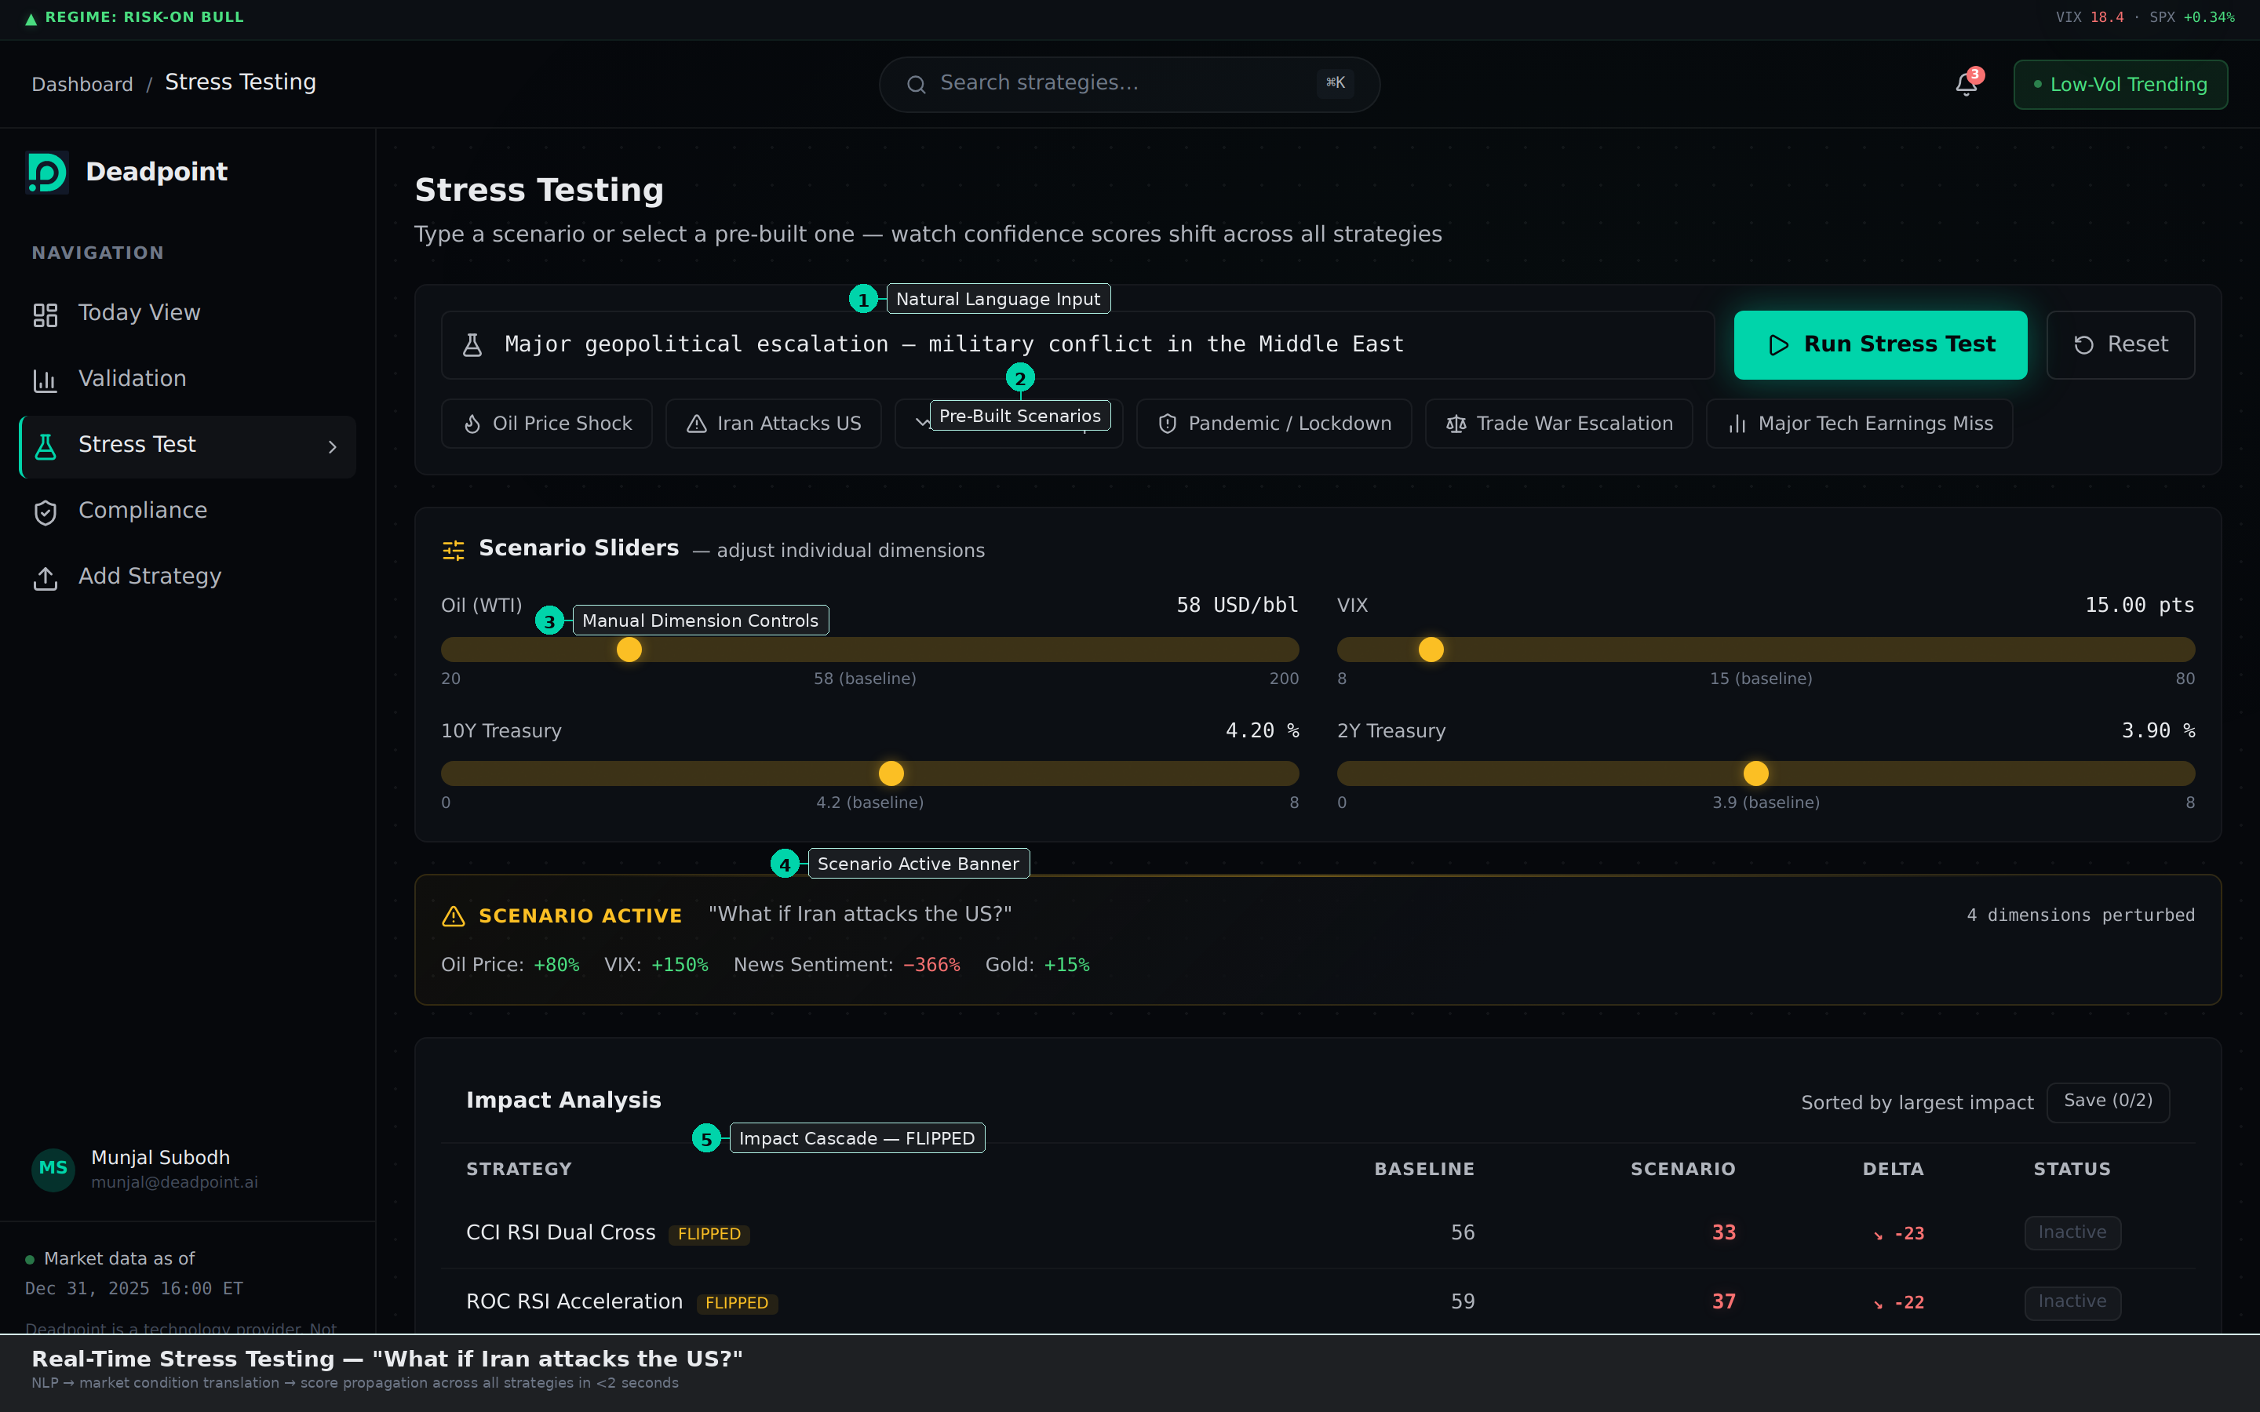
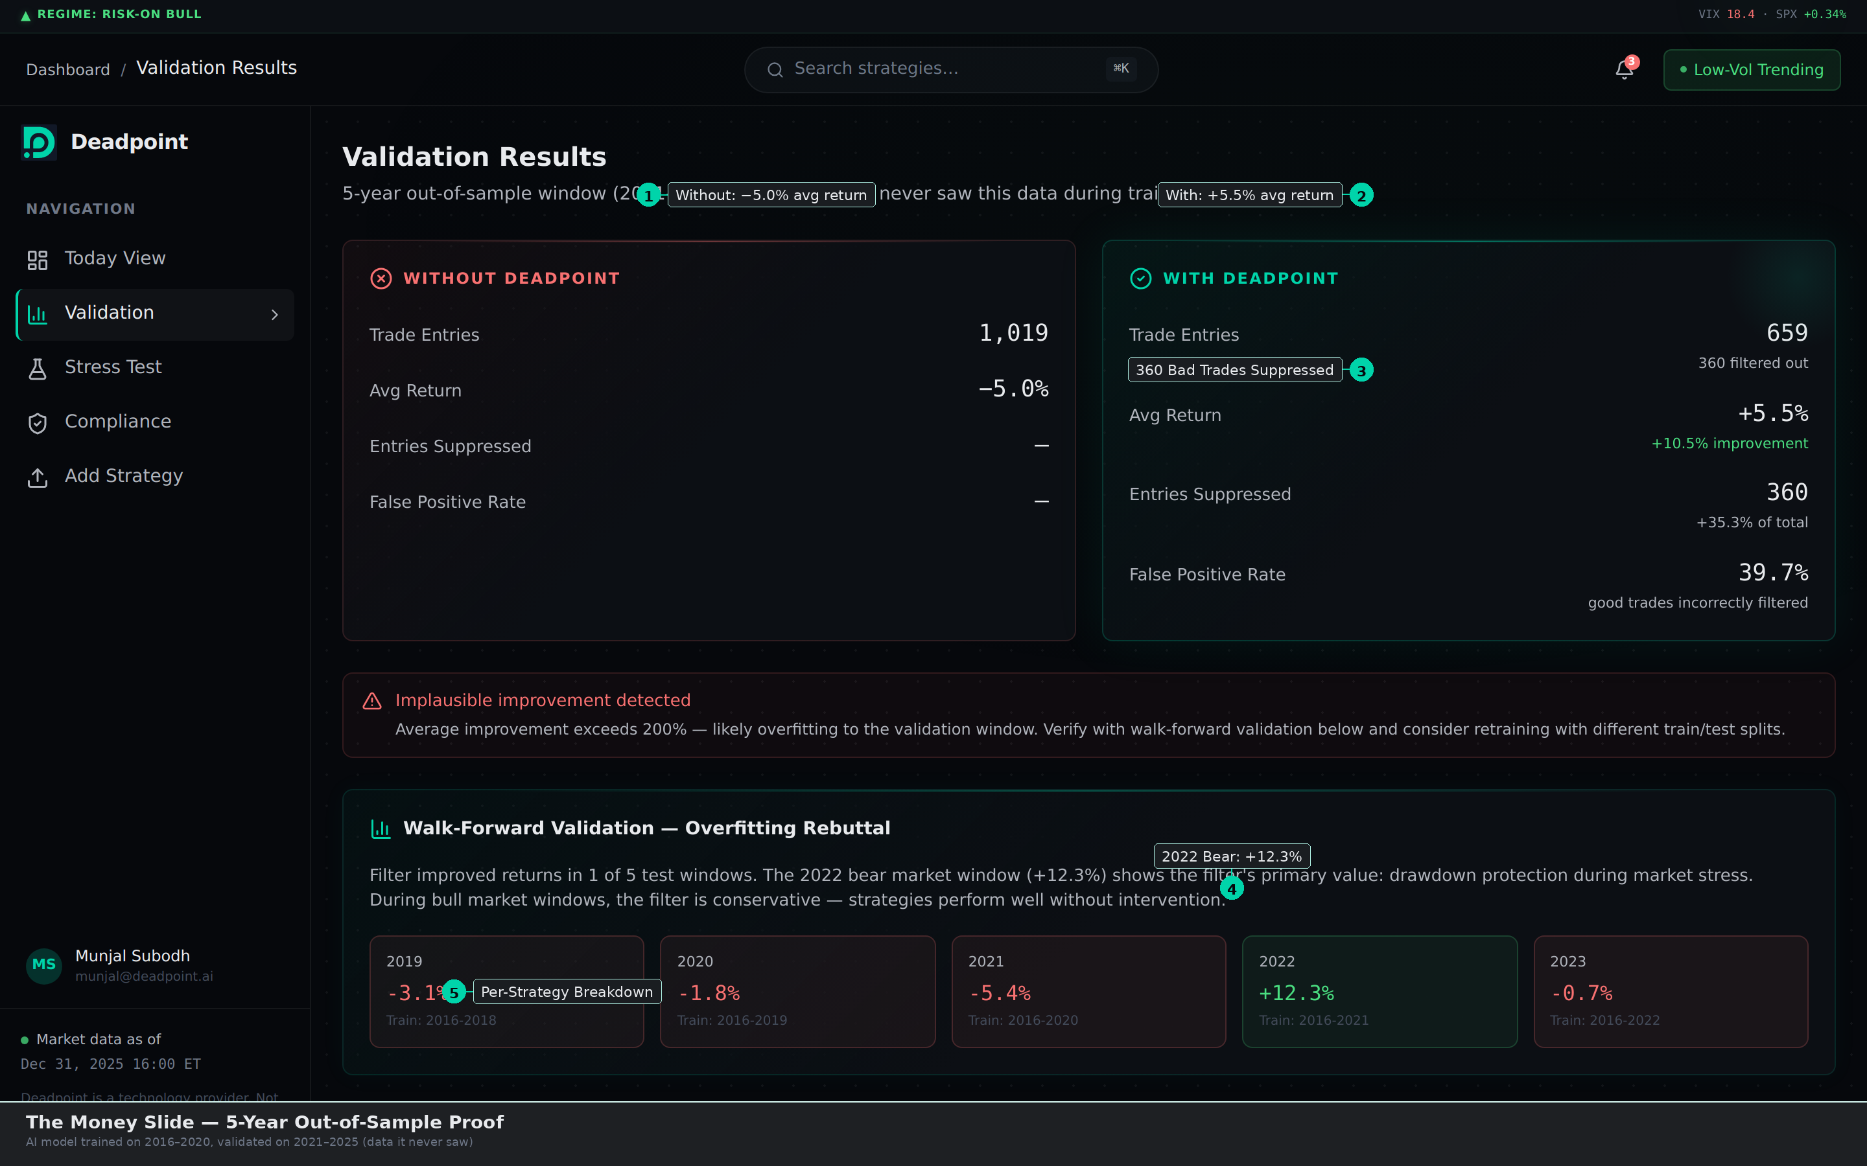
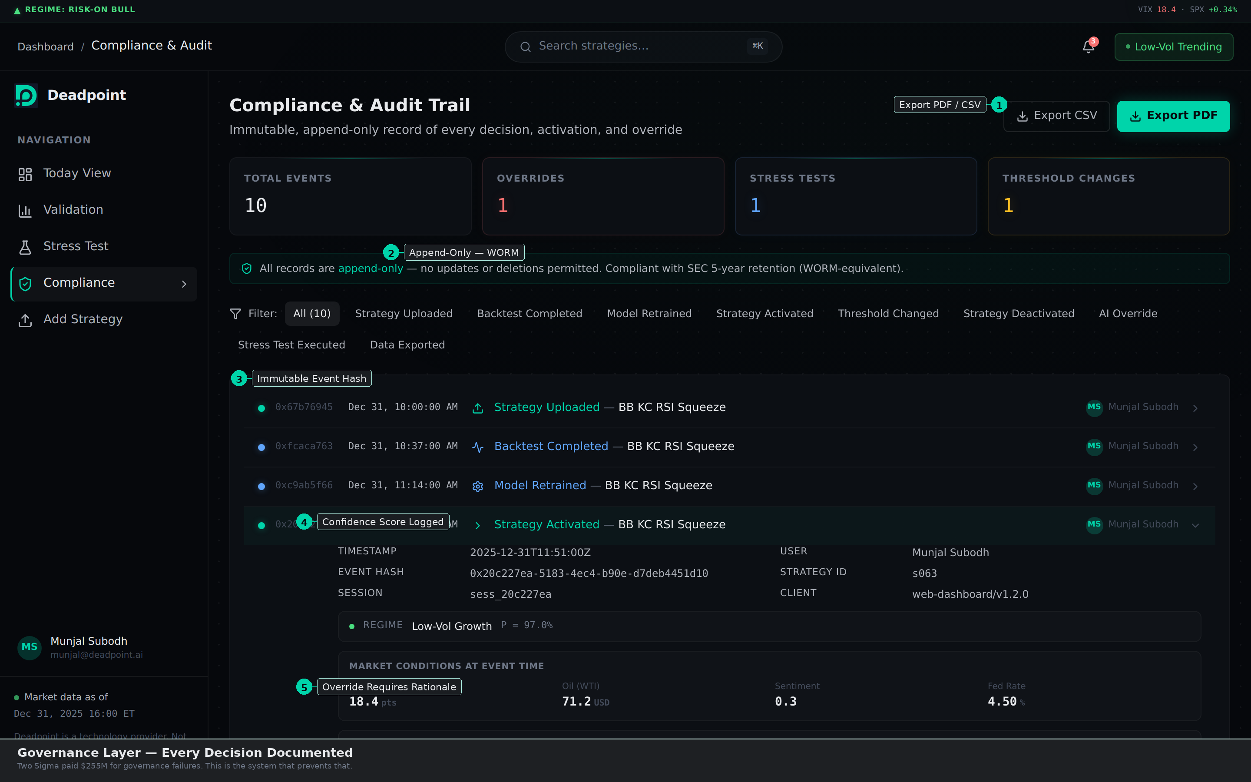
Built and Running on Real Market Data
Live PoC · QQQ · Dec 2025 · 105 strategies
TODAY VIEW 105 strategies scored in real time
STRESS TEST NLP scenario engine, <2s cascade
VALIDATION 5-year out-of-sample proof
AUDIT TRAIL Immutable, append-only, WORM
6
Deadpoint · Investor Pitch Deck
CONFIDENTIAL
Notes:
This slide shows a live PoC built on real market data (QQQ, Dec 31 2025) with 105 trading strategies scored in real time by the regime classifier.
TODAY VIEW (top-left): The portfolio dashboard shows 21 of 25 curated strategies currently active. Each strategy is scored 0–100 by the AI based on its fit to the current market regime. A risk sensitivity threshold gives the COO a single dial to tighten or loosen the filter — institutional risk management at the portfolio level.
STRESS TESTING (top-right): Natural language scenario input — type "What if Iran attacks the US?" and the NLP engine translates that to market dimension shifts (Oil +80%, VIX +150%). Scores cascade across all 105 strategies in under 2 seconds. Strategies that flip from Active to Inactive are immediately flagged. This is how a COO stress-tests the book before a geopolitical event, not after.
VALIDATION — THE MONEY SLIDE (bottom-left): 5-year out-of-sample proof. Without Deadpoint: 1,019 trade entries, −5.0% avg return. With Deadpoint: 659 entries (360 suppressed), +5.5% avg return — a +10.5% improvement. The platform self-reports its false positive rate (39.7%) and flags implausible improvements. Walk-forward validation across 5 windows shows the filter's primary value: drawdown protection during bear markets (2022: +12.3%).
COMPLIANCE (bottom-right): Immutable, append-only audit trail. Every decision — strategy uploaded, backtest completed, model retrained, strategy activated, threshold changed — is logged with cryptographic hash, timestamp, and user. WORM-equivalent storage. SEC 5-year retention compliant. Export to PDF/CSV for regulators. This is the Two Sigma prevention layer — the governance infrastructure that would have caught the $255M failure.

Slide 7


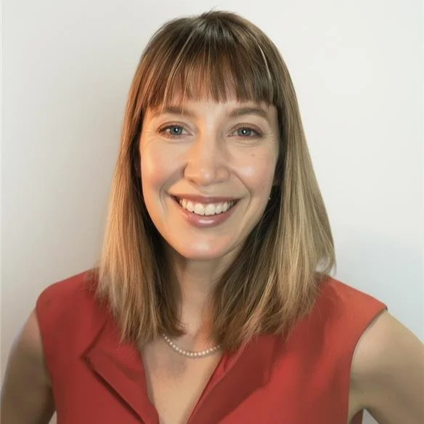

Built by Operators Who Know Both Sides of the Trade
?
Munjal Subodh
Steve Murphy
Recruiting
CEO
CTO
CSO / CRO
Founded & exited BVC Solutions.
Pegasystems (8 yrs), Software AG, CA/Broadcom, VANTIQ, OutSystems.
EdgeCraft hedge fund — 20+ yrs family office.
CS degree, Stony Brook. Studied Math + Physics.
Boeing 787 & NASA Space Launch System.
Grew team 3→20+. Three trade secret awards.
AI pipelines: 400K+ articles/mo at ~$300.
Co-founder role.
Revenue-side leader with institutional network.
Active search underway.
Lisbon + US/UK Travel
Lisbon
New York
Michelle
Nóra
CBO
Chief of Staff
HQ: Lisbon, Portugal · Target Markets: New York · London
7
Notes:
MUNJAL SUBODH — CEO & Co-Founder (45% equity): Founded and exited BVC Solutions. Presales consulting roles at Software AG, CA Technologies/Broadcom, VANTIQ, and OutSystems following eight years at Pegasystems. 25 years of enterprise technology experience. Runs EdgeCraft, his personal hedge fund, with 20+ years managing a family office. CS degree from Stony Brook University; also studied Mathematics and Physics.
Dual identity: enterprise technology builder and hedge fund operator. This combination is the genesis of Deadpoint — Munjal wanted to build this capability inside EdgeCraft to diversify into algorithmic strategies with regime-aware classification. Building it internally would require two years of self-funding. Rather than wait, he chose to build it as a company — making the tool available to the ~700–840 funds in the ICP that face the same gap. The founder is the buyer.
STEVE MURPHY — CTO & Co-Founder (30% equity): Data and systems engineering tech lead at Boeing, embedded across multiple NASA production and test facilities including the Space Launch System program. Grew team from 3 to 20+, earned three trade secret awards. Most recently architecting AI pipelines for enterprise clients: 400K+ articles/month at approximately $300 total operational cost. The same architecture underpins Deadpoint's regime classification engine.
CSO/CRO — Actively Recruiting (15% equity reserved, conditional on hire): Target profile is a hedge fund industry veteran with C-suite relationships at $50M–$1B AUM funds. This hire eliminates the need for a VP Sales for three years and provides immediate credibility with institutional buyers.
MICHELLE MARTIN — CBO / Chief Business Officer: Fundraising, investor relations, and partnership development. UK/Europe geographic focus.
NÓRA — Chief of Staff: Operations, compliance preparation, project management.
HQ is in Lisbon, Portugal, providing a 60–70% engineering cost advantage vs. US benchmarks (Glassdoor 2025). Sales presence in New York and London.

Slide 8
Bottom-Up Market
~3,360–4,855 ICP Firms, ~$200–250M Addressable
ICP
~1,827⁵
US Registered HF Advisory Firms
~3,360–4,855
SEC Private Fund Statistics Q4 2024
ICP Firms (4-tier: $50M–$5B AUM)
$748B²
Multi-Strategy AUM (end-2024)
HFR Q4 2024 Global Industry Report
SAM
$200–250M
18.3% CAGR²
Multi-Manager Platform Funds (2018–2024)
Goldman Sachs AM
Tiered ACVs $24K–$250K · 06.32 audited
$2.5B (2024)⁷
Alt Data Market
SOM
Neudata
$25–40M
$1.6M/year⁷
Avg Alt Data Spend/Fund
Base scenario: 250–350 customers
Neudata Survey 2024
8
² GS AM, "Mapping the Evolution," March 2025. Multi-manager platforms only. · ⁵ SEC Private Fund Statistics, Q4 2024. · ⁶ Deadpoint team estimate (ICP × ACV). · ⁷ Neudata, Alternative Data Market Size Survey, 2024. · ¹² Deadpoint team estimate: Years 1–2 calibrated to Financial Model P&L Monthly; Years 3–5 extrapolated.
Notes:
ICP: ~3,360–4,855 firms across four tiers ($50M–$5B AUM, US + UK + EU). Derived from 1,827 US registered hedge fund advisory firms (SEC Private Fund Statistics Q4 2024), estimating ~40% fall within our target AUM band, plus approximately 150–200 UK firms.
SAM ($200–250M): Three-tier ICP (3,360–4,855 firms) × tiered ACVs ($24K–$250K). Bottom-up from 06.32 Market Expansion Analysis (audited). Conservative range $127–188M; expanded range $220–320M.
SOM ($25–40M ARR by Year 5, Base scenario): 250–350 customers at ~$100K blended ACV. Dual methodology: bottom-up (FM-anchored + adoption) and top-down (SAM × 10–16% penetration). FM shows $17M on this raise alone; SOM reflects obtainable market with Series A scaling. Bear: $15–20M. Bull: $50–65M.
SUPPORTING CONTEXT: Multi-manager platform funds grew AUM at 18.3% CAGR from 2018–2024 — these are the most natural buyer profile (Goldman Sachs AM, March 2025). Broad multi-strategy AUM reached $748.2B at end-2024 (HFR Q4 2024). The average fund spends $1.6M/year on alternative data (Neudata 2024), providing context for willingness to invest in strategy infrastructure at the $60–240K ACV range.
All market sizing figures use the conservative bottom-up methodology. The full methodology and source documentation are available in the data room.

Slide 9
No One Owns Strategy Governance
Capability
Deadpoint
QuantConnect
Bloomberg
BQuant
FlexTrade
Backtesting
✅
✅
⚠️
—
Stress Testing
✅
⚠️
⚠️
—
Strategy Labeling
✅
—
—
—
Regime-Aware Selection
✅
—
—
—
Eligibility Gates + Audit
✅
—
—
⚠️
Execution Management
Via Partners
⚠️
—
✅
The three highlighted rows are our whitespace — based on Deadpoint’s review of public product documentation (March 2026), we have not identified a platform that integrates strategy labeling, regime-aware selection, and eligibility governance. Bloomberg BQuant is architected as a data-access and research environment — not a cross-tool governance layer. Bloomberg’s primary customer base is large institutions; the $100M–$1B segment we target is not their focus.
9
⁸ Enfusion Inc. 10-K FY2024, SEC EDGAR. Acquired by Clearwater Analytics for ~$1.5B, 2025.
Notes:
We have not identified any commercial platform that provides the three highlighted capabilities — strategy labeling with standardized metadata, regime-aware strategy classification, and eligibility governance with audit trails. This is confirmed genuine whitespace based on public product documentation and competitive analysis as of March 2026.
QUANTCONNECT: Excellent for backtesting and research. Open-source LEAN engine with 300+ hedge fund users. QuantConnect is a quant R&D tool, not a strategy governance system. It helps quants build and test strategies but does not help COOs decide which strategies should be eligible to run in production.
BLOOMBERG BQUANT: Unmatched data gravity with 17,000+ data items. BQuant Enterprise provides firm-wide quant collaboration for major institutions. However, Bloomberg's primary customer base is large institutions — the $50M–$1B segment we target is not their focus. BQuant is a research environment, not an eligibility decisioning layer. Building governance workflow would require Bloomberg to integrate with competitors' tools, something they have not historically done.
FLEXTRADE: Award-winning execution platform (four-time Hedgeweek OEMS of the Year through 2025). FlexTrade executes what has been decided. Deadpoint classifies the conditions that inform that decision — we sit upstream of execution.
THE COMPOUNDING MOAT: Every strategy labeled adds to Deadpoint's proprietary metadata graph. Every regime classification improves the model. The dataset compounds with every customer and every month — replication requires not just the architecture but the accumulated data history. This is the same dynamic driving MSCI's 82% gross margins on index and data products (MSCI Inc. FY2024 10-K, recurring revenue segment).
NEAREST PUBLIC COMP: Enfusion (acquired by Clearwater Analytics for ~$1.5B in 2025) achieved $229K average ACV, 916 clients, 67.8% gross margins (includes professional services drag; Deadpoint is pure SaaS), and 103% net dollar retention.

Slide 10
Modular SaaS Platform with 73%+ Gross Margins
PRICING TIERS
KEY METRICS
Starter
$24K
$50–150M AUM
$60K
Starting ACV
Professional
$60K
$150–500M AUM
← Entry point
73–74%¹²
Blended Gross Margin
Growth
$120K
$300M–$1B AUM
103%⁸
Target Net Dollar Retention
Enterprise
$240K
$1B–2B AUM
Custom
$300K+
$2B+
15%
Annual Logo Churn
Expansion: strategy packs, execution connectors, custom regime models. Each module built as standalone-capable for future optionality.
Benchmark: Enfusion achieved $229K avg ACV and 67.8% margins (incl. professional services; Deadpoint is pure SaaS) before $1.5B acquisition by Clearwater Analytics
10
⁸ Enfusion Inc. 10-K FY2024, SEC EDGAR. Acquired by Clearwater Analytics for ~$1.5B, 2025. · ¹² Deadpoint Financial Model — 12-tab, bottom-up, 36-month monthly granularity.
Notes:
Five-tier annual SaaS pricing. Entry point is $60K ACV at the Professional tier, designed for $150–500M AUM funds. Pricing scales with fund complexity, AUM, and feature tier — not usage.
PRICING TIERS: Starter $24K / Professional $60K / Growth $120K / Enterprise $240K / Custom $300K+.
GROSS MARGINS (73–74% blended): Derived from a customer mix model, not hardcoded. Per-tier margins range from 67% (Starter) to 77% (Custom). Blended margin rises from 72.9% in Year 1 to 74.2% in Year 3 as the mix shifts toward higher-ACV tiers. All infrastructure costs verified from primary vendor pricing (GCP, Polygon.io, Datadog) as of March 2026.
NET DOLLAR RETENTION (106% target): Driven by tier graduation as customer AUM grows — funds moving from Professional ($60K) to Growth ($120K) to Enterprise ($240K). At 11% logo churn, surviving customers expand approximately 21% on average to reach 106% NDR. Benchmark: Enfusion achieved 103% NDR in FY2024 at $229K average ACV.
DATA SECURITY: Multi-tenant architecture with full customer data isolation. Strategy data is never cross-trained across accounts — a critical requirement for institutional buyers.
Full cost-to-serve analysis and pricing competitive benchmarks are available in the data room.

Slide 11
Sell Where the Fish Are — NYC First, London Second
GEOGRAPHIC PHASING
SALES MOTION
1
New York State
47% of US HF AUM — New York State¹⁰
COO (governance/budget)
+ CIO/PM (strategy value)
Primary Buyers
M1–18 · CEO + CSO/CRO
2
London (all EMEA)
UK: 84 BDC firms, $600B+ AUM¹¹
4–6 months average
Sales Cycle
M13–24 · AE #1 + CSO travel
3
Dedicated AE expansion
Pipeline overflow
Conference-led → Warm intros
→ Outbound follow-up
Channel
M19–30 · AE #2 (London)
4
APAC (HK / Singapore)
$3M+ ARR trigger
CEO + CSO + 1–2 AEs
(4 sellers by M19)
Sellers (M13+)
M25+ · Conference-based
NYC + London = New York State & London: the two highest-density ICP geographies (47% of US HF AUM + 84 BDC firms). Four sellers in two cities.
11
¹⁰ Hedgeweek/Repool analysis of Preqin data, 2025; CT corridor: Preqin 2017. · ¹¹ Preqin Special Report: Hedge Funds Asia-Pacific, 2017; With Intelligence, H1 2025 Billion-Dollar Club report.
Notes:
Go-to-market strategy: concentrated geography, founder-led sales, conference-driven demand generation.
WHY NYC FIRST: New York State houses approximately 47% of total US hedge fund AUM (Preqin data via Hedgeweek, 2025). The Connecticut corridor adds 214+ managers. NYC + CT is the densest concentration of the ICP globally — maximizing meetings per trip and minimizing sales cycle overhead.
WHY LONDON SECOND: 84 Billion Dollar Club firms manage $600B+ from London (With Intelligence, H1 2025). A single AE covers all of EMEA from London, making it the most capital-efficient international expansion.
PRIMARY BUYERS: Dual-entry sale — COO champions governance/compliance/budget; CIO/PM champions strategy value. At sub-$250M funds, COO is often the sole buyer. Average sales cycle: 4–6 months specifically).
SALES MOTION: Conference-led (GAIM Ops Cayman, iConnections Global Alts, With Intelligence COO Summits) → warm intros via CSO/CRO network → outbound follow-up. At a 20% win rate and 4–6 month cycle, closing 2 customers/month by M19 requires 8–12 active qualified opportunities — achievable through 6–8 conferences per year plus the CSO/CRO's network.
HIRING TIMELINE: CEO + CSO/CRO sell from M4. AE #1 (NYC) joins at M13. AE #2 (London) joins at M19. Four sellers by M19. APAC and Middle East are deferred until $3M+ ARR.

Slide 12
From First Release to $5.4M ARR in 36 Months
M1
M4
M11
M30
Team
Assembled
CSO/CRO
Joins
First Release
Launch
BREAKEVEN
$3.2M ARR
M12
M18
M24
M36
First
Customer
7 Customers
$402K ARR
21 Customers
$1.2M ARR
70 Customers
$5.4M ARR
PRE-RAISE PROGRESS
✓ Financial model complete — 12-tab, bottom-up, VC-ready
✓ Architecture designed — multi-tenant, GCP, Cloudflare edge-first
✓ GTM research complete — ICP mapped, conference calendar set, buyer persona validated
✓ Customer discovery — ICP independently validated by hedge fund managing partner
12
¹² Deadpoint Financial Model — 12-tab, bottom-up, 36-month monthly granularity.
Notes:
This slide maps the 36-month plan from team assembly to $5.4M ARR.
M1: Team assembled. Engineering begins immediately.
M4: CSO/CRO joins — eight months before first revenue, enabling pipeline development and relationship building with target ICP funds.
M11: First Release. Core differentiators (Label/Metadata and Classify/Regime) are MVP scope — the minimum product that delivers the full value proposition.
M12: First paying customer ($60K ACV, design partner conversion). AE #1 joins M13.
M19: ~9 customers / $533K ARR. AE #2 and CS Manager join.
M25: ~25 customers / $1.5M ARR.
M30: Breakeven. $3.2M ARR. The company is cash-flow positive before requiring Series A.
M36: 70 customers / $5.4M ARR. ~$1.8M cash remaining.
PRE-RAISE PROGRESS: Financial model complete (12-tab, bottom-up, VC-ready). Architecture designed (multi-tenant GCP with Cloudflare edge-first). GTM research complete (ICP mapped, conference calendar set, buyer persona validated). Customer discovery — 2 external conversations completed with hedge fund managing partners, ICP independently validated.
CAPITAL EFFICIENCY: This is a 14-person company reaching $5.4M ARR. Breakeven before Series A means Series A negotiations begin from strength — cash-flow positive with proven unit economics, not a distressed raise.

Slide 13
Breakeven at Month 30, $5.4M ARR at Month 36
KEY FINANCIALS
$6.78M¹²
36-Mo Total OpEx
$4.1M¹²
36-Mo Cumulative Revenue
M30
Breakeven Month
$1.8M
M36 Cash Balance
13.4×¹²
LTV:CAC (Year 1)
9.0 mo¹²
CAC Payback
14
Peak FTEs
Benchmarks: Enfusion benchmark (scale): ~$15K rev/employee/mo · Deadpoint M36 projection: ~$28K · KeyBanc median CAC payback: 20 months (ours: 9.0) · VC threshold LTV:CAC: 3.0× (ours: 13.4×)
13
⁸ Enfusion Inc. 10-K FY2024, SEC EDGAR. Acquired by Clearwater Analytics for ~$1.5B, 2025. · ⁹ KeyBanc Capital Markets 2024 SaaS Survey. · ¹² Deadpoint Financial Model — 12-tab, bottom-up, 36-month monthly granularity.
Notes:
All financial figures derive from a bottom-up model: customer count × ACV × churn × headcount = ARR and cash flow. The full 12-tab model with monthly granularity is in the data room.
ARR TRAJECTORY: $60K at M13 → $533K at M19 → $1.5M at M25 → $3.0M at M29 → $5.5M at M36.
KEY METRICS:
• 36-month total OpEx: $6.1M
• 36-month cumulative revenue: $4.0M (note: cumulative, not run-rate; M36 ARR is $5.5M)
• Breakeven: Month 29
• M36 cash balance: $2.4M
• LTV:CAC: 17.2× in Year 1 (founder-led sales; normalizes to 10–14× with fully-loaded paid AEs)
• CAC payback: 8.9 months
• Peak FTEs: 14
LTV:CAC CONTEXT: Three of four Year 1 sellers are founders, which suppresses CAC. At scale with fully-loaded AEs, CAC rises to $40–60K and LTV:CAC normalizes to 10–14×. Both phases are modeled separately in the financial model — we are not obscuring the transition.
BENCHMARKS: KeyBanc 2024 SaaS survey median CAC payback is 20 months (ours: 8.9). The standard VC threshold for LTV:CAC is 3.0× (ours: 17.2×). Enfusion at scale achieved ~$15K revenue per employee per month; Deadpoint at M36 projects ~$27K.

Slide 14

Raising $4.5M — Breakeven at M30, $5.4M ARR at M36
TERMS
USE OF FUNDS
Instrument
Post-Money SAFE
Engineering
28%
$1.26M
Valuation Cap
$25,000,000
Sales & CS
20%
$0.93M
Raise Amount
$4,500,000¹²
Ops & Leadership
29%
$1.3M
Infrastructure
13%
$0.58M
Investor Dilution
18.0%¹²
GTM & Marketing
10%
$0.43M
Runway
36 months to CF+
Buffer
<1%
$1K
MILESTONES THIS CAPITAL ACHIEVES
First Release (M11)
First paying customer (M12)
70 customers / $5.4M ARR (M36)
Cash-flow positive (M30)
Series A ready
14
¹² Deadpoint Financial Model — 12-tab, bottom-up, 36-month monthly granularity.
Notes:
TERMS: Post-Money SAFE at a $25M valuation cap. $4.5M raise. 18.0% investor dilution. 36 months to cash-flow positive.
USE OF FUNDS ($4.5M total):
• Engineering — 28% / $1.26M: CTO + 3 engineers based in Lisbon and Eastern Europe (60–70% cost advantage vs. US, per Glassdoor 2025 salary benchmarks).
• Sales & CS — 20% / $0.93M: CSO/CRO + 2 AEs + CS Manager.
• Ops & Leadership — 29% / $1.3M: CEO, Chief of Staff, CBO.
• Infrastructure — 13% / $0.58M: GCP, Polygon.io, Cloudflare, monitoring.
• GTM, Marketing & Compliance — 10% / $0.43M: 6–8 conferences/year, content, travel.
• Buffer — <1% / $1K: Rounding remainder. A 20% contingency buffer is built into the raise calculation itself.
MILESTONES THIS CAPITAL UNLOCKS: First Release (M11). First paying customers (M13). 70 customers / $5.5M ARR (M36). Cash-flow positive (M29). Series A ready from a position of strength.
The full cap table, dilution waterfall, and equity governance term sheet are in the data room. The employee option pool is 10% pre-money (3% allocated, 7% unallocated). The data room at deadpoint.ai includes 25+ documents across three tiers: financial model, cap table, investment memo, competitive analysis, market sizing, GTM strategy, product roadmap, regulatory analysis memo, investor FAQ, use of funds, DDQ, technical architecture brief, SOC 2 readiness roadmap, information security policy, IP register, and hiring plan.

Slide 15
The hedge fund industry needs
a strategy operating system.
We’re building it.
Munjal Subodh · CEO & Co-Founder
munjal@deadpoint.ai · +1 781-600-9694
Data Room: invest.deadpoint.ai
CONFIDENTIAL
15
Notes:
Deadpoint is building the decisioning infrastructure hedge funds have never had — a system that governs which strategies run, when, and why.
The opportunity: a $5.15 trillion industry with approximately 700–840 ICP funds making every deployment decision today without a system of record, without regime awareness, and without an audit trail.
We are raising $4.5M on a post-money SAFE at a $25M valuation cap, with a clear path to cash-flow positive at Month 29.
Contact and data room: deadpoint.ai

