Slide 1
~ Bridging Asia and the World ~

Slide 2

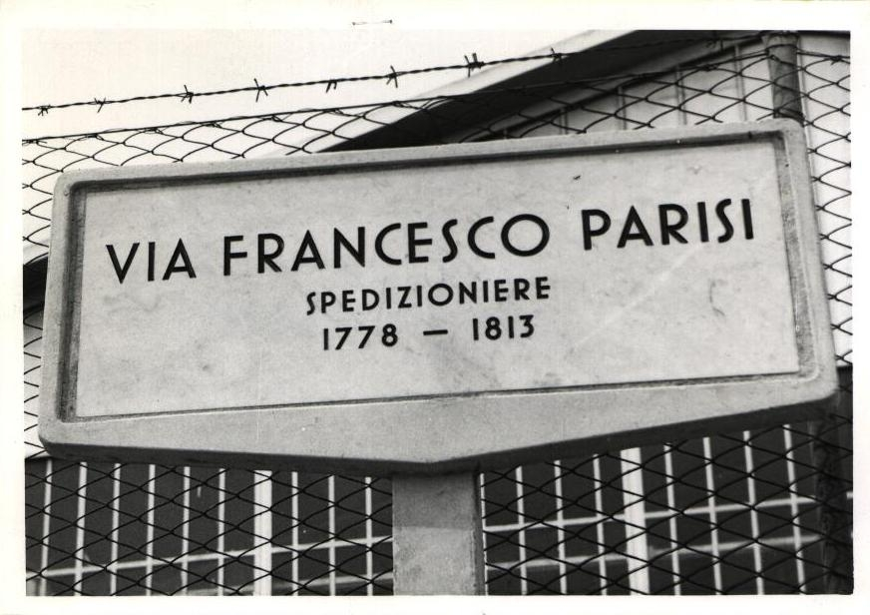
PGS Logistics Group Asia – Portfolio
Headquarters: | Hong Kong, SAR
Established: | 2003 (Group Head Office in Trieste, Italy 1807)
Profile: | International Freight Forwarder and Logistics Provider operating worldwide Managing own warehouses in Asia and provide 3PL services E-commerce expert, FBA Shipping and cross-border eCommerce Provider
Memberships Accreditation | IATA, FIATA, CIFFA, HAFFA, FMC;
600
Millions USD Sales
turnover in Asia
+200K
TEUs
Shipping In/out
of Asia annually
+800
Employees
In Asia
+200
years
in business (group)
+35
Offices in Asia and Indian Sub
1
single cloud-based
ERP system
Management Team
Group CEO - Dr. Francesco Parisi (center)
Managing Director - Tak Chu (left)
Director Sales & Marketing - Helmut Horvath (right)
“Over 200 years of shipping expertise teamed up with local knowledge”

Slide 3

History
One Organization – Globally Connected
Parisi Grand Smooth Logistics Ltd – PGS Logistics Ltd is a subsidiary of the Francesco Parisi Group of Companies with its Head Office in Trieste, Italy.
The Group was established by Mr. Francesco Parisi (1778-1813) in Trieste and present in Central Europe since 1807. The Group is engaged in Freight Forwarding, Shipping Agency Service, Port Operating, and Infrastructure Management for marine and intermodal rail terminals.
PGS Logistics set up its first Asian office in Hong Kong SAR, in 2003.
PGS Logistics has expanded rapidly and operates now 28 service centers across Asia.
PGS provides its customers with a comprehensive range of services covering all essential segments in logistics and transport.
Group Headquarters – Trieste, Italy

Slide 4
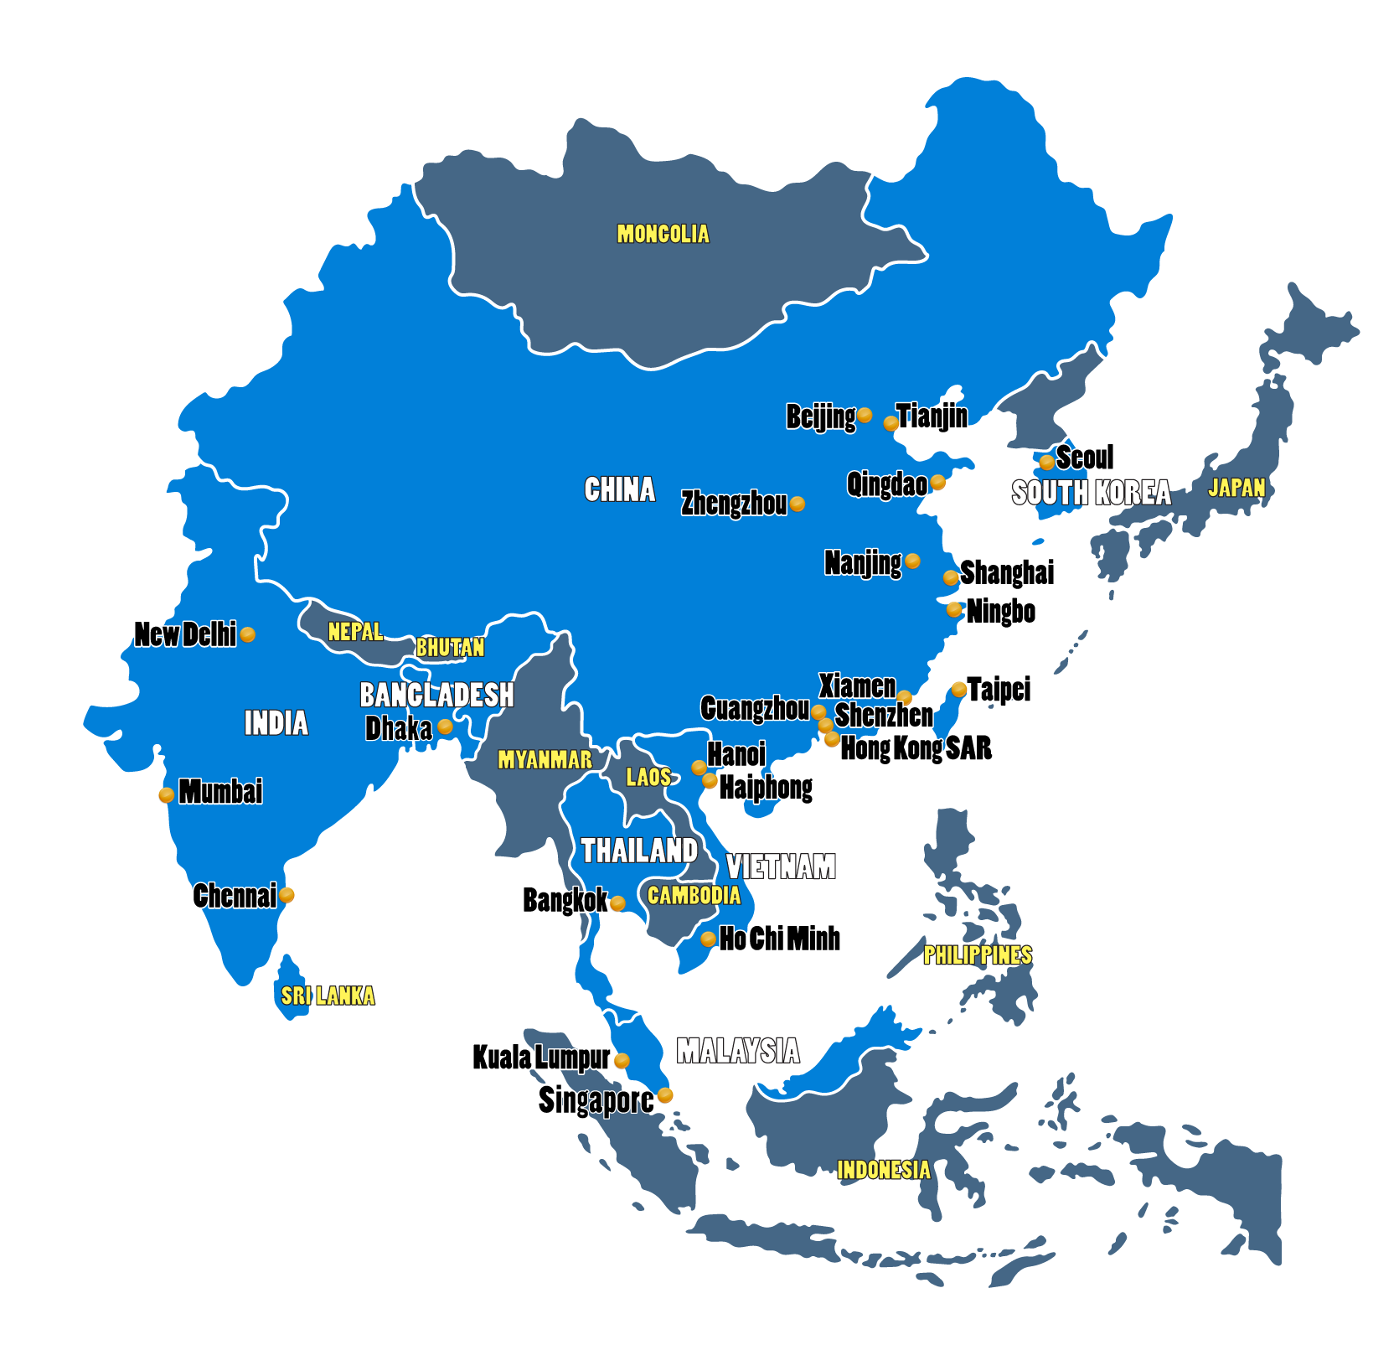
Office Network
One Organization – Globally Connected

Slide 5
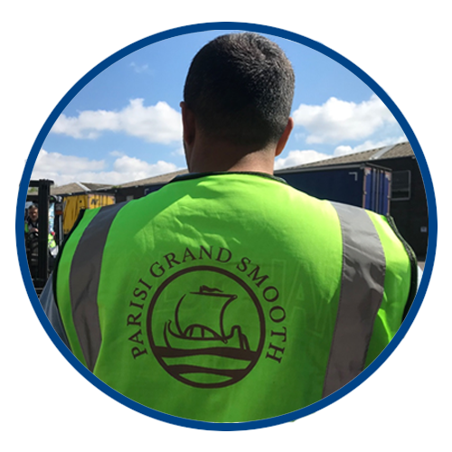

Mission and Values
Mission statement
Our Mission is to create new logistics solutions, tailor-made to our customer’s needs, and provide top quality and personalized services at a competitive price.
“Bridging Asia and the World”
Group core values
For more than 200 years, Parsi Group’s core value have been the foundation of who we are and what we stand for:
Respect for People
Highest ethical behavior
Be innovative and creative

Slide 6
Service Portfolio
Airfreight has become an essential factor in the supply chain management to keep pace with the increasing demand for worldwide markets PGS Logistics provides contracted block-space agreements and dedicated air freight solutions such as:
Priority Cargo service:
Our team understands that certain goods need a faster delivery time. PGS Logistics will help you to tailor-make a more flexible and efficient shipping schedule as per specific requirements
Consolidation Services:
PGS Logistics will offer you a variety of cost-effective and time-saving air cargo solutions to move shipments on a global extent, and also will provide regular and frequent flight schedule to ensure flexibility to your needs
Sea and Air:
PGS offers a clear Sea/Air defined schedule so that our clients can confidently manage their supply chain and benefit from the attractive Sea/Air Tariffs
Air Door to Door Service:
PGS Logistics has a global network to provide a reliable Door-to-Door service
Dangerous Goods:
PGS is an IATA Cargo Agent and has a trained team to handle Dangerous Goods. Our offices will guide customers through the whole process as required packing, shipping marks, and documentation.

Slide 7
Service Portfolio
Sea Freight
PGS offers comprehensive services for global delivery of port to port or Door-Door with quality shipping lines and the support of our worldwide Agency network
Port to Port or Door to Door:
PGS has the knowledge to select the possible transport mode to move your containers to the final destination – as MTO (Multi Modal Operator) PGS Logistics engages various mode of transport such as road, rail, and feeder transport services to achieve the most efficient container door to door rate.
LCL – Less than Container Load:
PGS offers LCL consolidation service to current key markets as India, Europe, North America, and Latin America. With an own CFS warehouse, PGS facilitates safe storage, loading, and handling of your merchandise.
Buyer’s Consolidation:
It is the management of multiple supplier consignments at origin “consolidation hubs” to reduce the number of smaller shipments and optimize transportation costs.
Break-Bulk Cargoes:
Either shipment from or to Asia, PGS Logistics has the expertise and network to offer you quality breakbulk service. Commodities as farm machinery, mining equipment, windmills, transformers, timber, steel, yacht, vehicles or raw material packed in bundles, barrels, or even grains ores etc. are typical breakbulk cargoes.

Slide 8
Service Portfolio
Railway and Road Transportation
PGS Logistics has a dedicated Railway Team based in Zhengzhou, one of the central railway hubs in China. PGS ships regular FCL and LCL from China to Europe and vice versa. Also. PGS provides Railway service from/to Mongolia, Kazakhstan, Uzbekistan, Russia, and beyond. PGS selects the most advantageous routes, advice on the most suitable railcars, negotiations with rail transport operators and, designs intermodal solutions, flexible and efficient Road Freight Services. Our Road Freight services include:
Domestic FTL and LTL service
Cross Border Service within the Asia zone
Combined / Multimodal services
PGS is happy to offer individual transport agreements according to our client’s wishes and requirements:
PGS 4 step model:
Cost-Effective
Safe
Within the required time frame
Less Carbon Foot Print
Courier Services
PGS Group has established a dedicated courier company in China to assist our customers for courier Door to Door services.
PGS Global Express has contacts with the leading courier integrators and can offer you favorable rates and add-on services
For more information, please visit their website at www.pgs-exp-.com

Slide 9
Service Portfolio
Project Management
With many years of experience in the OOG Shipping (out of Gauge – special container cargo), Break-Bulk, and heavy lift management, PGS has established a strategic partnership with the significant Shipping-Lines, Break-Bulk and Ro/Ro vessel providers, Railway, and heavy lifts operators.
Break-Bulk Cargoes:
Either shipment from or to Asia, PGS Logistics has the expertise and network to offer you quality breakbulk service. Commodities as farm machinery, mining equipment, windmills, transformers, timber, steel, yacht, vehicles, or raw material packed in bundles, barrels, or even grains ores, etc. are typical breakbulk cargoes.
PGS has an extensive Partner-Network to offer a multimodal Door-Door solution for any Project Cargo
Safe and Efficient:
PGS reviews the project requirements, plans out the most reliable and most efficient way to deliver your cargo through multiple mods of transports. PGS ensures that your project is delivered safely, on-time, and within the budget.
Commodity Project experience:
Oil & Gas, Industrial Plants, Chemicals, Power Generators, machinery, Coal, Vehicles (Bus/Crane)
Trade Route Project experience:
Within Intra-Asia, from/to Asia-Latin America, Asia-Europe, Asia-Africa, Asia-North America

Slide 10
Service Portfolio
Cross Border eCommerce – Global eCommerce Trade
eCommerce sites are no longer merely online galleries. They have become a place people go to learn. To be inspired and be immersed in a brand’s universe. The Supply China and understanding social media are equally important as the brand itself – finding the right partner and solutions for your
success in Asia is our mission.
PGS Cross Border eCommerce Logistics (CBEL) is a professional team dedicated to the Global eCommerce trade.
based on the group’s extensive overseas network and global warehouse facilities, CBEL takes up all the logistic challenges and overcome
All the difficulties for eCommerce customers.
“One Top Shop Fulfilment” powered by PGS CBEL Department
eCommerce Fulfilment Solutions:
PGS CBEL focus on Global eCommerce Supply Chain Fulfilment Solutions, aims to integrate of all cargo
Movements, information, and visibility.
PGS CBEL is optimizing all aspects of your supply chain fulfilment to enhance operational process and last-mile delivery.
Multi-Country Delivery:
PGS CBEL Global eCommerce Supply Chain Fulfilment solutions is capable of taking up all challenges to minimize your operation costs in consolidation your B2B2C or B2C order to the delegated overseas fulfilment center for Multi-Country Delivery

Slide 11
Service Portfolio
Fulfillment by Amazon FBA Deliveries
Across the globe, Amazon has more than 180 operating fulfillment centers and more than 14 Million square meters of space where associates pick, pack, and ship millions of Amazon customer’s orders to the tune of millions of items every year. Thousand of sellers and suppliers delivering goods to their fulfillment centers and PGS established itself as a specialist on FBA deliveries from China and the rest of Asia to Amazon fulfillment centers.
PGS CBEL team services:
Freight collection via PGS global network
Customs clearance from Country of Origin
Shipping process by air or sea freight
Import customs clearance and duty/taxes arrangements
Order soring, Pick & Pack
Last Mile-delivery to Amazon warehouse
End to End Track & Trace

Slide 12
Service Portfolio
Warehouse Services
When it comes to the Supply Chain, knowledge and visibility are the true factors in controlling costs.
PGS Logistics has the capability of reducing your overall supply chain costs by managing your stock in Asia. Maintain an inventory system and directly send your products to the final customers or logistics hubs. Local deliveries are arranged by own or subcontracted lorries and worldwide distribution by own air and sea freight products or integrators.
“PGS team is helping you to reduce Supply Chain Costs”
Customized Reports; PGS Logistics can store your product, re-label, re-work, and deliver with full reporting on stock on hand by reference number, Lot number, or serial number. All of our stock on-hand reports can be customized to suit your specific requirements. Our Logistics hubs can take over all your invoicing and administrative duties, with a smooth and efficient electronic transfer back to your operating system.
PGS Warehouse services:
Storage and distribution
Cross-docking
Palletisation, sealing, sorting
Storage and transshipment
Quality control
Order and stock management
Order picking

Slide 13
Service Portfolio
Value-Added Logistics
Not limited to traditional warehousing and cargo-in-out services, PGS is aiming at generating value for your goods at our logistics centers.
The fully cater to your individual needs, and PGS provides a wide variety of value-added services at our logistics centers:
Value-Added Services:
Packing, repacking, and labeling of goods
Merging or assembly
Testing/Sorting lines
Inventory management of the merchandise-order picking
Logistical information through EDI
Invoicing
Fiscal representation.

Slide 14







Reference Customers

Slide 15
www.pgs-log.com

