Slide 1
The EU Disability Employment Package
Monika Chaba, European Commission, Belgium
Tom Rüütel, Employer Counsellor, Estonian Unemployed Insurance Fund, Estonia
Laura Jones, Freelance Researcher, Greece
Nadia Hadad, Executive Committee Member, European Disability Forum, Belgium
Brigitte van Lierop, Director, Disworks, Netherlands
6 March 2025, 11:00
Notes:
Please add your notes here.
Title; First name, last name of speaker(s); Name of Organization, Name of Country, Name of Session (as written in Agenda)
#ZeroCon24
Day and Time of Session

Slide 2
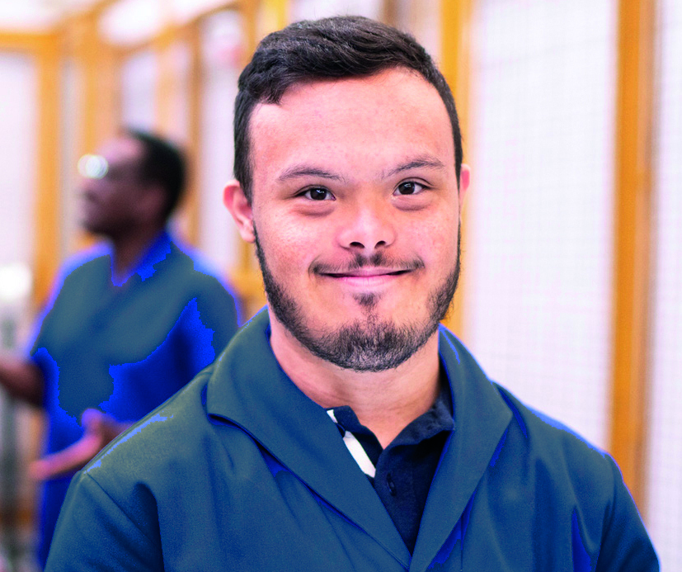
What is this session about?
Situation of persons with disabilities in the European Union labour market
  Barriers
  Solutions
  Actors
  Perspectives
  Lessons learnt
  Recommendations
Notes:
Sample Slide: presenting three points on our project and the relationship to this year’s theme of the Zero Project Conference. Point 1; Point 2; Point 3 connect together in this way.

Slide 3
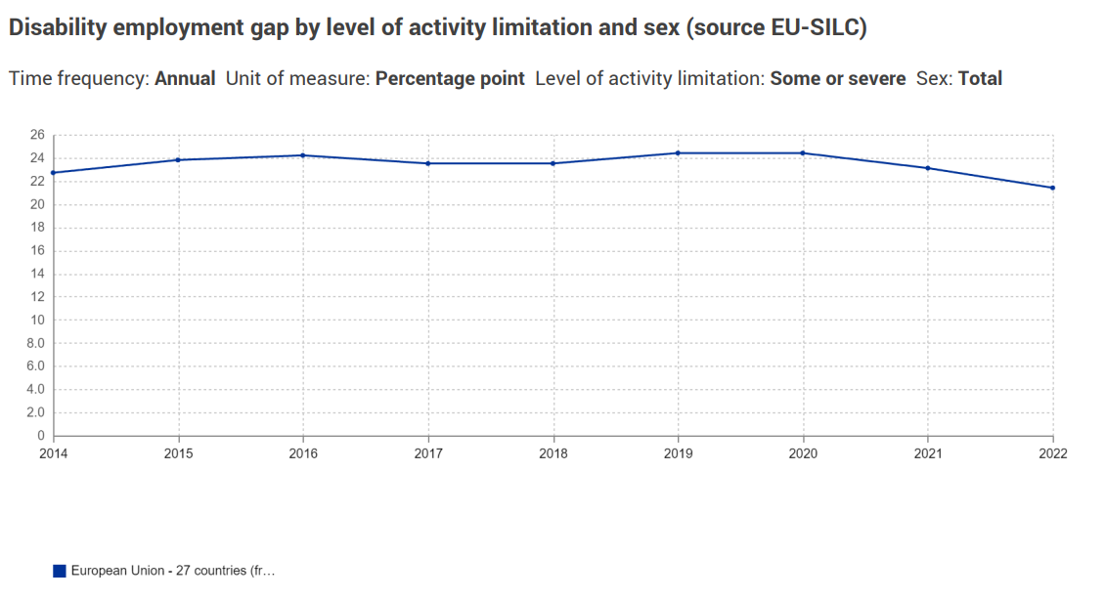
Starting point: high prevalence of disability and continuously low employment
48 million people of working age
  Almost 1/5 of the working age population (19,4%, 2023)
  +- 50% in employment
  +- 40% inactive = outside of the labour market
Notes:
High prevalence, including in the working age population
Low employment
No significant change over the last decade

Slide 4

The Strategy for the rights of persons with disabilities (2021-2030)
7 Flagship initiatives
1 Disability Platform
2 Disability Employment Package
3 AccessibleEU
4 Guidance on independent living
5 Disability Card
6 Quality framework social services
7 New Commission HR strategy

Slide 5

What is Disability Employment Package
Explanation of legal and policy frameworks
Guidance and model practices
Addressed to employers and other actors

Slide 6
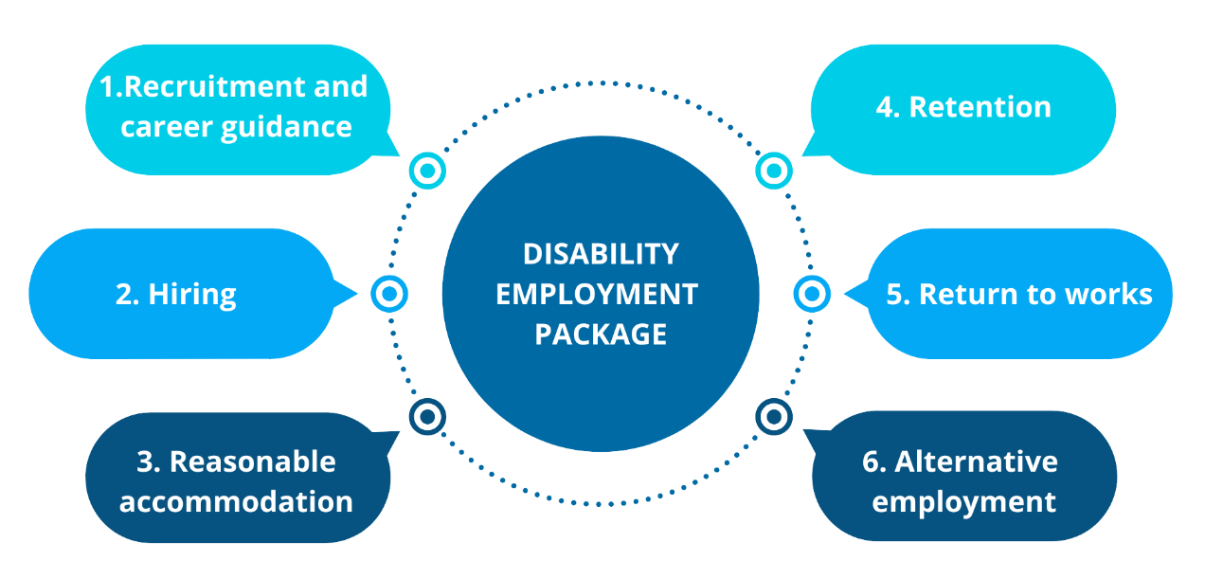
The Package covers the whole employment cycle
  Assessment
  Recruitment
  Staying in employment
  Return to work

Slide 7



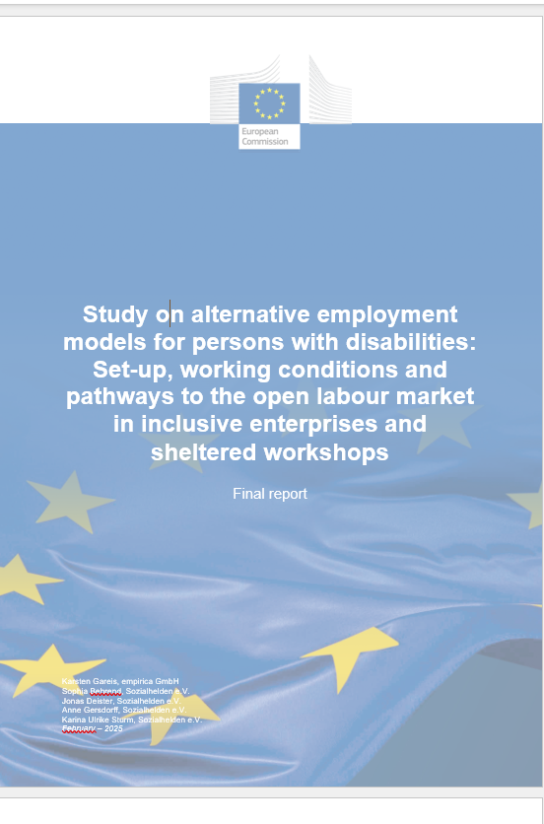

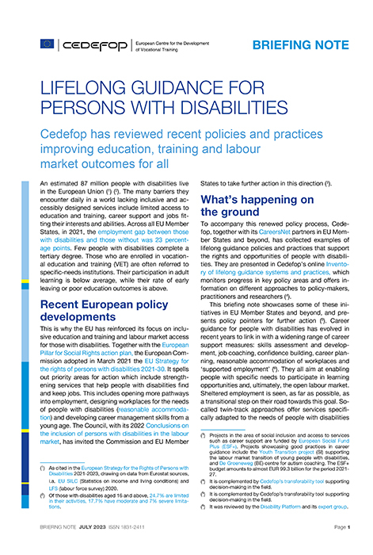


Slide 8
Government perspective: Work Ability Reform – from assessment to employment
In 2016, the work ability reform took place in Estonia.
The aim of the changes was to change attitudes towards people with reduced ability to work.
The services UIF is providing among others to people with health related problems are: Employers’ Counselling service.
Work-required special aids and workplace adaptation.
Working with a support person.
Wage subsidy.

Slide 9

Practitioners perspective - from assessment to employment
Practitioner toolkit on strengthening PES: assessment, recruitment, retention/staying at work, return-to-work
Lifelong Guidance for persons with disabilities: assessment, recruitment, retention
Manual for the Management of Chronic Diseases & Preventing the Risk of Acquiring Disabilities: retention, return-to-work
Guidelines for Effective Vocational Rehabilitation Schemes: assessment, return-to-work

Slide 10
Key challenges addressed for service providers & employers
How can I create an inclusive learning experience?
How can we ensure an effective, co-produced plans for personal development, returning to work or staying in work?
What support can help people with a disability or chronic disease to get & keep a job?
How can services be enhanced to better support individuals and employers?
How can work & the workplace be adapted for someone with a disability or chronic disease? Where can resources be accessed?
How can I build an inclusive, safe & healthy work environment for all?
What benefits does vocational rehabilitation offer employers?

Slide 11

The perspective of persons with disabilities - European Disability Forum
Embrella organisation defending the rights of more then 100 million persons with disabilities to the EU and Council of Europe
Organisation run by persons with disabilities, with member organisations all across Europe
Part of the EU’s Disability Platform subgroup on employment giving input to employment package
Particular focus on deliverables on reasonable accommodation and ensuring transition from sheltered employment

Slide 12

Reasonable accommodation in all stages of employment
Clearer guidance for employers on where/how to access subsidies
Call for simplified and quicker systems to get reimbursed
Improve awareness of how reasonable accommodation is often free

Slide 13

Employment – open labour market vs. sheltered employment
Input on the need to focus on transition from sheltered employment to open labor market
While sheltered employment exists, at least respect age and labor laws
Should focus on training and upskilling, to facilitate transition to mainstream employment

Slide 14


Supporting SMEs in Inclusive Hiring through EU funds
The Employment and Social Innovation (EaSI) programme of the European Social Fund Plus (ESF+) supports social experimentation – ‘Inclusive SMEs in Europe: i-SME’
🔹 The Story of James
🔹 A New Perspective
🔹 The Impact
A key challenge for SMEs—how to embrace inclusive hiring while maintaining productivity?
🔹 The Bigger Picture: A Consortium for Inclusion
What helps SMEs become more inclusive?
Co-funded by the European Union
Notes:
Supporting SMEs in Inclusive Hiring
The Story of James
A New Perspective
The Impact
A key challenge for SMEs—how to embrace inclusive hiring while maintaining productivity?
The Bigger Picture: A Consortium for Inclusion
What helps SMEs become more inclusive?

Slide 15
Empowering SMEs with Practical Tools
🔹 Our Research Focus
🔹 Our Contribution: A Practical Support Package for SMEs
Video stories, Case studies, Instructional materials, Top 10 tips for inclusive hiring
12-step Action Guidelines – organizing effective events to motivate SMEs
🔹 Making SMEs More Inclusive
Let’s work together—using the right strategies, sharing impactful stories, and offering the right tools—to create more inclusive workplaces across Europe.
https://disworks.eu/en/i-sme-english/
Notes:
Empowering SMEs with Practical Tools
Our Research Focus
Our Contribution: A Practical Support Package for SMEs Video stories, Case studies, Instructional materials, Top 10 tips for inclusive hiring
12-step Action Guidelines – organizing effective events to motivate SMEs
Making SMEs More InclusiveLet’s work together—using the right strategies, sharing impactful stories, and offering the right tools—to create more inclusive workplaces across Europe.
https://disworks.eu/en/i-sme-english/

Slide 16
Discussion

Slide 17
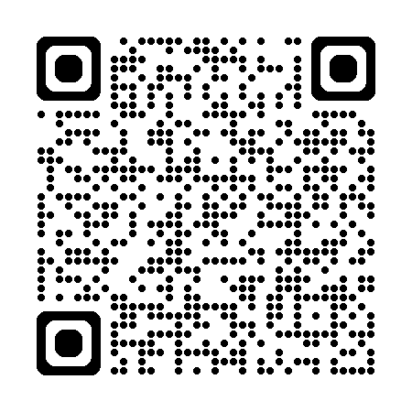
Please visit the Package website and share!

