Slide 1
TECHNICAL NOTES · SEPTEMBER 2026
Evidence2Scenario
From road accident evidence to traceable scenarios and inspectable validation outputs
Technical prototype. Text, map context and visual features share an evidence record.
App 0.5.0 and SSR schema 0.3.0.
EVIDENCE2SCENARIO
01

Slide 2
TECHNICAL OVERVIEW
The evidence-to-scenario problem
Source material does not arrive with consistent scenario semantics or complete parameters.
Source diversity
Narratives, official crash records, maps and image clips describe different parts of an incident.
Engineering task
Identify actors, conflict, environment and manoeuvres while retaining the supporting evidence.
Decision supported
Review justified scenario fields, inspect missing inputs and identify gaps in a validation portfolio.
Primary users: scenario engineers, validation leads, assurance reviewers and ML researchers.
EVIDENCE2SCENARIO
02

Slide 3
TECHNICAL OVERVIEW
Text and visual evidence in one workflow
Deterministic processing and neural visual features feed a common scenario record.
Text & records
Deterministic analysis
Accident narratives
STATS19 records
Map context
Rules and schema adapters
Optional LLM assistance
Scenario record
(SSR)
Checks & outputs
Contradiction checks
Scenario matching
SSR JSON
OpenSCENARIO draft
Evidence-linked fields
Explicit unknowns
Image clips
Visual neural network
Four frames
per clip
MobileNetV3-Small
Visual labels + probabilities
Deterministic checks preserve uncertainty and govern the use of model outputs.
EVIDENCE2SCENARIO
03

Slide 4
TECHNICAL OVERVIEW
One pipeline with a common scenario record
SSR is the shared structured scenario representation used across inputs and exports.
01
02
03
04
Ingest
Structure
Check
Inspect
Text, STATS19/map context or DeepAccident visual clips.
Functional scenario with actors, conflict, environment and explicit unknowns.
Logical ranges, contradictions, matching and export preflight.
SSR JSON, catalogue matches, coverage gaps and an OpenSCENARIO draft.
Evidence identifiers and source provenance follow the transformations.
EVIDENCE2SCENARIO
04

Slide 5
TECHNICAL OVERVIEW
An assertion remains connected to its source
A deterministic example of normalisation and explicit missing values.
Stage | Example | Evidence retained
Source record | accident_severity = 2 | STATS19 CSV and artifact SHA-256
Normalised assertion | severity = serious | Adapter transformation and evidence ID
Missing parameter | speed = unknown | No invented point estimate
Export preflight | blocking gaps, review_only = true | Missing inputs remain visible to the reviewer
Provenance supports review. It does not, by itself, establish the correctness of every assertion.
EVIDENCE2SCENARIO
05

Slide 6
TECHNICAL OVERVIEW
Learned features and deterministic decisions
The architecture assigns different responsibilities to each component.
Component | Role | Method
Visual model | Extract visual characteristics | Frozen ImageNet backbone, trained head
Scenario core | Normalise fields and retain unknowns | Adapters, rules and contradiction checks
Matcher | Rank compatible reference scenarios | Symbolic/TF-IDF combination and hard gates
Optional LLM | Assist interaction or generation | Schema-constrained output and run context
The neural model proposes characteristics. Evidence checks and preflight govern their use.
EVIDENCE2SCENARIO
06

Slide 7
TECHNICAL OVERVIEW
Pipeline consistency and traceability checks
We checked execution completion, evidence links, parameter ranges and reproducibility across 1,000 development cases.
Check | Reported result | What it measures
Run completion | 2,000 / 2,000 | Completion across the reported runs
Assertion grounding | 6,000 / 6,000 | Presence of supporting evidence
Logical ranges | 3,887 / 3,887 | Validity under the implemented range checks
Semantic reproducibility | 1,000 / 1,000 | Identical semantic hashes
2,902 explicit abstentions. These checks are separate from real-world accuracy or safety validation.
EVIDENCE2SCENARIO
07

Slide 8
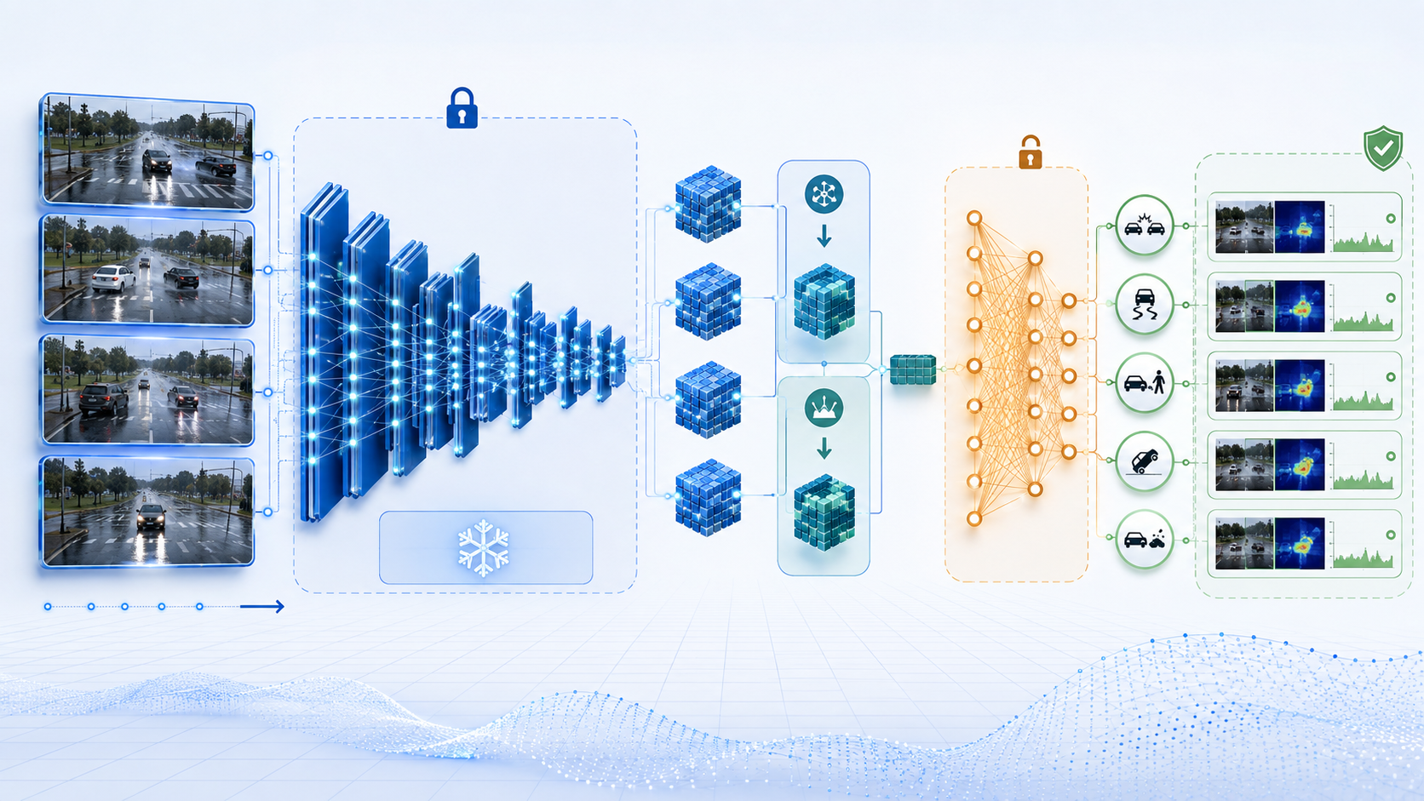
TECHNICAL OVERVIEW
Visual model: four frames to five labels
MobileNetV3-Small provides pretrained image features. Training updates the multi-label head.
EVIDENCE2SCENARIO
08

Slide 9
TECHNICAL OVERVIEW
Visual model: four frames to five labels
MobileNetV3-Small provides pretrained image features. Training updates the multi-label head.
01
02
03
Frames
Features
Clip model
Four frames per clip, each at 320 × 180 pixels.
Frozen ImageNet backbone. Spatial average/max pooling.
Temporal mean/max pooling. A 595,973-parameter head.
Outputs: truck, van, motorcycle, cyclist and pedestrian. Training ran on CPUs.
EVIDENCE2SCENARIO
09

Slide 10
TECHNICAL OVERVIEW
Visual evaluation uses disjoint simulated towns
Candidate and threshold selection use development clips. The locked set uses other towns.
525
315
development clips
locked evaluation clips
Town01, Town02, Town03, Town05
Pooling comparison and threshold design
Town04, Town07, Town10HD
Excluded from candidate and threshold selection
840 four-frame clips. Across v1, v2 and v2.1: 108 fits, three seeds and CPU-only execution.
EVIDENCE2SCENARIO
10

Slide 11
TECHNICAL OVERVIEW
Visual features improve pooled macro AP
Average precision (AP), macro-averaged across labels, on the locked simulated set.
+7.6
AP points, approximately
+13.1% relative uplift
3/3 positive seed comparisons
The aggregate gain coexists with label and town regressions, shown on the next slide.
EVIDENCE2SCENARIO
11

Slide 12
TECHNICAL OVERVIEW
Visual gains vary by label and town
The evaluation shows gains across three labels and identifies priorities for further refinement.
ONGOING MODEL REFINEMENT: Current results do not yet meet the strictest acceptance criteria.
Motorcycle: −0.1021
Limit: −0.10
Town07: −0.0236
Prototype development continues under the study decision, with further work on label-specific performance and validation of real-world generalisation.
EVIDENCE2SCENARIO
12

Slide 13
TECHNICAL OVERVIEW
Predictions enter a guarded scenario workflow
The public visual demo uses explicit decision thresholds and preserves the model source.
Model probability | Decision | Downstream treatment
p ≤ 0.35 | Absent | Retain frame and model/report identity
0.35 < p < 0.65 | Abstain | Preserve uncertainty in the common record
p ≥ 0.65 | Present | Apply compatibility and export checks
OpenSCENARIO output remains a review-only draft.
Matching combines 0.7 symbolic and 0.3 lexical scores, with hard incompatibility gates.
EVIDENCE2SCENARIO
13

Slide 14
TECHNICAL OVERVIEW
Inspecting the demonstrator
Follow a case through the evidence record, matching result and export checks.
Case
Select text, map or visual input and run the pipeline.
Evidence
Inspect source fields, unknown values, ranges and score decomposition.
Outputs
Review SSR JSON and the OpenSCENARIO draft with their remaining gaps.
automotive.voxcari.com
Open questions: domain shift, label-specific regressions and simulator-specific export requirements.
EVIDENCE2SCENARIO
14

Slide 15
APPENDIX A · VISUAL STUDY
Visual study record
Image inventory, clip evaluation and repeated fits describe different aspects of the study.
Item | Reported value
Image inventory | 8,290 aligned front-camera images
Clip protocol | 840 four-frame clips: 525 development and 315 locked
Repeated fits | v1: 12, v2: 48, v2.1: 48, total: 108
Model | MobileNetV3-Small, frozen ImageNet backbone 595,973-parameter multi-label head
Report reference | visual_model_research_v21.json Report SHA-256 prefix: c20a1b79…
EVIDENCE2SCENARIO
15

Slide 16
APPENDIX B · ENGINEERING
Matching, exports and runtime
Matching configuration, export constraints and operational components.
Matching
0.7 symbolic + 0.3 TF-IDF. Hard actor/conflict gates. Unknown dimensions are excluded from the score denominator.
Exports
15 matching reference entries. OpenSCENARIO preflight preserves blocking gaps and review-only status.
Runtime
FastAPI, React/TypeScript, Docker and Caddy TLS. UID 10001, SBOM, frozen hashes and 7/7 verified artifacts.
Operational measurements concern the CPU development sample and are separate from visual-model accuracy.
EVIDENCE2SCENARIO
16

Slide 17
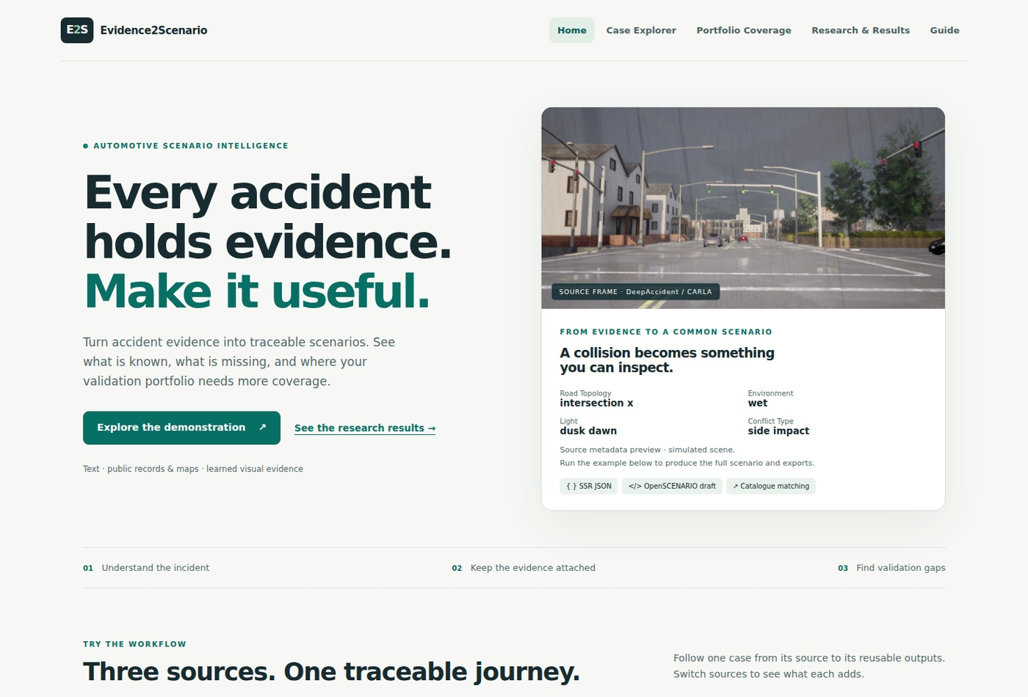
APPENDIX C · DEMONSTRATOR
Demonstrator context
Public demonstrator, September 2026.
Inspect source
context and
scenario outputs.
EVIDENCE2SCENARIO
17

Slide 18
PRODIGY AI SOLUTIONS
STRICTLY CONFIDENTIAL
Ownership, permitted use and external sources
Ownership
This presentation and its original content are the property of
Prodigy AI Solutions. All rights reserved under applicable
intellectual property laws.
Confidentiality
For intended recipients only. Do not reproduce, disclose or
distribute without prior written authorisation from Prodigy AI
Solutions, except as permitted by applicable law.
External sources
External materials used in preparing this presentation were
limited to sources freely accessible to the public. Third-party
materials remain subject to their owners’ rights and licence terms.
© 2026 Prodigy AI Solutions. All rights reserved.

