Slide 1


Excellence in Plastics
JANUARY 2024

Slide 2
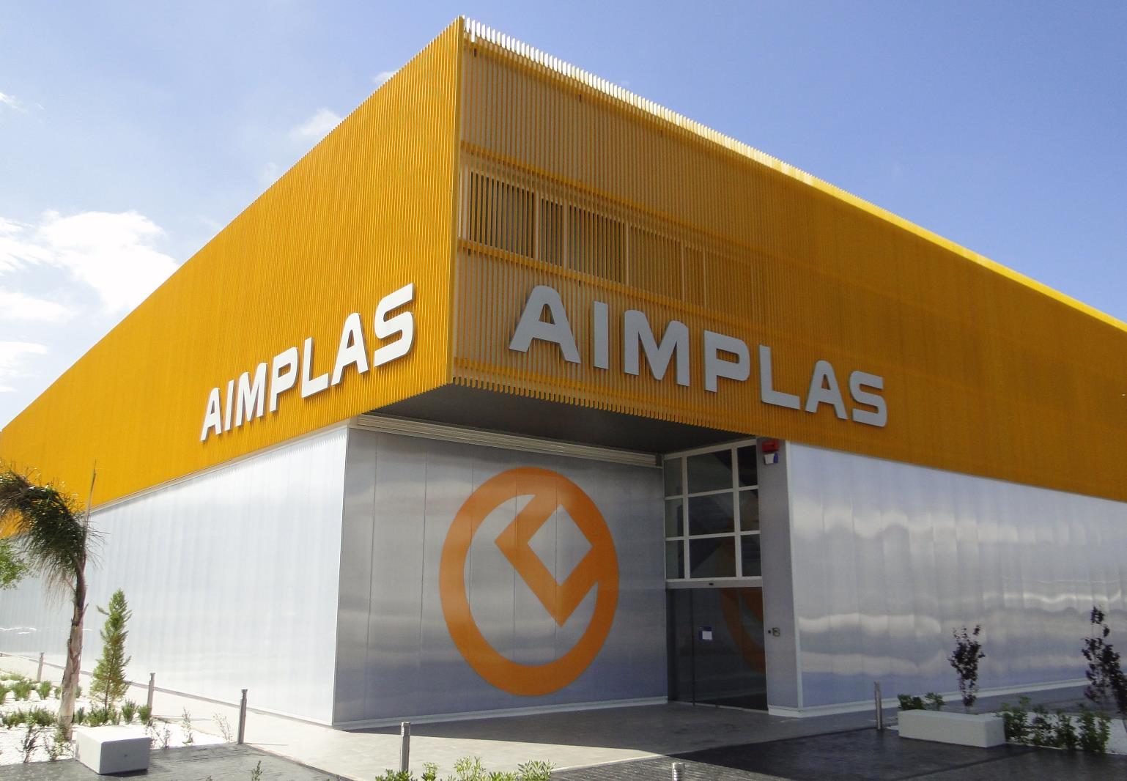
What is
AIMPLAS?
A technology centre with more than 30 years’ experience in the plastic sector.

Slide 3




Our Purpose
Add value to companies to generate wealth and create employment.
Add value to society to improve quality of life and ensure environmental sustainability.

Slide 4

The Institute’s Management Model
Associated
companies
General
Assembly
Governing Board
AIMPLAS
Notes:
Las empresas asociadas constituyen la Asamblea, que es el máximo órgano de representación del centro.
Anualmente la Asamblea elige el Consejo Rector
El Consejo está conformado por: Presidente, Vicepresidente 1º, Vicepresidente 2º, Secretario, Director del Centro y Vocales
Del CR ‘cuelga’ la estructura organizativa de AIMPLAS

Slide 5
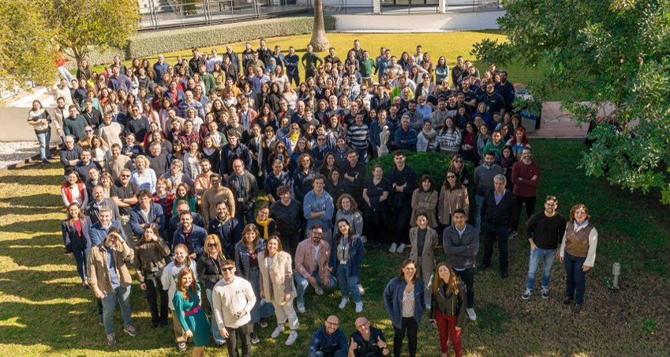
Our team is made up of more than
250 highly qualified professionals
23%
specialist technicians
57%
women
43%
men
77%
university graduates
average age:
37
39 PhDs
2023 DATA

Slide 6
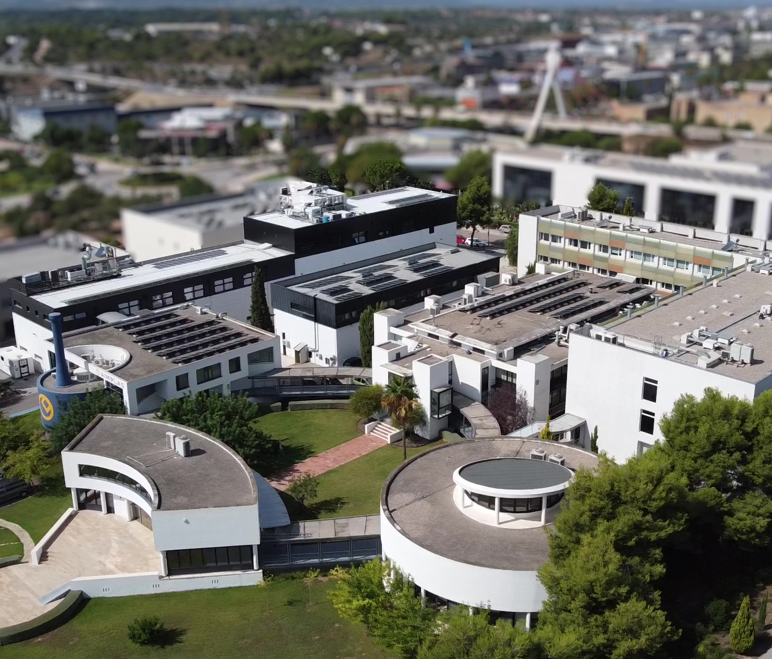
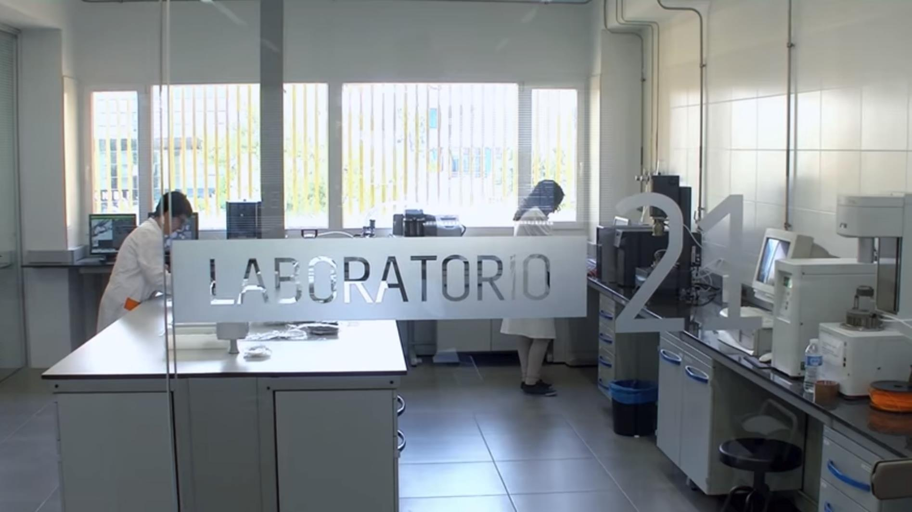
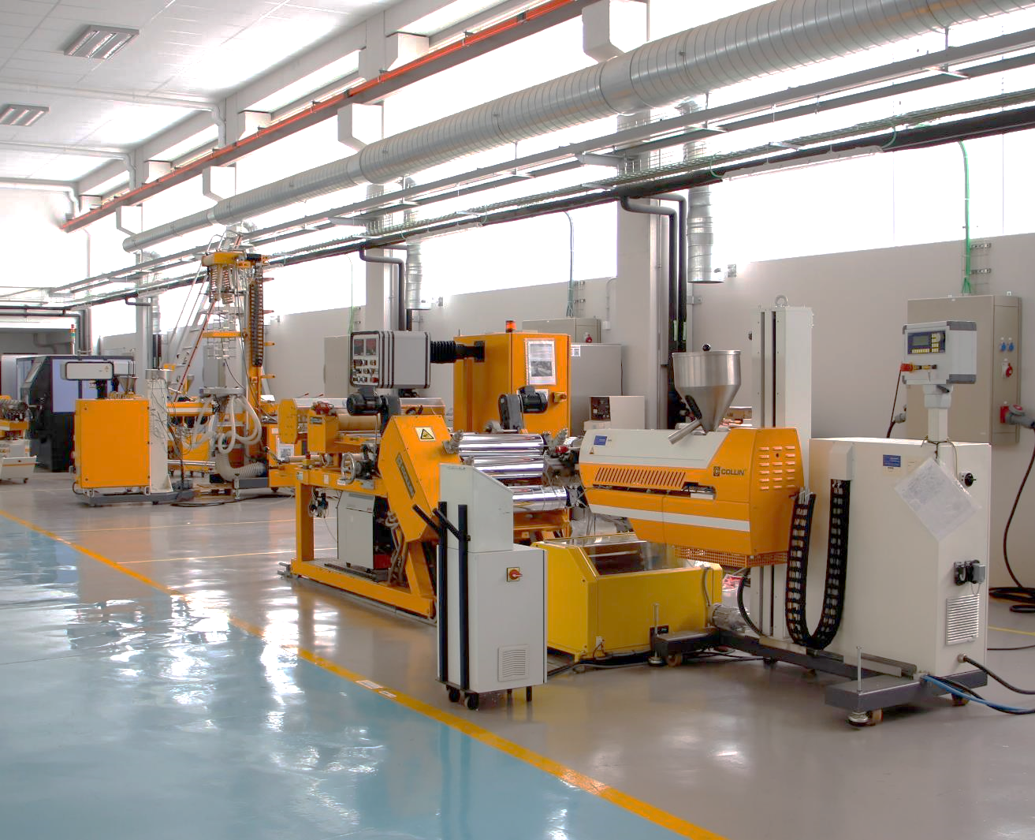
More than 12,000 m² of cutting-edge facilities
Pilot plants (6,500 m²)
Laboratories (4,500 m²)
Training (1,000 m²)

Slide 7
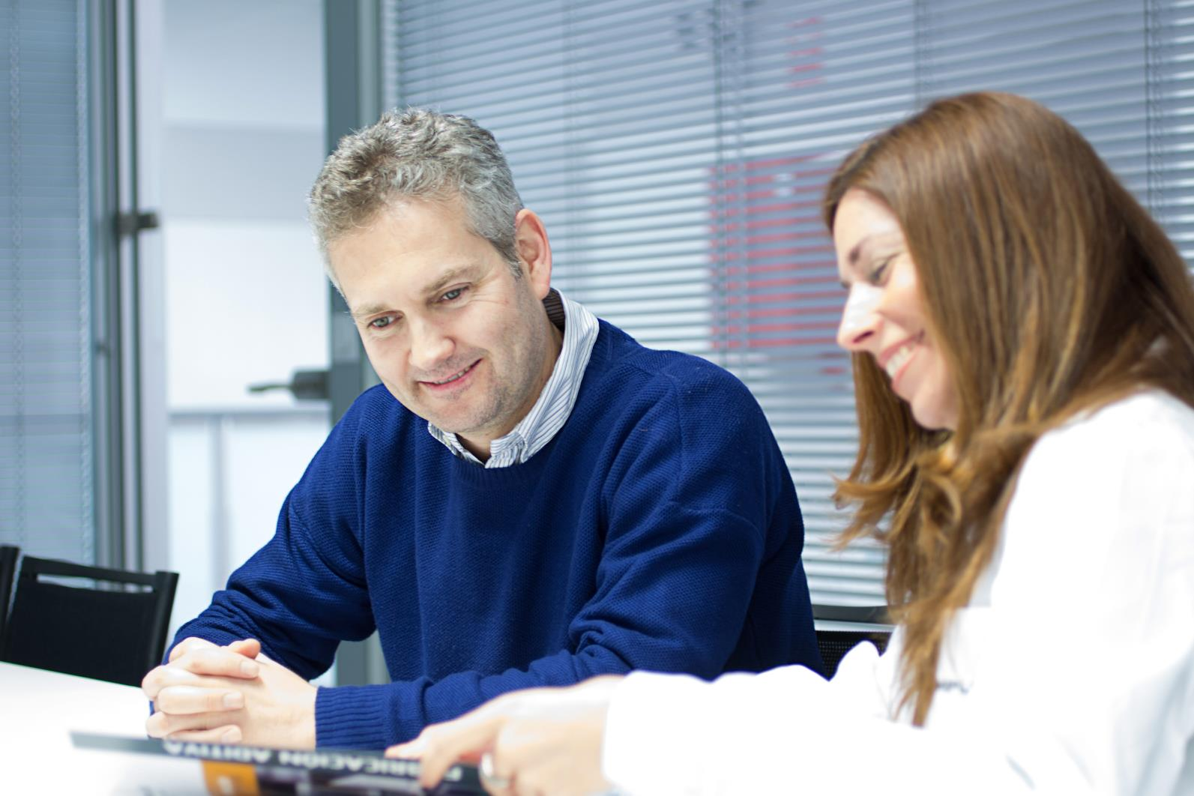

EUR 21.3M
revenue
3,300+
clients
840+
member
companies
2023 DATA

Slide 8
Revenue by Activity
R&D&I 70%
Technological services 23%
Training 5%
Associated company fees 2%
2023 DATA

Slide 9












Market Orientation
Packaging
Construction
Automotive and transport
Recycling
Printing
Aeronautics
Agriculture
Electrical and Electronics
Energy
Health
Navigation
Aerospace
Furniture
Sports and Leisure

Slide 10

Expertise across the entire plastics value chain
Polymer
synthesis
Raw
materials
Recovery of plastic waste
Compounding
End users
Manufacturing /
Processing

Slide 11


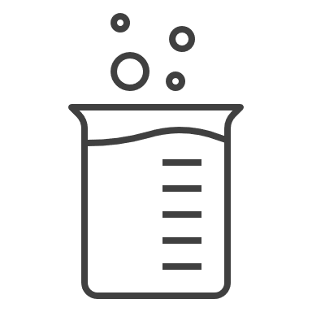





Comprehensive management to provide global solutions
Technologies Management
Business Management
GENERAL MANAGEMENT
Laboratory Management
Risk Management
R&D&I Management
Services Management
Projects Management
People and Training Management

Slide 12
Comprehensive management to provide global solutions
Sustainable Chemistry
Packaging
Consumer and
Environmental
Health and Safety
Laboratory
Cities, Mobility and Sustainable Energy​
Technologies & Laboratories
Material Characterization and Testing​
Laboratory
Agriculture and Aquatic Environment​
Recycling, Recovery and Biotechnology​
Circular Economy and Environment​

Slide 13




















We work with industry leaders

Slide 14















And SMEs committed to R&D&I and quality

Slide 15




Solutions for Plastics
  1.
  2.
  3.
R&D&I
Technology
services
  Training and events

Slide 16


R&D&I Projects
Innovative solutions accessible to companies
279
R&D&I projects
85
international
194
national
532
companies
401
SMEs
2023 DATA
Return of over €73.6 million to companies

Slide 17


Projects according to technology readiness level
0%
40%
30%
30%
Technology readiness level (TRL)
1
2
3
4
5
6
7
8
9
Early innovation and research
Applied research and development
Validated technology
IDEA
PRODUCT
Notes:
• TRL 1: Investigación básica. - Mínima disponibilidad
• TRL – TRL 4: Concepto tecnológico. Prueba de concepto. Validación en laboratorio.
• TRL 5: Validación en entorno relevante.
• TRL 6: Demostración en entorno relevante.
• TRL 7: Demostración en entorno operacional (real).
• TRL 8: Sistema completo y certificado.
• TRL 9: Despliegue. Sistema probado con éxito en entorno real - Pruebas con éxito en entorno real.- Máxima disponibilidad

Slide 18

RESEARCH AREAS ORGANIZED BY
KETs
Key Enabling Technologies
Nanotechnology
Biotechnology
Advanced materials
Sustainable development. Industries of the future
Plastic product development

Slide 19

RESEARCH AREAS ORGANIZED BY
Societal Challenges
Health
Industry 4.0
Circular economy
Climate change. Decarbonization of the economy
Food safety
Sustainable agriculture and silviculture
Sustainable mobility

Slide 20
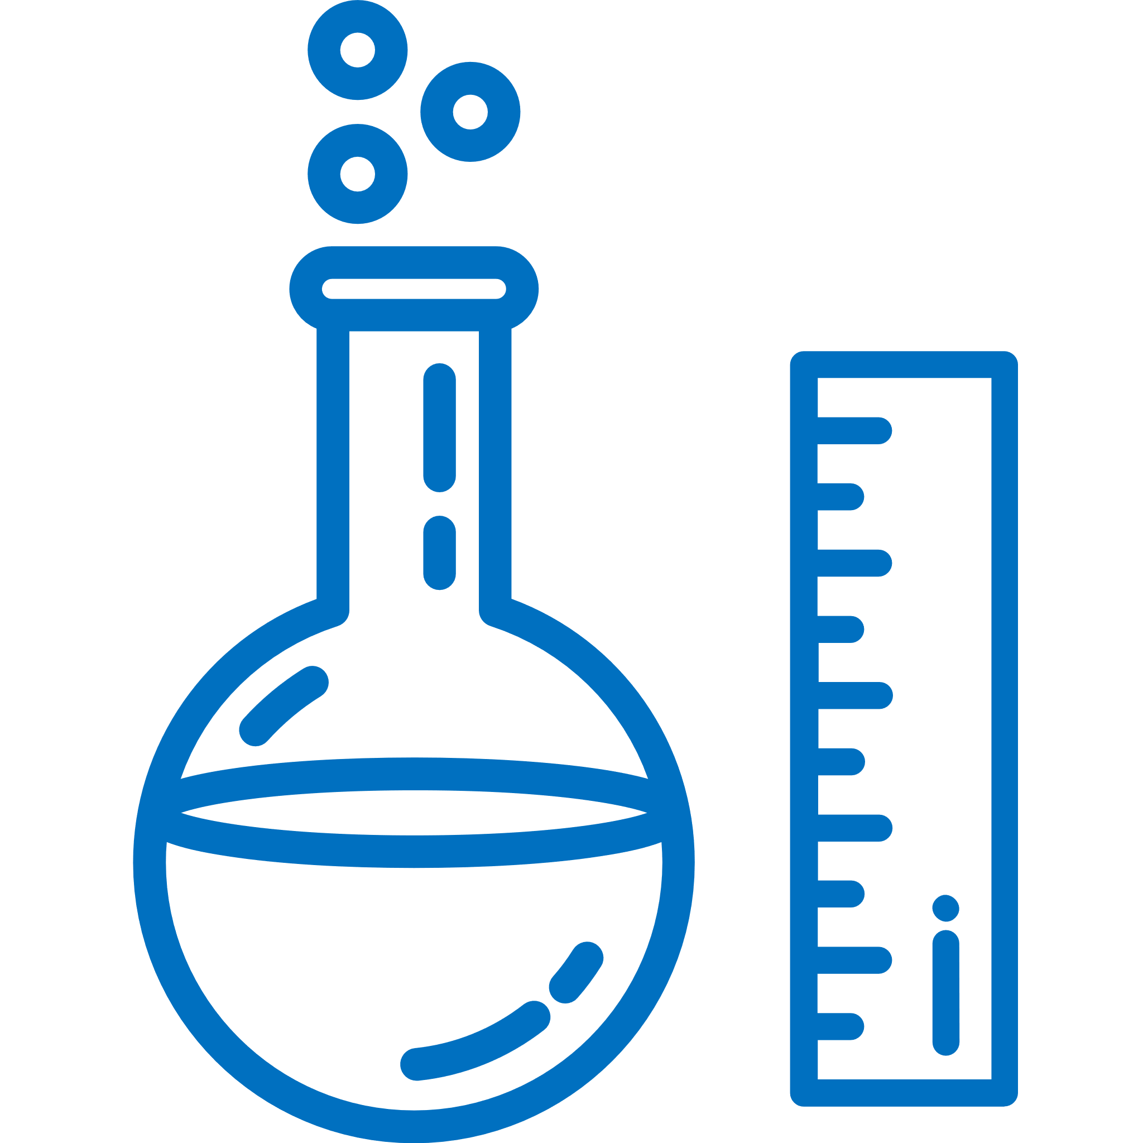



  Analysis and testing
  Processing and prototyping
Technological
Services
  Technical assistance
  Competitive intelligence and technology watch

Slide 21


Analysis and Testing
Value creation for top quality
7,499
services
1,021
clients
2023 DATA

Slide 22
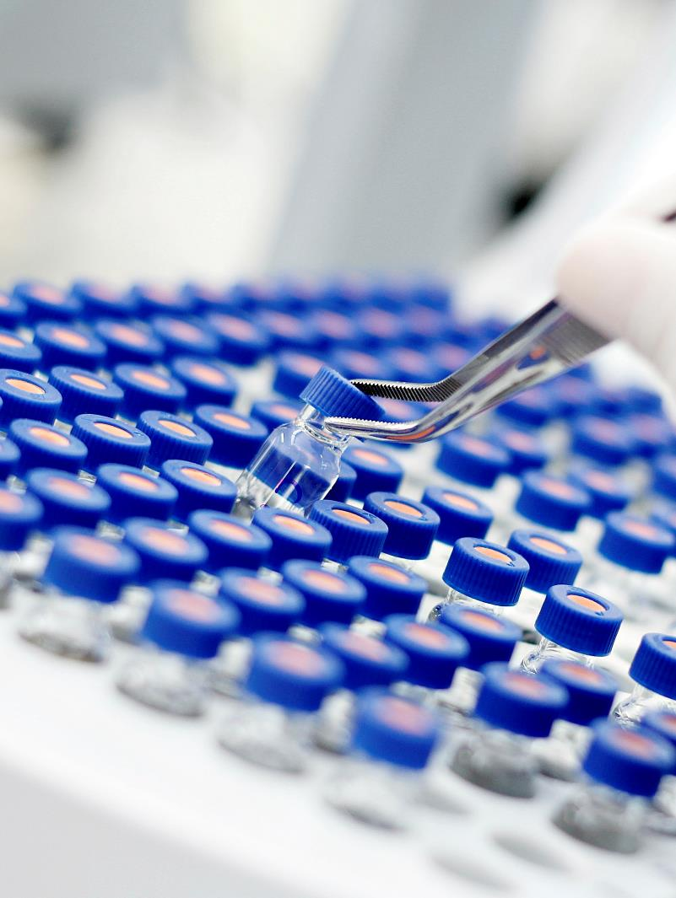
We provide value through results
Identification and characterization
  Polymers
  Additives and fillers
  Residual substances
Mechanical properties
Optical properties
Rheological properties
Physical and thermal properties
Performance against external agents
VOC emissions testing

Slide 23
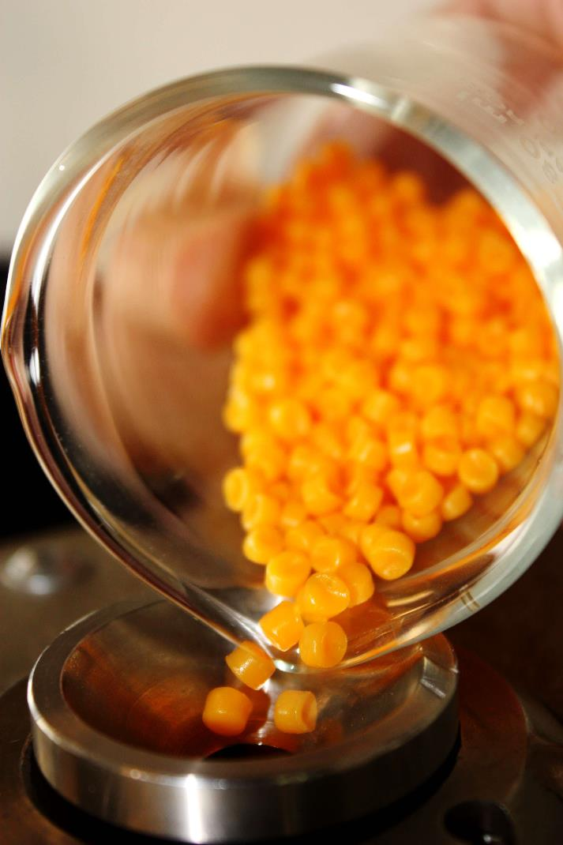






AIMPLAS laboratories have earned the most accreditations for plastics in accordance with UNE-EN ISO/IEC 17025 standard
Laboratory recognised by certification bodies
TÜV Austria Belgium and DIN CERTCO

Slide 24

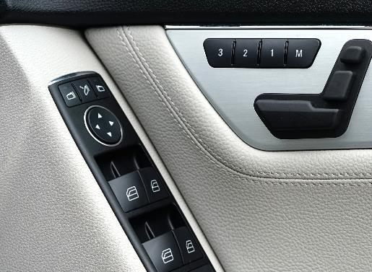
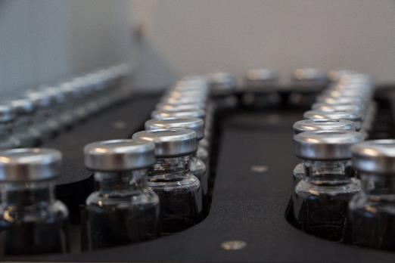
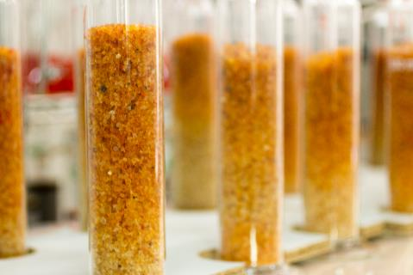
Sector Laboratories
Packaging
Construction
Automotive
Biodegradation
Packaging characterization tests and product-packaging interaction studies:
  Permeability (O₂ and H₂O vapour)
  Sensory analysis
  Leakage detection
  Migration tests
  Compatibility
  NIAS
Characterization and assessment of compliance with regulations for plastic products for construction (waterproofing, conduction, insulation, etc.).
Specific tests certified by the main car manufacturers: emissions (VOC, formaldehyde, odour and fogging) and combustibility, among others.
Biodegradation in controlled composting conditions, biodegradation in soil, disintegration of plastic materials under simulated composting conditions in laboratory-scale, determination of the ultimate anaerobic biodegradation under high-solids anaerobic-digestion conditions and Aerobic Biodegradation of Plastic Materials in the Marine Environment. Standards: UNE-EN ISO 14855-1, UNE-EN ISO 17556, UNE-EN ISO 20200, ISO15985:2014 and ASTM D6691-17 .

Slide 25
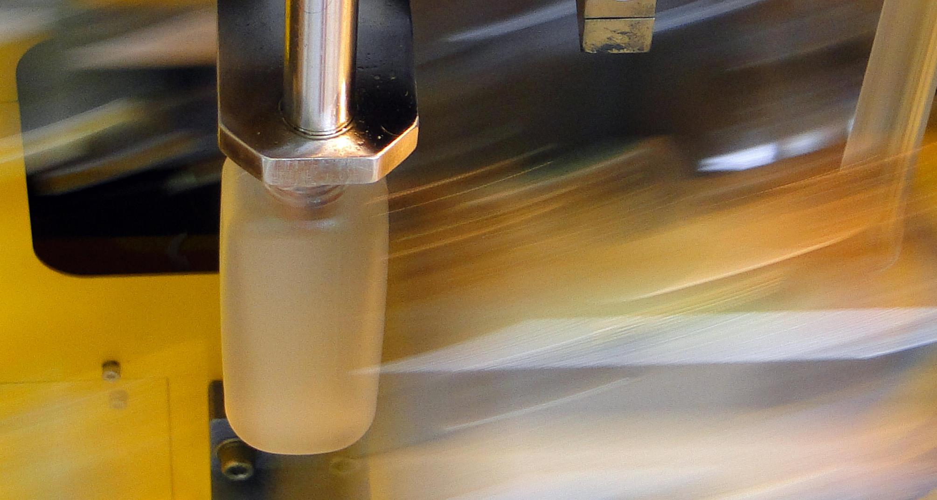
Processing and Prototyping
Building the future
Notes:
Trabajamos con más de 20 procesos de transformación:
más de 5.000 m² de plantas piloto a su disposición

Slide 26




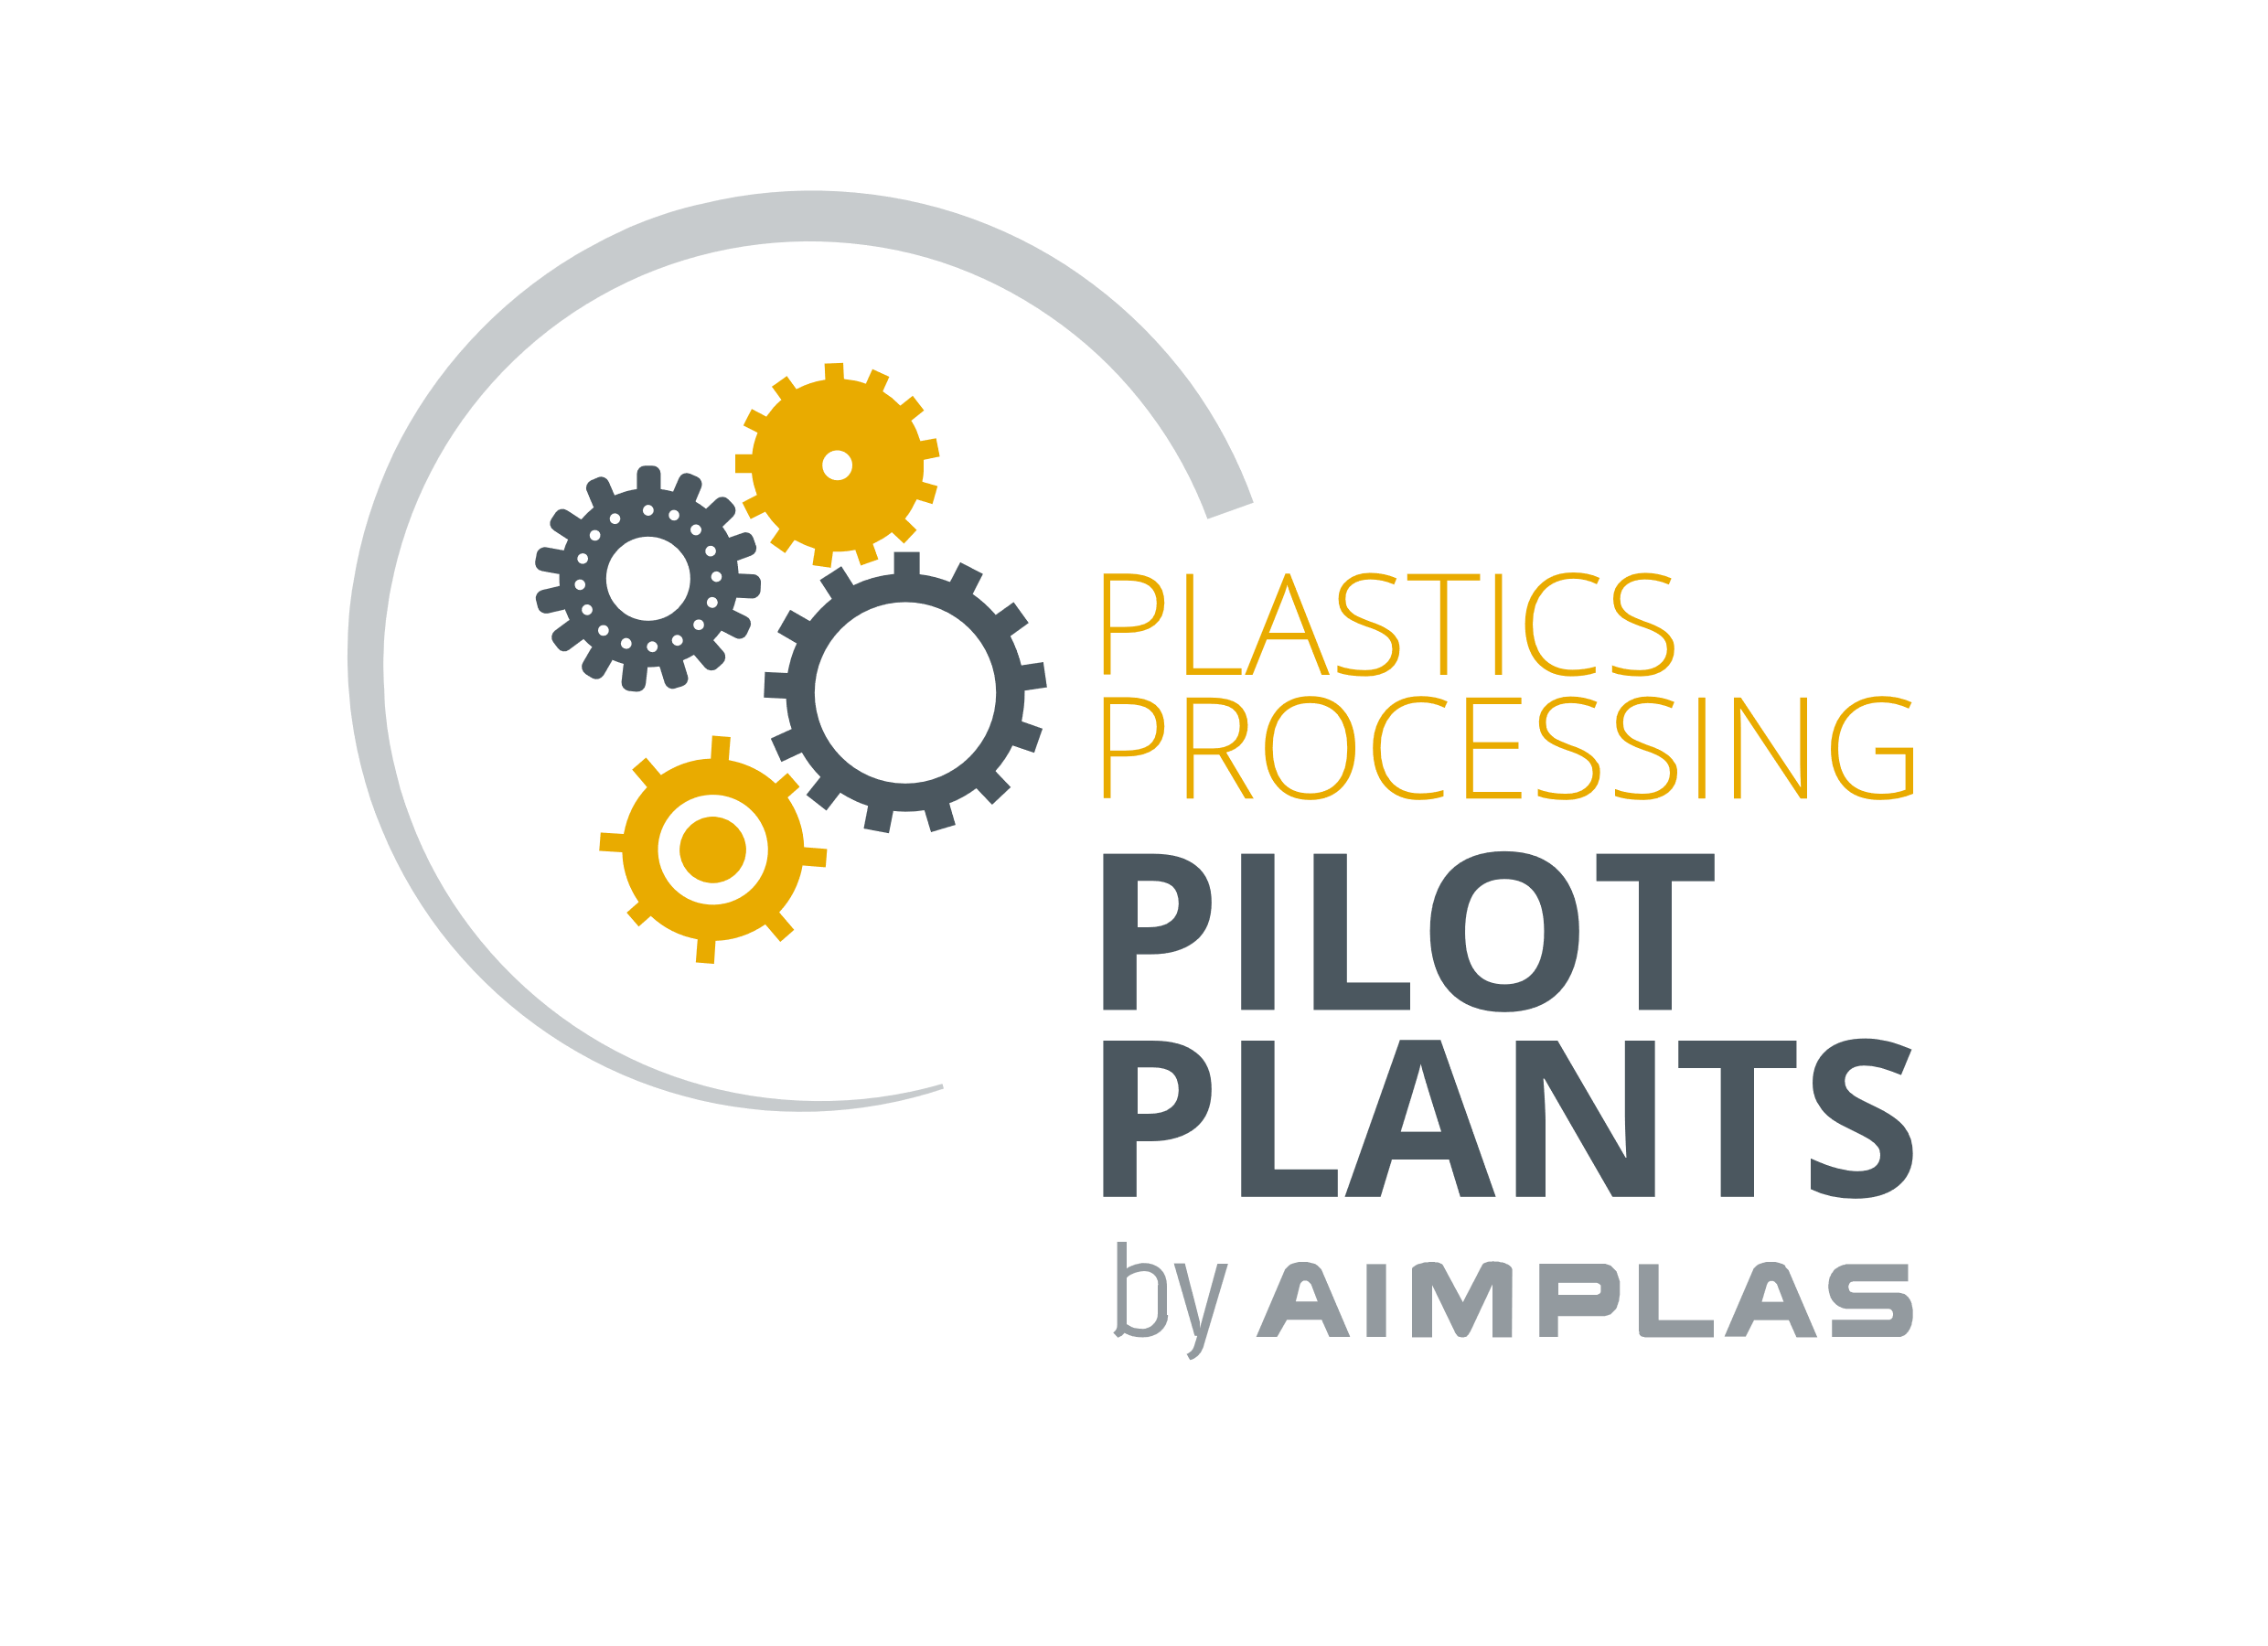

Compounding
Extrusion
Injection Moulding
Blow Moulding
3D Printing
Synthesis
Recycling

Slide 27

Materials Processing: COMPOSITES
Pultrusion
RTM – Infusion
PU Foaming RIM
Solid Surface
Microwave Curing
SMC
Synthesis
Recycling

Slide 28
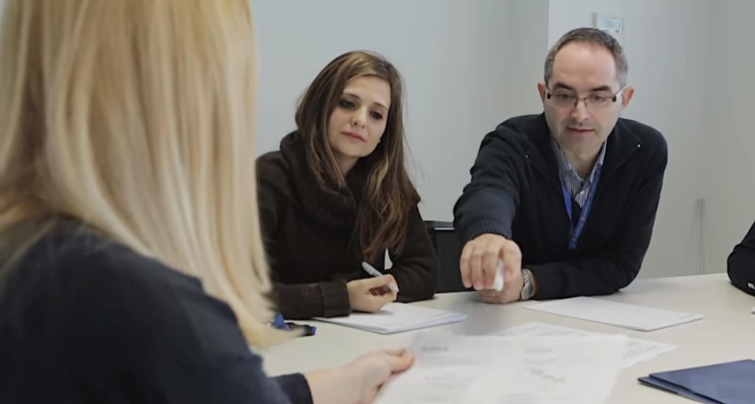

Technical Assistance
More than a supplier: a technology partner

Slide 29

Specialist Advice on Plastics
Eco-design
Product and process development
Improvement of product properties
Failure analysis
Cost optimization
Eco-labels and certifications
Technology audits
Compliance with legislation and standards
Expert reports

Slide 30


Competitive Intelligence
and Technology Watch
New business opportunities for your company

Slide 31
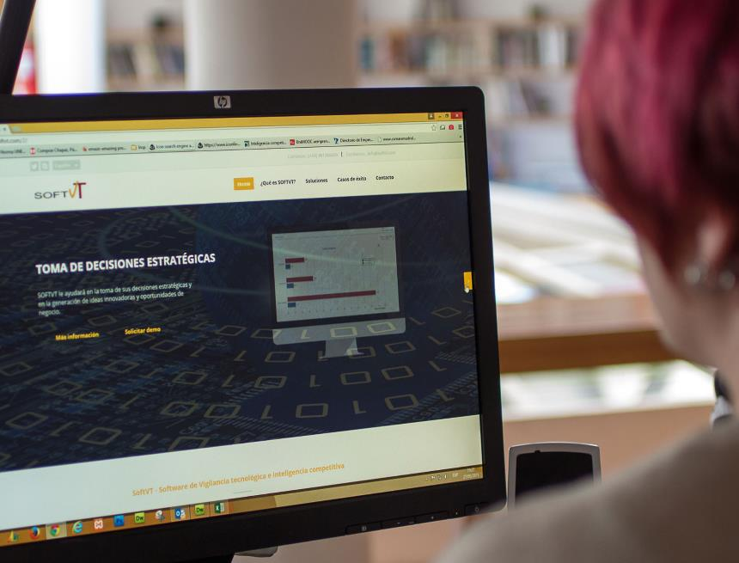
Plastics Observatory
The most complete technology watch system
TECHNOLOGY · MARKET · ECONOMIC ENVIRONMENT
www.observatorioplastico.com
Information for innovation
Information to manage innovative ideas and business opportunities
Competitor monitoring
Trend detection
State-of-the-art reports
Technology watch reports
www.softVT.com

Slide 32
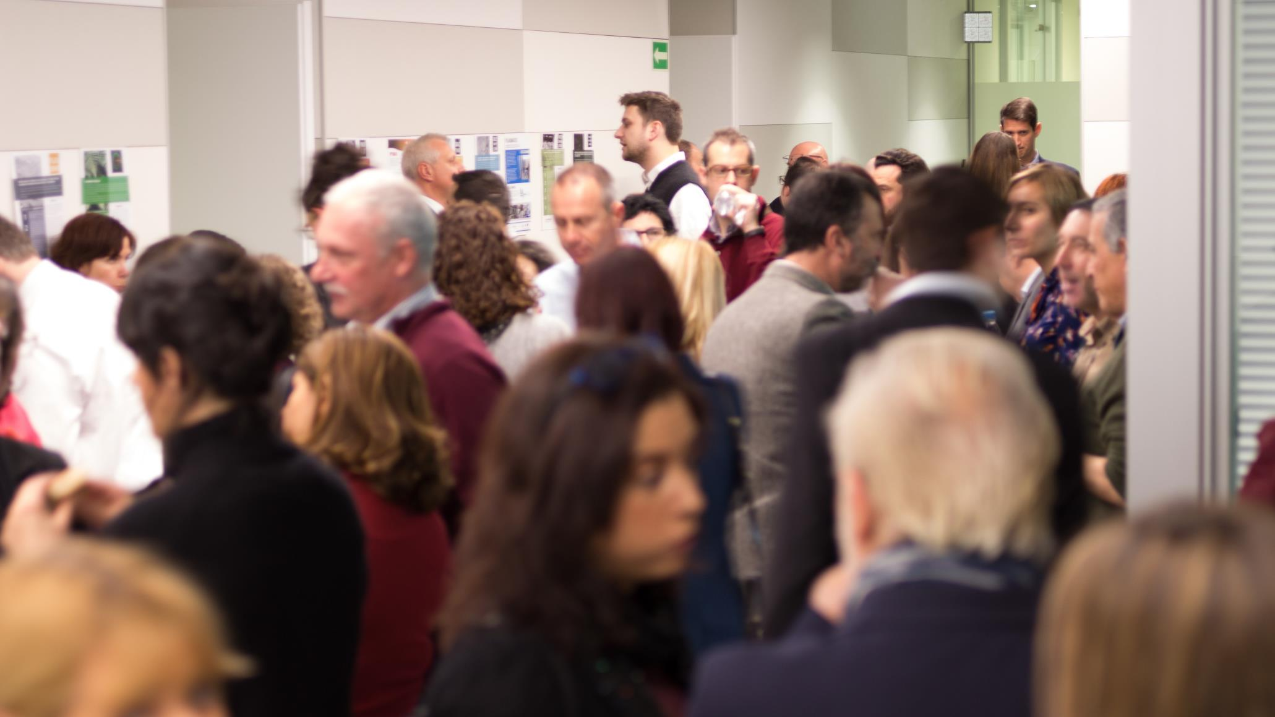

Training and Events
We promote professional excellence in the sector
223
training activities
3,578
professionals
1,000+
companies
4,789
hours
8.6
satisfaction rate
2023 DATA

Slide 33
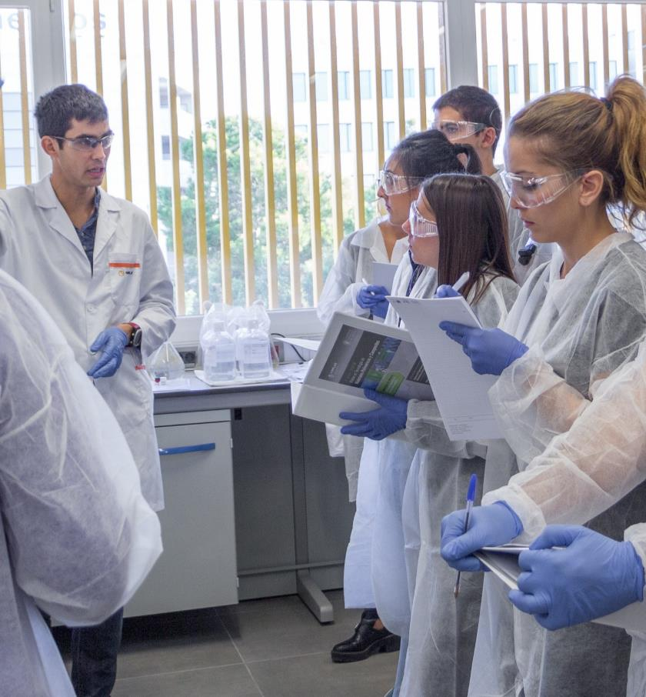



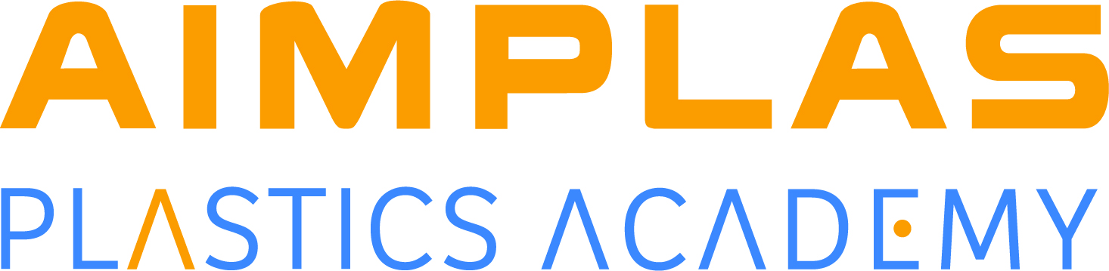
The most complete training in the plastics sector
Online courses and webinars
Face-to-face training
Tailor-made training for companies
AIMPLAS Expert certifications
Master’s Degree in Polymer and Composite Technology - UPV
Professional certificate of thermoplastics transformation operations.

Slide 34
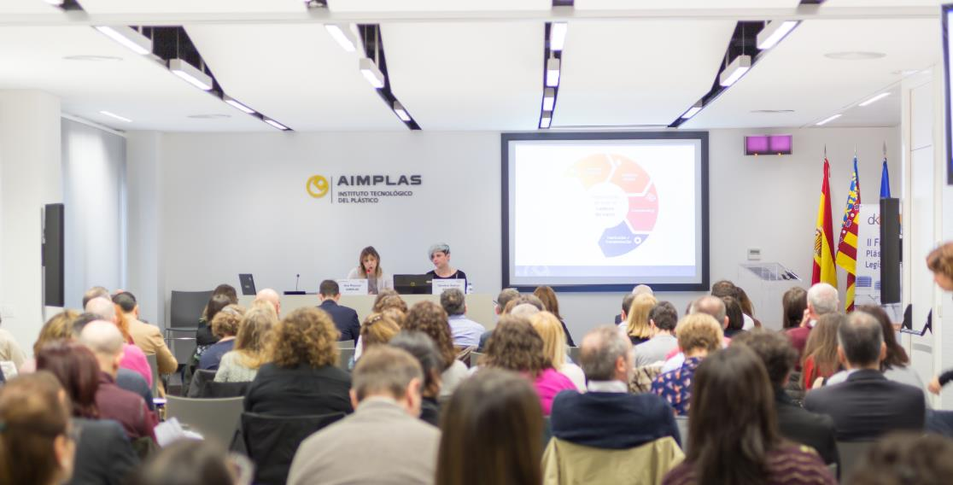








We organize key conferences and seminars for the plastics industry

Slide 35









www.aimplas.net
Valencia Technology Park
Gustave Eiffel, 4
46980 Paterna · Valencia, SPAIN
info@aimplas.es
+34 96 136 60 40
Follow us

