Slide 1


Prepared for our valued research & development partners

Slide 2
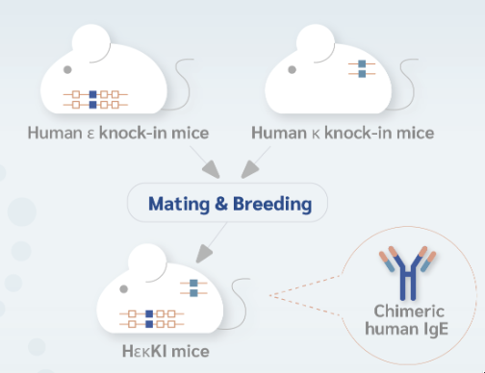
A Great Tool for Investigating Human IgE Inhibition
Human IgE (ε, κ) Knock-In Mice — the HεκKI Platform
IgE plays a central role in mediating type I hypersensitivity reactions responsible for allergic diseases — including allergic asthma, allergic rhinitis, and atopic dermatitis.
HεκKI mice produce humanized IgE-secreting B cells and antigen-specific humanized IgE after immunization, enabling chimeric human IgE inhibition studies with antibodies, small molecules, or vaccines.
How HεκKI Mice Are Generated
Human ε knock-in mice
+ Human κ knock-in mice
▼
Mating & Breeding
Application
▼
Contract research or drug development
Chimeric human IgE inhibition animal model
HεκKI mice
▼
Chimeric human IgE
(after immunization)
Features
30-fold higher human IgE response than mouse IgE
Does not produce mouse IgG₁
The transgenic mouse genome has its Cγ1 constant region replaced by the human immunoglobulin Cε constant region, and the Cκ constant region replaced by the human immunoglobulin Cκ constant region.

Slide 3
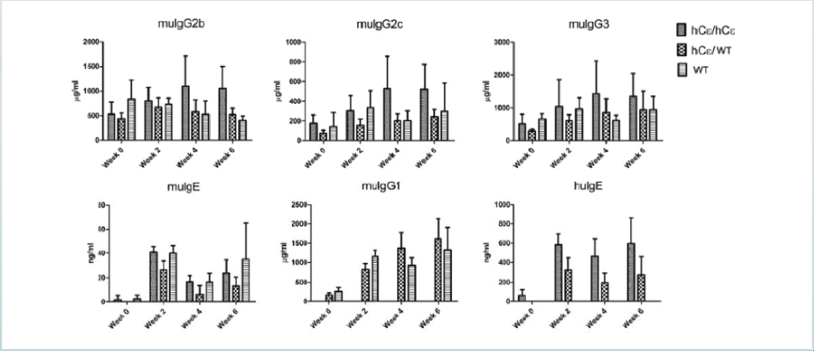
HεκKI Mice Deliver a Strong, Specific Human IgE Response
30×
Serum immunoglobulins were measured in three genotypes (h Cε/h Cε, h Cε/WT, WT) at days 1 and 29 after immunization.
HεκKI mice (hCε/hCε and hCε/WT) secreted markedly higher levels of human IgE (hIgE panel) upon immunization, while mouse IgG isotypes (mIgG1, mIgG2b, mIgG2c, mIgG3) stayed comparable across genotypes — showing the humanized response is specific and clean, without disrupting normal antibody class-switching.
higher human IgE response than mouse IgE
Serum levels of immunoglobulins of different isotypes in three genotypes of mice, immunized at day 1 and day 29. HεκKI mice show a higher level of hIgE with similar levels of other IgG isotypes.
Source: Lu CS, et al. Generating allergen-specific human IgEs by employing human ε gene knockin mice. Allergy. 2015;70(4):384–390.

Slide 4
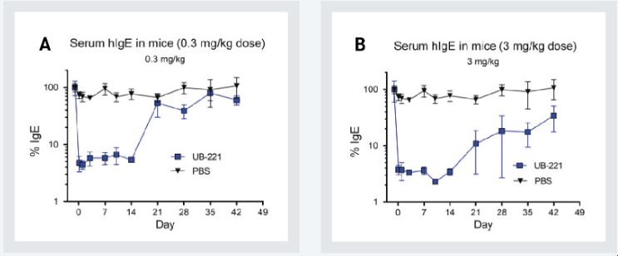
Case Study — Anti-IgE Drug Development
Chronic Spontaneous Urticaria (CSU) — UB-221 Efficacy in HεκKI Mice
A customer developing a drug for chronic spontaneous urticaria (CSU) used the hIgE transgenic mouse model to characterize serum free-chimeric-IgE levels in response to treatment.
In these mice (N = 6), a single intraperitoneal injection of UB-221 lowered the elevated serum free-chimeric-IgE level by more than 90%, at both 0.3 mg/kg (Panel A) and 3.0 mg/kg (Panel B) doses — with suppression sustained for multiple weeks.
>90%
reduction in serum free-chimeric-IgE
Source: Kuo BS, et al. IgE-neutralizing UB-221 mAb, distinct from omalizumab and ligelizumab, exhibits CD23-mediated IgE downregulation and relieves urticaria symptoms. J Clin Invest. 2022 Aug 1;132(15):e157765.

Slide 5

Let's Discuss Your Human IgE Research
From diagnostics and infectious disease to vaccines and biologics —
the HεκKI platform is built to move your program forward.
WEBSITE
EMAIL
www.croyezbio.com
info@croyezbio.com
Croyez Bioscience Co., Ltd.

