Slide 1


Educational and support strategies during humanitarian crises
Siân Tesni
Christian Blind Mission
Wednesday, 21st Feb 2024, 16:00
Notes:
Educational and support strategies during humanitarian crises
Siân Tesni
Christian Blind Mission
Wednesday, 21st Feb 2024, 16:00
#ZeroCon24

Slide 2
Project Details:
Title: Developing an Inclusive Education Environment for Children with and without Disabilities in the Gaza Strip
Funding: The European Union (75%) and CBM (25%), supported inclusive education and e-learning.
Implementation partner: Atfaluna Society for Deaf Children (ASDC)
Government involvement: Ministry of Education and Higher Education (MoEHE) and Ministry of Health
Location: Gaza City and surrounding areas
Amount: 499,980 EUR
Duration: 01-01-2022 - 31-12-2024 (36 months)
Overall objective: Contributing towards building an inclusive society with equal access to inclusive education and accessible health services for people with and without disabilities in Palestine
Notes:
Summary of the project, Developing an Inclusive Education Environment for Children with and without Disabilities in the Gaza Strip

Slide 3
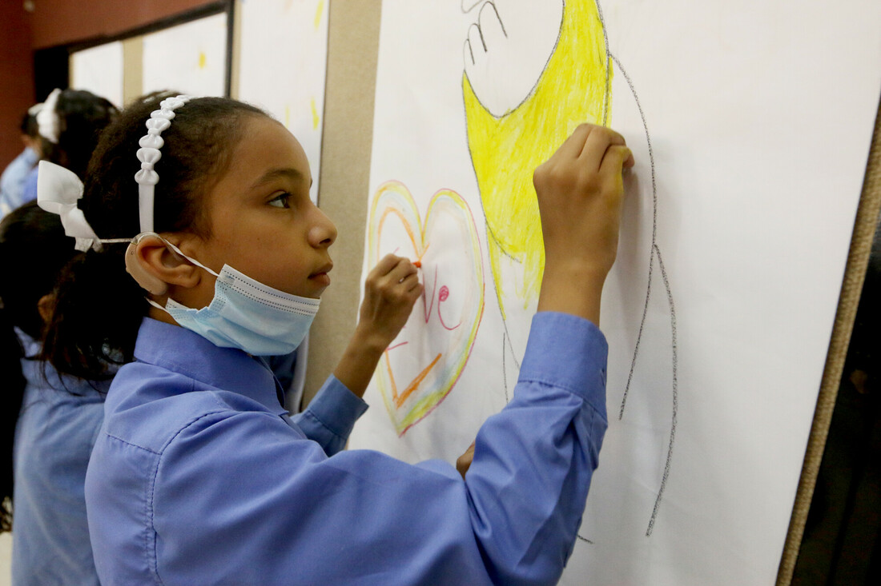
Innovation
Impact of Covid-19
Response to the need for continued education in a crisis
E-learning
Distance learning methodologies
Photo: CBM/ASDC
Notes:
Long partnership with Atfaluna and CBM – about 30 years
Innovation in response to Covid and other crisis leading to disrupted schooling.
Atfaluna had good experience in developing accessible resources.
E-learning seen as an innovation to provide distance education for children not able to attend school / when education disrupted
Atfaluna already had a library of resources to support the inclusion of learners with disabilities in mainstream schools, but lessons learned from Covid indicated that to continue education, teachers needed to learn skills in e-learning to ensure that education could continue.
E-learning methodology:
Continual needs assessment
Building Inclusive Platforms using ICT Solutions
Capacity Building of Teaching Staff on Inclusivity and Digital Skills
Promoting for the Inclusive E-learning
Training Parents on Inclusive E-learning Skills
Involve all actors in the design local government, donors, and community
Include the Psychosocial Component to Help the Healthy Growth of Students

Slide 4
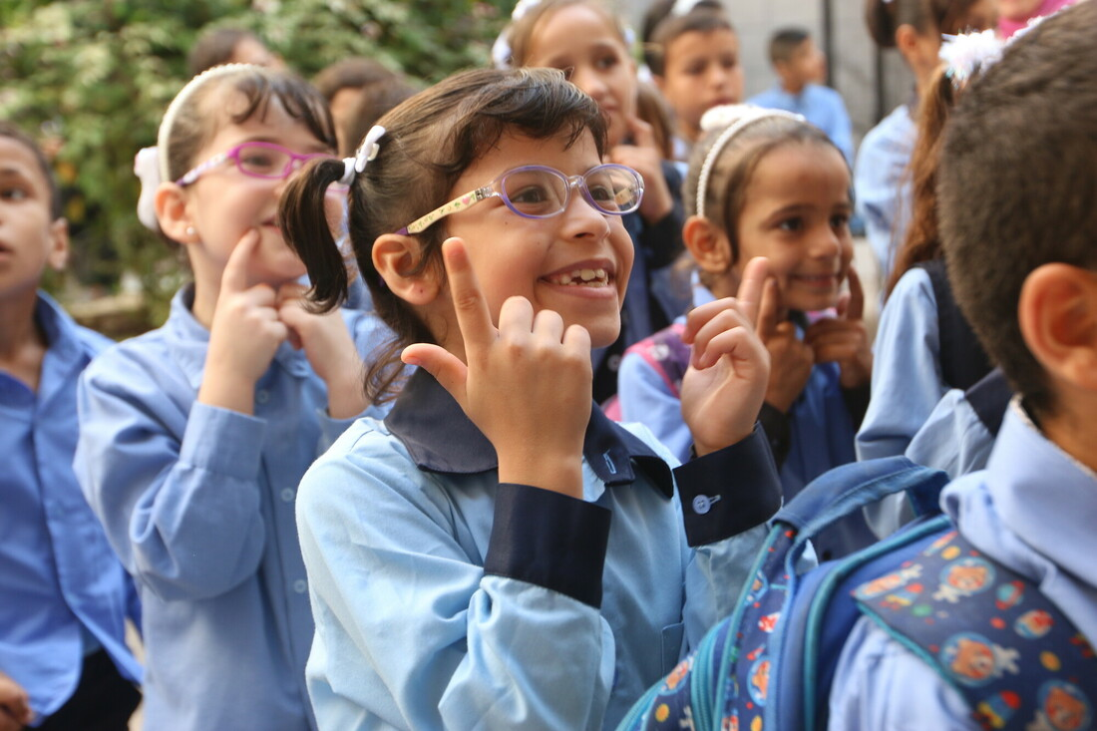
Impact of the project
Teachers, caregivers and learners advance their skills in e-learning
E-learning resources expanded
Caregivers more engaged in education
Learners able to learn at home and in school
Psychosocial support (unexpected)
National framework for inclusive education
Photo: CBM/ASDC
Notes:
Collaboration with Ministry of Education and Health enabled ASDC to arrange training for educators.
Educators, caregivers and learners enhanced their e-learning skills
ASDC staff enhanced their production of e-learning resources
Online and offline learning
Unexpected development was the provision of ‘psychosocial support’
Distance education / hybrid / e-learning provision incorporated in the National Framework for IE.
Atfaluna already had a library of resources to support the inclusion of learners with disabilities in mainstream schools, but lessons learned from Covid indicated that to continue education, teachers needed to learn skills in e-learning to ensure that education could continue.
E-learning methodology:
Continual needs assessment
Building Inclusive Platforms using ICT Solutions
Capacity Building of Teaching Staff on Inclusivity and Digital Skills
Promoting for the Inclusive E-learning
Training Parents on Inclusive E-learning Skills
Involve all actors in the design local government, donors, and community
Include the Psychosocial Component to Help the Healthy Growth of Students

Slide 5
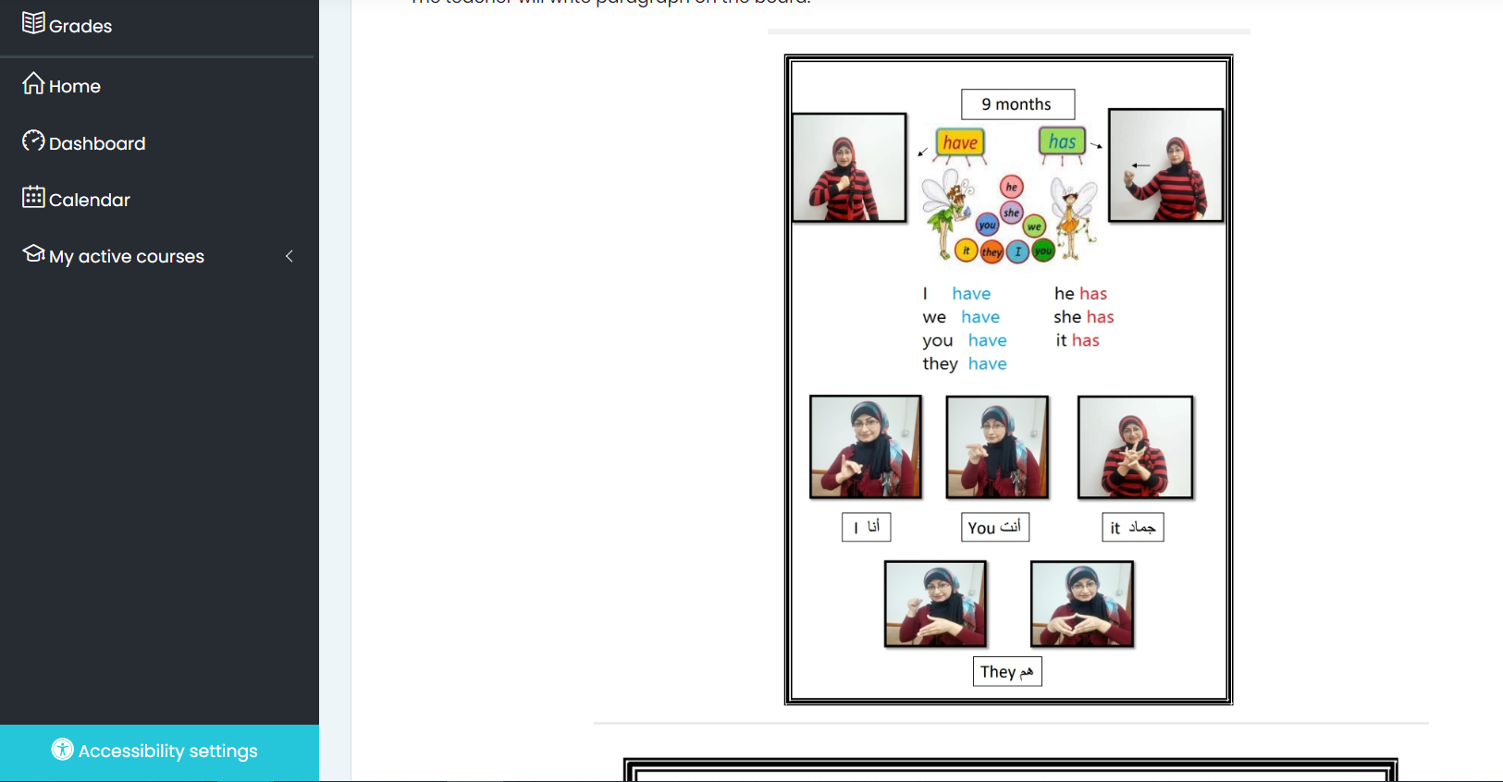
Online learning: different types of resources2
Screenshot of ASDC learning platform
Notes:
Resources are presented in a variety of formats
Accessibility always ensured
Online and offline learning
Resources can be accessed when connectivity is available.

Slide 6
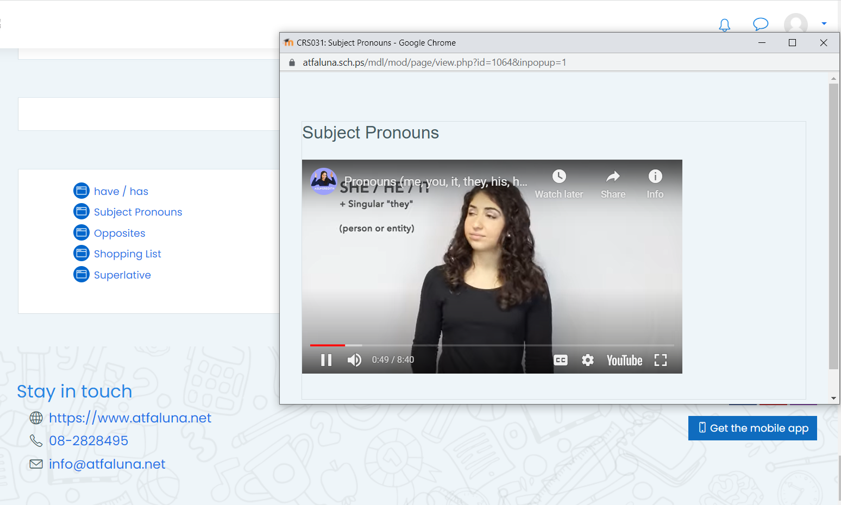
Online resources:
Screenshot of the ASDC learning platform featuring the @ASLMeridith YouTube channel.
Notes:
Videos and resources can be downloaded when connectivity is available.

Slide 7
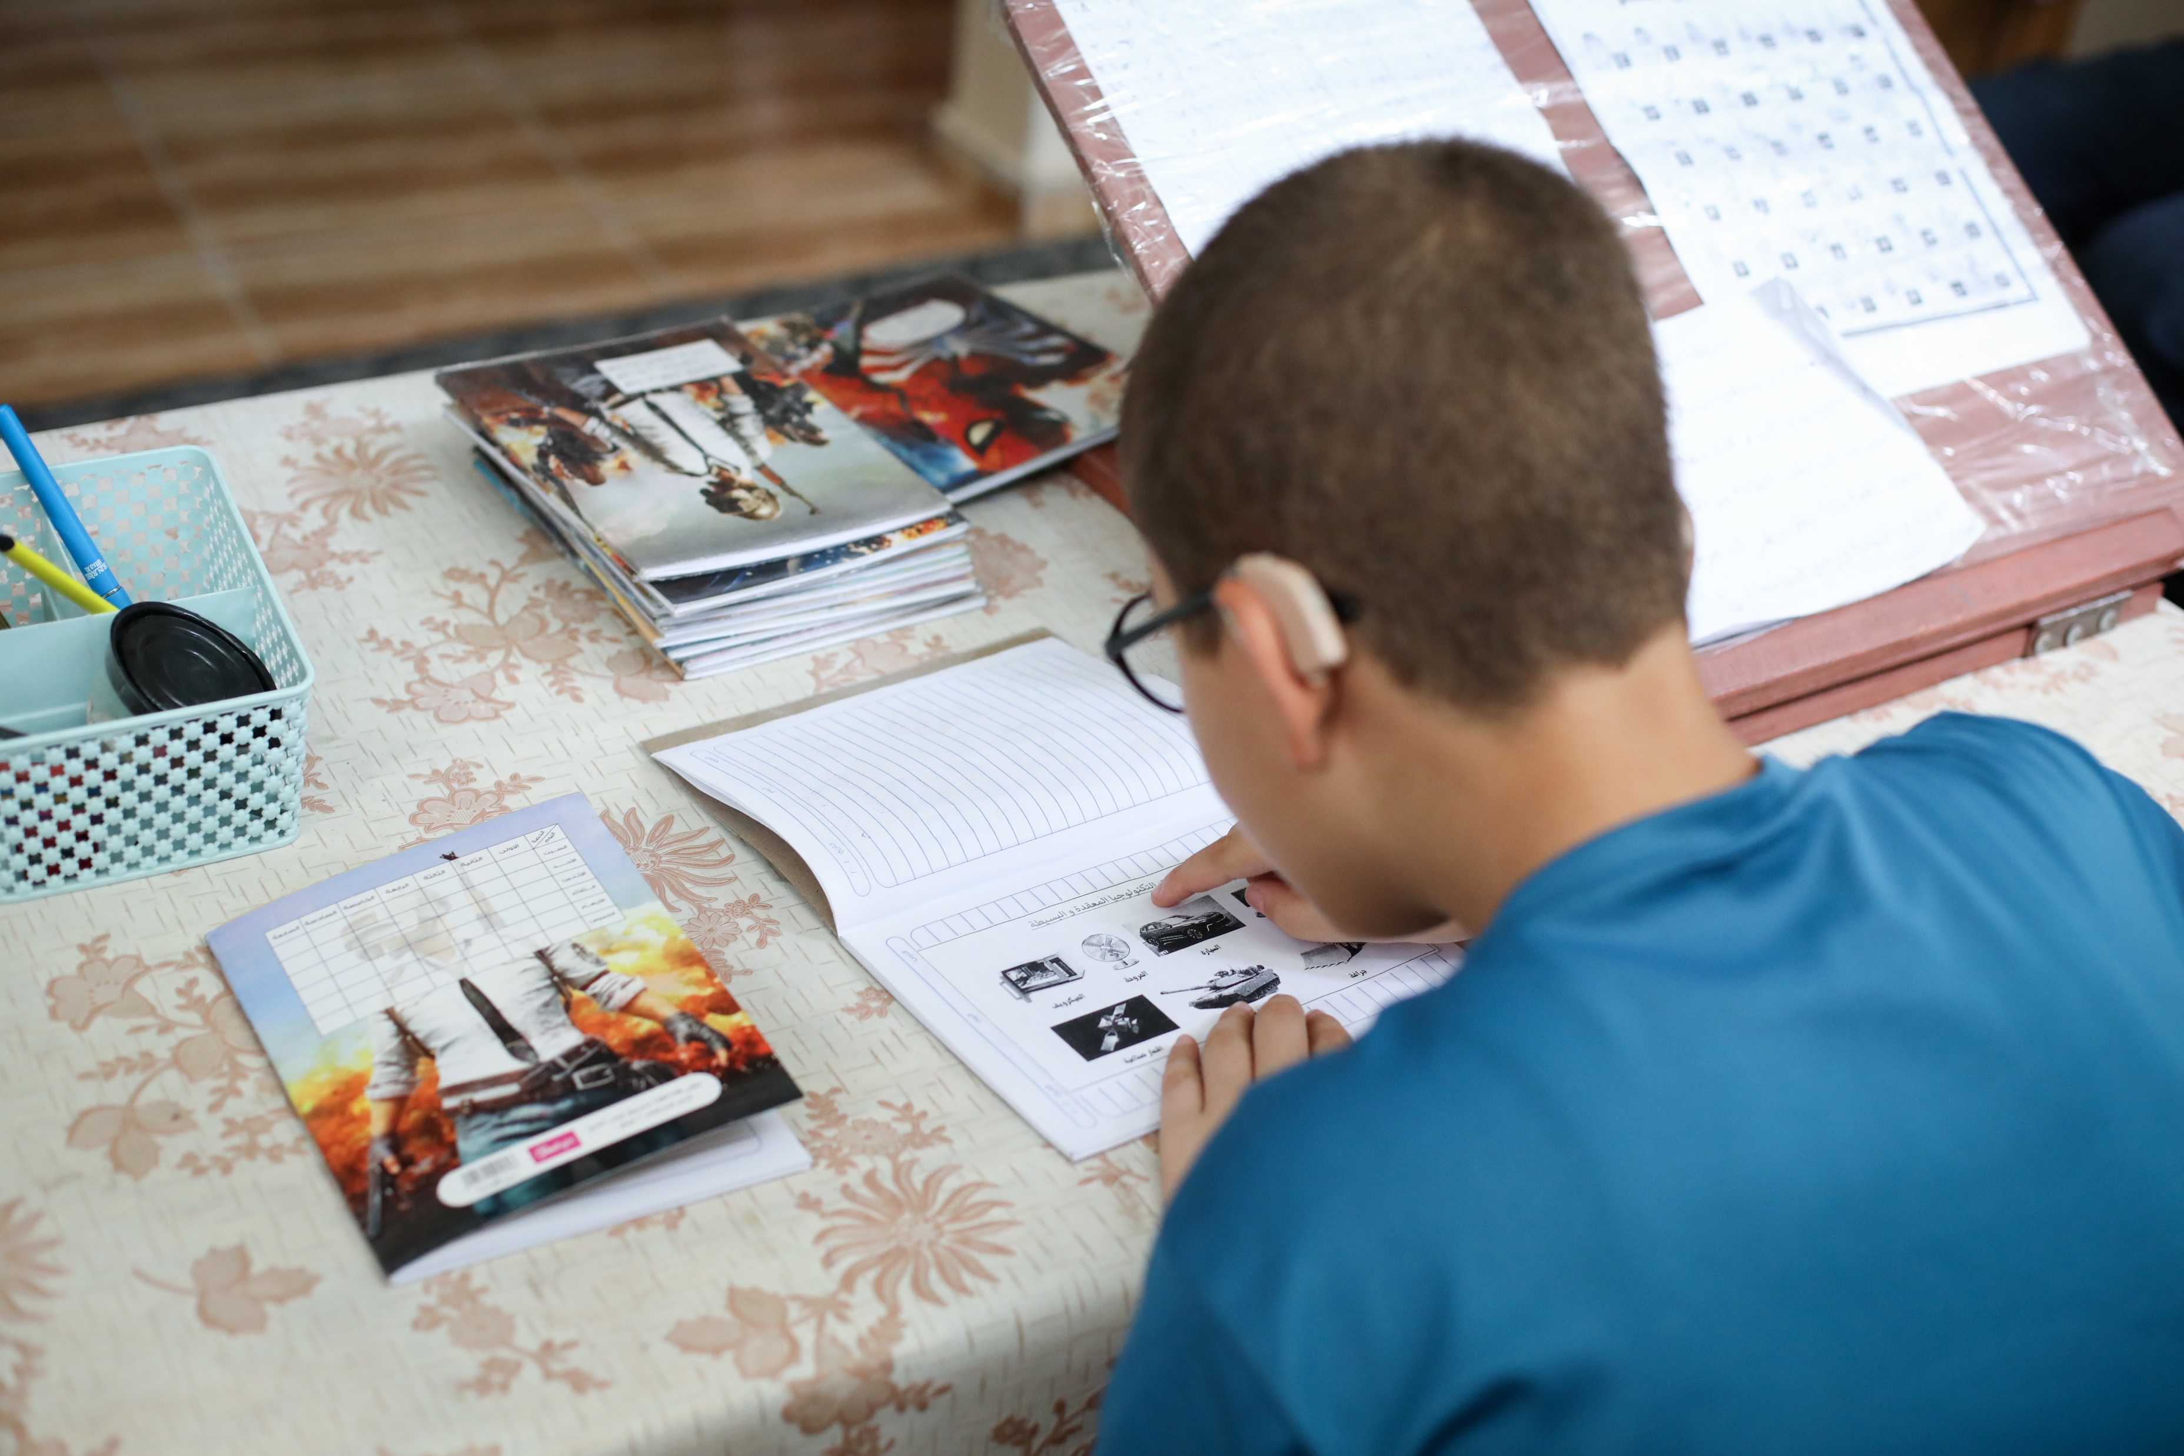
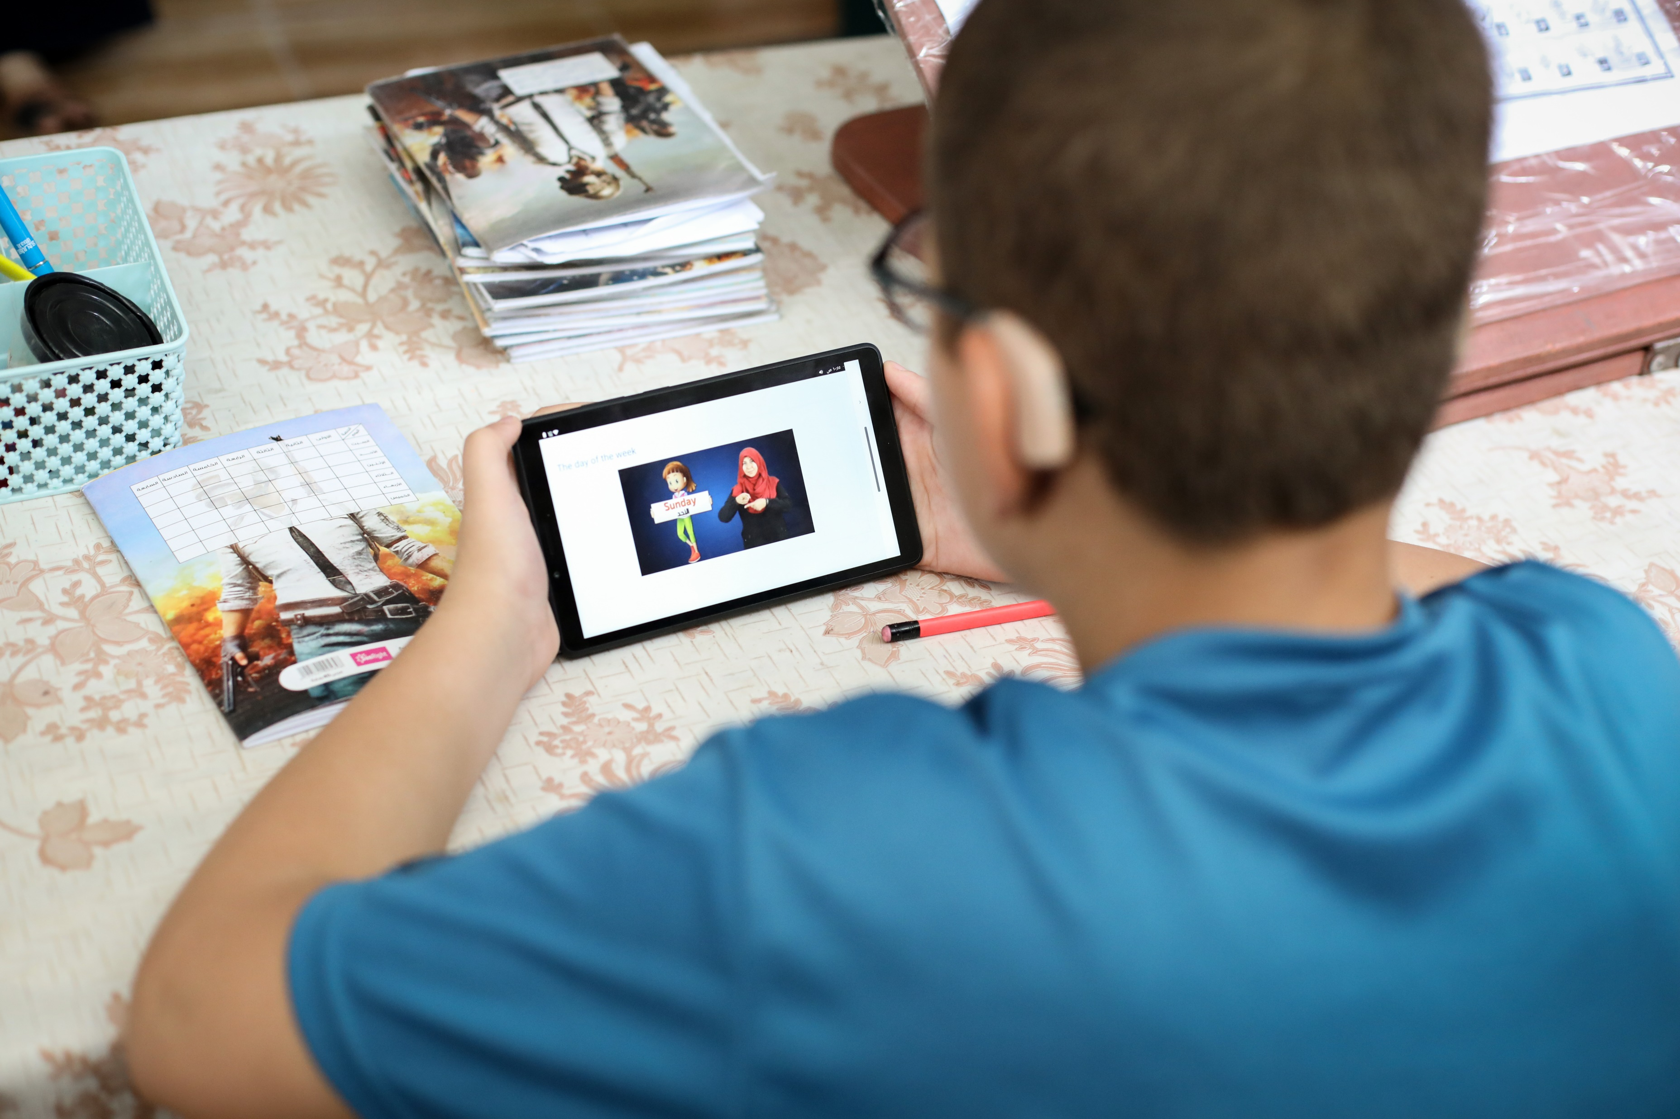
Learning at home
Photos: CBM/ASDC
Notes:
Educators prepared resources in different formats, including video
An example of the variety of resources with a child learning at home.

Slide 8
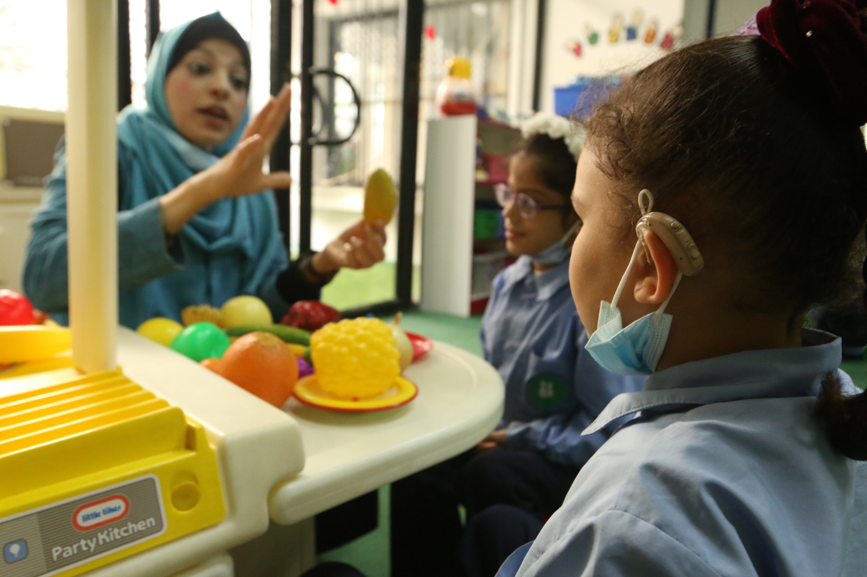
Learning together
“E-learning gave me the chance to be an innovative teacher. It helps parents to support their child’s education at home.”
Photo: CBM/ASDC
Notes:
A photo showing a teacher at Atfaluna in conversation with two pupils.
Psychosocial support and therapies are also provided online

Slide 9
Challenges, solutions and outlook
CHALLENGES
Connectivity
Download resources when connectivity available
OUTLOOK
Inclusive education framework
SOLUTIONS
Diverse needs of learners
Interactive, friendly, and accessible teaching
Academic achievement reported
Digital resources expanded
Teachers and caregivers lack knowledge on digital learning
Training provided
Increased confidence
Therapy
On-going therapy
#ZeroCon24
Notes:
inclusive education framework digital learning
mental health guidelines for deaf and hard-of-hearing children in the Gaza Strip has been published. These guidelines were developed in collaboration with CBM's Eastern Mediterranean Programme, Atfaluna Society for Deaf Children, the London School of Hygiene and Tropical Medicine (LSHTM), and the German Federal Ministry for Economic Cooperation and Development (BMZ). The guidelines will support and promote the well-being of deaf and hard-of-hearing students in educational settings.

Slide 10
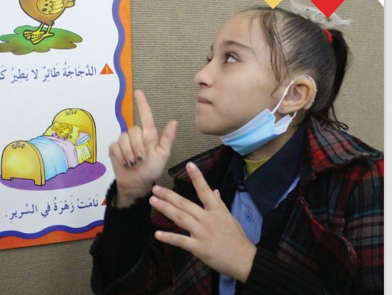
Alma’s story
“I continue to learn, feel safe with my family and make friends…. My learning does not have to stop… Learning is my safe place.”
Photo: CBM/ASDC
Notes:
A photograph of Alma, a pupil at the school along with a quote from her about her experience.

