Slide 1


Just Ride
Charging Grid Reimagined

Slide 2
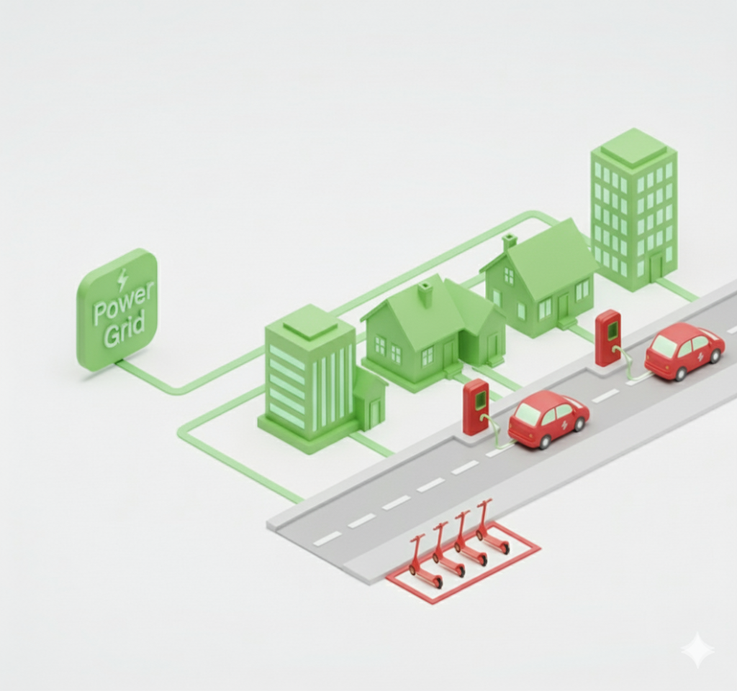




Problem
E-Fleets Are Ready, The Grid Isn't
The Grid Was Built for Yesterday
Fixed, Steady loads in homes, offices & factories
Electric Mobility Brings New Challenges
In streets and parking lots
Spiky, Unpredictable demands
Light-EV Fleets Face Operational Strain
Battery Swapping and Manual Charging
Resulting in Low Availability, Wear, and Fire risk
12% Rev loss
35% Labor
10% Wear
* % of operational expenses

Slide 3
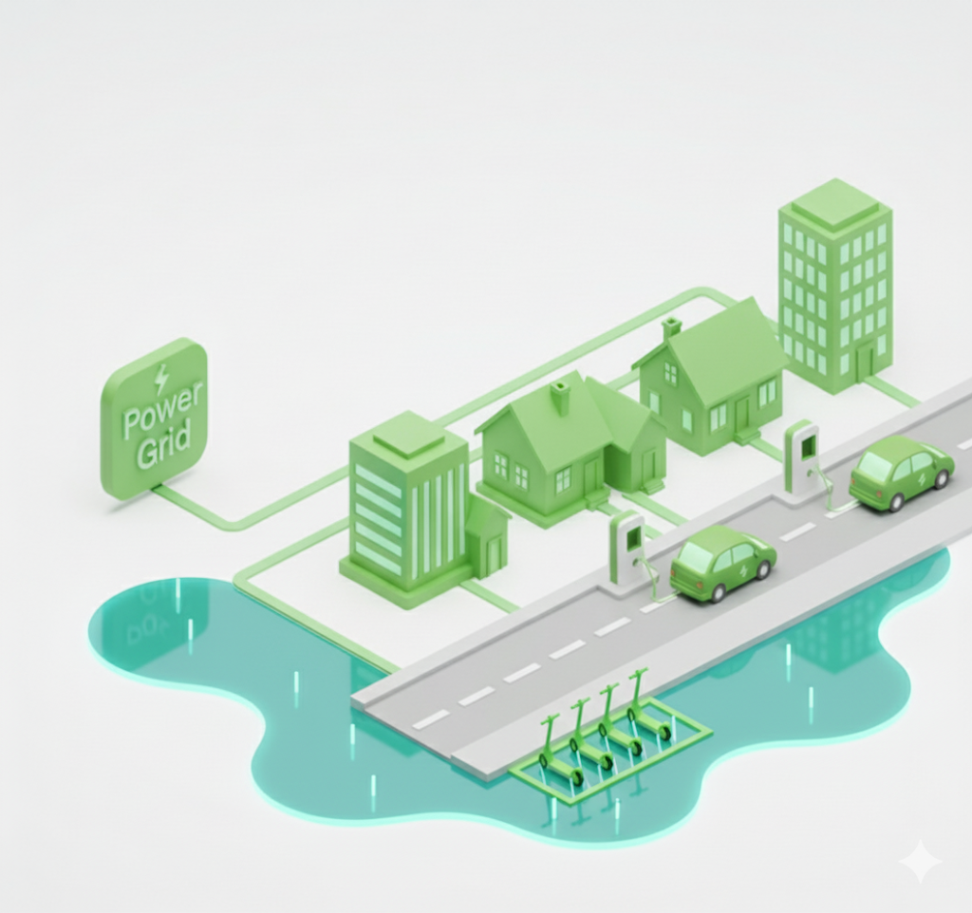

Solution
Charge Wherever You Park
Power Lakes - The missing Grid layer
✔ Always Available
Charging wherever vehicles park
✔ Scalable & Flexible
From parking lots to city-wide coverage
✔ Efficient
One Waterfall powers many vehicles
Notes:
What we know to do is to flood the city with the availability of electricity, fed by waterfalls of power from the available grid connections or local green energy sources.
This way we provide distributed charging available anywhere vehicles park, over large parking lots and streets.

Slide 4
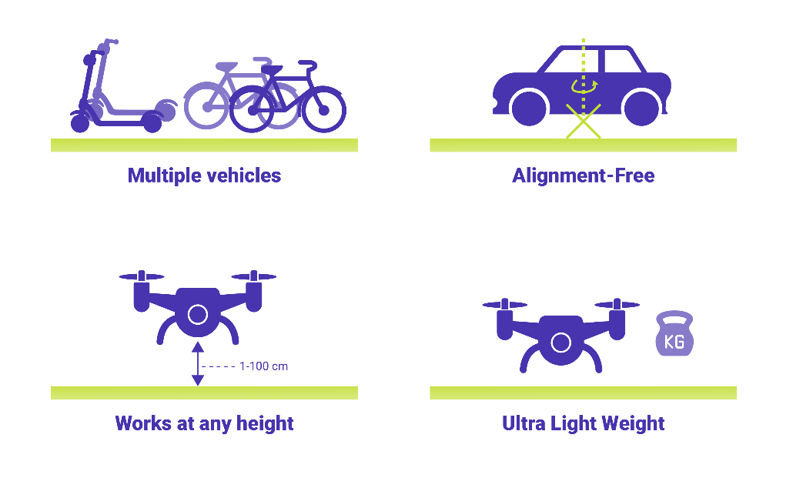
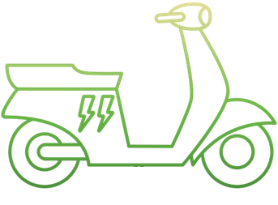

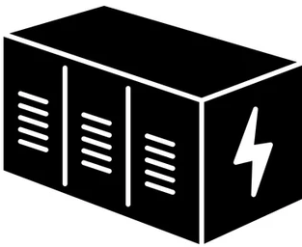

Technology
Power Lakes and Waterfalls
Green “waterfalls”
Storage
“Dams”
EW power Receiver
EW “Waterfall” (RF Transmitter)
Electric coupling
EW “Lakes”
RF lines
Transmitting antenna
Notes:
How we build those lakes:
EFSR is a technology that uses RF to distribute electricity – very similar to cable TV infrastructure: one transmitter feeds many clients.
The technology enables highly efficient splitters and combiners, allowing transmission to travel through wires (coax cables) and, when connected to an antenna, wirelessly into a vehicle.
This way, we can build local lakes such as parking lots or a street, and over time aggregate to larger lakes.

Slide 5





Charge Where You Park
Not: park where you charge
Wireless Charging-As-A-Service
Seamless - No cables, No Docking, Safe and Secure
Streets, Train stations, Retail, and Office buildings
Accessible anywhere, Simple and Clean

Slide 6
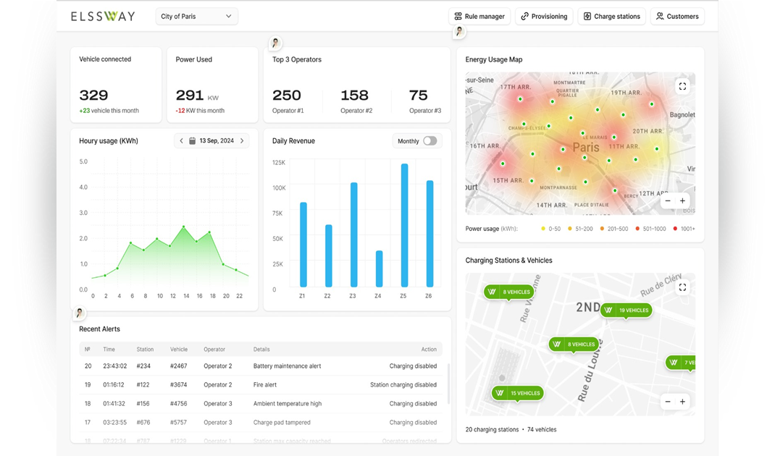
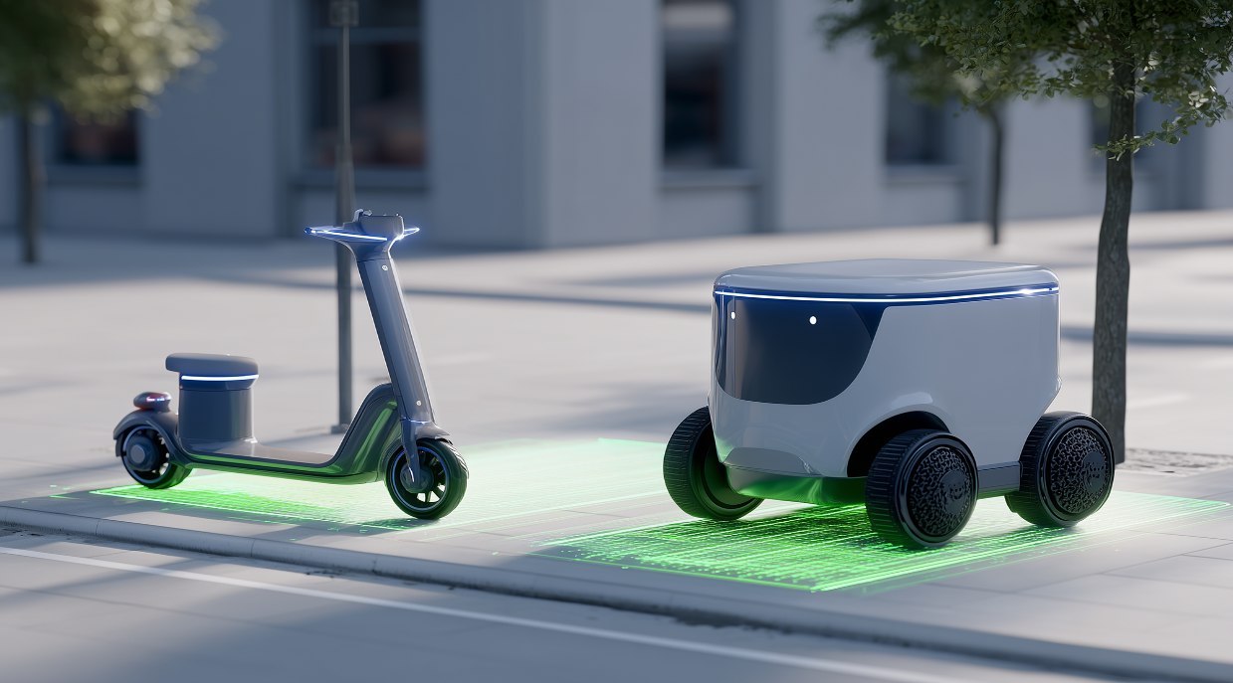
Charge-As-A-Service
Designed with ORDER and SAFETY in mind

Slide 7
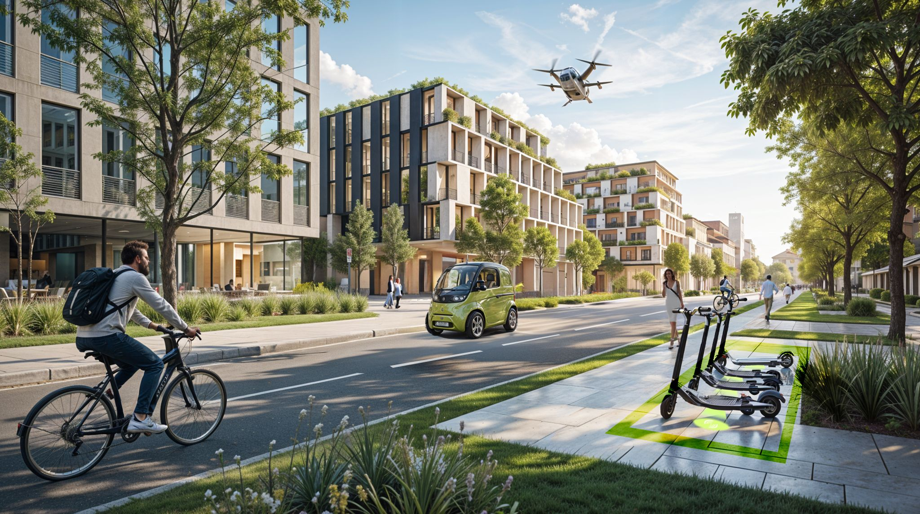
Just Ride
Charging Grid Reimagined

