Slide 1
Cultivating Deaf Leadership and Global Advocates from China to the United States
Amy Hebert Knopf
Center for International Disability Advocacy and Diplomacy at St. Cloud State University
United States
Inclusive practices in universities and higher education institutions
Wednesday, February 21, 2024
13:40 – 15:00 CET
Notes:
Please add your notes here.
Title; First name, last name of speaker(s); Name of Organization, Name of Country, Name of Session (as written in Agenda)
#ZeroCon24
Day and Time of Session
w

Slide 2
Deaf Leadership and Advocacy Graduate Program
#ZeroCon24
International Deaf Students
1 Year Program
Deaf School Partnerships
Deaf Culture and Deaf Identity
20 Credits
Leadership and Teaching
Notes:
Sample Slide: presenting three points on our project and the relationship to this year’s theme of the Zero Project Conference. Point 1; Point 2; Point 3 connect together in this way.

Slide 3
Overview of the timeline
Maximizing of the United Nation’s Sustainable Development Goals
#4 Inclusive Education
#8 Inclusive Employment
#10 Reduce inequality
#16 Inclusive Societies
#17 Strengthen Partnerships
2016 Inception with one student
2019 Pilot with 3 interns and 1 fellow
2024 DLA Grad Cert with 30 students
2025 goal to grow with China Universities
Notes:
In 2016 Dr. Zheng Xuan spent one year at Metro Deaf School in Minneapolis teaching CSL and Chinese Culture. In 2019 we were able to expand this to three interns and a fellow placed at three schools for the Deaf. This Fall we expanded the project to accept 30 Deaf International students for one semester and then placed a 15 U.S. Schools for the Deaf. This supports the United Nation‘s sustainable development goal #17.

Slide 4
Innovative Aspect
#ZeroCon24
Power of People-to-People Exchange
Knowledge Mobilization
Inclusive Scientific Diplomacy
Exchange of best practices
Advancement and Promotion
Human Rights and Communication Access and Innovative Solutions
Research and Development
Development of Global Competencies
Enhancement of One’s World View
Cross-cultural learning
Innovative Research
Policy Development

Slide 5
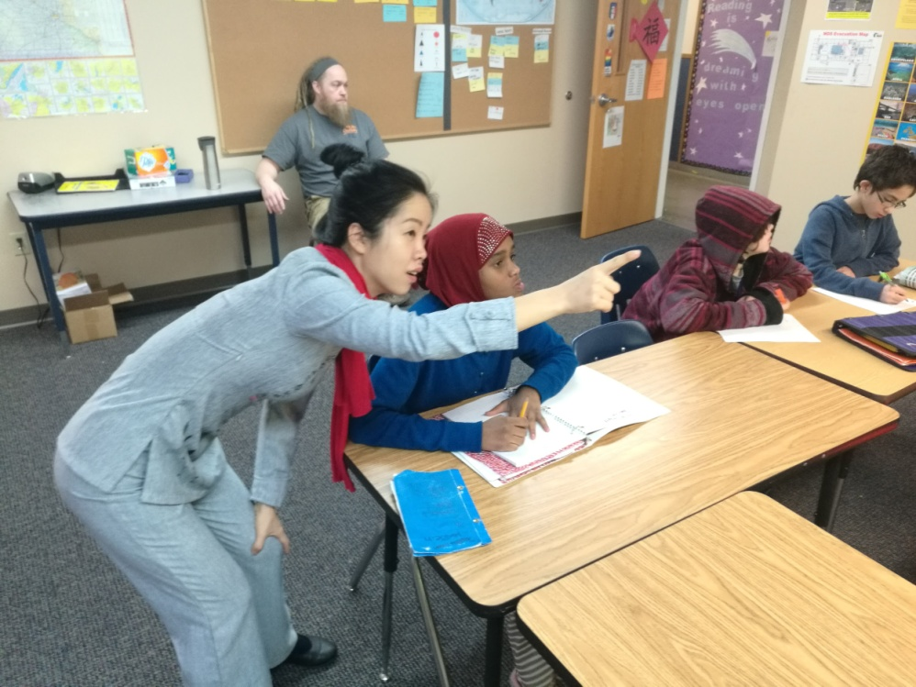
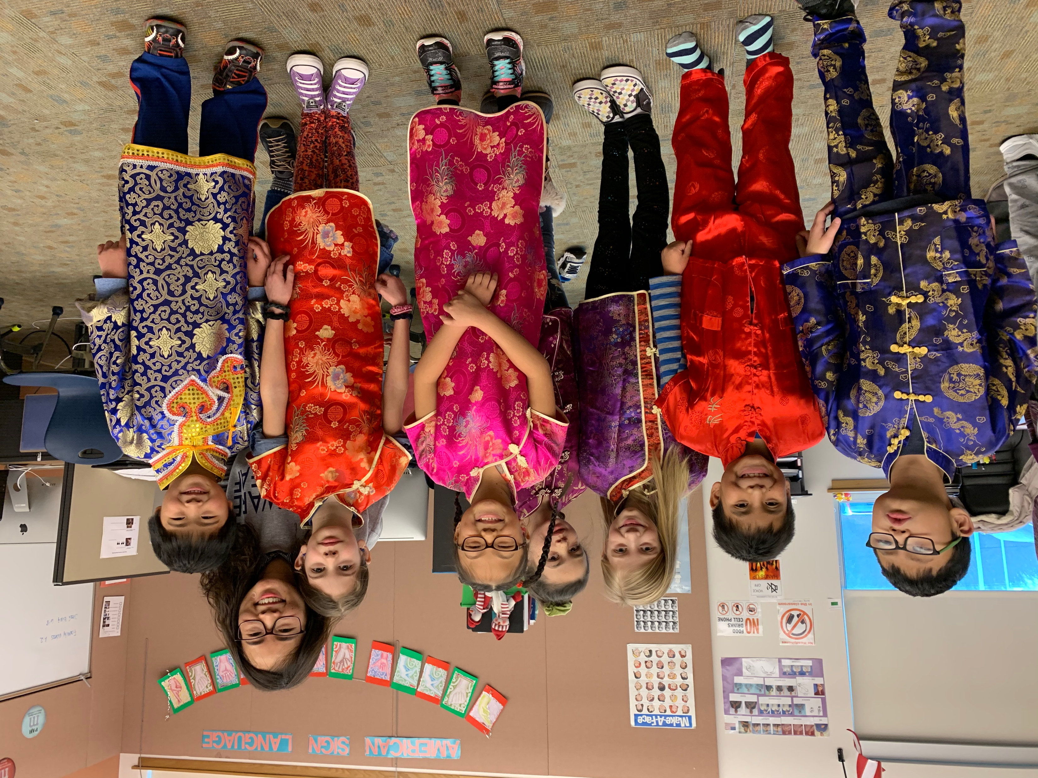
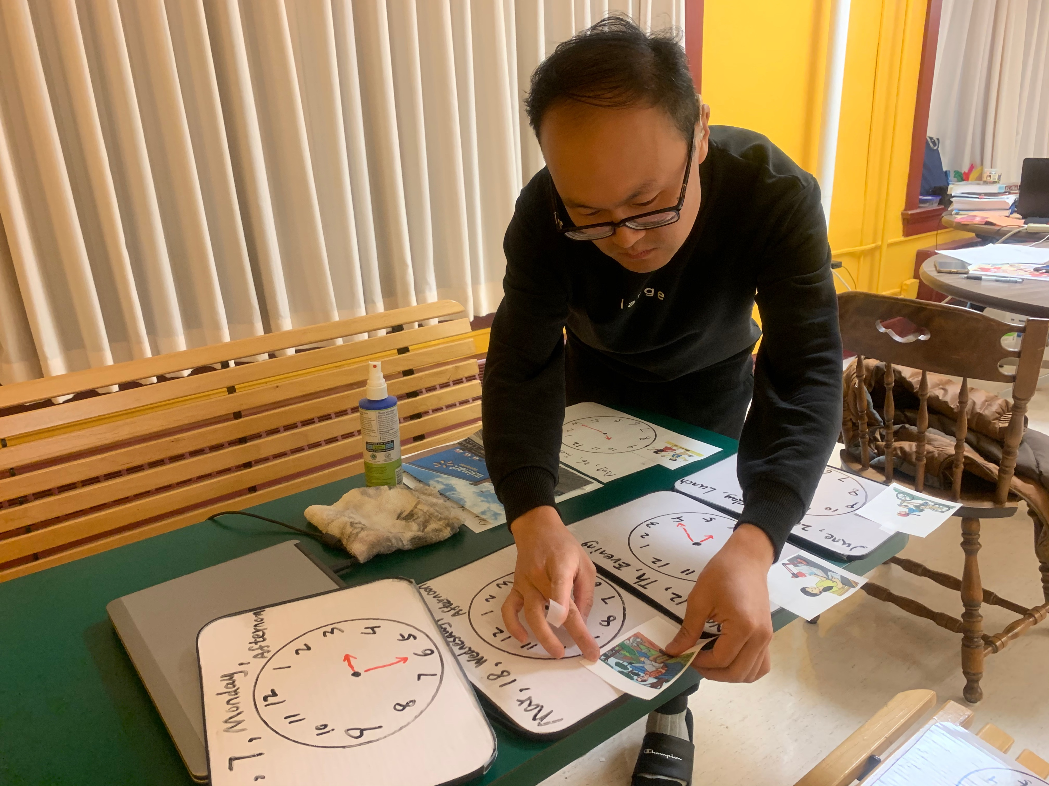
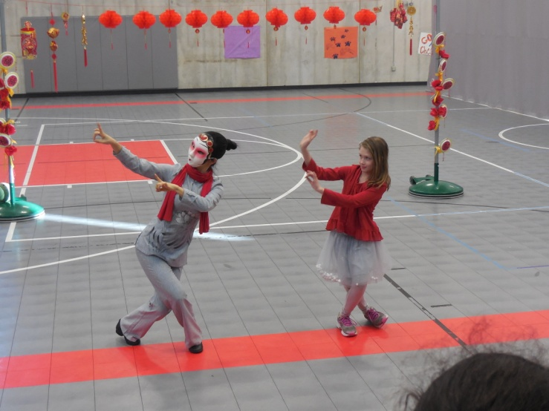
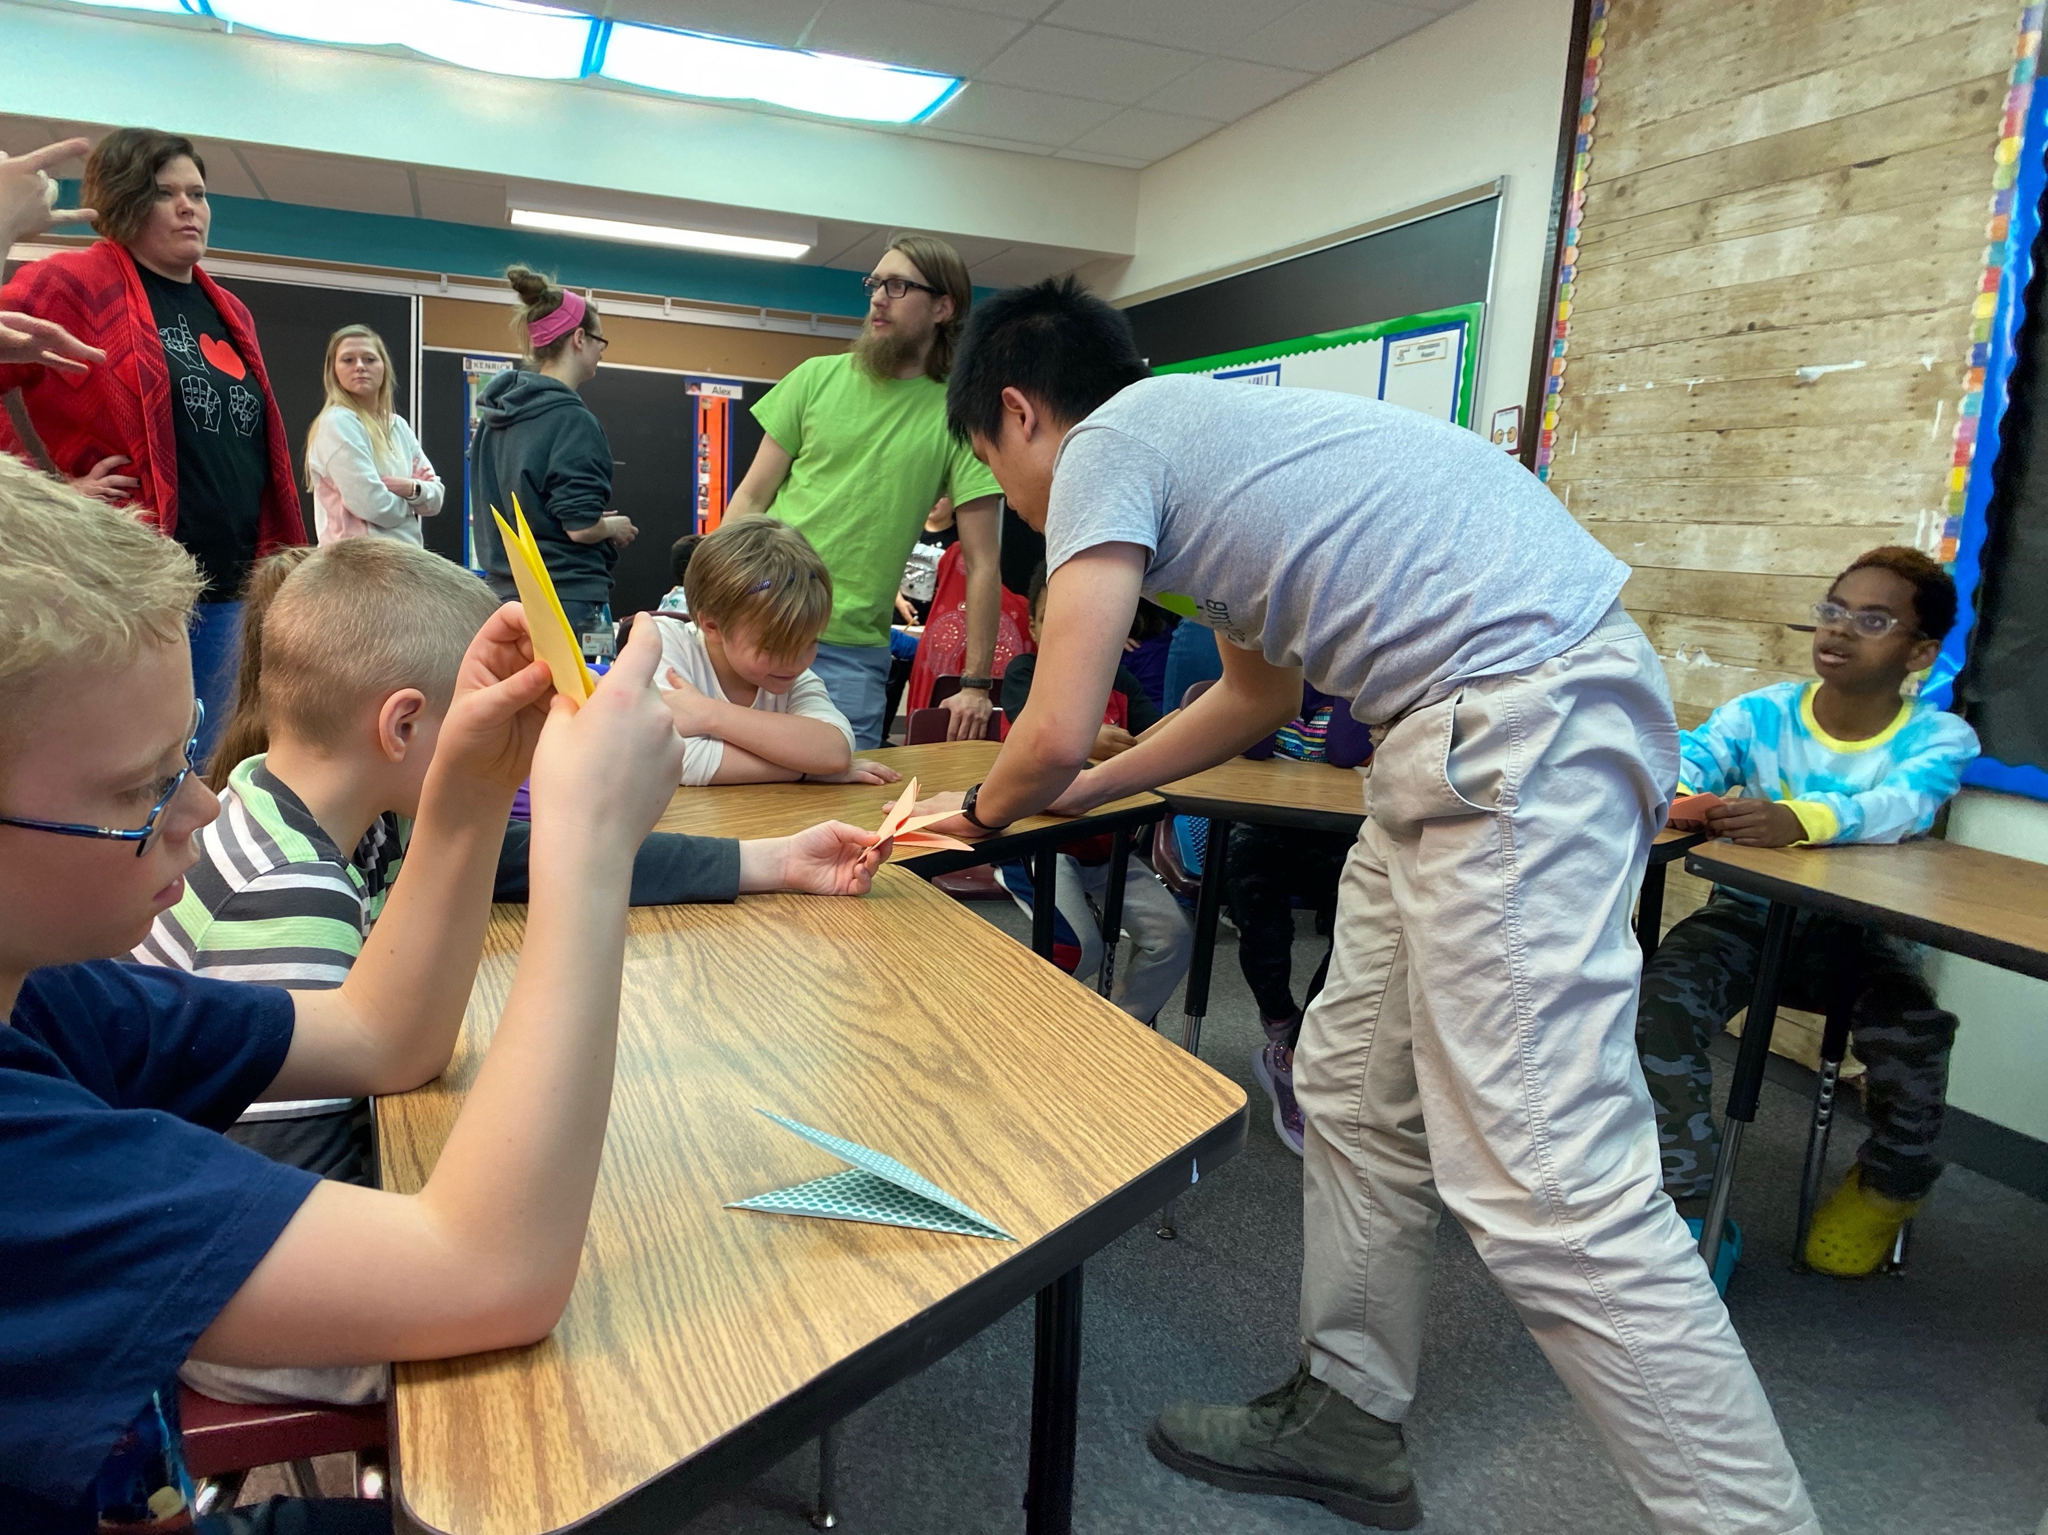
Advancing Cross Cultural Knowledge and Understanding
People to People Diplomacy in Action
Notes:
Dr. Zheng illuminated the power of this project by serving as the first Chinese Deaf Teacher. Students advanced their cross-cultural knowledge and understanding as global citizens through this people to people diplomacy project.

Slide 6
Impact
Educational Opportunities through increasing communication access
Employment opportunities through communication access
Increase the social-cultural value of Deaf identity and Deaf community
Expand the access to professional academic disciplines.
Notes:
The innovative impact will lead to the development of leadership and advocacy through leadership development by creating Educational Opportunities through increasing communication access, Employment opportunities through communication access, Increased social-cultural value of Deaf identity and Deaf community, and Expanded access to professional academic disciplines.

Slide 7
Next Steps: Maximizing Inclusive Scientific Diplomacy
Deaf Leadership Graduate Certificate
Fall 2024
15 U.S. Schools for the Deaf
Training & Development
Access to All
China Conference June 2024
SCALING UP
Expand to China Campuses
Expand to Global Campuses
Notes:
The next steps in maximizing inclusive scientific diplomacy is in creating a global network of partnerships with global Schools for the Deaf, further training and development through professional development, and by increasing people to people exchange opportunities for people with disabilities.

Slide 8
FOR MORE INFORMATION
CIDAD@STCLOUDSTATE.EDU
Notes:
CONTACT INFORMATION CIDAD@STCLOUDSTATE.EDU

