Slide 1

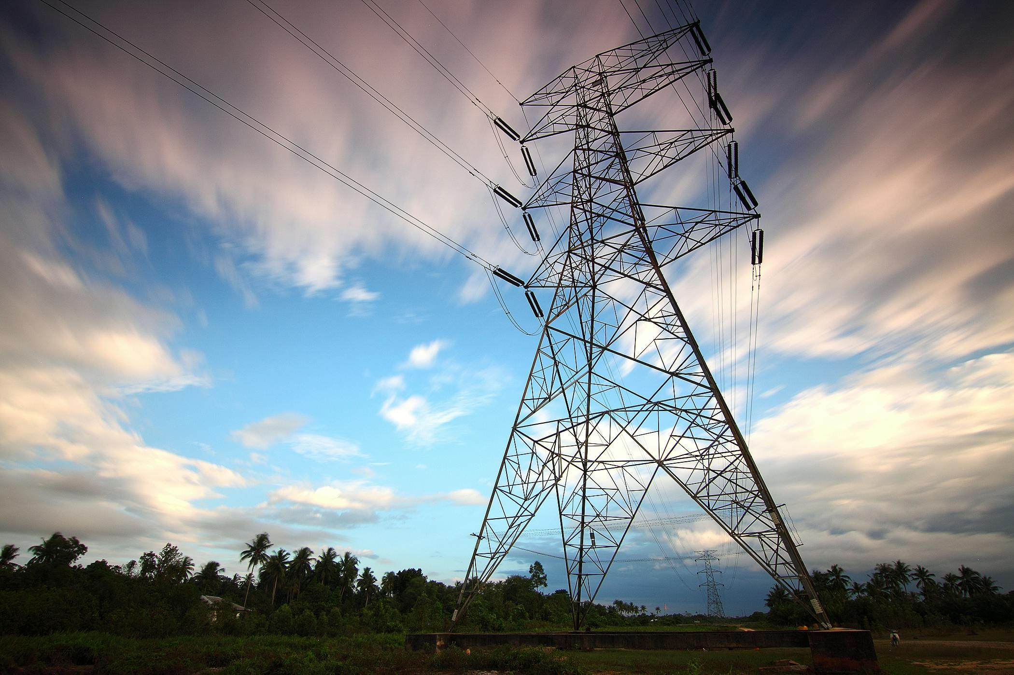
Energy Matters Ireland
Areas Covered:
Energy Saving Brokerage
CSRD Compliance
Empowering Businesses for Sustainable Growth
Presented by: Steve King, Founder EMI

Slide 2
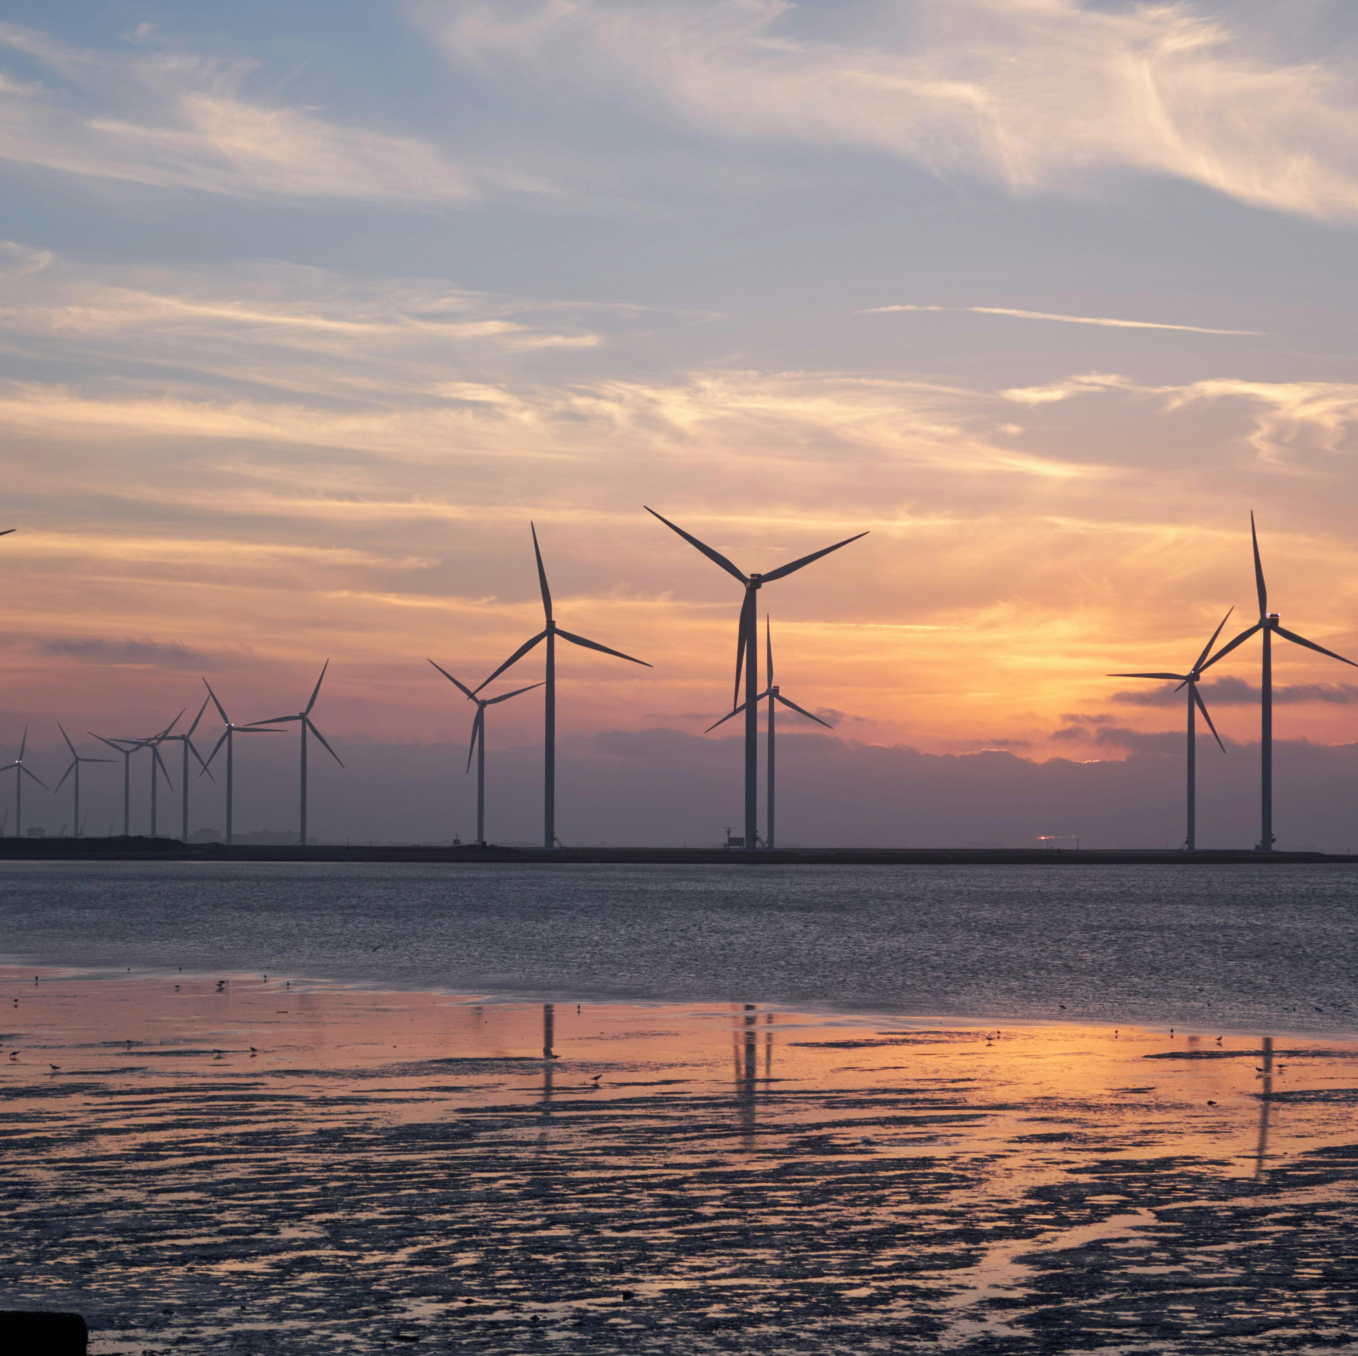

Our Mission and Expertise
Mission Focus: Dedicated to helping businesses cut costs and carbon footprints
Competitive Energy Brokerage: Offering brokerage services to secure best energy units
Supporting compliance in Corporate Sustainability Reporting Directive (CSRD)

Slide 3






Our Solution Impacts World, Saves Energy and Reduces Waste
Identify Energy Waste Areas
Evaluating the Cost Saving and Energy Saving Strategy
Identifying Best Energy Solutions
Procuring Energy
Brokerage Services
Saving resources to funnel further business growth
Energy audit and data collection
Bill analysis and project identification
Tender process and project cost evaluation
Supplier tender for best costs
Evaluation of supplier offers and market knowledge.
Long term planning for energy reduction strategy.

Slide 4

Our Value Energy Brokerage Services Gets You Best Deal
Competitive Rates
We offer competitive rates for energy brokerage.
Established Relationships
We have established relationships with leading energy suppliers.
Negotiate Best Rates
We negotiate the best possible rates for our clients.
Appointed Broker
We are the appointed broker for CSNA, with over 1500 members.

Slide 5

CSRD - Scope
Meet European Green Deal’s climate change action objectives
Ireland and other member states have until mid-2024 to transpose the directive
Disclose not only the risks they face from a changing climate and other ESG matters (financial materiality), but also the impacts they themselves may have on climate and society (impact materiality)
CSRD introduces 12 mandatory reporting standards developed by EFRAG
Government supports such as the Green Transition Fund and to use the Climate Toolkit 4 Business
1
Scope 1
Direct emissions from a company's operations or facilities.
2
Scope 2
Indirect emissions from electricity purchased and used by the company.
3
Scope 3
All other indirect emissions throughout a company's value chain.

Slide 6
CSRD Reporting: Double Materiality
Financial Materiality
Risks faced by the company from a changing climate and other ESG matters.
Impact Materiality
The company's effects on climate and society.
Value Chain
Companies must provide information on their value chain.
Reporting: Key Timelines
1 January 2024
1 January 2025
1 January 2026
Public interest entities in scope of EU non-financial reporting rules (greater than 500 employees)
Other larger companies and public interest entities (greater than 250 employees)
Listed SMEs, with an ‘opt out’ possible until 2028

Slide 7

We Support You in Compliance
What we can do for you:
1. Scope Assessment: Determine if your company is directly or indirectly affected by the directive, including through your value chain.
2. Current Position Evaluation: Analyse your existing sustainability reporting processes, internal controls, and governance to understand your company's current stance.
3. Engage with Accountants/Auditors/Advisors: If you’re required to report in 2024, consult with your auditor, accountant, or business adviser about the directive and relevant standards.
4. Stay Informed: Subscribe to updates from the Department of Enterprise, Trade and Employment by emailing csrd@enterprise.gov.ie.
5. Collaborate with Partners: If you might be impacted through a large company’s value chain, start discussions with them and your business adviser to clarify expectations.
6. Data Readiness: Evaluate your ability to collect necessary data, either as a company in scope or as part of a value chain.

Slide 8




Reach out to Energy Matters Ireland
Exceptional Service
We take pride in providing exceptional customer service.
Ongoing Support
Our team is always available to answer questions and provide ongoing support.
Contact Us
Steve King, Guinness Enterprise Centre, Taylors Lane, Dublin 8, 0831 856272,
01 410 0600

