Slide 1
Together: A Co-designed Accessibility Training
Is Hay (he/they)
Youth Disability Advocacy Service (YDAS)
Australia
Entrepreneurship and leadership development for young people with disabilities
Thursday February 22nd (14:40 – 16:00 CET)
Notes:
Together: A Co-designed Disability Training
Is Hay (he/they)
Youth Disability Advocacy Service (YDAS)
Australia
Entrepreneurship and leadership development for young people with disabilities
Thursday February 22nd (14:40 – 16:00 CET)
#ZeroCon24
Speaker notes:
- Acknowledgement of Aboriginal Country – the land of the Wurundjeri Woiwurrung people of the Kulin Nation
- Introduce self and YDAS, my lived experience as a trans, disabled young person and how that falls into the work we do at YDAS and in Together Training
- How YDAS defines disability is expansive and based on the social model

Slide 2
The story of Together
Grant funded
Entirely disabled-led recruitment and project team
Co-design and content development
Together in delivery & practice
  Free Organisation & Open Training
  Paid Training Model
Fully accessible online delivery
Notes:
This slide will talk about the story of Together Training from our accessible recruitment of an entirely disabled team, to the in-depth and meaningful co-design of information and development of training content to what Together looks like in practice.
Together is a 4-hour access and inclusion training for organisations and workers who do or want to work better with disabled young people. It teaches this through lived experience storytelling and innovative and practice interactive activities and lessons. It was developed fully online using innovative accessible delivery strategies and tools, modelling what access and inclusion can look like in practice.

Slide 3
Impact
Impact for organisations & workers
  Nearly 2,000 workers have completed the training
  At least 95% of participants feel confident working and communicating with disabled young people, planning accessible events, implementing inclusion into their work, finding resources and understanding access needs.
Impact for disabled young people & our team
  Skills and career development
  Influencing youth, community and disability sectors
Notes:
This slide discusses the two-pronged impact of Together Training, for organisations and workers who have completed the training as well as disabled young people, in our team and the community. Nearly 2,000 workers have completed the training. At least 95% of participants feel confident working and communicating with disabled young people, planning accessible events, implementing inclusion into their work, finding resources and understanding access needs. Our disabled young team have led the entire project, built their skills and career development and have Influenced youth, community and disability sectors across Victoria and Australia.

Slide 4
Success Stories
Sector-wide Access Key development & utilisation
Creation and distribution of Social Scripts in a variety of contexts
Development of YDAS’s Lived Experience Social Enterprise Offerings
Disabled young team member progression within YDAS and across other organisations
Notes:
We have had lots of success from our program. This includes:
Sector-wide Access Key development & utilisation
Creation and distribution of Social Scripts in a variety of contexts
Development of YDAS’s Lived Experience Social Enterprise Offerings
Disabled young team member progression within YDAS and across other organisations

Slide 5
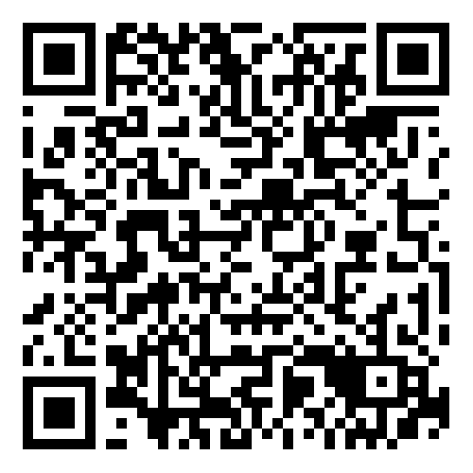
The Future…
Further YDAS Programs Co-design & Development
Innovation of accessible in-person and hybrid (online & in-person at the same time) delivery models
Find out more by going to our website (using the QR code) or contacting our team by emailing together@ydas.org.au
Notes:
We are continuing to use our innovative and disabled-led design processes to develop more training, workshop and program offerings, for audiences of workers and disabled young people. A few focusses are neurodivergence, queerness, accessible education, leadership, goal-setting and self-advocacy. We have also designed a process for hybrid and in-person training delivery that builds the skills of organisations to be accessible beginning in the planning process. This ensures the spaces are physically accessible for our facilitators and takes organisations on a journey of implementing access before the training even begins.
Find out more by going to our website (using the QR code) or contacting our team by emailing together@ydas.org.au. The QR code takes you to YDAS’s Programs & Training webpage which shows all our current offerings. Here is the link: https://www.yacvic.org.au/ydas/resources-and-training/ydas-programs/

