Slide 1
A global business and technology transformation company implementing a global programme to support neurodiverse employees.
Karine VASSELIN
CAPGEMINI
France
March 5, 2025
03:00 pm – 04:30 pm
Notes:
Please add your notes here.
Title: A global business and technology transformation company implementing a global programme to support neurodiverse employees.
Capgemini's Neuro-Inclusion program mobilizes all levers, training, employee networks, digital apps, exchanges with experts and partners to create an environment more inclusive to all and unleash the potential of neuroatypical people.
First name, last name of speaker(s); Karine VASSELIN
Name of Organization: Capgemini
Name of Country: France
Name of Session (as written in Agenda): Inclusive employment strategies of large companies#ZeroCon24
Day and Time of Session: March 5, 2025| 03:00 pm – 04:30 pm

Slide 2
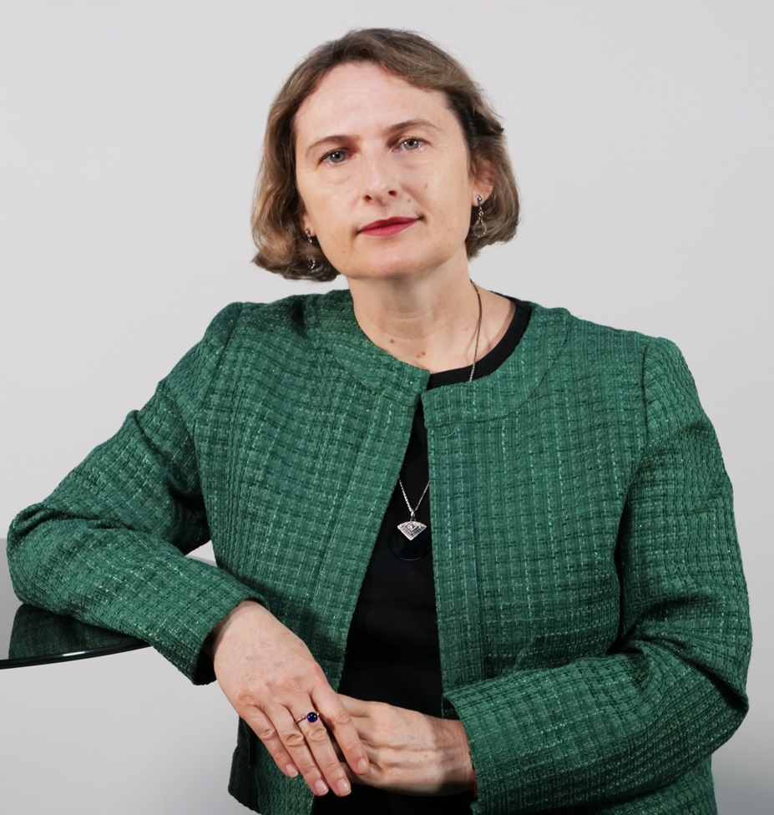
Karine Vasselin
Vice President Capgemini
Group Diversity & Inclusion Lead
Through our Neuro-inclusion global programme and in engaging with our Neuro-Ability employee groups, we want to unlock the potential of neurodivergent talent and be a neuro-friendly employer.

Slide 3

Unlocking the potential of neurodivergent talent
Neuroinclusion Program :
Capgemini Test & Learn Glocal approach

Slide 4
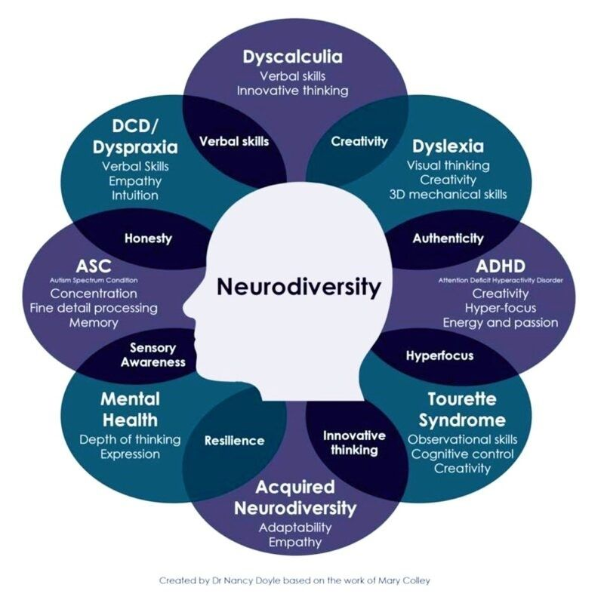
Building an Inclusive Workplace for Neuroatypical Individuals
1
LEARNING
2
ADAPTING
3
EMPOWERING

Slide 5
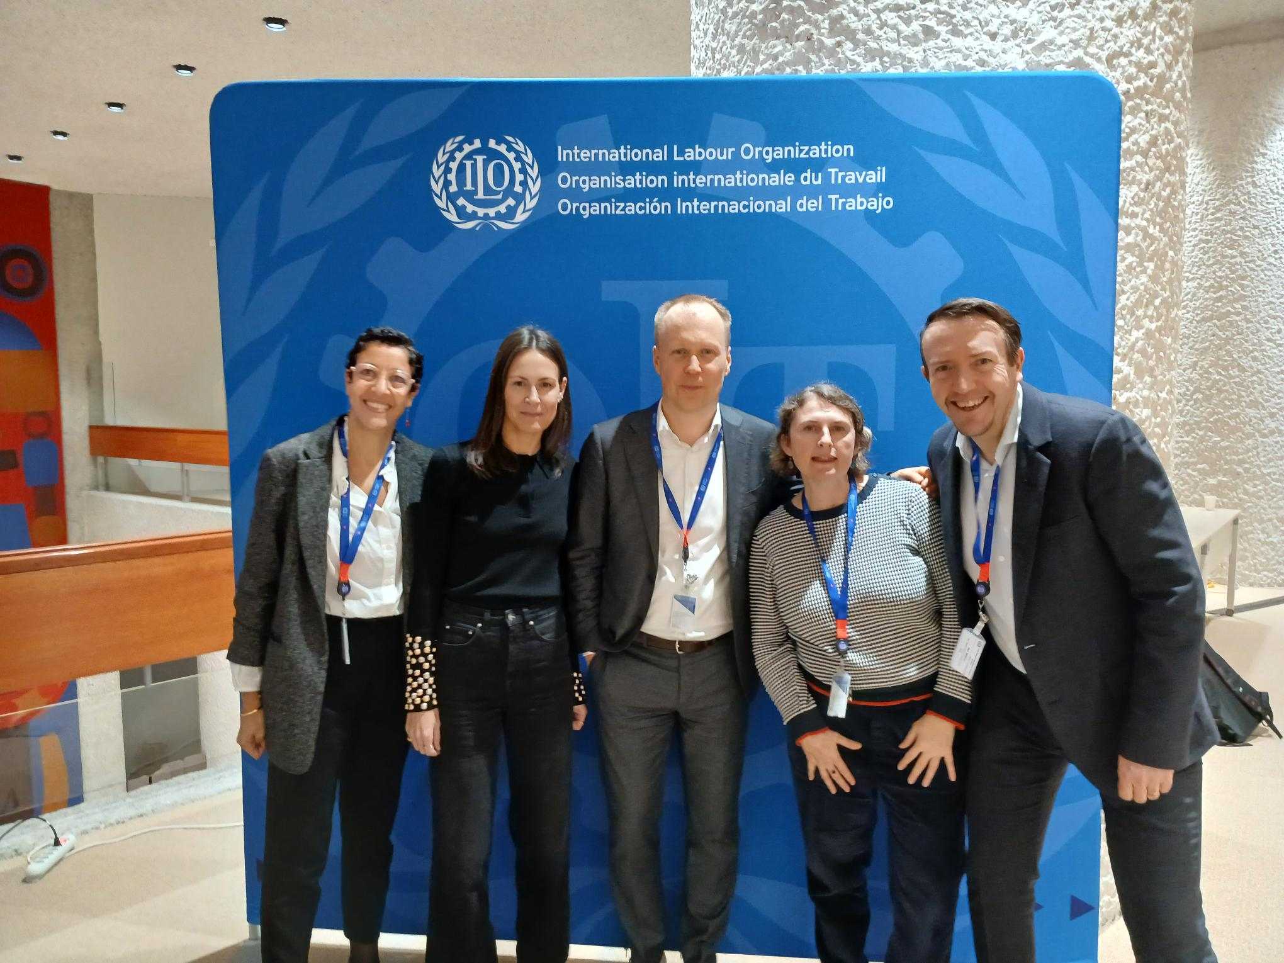

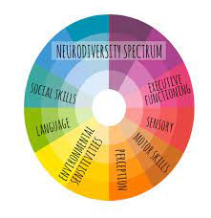
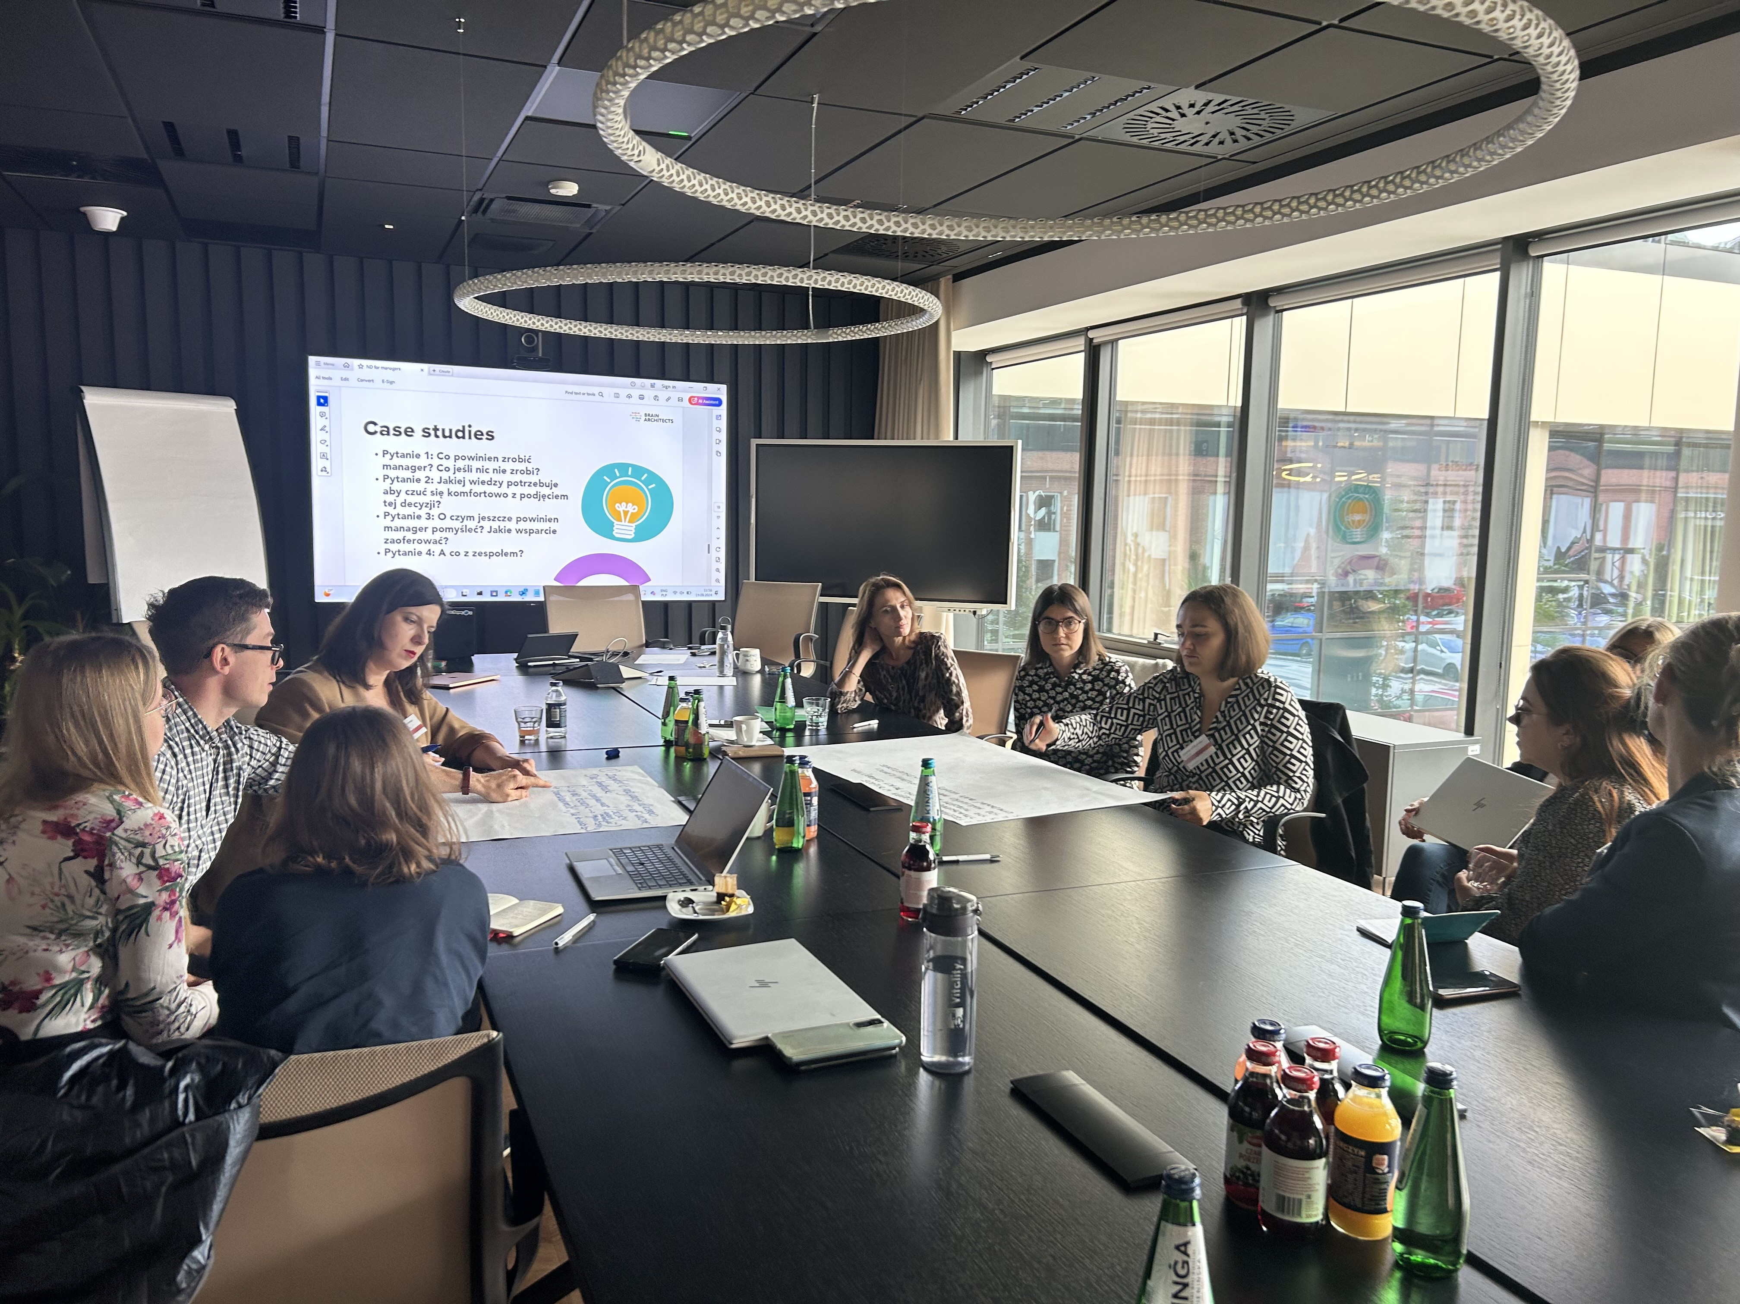
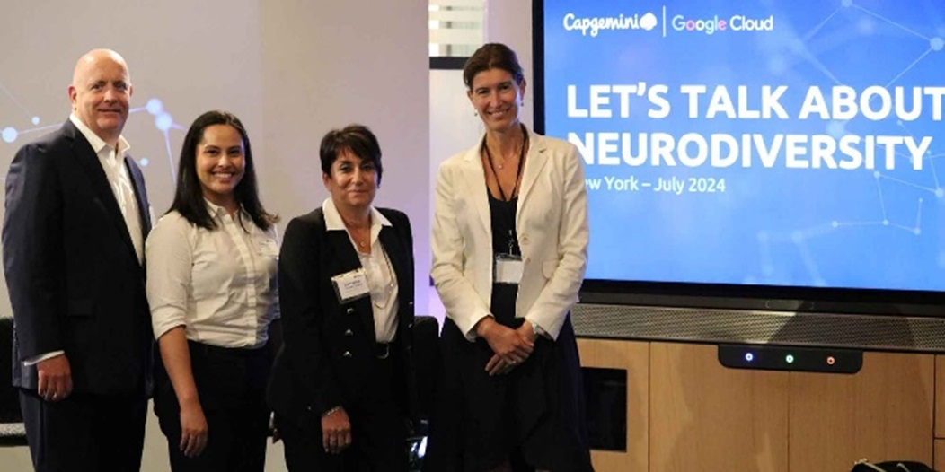
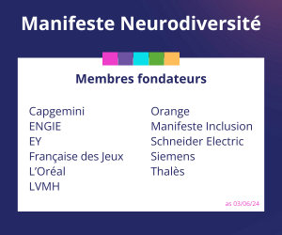
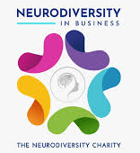
LEARNING TOGETHER WITH
OUR EMPLOYEES
EXTERNAL EXPERTS
OUR PARTNERS
OTHER COUNTRIES
Global taskforce with 12 Countries
Company Confidential © Capgemini 2025. All rights reserved
#ZeroCon25
5

Slide 6
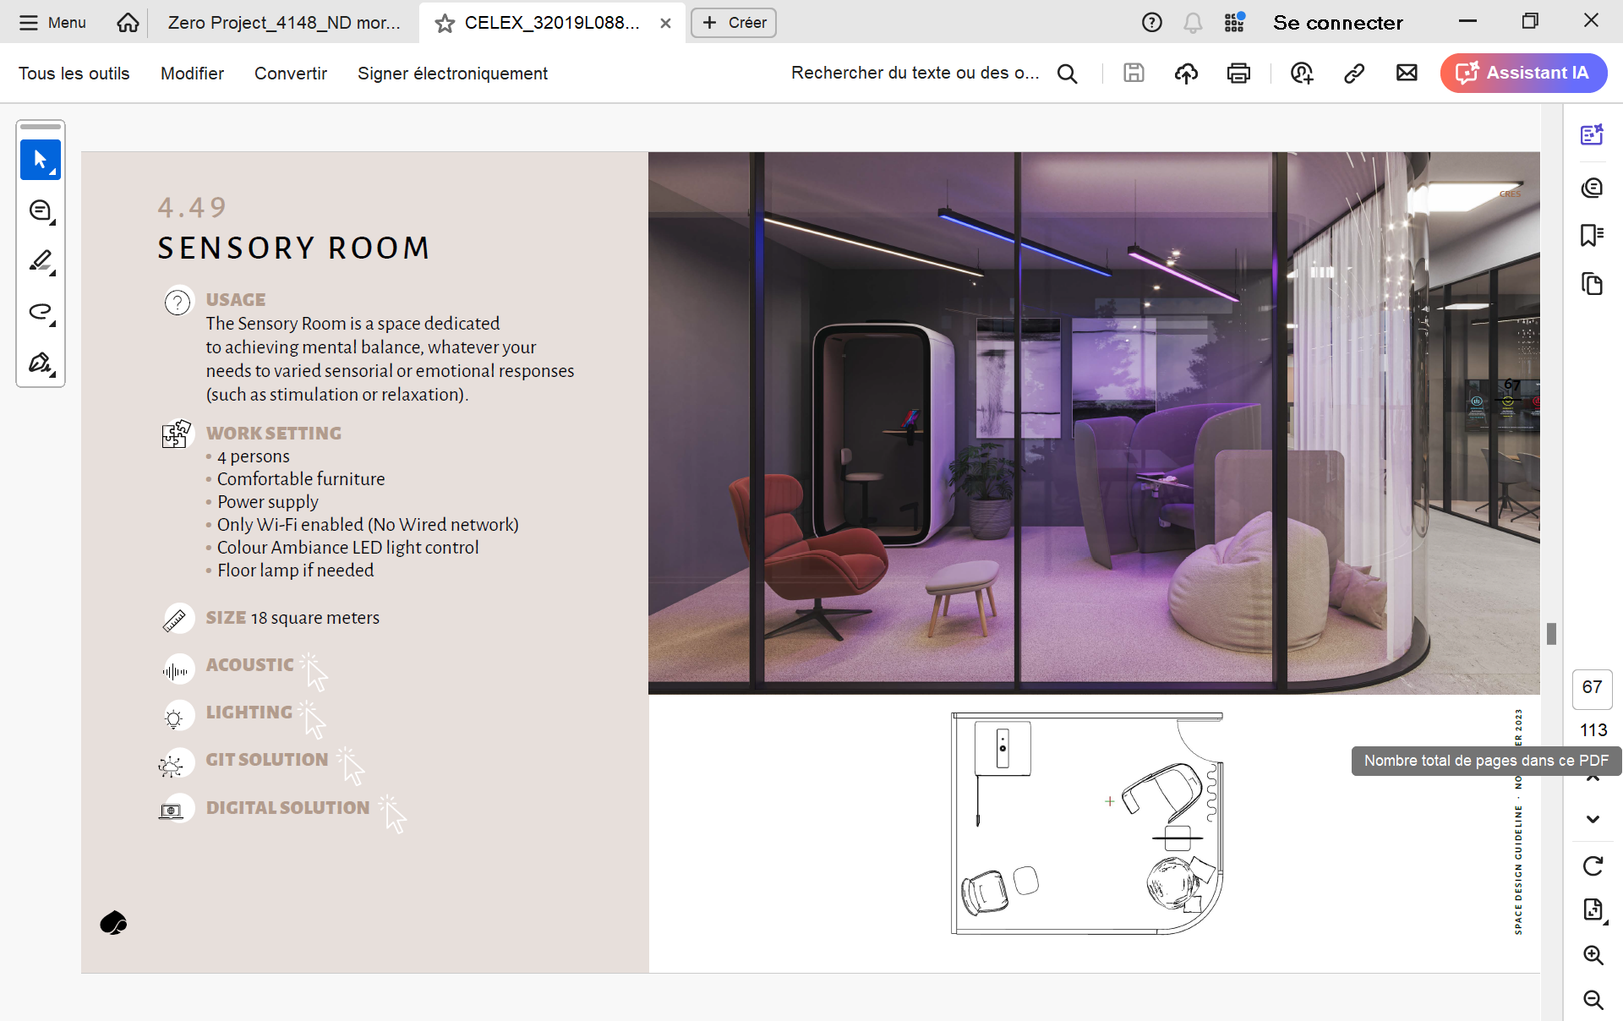

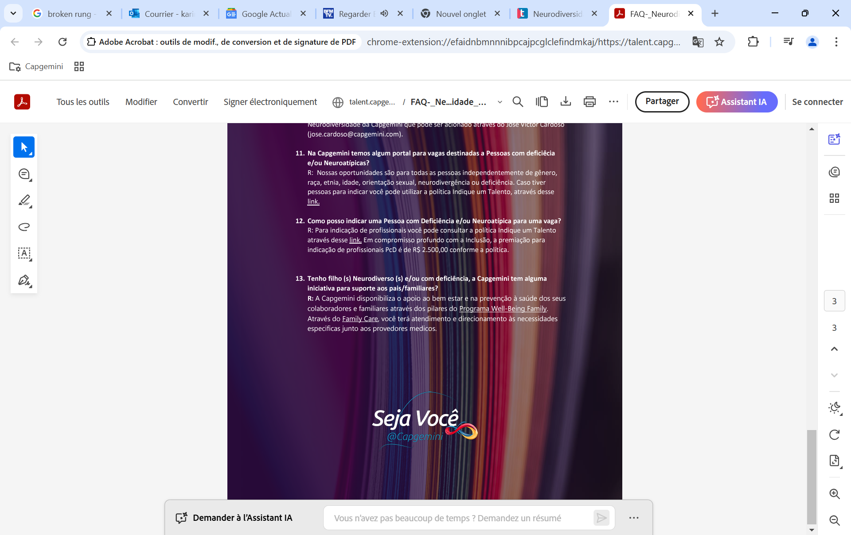

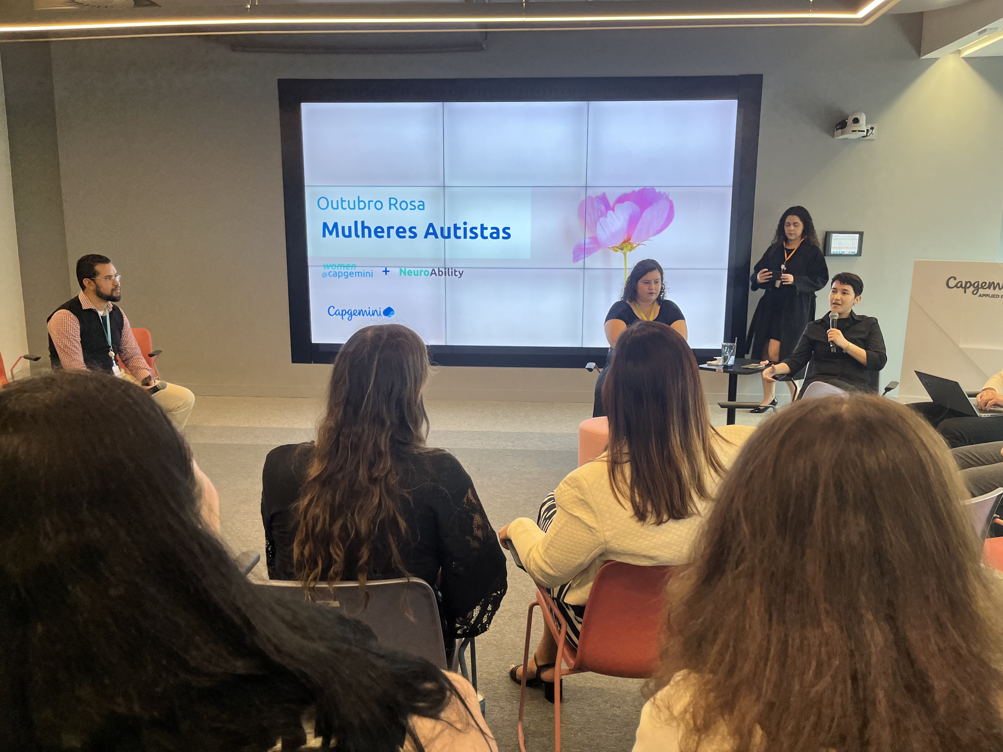

ADAPTING OUR
WORKPLACE
RECRUITMENT
SYSTEMS
WORK TOGETHER
In Brazil
Autism awareness day
Partners In UK and US
Belgium Office
Sensory Room
Global Disability etiquette training
450+ People managers trained in India
New Inclusive global guidelines
Neurodiversity explained to Talent Acquisition and HR
Self ID possibility
and accessible features
Company Confidential © Capgemini 2025. All rights reserved
#ZeroCon25
6

Slide 7
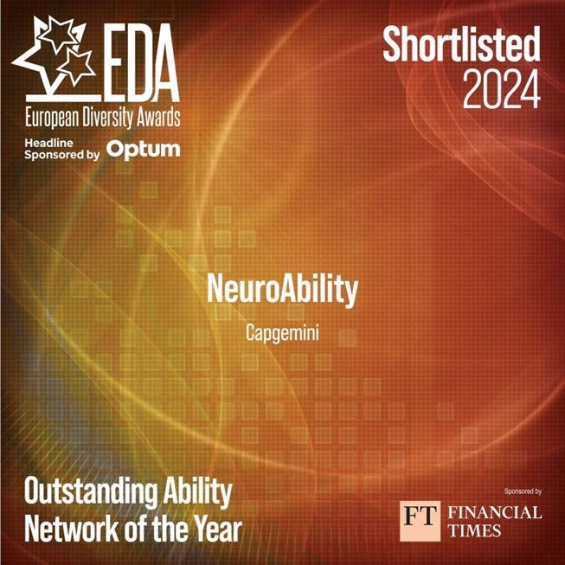
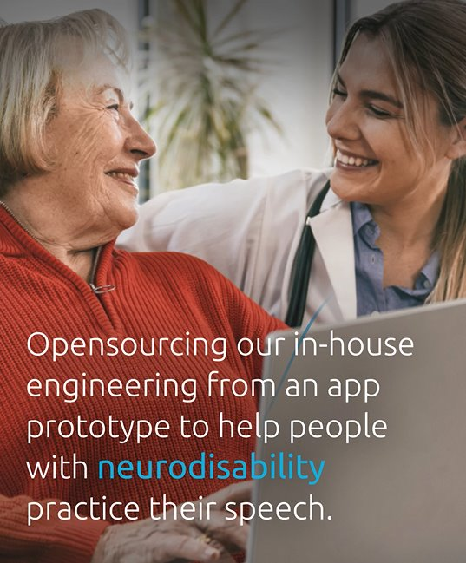
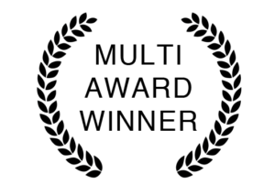
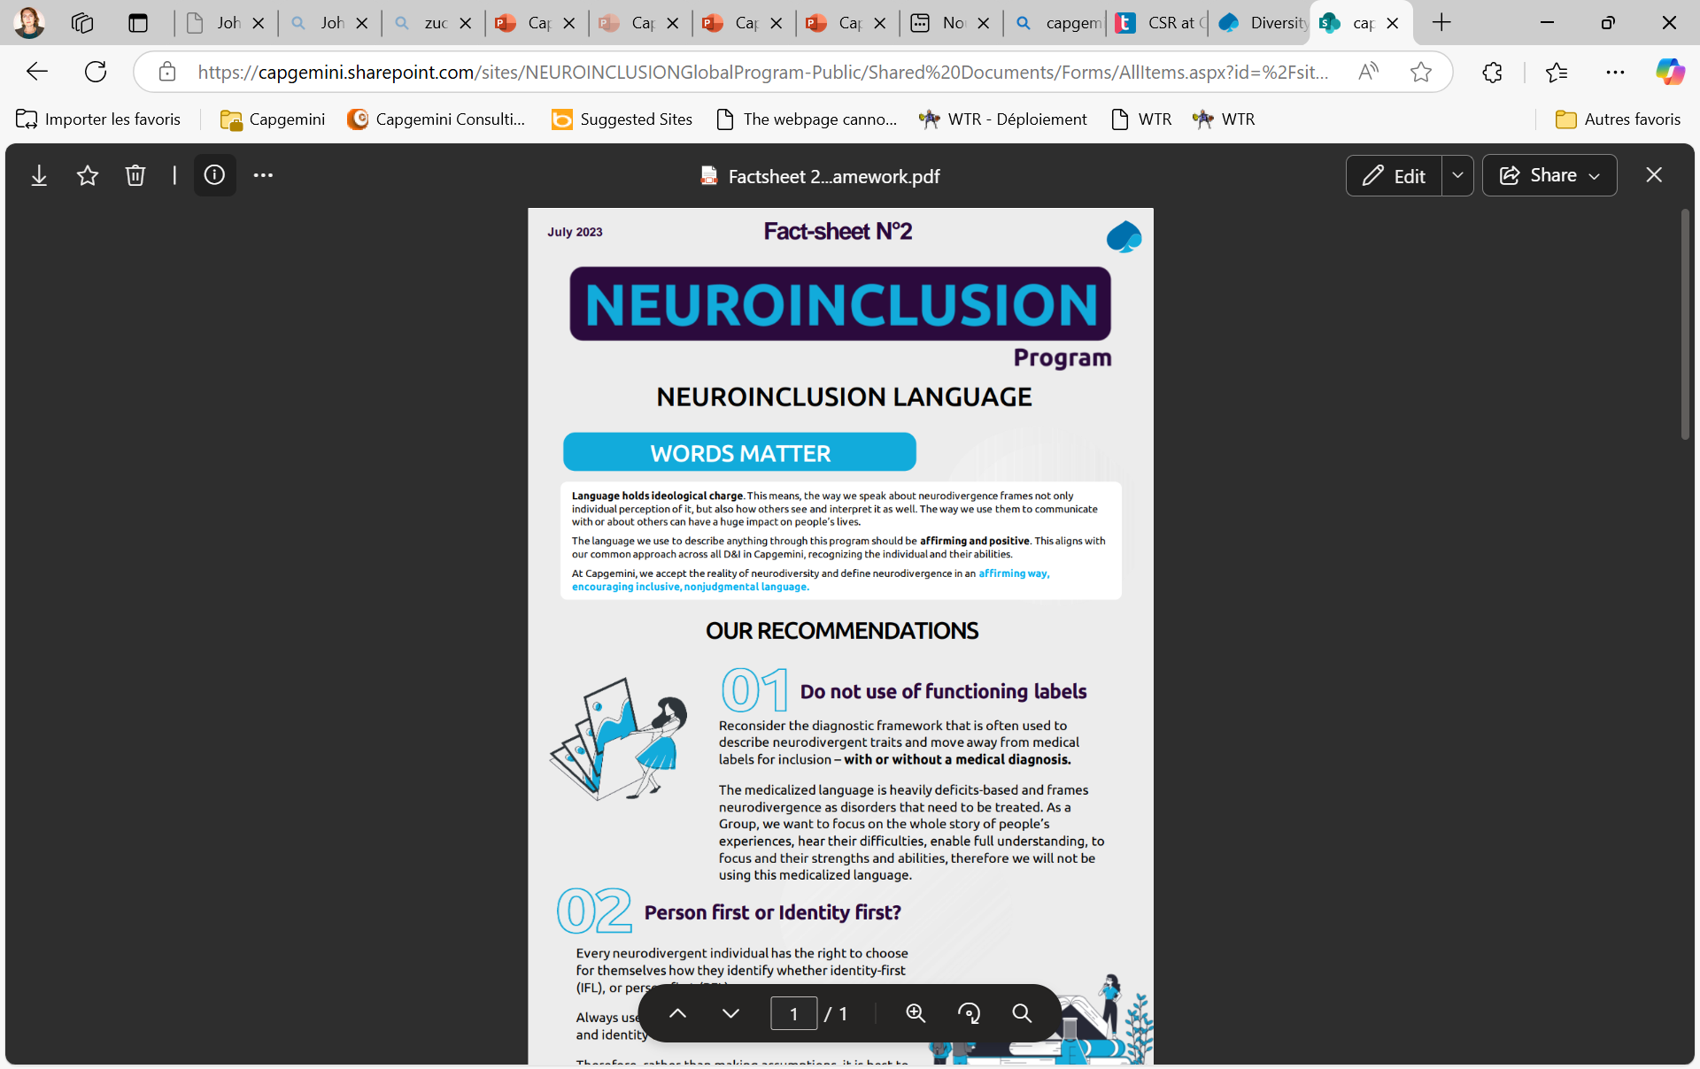
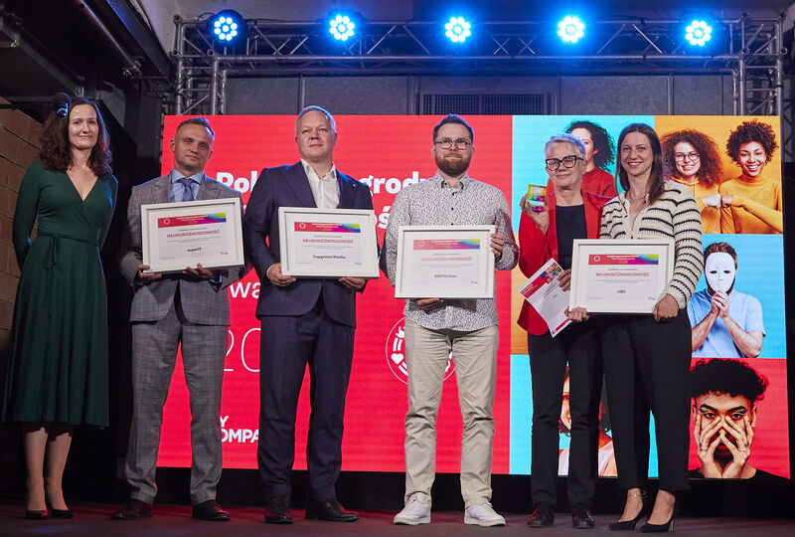






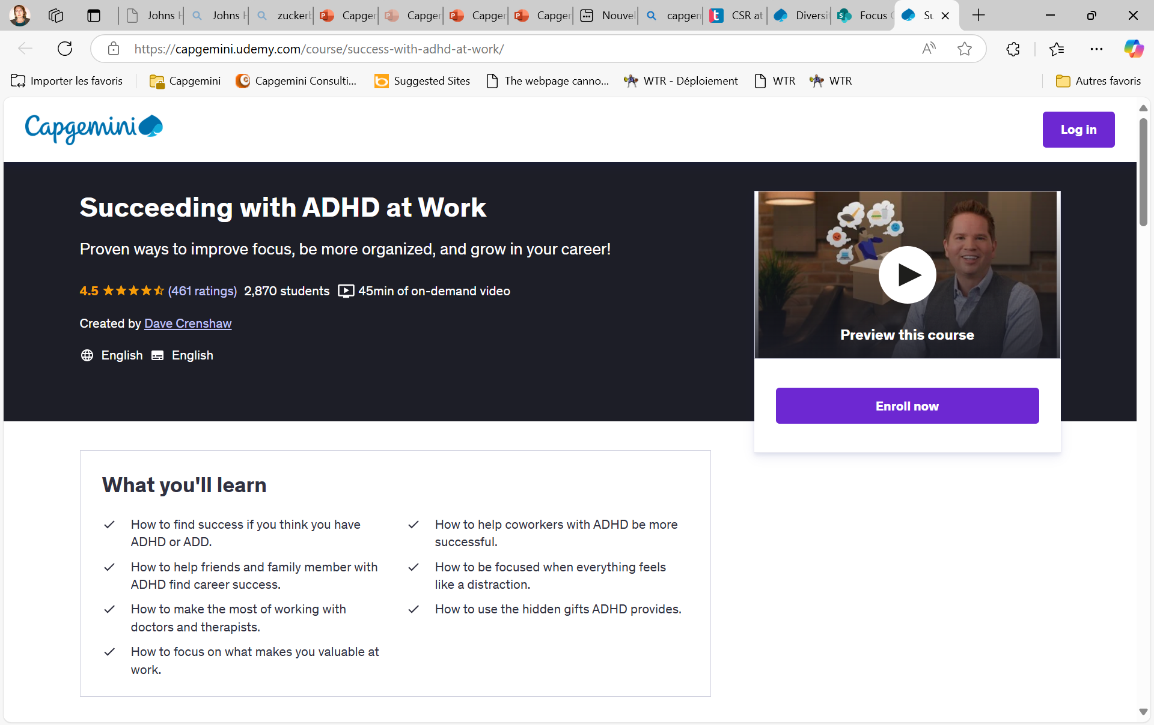
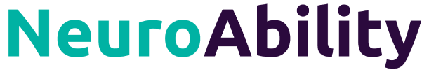
EMPOWERING THROUGH
TRAINING & COMMS
EMPLOYEE
NETWORK
NEUROABILITY
APPS
COMMUNITY
PROGRAMS
For ALL
Digital Seeds
Volunteer Program
For our Neurodivergent colleagues
In-house app for neuro-ability speech practice
Innovative learning strategies for neuroatypical children
In Australia, India, New Zealand, Brazil, UK, Poland
Company Confidential © Capgemini 2025. All rights reserved
#ZeroCon25
7

Slide 8
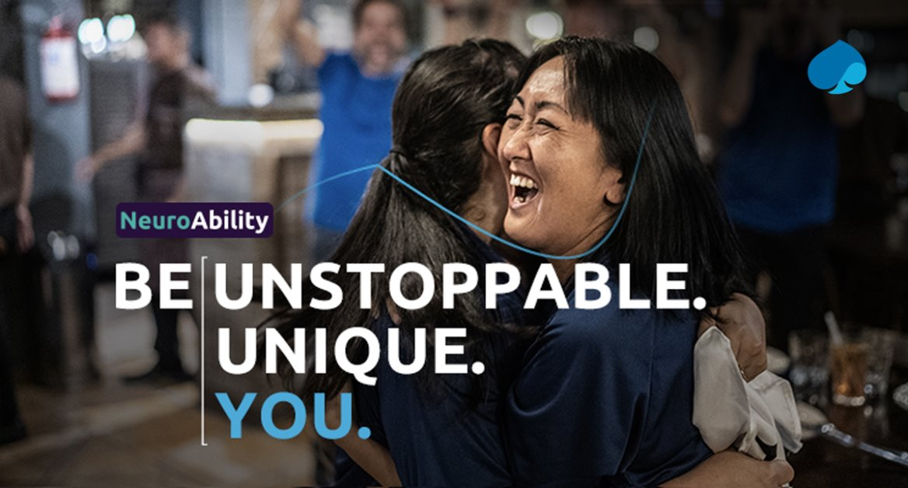
NEXT STEPS
Strengthening Our Global Framework

