Slide 1

EPN Consulting Research and Innovation
Dublin, Ireland

Slide 2
EPN Consulting Research and Innovation Ltd. was established in Dublin (Ireland) in February 2022 by Dr Ing Stefano Mainero who, previously in 2009, founded EPN Consulting Ltd. in London.
The Dublin-based company carries out Research & Innovation activities on Smart & Sustainable Transport, Smart Cities, Climate Change Adaptation and Resilience, and Circular Economy, thanks to an international team of high-level professionals boasting decades of experience and a network of 3,000+ professional contacts in Europe.
Besides, EPN Consulting R&I provides advice to professional clients (SMEs, Start-Ups, large organisations, Local & National Authorities as well as Universities) on how to convert innovative ideas into EU-funded projects and help them manage projects once approved for funding.

Slide 3











EPN Consulting Research and Innovation Ltd. aims to meet the following UN SDGs
Main topics
Inter-connected topics

Slide 4

EPN Consulting Research and Innovation Ltd. works on the following fields

Slide 5
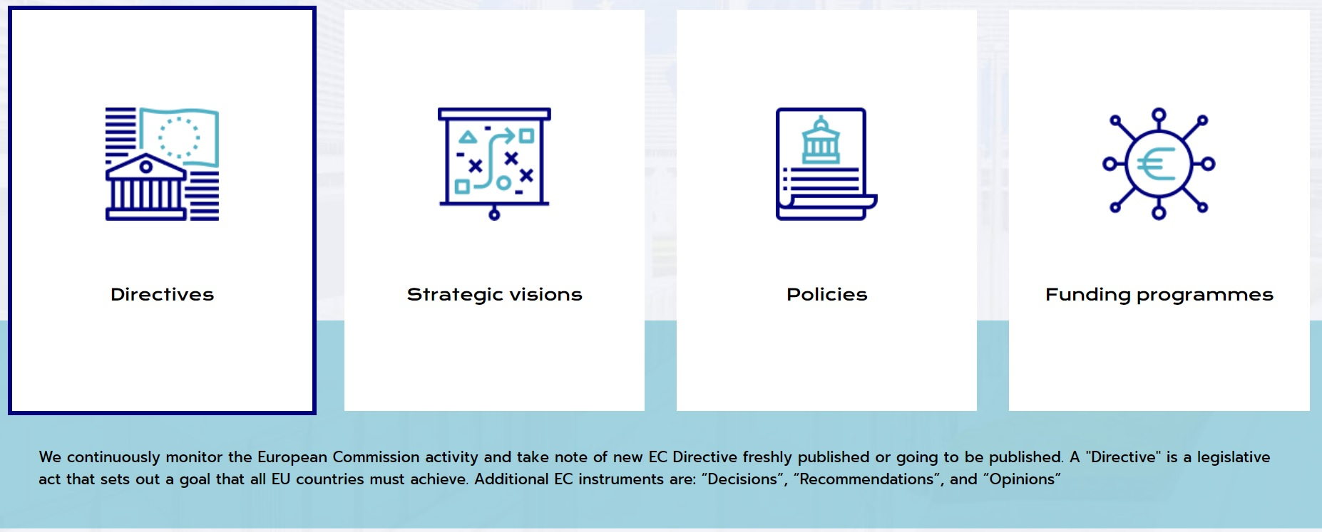
EPN Consulting Research and Innovation Ltd. works on the EU Projects and Affairs

Slide 6


EPN Consulting Research and Innovation Ltd. is part of:
The Sustainability@GEC Cluster
GEC=Guinness Enterprise Centre, an excellent business incubator based in Dublin
The ENFUSE Programme, sponsored by the Dublin City Council
The project designed by EPN Consulting R&I and implemented by a team of students of the National College of Ireland has been added to the finalists list

Slide 7
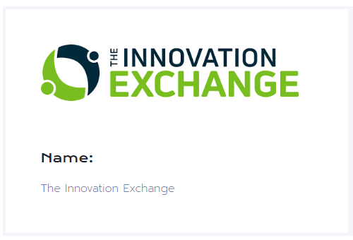

EPN Consulting Research and Innovation Ltd. is Member of:
The Innovation Exchange Programme (Dublin)
It facilitates the collaboration between Irish SMEs and large multinationals to boost innovation
The Dublin Chamber of Commerce
It gives the opportunity to network and connect with over 1,300 of fellow member companies

Slide 8
EPN Consulting Research and Innovation Ltd. contact details
Address: Guinness Enterprise Centre, Taylor’s Lane, Dublin, D08 YE0P, Ireland
Website: https://EPNConsultingResearch.eu
- Twitter: @EPNConsResearch
- Facebook: @EPNConsultingResearchLtd
- Instagram: @EPNConsultingResearch
- LinkedIn: https://www.linkedin.com/company/epn-consulting-research-innovation-ltd/

