Slide 1

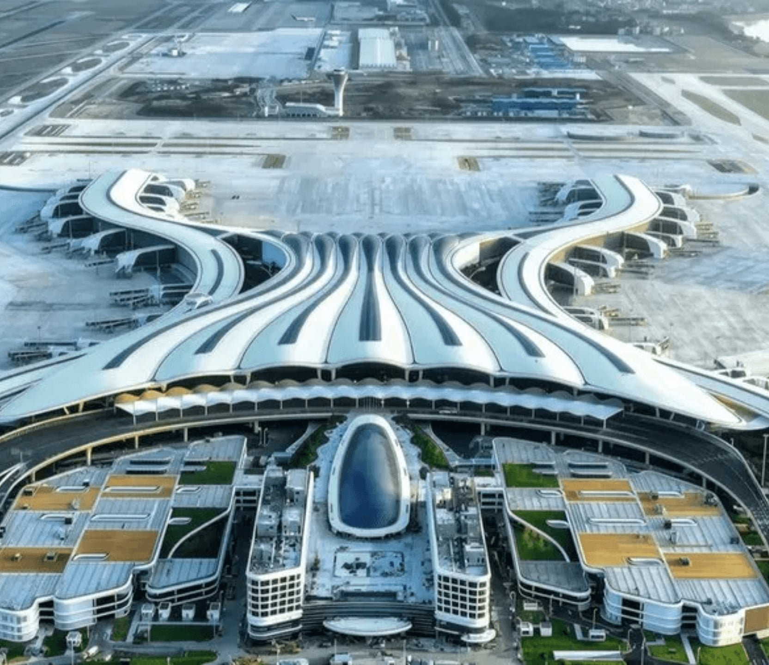
SKIES CENTER:
SINO
KNOWLEDGE
INTERNATIONAL
EXHIBITION &
SPORTS
CENTER
A Global Oasis for Joint Venture Model:
Strategic Technology Interflow & Portfolio Diversification
（Close to the Tier-1 City Airport）
Presented by: Addie Choy
Strategic China Advisor & Official Government Mentor

Slide 2
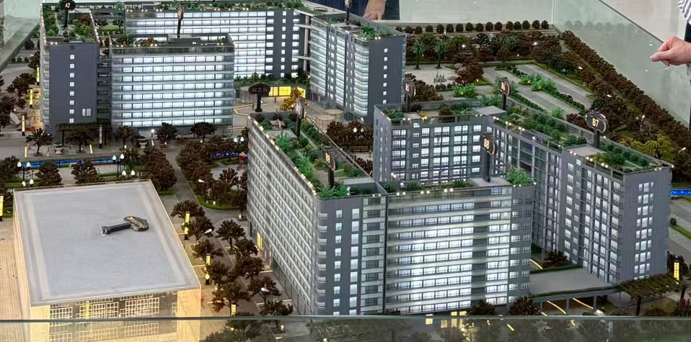
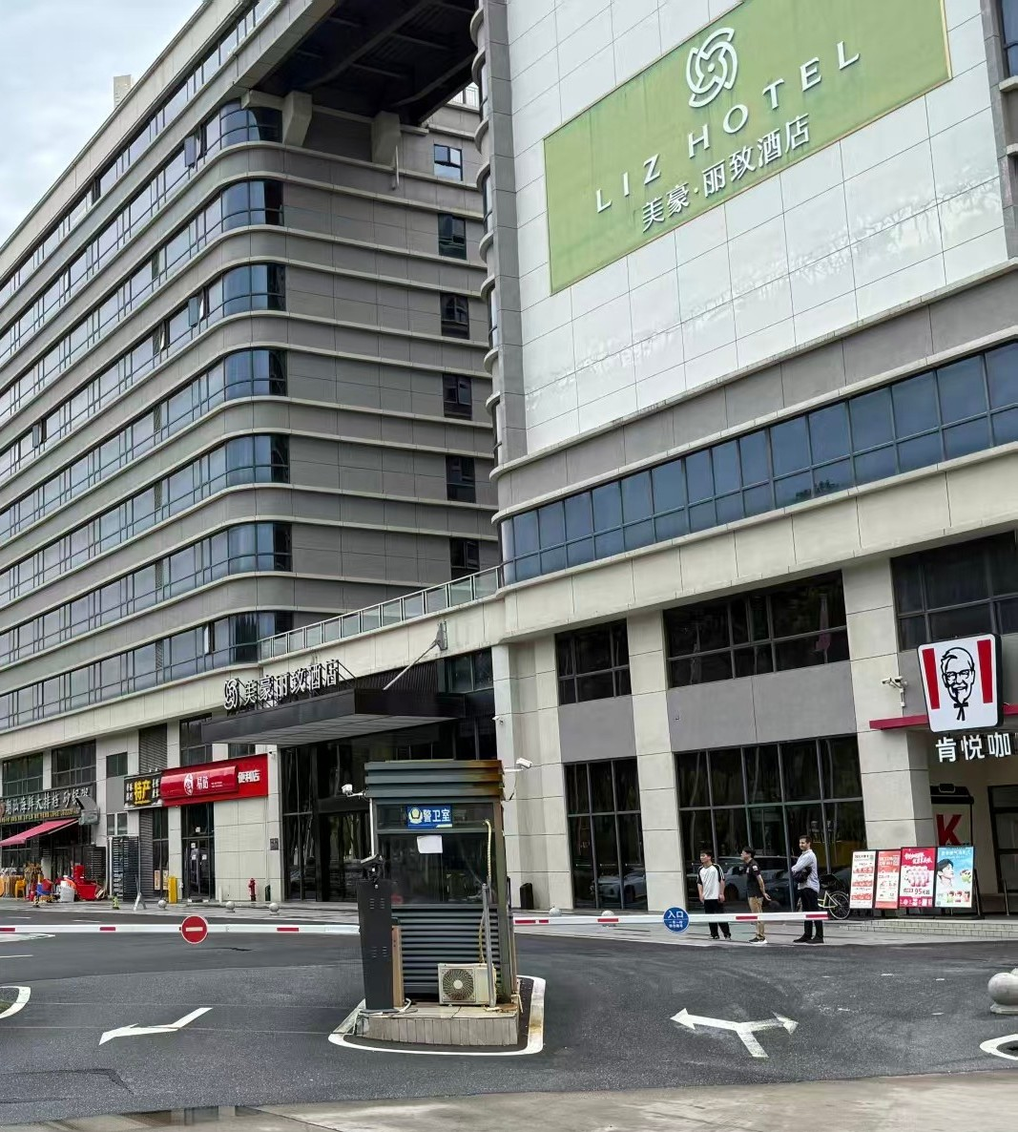
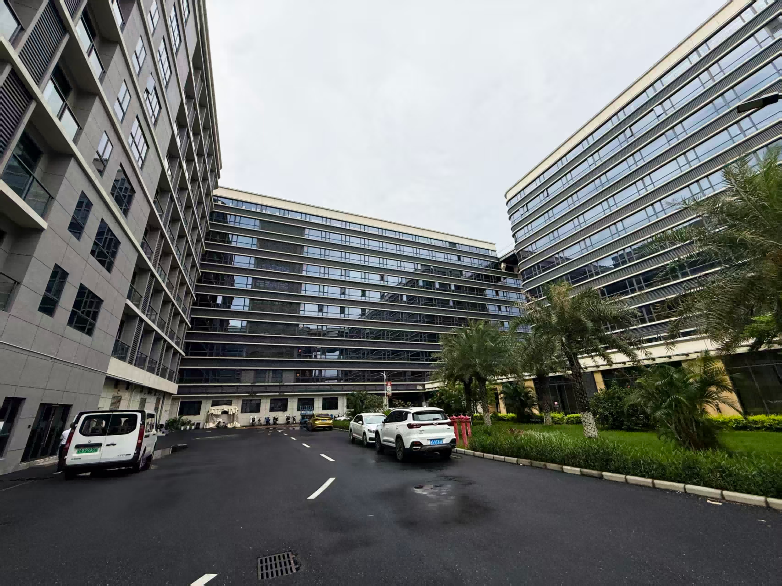
https://www.linkedin.com/in/addie-choy-elite/

Slide 3

THE JOINT VENTURE(JV ) MODEL:
REVERSE TECH TRANSFER
Past
NOW
Others is learning from China.
Leverage the Sino-Foreign JV framework to secure IP Sovereignty in EVs, Robotics, and Green Tech.
China learned from the west by Joint Ventures
"The flow of knowledge is no longer a one-way street. Western firms now form JVs to access Chinese tech and manufacturing speed."

Slide 4
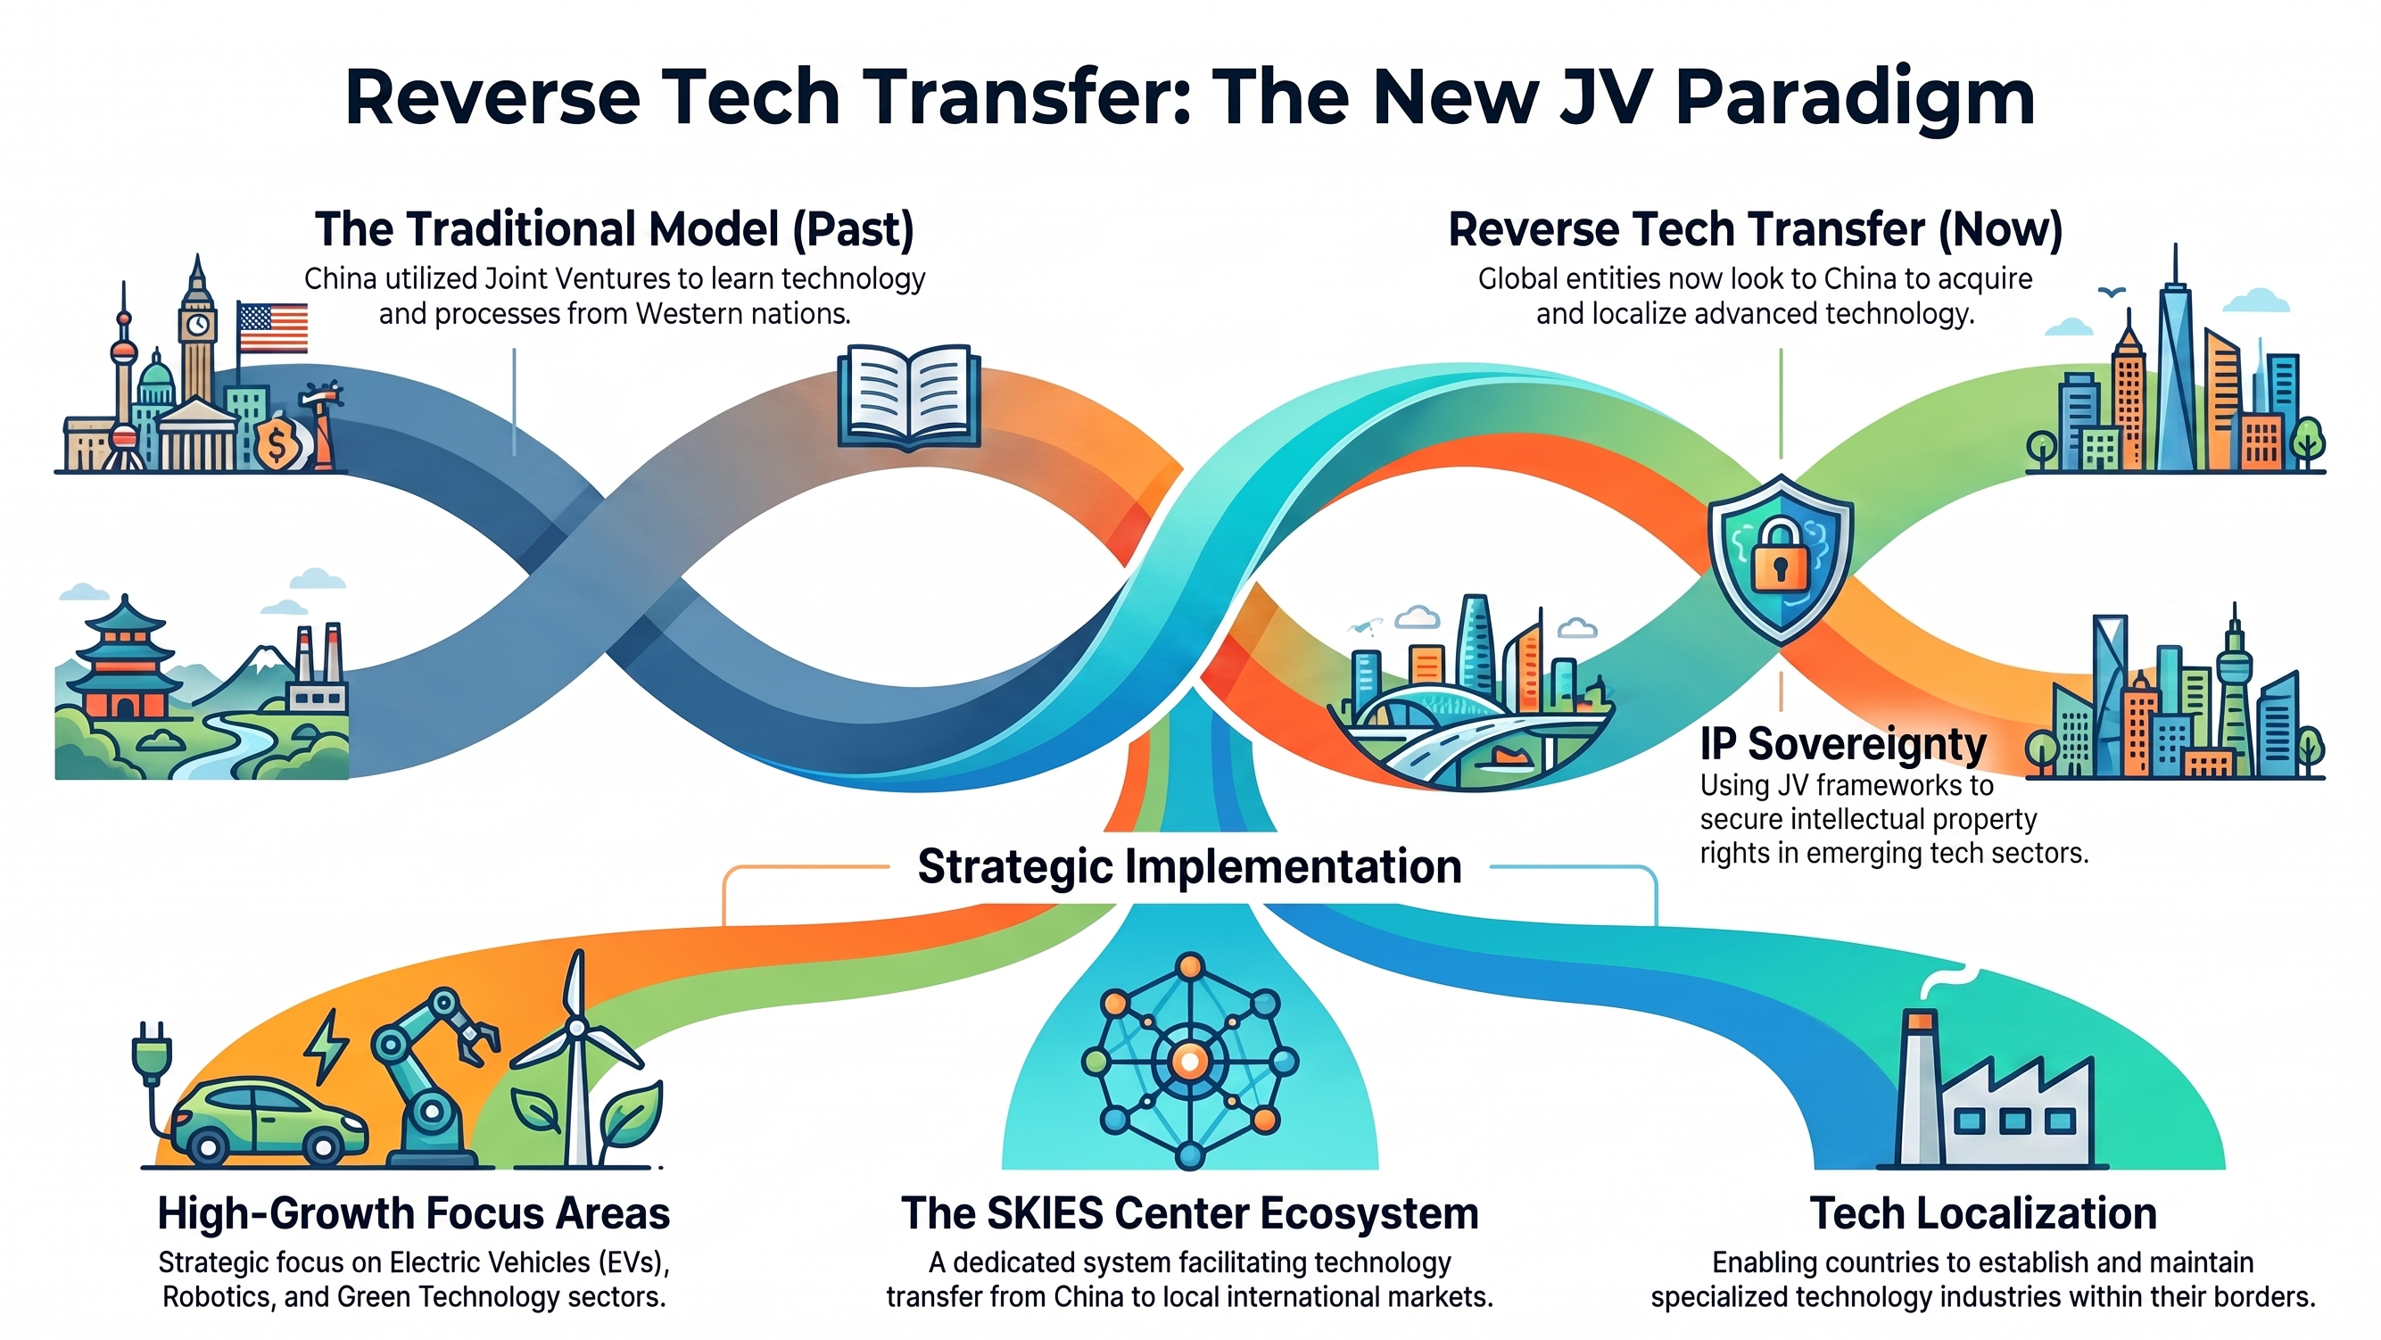

Slide 5
Four Zones — Four Functions in SKIES Center
Zone A + B
Talent Residence Hub: Dual-residency model
Zone C
China–Knowledge Summit Platform
Hotel Cluster · 1,546 Keys · 10 Brands
Convention Centre · GFA 14,500 sqm · Approved · Unbuilt
Fixed-rent income: USD 6.11M NOI p.a.
Passive landlord — zero operational risk
24-hr airport shuttle — rotation-ready
Owned by project owner — full control
Annual China Tech & Sports Summit
MICE hub: corporate delegations, govt missions
Aircraft display capability (aviation niche)
Convention LUR to Oct 2064 — 38.6 yrs
:
:
Zone D
Business Liaison & JV Centre
Zone E
China Sports Training Base
Back-Office / Admin · 3,888 sqm · Operational
Sports Ground · 22,101 sqm · 33 mu · Unbuilt
MISA registration support for Chinese firms
Dual-residency structuring desk
RHQ pre-deployment preparation centre
Soft-landing hub for JV: legal, visa, culture
Sports professionals train in China
Chinese sports science + esports showcase
Naming rights: Sports Commission
Esports facility — National Gaming Strategy
Adjacent to 120M PAX airport by 2035
https://www.linkedin.com/in/addie-choy-elite/

Slide 6

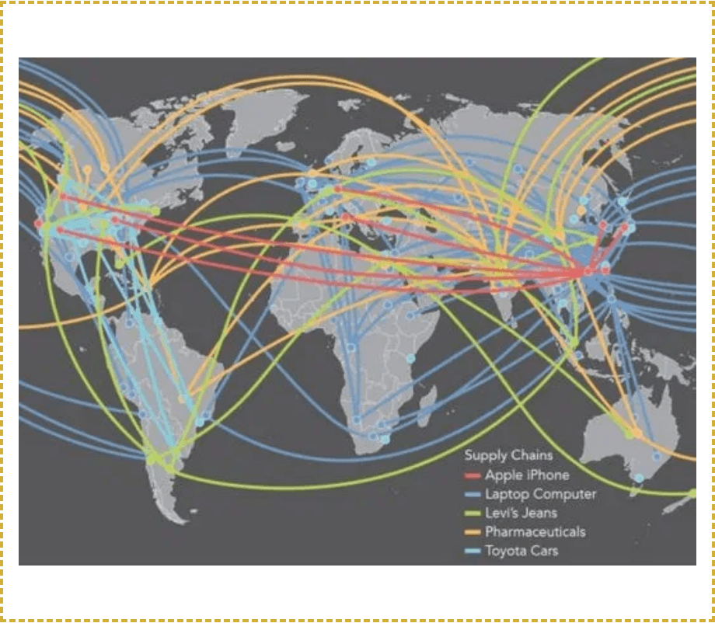
SKIES CENTER REDUCE
GEOPOLITICAL
RISK.
Diversify portfolios over-allocated to US assets (60%+).
All incomes generated from JV are denominated in Chinese yuan.
Source: Global Strategic Risk Index 2026

Slide 7
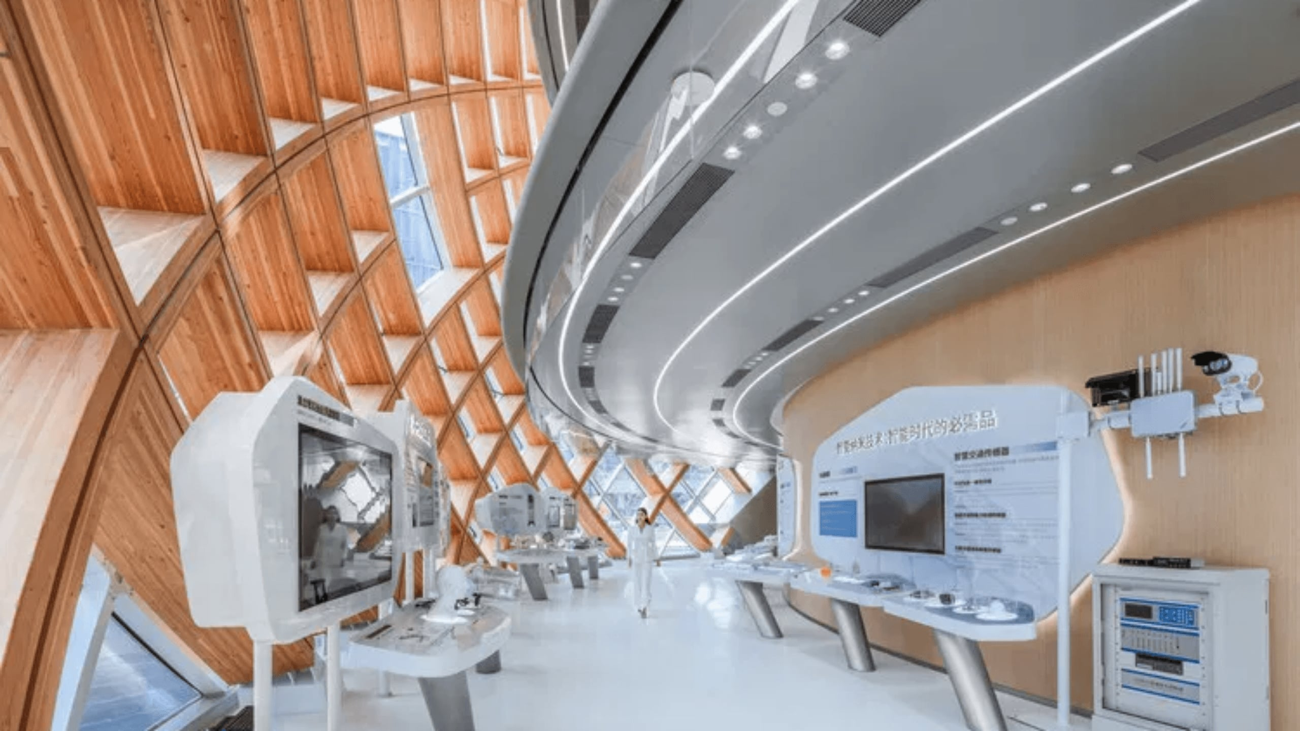
YOUR TECH OASIS
In the Heart of the Greater Bay Area
SKIES CENTER: DIVERSIFY & SECURE

Slide 8

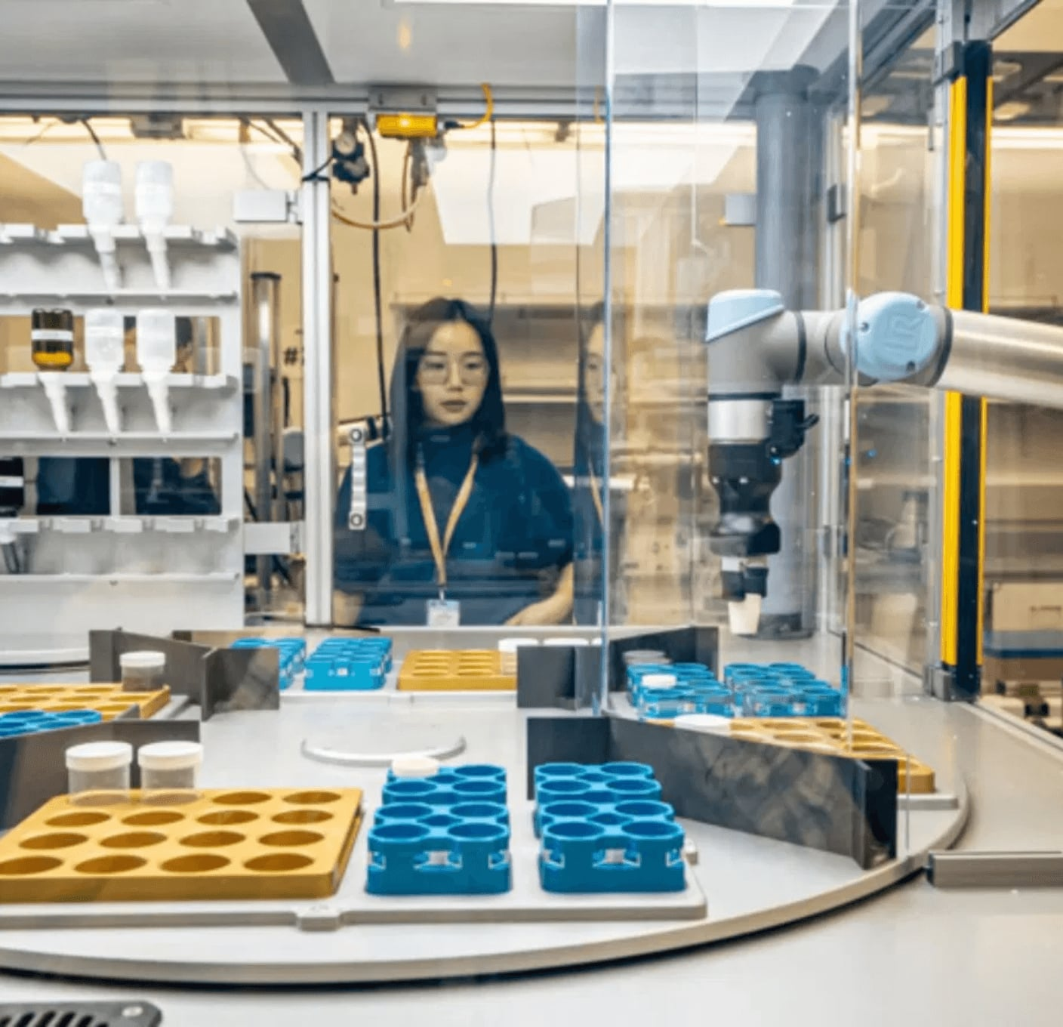
AGGREGATING
CHINA'S
ELITE R&D
Centralizing AI, Robotics, and 5G research to facilitate structured technology transfer.
SKIES CENTER: THE TALENT ENGINE

Slide 9

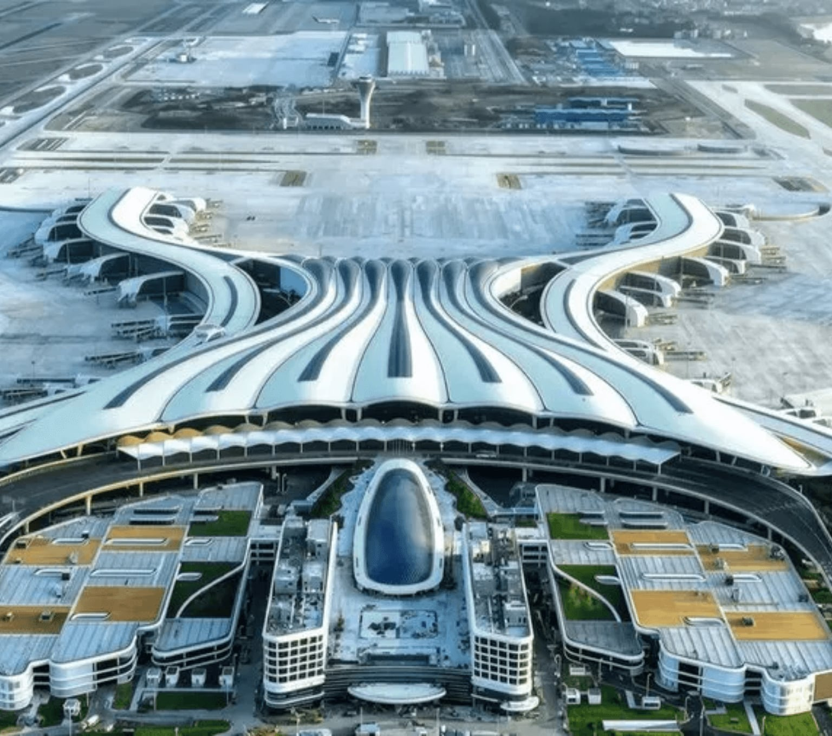
GLOBAL
CONNECTIVITY
120M+
Annual Passengers by 2035
#1
Global Tech Ecosystem Gateway
24/7
Tier-1 City Airport in China
Seamless Airport-to-Hub Access

Slide 10

BUILD YOUR OWN
DOMESTIC INDUSTRIAL DEPTH
01
02
03
R&D ACCESS
TECH KNOW HOW TRANSFER
LOCAL PRODUCTION
Secure core IP and material processing from China's elite tech clusters.
Adopt proprietary manufacturing logic and automated production stacks.
Establish self-sustaining domestic lines independent of external geopolitical actors.
STRATEGIC AUTONOMY: FROM CONSUMER TO OWNER

Slide 11
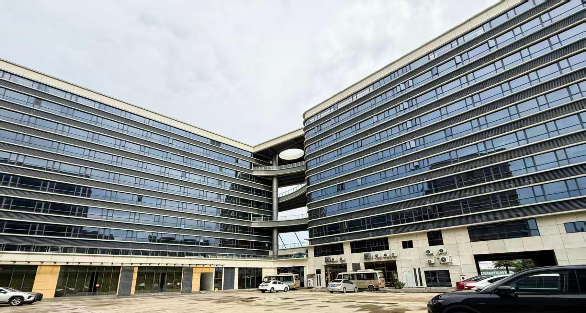
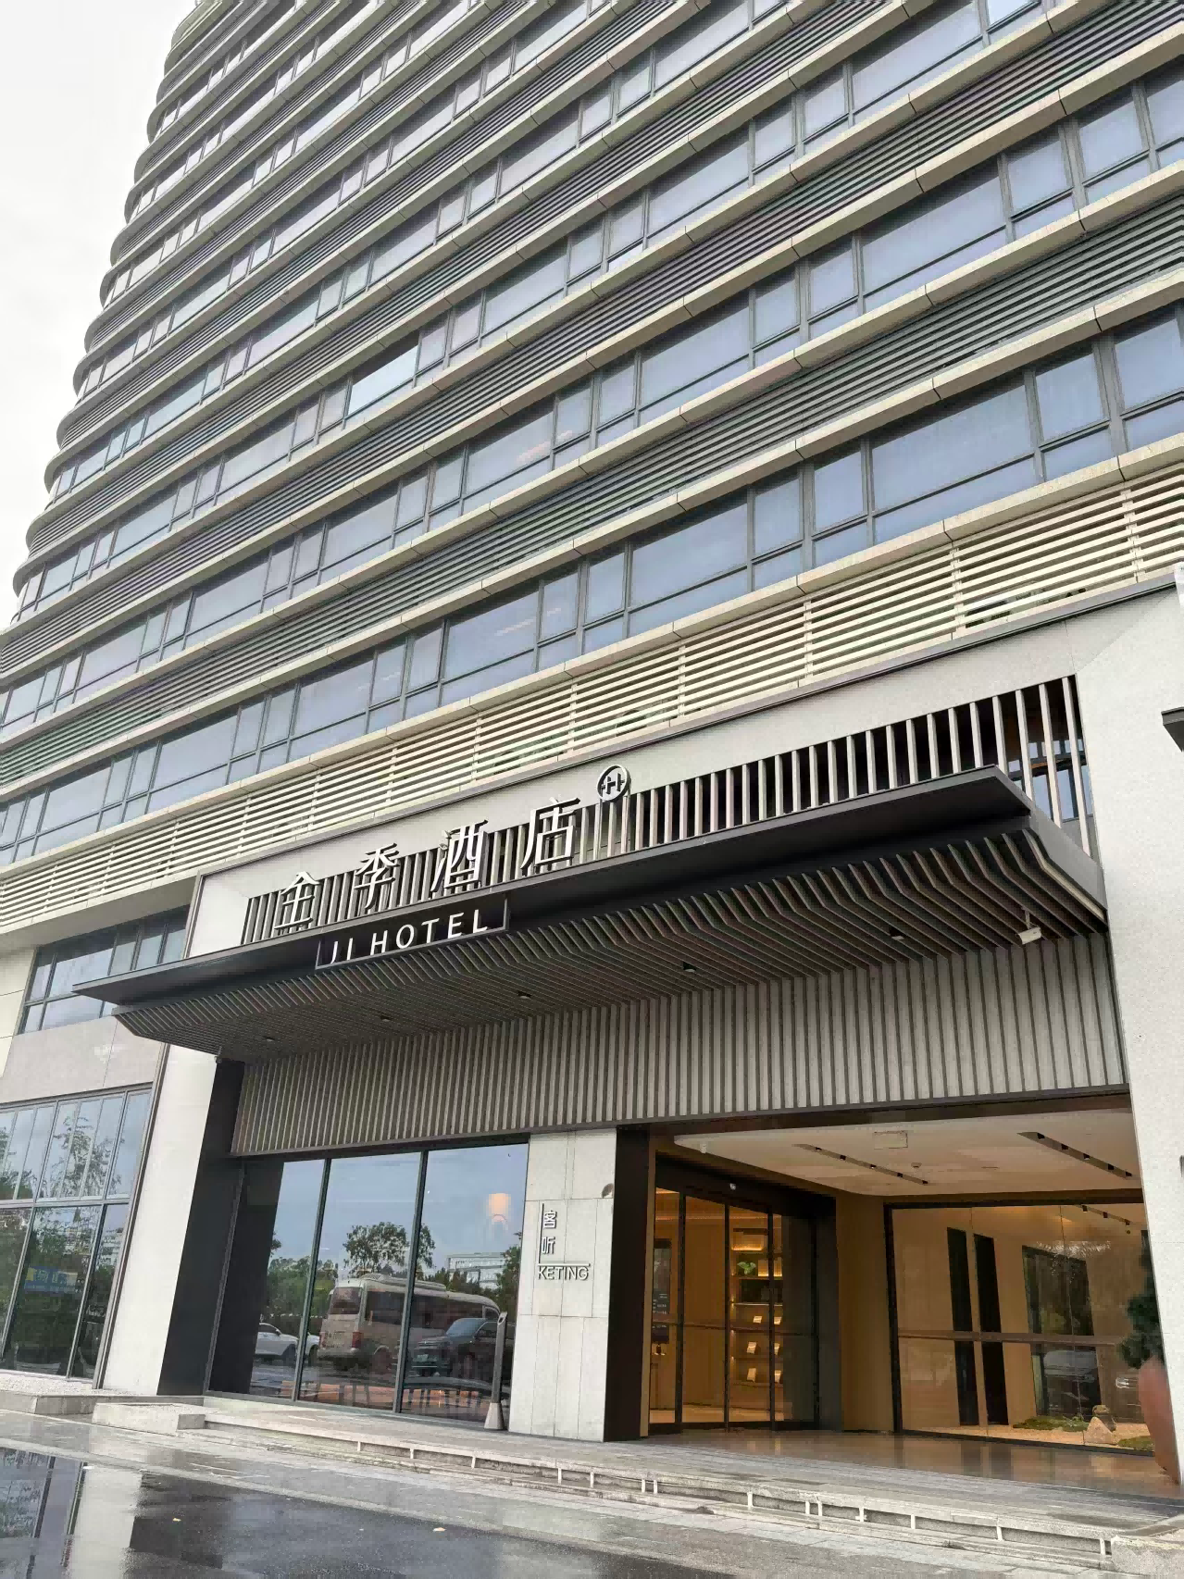
https://www.linkedin.com/in/addie-choy-elite/

Slide 12
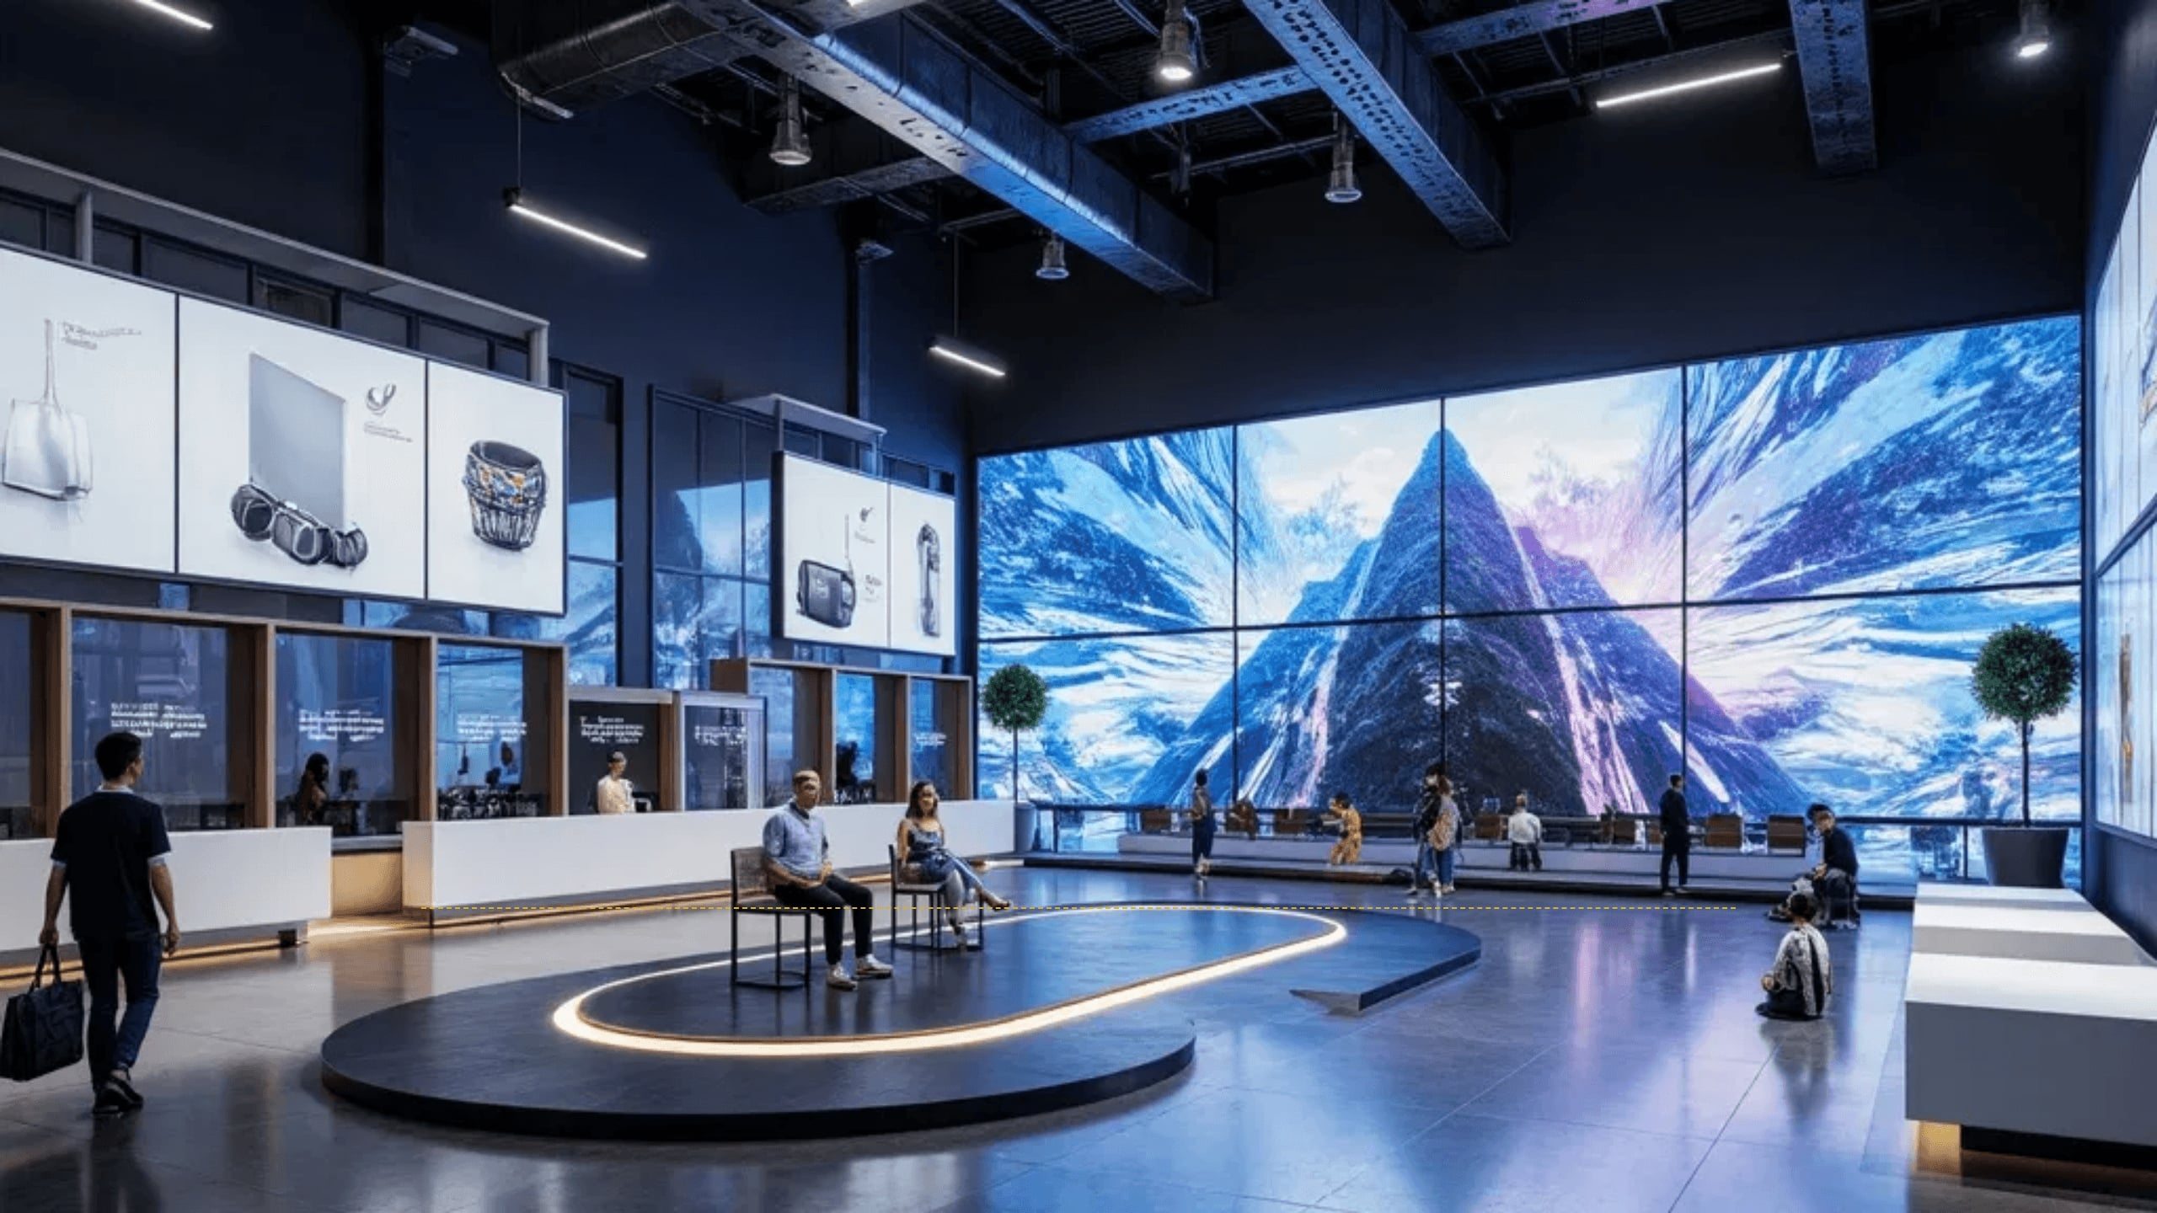

DIVERSIFY.
SECURE. LEAD.
"In an era of uncertainty, the most valuable asset is strategic autonomy. Secure your tech oasis today."
ADDIE CHOY
STRATEGIC CHINA ADVISOR & OFFICIAL GOVERNMENT MENTOR
linkedin.com/in/addie-choy-elite

