Slide 1
Promoting Accessibility at African Universities:
The CapAble Platform and USIU Disability Inclusion Practices
Erika Bojarczuk - L88ight for the World, Uganda
Eannes Ongus - USIU-Africa, Kenya
Inclusive practices in universities and higher education institutions
Wednesday, February 21, 2024; 13:40 – 15:00 CET
Notes:
Please add your notes here.
Title; First name, last name of speaker(s); Name of Organization, Name of Country, Name of Session (as written in Agenda)
#ZeroCon24
Day and Time of Session

Slide 2
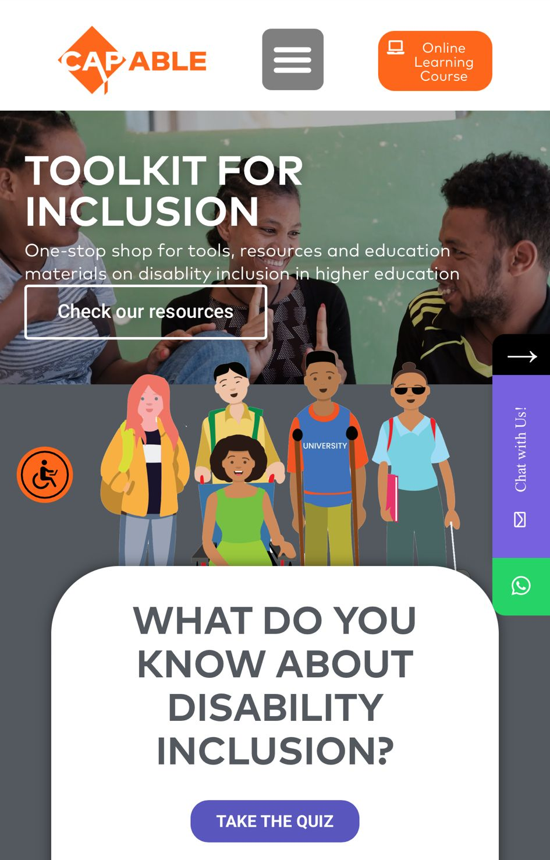
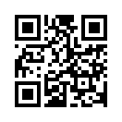
The CapAble Platform
The CapAble Platform was launched in December of 2021
Online resource platform, sharing practical tools to support disability inclusion
Designed in an African context to have a global reach
The CapAble platform has reached over 30,000 unique users across Africa and around the world
Visitors have explored our Awareness Game, the Assistive Technology Hub, an eLearning course, and best practice stories
Seeing impact beyond our initially intended audiences
Notes:
Hello, my name is Erika Bojarczuk, I am the Content Development and Documentation Specialist at Light for the World working on the We Can Work Program.
The CapAble platform was launched in December of 2021, developed by Light for the World to support the Mastercard Foundation Scholars Program to become disability inclusive.
Since the launch of the platform, we have reached over 30,000 users globally
CapAble serves as an online resource platform, sharing practical tools to support disability inclusion, a board game, an assistive technology hub, an e-course on the basics of inclusion in higher education, and best practice stories from across the African Continent.

Slide 3
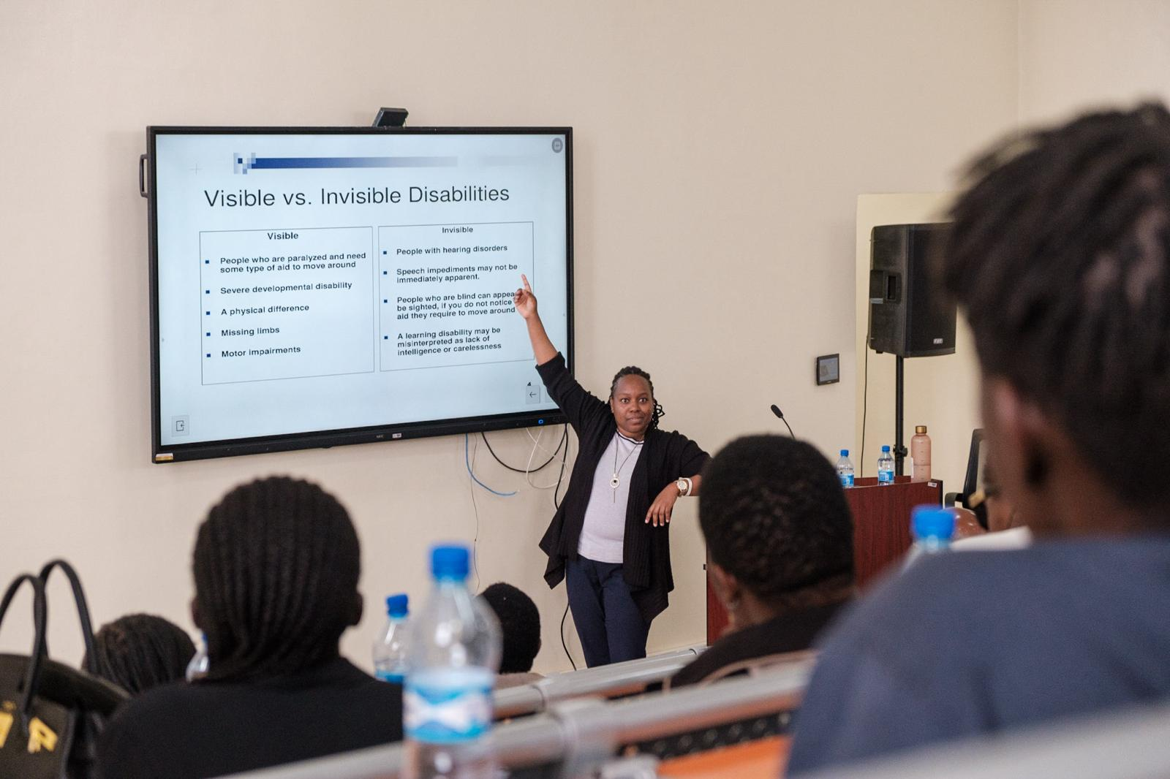
Enablers for success
Diverse technical support strategy for Mastercard Foundation Scholars Program partners with CapAble at the heart
  Master Trainers program
  Community of practice of university Disability Inclusion Focal People
  Inclusion working group
High level of partner engagement and commitment
Consistent incorporation of feedback on the platform and needed tools and resources
Notes:
Light for the World’s overall approach to technical support to the Mastercard Foundation Scholars Program has enabled the platform to grow for a number of reasons:
First, the Master Trainers program which has trained 70 people at 10 different universities to drive DI on their campuses uses the capable platform as a living digital resource. Trainers regularly use tools and resources to support their work and influence administrations
Secondly, a growing community of practice group made up university disability inclusion focal people meets and shares best practices, which again drives them to the platform for continued support. Their best practices are a way to source stories to keep the platform up to date
And third, a Inclusion Working group meets quarterly and discusses themes related to the content on CapAble. This brings in a wider audience of universities including prominent Universities outside of Africa. One of the most active members in this working group network is USIU Africa, who you will here from shortly to tell you about their inclusion successes and the work that CapAble has supported them with
Lastly, we use all of these groups as a way to tailor the material on the site, and develop tools and resources specially designed to support African Universities with their inclusion needs. We get frequent feedback from partners and are always looking for best practices to share and new tools to develop. The open source nature of the platform has allowed those outside of these groups to participate in the learning as well.
Overall we have see

Slide 4

Next Steps for CapAble
Scale up content to fit a wider audience under the We Can Work program – in partnership with Mastercard Foundation in 7 African Countries
More interactive functionalities, building a community around disability inclusion
Continued support to Mastercard Foundation Scholars Program Partners with more opportunities for transition to work
Further expand on gamification of learning
Grow our engagement and user base
Notes:
Content on the CapAble platform will be scaled up to provide inclusion tools outside of the higher-ed space, and will be able to serve the development sector more broadly.
With this scale up, you can look forward to more opportunities for interaction with others working in the space and hear the voices of young women and men with disabilities more directly. We hope to develop a thriving community centred on disability inclusion and we would love you all to be a part of it.
As we expand the platform, we will continue to strive to make CapAble as engaging as possible, and are excited to work towards gamifying the platform to incentivise active readership.
The support to Mastercard Foundation Scholars Program partners will continue and will include support to Young Africa Works Partners as well through the We Can Work program

Slide 5
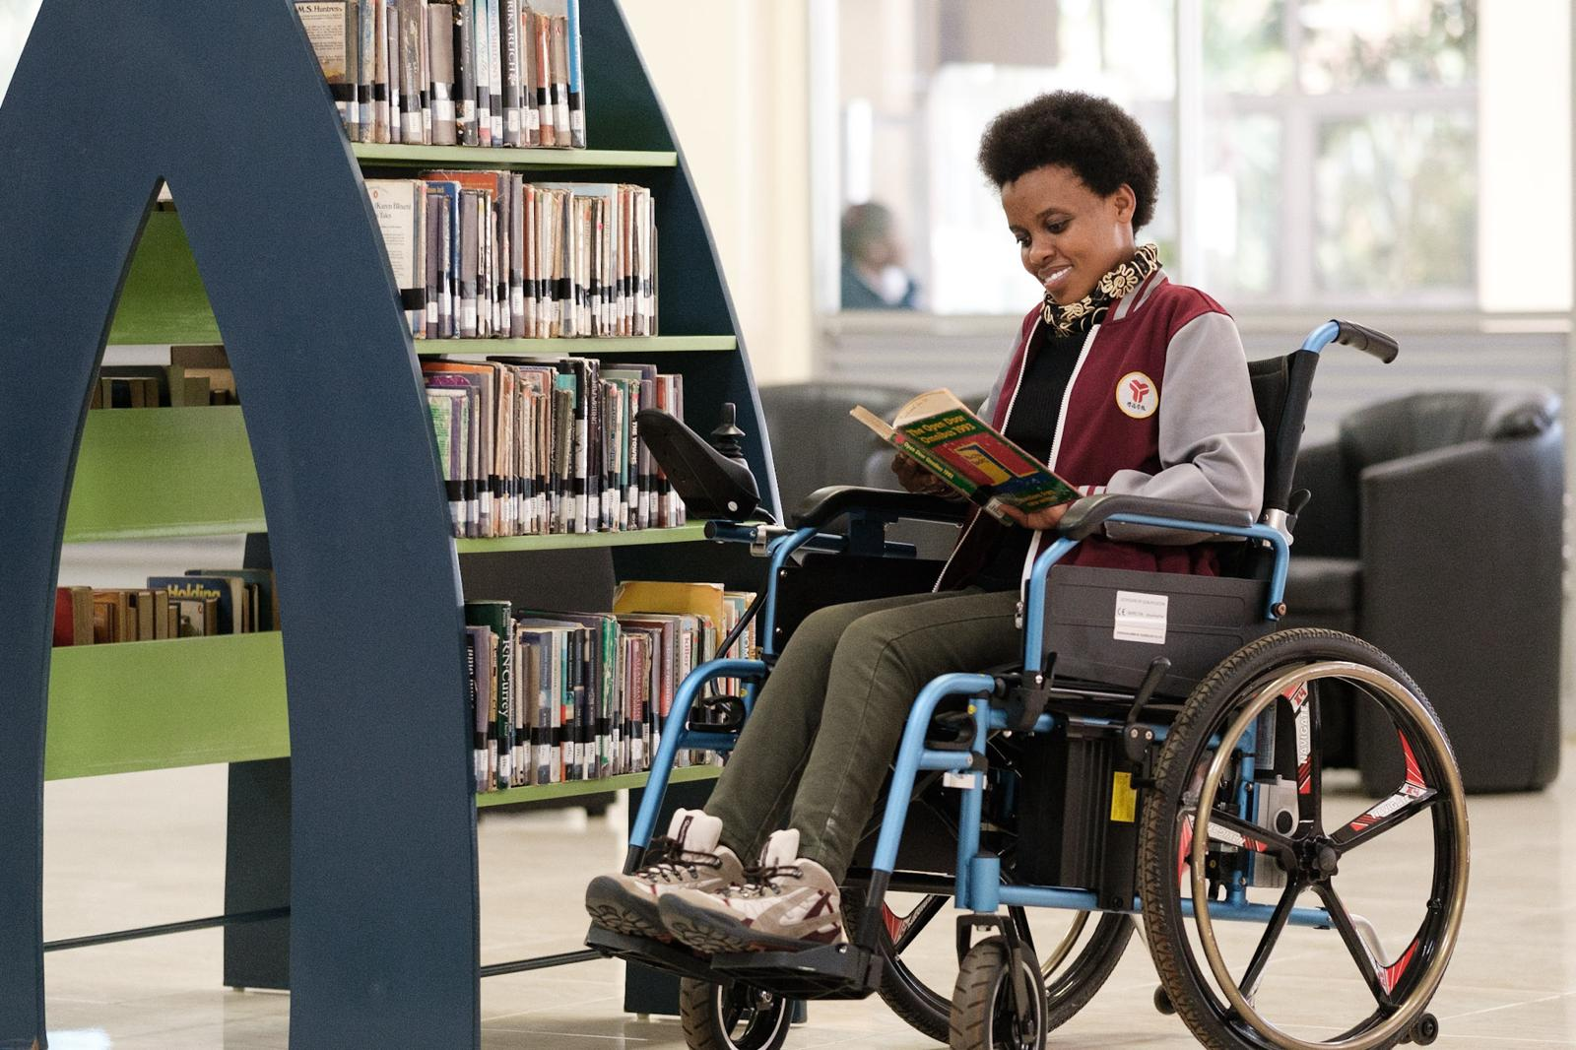
Key Successes at United States International University - Africa
Through a partnership with Light for the world and Mastercard Foundation, the university number of Students with Disability has grown from 5 in the year 2020 to 72 in the year 2024.
The university now recruits students with all forms of disability across the globe with a focus in Africa.

Slide 6
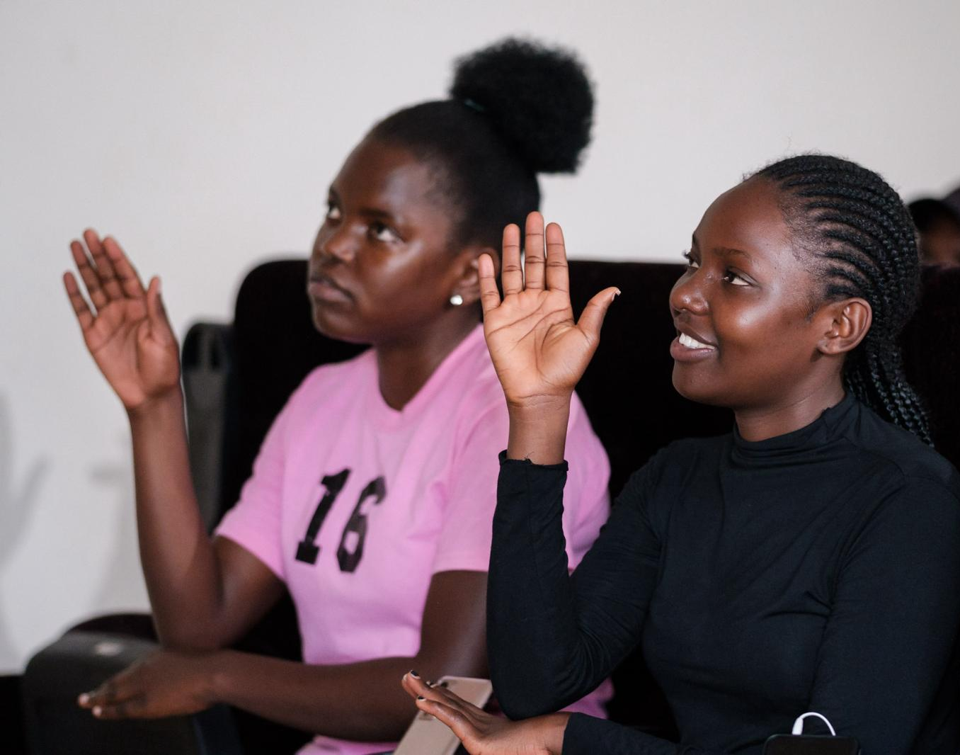
Featured Initiatives– Sign Language Support
Student run Sign Language Club hosting weekly lessons run by students.
Club members come from a variety of backgrounds, and is an opportunity to develop skills that will both further their own careers, and allow them to practice inclusion in their everyday lives.
The club holds awareness and fundraising events and regularly uses them to highlight the unique opportunities and challenges of people with disabilities
Formal Sign Language classes are open to the entire campus community, including university faculty, administration and staff
Notes:
The Club regularly holds awareness and fundraising events as well as performances at other campus events such as Culture Week, Black History Month, Freshmen Orientation, Counseling Centre Disability Week, among others.
The Club regularly uses such events to highlight the unique opportunities and challenges of people with disabilities with a special emphasis on the deaf community in Kenya. The Club also raise funds towards adding more disability-friendly facilities at the university campus such as accessible spectator benches, shade, washrooms and bins at the USIU-Africa sports field.
In addition to the student run club, formal Sign Language classes are open to the entire campus community, including university faculty, administration and staff. These lessons are consistently well attended.

Slide 7
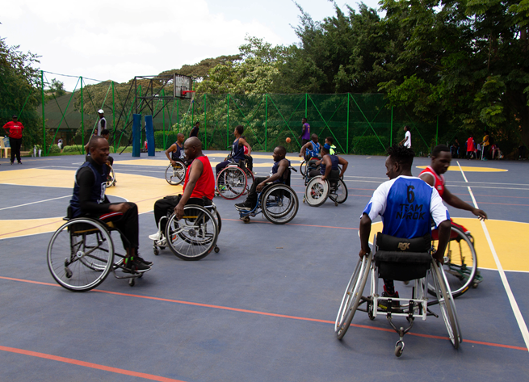
Promoting Access – Disability Inclusion Resource Center
The Center provides guidance and training on assistive technology and adaptive equipment to persons with disabilities
Does regular maintenance of assistive technology devices
Adhere and guide the university on digital accessibility
Coordinate Kenyan Sign Language interpretation services
Support curriculum content and other material adaptation for accessibility
Assist with implementation of Individualized Accommodation Plans and reasonable accommodations for persons with disabilities
Notes:
Sample Slide: presenting three points on our project and the relationship to this year’s theme of the Zero Project Conference. Point 1; Point 2; Point 3 connect together in this way.

Slide 8
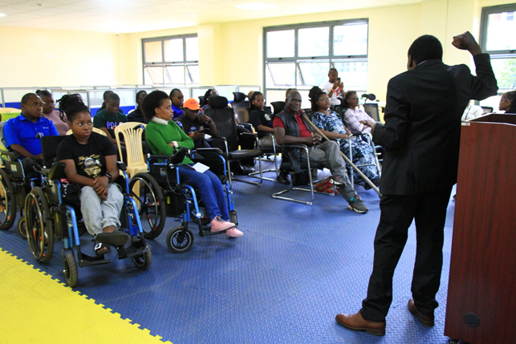
Promoting Access – Institutional Change
A creation of USIU –Africa Disability Policy of 2022 to promote inclusion across the university
A partnership with Mastercard Foundation supported its establishment and equipping
A partnership with Light for the World support skilling through Master Trainer involvement
Learnings from CapAble supported the process and scaling of center activities
Notes:
Sample Slide: presenting three points on our project and the relationship to this year’s theme of the Zero Project Conference. Point 1; Point 2; Point 3 connect together in this way.

Slide 9
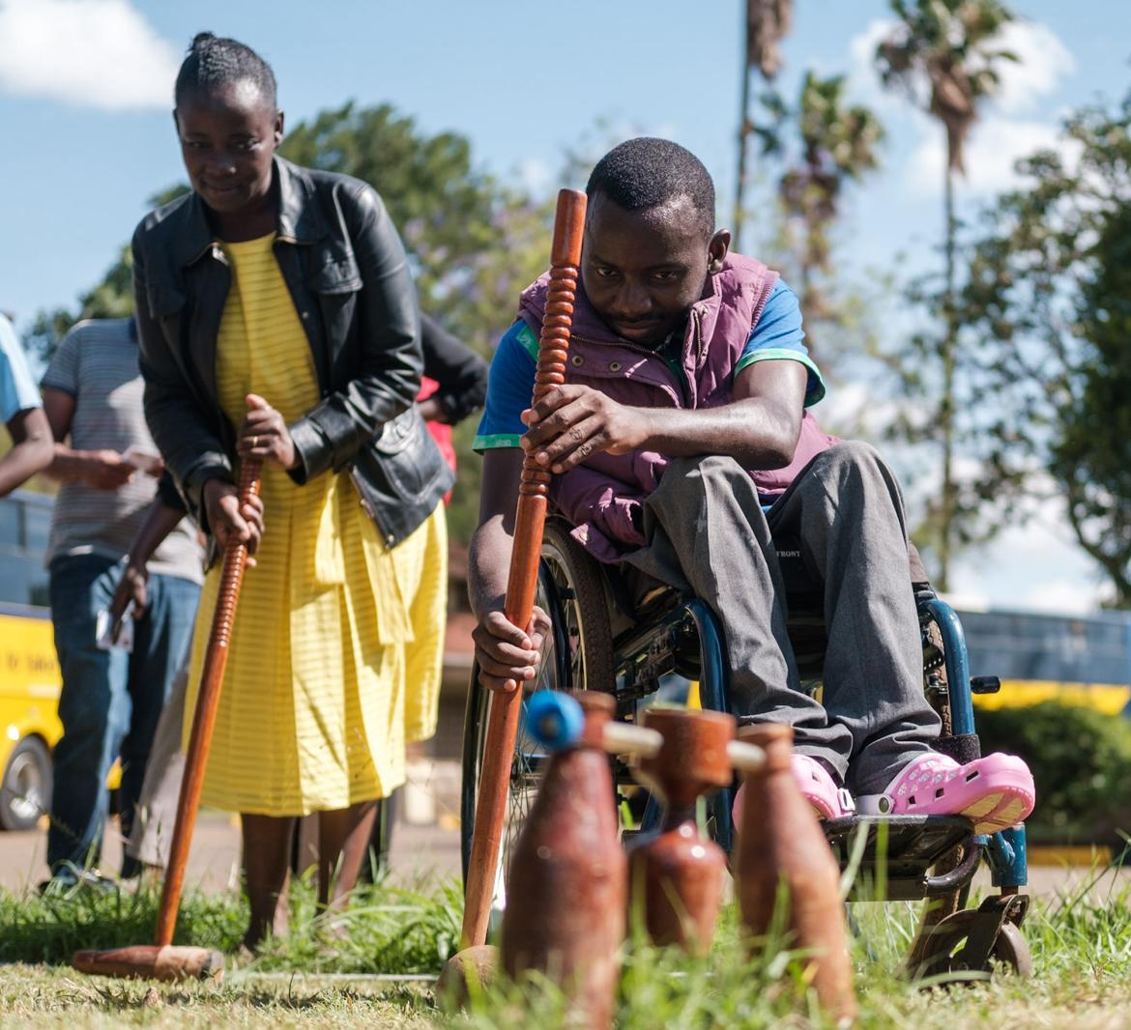
Key Enablers to Success and Next Steps
Partnerships/Collaborations Leadership Support
Systems – Assistive Technology, Hardware, Software, systems
Progressive policies and procedures
Reasonable accommodations Budgets
Investment in capacity building programs
Target 10% of university student population to be persons with disabilities by 2030.
Continue to seek partnerships for inclusion and investment in technology/systems to achieve this ambitious goal.

