Slide 1
A RESPECTED EQUAL & ACCESSIBLE
MEDICAL SERVICE
Michal Menashe Printz
Medical Centers Assuta
Israel
Professionals with Disabilities in Health-Care Careers
Thursday, March 6, 10:20 AM -11:20 AM
Notes:
Please add your notes here.
Title; First name, last name of speaker(s); Name of Organization, Name of Country, Name of Session (as written in Agenda)
#ZeroCon24
Day and Time of Session

Slide 2

ASSUTA'S VISION
ASSUTA shall promote the health and quality of life in Israel by providing quality medical care and health experience, placing the person, his dignity, needs and freedom of choice at the top of its priorities.
Within this vision, we undertake to become a model for excellence in promoting the health and treatment experience in Israel and to be worthy of the trust and hope that our patients and their families have in us.
Notes:
Sample Slide: presenting three points on our project and the relationship to this year’s theme of the Zero Project Conference. Point 1; Point 2; Point 3 connect together in this way.

Slide 3


Accessibility
MORE THAN DEALING WITH PHYSICAL OBSTACLES
Notes:
Sample Slide: presenting three points on our project and the relationship to this year’s theme of the Zero Project Conference. Point 1; Point 2; Point 3 connect together in this way.

Slide 4



Policy & Implementation I Main Domains
Physical accessibility
Accessibility in service
Accessibility in the workplace
Team education & training
Notes:
Sample Slide: presenting three points on our project and the relationship to this year’s theme of the Zero Project Conference. Point 1; Point 2; Point 3 connect together in this way.

Slide 5


Accessible Call & Appointment Center
Various ways of contact
Accessible information
Arranging for further idiosyncratic accessible services
Notes:
Sample Slide: presenting three points on our project and the relationship to this year’s theme of the Zero Project Conference. Point 1; Point 2; Point 3 connect together in this way.

Slide 6


Accessible Information
Audio file
Enlarged font
Braille
Accessible PDF
Sign language
Notes:
Sample Slide: presenting three points on our project and the relationship to this year’s theme of the Zero Project Conference. Point 1; Point 2; Point 3 connect together in this way.

Slide 7
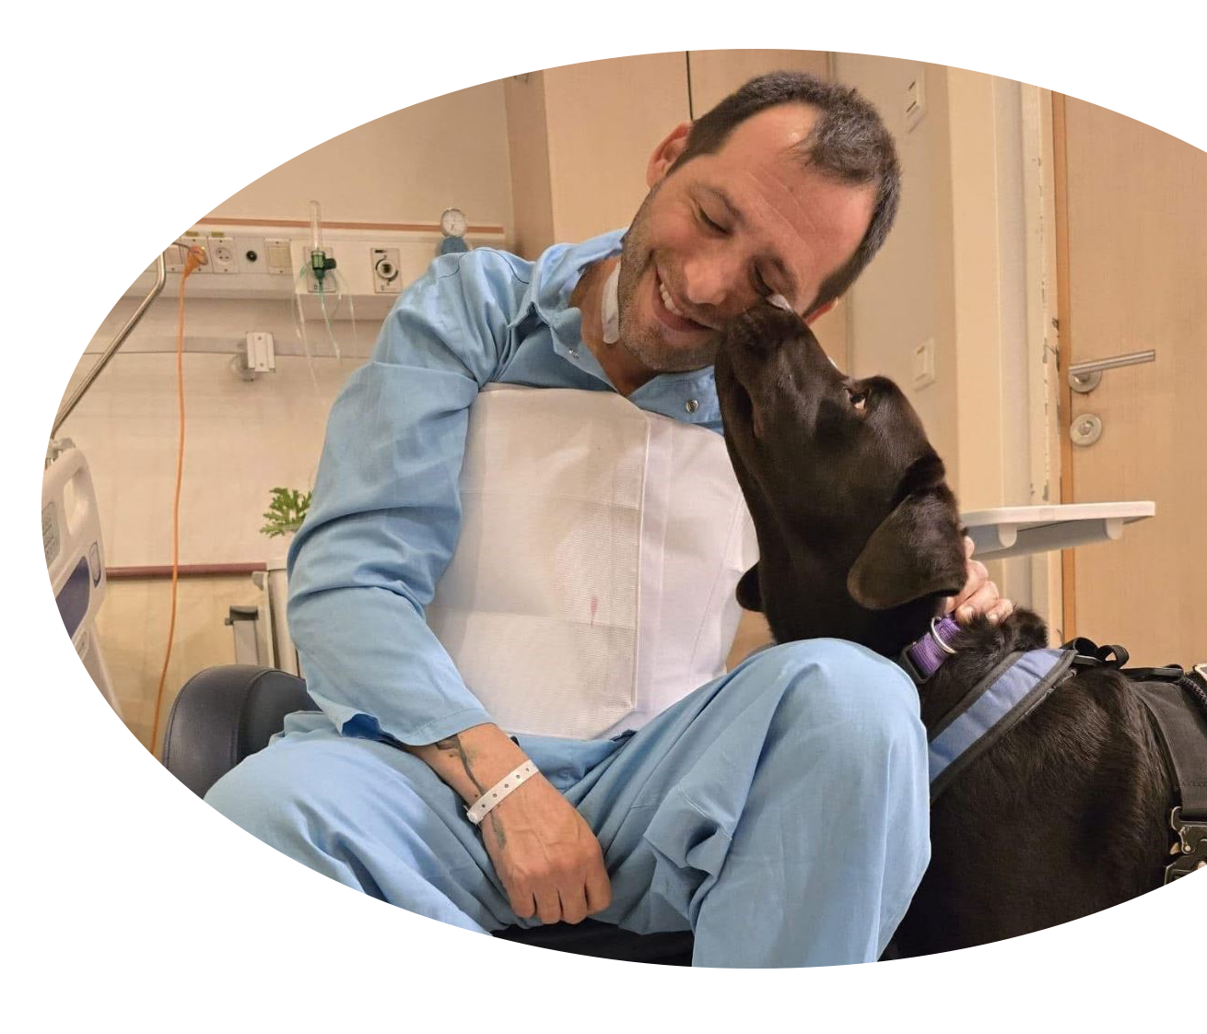
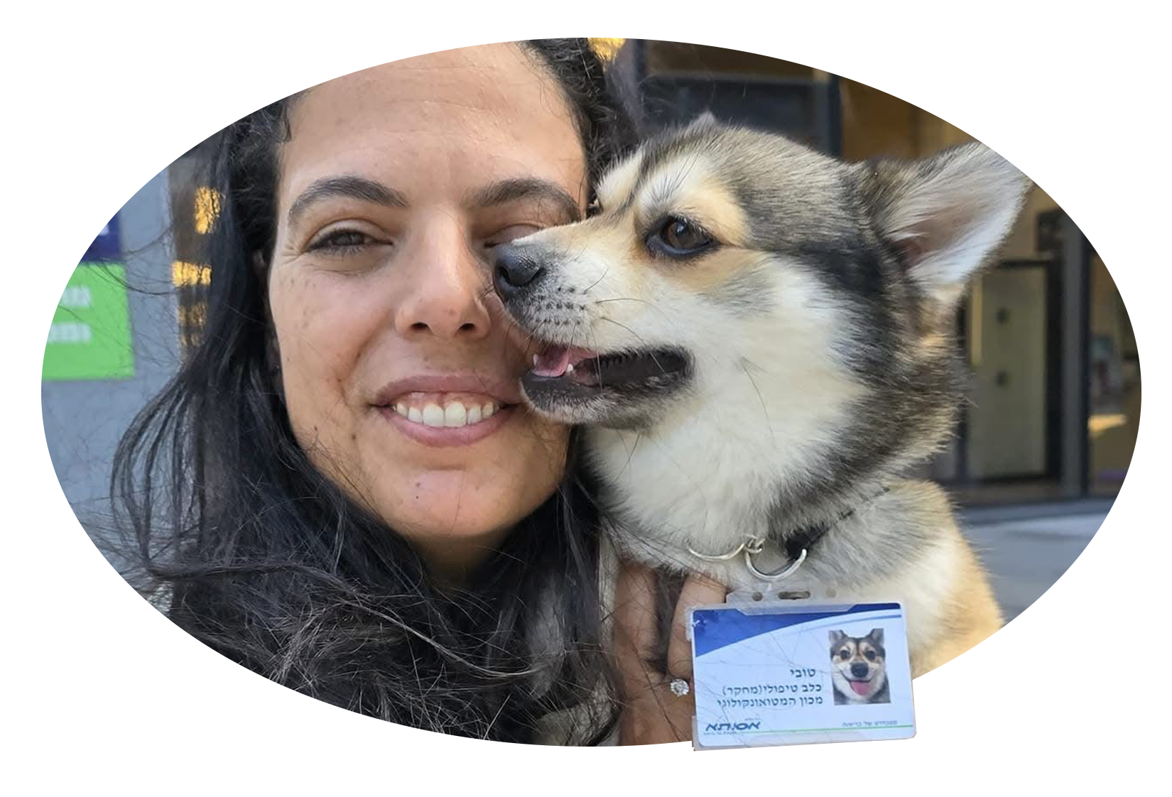

Service Animals
ASSUTA’s embracing policy
Adopting U.S principles & policy
Notes:
Sample Slide: presenting three points on our project and the relationship to this year’s theme of the Zero Project Conference. Point 1; Point 2; Point 3 connect together in this way.

Slide 8
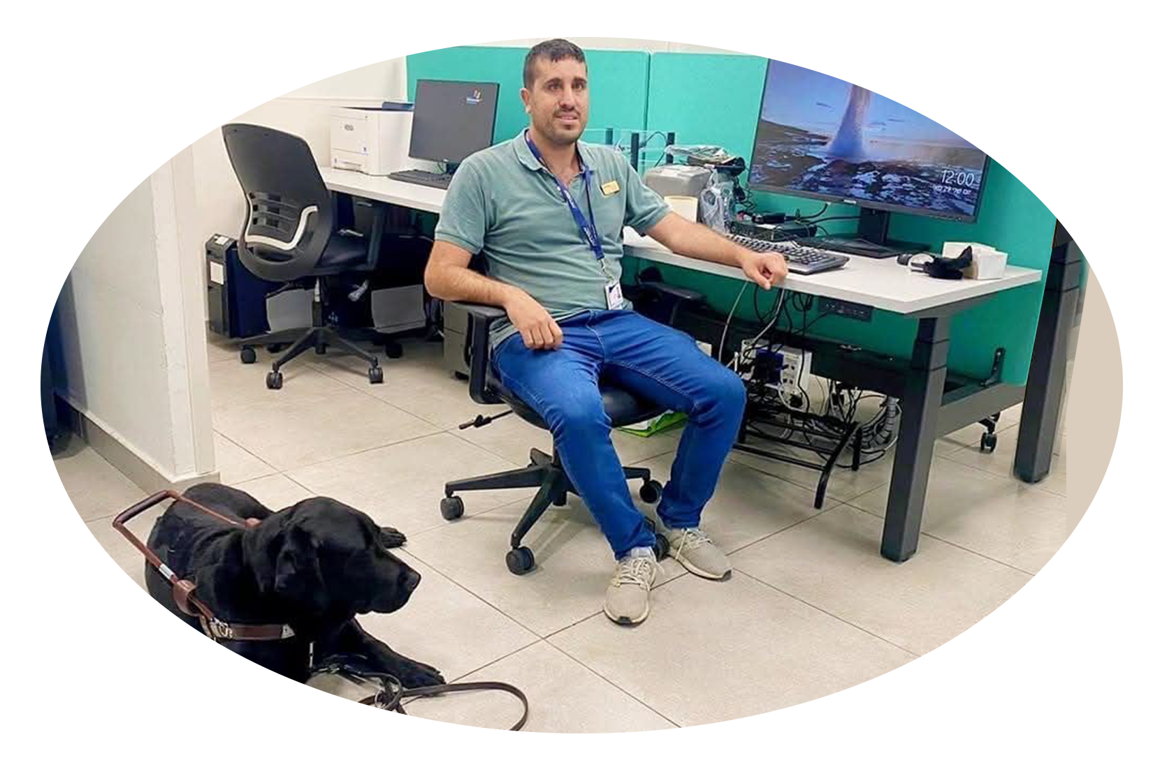

Equal Employment Opportunities
Supportive & personalized environment In the workplace
Professional tools
Notes:
Sample Slide: presenting three points on our project and the relationship to this year’s theme of the Zero Project Conference. Point 1; Point 2; Point 3 connect together in this way.

Slide 9
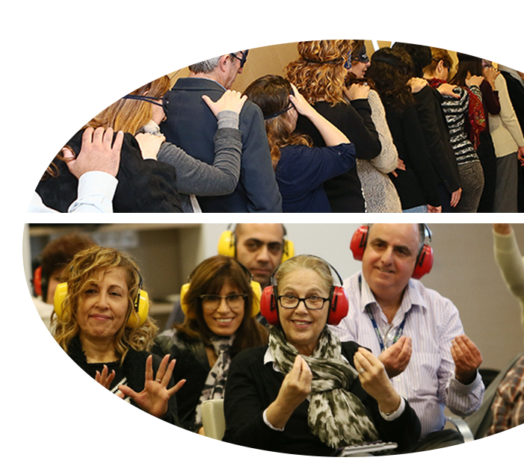
Team Education & Training
Mandatory 4 hours experiential training
Interactive educational software
Current controls by Quality Control Unit
Notes:
Sample Slide: presenting three points on our project and the relationship to this year’s theme of the Zero Project Conference. Point 1; Point 2; Point 3 connect together in this way.

Slide 10
To Conclude…
Make out accessibility-integrating policy and standards
Develop our own education and training programs
Adopt accessibility as on integral part of our regular controls in medical care and services
Ensure accessibility budget is an integral part of our annual budget
Learn and draw lessons from complaints
Notes:
Sample Slide: presenting three points on our project and the relationship to this year’s theme of the Zero Project Conference. Point 1; Point 2; Point 3 connect together in this way.

