Slide 1
Bogotá Chamber of Commerce
2026

Slide 2
The Bogotá Chamber of Commerce

Slide 3
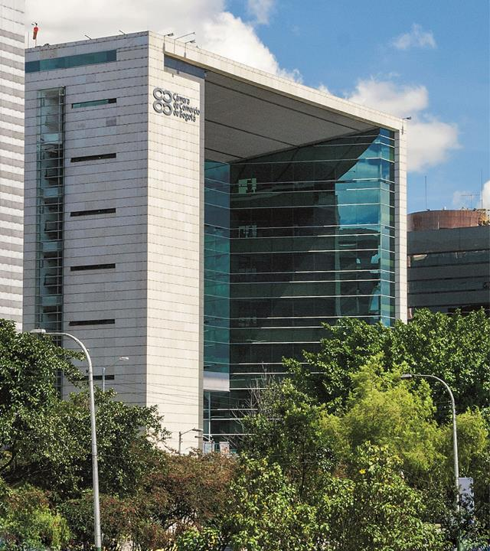



The Bogotá Chamber of Commerce
is a private entity that has served the business sector of Bogotá and Cundinamarca since 1878.

Slide 4


Who are we?
We have been a private, non-profit entity for more than 147 years. Since 1931, by mandate of the national government, we have been managing public registries.
We serve business owners and entrepreneurs to have more and better companies and achieve a more prosperous and equitable society in Bogotá and the 59 municipalities of Cundinamarca.
We work continuously to strengthen business capabilities, we accompany companies throughout their life cycles, we provide legal security, and we develop actions that improve the competitive environment.
Higher Purpose
Achieving a more prosperous and equitable society, serving the economic fabric of Bogotá and Cundinamarca and facilitating its transformation to achieve sustainable growth.

Slide 5
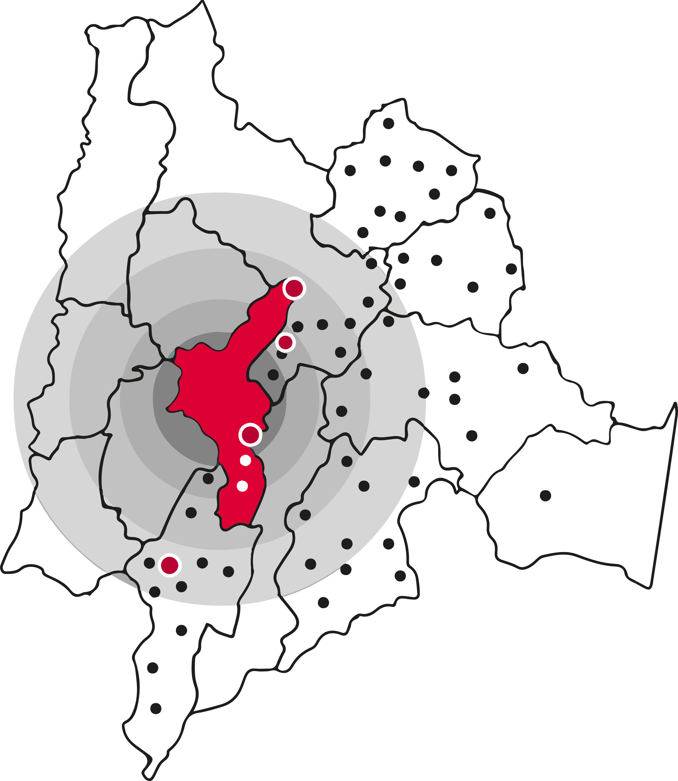

Where we operate
Bogotá
58 Municipalities
10 Offices – 4 Business Centres
Cundinamarca
5 Mobile Offices
2 Community Offices
1 Arbitration and Conciliation Center
3 Service Points in Cota, Ubate and Tocancipa
10 Reindustrialization Centers - Zasca

Slide 6
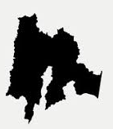







Who we serve
January - December 2024
Operating Enterprises
Business Dynamics
Zone | Jan-Oct 2024 | Jan-Oct 2025 | Variación % 2025-2024
Bogotá | 418.623 | 424.547 | 1,4%
Municipality | 58.755 | 61.168 | 4,1%
Total | 477.378 | 485.715 | 1,7%
Bogotá
Cundinamarca
477,378
Active companies in
2024
485,715
Ractive companies from January to October
2025
409,482
Renewed companies from January to December
2025
1,7%
87,4%
424.547
12,6%
61.168
405,471
Renewed companies in
2024
1,0%
71,907
Companies created in
2024
76,233
Companies created from January to October
2025
Micro
Small
Big
Medium
6,0%
93,0 %
5,0 %
1,4 %
0,7 %
Betweern January and October 2025 an increase of
1,7%
in active companies was observed compared to 2024.
This result is explained by a 6% improvement in the renewal of companies so far in 2025, compared to 2024.
The Services macro-sector grew by 2,2%, industry by 1,1%, and commerce by 1,2%.
Industry
Natural Person
Legal
Person
Services
Commerce
13,7%
55,3%
31,0%
54,8%
45,2%
66.554
268.549
150.612
266.609
219.106
Fuente: Registro Mercantil, 2024, CCB.

Slide 7
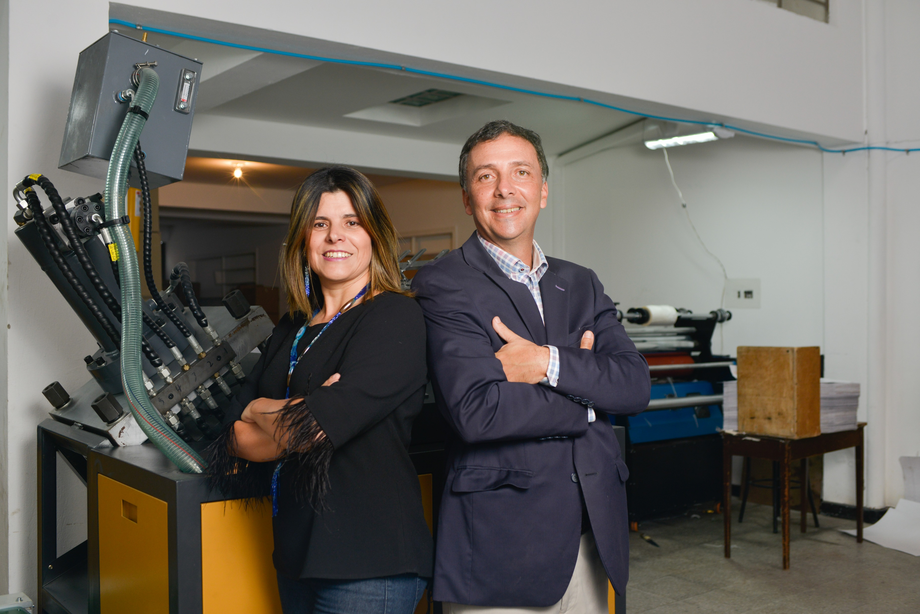

2. Services

Slide 8

Corporate Focus
Business Strengthening
Civic management and enabling environment for business
We offer a wide portfolio of support services for business initiatives and companies, from the business idea to its formalization and strengthening
We represent the interests of entrepreneurs to improve the business environment and promote the city and region. We generate knowledge about economic and social behavior
Dispute Resolution
We support employers in resolving any conflict through alternative mechanisms with the Arbitration and Conciliation Center
International relations
We channel, lead and articulate international initiatives that provide added value to the business sector, the region and the BCC
Legal Certainty
We guarantee the competitiveness and legality of companies, through the administration of public registries

Slide 9
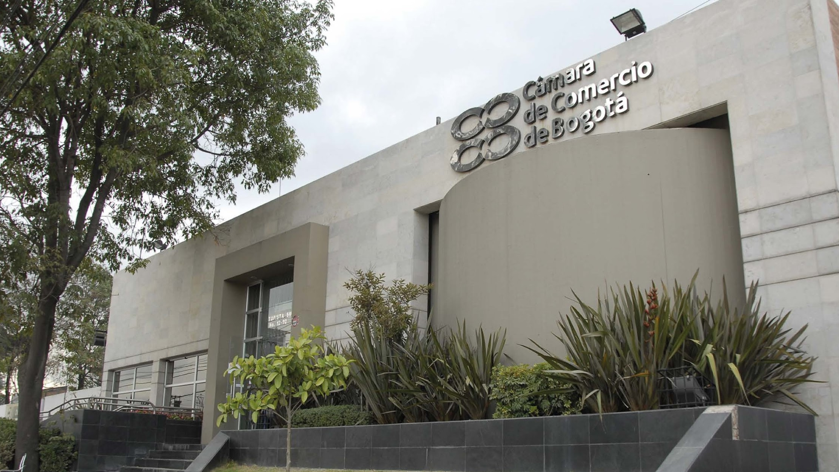

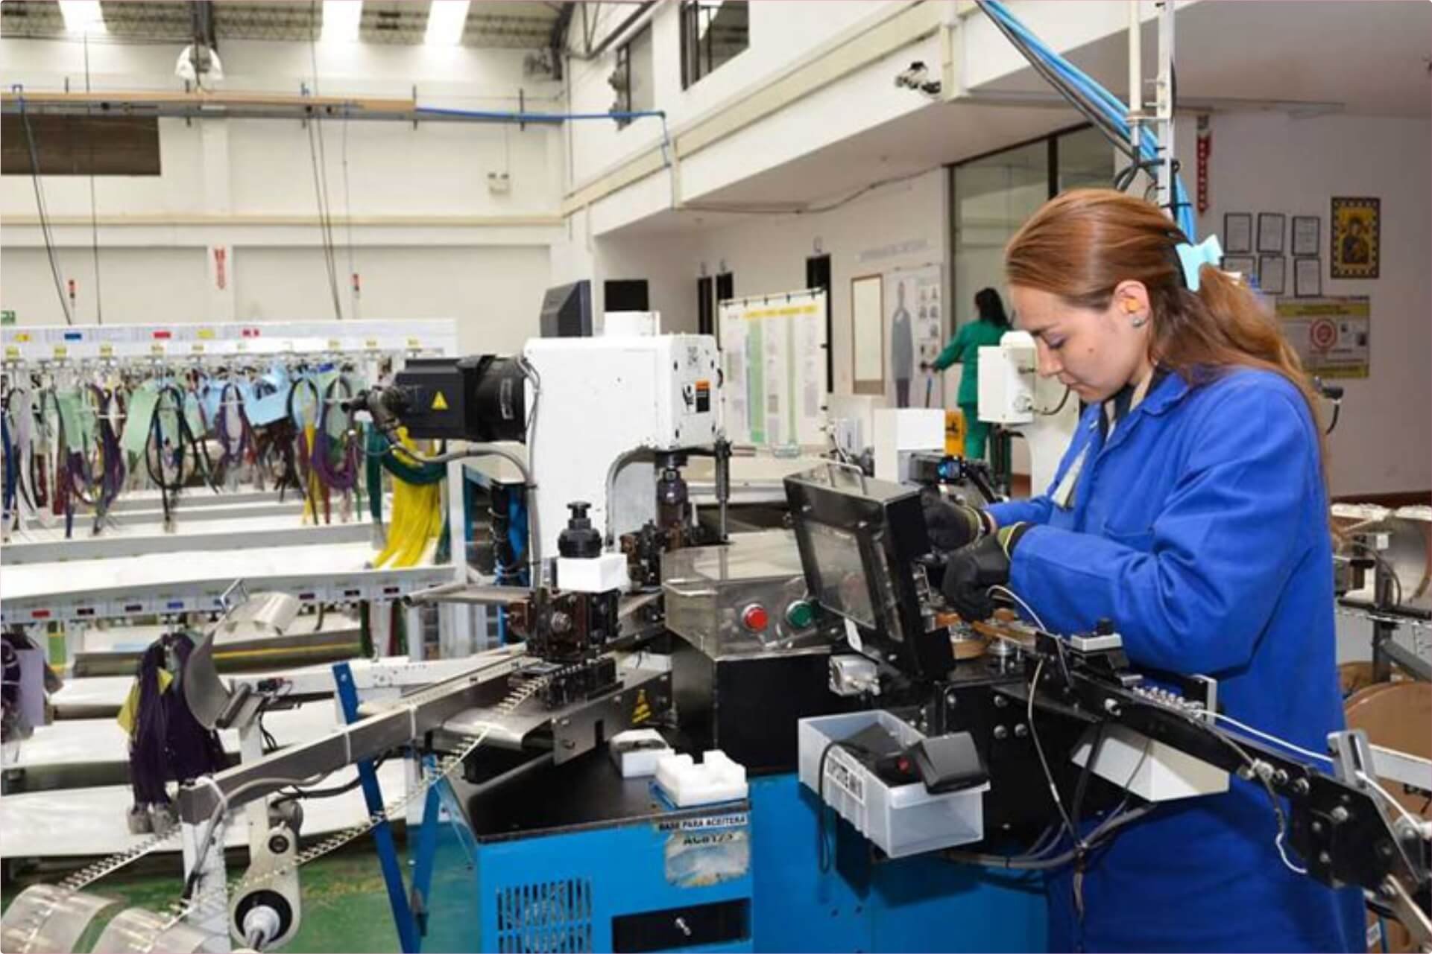
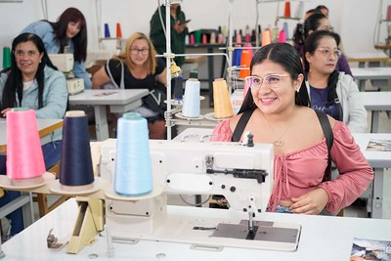
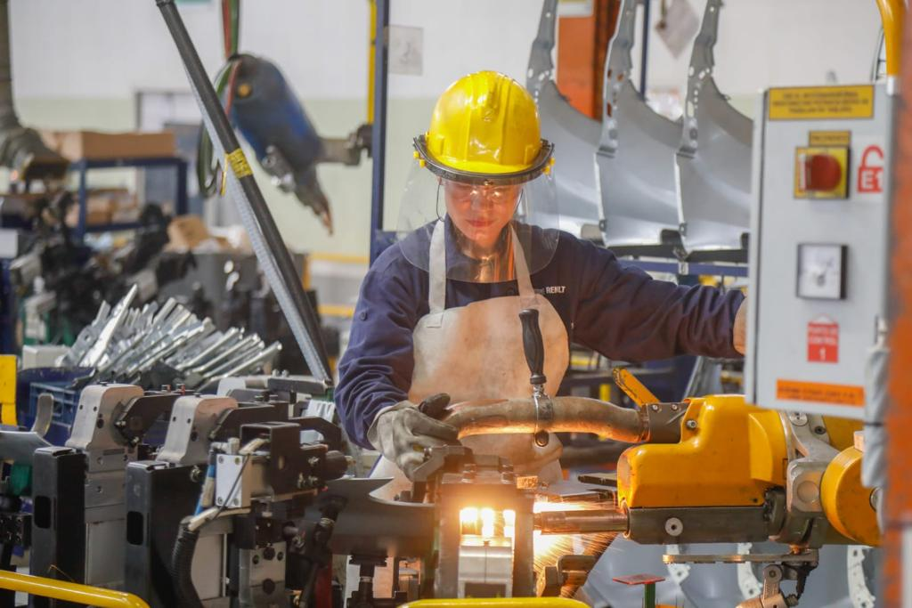
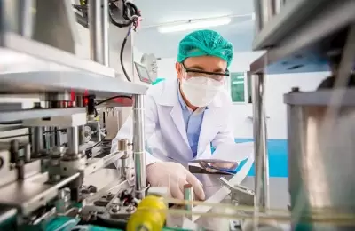
3. Clusters
BCC Cluster Initiatives as a tool to promote Competitiveness, business, and social development in Bogotá - Region

Slide 10




















19
Clusters
Lead by the Bogotá Chamber of Commerce
Music
Creative and Contents Industries
Tourism
Sports and
Recreation
Food
Security
Printing & Packaging
Animal Welfare and Protection
Water and Circular Economy
Construction
Energy
Knowledge Economy & IT
Financial
Services
Logistics and Mobility
Health
Pharmaceutical
Cosmetics and Wellbeing
Shoes and
Leather
Clothing
Jewelry
Notes:
NO AJUSTAR

Slide 11
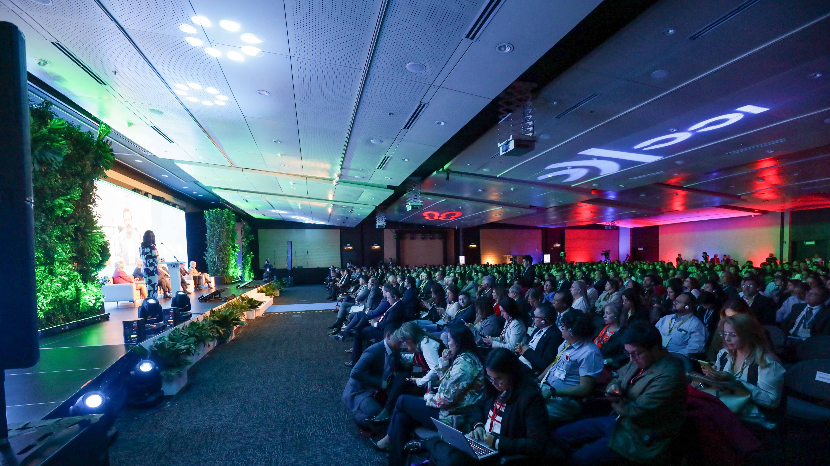

3. Vice Presidency of International Affairs and Cooperation

Slide 12
International Affairs and Cooperation
We contribute towards business reactivation with services and information aimed at promoting international commercial activities, obtaining cooperation resources, implementing projects that facilitate the dynamics of international trade and managing the network of allies for the benefit of the business community
International Engagement
International Cooperation
Enterprises
BCC
Economic diplomacy
Trade
Product validation and adaptation of market standards
European Union:
  Inclusive and sustainable economy. Migration, Market Access Latam – EU
  Sustainable Fashion
  Al Invest Verde
  Erasmus +
LOAD: Cooperación Italiana
IPD: Cooperación Alemana
SIPPO: Internationalization Project
Global Training and América Scolarships
International
Missions
ABC Cooperation Workshops
Individual Group Mentoring
Accompaniment of the presentation of proposals, projects or initiatives
International Delegations
International Events
International Policy Management
International Allies Newsletter
Commissions
F. Consejo España
CEAPI
AICO
ICC’s WCF
Arbitration and ADR
Banking
Business Integrity
Commercial Law and Practices
Customs and trade facilitation
Digital economy
Environment and energy
Intellectual property
Trade and investment policy
International organizations

Slide 13
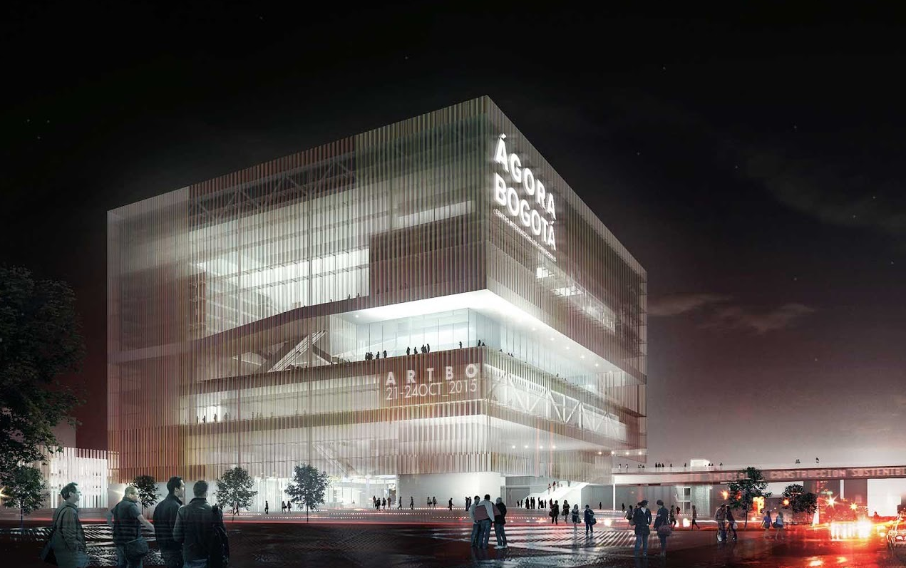
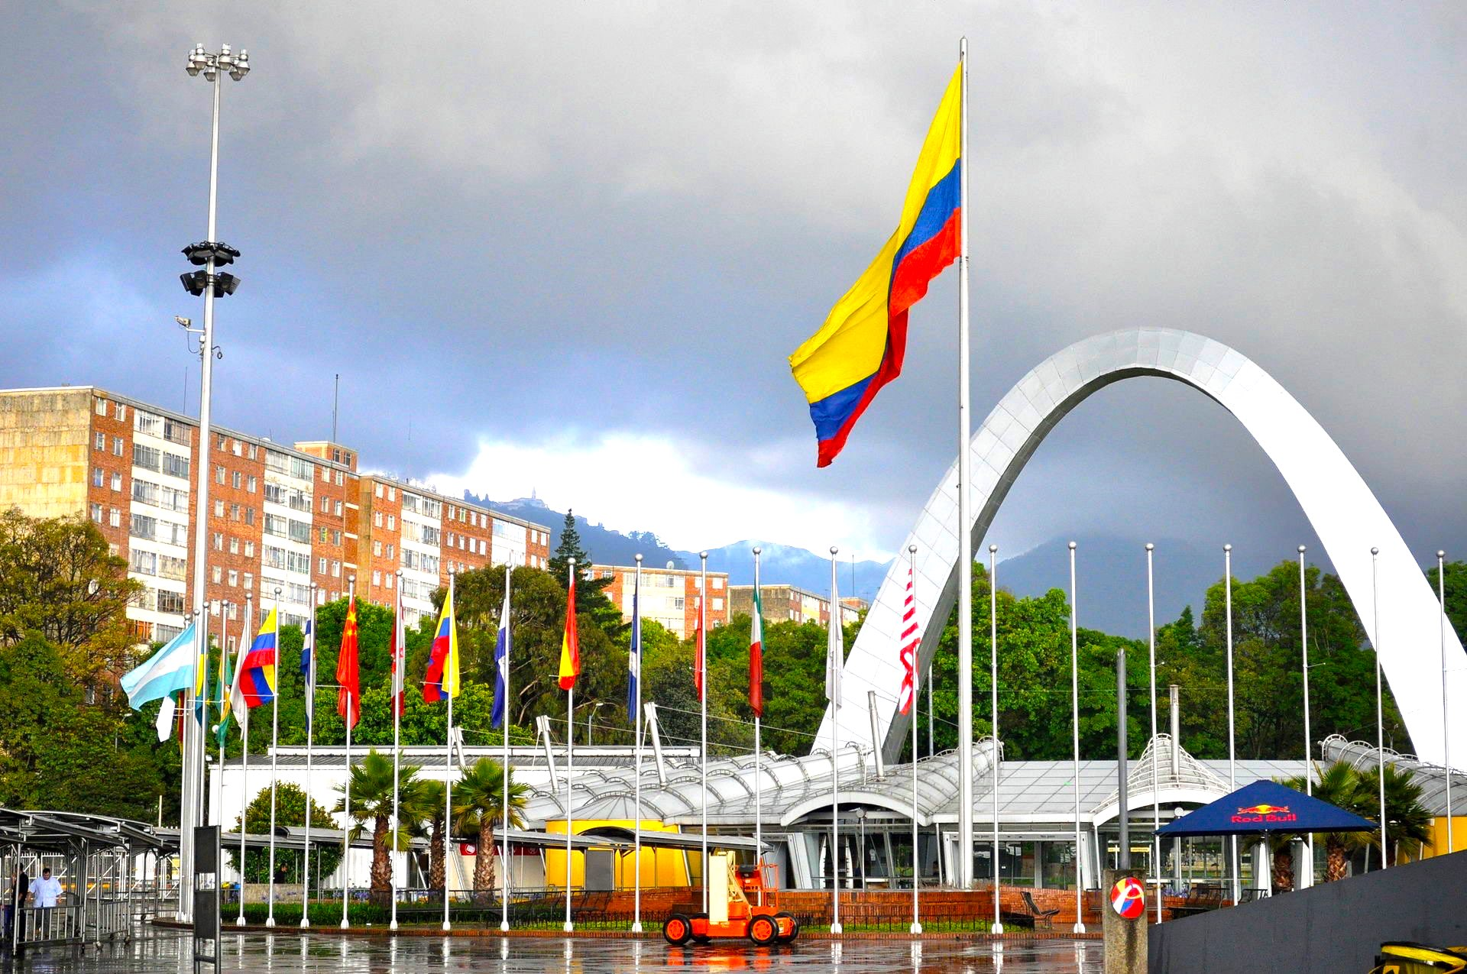
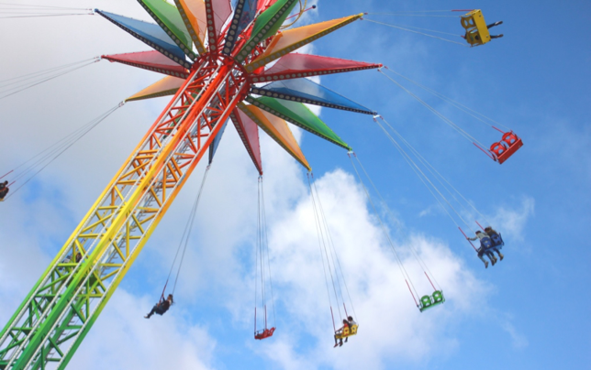
5. The Bogotá Chamber of Commerce Group and its Affiliates

Slide 14
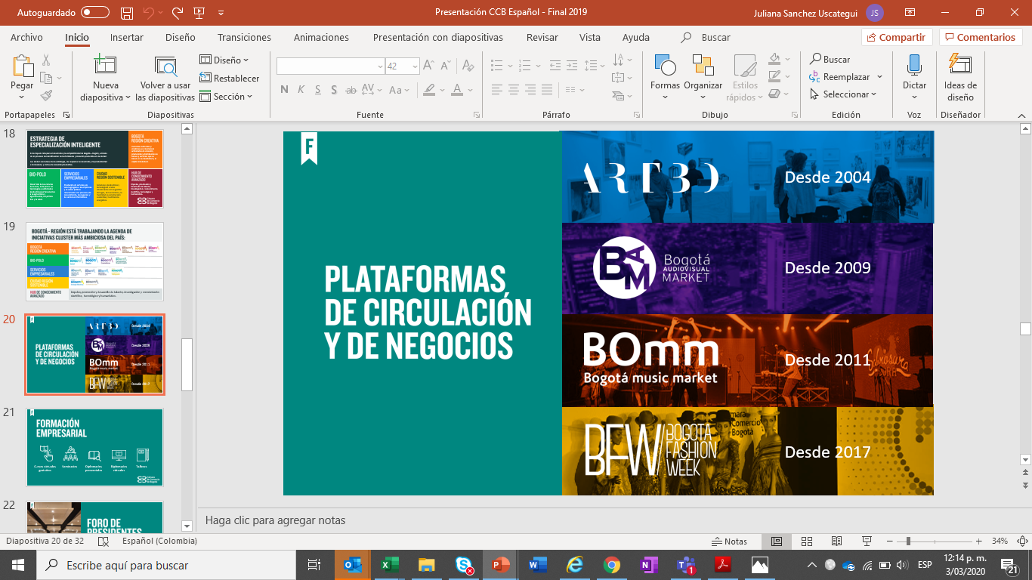


Platforms and sector offer
Platforms
Led by The BCC
Desde 2018
Notes:
13- Industrias Culturales y Creativas
Reconocemos el aporte de la actividad creativa en el desarrollo social, económico y cultural de la ciudad.
Así mismo, sabemos que su organización cultural o empresa creativa se enfrenta a algunos obstáculos que limitan su potencial de sostenibilidad; por ello, aquí le brindamos algunas claves para que su emprendimiento creativo y cultural multiplique sus opciones de progreso, a partir de la formalización de su iniciativa empresarial.
Por esta razón tenemos iniciativas como:
-BAM (Bogotá Visual Market): su objetivo es difundir la oferta nacional e internacional de proyectos en desarrollo de películas y servicios relacionados con la producción audio visual.
-BOMM (Bogotá Music Market): es un espacio diseñado para que músicos, compositores, productores y agencias, disqueras entre otros, descubran nuevas oportunidades de negocio y aprendan sobre las últimas tendencias de la industria de la música.
-Artecámara
Busca promover los nuevos talentos en artes visuales y diseño, con el fin de impulsar el desarrollo empresarial.
-ARTBO (Feria internacional de Arte de Bogotá)
Es el encuentro por excelencia para el mercado del Arte en América Latina, para disfrutar y comprar obras de arte cuidadosamente seleccionadas.

Slide 15
THANK YOU

