Slide 1
The story of emergence Grassroots – AI
Sayomdeb Mukherjee (Den)
EnAble India
India
How to build AI that works for your organization
07 March 2025 10:00-11:00
Notes:
Please add your notes here.
Title; First name, last name of speaker(s); Name of Organization, Name of Country, Name of Session (as written in Agenda)
#ZeroCon24
Day and Time of Session

Slide 2
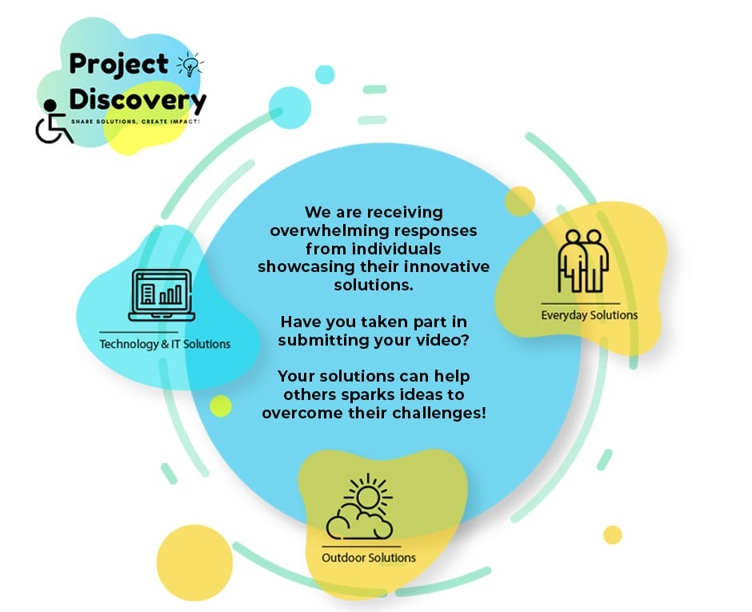

The Genesis
🎥 Project Discovery💡
A video competition for discovering innovative solutions that persons with disabilities use in their daily lives across India

Slide 3
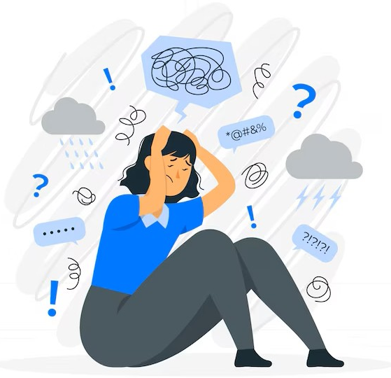

#ZeroCon25

Slide 4

Disability Innovative Solutions Hub

Slide 5






#ZeroCon25

Slide 6

Incluss AI

Slide 7

Incluzz AI Cercle
No Hallucination, Just Accuracy
Text or Speech
Multilingual Support
Targeted Search

