Slide 1

PRESENTER FULL NAME: Büşra ÜNLÜ
ORGANIZATION: Kardinero Medical Systems Inc.
WORKSHOP NAME: Workshop #1-Digital and Smart Health
E-MAIL: busra.unlu@kardinero.com.tr

Slide 2

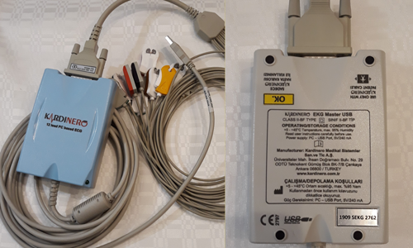
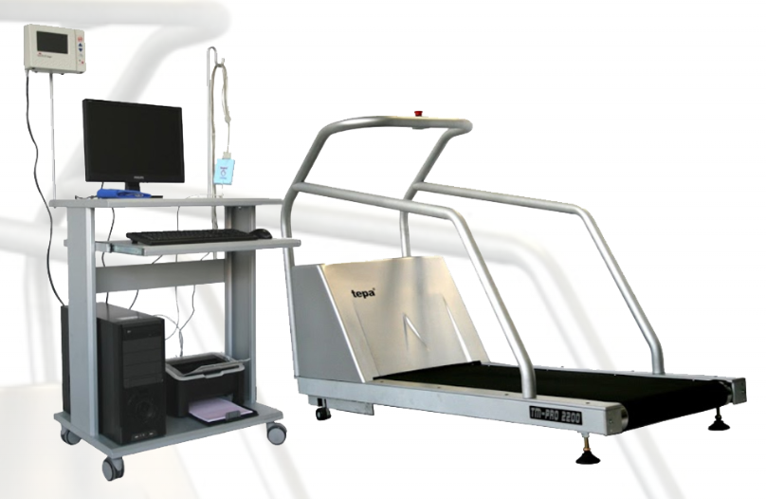
Kardinero is a company that develops and manufactures medical devices, including. diagnostic and therapeutic software applications, and AI solutions. (SME)
Description of the Organisation
Over 30 years of experience in developing and manufacturing PC-based ECG and ECG Stress Test systems hardware and software, and their clinical applications.
Experience in EU project (1 ongoing project)
Roles: Project Partner

Slide 3

Your Teams’ Expertise
Medical electronic equipment design and R&D
ECG signal analysis programs
Cybersecurity
Medical device quality management and certification
Big data availability

Slide 4

Your Research Fields
Regulatory Compliance & Certification
International medical device regulations, including CE-MDR and FDA requirements.
Medical device quality management
MDR and ISO 13485 certifications
Medical Device Design & Development
Embedded systems design
Hardware and software integration for medical devices
Multi-parameter medical monitoring systems
Cybersecurity in Medical Devices
Flexibility in implementing cybersecurity testing and scenarios for medical devices
Secure data transmission, encryption, and protection of patient information
Data
ECG signal analysis
Multi Signal Analysis
Big data with availability in ECG Stress Test systems and ECG records
Clinical applications with clinics for clinical trials and health services research

Slide 5


Your On-going Projects
Ensuring Secure & Safe Connected Medical Devices Design with Zero Trust Principles

Slide 6
Project Idea
Call Topic: HORIZON-HLTH-2025-01-CARE-01: End user-driven application of Generative Artificial Intelligence models in healthcare (GenAI4EU)
Deadline Dates: 18 Sep 2025
    Objectives:
    Multi-modal physiological data recording
    AI-driven risk estimation, AI-assisted decision support
    Advancement of collaboration and data sharing
    Expected Results:
    Enhanced Patient Monitoring and Personalized Health Insights
    Clinician Support with AI Recommendations
    High Performance Through Clinical Trials
    Cost Savings and Health System Efficiency

Slide 7
Consortium - profile of known partners (if any)
No | Partner Name | Type | Country | Role in the Project
01
02
03
04
05

Slide 8
Consortium – required partners
No | Expertise | Type | Country | Role in the project
01 |  |  |  | Healthcare Telemedicine Services
02 |  |  |  | Healthcare Providers
03
04

Slide 9


PRESENTER CONTACT: Büşra Ünlü
DETAILS: Biomedical Engineer
COUNTRY: Turkey
busra.unlu@kardinero.com.tr
www.kardinero.com.tr/english/

