Slide 1

PRESENTER FULL NAME: Janusz Poplawski
ORGANIZATION: Lortek
WORKSHOP NAME: HE Clean Industrial Deal Brokerage Event
E-MAIL: jpoplawski@lortek.es

Slide 2



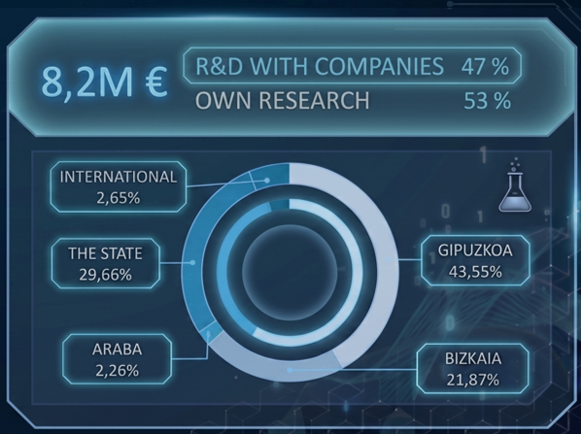
Description of the Organisation
LORTEK is a private technology center, a member of the BRTA (Basque Research & Technology Alliance), and a cooperative integrated into the MONDRAGON Corporation. We specialize in digitalization and the development of advanced and smart manufacturing solutions, designed to address the challenges of the digital and energy transition.
LORTEK focuses its activity on transferring scientific knowledge into applicable solutions through R&D projects developed in collaboration with companies and institutions, closely aligned with industrial ecosystem needs.

Slide 3
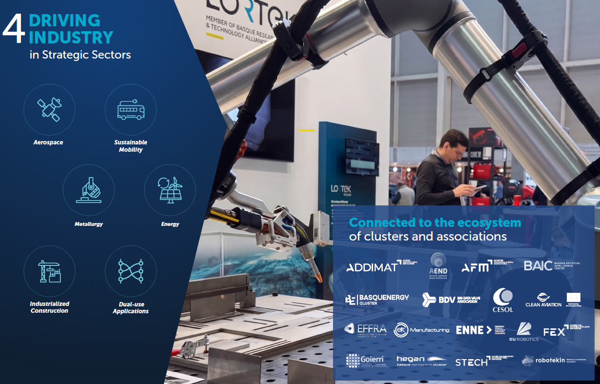
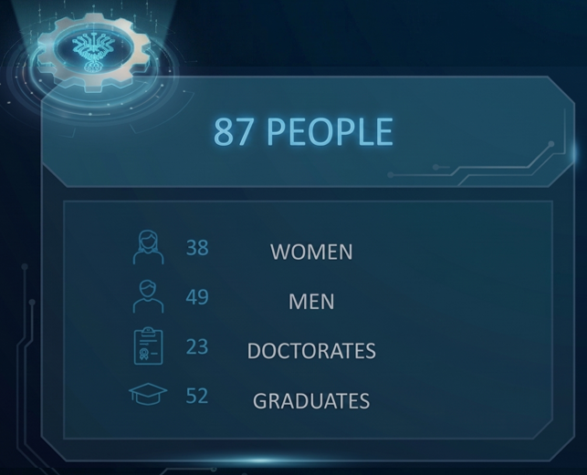
Your Teams’
Expertise

Slide 4


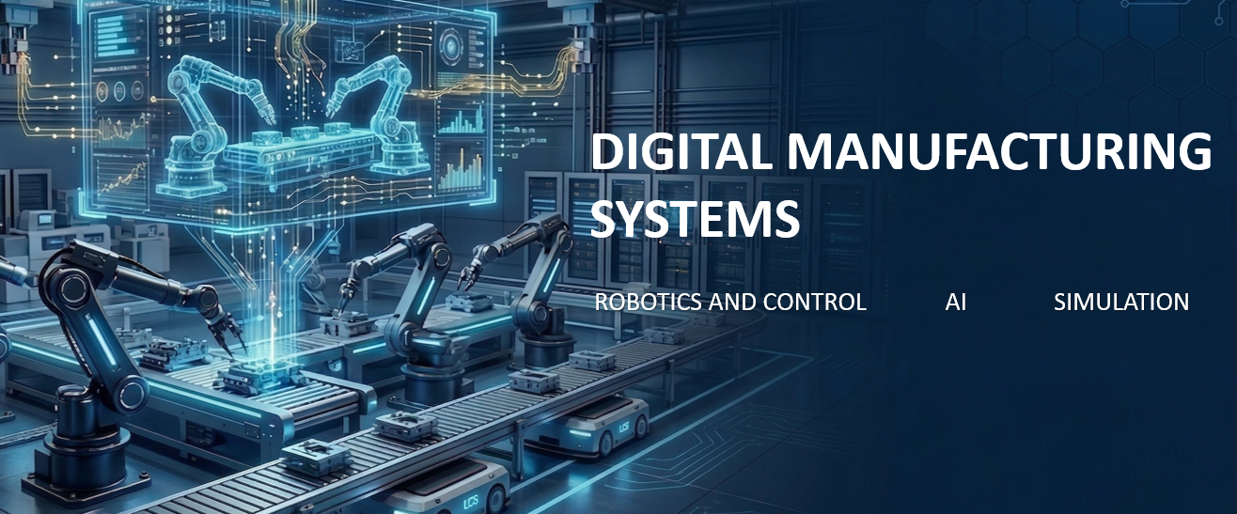
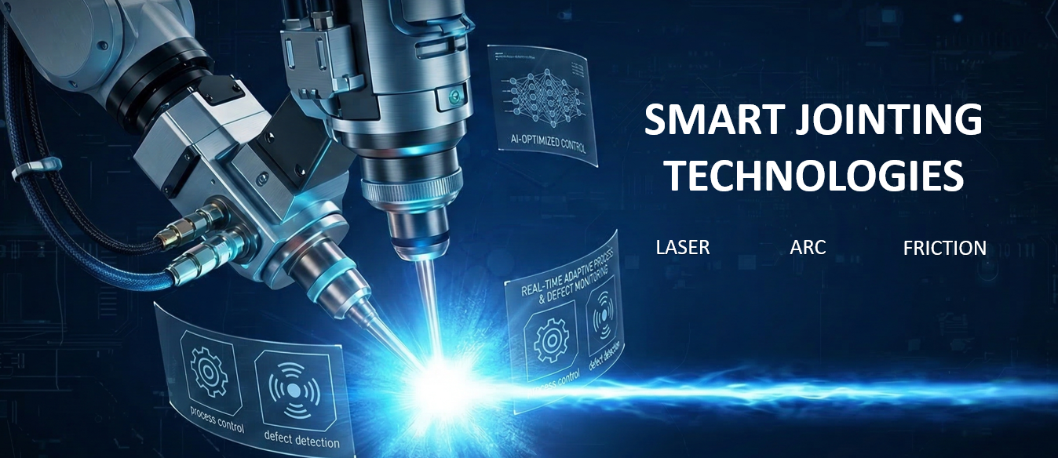
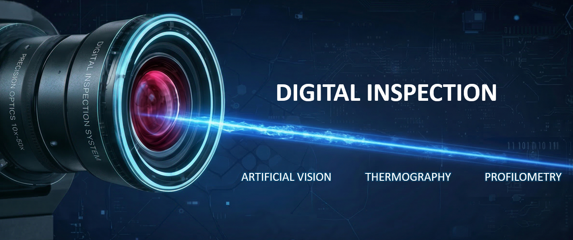

Your Research Fields

Slide 5
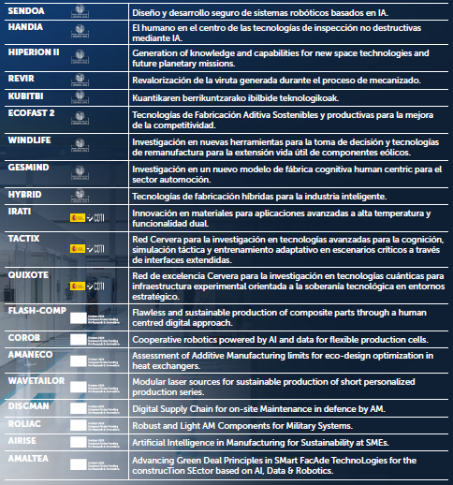
Your On-going Projects
Twenty on-going strategic R&D projects:
  9 regional (Gobierno Vasco)
  3 national (CDTI/Spain)
  8 European (HorizonEurope & EDF)
From Horizon Europe FLASH-COMP and COROB are coordinated by Lortek.

Slide 6
Project Ideas
Our principal interest:
  HORIZON-CID-2026-01-01
  HORIZON-CL4-2027-01-MAT-PROD-02
  HORIZON-CL4-2027-01-MAT-PROD-03
  HORIZON-CL4-2027-01-MAT-PROD-06
  HORIZON-CL4-2027-01-MAT-PROD-61
  HORIZON-CL4-2027-01-MAT-PROD-49
Within Material Production topics we plan to coordinate at least one proposal – detailed idea and scope will be defined within next 2 months
We are open to collaborate on different other proposals, such as HE Cluster 5, EDF or SMART EUREKA

Slide 7

PRESENTER CONTACT DETAILS:
Janusz Poplawski
jpoplawski@lortek.es
+34 747 455 804
COUNTRY: Spain

