Slide 1




Quantum Charging
POWERING TOMORROW’S ELECTRIC ECONOMY
RUSLANA DOVZHYK | CO-FOUNDER & CEO
R.DOVZHYK@TECHNOVATOR.CO
WWW.TECHNOVATOR.CO

Slide 2



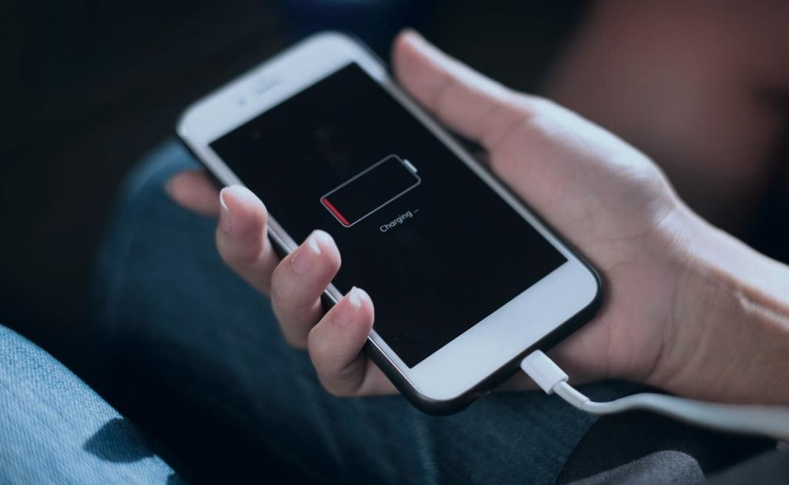
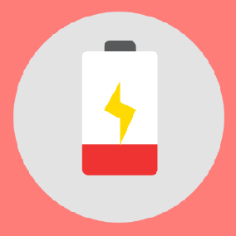

THE PROBLEMS AND WHY THEY MATTER
CHARGING IS A FRUSTRATING PART OF EVERYONE’S LIFE
ELECTRONIC WASTE (BROKEN WIRES AND USED BATTERIES)

Slide 3
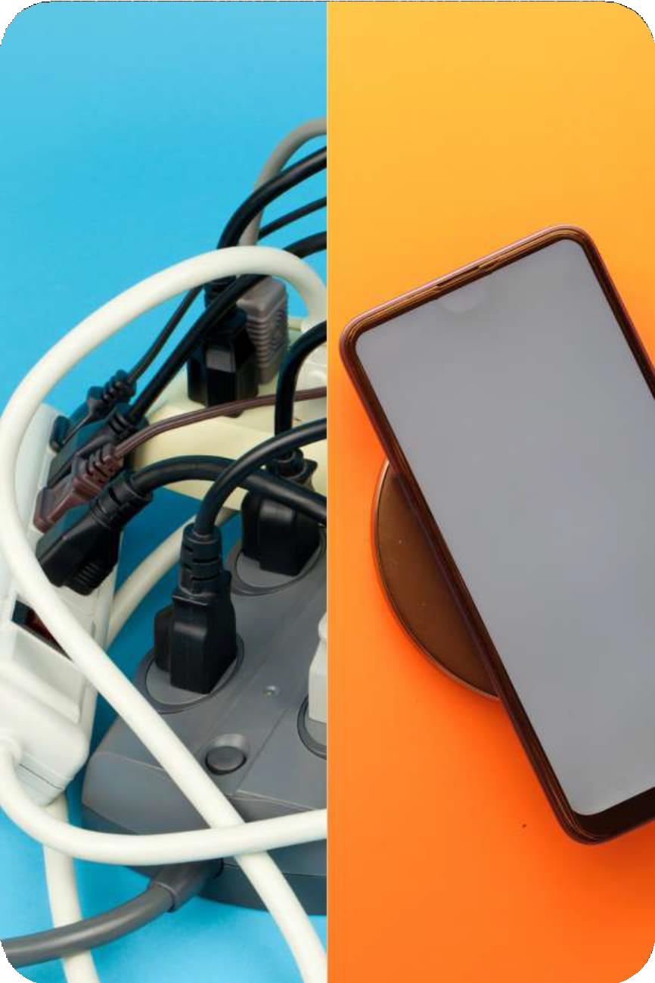





Electric charging
is stuck in the past
Heat generation Electromagnetic Radiation Distance limitations
Wired
Always connected 1 device/charger
Pseudo-wireless (Qi)
Requires contact, precise positioning Device unusable while charging
3 devices/pad, up to 15 Watts

Slide 4

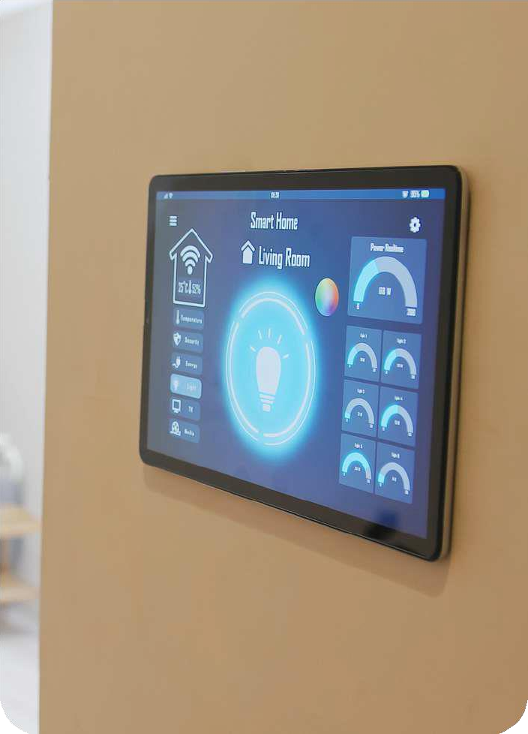
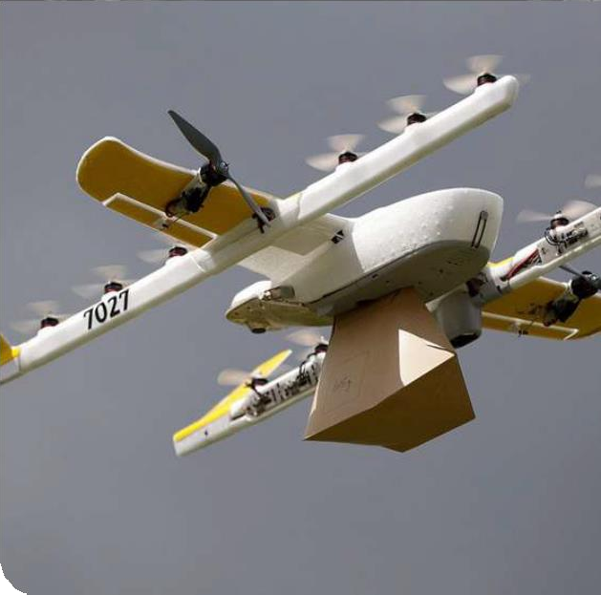
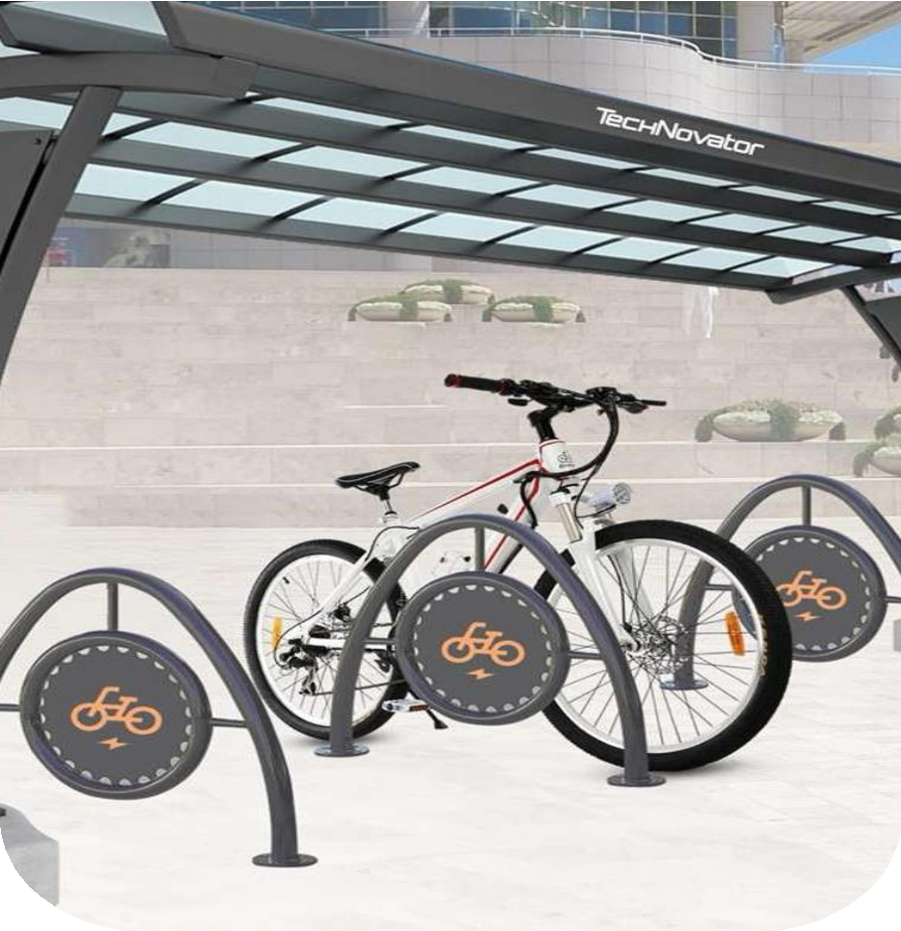




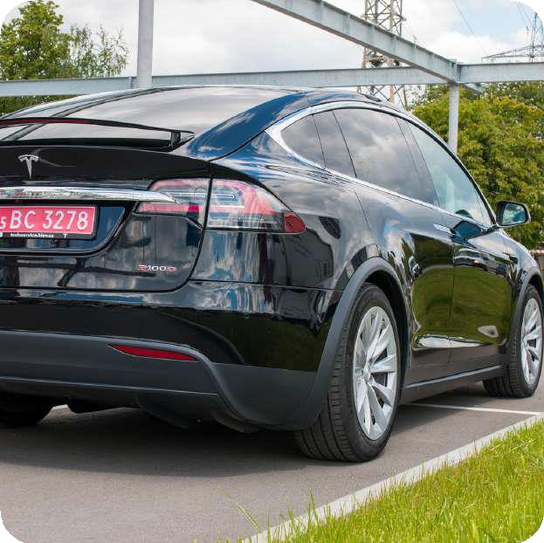
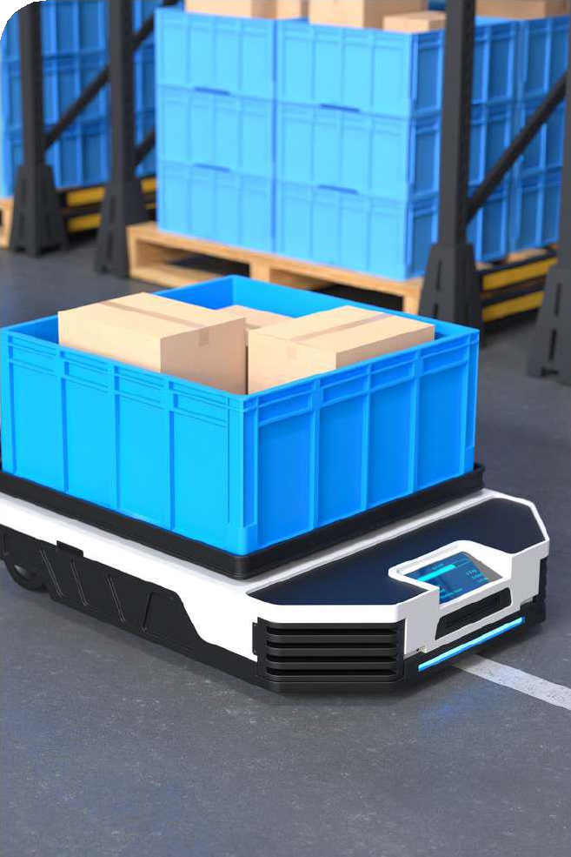
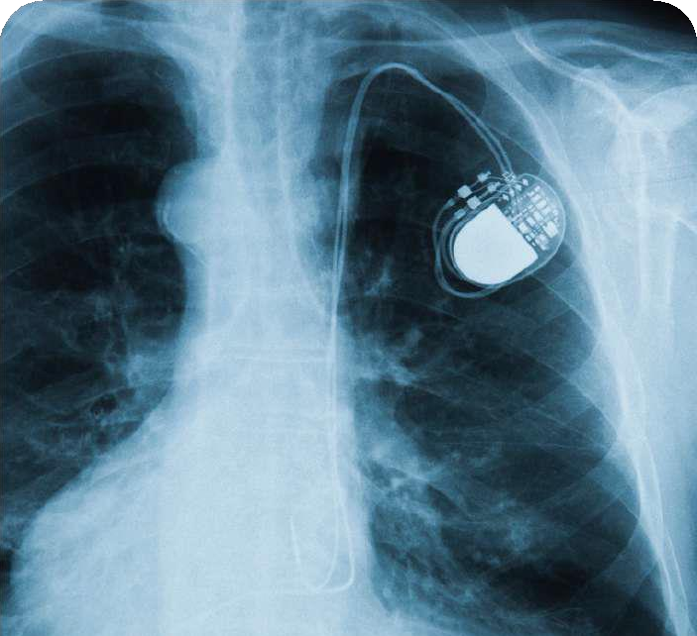

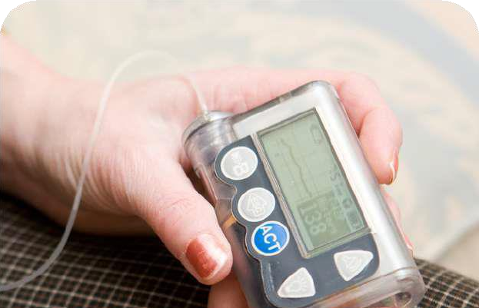




SOLUTION
Imagine a life without cables…

Slide 5



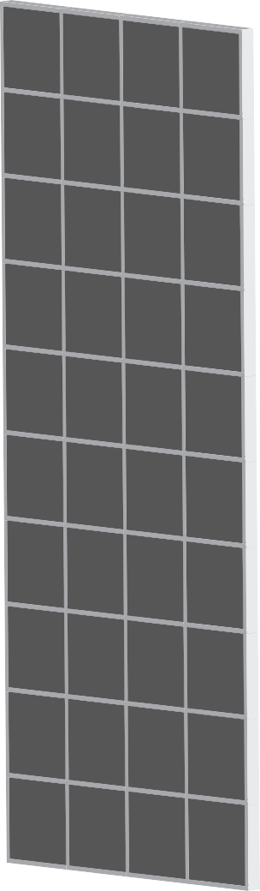
TECHNOLOGY
Technology Validated
Certified
Pending Patent
T R L 7 : C o n s u m e r E l e c t r o n i c s T R L 7 : E - b i k e s
TX
TRANSMITTER
Energy compression
Synchronized mode
RECEIVER
Energy Reconstruction
RX

Slide 6


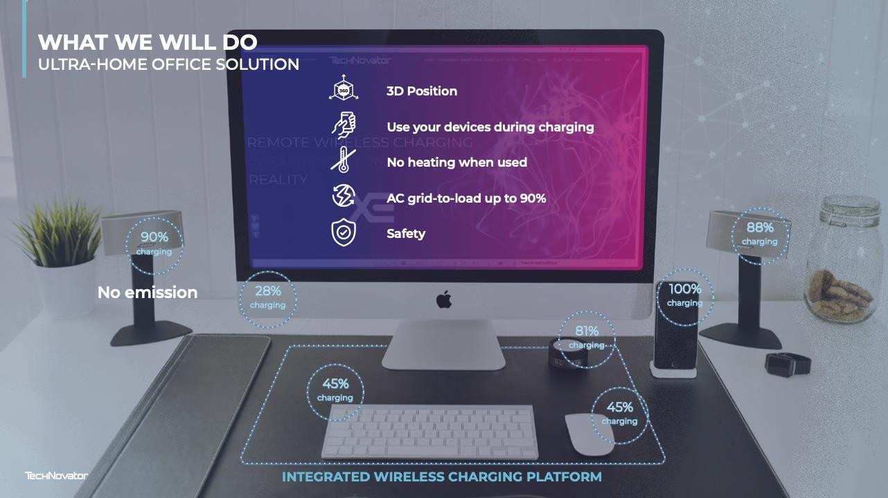



BUSINESS MODEL (B2B) & GO-TO-MARKET STRATEGY
Pilot project
Technology integration into various products (to showcase technology)
Selling licenses
(USD 50mn, 3yrs exclusive )
Consumer Electronics Transportation

Slide 7
Technology Competitive Landscape
Unique selling points | Quantum Charging | Wired charging | Current wireless charging
Multiple Devices | V | X | X (only up to 15 Watts safely)
High efficiency | V | V (but tends to heat up) | X (generate heat)
No contact needed | V | X | X
3D positioning | V | X | X (precise positioning)
No interference | V | X | X
Low electromagnetic emissions | V | X | X (emits significant EM waves)
Dynamic power transfer | V | X | X
Scalability | V | X | X

Slide 8
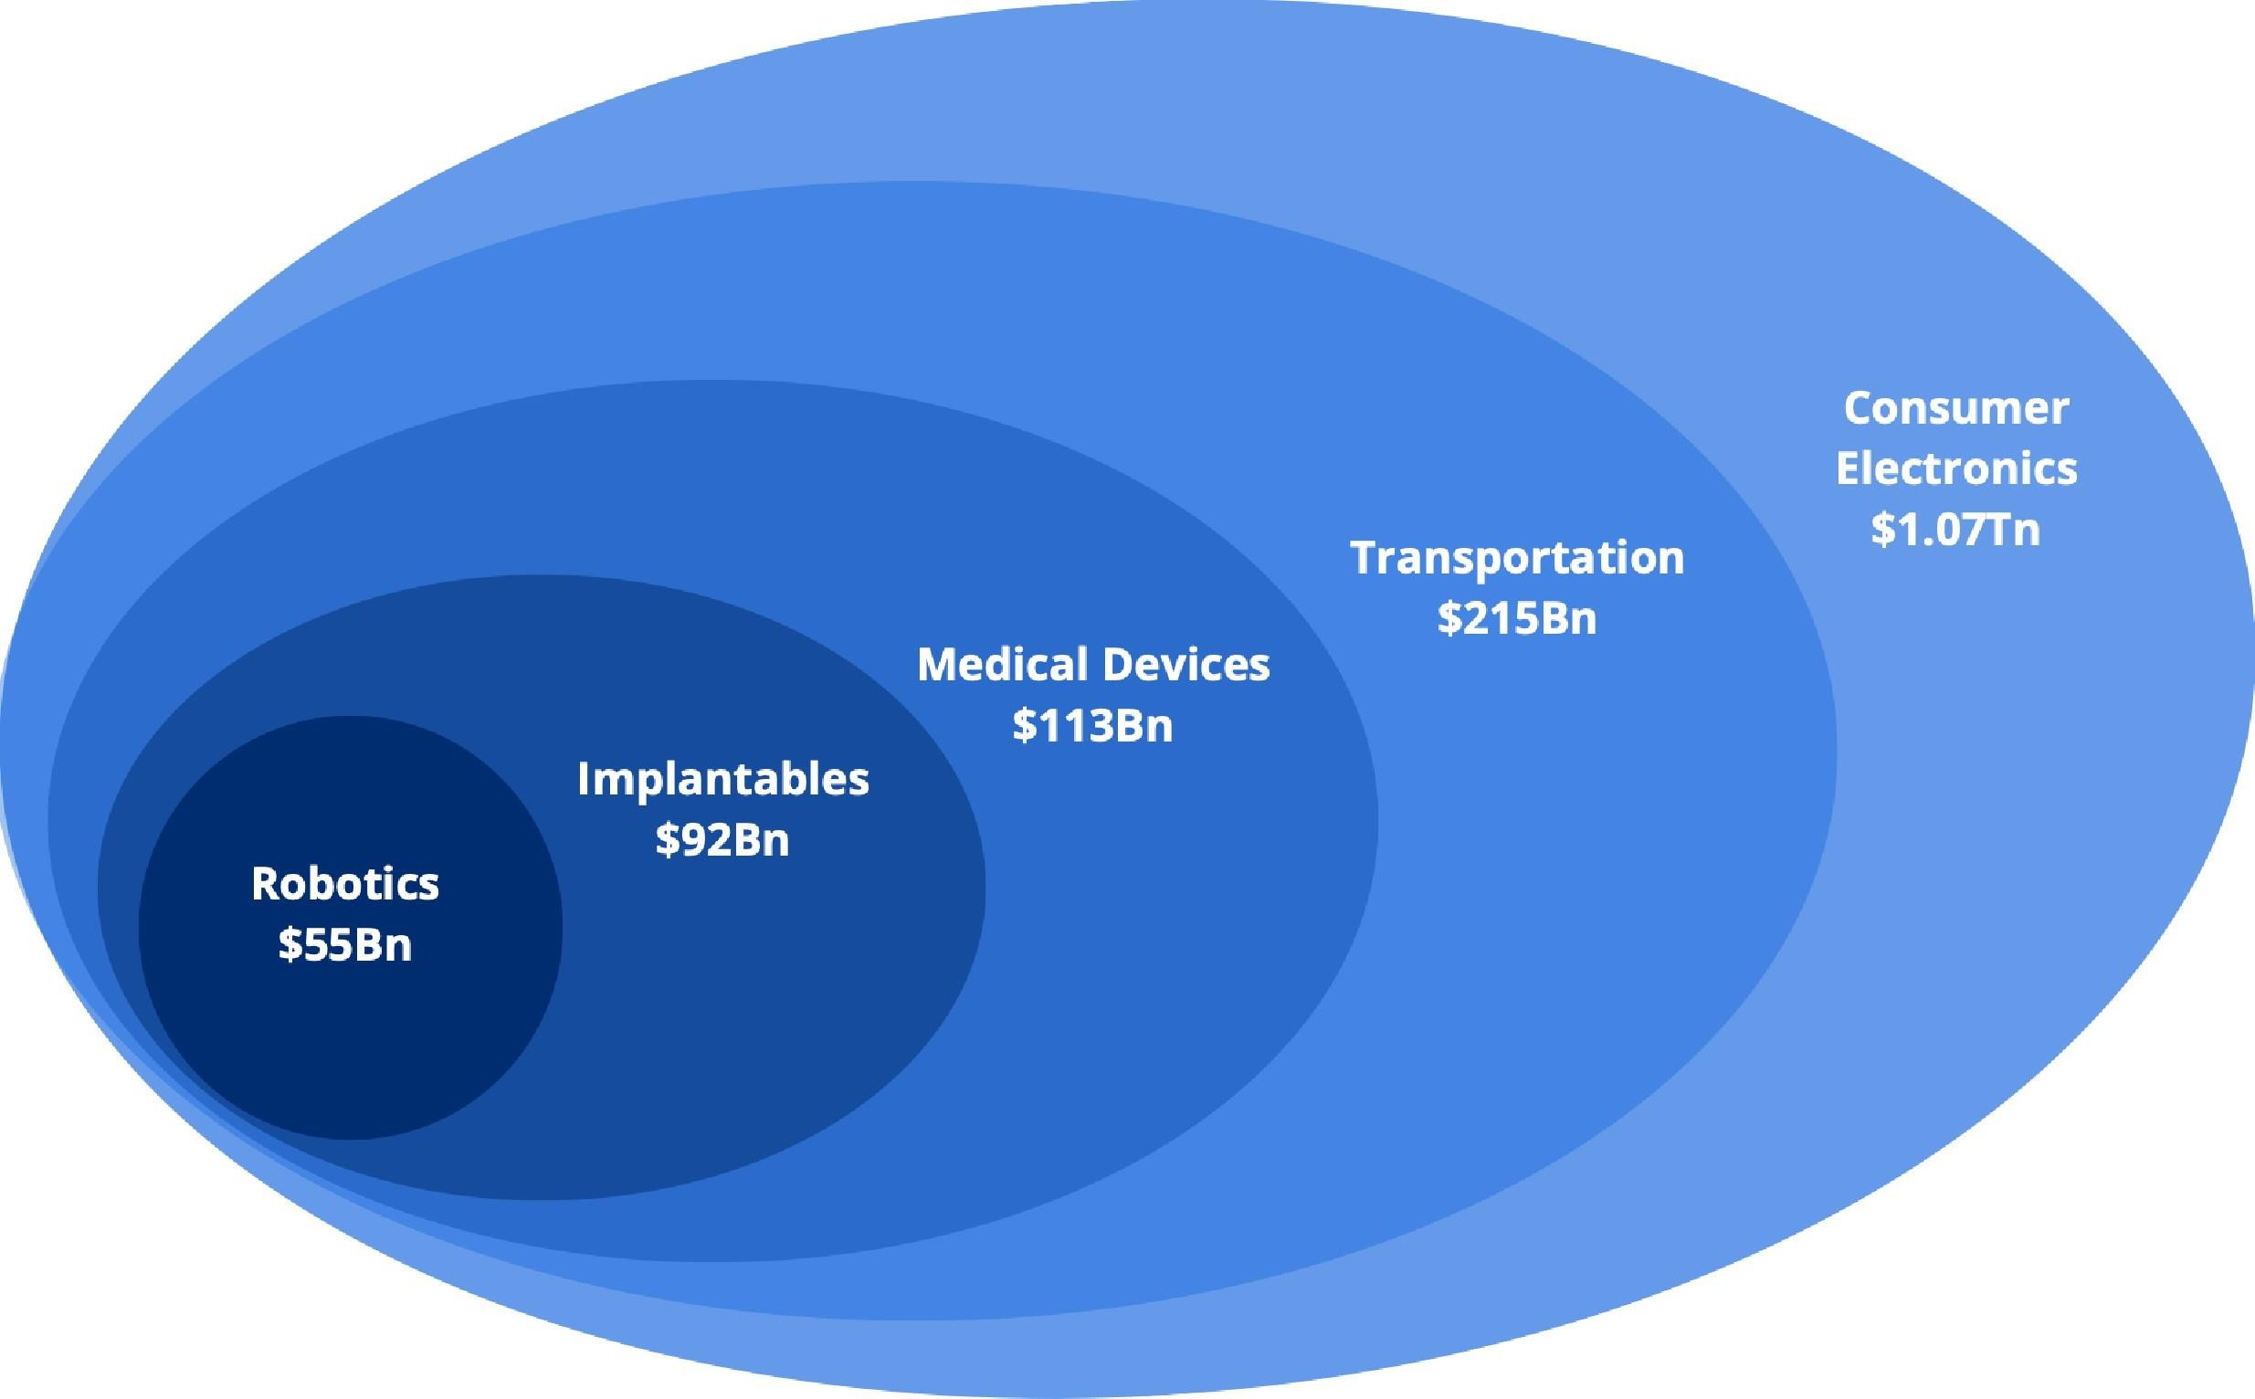


MARKET SIZE
The wireless charging market size was valued at USD 22.17 billion in 2022 and is projected to grow from USD
25.87 billion in 2023 to USD 129.02 billion by 2030, exhibiting a CAGR of 25.8%.
Transportation
$2.81 Tn
Consumer Electronics
$1.10 Tn
Source: https://www.fortunebusinessinsights.com/wireless-charging-market-105183

Slide 9

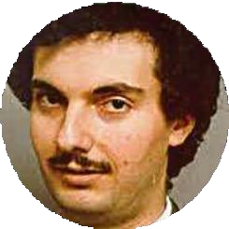

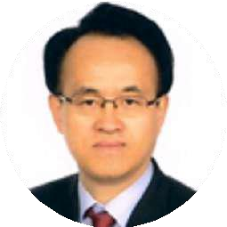

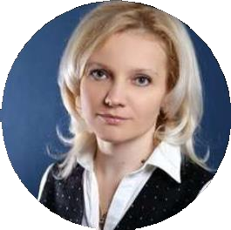















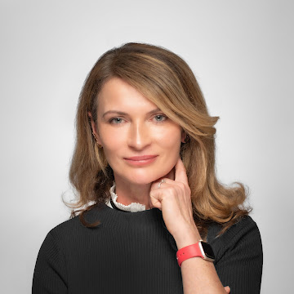


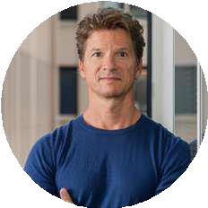

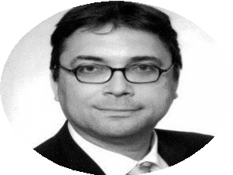
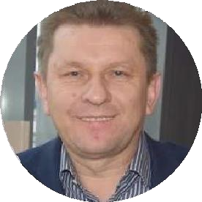
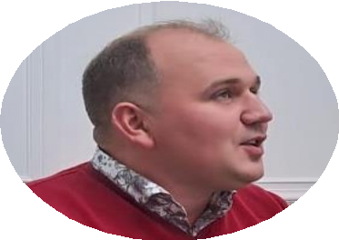














Science Advisors
TEAM
Inventors, co- founders
Dr. Mikhail Dovzhyk
Mathematics, Physics
Dr. Milan Prokin
Physics & Technology
Dr. Alan Lowdon
GEP Representative (Energy Scope)
Dr. Young Chul
Electronic Engineering
Dr. Fotis Filippopoulos
Corporate Innovation
Ruslana Dovzhyk
Chief Executive Officer
Igor Lykahovyi
COO / Head of R&D
Arkadii Romanenko
Chief Technology Officer
Business Advisors
Co-founders
Alina Adams
Alchemist program
Slawomir Olejnik
Deep Tech
Patrick Pestalozzi
MassChallenge
Maren Lesche
General Advisor
Dr. Thomas Brzoska
Healthcare
Leszek Sawickia
Chief Product Officer
Adam Zetek
E-bikes Direction
Iwona Kerr
Chief Strategy Officer

Slide 10

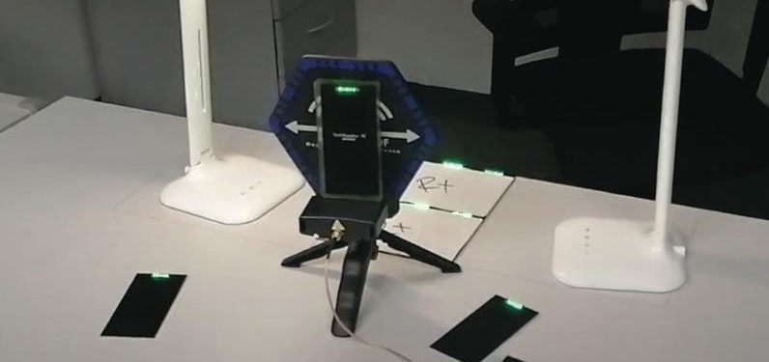
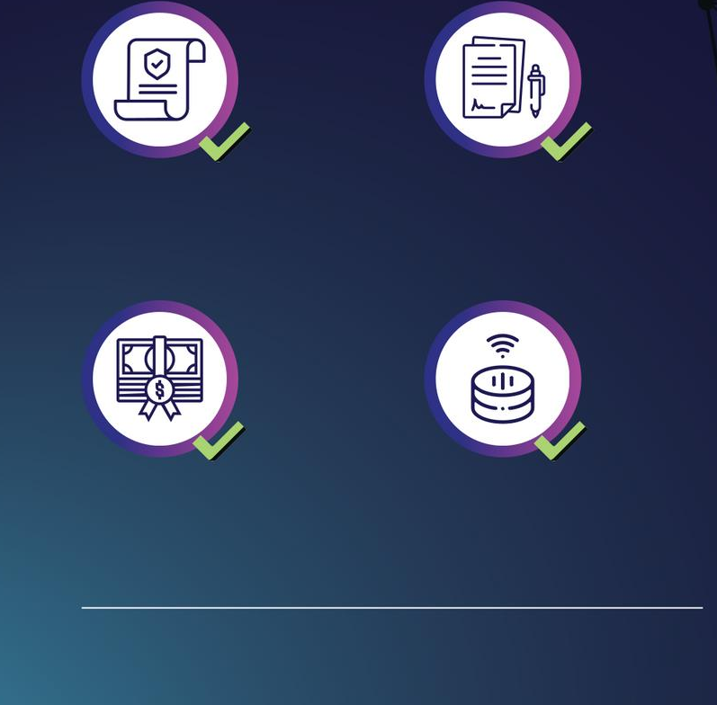

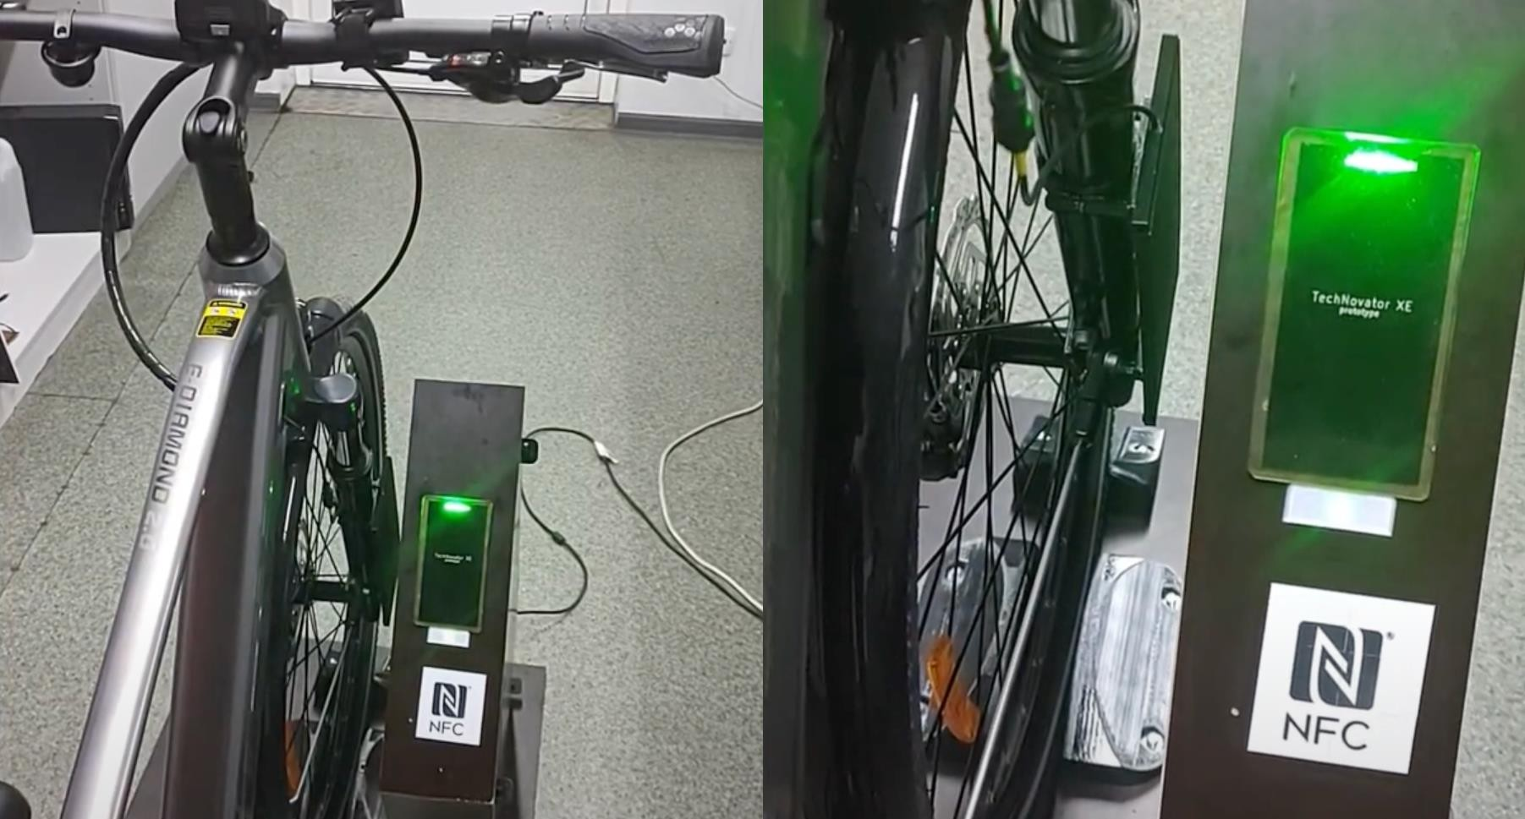
Working prototype demonstration videos Consumer Electronics
WHERE WE ARE NOW
Safety test report CE
Signed
MOUs
Transportation
R&D scientific grant
Pre-sales products
Wireless charging technology is ready to be deployed
into various consumer electronics.

Slide 11





MILESTONES & ACHIEVEMENTS
MILESTONES & ACHIEVEMENTS
Safety Test Report CE
R& D Scientific Grant
Signed several MOUs
"Core" working prototype
Ready Go-to market product
2015
2019
2022
2024
Technology tests and research
Invention
Technology mastering
Ready to deploy and scale up
TechNovator Health

Slide 12


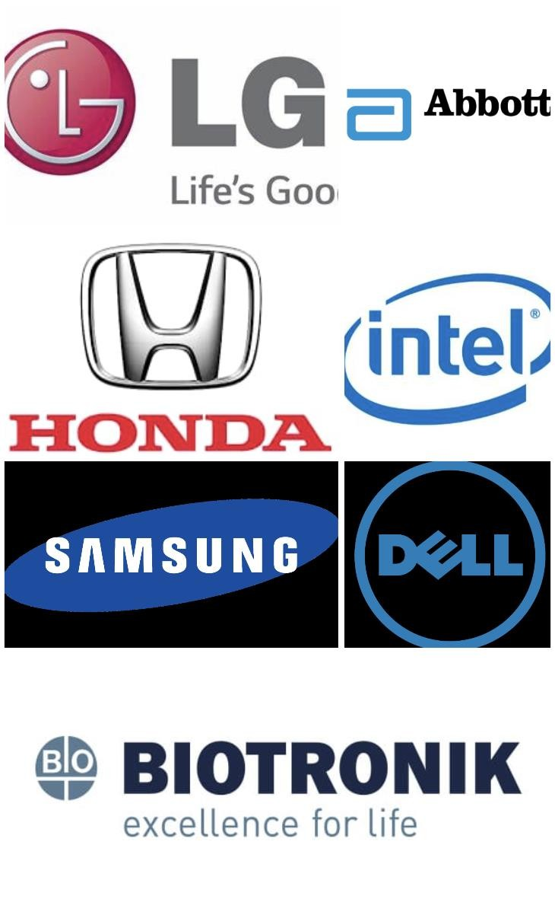
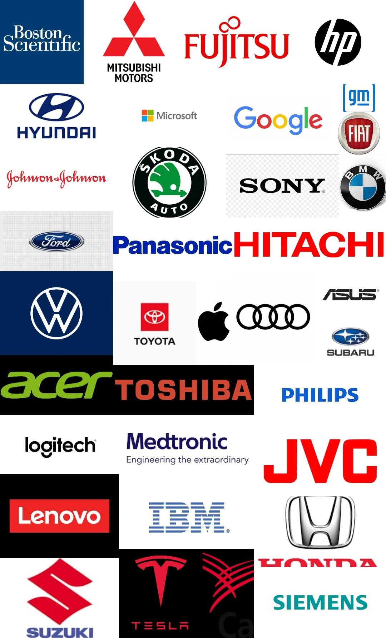



Partnerships
Trusted Partners/ Support Ecosystem
In negotiations:
Future/Target Partners:

Slide 13





Our A s k
Total funding till now EUR 2mn
Standards and Certification
€5,000,000
15%
Legal and IP Protection
15%
Operations and R&D
60%
10%
M a r k e t i n g a n d P r o m o t i o n
Currently raising a EUR 5Mn Seed round to launch our first OEM product based on
quantum charging technology

Slide 14

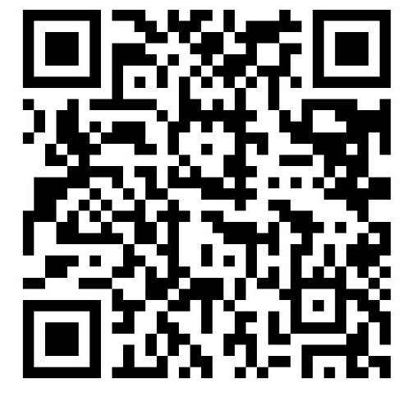
Thank you
Let’s power the future together by setting a new standard for wireless charging solutions
info@technovator.co
http://technovator.co/
Ruslana Dovzhyk
+380961775599
+48889411422
r.dovzhyk@technovator.co

Slide 15
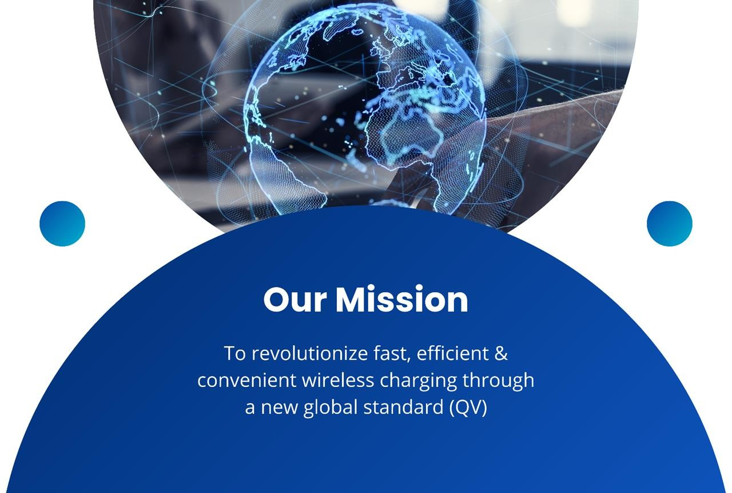

Slide 16
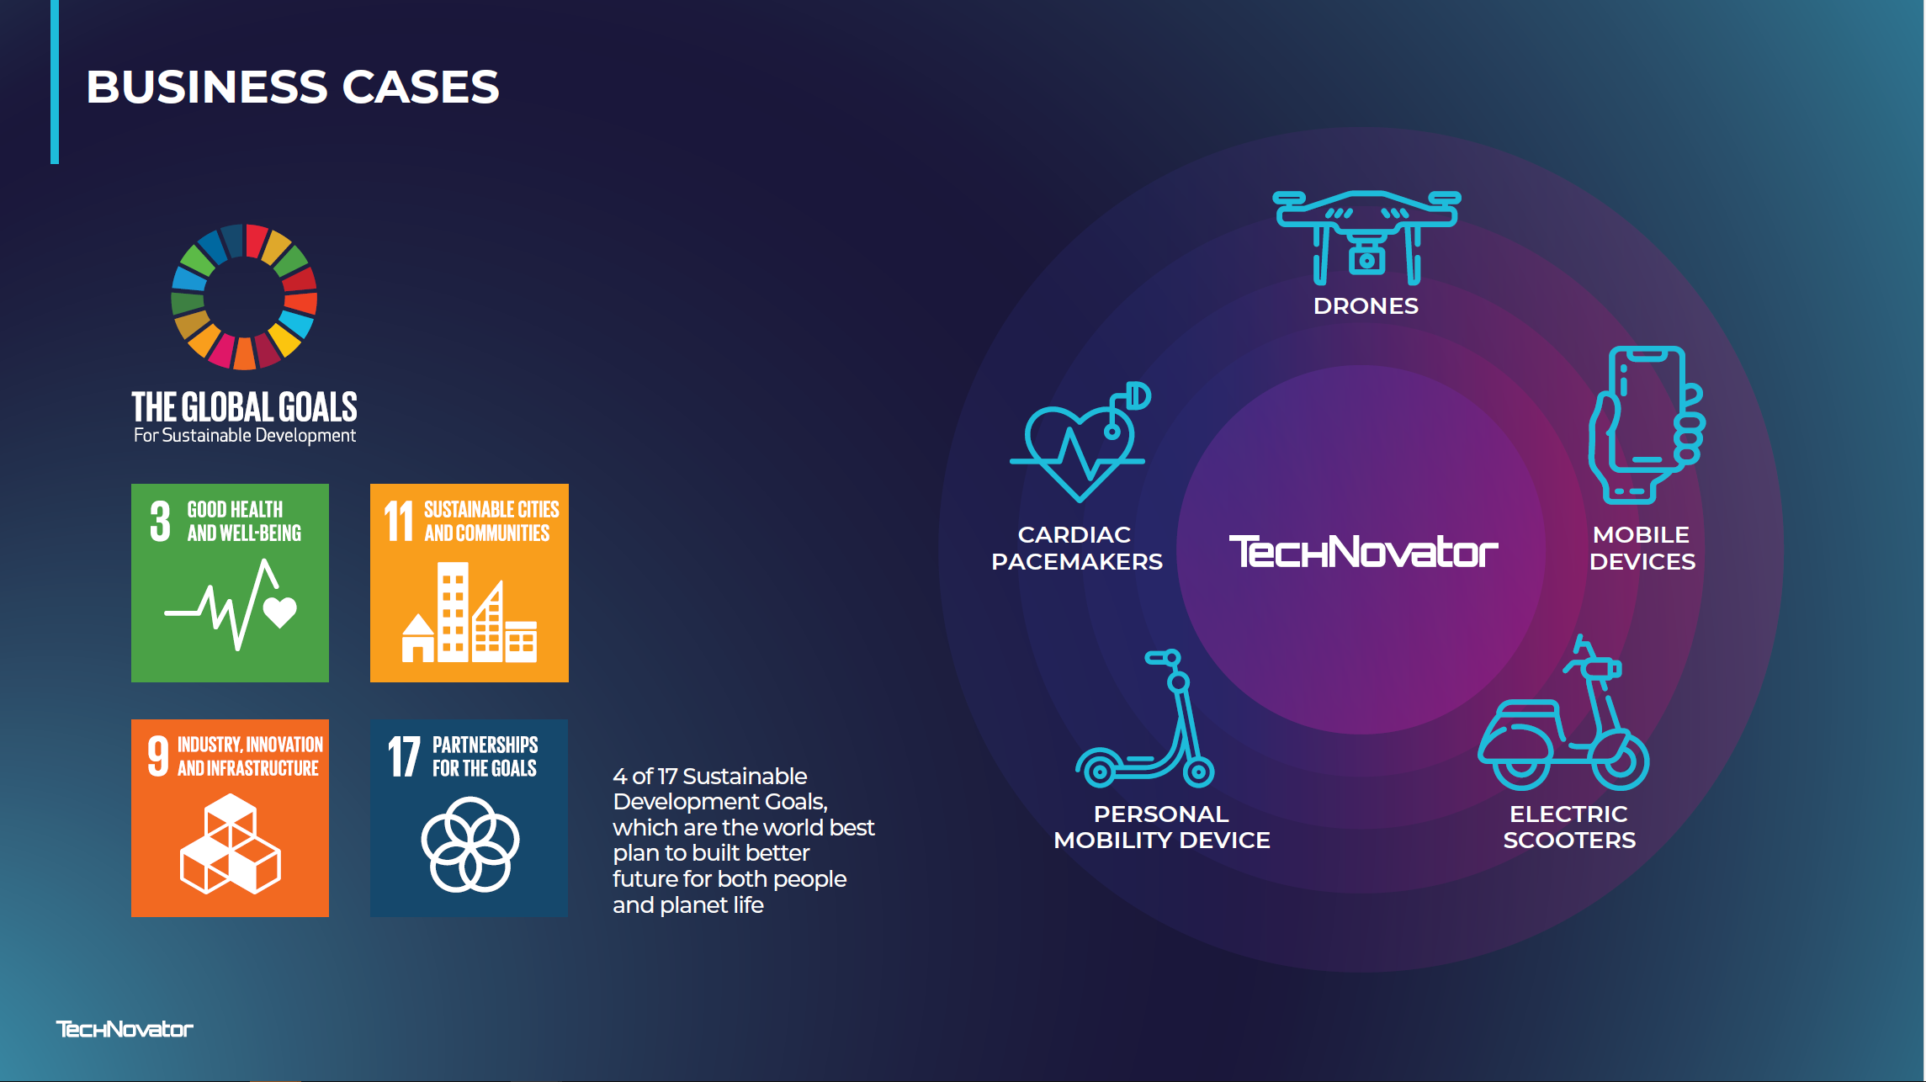

Slide 17
GO TO MARKET
Licencing model
Key Target
Markets
Future Target
Markets
Transportation
$2.81 Tn
Consumer
Electronics
Transportation
HEALTH CARE Implantable devices
Consumer Electronics
$1.10 Tn
TAM $1,10T
TAM $2,81Tn
TAM $92 Bn
SAM $6.2Bn
SAM 4.5Bn
SAM 45 Bn
SOM 50% of SAM
SOM 40% of SAM
SOM 35% of SAM

Slide 18
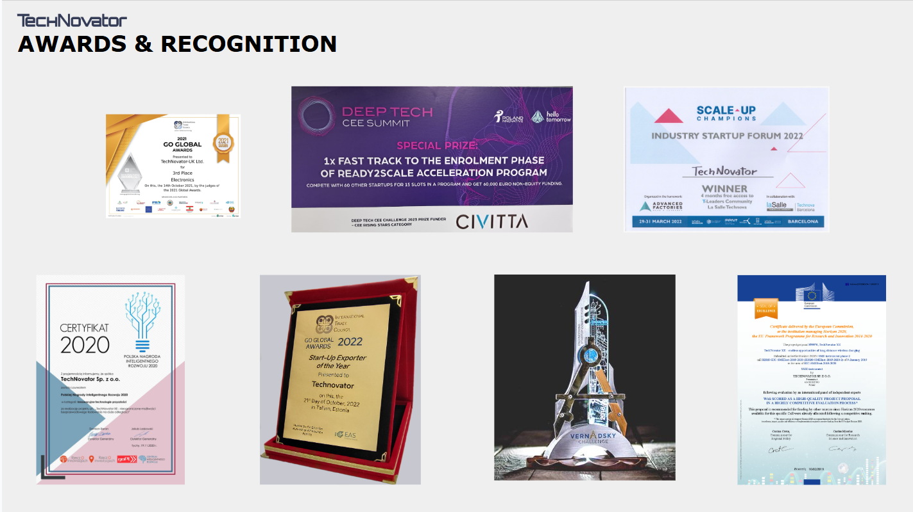

Slide 19







ADVANTAGES OF QUANTUM CHARGING TECHNOLOGY
No contact required
reclaim your freedom
Equal efficiency
to cable charging
Charge multiple
devices without a cable
No emissions interference (EMI)
no electromagnetic field, no heating
Up to 1000W
charging capability for consumer electronics
Distances up to 50 cm
in any orientation

Slide 20
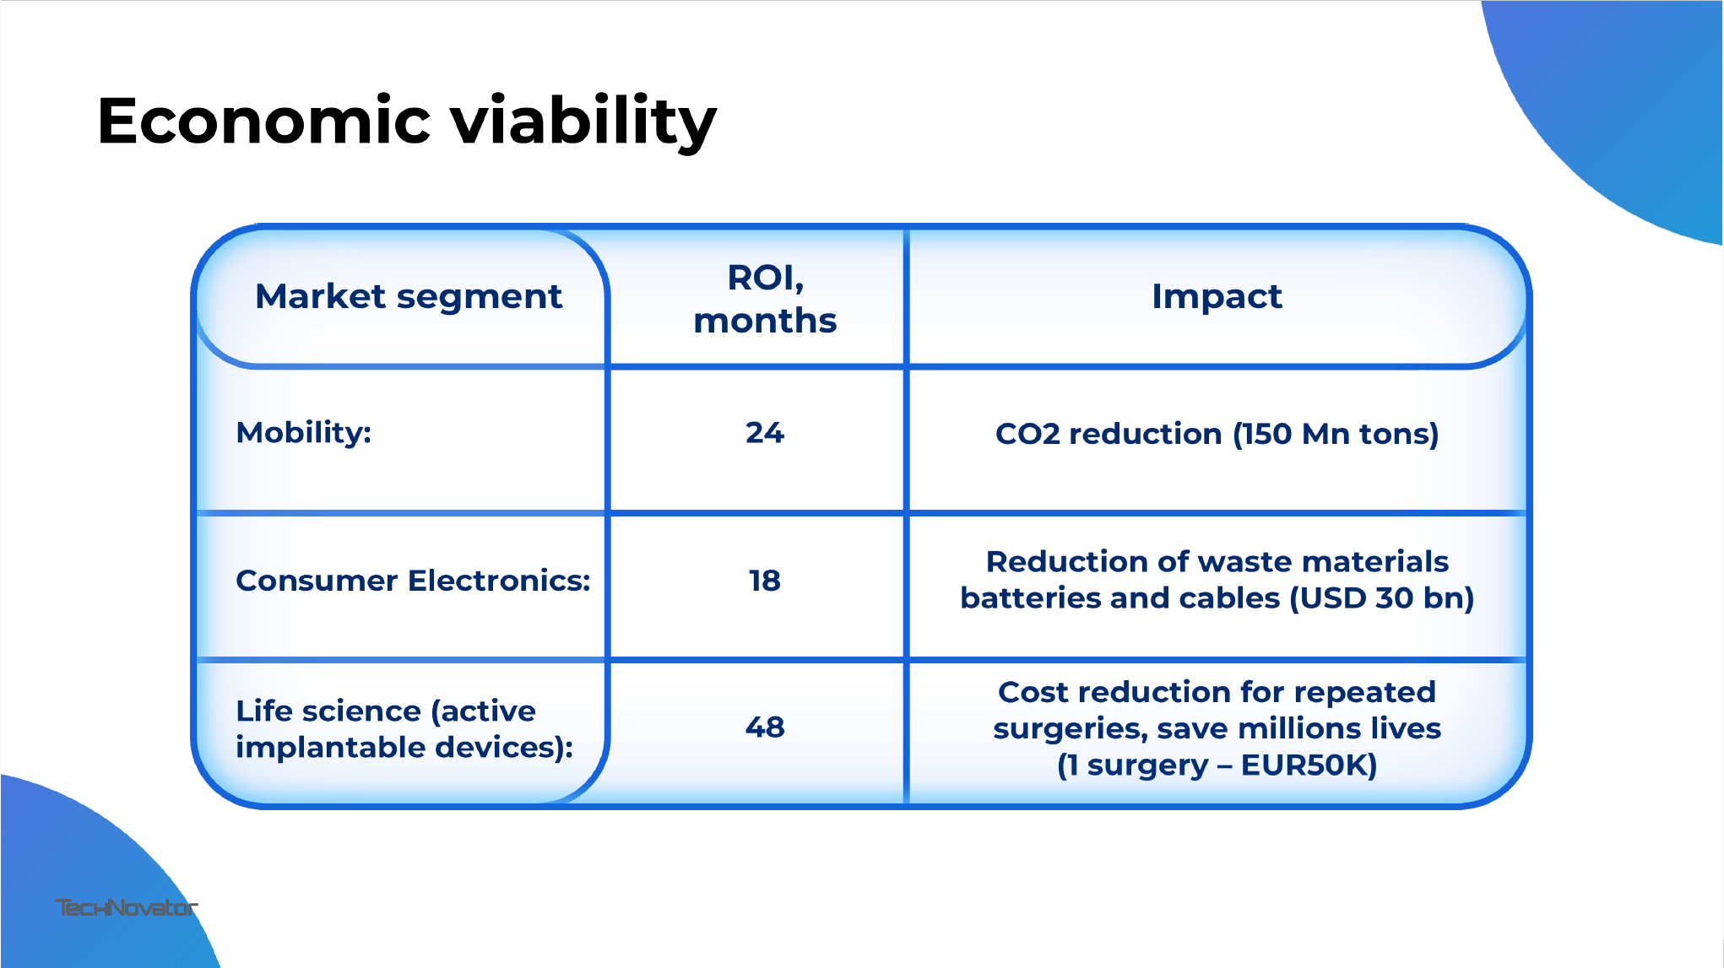

Safety Test Report CE
R& D Scientific Grant
Signed several MOUs
"Core" working prototype
Ready Go-to market product
Technology tests and research
Invention
Technology mastering
Ready to deploy
and scale up

Slide 21
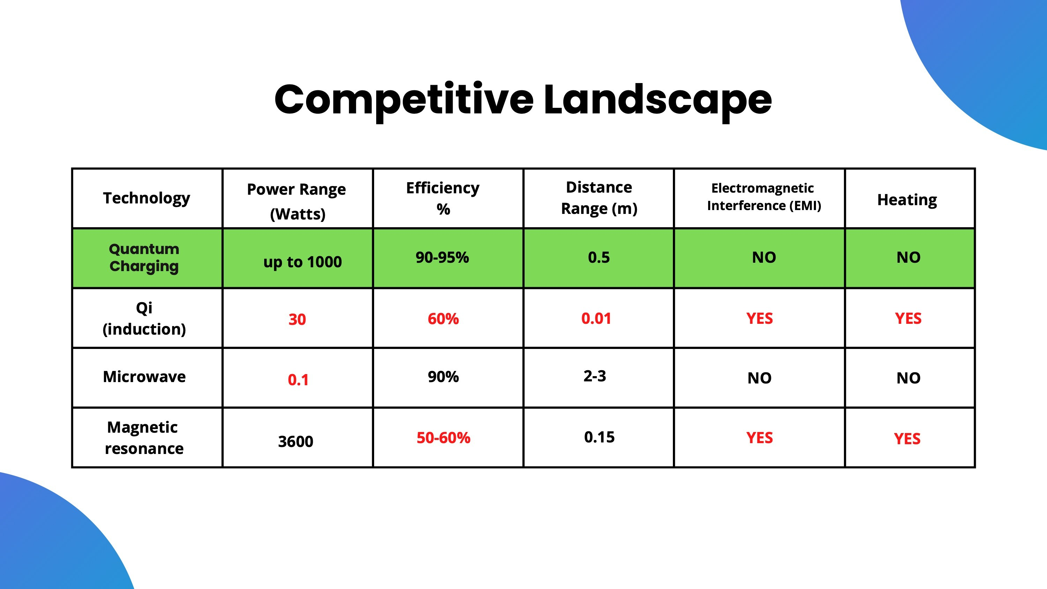



Wireless charging competitors
No other solution matches our high efficiency and remote charging safety standards

