Slide 1

Model Program Strategy
Barsha Banerjee
Perkins School For The Blind India Foundation
Zero Project India Forum
Thursday, 12:40pm
Notes:
Model Program Strategy
Barsha Banerjee
Perkins School For The Blind India Foundation
India
Zero Project India Forum
#ZeroCon24
Day and Time of Session

Slide 2
Every child can learn.
Anywhere.
We provide the know-how to prepare children with disabilities for the future.
#ZeroCon24
© Perkins India
Notes:
Our Motto: Every Child Can Learn. Anywhere.
We provide the know-how to prepare children with disabilities for the future.

Slide 3
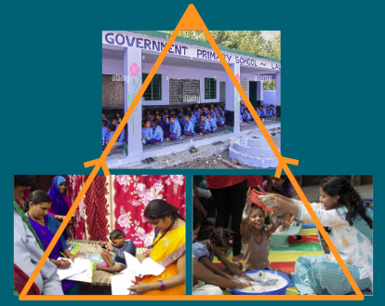
Model Program Approach
SCHOOL
COMMUNITY
FAMILY
#ZeroCon24
© Perkins India
Notes:
Model Program Approach
Triad (Image): School on the top side, Community on the bottom left hand side and Family on the bottom right hand side.

Slide 4
Model Program Approach: What does it mean?
We support schools/programs to improve quality and accessible learning for children with disabilities.
We work with local partners, families, communities and the government.
We develop these schools/programs to model school to replicate the same in other neighbouring schools/programs.
We strengthen and transform schools to provide systemic change in education.
We have launched Model Programs in three geographies in India- Maharashtra, Gujarat and Rajasthan.
© Perkins India
Notes:
Summary of the Model Program Approach:
Supporting schools to improve quality and accessible learning for children with disabilities
Working with local partners, families, communities and the government
Developing schools to model schools to replicate in other neighbouring schools
Transforming schools to provide systemic change in education
Launched Model Programs in three geographies in India

Slide 5
Model Program (School) Process
Formal agreement with school partner (NGO or government)
School selection by Perkins
Baseline assessment (standard quality indicators)
Agree on a comprehensive action plan for quality improvement
Year-long coaching and mentoring: training curriculum (teachers, administrators, families), strategic planning, leadership development.
#ZeroCon24
5
© Perkins India
Notes:
Model Program Process
Formal agreement with school partner
School selection by Perkins
Comprehensive action plan for quality improvement
Year long coaching and mentoring- training curriculum, strategic planning and leadership development

Slide 6
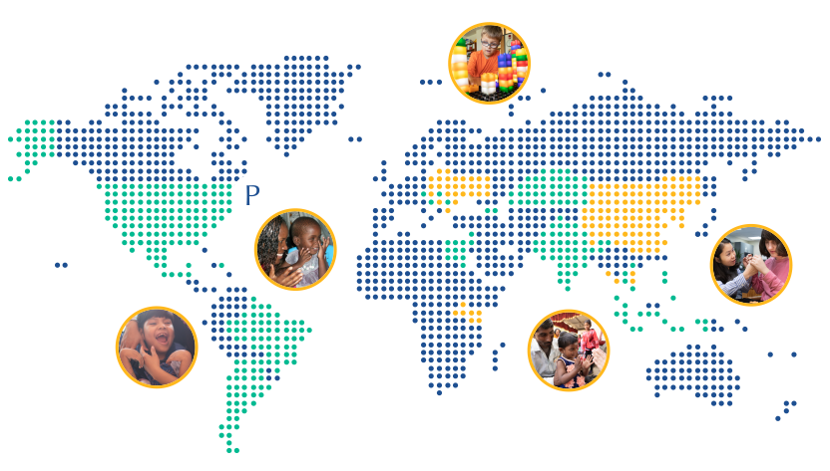
16 Countries
• Argentina
• Armenia
• Bhutan
• Brazil
• Chile
• Croatia
• Dominican
Rep.
• Egypt
• India
• Indonesia
• Jerusalem
• Kazakhstan
• Mexico
• Philippines
• Serbia
• Thailand
#ZeroCon24
© Perkins India
Notes:
Perkins School For The Blind’s strong presence in 16 countries

Slide 7
1,232,503
Children reached in 2023
44,586 Adults trained
161 Programs supported
#ZeroCon24
© Perkins India
Notes:
Perkins has reached 1,232,503 children in 2023, trained 44,586 adults and supported 161 Programs.

Slide 8
Children need us to do more.
Scaling up takes people and pipeline
#ZeroCon24
© Perkins India
Notes:
Children need us to do more.
Scaling up takes people and pipeline

Slide 9
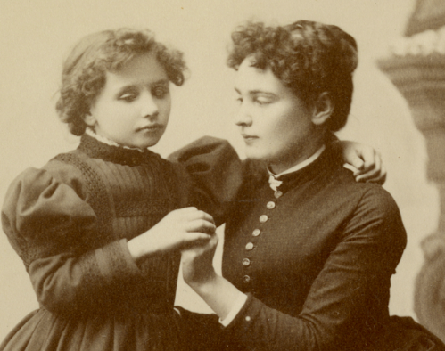
Call for Partners…
‘Alone, we can do so little; together we can do so much.’
Helen Keller
#ZeroCon24
© Perkins India
8
Notes:
Call for Partners: ‘Alone we can do so little; together we can do so much’. - Helen Keller

