Slide 1


Give and Take Coffee
A Socially Inclusive Coffee Brand
Yiyi (Becky) Chen & Lulei Chen
Give and Take Coffee
China
Small organizations as inclusion champions
Wednesday 5 March 2025 | 14:00 - 15:00
#ZeroCon25
Notes:
Please add your notes here.
Title; First name, last name of speaker(s); Name of Organization, Name of Country, Name of Session (as written in Agenda)
#ZeroCon24
Day and Time of Session

Slide 2

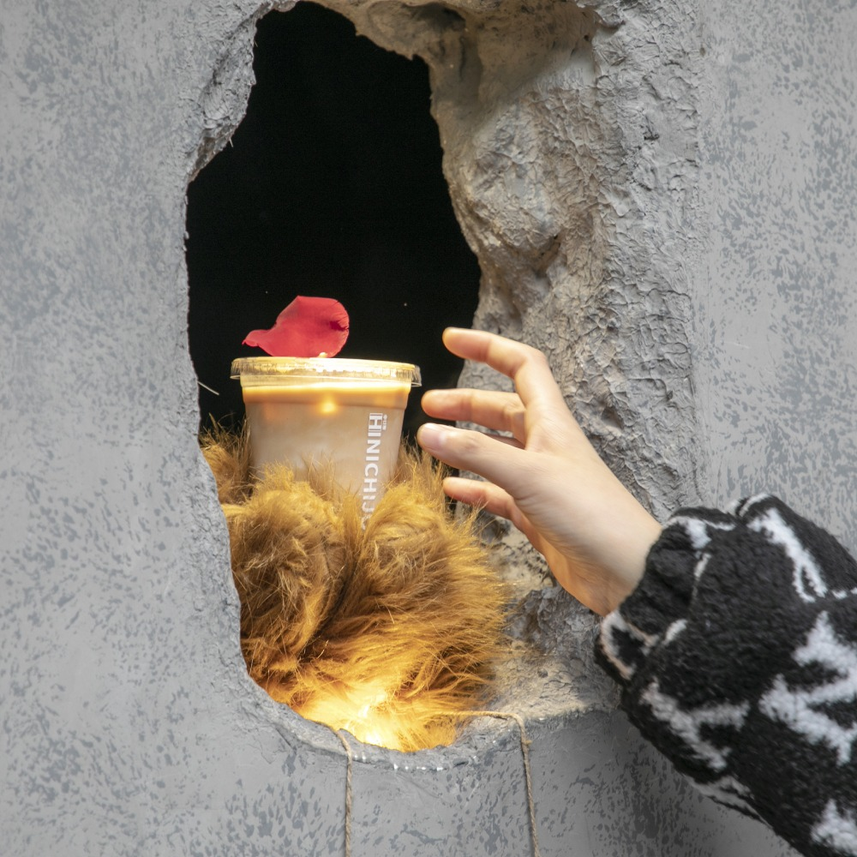
Give and Take — The Rhythm of Life
1
Founded
2019, Shanghai, China
2
Mission
To create a sustainable employment model for people with disabilities through specialty coffee and social impact.
3
Business Model
Combining ESG-focused business strategies with inclusive employment practices, ensuring long-term sustainability.

Slide 3


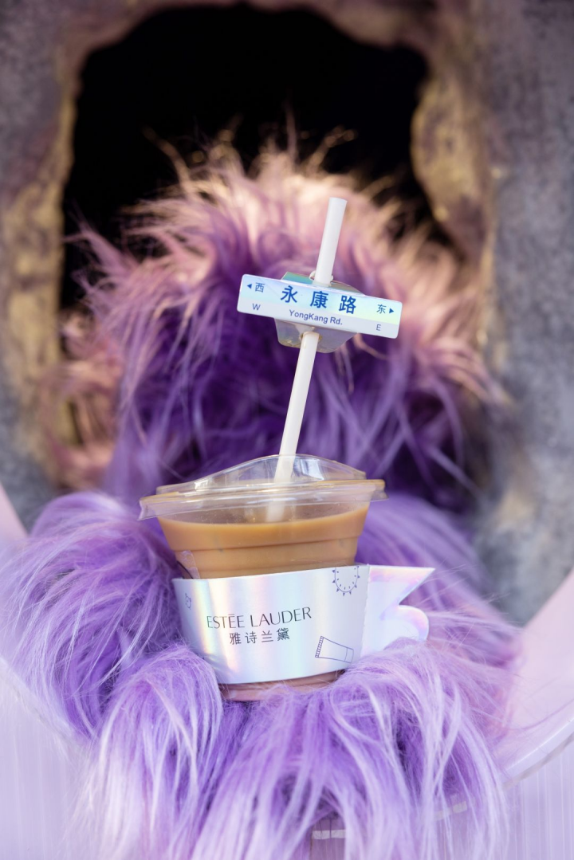
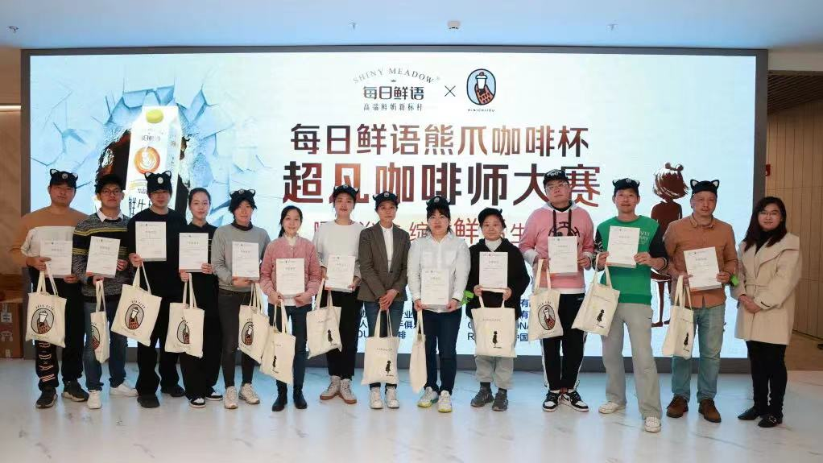
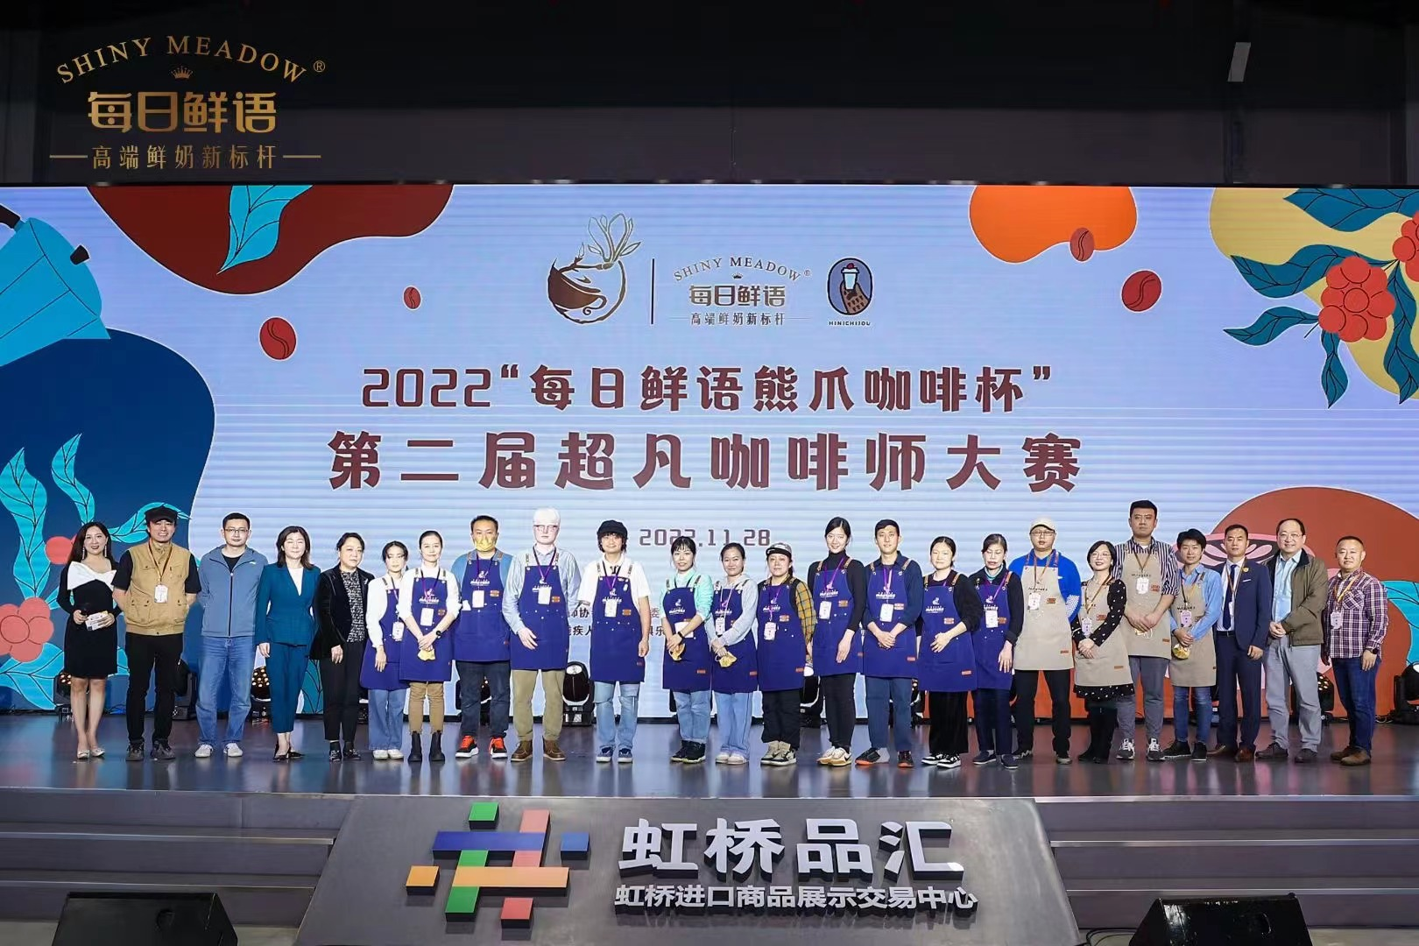
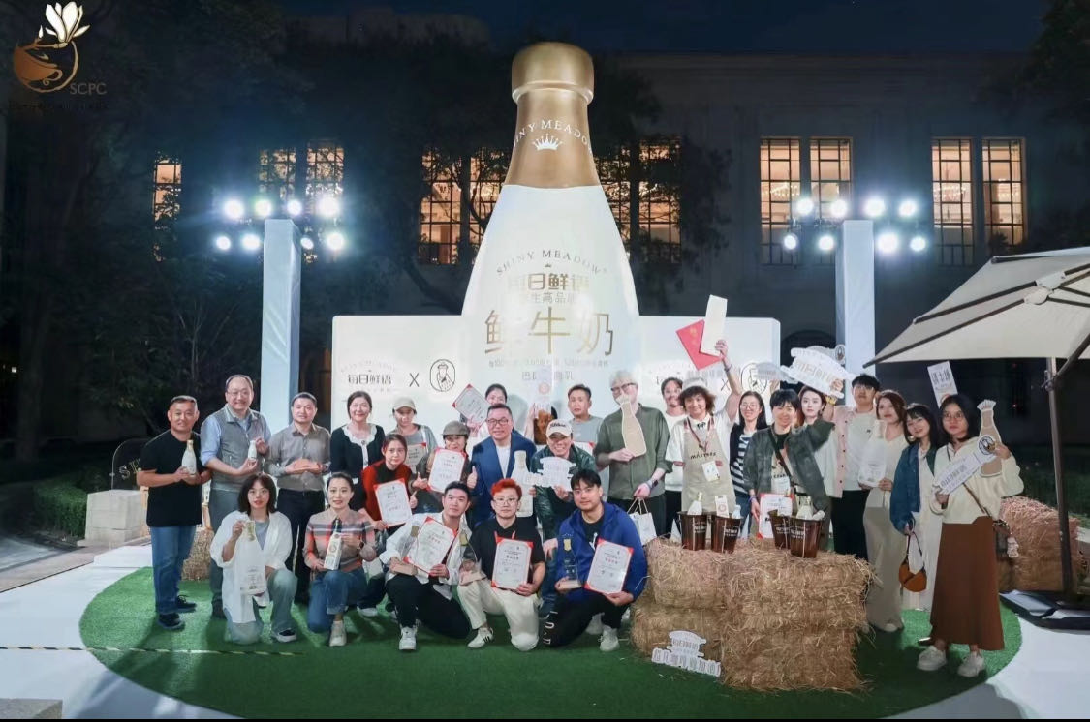
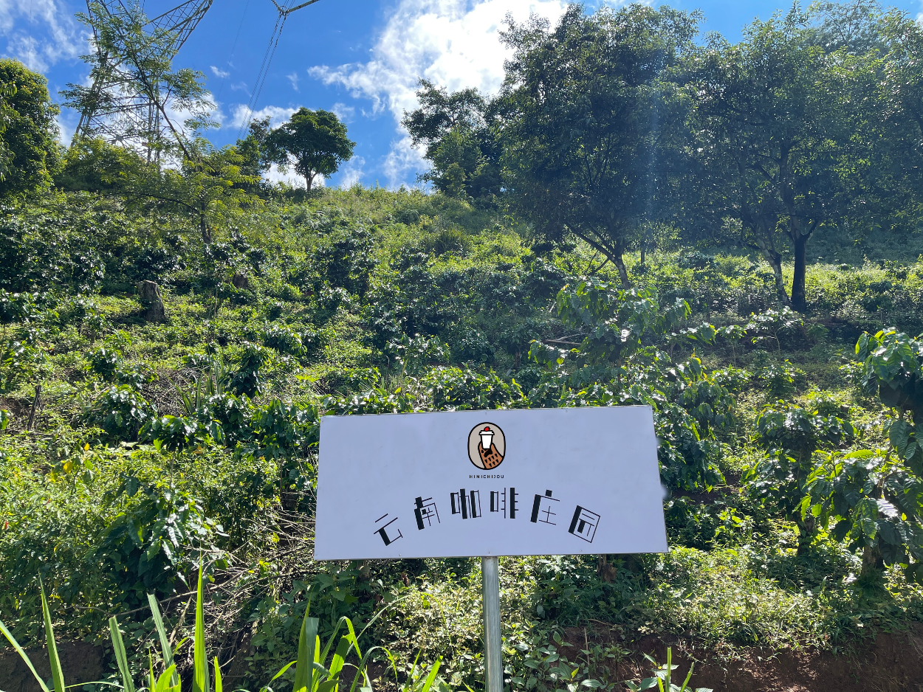
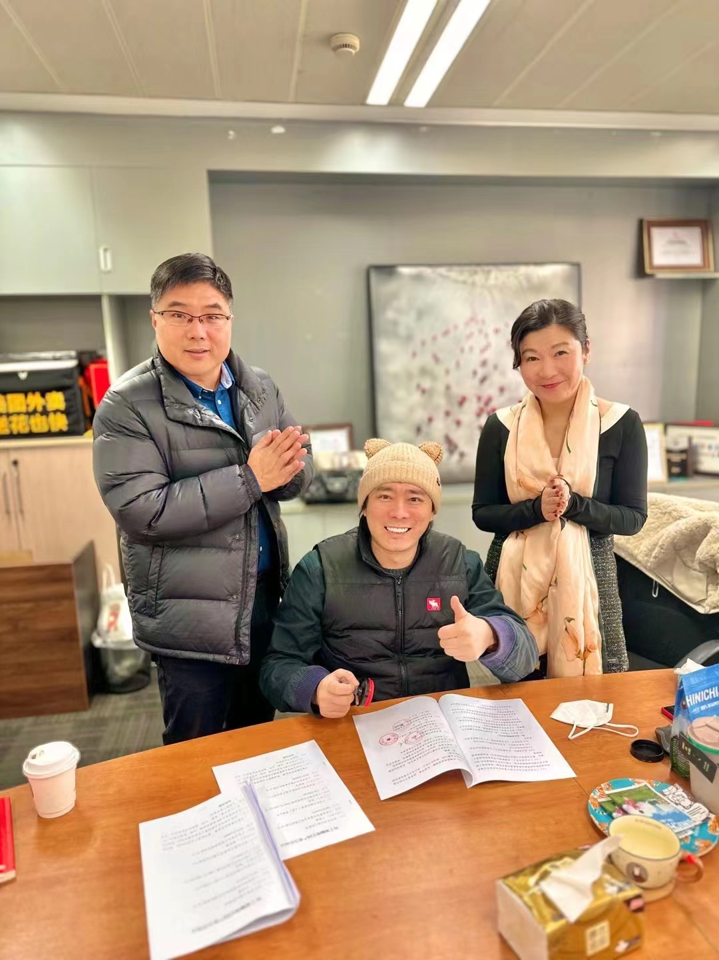



Essence of the Project
Give and Take is more than a coffee brand — inclusive employment and social integration model for people with disabilities.
14 Chain Stores + 3 Coffee Farms
Education
Social enterprise partnerships
90% of its employees are individuals with disabilities, covering both baristas and management positions.
2 schools for disabled baristas
NeverMind coffee
  Trained and employed over 100+ baristas with disabilities, including individuals who are blind, deaf, physically impaired, on the autism spectrum, etc.
Coffee competition
Co-branded coffee stores with corporations such as Michelin China, China Telecom, and China Resources Group.
innovative VR AR

Slide 4
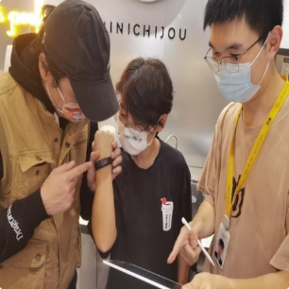
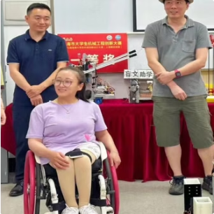
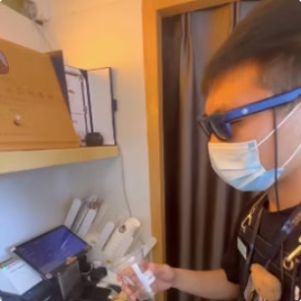
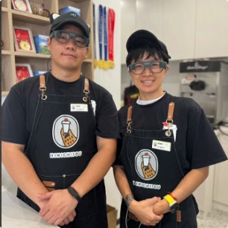
Innovative Aspects
Wristband for Deaf Baristas
Exoskeleton Mechanical Chair for Wheelchair Baristas
Smart AI Glasses
For Blind Baristas
Smart AR Glasses
for Deaf Baristas
Vibrates to alert baristas of new orders
A camera detects QR codes and broadcasts information via bone-conduction headphones.
Displays customer speech on the AR glasses
Designed to assist baristas in standing and making coffee

Slide 5
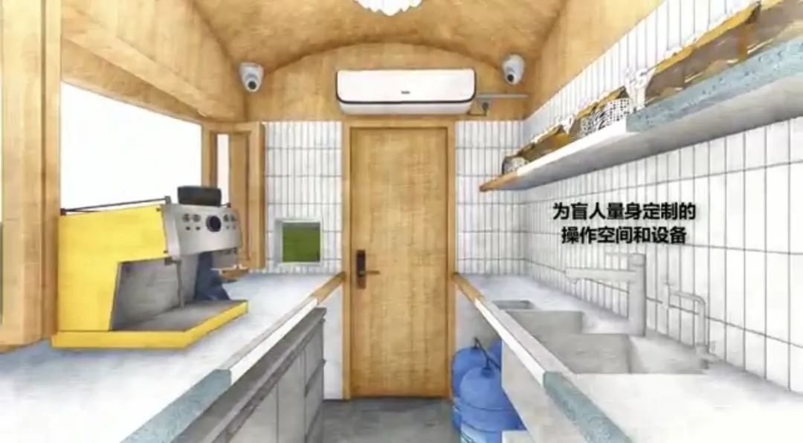
Innovative Aspects
S
P
O
Give and Take Coffee store employees customized SOPs to match the workforce structure.
The training system is well-established, with new employees receiving 57 hours of training before starting their jobs.
Give and Take coffee places a high value on employee satisfaction, resulting in a low employee turnover rate.
>>
>>

Slide 6



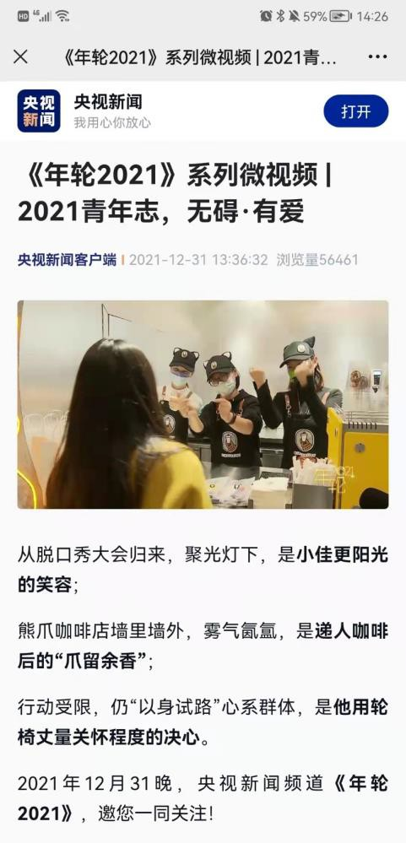
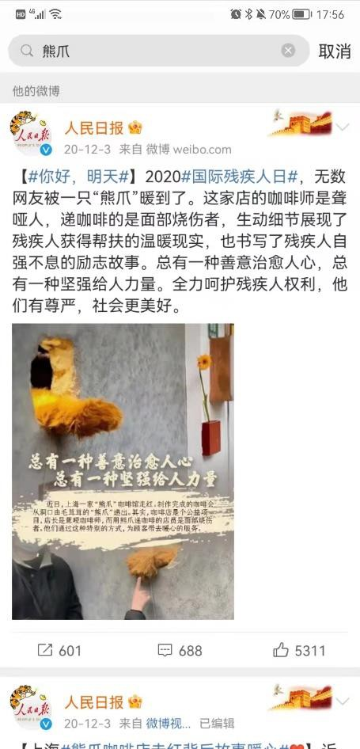
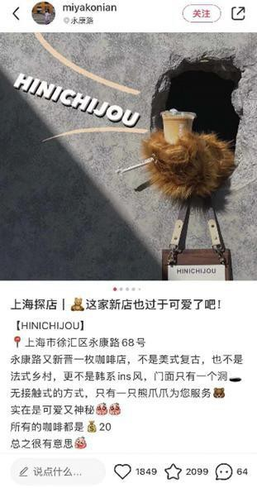
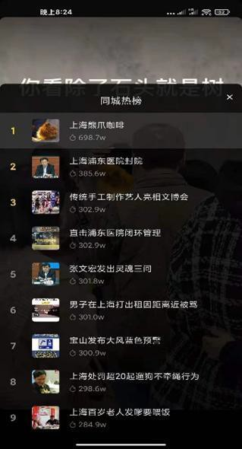
Impact Created
Social Media and Media Coverage
Brand Influence & Media Coverage
Featured in over 20 reports by official media outlets (e.g., CCTV, People's Daily)
Over 1 billion views on Douyin (Tiktok China), multiple #1 spots on local trending lists
Over 100k+ views on related Weibo posts and articles
Featured on major platforms: The Red Note, Bilibili, Kuaishou, Weibo, Toutiao, etc.
Related videos reached an audience of 100k+
155 million related pages on Baidu, 12,500 articles in media reports

Slide 7
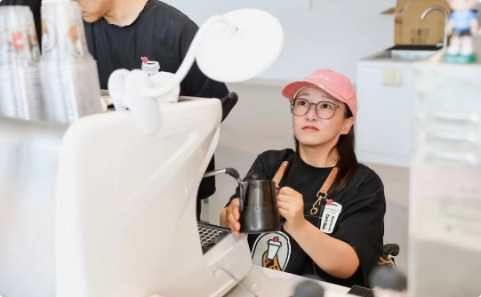
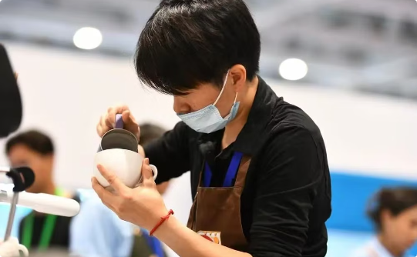
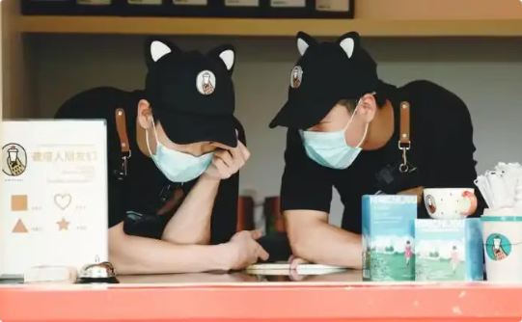
Our Stories
Physically Disabled Barista
Hearing impairment Barista
Visual impairment Barista
Xiaoyan Wang
Lulei Chen
Tianbao Yin & Tianyou Yin

Slide 8
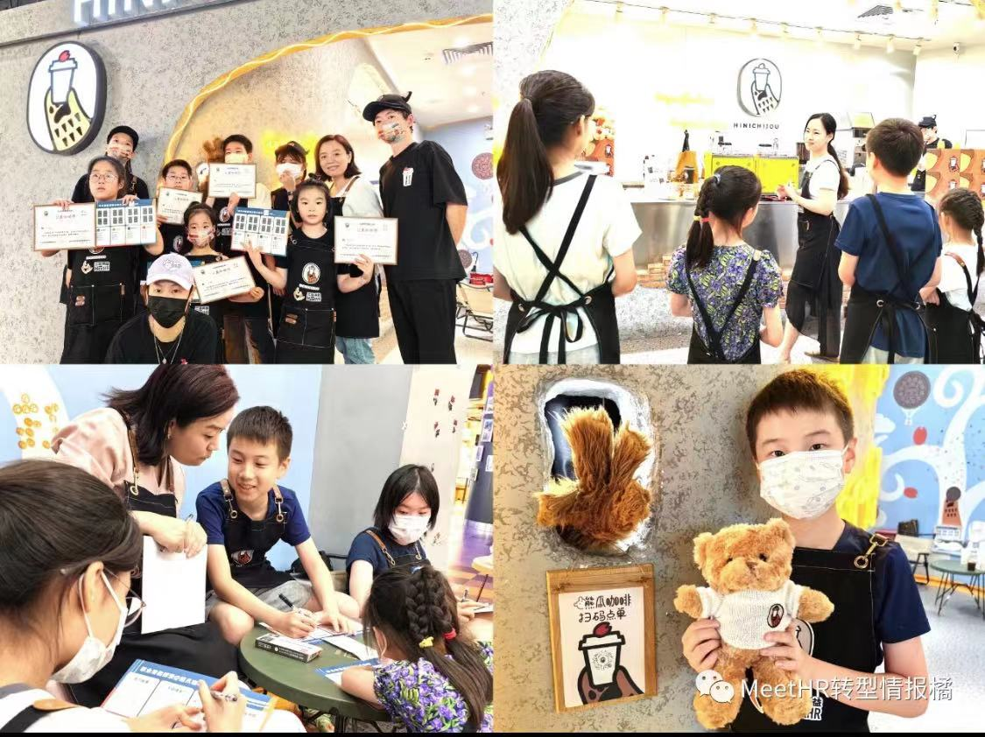


Next Step 100 stores
Build a public welfare network with a "snowball" effect
Reaching 70,000+ corporate employees across 40 key commercial areas
Collaboration with top brands
Helping 200-300 disabled individuals, bringing hope to 300 families, while professionalizing coffee chain operations for disabled employees

Slide 9
Lighting the Future with Kindness
Lighting the Future with Kindness
A commercially sustainable model designed to give back to society, fostering social value and creating meaningful impact by breaking barriers.
Our Goal: To become the largest socially responsible coffee company in the Asia-Pacific region, generating both social and economic benefits for shareholders, consumers, and employees with disabilities..

