Slide 1
Sovereign AI -
Zhipu Cooperation Proposal
Global Business Center
Zhipu
Notes:
单击此处添加文本

Slide 2
Why Zhipu
2

Slide 3

About Zhipu
Mission:
Teaching Machines to Think Like Humans
UK R&D
Beijing HQ
北京总部
Branches:
Hangzhou Shanghai
Chengdu Zhuhai
Shenzhen HK
ME Branch
Malaysia Branch
Singapore Branch
Business Operations
FTEs
R&D percentage
ToC(chatglm.cn) Users
ToB(bigmodel.cn) tokens/day
800+
70%
30M+
250B+

Slide 4






Zhipu is Leading the LLM Evolution
1st 10B LLM
In China
1st 1000B+ LLM
in China
1st Chat LLM
in China
1st Multimodal Model
in China
2020
All in LLM
2021.6
GLM-10B
Opensource
2023.3
ChatGLM
ChatGLM-6B
Opensource
2024.1
GLM-4
2024.7
CogVideoX
Opensource
2024.10
AutoGLM
GLM-4-Voice
Opensource
2024.12
GLM-Zero
Preview
2025.3
CogView-4-6B
GLM-4-Z1-Ruminiation
Opensource
2019
Founded
2021.3
GLM
CogView
Opensource
2022.10
GLM-130B
Opensource
2023.8
智谱清言
chatglm.cn
2024.6
GLM-4-0520
GLM-4-Air
GLM-4-9B
Opensource
2024.8
GLM-4-Plus
VideoCall
2024.11
GLM-PC
2025.1
GLM-Realtime
GLM-4-Air-0111
GLM-4V-0111
CogView-4
https://github.com/THUDM
4
Notes:
单击此处添加文本

Slide 5
Zhipu Latest Foundation Model - GLM-4-Plus
GLM-4-Plus matches GPT-4o and Llama3.1, which has 405B parameters, in terms of language processing capabilities.
 | AlignBench | MMLU | MATH | GPQA | LCB | NCB | IFEval
Claude 3.5 Sonnet | 80.7 | 88.3 | 71.1 | 56.4 | 49.8 | 53.1 | 80.6
Llama 3.1 405B | 60.7 | 88.6 | 73.8 | 50.1 | 39.4 | 50.0 | 83.9
Gemini 1.5 Pro | 74.7 | 85.9 | 67.7 | 46.2 | 33.6 | 42.3 | 74.4
GPT-4o | 83.8 | 88.7 | 76.6 | 51.0 | 45.5 | 52.3 | 81.9
GLM-4-Plus | 83.2 | 86.8 | 74.2 | 50.7 | 45.8 | 50.4 | 79.5
GLM-4-Plus/GPT-4o | 99% | 98% | 97% | 99% | 101% | 96% | 97%
GLM-4-Plus/Claude 3.5 Sonnet | 103% | 98% | 104% | 85% | 92% | 95% | 99%
LCB: LiveCodeBench, NCB: NaturalCodeBench
represents reproduced results
5

Slide 6
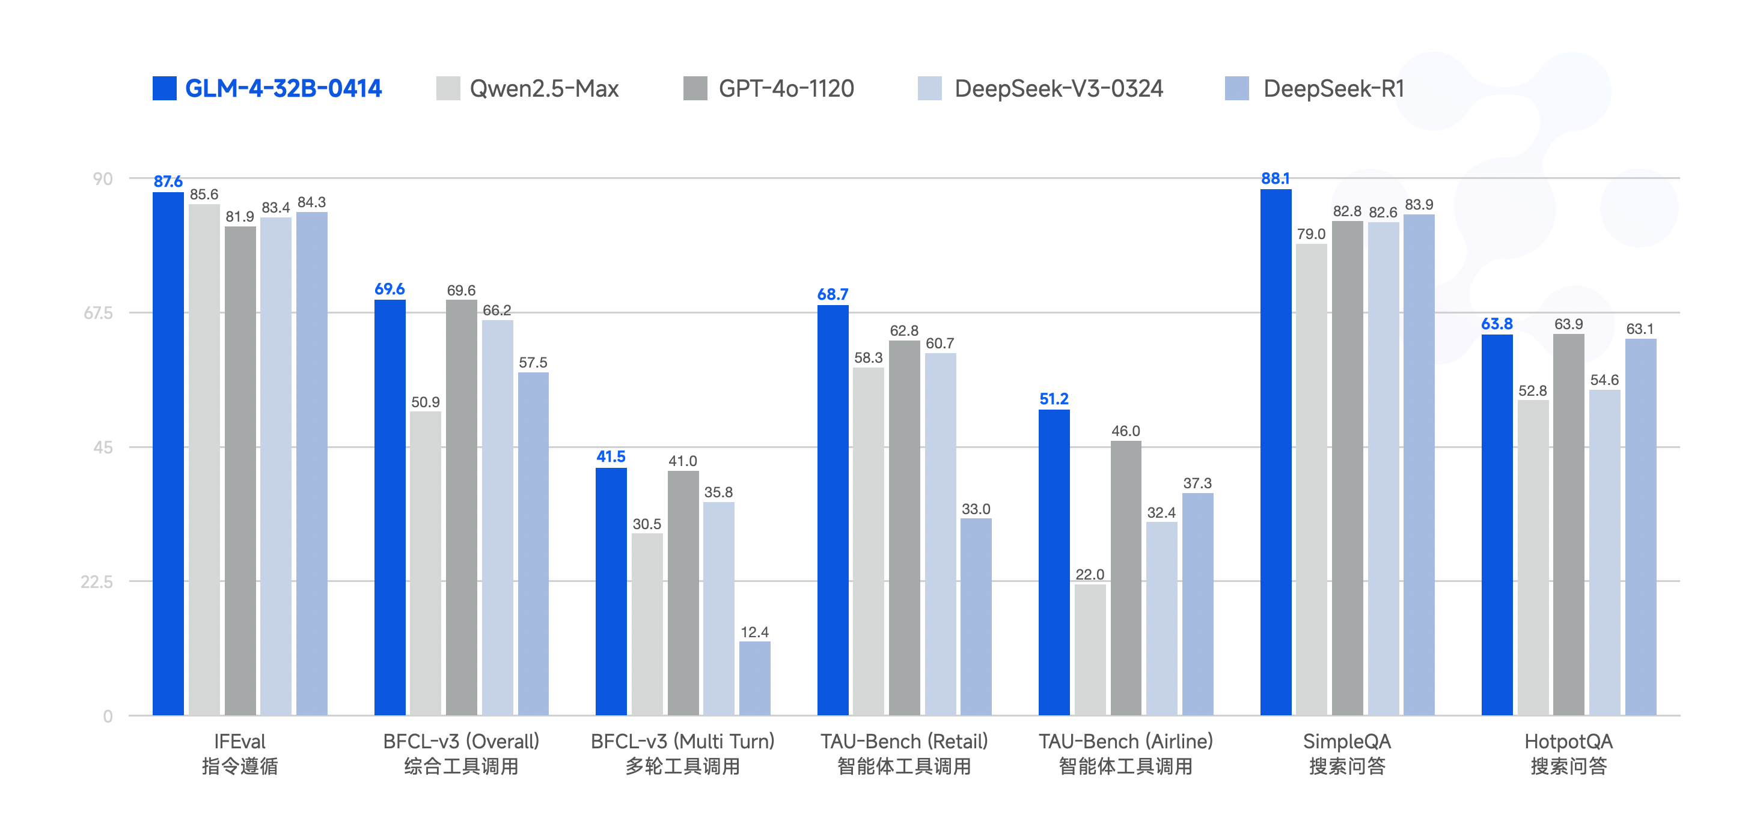
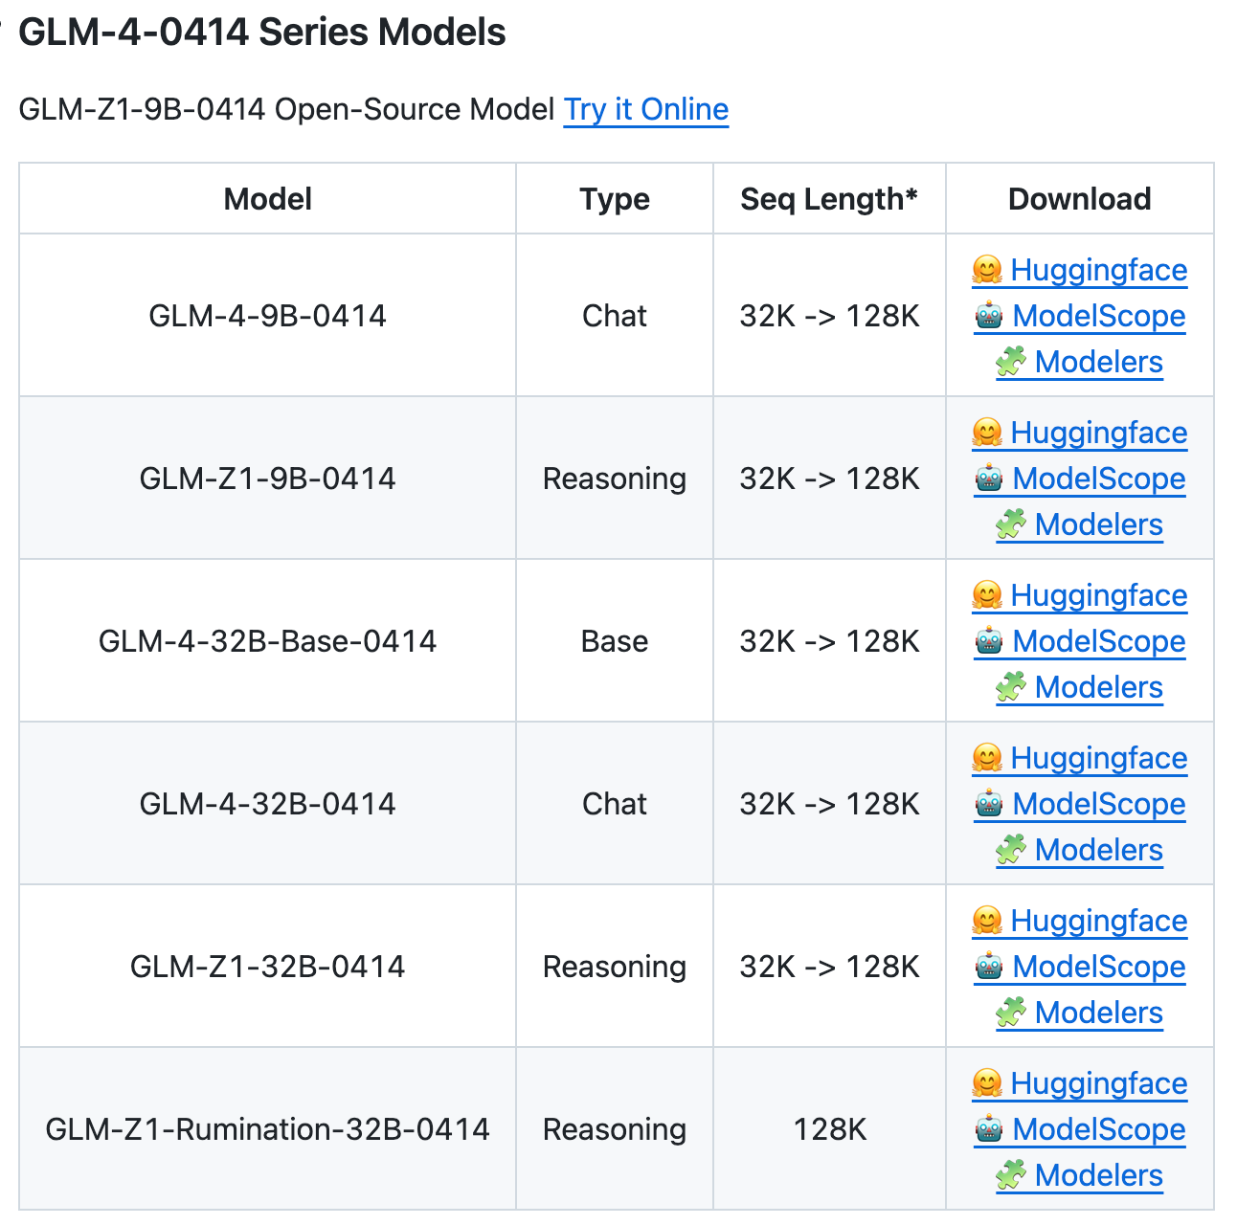
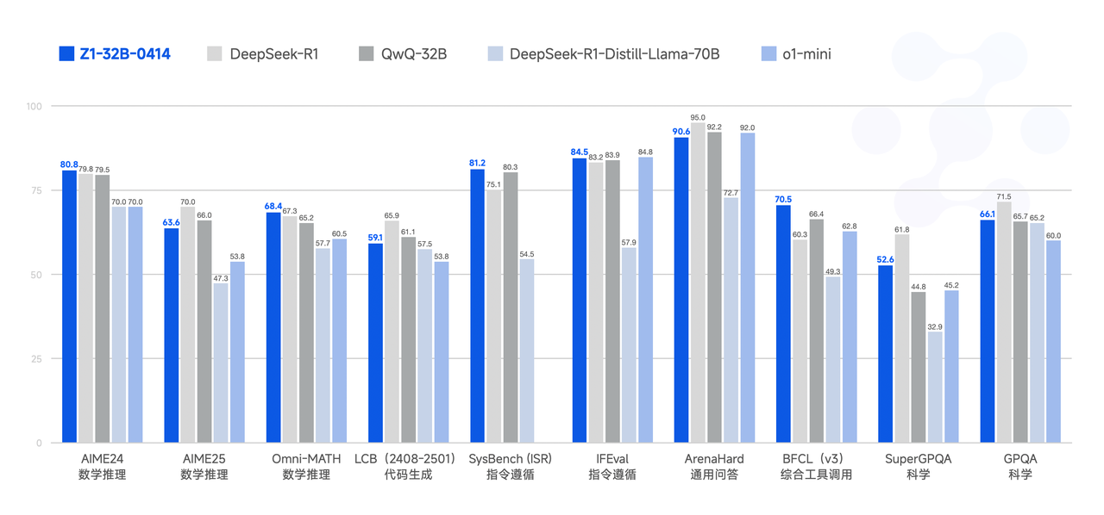
Zhipu latest opensources
https://github.com/THUDM/GLM-4
7

Slide 7
Zhipu GLM Product Line
Language Models
Multimodal Models & Agentic GLM
Other Models
The fully self-developed fourth generation base model GLM-4 has improved performance by 60% compared to GLM-3, with an IFEval instruction following ability evaluation of up to 90%, and 100% accurate recall in 128k context needle in haystack testing with visual and agent capabilities.
Capabilities in visual understanding, text-to-image generation, etc. More accurately understands Chinese descriptions and instructions, and more precisely completes multimodal reasoning tasks, generating high-quality images, videos, and other content.
Role-playing models, psychological companionship models, and code generation models based on GLM architecture
GLM-4-Mini/Nano
On Device
GLM-4-9B
Open Source
GLM-4-Plus
Latest
GLM-4V-Plus
CogView-4
CogVideoX
Embedding
CodeGeeX
GLM-4-AllTools
Agent Model
GLM-4-Assistant
(Zhipu Qingyan)
GLM-4-Aix / AirX /Long / Flash
VideoCall
&
VoiceCall
GLM-4-Voice
AutoGLM
&
GLM-PC
CharGLM-3
Emohaa
8
Notes:
单击此处添加文本

Slide 8




































GLM
MaaS
https://open.bigmodel.cn/
10
Notes:
单击此处添加文本

