Slide 1
SWASHAKTI -MISSION 100K
BUILDING A SUSTAINABLE ECOSYSTEM FOR TRAINING & LIVELIHOODS FOR PERSONS WITH DISABILITIES IN RURAL INDIA
Antony Helenraj
EnAble India
India
Entrepreneurship and leadership development for young people with disabilities
Thursday, February 22, 2024 | 14:40 – 16:00 CET
Notes:
Please add your notes here.
Title; First name, last name of speaker(s); Name of Organization, Name of Country, Name of Session (as written in Agenda)
#ZeroCon24
Day and Time of Session

Slide 2
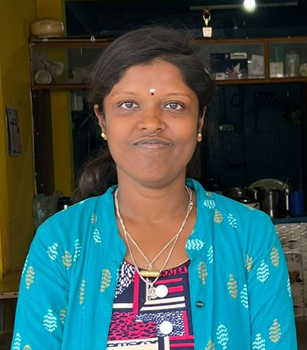
Before Swashakti
Introducing Sowbhagya
She is a Deaf person
She did not know sign language
She was dependent on her mother
Like Sowbhagya there are 2.5 million PwDs in India (as per census 2011)
PwDs in rural are often waiting for 35 years to receive the first livelihood opportunity

Slide 3
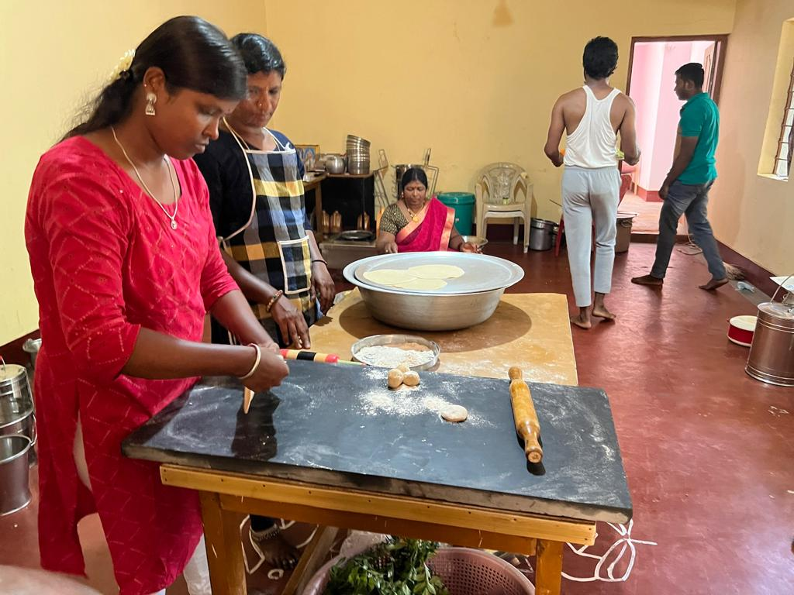
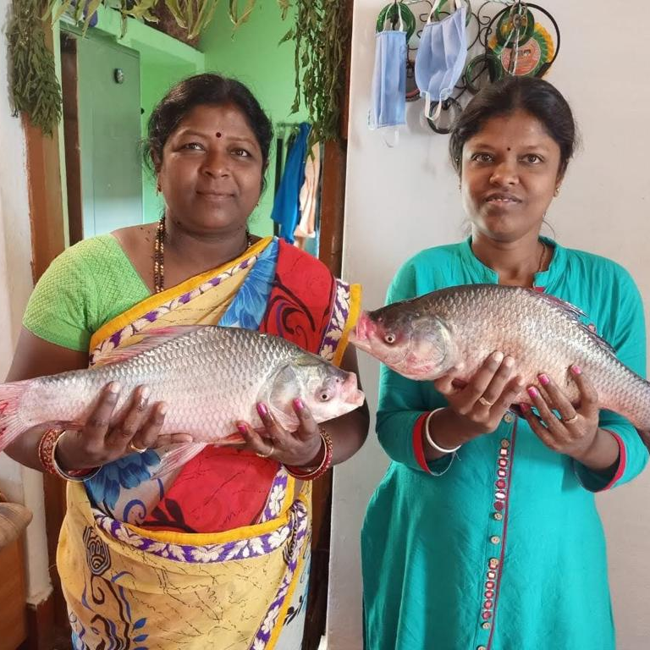
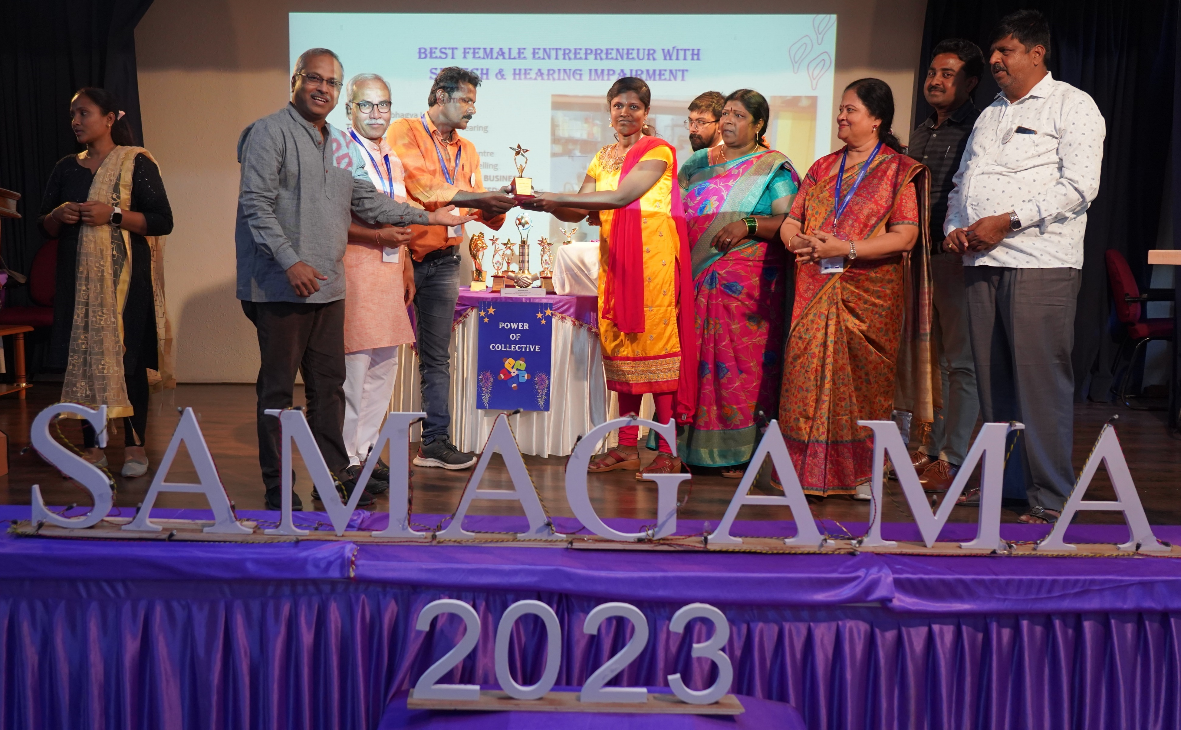
After Swashakti : Sowbhagya created livelihood for her entire family
Catering
Fish farming
v
v
Per capita in India is $2069
Sowbhagya earns 3 times more ($7218)
Sowbhagya was awarded with
Best Deaf Entrepreneur of the year 2023
3

Slide 4

EnAble India adopts a three-layered approach to drive systemic changes, ensuring sustainability in the development of entrepreneurs with disabilities within the mainstream.
How EnAble India made this transformation?
Mainstreaming RSETI
Support System-Partners in Ecosystem, Unlocking services
Garv Se approach – Ecosystem building, Livelihood creation & Capacity building
RSETI
*RSETI-Rural Self Employment Training Institute

Slide 5



How EnAble India made this transformation?
Mainstreaming self-employment program for persons with disabilities with Indian-wide government led institutes – Rural Self Employment Training Institute (RSETI)
NAR
Curriculum for PwDs
MoRD
National
NACER
Circular
Capacity Building
State
Directors
Disability Inclusion Program
Trainers
Districts
RSETIs
Garv Se Partners
MoRD-Ministry of Rural Development
NAR-National Academy of RSETIs
NACER-National Centre for Excellence of RSETIs
#ZeroCon24

Slide 6
Mainstreaming made possible through Garv Se and support system approach
How EnAble India made this transformation?
Garv Se
RSETI
Enabler committee
Self -employment training (EDP) at RSETI
She had an agency to choose through Margadarshi
Recommended Sowbhagya to Garv Se
Unlocking schemes
Solar business material
Business settlement
Through committee
Through support system
Through support system

Slide 7
Impact of Swashakti
In rural disability sector of India
590 RSETIs started including PwDs in their Entrepreneurship Development Programs
PwD entrepreneurs are self-employed across 141 trades
45 different types of stakeholders have been aligned in the ecosystem
Developing PwD entrepreneurs across 11 States and 1 Union Territory in India through 40 Garv Se Centres
Scaling gives economies of scale-
40% reduction in cost by the third year
Life of PwDs in rural India
Every single day 5 PwDs are becoming an entrepreneur
Entrepreneur across 15 types of disabilities
40% of entrepreneurs are women
20% of entrepreneurs are doing multiple business
10% of the entrepreneurs got married because of financial independence

Slide 8
THANK YOU

