Slide 1


Reward by decarbonization
of employee commuting

Slide 2



Urban mileage app
Our vision is reduce +10 M CO2e emissions from daily employee commuting (S3) world wide
We help companies reduce or offset CO2e emissions from commuting and business travels by encouraging and rewarding the best employees to opt for walking, cycling, public transport and even Electric Vehicles.
+ 45.120 users
- 40.000 tCO2e
UN monitors Ecomiles decarbonization results under the 2030 Agenda UN Global Compact
in Latin America (BR majory)
Is the average reduction per year
+ 12.000.000
+ 90 NPS
Net Promoter Score Collected from users who send daily routes
of km audited by
Source: United Nations

Slide 3
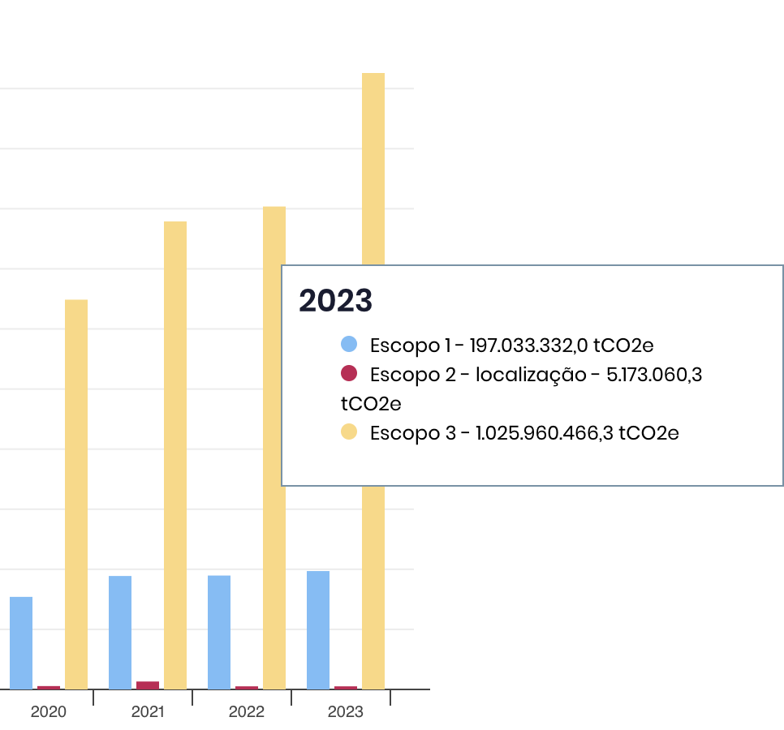

Problem: +5 B tCO2e was emitted by 843 biggest companies in Brazil only past 4 years
Data insights:
+82% was from scope 3 emissions
+40% tCO2e growth YoY 2020-2024
Less then 1% of total companies in Brazil report CO2e following GHG protocol.
It will cost 200 B EUR at least to offset 100% CO2e
There is no amazon forest capacity to capture CO2e enough and stop climate change until 2030.
https://registropublicodeemissoes.fgv.br/emissoes-historicas

Slide 4
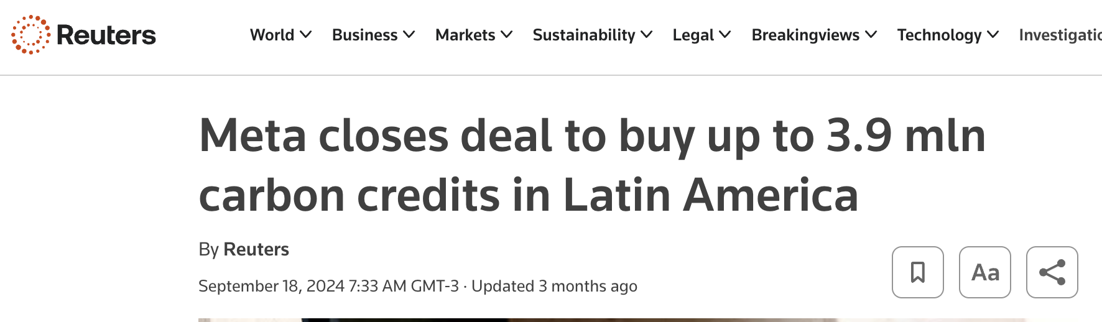
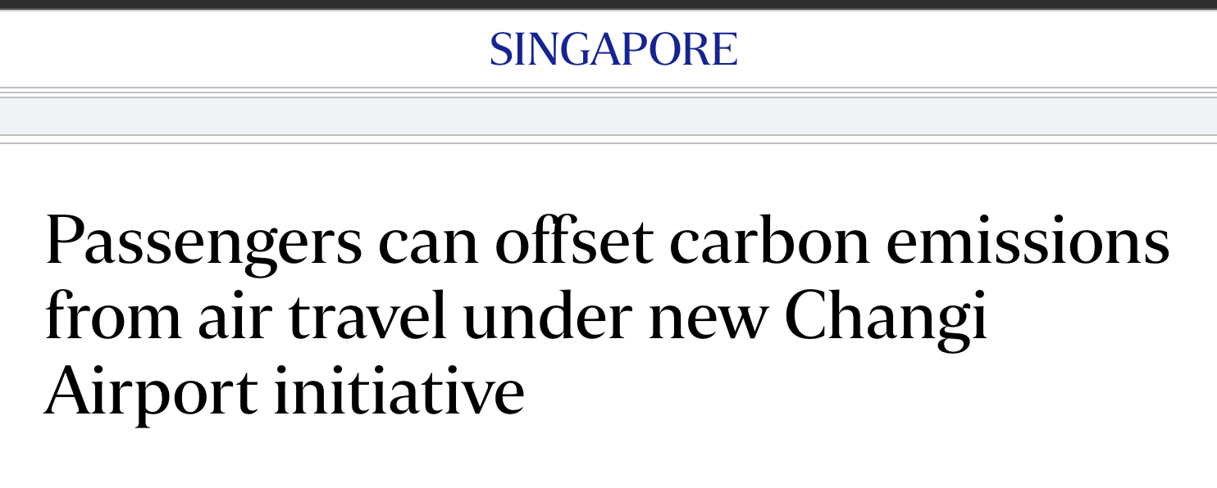
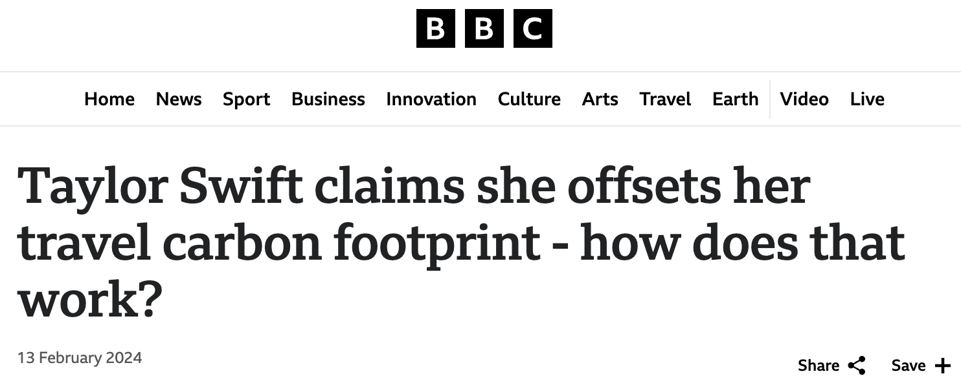
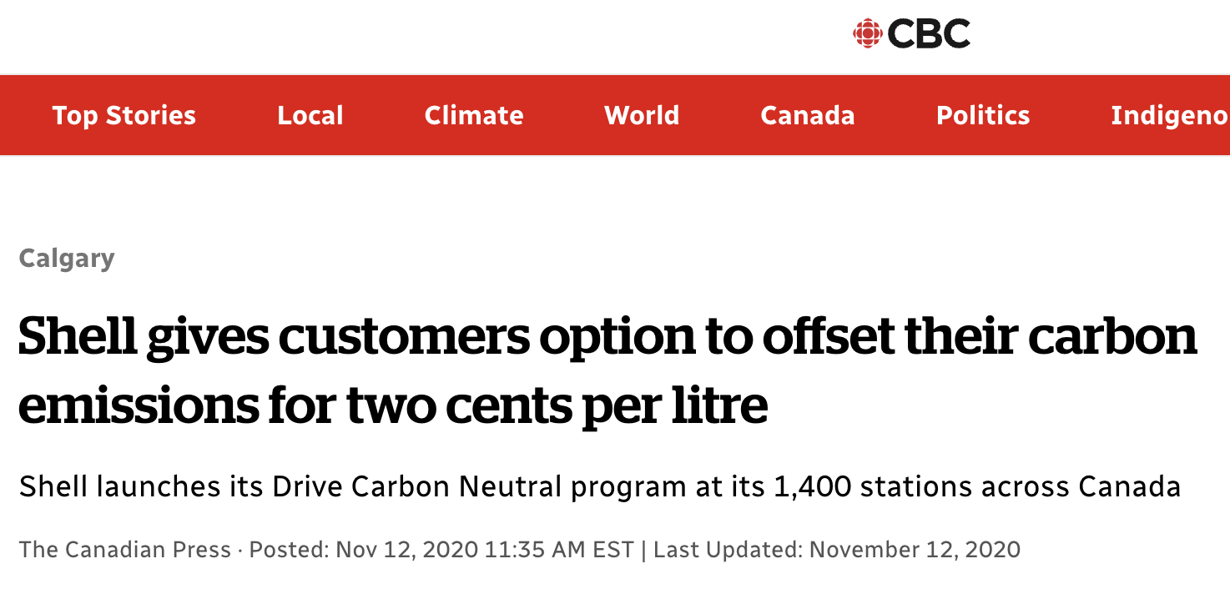
Despite it, companies still marketing that they are "saving the world"

Slide 5
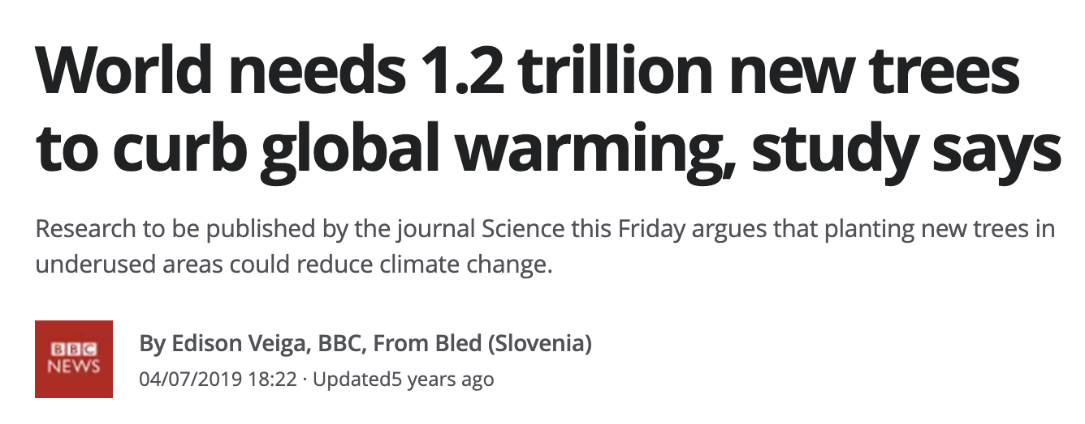
12/12/2024 at 10h45
Q: What if we just pollute less?
A: change consumer behavior is not that simple.
Source: https://g1.globo.com/natureza/noticia/2019/07/04/mundo-precisa-de-12-trilhao-de-novas-arvores-para-conter-o-aquecimento-global-diz-estudo.ghtml

Slide 6
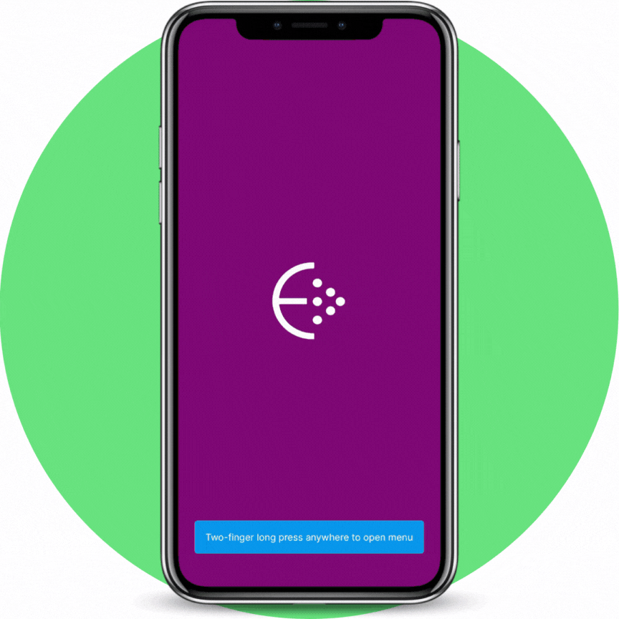






How it works - UX
Our process is designed to help your company build up a ESG culture with rewards
02
04
Onboarding Employees
ESG analytics
With the dashboard configured, the client provides a link for employees to download the app and send routes
CSR sustainability managers evaluate socio-decarbonization indicators
01
03
Onboarding Manager
Benefits redemption
Client receives support for initial configuration of the panel for managing reduction targets and offering benefits to employees
By sending routes, employees accumulate Ecomilhas balance and redeem benefits of greater interest in the app store
‹#›

Slide 7
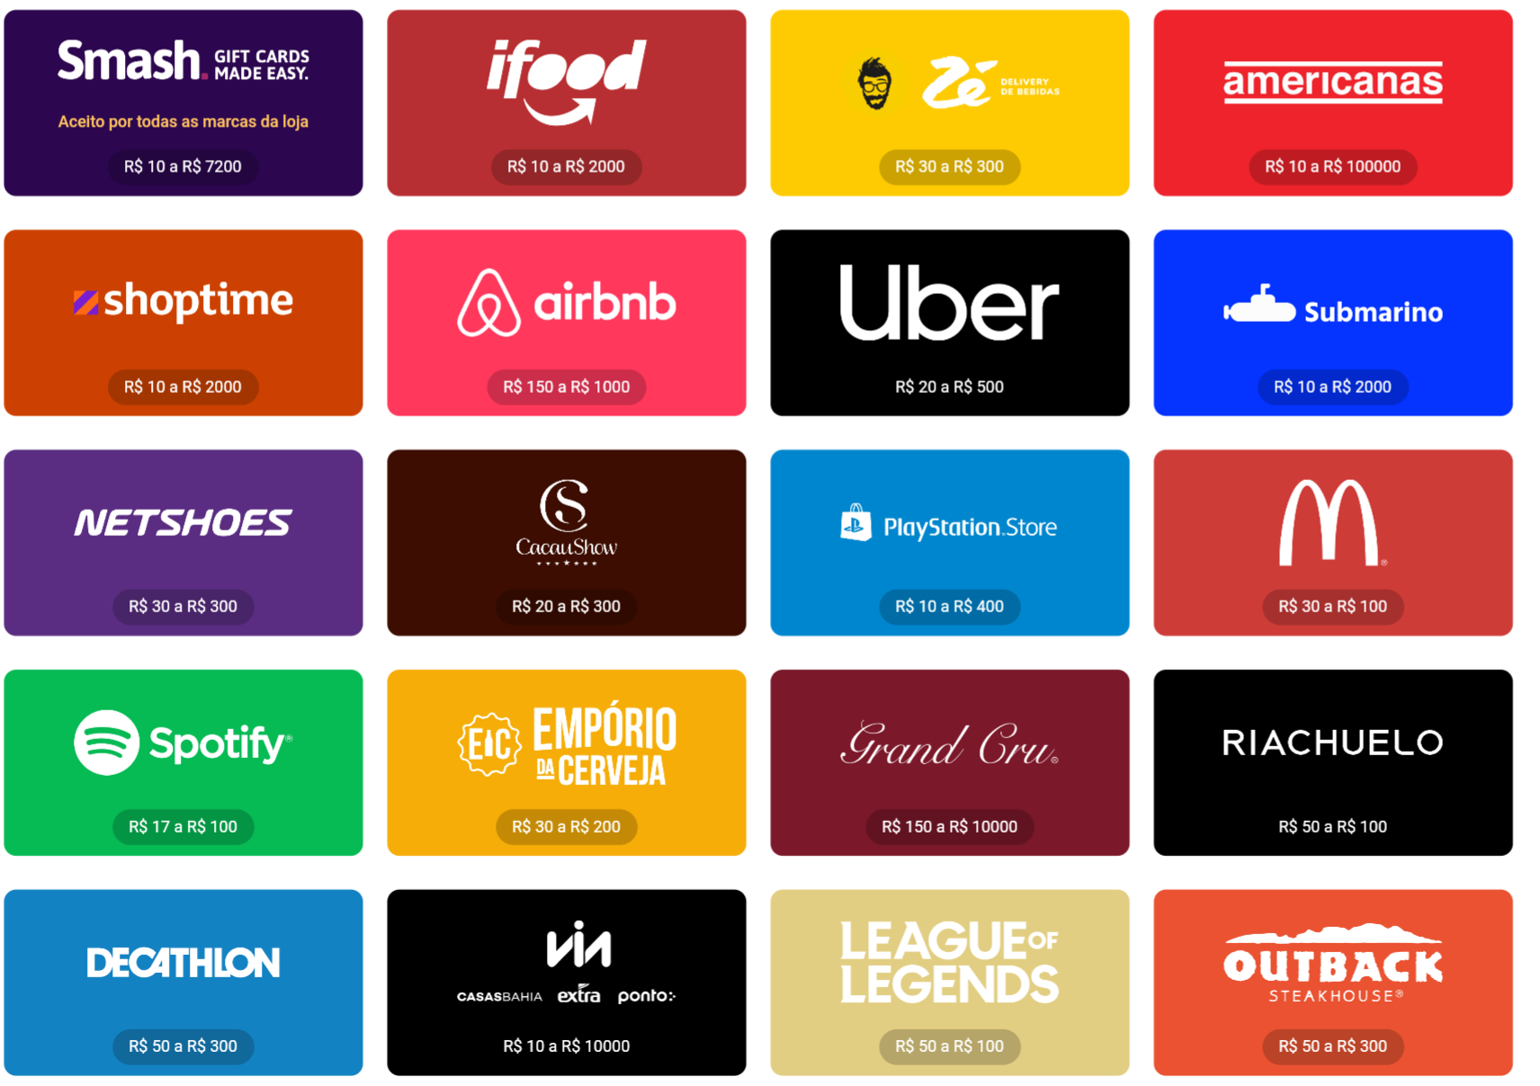
Which benefits your employees can redeem for green commuting?
Temos mais de 50 parceiras implementados no programa com gift cards disponibilizados
em até 5 dias úteis

Slide 8
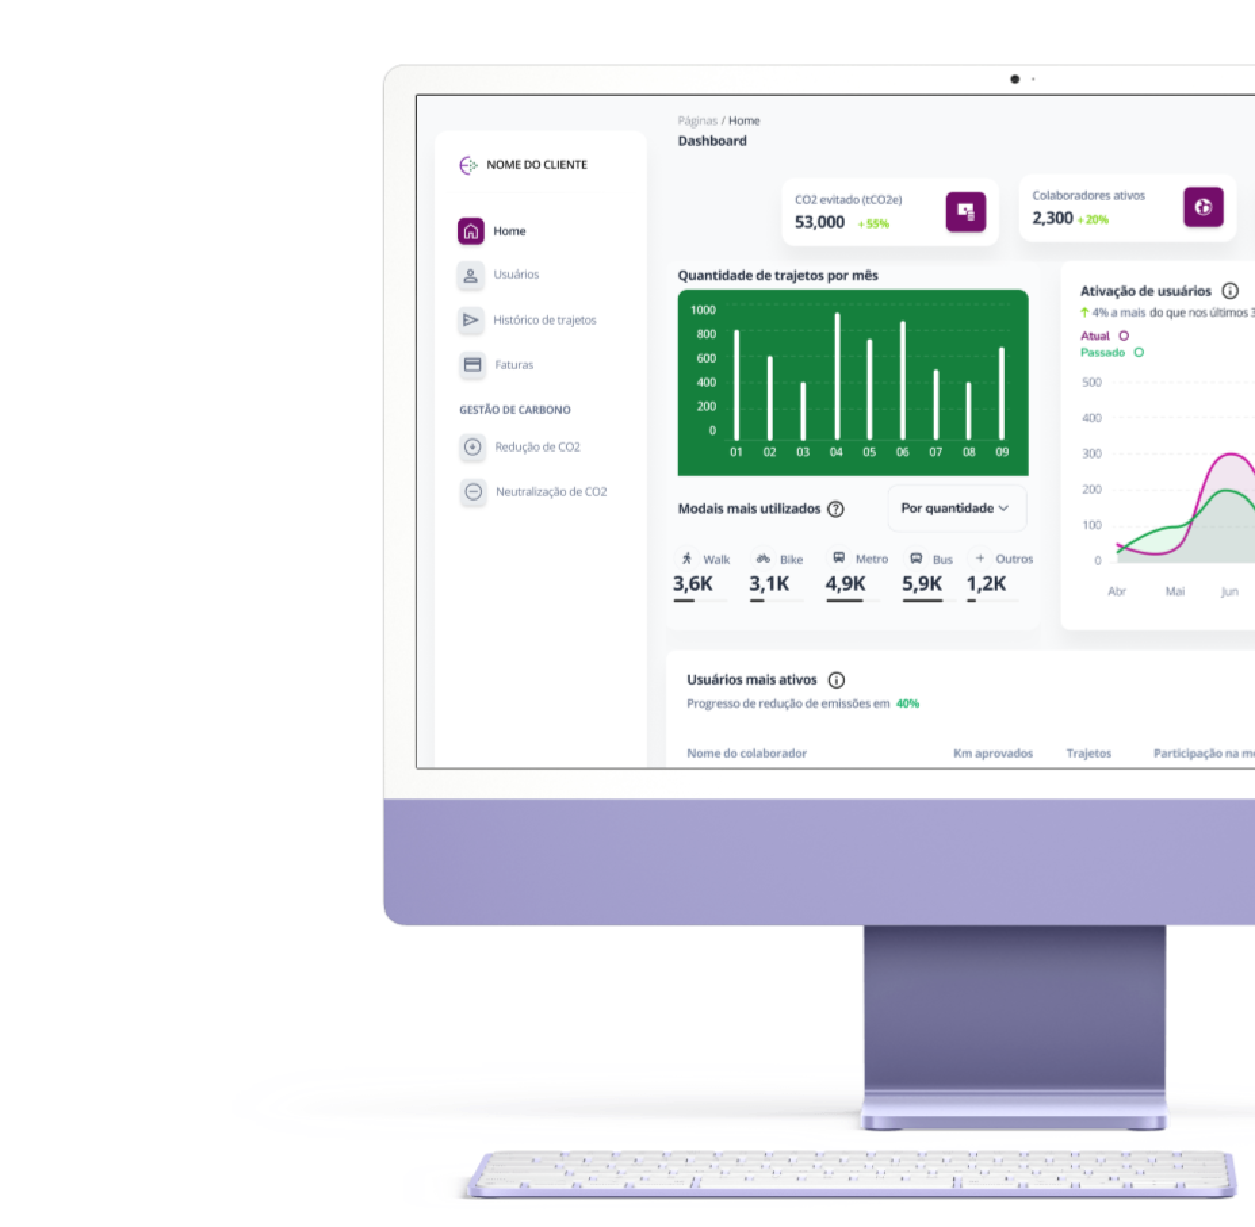




Our business model partnership
(B2C) - Green Card subscription
Users can use their Ecomiles to redeem financial or gift card rewards for the app subscription for $7/month
(B2B) - Dashboard platform
Employers sponsor recharge values for employee benefits and can customize them from $2/employee monthly.
ASK FOR DEMMO

Slide 9

What ESG managers can evaluate for decarbonization from daily commuting employee
Environmental
Social
]]]
- -Amount of CO2 avoided daily through the use of sustainable transport by employees.
- Comparison of emissions between different means of transport (ethanol or electric car, bicycle, public transport, walking, etc.)
- Rate of contribution to CO2 emissions reduction target per employee, department and work unit
- Employee satisfaction rates with incentives for sustainable transportation.
- Rate of employee adherence to sustainable transport programs
- Improved quality of life by adopting active transportation
Auditability by Carbon avoidance in Brazil
- VMR0002 - "Methodology for Greenhouse Gas Reductions through the Use of Grid-Connected Electricity from Renewable Sources in Electric Vehicles"
- AM0090. "Modal shift in transportation from road transportation to ethanol or rail transportation"
- AMS-III.C: Emission reductions by electric and hybrid vehicles.
Governance
- Implementation and compliance with sustainable transportation policies in the company.
- Comparison of emissions between different modes of transport (car, bicycle, public transport, etc.).C
- Disclosure of sustainability and environmental impact data for ISO14040 and ISO26000
‹#›

Slide 10






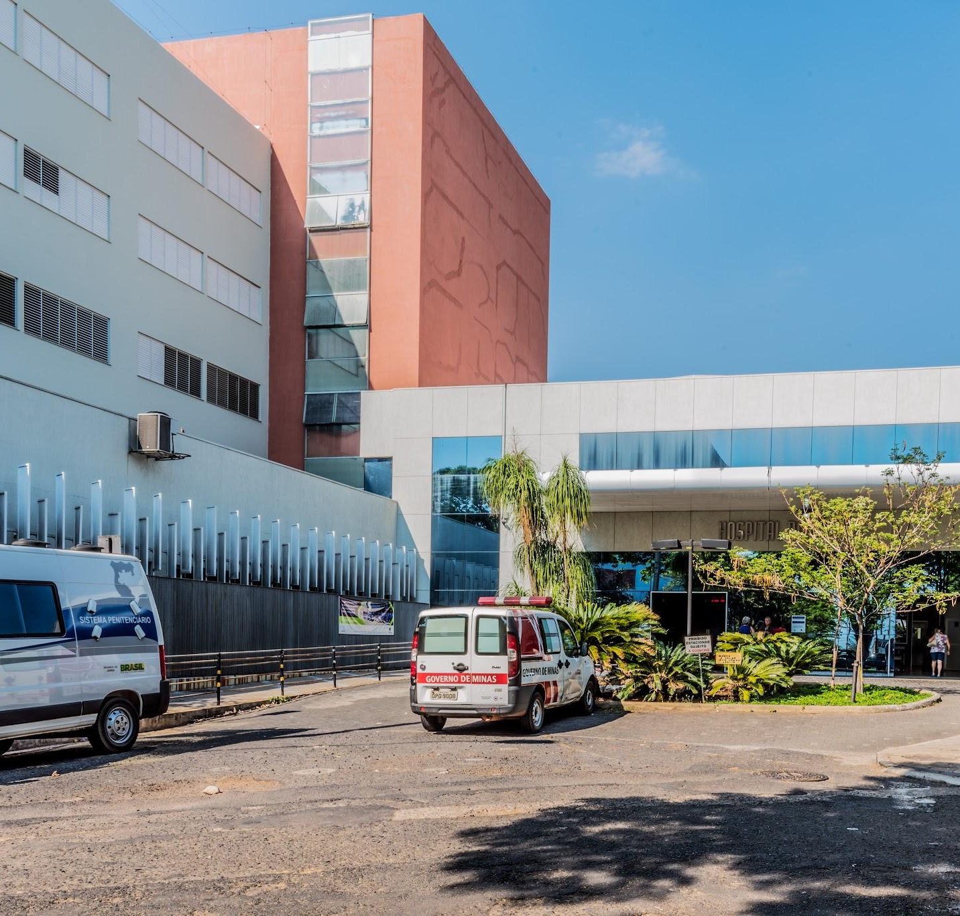


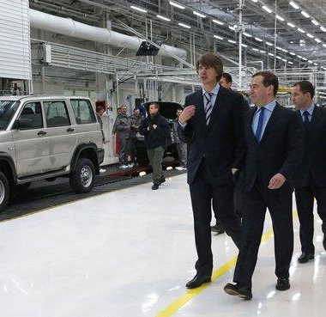






Carbon inset: success cases from reduce CO2 emissions
Reducing costs to offset, generate return of investment through a sustainability engagement
How we build a culture of sustainable mobility consumption among employees through corporate benefits connected to the company's ecosystem. We put employees in a leading position to decarbonize commuting emissions.
RETAIL
FINANCIAL
DELIVERY
INDUSTRY
TELECOM
BRAND
Decarbonization strategy for employee commuting
Corporate social responsibility strategy in income generation
Meta made by clean delivery modes in national delivery
How to encourage the use of ethanol for vehicles in the value chain
Innovation marathon for sustainable mobility
How to connect benefits and employees through sustainable mobility

Slide 11


Decarbonization of daily commutes
Through our platform, your company can reduce up to 100,000 tCO2/year.
Promoting 'walk the talk' ESG culture
Data audited by
KPMG
Access at
multi benefits
Without begging for
Employees
With precision of CO2 emissions avoided
with easy
onboarding

Slide 12



