Slide 2

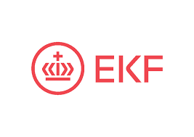

Denmark's Export and Investment Fund
Denmark's Export and Investment Fund (EIFO) is a merger of Vækstfonden, Denmark's Green Investment Fund and EKF Denmark's Export Credit Fund.
We are a financial company with a total exposure of approximately €23 billion and have over 500 employees in the new organisation

Slide 3
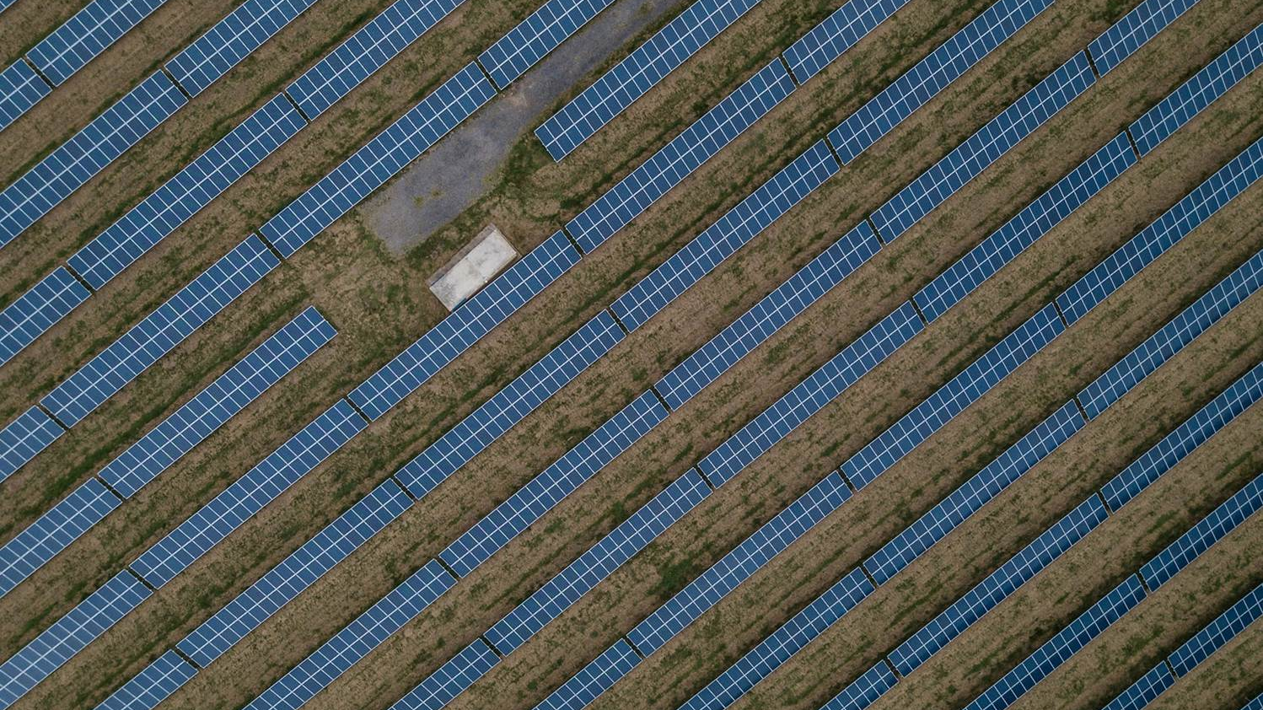
Denmark's Export and Investment Fund must make Denmark richer and the world greener
Together with entrepreneurs, investors and companies, Denmark's Export and Investment Fund must create the greatest possible social return by financing and investing in growth, exports and green transition in Denmark and globally

Slide 4

MAIN Title
Equi aliscie ndaerio nsequat dus samus, untio et aut ped quo to erae. Ut magnistiore, nia volupta tempera dolessit, cus, cum earchic tem. Aceatem dignatio. Ut venda aut audaecabo. Ic tem quia conserspedi:
  Equi aliscie ndaerio nsequat dus samus, untio et aut ped quo to erae. Ut magnistiore, nia volupta
  Nia volupta tempera dolessit, cus, cum earchic tem ceatem dignatio.
  Nsequat dus samus, untio et aut ped quo to erae. Ut magnistiore, nia volupta tempera dolessit.

Slide 5

A 84 percent drop in venture capital investments in sustainable businesses in Denmark
(H1 2024 vs. H1 2025)
84%

Slide 6
Europe’s pensions hold €3 trillion
Unfortunately, only 0.12% ever reaches venture capital

Slide 7


Slide 8


Slide 9
Killing Complexity Before Complexity Kills Growth

Slide 10


Slide 11
October 2021:
Invitation to market testning process
July 2022:
Application sent to the EIF
December 2022:
Agreement signed
Maj 2023:
Internal preparations in EIFO completed
June 2023:
First loan disbursed

Slide 12
Implementation of the guarantee
  Legal documentation
  Internal check-scheme for eligibility
  Internal Product leaflet & Intranet site
  Adaptation of existing of IT-systems
  Multiple training sessions internally
  Reporting to the EIF
  Marketing to the market

Slide 13
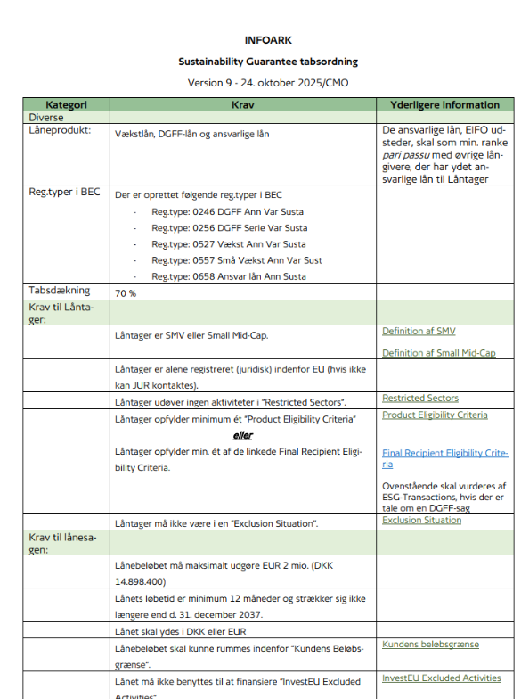
Internal InvestEU Guarantee Product leaflet
Product leaflet with key criteria, limitations and practical infomation on ”how-to-use-the-guarantee”
Accessable on the EIFO Intranet
Totalling 9 pages

Slide 14
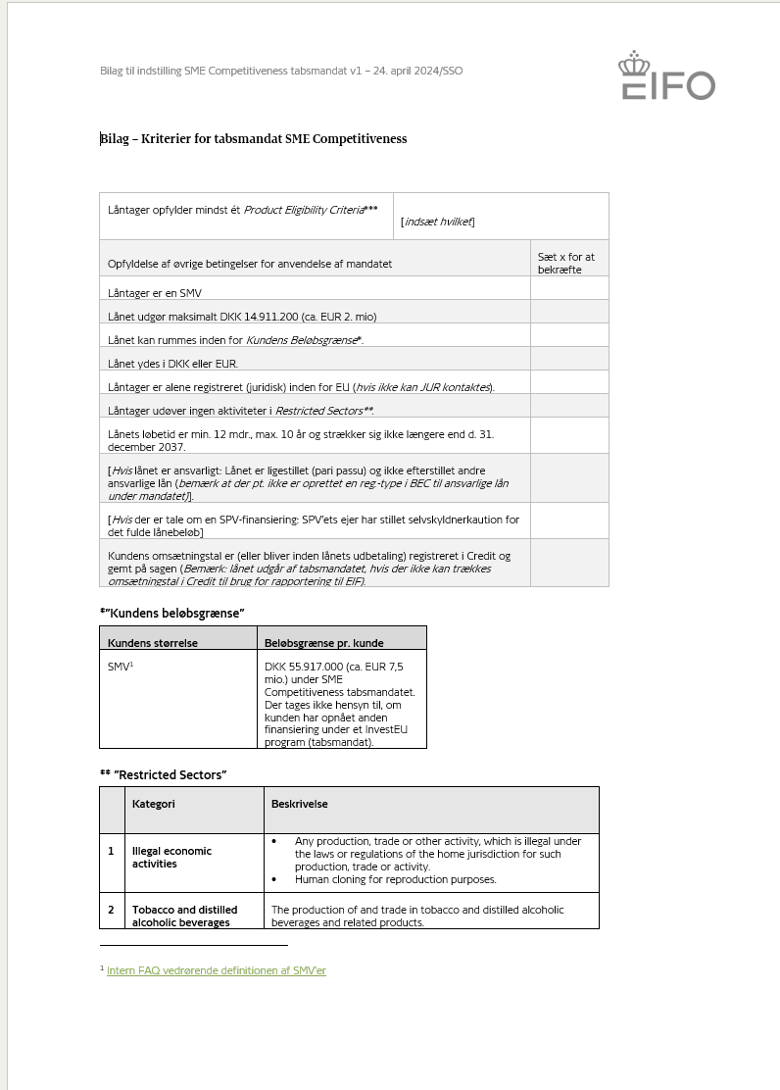
InvestEU eligibility check-scheme
Check-schemes for EIFO employees
Builds confidence and comfort in the employees to actually use the guarantee (yes, we can!)
Useable for future EIF monitoring visits

Slide 15
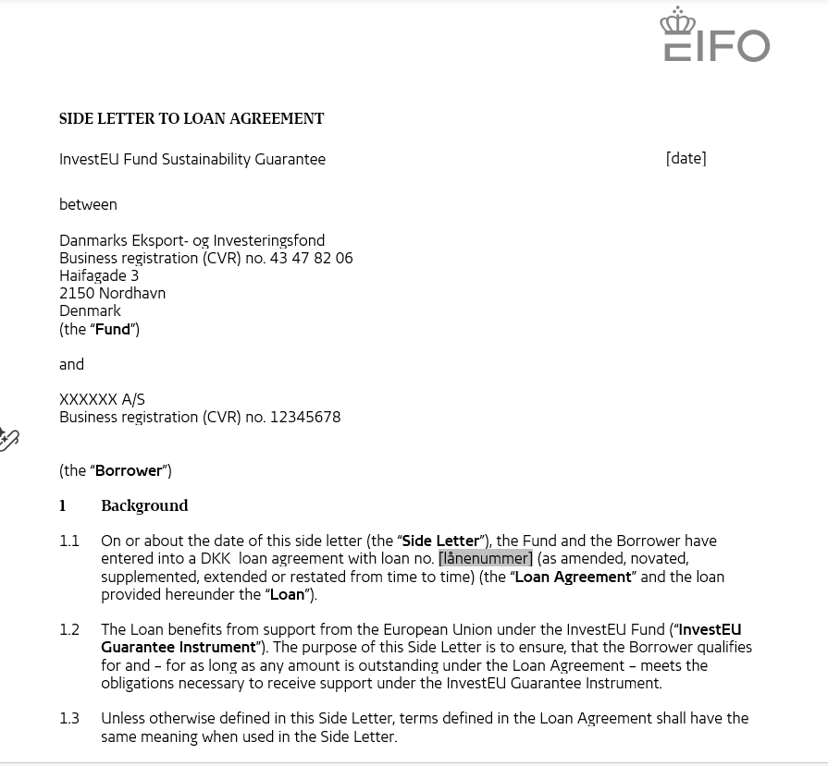
InvestEU side letter to EIFO’s loan agreement
Side letters for the different EIF Guarantee Products to EIFO’s normal loan agreements
All the different requirements from the EIF are combined into one document and digitally signed by the company as part of the legal documents from EIFO
Totalling 14 pages

Slide 16
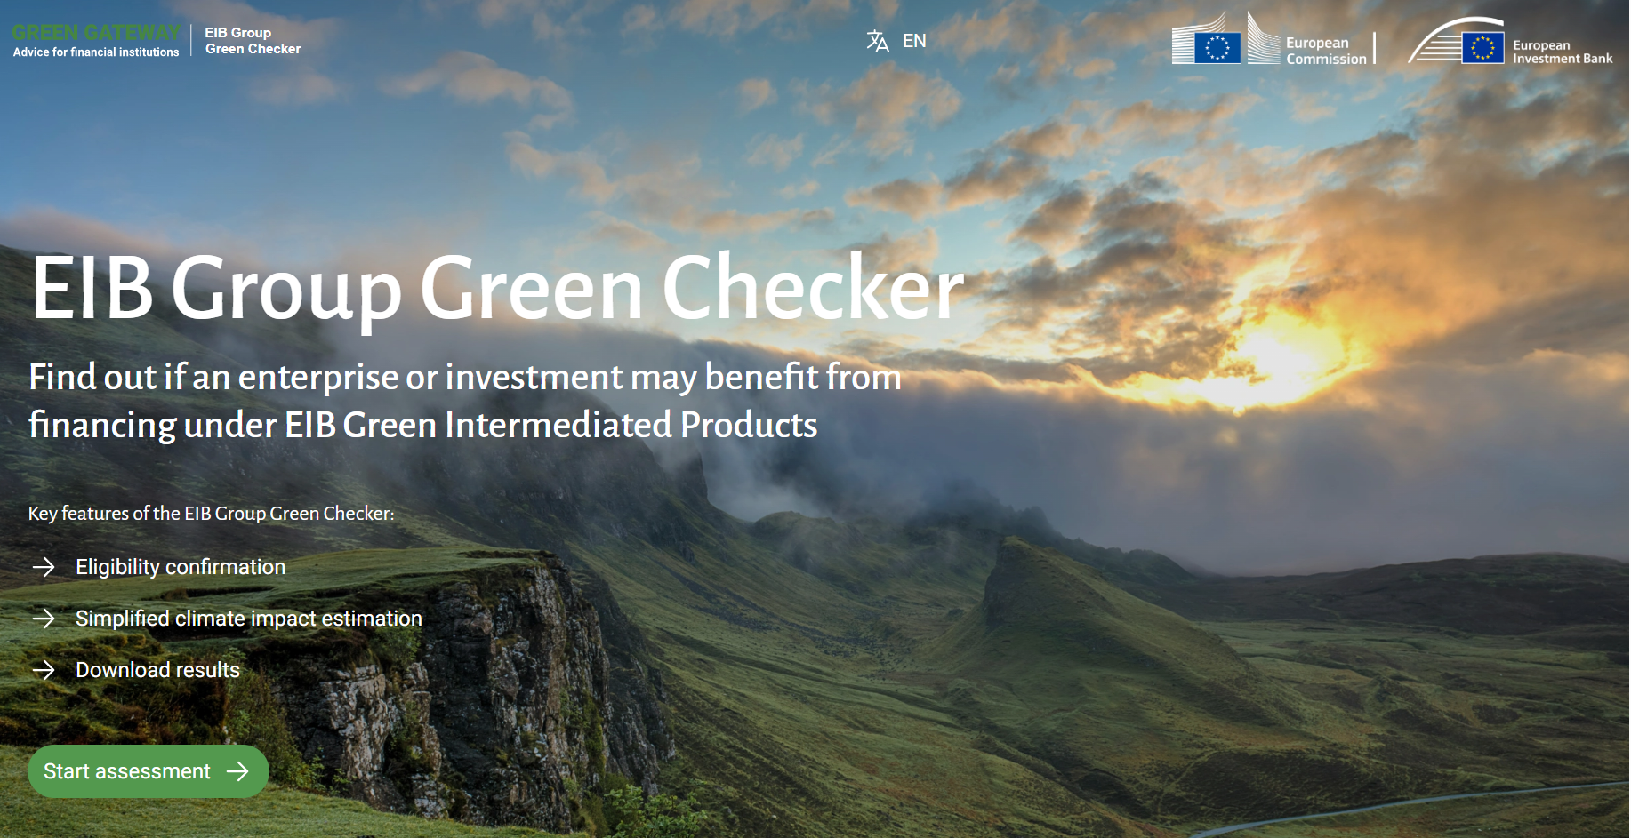
Additional tools
Green Gateway Helpdesk Portal
The EIB Group Green Checker
The EIF Use Case Document
→ Important to keep things as simple and digital as possible → build confidence in the users

Slide 17



Does the Sustainability guarantee matter?
Retail shop selling certified
and local grown flowers
with a 35 percent lower C02 footprint
compared to conventional flowers
Developing a nature-based
feed supplement
to live stocks using seaweed that
reduces methane emissions
in cattle by at least 80%.
Offering a data-drive AI energy trading
system and a virtual power plant
for the customers’ stationary battery
units for a constant
balancing of the power grid

Slide 18
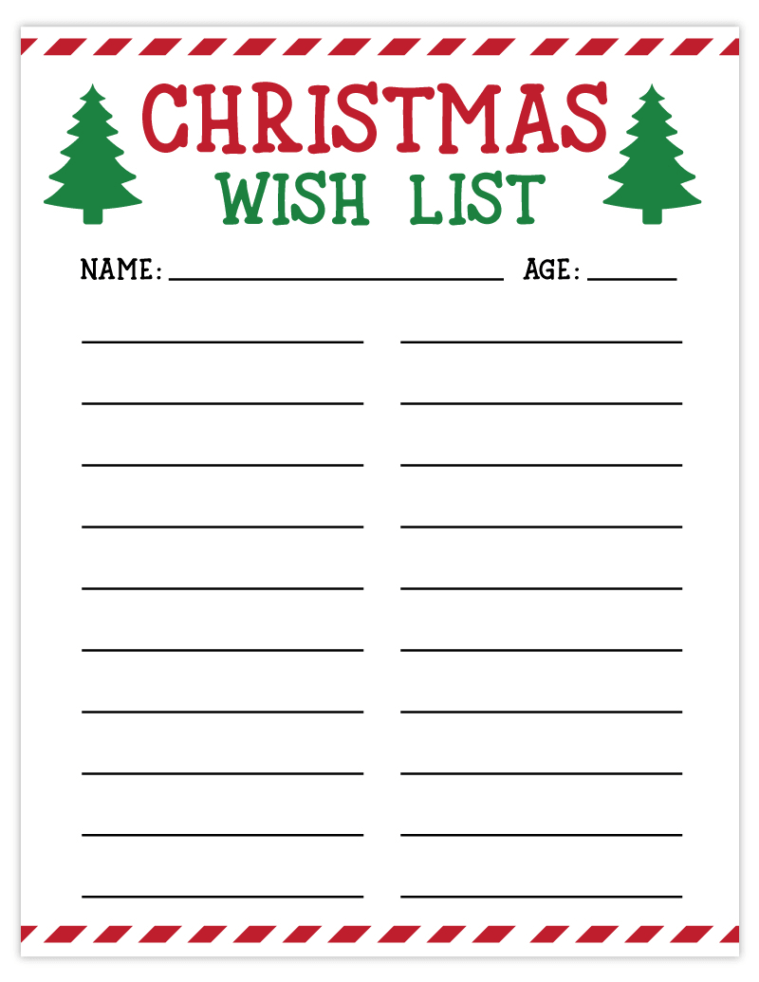

EIFO
3 years
EIF agreement can be simplied (163 pages)
A unified guarantee product from the EIB Group
Increased digitalisation of help and support tools
Only ”Need-to-know’ reporting, not ”Nice-to”
Increased focus on simplification
Focus on increased flexibility
Activation of pension funds (€3 trillion!!!)
Fast track approval of known intermediaries

Slide 19


