Slide 1
House of Disability Organizations
Sif Holst, Vice President,
Disabled People’s Organizations Denmark
Denmark
Champions of Inclusive Spaces
March 5, 12:00 – 13:00
Notes:
House of Disability Organizations
Sif Holst, Vice President,
Disabled People’s Organizations Denmark
Denmark
Champions of Inclusive Spaces
#ZeroCon24
March 5, 12:00 – 13:00

Slide 2
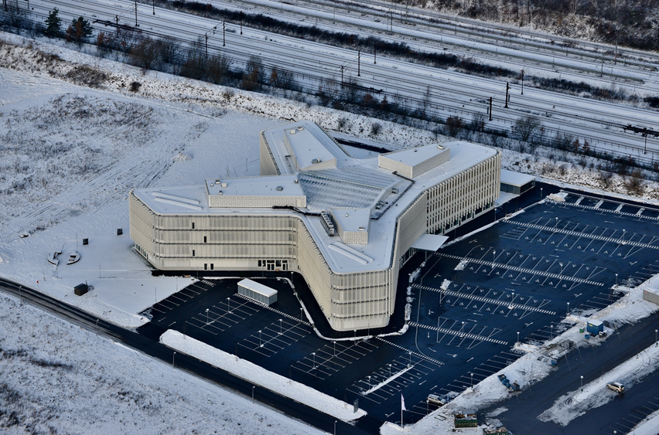
Introduction
The house was established in 2012
The House is a collaborative workspace hosting 30 organizations and approximately 300 employees
Exemplifying the pinnacle of accessible office environments
Notes:
Introduction:
The house was established in 2012. Competition for architects started in 2010.
The House is a collaborative workspace hosting 30 organizations and approximately 300 employees.
Exemplifying the pinnacle of accessible office environments.
Total price for the house: roughly 260 mil. kr. (roughly 34.9 mil. Euros). 12.600 square meters.

Slide 3
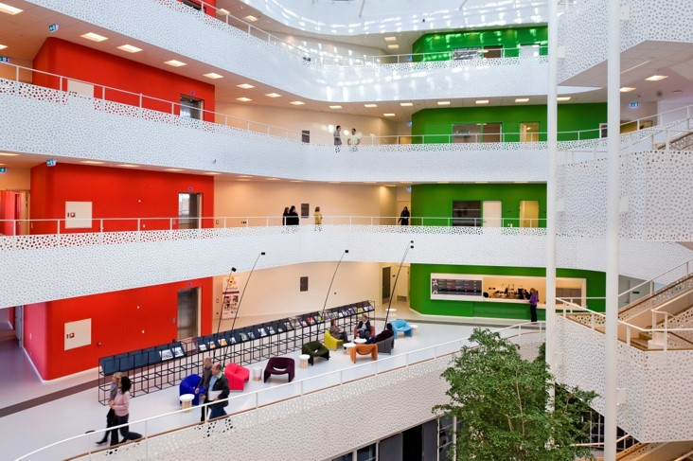
Our goals with the house
Ambitious Accessibility
User driven innovation
Social Impact through inspiration
Universally designed sustainability
Notes:
Our goals with thw house
Ambitious Accessibility: Construct the world's most accessible office building.
User driven innovation: Emphasize user needs and involvement to drive innovation – from the beginning and all the time
Social impact through inspiration: Enhance disability visibility and influence public policy on inclusivity.
Univsersally designed sustainability: Achieve high sustainability standards and foster a dignified, equal opportunity workplace.

Slide 4
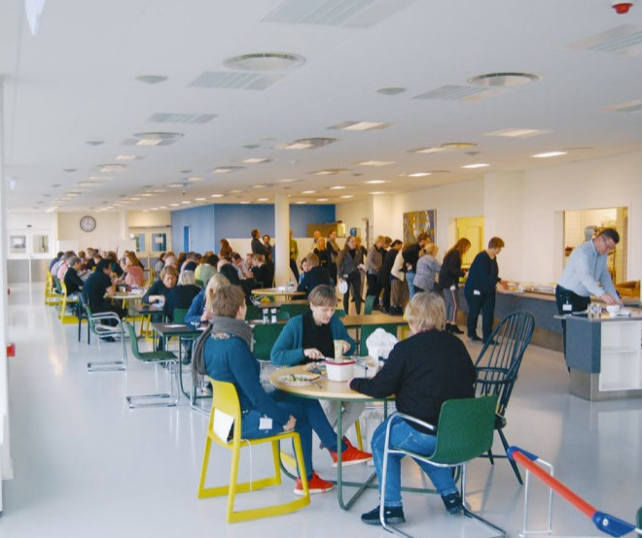
Continuous development
A dynamic laboratory:
New bathroom faucets
Cafeteria design
Hybrid teleloop screen system in the meeting rooms
Notes:
The house is intended to function as a dynamic laboratory where new solutions are constantly being developed.
In the last 10 years, more and more modern solutions have emerged that can improve the accessibility of the house.
low hand functionality and cathethers.
Organising the cafeteria – including videos.
New technical solloutions.

Slide 5
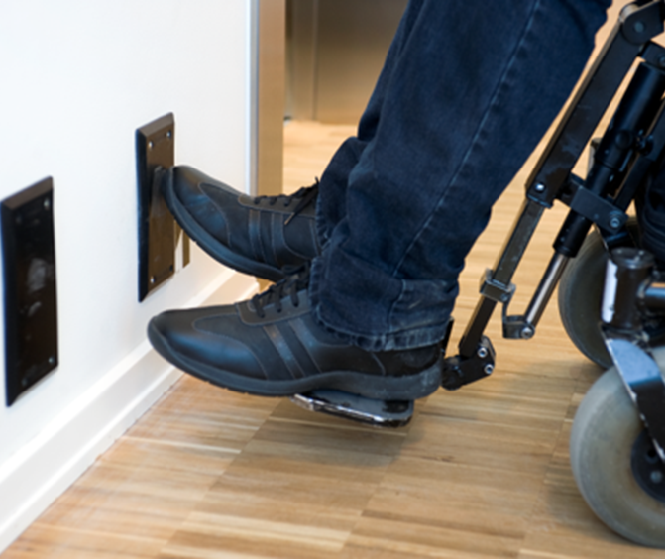
Examples of complex solutions
The lifts
Evacuation system
Variety of toilet types
Increased air circulation
Notes:
Examples of complex solutions:
Lifts as part of the evacuation system
Foot panels supplementing the traditional button (practical during COVID)
A variety of toilet types, from changing places to the small cubicle, no marked with disability (or gender) symbol
Increased air circulation: The air in the building is exchanged 2.5 times more frequently than normal, partly to accommodate individuals with allergies.

Slide 6
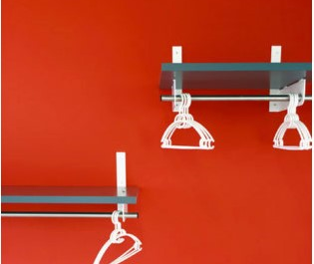
Examples of simple solutions
Reception desk
Coatracks
Small pins on the handrails
Using colours to navigate
Notes:
Examples of simple solutions:
The reception desk has two heights to ensuring that all visitors kan receive information and assistance at eye level
Wall coatracks different heights
Small pins on the handrails act as tactile markers, indicating the floor.
Using colours to navigate: each offlice wing is marked with a distinctive colour in high contrast to the surroundings.

Slide 7
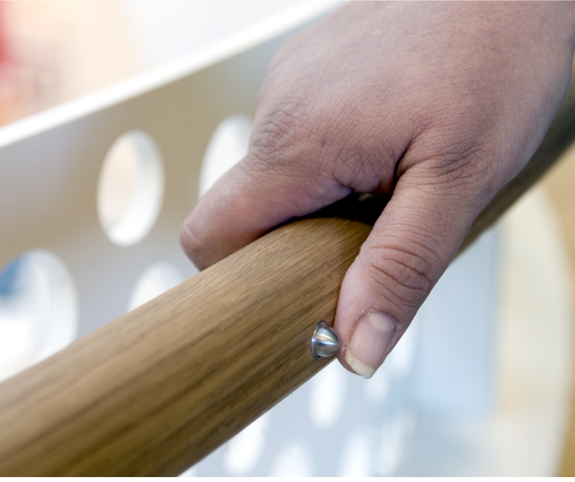
More inspiration
Visit our website for further information
https://handicap.dk/huset/magasin-om-huset
Or follow Handicaporganisationernes Hus on LinkedIn
Notes:
More inspiration:
Visit our website for further information or follow us on LindkedIn.

