Slide 1

The next level of System Integration

Slide 2




IGMAKO Smart Solutions
Regionally operating technology group in the field of Telecommunication and IT
Regionally operating technology group in the field of Telecommunication and IT
Founded in 2020
20 employees, all engineers
20+ partners like Lenovo, Huawei, VMWare, Dell EMC, MindTitan, NEC, etc.
ISO 9001:2015 certified company
ISO 14001:2015 certified company
ISO 27001:2013 certified company
ISO 20000-1:2018 certified company
Founded in 2020
20 employees, all engineers
20+ partners like Lenovo, Huawei, VMWare, Dell EMC, MindTitan, NEC, etc.
Notes:
Dodati Oracle

Slide 3

Our company …
Igmako Smart Solutions takes roots from a team of experienced experts and thus gathered competences needed to address end-to-end telecommunications solutions for the entire range of access, transport and mission-critical products, technologies and services for both private and public sector customers and we are active in the fields of telecom, enterprise, industrial and public infrastructure.
Igmako Smart Solutions is a trusted partner to organisations who benefit from a comprehensive array of services spanning design, supply, construction, installation, commissioning and maintenance of telecommunication infrastructure.
By acquiring Kapsch Serbia team, Igmako Smart Solutions gathered competences and experience to address mission-critical communications for the railway or road operators.
Igmako Smart Solutions d.o.o. is the ideal partner to envision and accelerates enterprise transformation with innovative technologies and deep industry experience to deliver lasting value. The company works with an ecosystem of strategic partners to maximise value for clients and help them increase their business success.
Notes:
Dodati Oracle

Slide 4
Our expertise and portfolio …
Telecommunication Infrastructure and Services
IoT and Smart Everything
ICT Infrastructure and Data Center
Critical Infrastructure and Services

Slide 5






ICT Infrastructure and Data Center …
Storages
Software-Defined Data Center (SDDC)
Backup & Replication solutions
Servers
Data Center Networking
Power, Cooling, Racking
Notes:
Dodati Oracle

Slide 6
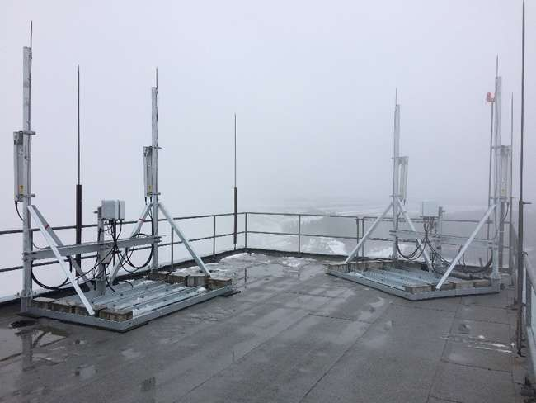
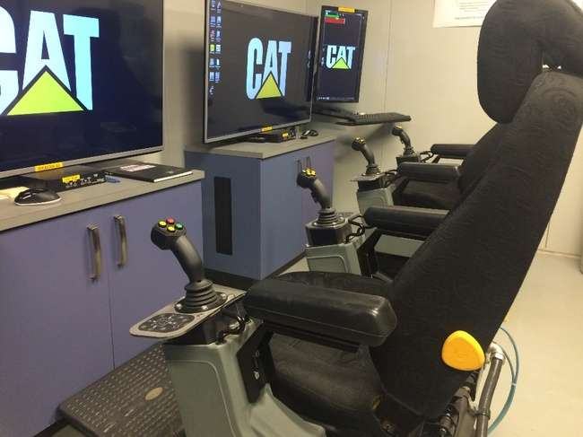




Private LTE/5G deployment in mining
Time to market
Flexibility/ Scalability
Efficiency

Slide 7
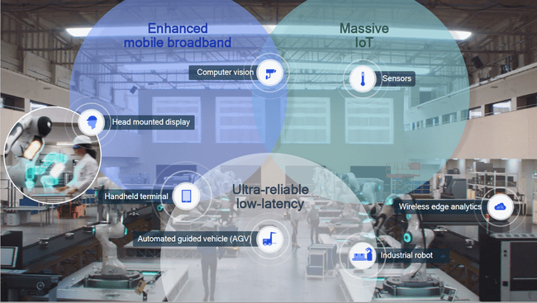

Slide 8

Smart mining
For autonomous operations, communication system needs the ability to:
  Enable fully remote monitoring, involving very high bandwidth and low latency requirements
  Potentially carry many other autonomous and remotely controlled machines, of different brands and with different control systems
  Handle an ever-changing production environment and geography
  Maintain broad coverage for all corners of the mine where machinery or staff could potentially be located
  Track and coordinate mobile equipment fleets and many sensors and other devices within one communications network
  A 4G mobile communication system would offer a secure, flexible and future proof solution. However, while 4G can support the current identified use case, only 5G can comfortably handle the most demanding requirements – bandwidth, quality of service, latency and positioning.
With high-performance communications, a whole range of safety and efficiency measures become available to the mine. While some applications only need to send minor amounts of data, others (such as fully remote controlled machines) need the capabilities and capacity offered through mobile communications such as 4G and especially 5G.

Slide 9
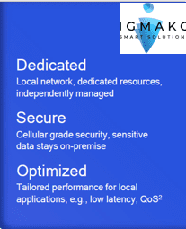
What private networks offer
the richest level of connectivity for the smart industries
4G/5G technology designed to support mission-critical applications for Industries – 4G/5G technology deliver a significant improvement in functionality
    High-speed connectivity, very low latency, extremely high availability, full coverage, high reduction in network energy usage and strong performance in high device density environments.
    Remote operation of Caterpillar/ Sandvik equipment and Epiroc drills over 4G/5G

Slide 10

Remote operation of Caterpillar equipment over 4G/5G

Slide 11
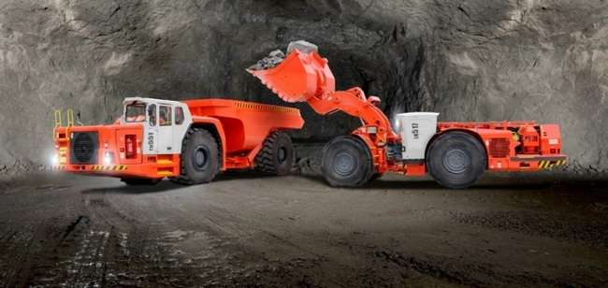
Remote operation of Sandvik equipment over 4G/5G
Sandvik is now recommending the use of 4G/5G for remotely operating their machines

Slide 12
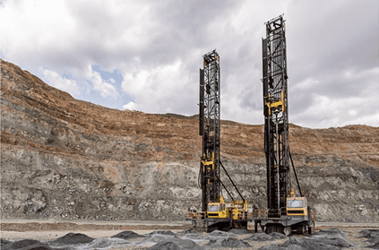
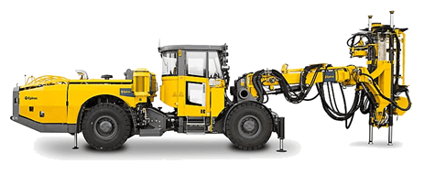
Remote operation of Epiroc drills over 4G/5G

Slide 13
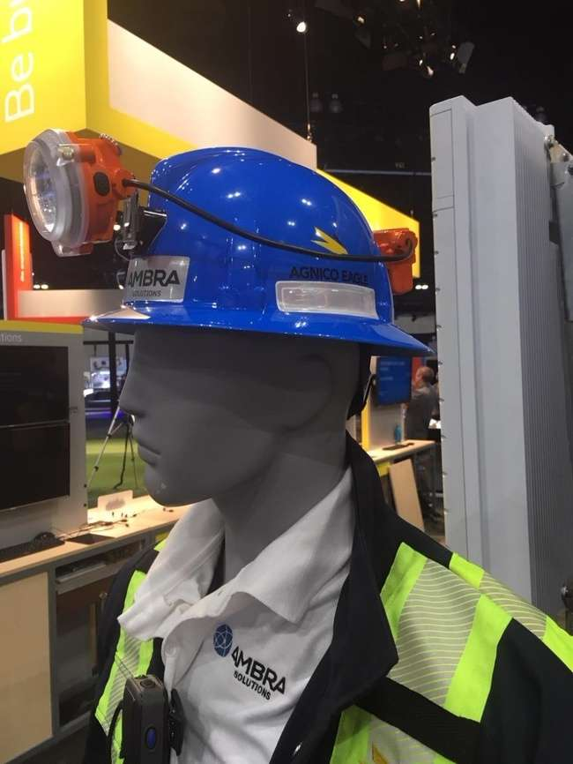
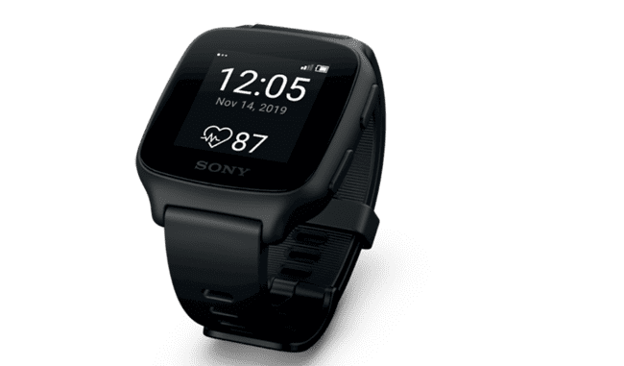
Tracking

Slide 14
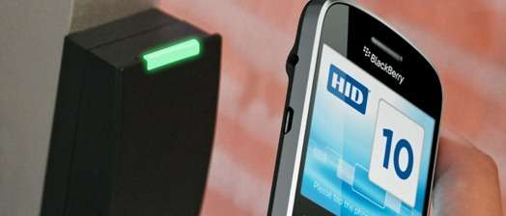
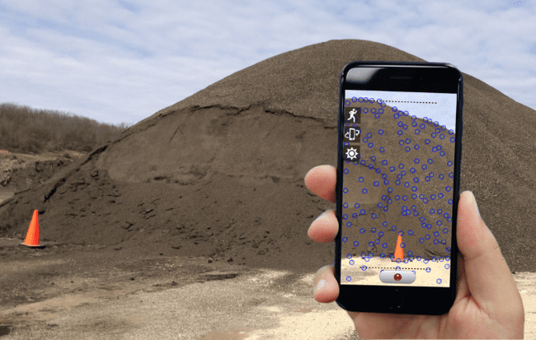
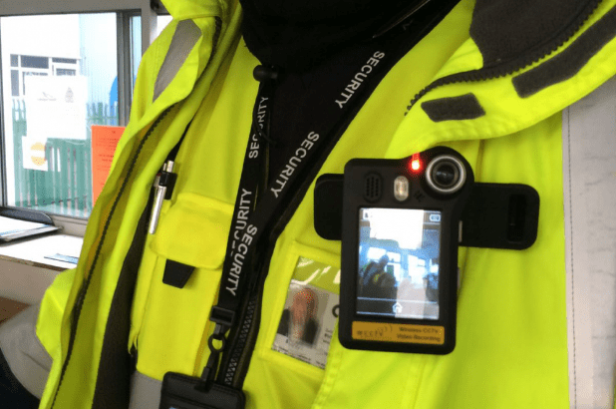
LTE applications
Generic LTE mobile communication for 900 potential users
Push to talk communication
Secure access and Availability of 99.999%
People and machine tracking
Video surveillance
Authentication on a mobile equipment or a building using secure NFC protocol.
Measuring stock piles using a smart phone
Using body worn camera for confined spaces
Remote operation of Caterpillar/ Sandvik equipment and Epiroc drills over 4G/5G

Slide 15
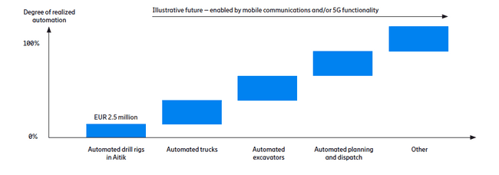
Smart mining – Boliden mining
Enabled by Private network
An estimated 10 % saving in fuel consumption corresponds to a reduction of 9,400 metric tons of CO₂ emissions at Aitik.
7,000 hours per year of drill rig operation could be achieved through automation, an increase of 2,000 hours or 40 %.

Slide 16
4G/5G Overview

Slide 17

High Level 4G System View
Packet Data Network (PDN) eg. Internet
Devices
Spectrum
Antennas
eNodeB
Microwave
Mobile Core
RRU
MPLS
SGi
Applications & Funtions
BBU
Optical
User Equipment
(UE)
Evolved UMTS Terrestrial radio
Access Network (E-UTRAN)
Evolved Packet Core
(EPC)
LAN

Slide 18
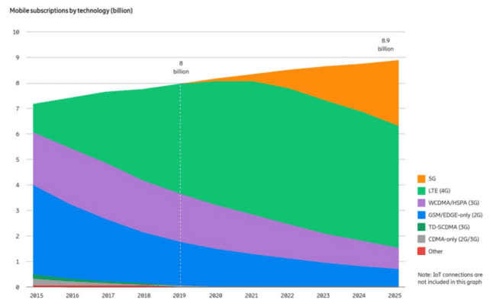
Standardisation
Source : Ericsson (November 2019)

Slide 19
LTE(4G) vs Wi-Fi

Slide 20
Comparison between Wi-Fi and LTE
  Wi-Fi
  Unlicensed band
    2.4Ghz, 5.4Ghz, 5.8Ghz
    Subject to interference
  TX limits to 4W EIRP
  Lowest reliable RSSI: -85dbm
  Based on the 802.11 technology
  Latency increase as the network traffic increase
  Time Division Duplex (TDD)
    Use the same channel for uplink and downlink
  Limited mobility (break before make)
  Limited QoS capabilities
  Limited range resulting in excessive number of Aps to manage
LTE Technology
  Licensed bands
    700Mhz, 800Mhz, 1800Mhz, 2100Mhz, 2600Mhz, 3500Mhz
    Allows carrier aggregation
    Interference free
  Maximum base station EIRP: 3000W
  Lowest working RSSI: -115dBm
  Optimized for high number of devices (using radio blocks)
  Latency remains constant as the network traffic increase
  Frequency Division Duplex (FDD) & Time Division Duplex (TDD)
    Can use two channels for uplink and downlink
  Full mobility up to 350Km/h
  Superior end to end QoS capabilities natively implemented in the standard.
  Compatible with commercial cellular LTE networks

Slide 21
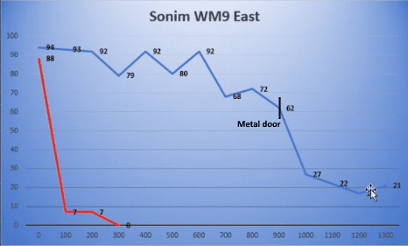
Wi-Fi vs LTE RF propagation in room and pillar mine
Wi-Fi (speed in Mbps)
LTE (speed in Mbps)

Slide 22
LTE deployment

Slide 23

Private LTE benefits
Customized SIM cards with advanced security features compatible with OEM vendors
High-Definition voice calls with local SIP PBX
Low latency using local LTE servers
Advanced QoS for remote operation
LTE and Wi-Fi authentication (EAP-SIM)
Support LTE roaming-in and roaming-out
Roaming-out capabilities on public network with corporate internal IP addresses

Slide 24
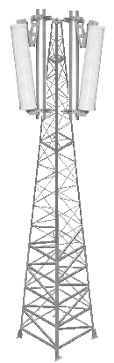

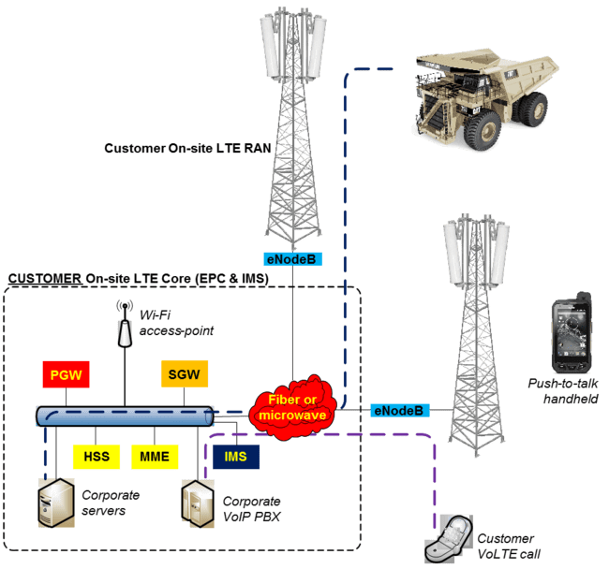
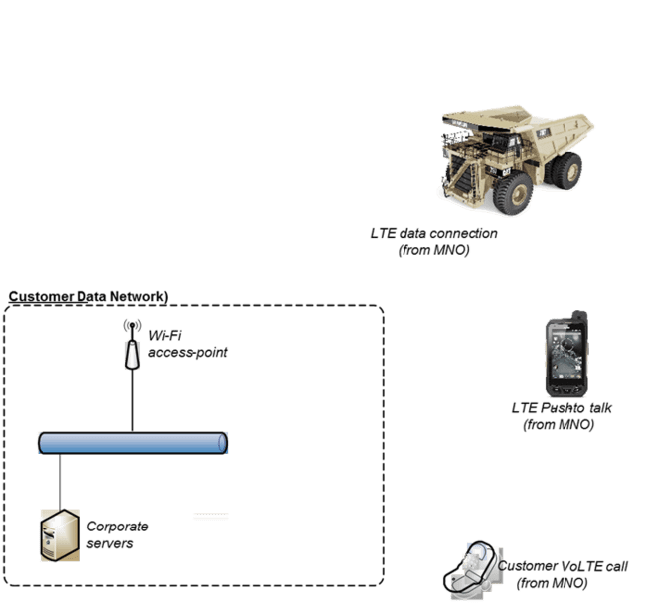

Why Private LTE?
Commercial LTE Network
MNO LTE Core
&
RAN Network
Private LTE Referenced Network
Versus

Slide 25
Redundant design: no single point of failure
Main fiber route
Redundant fiber route

Slide 26

Underground deployment using BBU and RRUs
Can connect up to 24 RRUs per BBU
Intelligence resides in the BBU
RRUs have no configuration and can easily be replaced
RRU uses low frequencies that propagates very well thought tunnels
Easy and cost effective underground installation using passive components
Voice and data on the same infrastructure.

Slide 27
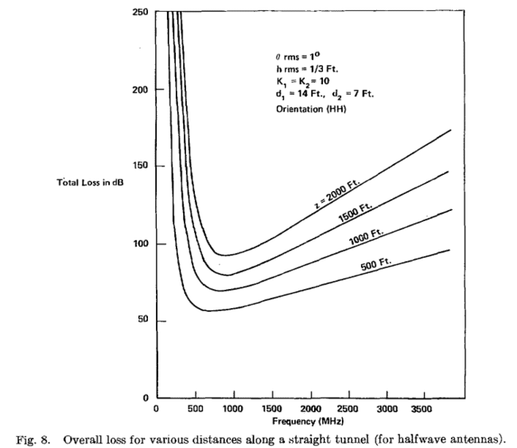
RF propagation in underground
One LTE radio can cover up to 6 branches of 1km
Between 60 and 80 Wi-FI AP must be installed to have equivalent RF coverage
Low frequency and high receive sensitivity provide very good non line-of-sight RF propagation
Select optimal frequencies based on the tunnel diameter

Slide 28
Pricing comparison for a 2km tunnel from real projects
Wi-Fi version (20 active radios):
Average cost: 56$USD/meter
Price of 2KM: 112k$USD
LTE version (1 active radio):
Average cost: 28$USD/meter
Price for 2KM: 56k$USD

Slide 29





Sales forecasting with AI
Integrate more than one ML module
Detect Recognize
Output
Sales forecast
Pattern-base alerts
Data from multiple sources:
Past sales, economic indicator, holiday calendar, seasonality
Trend
opportunity/ risk
Customer opportunity/risk
minimize prediction error – find the relationships and parameters that maximize prediction accuracy.
Deep learning model produces level of insight unattainable by hard-coded rules and produces results better than human
Notes:
Drustvene mreze to rade na drugi nacin ako imam dovoljno podataka o coveku ja mogu da ga klasifikujem.
Drugacija premija za razlicite vozace za osiguranje.
Machine Learning forecasting: Machine learning algorithms would learn the rules that would have to be manually designed in rule-based forecasting. This is done through a process called supervised learning. Supervised learning is the task of learning the relationship between outputs (sales) and inputs (past sales, economic indicator, holiday calendar etc.) Machine Learning algorithms find these relationships by minimising prediction error – i.e. finding the relationships and parameters that maximise prediction accuracy.
Bez dubokih podataka o klientu je.
Pristanak I odustanak.
Sta ja mogu da ponudim klientu kao benefit zarad GDPRa.
Google koristi podatke, ali to moj zivot cini laksim.
Ozbiljna prica za vase pravnike kako ovo uraditi, jer ce svi ovo raditi I ceo novi biznis I ne snemete zanemariti vrednost podataka u poslovanju.
Svaki korisnik analizira sve banke koje se nalaze na trzistu I ako vidi benefit on ce se sloziti da vam da.
Kembridz analitika, bilo je jako vidljivo I globalno I koliki ce biti customer curn, elon mask je obrisao svoj nalog, facebook trguje sa svojim podacima ili samo 2posto je obrisalo nalog.
Upakovati ai u dobar framework, gdpr je evropska prica koju gradjani ne cene pune.
Super kartica je svaki vas racun na kasi znaju sta ste kupili.
Mora da postoji popust benefit atraktivni I ne treba se igrati sa poverenjem.
Imate I onda efekat vayyyyy kako su znaliiiiiii

Slide 30
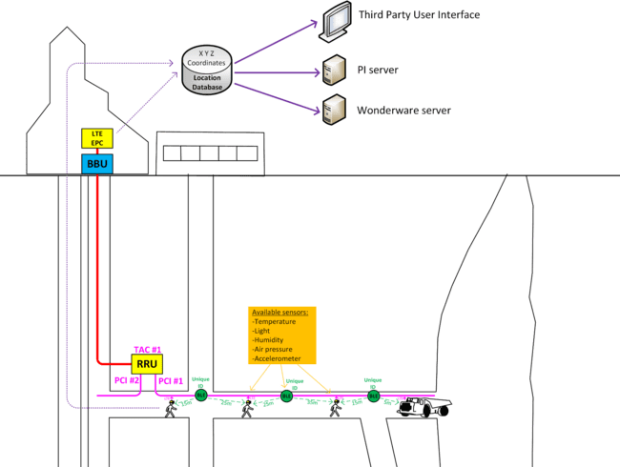
Indoor and outdoor tracking
Basic location tracking
  Per LTE physical Cell ID. Typically one cell-id (PCI) per level
  Precision: 500m - 1 km
Advanced location tracking
  Using external Bluetooth beacons
  Low cost/power Bluetooth beacons installed on the walls
  Precision: Less than 50 m
  LTE + Bluetooth readers located on
    Helmet
    Phones
    Vehicle
OPC

Slide 31
Example of LTE implementations

Slide 32
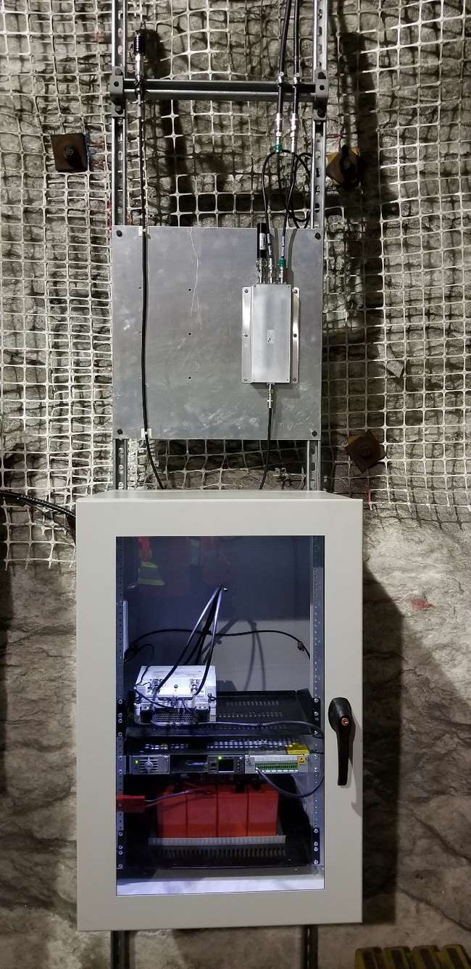
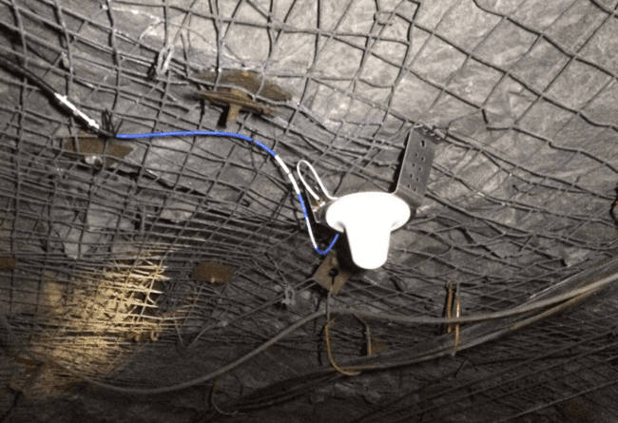
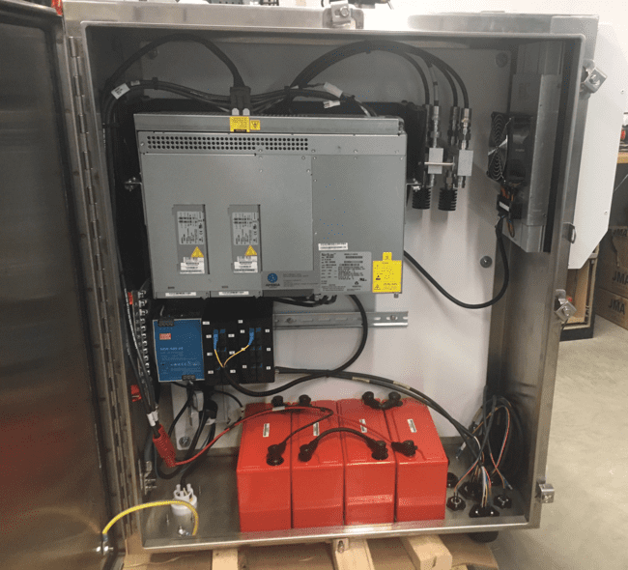
Underground radios
Rackmount cabinets
Stainless SteelCabinet

Slide 33
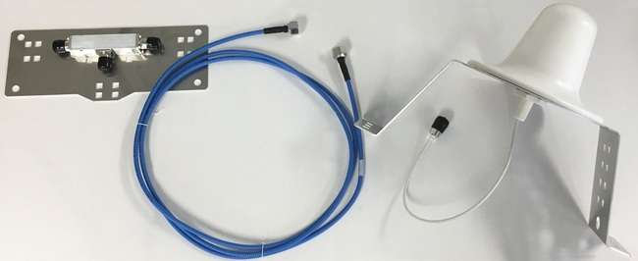
Underground DAS Kit

Slide 34
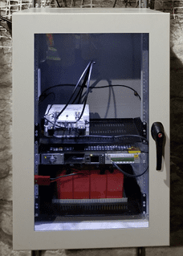
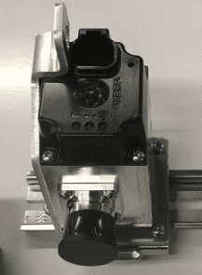
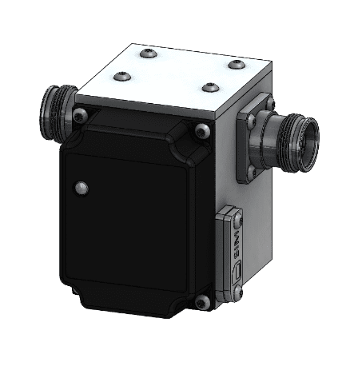
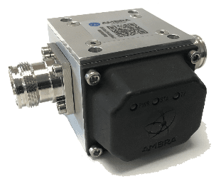
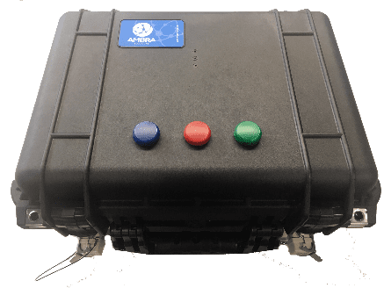
DC powered DAS
LTE cabinet
DC injector
BLE beacon
BLE beacon
Smart load
LTE camera suitcase
Sub-station
Tunnel

Slide 35

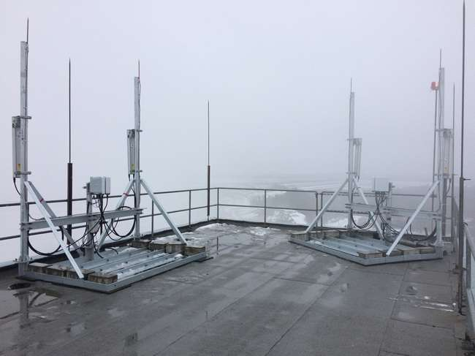
Above ground radios

Slide 36
Ensuring moving moments
- Our competences and experience -
Time to market
Flexibility/ Scalability
Efficiency

Slide 37
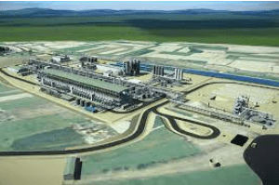
Our team experience – Private LTE
Rio Tinto mine "Jadar"
One access domain and unique frequency spectrum, independent network, independent core
Generic LTE mobile communication for 900 potential users
Push to talk communication
Secure access to Rio Tinto WAN via LTE data for Users and equipment via IPSec or MPLS VPN.
People and machine tracking
Video surveillance
Availability of 99.999% assured,

Slide 38

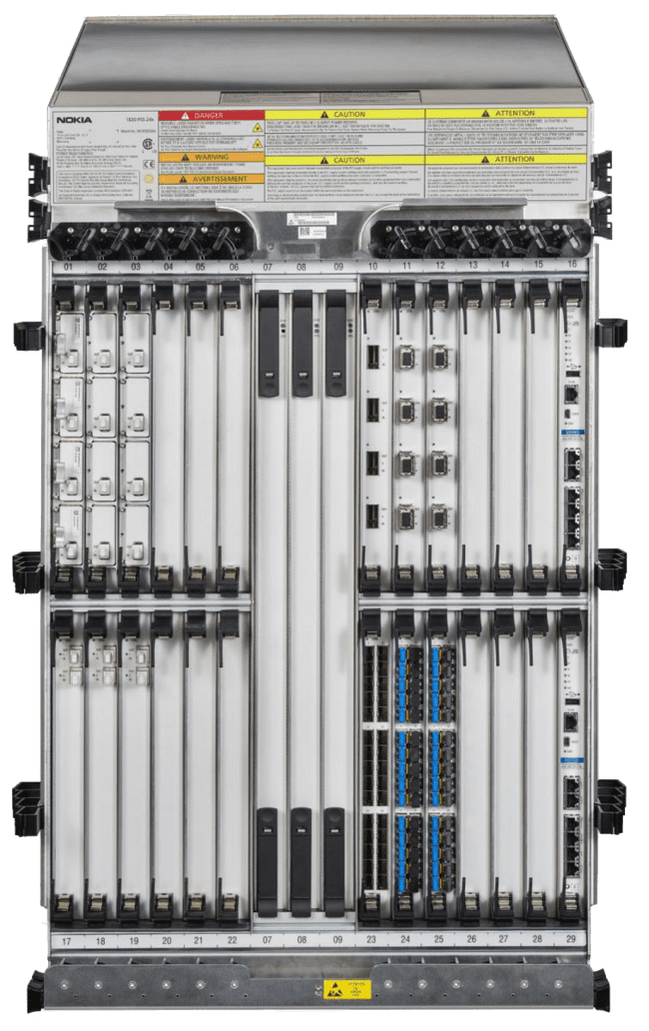





Our team experience – Transport
Radio Transport
Republički hidrometerološki zavod RHMZ - Microwave, on-going project
Radiodifuzna Agencija Crne Gora RDC - NEC Microwave, concept proposal
Orion Telekom - NEC Microwave, installation, commissioning & configuration
Vip mobile, Siemens Microwave, installation, commissioning & configuration
Telekom Srbija, MTEL - Microwave (Ericsson, NEC), installation, commissioning & configuration
Fixed Transport
AMRES Serbia - Huawei DWDM network, maitenance
A1 group: A1 VIPnet Croatia, Vip mobile Serbia, A1 Slovenia - Cisco IP/MPLS: MPLS L3VPN, MPLS L2VPN (VPLS, HVPLS,PW). Design, instalation, comissioning, acceptance test, migration of services as well as maitenance 24/7 of IP backhaul network.
Optima Telekom Croatia - Nokia DWDM, installation, configuration, maintenance
Vip mobile - DWDM, maitenance of pasive and active devices related to optic link Zagreb - Osjek – Beograd
Optima Telekom Croatia - laying of optical cable multiple lines
Orion Telekom Serbia and Montenegro - laying of optical cable multiple lines
N Gb/s
School / University
Notes:
Dojce telecom ipc core, optika ya orion

Slide 39
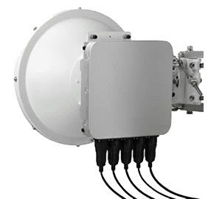
Our team experience – Access
Radio Access
Orion Telekom - PTP & PTMP base stations (RAD, Ruckus, Cambium, Mikrotik), installation, commissioning, service migration
A1 Slovenija - Femto base station (Casa), PoC, installation, commissioning, configuration
A1 Austria & Slovenija - LTE vRAN (Altiostar), installation, commissioning, configuration
Vip mobile - Altiostar 4G, Nortel 3G base station, Alcatel 2G BS, installation, commissioning, configuration
Telekom Srbija – vCPE (RAD, Advantech), PoC, installation, commissioning, configuration
RioTinto – pLTE (consulting, design and planning)
Fixed Access
A1 Austria – FTTH, consultancy on transformation principals
Orion Telekom – FTTN (Iskratel, Raisecom) GPON installation
OneVip Macedonia - Cisco BNG design, configuration and commissioning
MoTTT Serbia - project Connected Schools, PM and delivery

Slide 40

Our team experience – Core network
Packet core network
A1 group: A1 VIPnet Croatia, Vip mobile Serbia, A1 Slovenia. Design, instalation, comissioning, acceptance test, migration of services as well as maitenance 24/7
Deutsche Telekom goup in Croatia and Austria - vEPC node, design, instalation, comissioning, acceptance test, migration of services as well as maitenance 24/7
Notes:
Dojce telecom ipc core, optika ya orion

Slide 41

Our team experience - Railway
Železnice Srbije
Transmission part – SDH transport network
User Application – non-critical services (layer 2 network, PA, information boards, video surveillance, automatic fire alarm system)
Slovenske železnice
GSMR for Data and Voice Communication
Radio Part – BTSs (Iskratel as producer)
Transmission part (Ciena):
  PDH/SDH/Ethernet Equipment
  SDH network for mission-critical services
  Ethernet for non-critical services
  Optical network as backup
Network Monitoring System - NMS (Ciena)
Core Part - Packet Core [SGSN/GGSN], Voice Core [NGIN/MGW/HLR], 2 centers Ljubljana/Maribor
NOC – installation and maintenance
End Terminals (Iskratel)
User Application – non-critical services (video surveillance, indoor security) and critical services (voice and signaling)

Slide 42
Our team experience – Railway cont.
Germany DB
Transmission part - MPLS&OSPF IP transport network
Hungarian MAV
GSMR for Data and Voice Communication
Radio Part – BTSs
Transmission part PDH/SDH/Ethernet Equipment
Network Monitoring System - NMS
Core Part - Packet Core [SGSN/GGSN], Voice Core [NGIN/MGW/HLR]
End Terminals (Iskratel)
User Application
Bulgarian Rail NRIC
Transmission part - MPLS&OSPF IP transport network
Core Part - Packet Core [SGSN/GGSN], Voice Core [NGIN/MGW/HLR]
End terminals
Dispatcher extensions, CAB radios and handhelds

Slide 43
Our team experience – SDWAN
RTS – VeloCloud SD-WAN connecting remote reportage lcations with Head quaters
SITA Transportation/MCN customer - VeloCloud SD-WAN as Cloud & Fog vVAS enabler, Branch2Branch, Branch2DC
Major Insurance Company - Biggest European Insurance company, 2500 offices connected with SDWAN, Branch to Branch, Branch to DC, all type of access technologies covered, Public Internet, ADSL, LTE, MPLS
Somfy Home Automation Company - 140+ VCE’s for branch connectivity, Virtual and Legacy HW, Delivery, remote deployment, 24/7 support
Pirelli Tire manufacturer - 19 Manufacturing sites in 13 Countries, cloud services, VPNs, MPLS combined with Public Internet, legacy and SDWAN site combination
Notes:
Dojce telecom ipc core, optika ya orion

Slide 44

Our team experience – Smart City
Consulting projects
Projects related to Smart Cities led by Ericsson, approach and design
Projects related to Smart Cities led by Kapsch and Austrian Government, Vienna and Lindz, approach and design
EU projects related to development of Smart Cities Bulgaria led by Mtel Bg
Smart City Niš led by MoTTT Serbia, approach, design and budget

Slide 45
Our team experience – ICT Infrastructure and Data Center
Campus LAN networks & DC infrastructure
SatTrakt – Lenovo, Huawei
Minth Automotive Europe - Cisco
RTS – Huawei
Sberbank – Huawei
Poštanska štedionica – Huawei
MoTTT Connected schools – Cisco
Structure cabling and Passive Solutions
MoTTT Connected schools
Minth Automotive Europe

Slide 46

DIGITAL MINDSET
NEW CONCEPTS & WAY OF THINKING
„We can’t solve problems by using the same kind of thinking we used when we created them.“
Albert Einstein

