Slide 1

Company presentation

Slide 2
A global solution
Customers proximity
Services
Production
E shop
Rental

Slide 3

Manufacturer
7 factories
in Europe
An industrial and logistic presence

Slide 4










A manufacturer
Manufacturer
Our factories
tap-industrie.com
Containers
Machines frame
Pallets
Mezzanins
Plateforms
Ramps
Models
Workshop furnitures
Pallets containers
Manurack
Safety barriers
Containers
Spill pallets
Manuracks
Containers for nuclear industry
Packaging
Metallic structure
Bulding stuctures
Skips
Containers
Wire containers
Packaging
Wire mesh decking
Wire cages

Slide 5
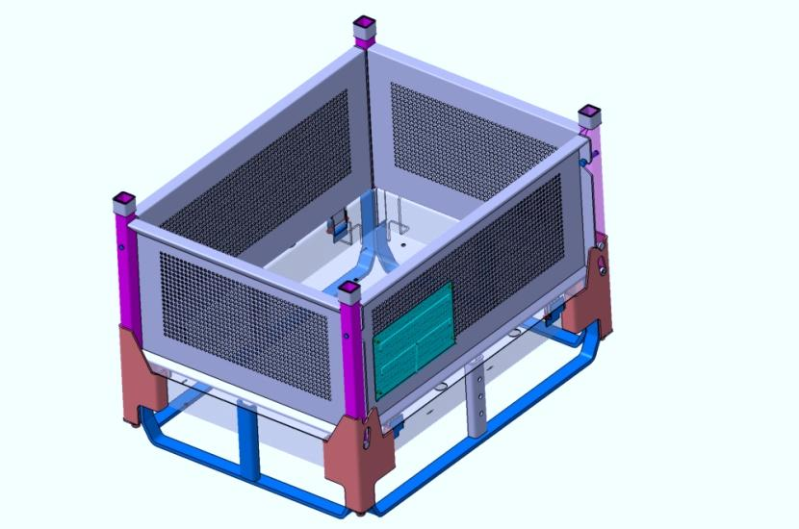
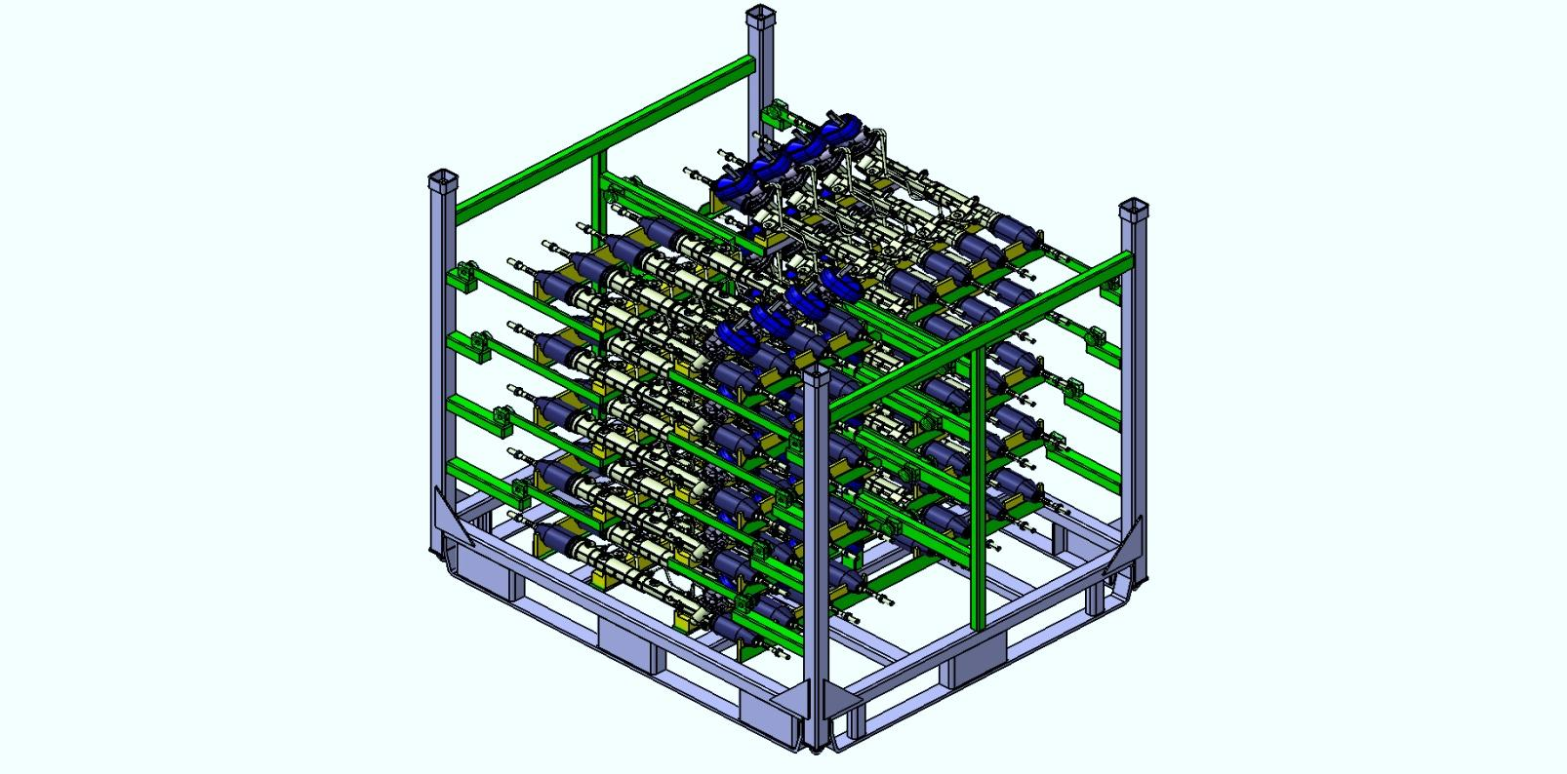
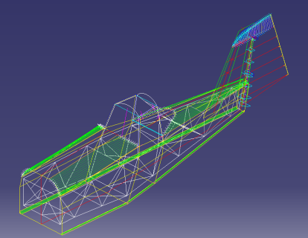
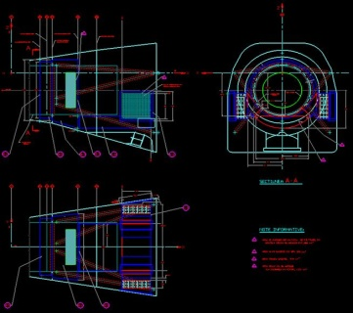
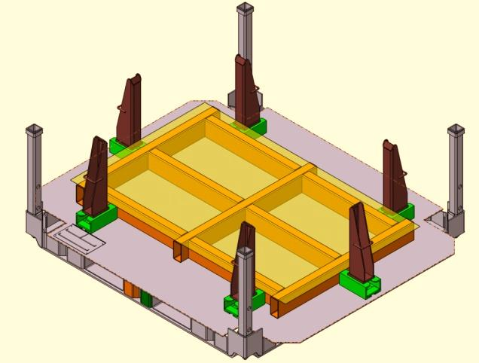
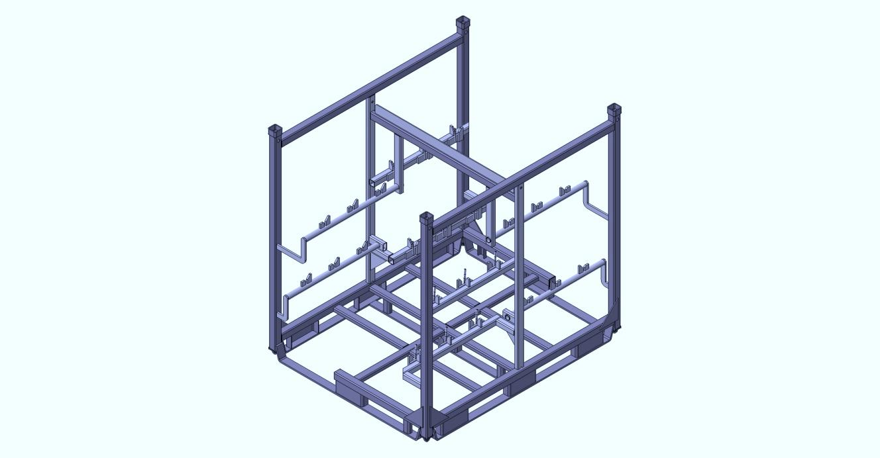
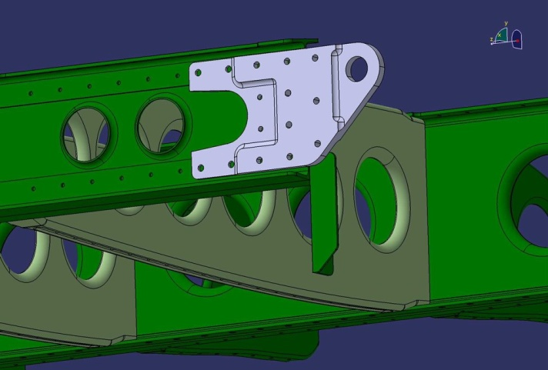
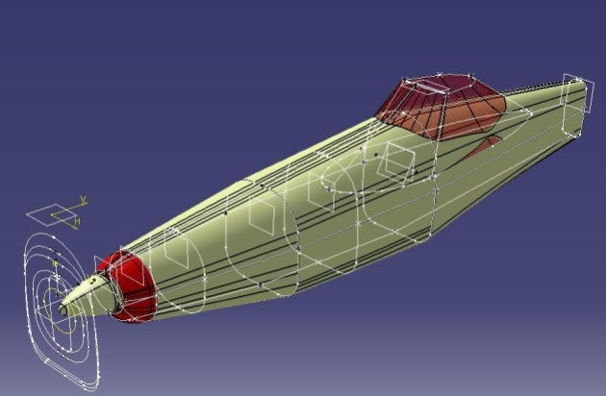
Manufacturer
COMPLETE TECHNICAL PROJECTS
Starting specifications to the realisation of the final technical file ( construction drawing , thermodynamics , aerodynamics and resistant calculation)
AERONOTIC AND TRANSPORT
Study for the definition of the final 3D technical solution starting from preproject draft
CAR INDUSTRY
Manufacturing standard and specific packaging
SUBCONTRACTING :
Manufacturing spare parts
AutoCAD , MathCAD , Catia V5 ,Ansys , Inventor and Solidworks licence , Fining element calculation ( Nastran ,Pastran , Catia)
Resistant , aerodynamic and thermodynamic calculation,
ing in 2D an 3D perspectiv
3D simulation for logistic solution

Slide 6
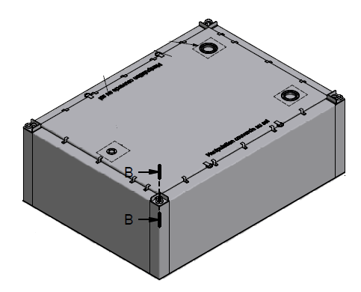
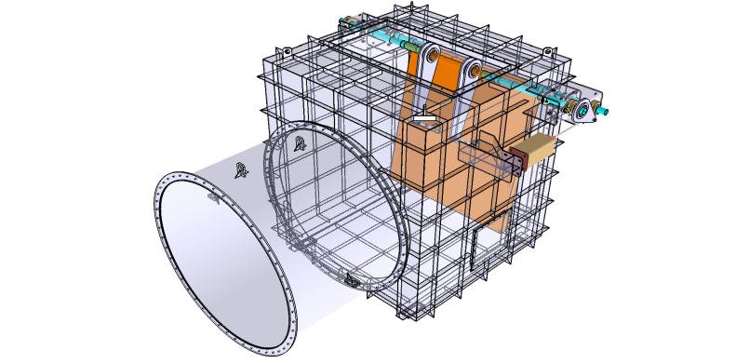
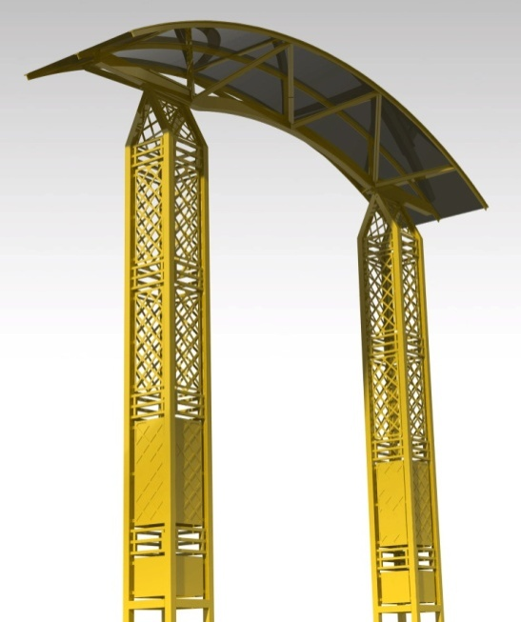
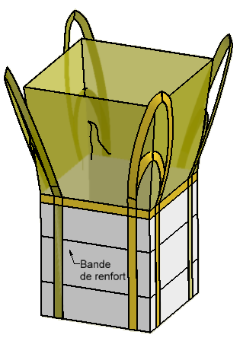
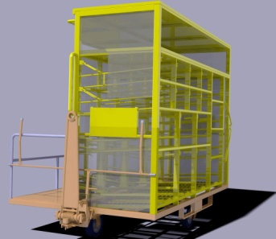
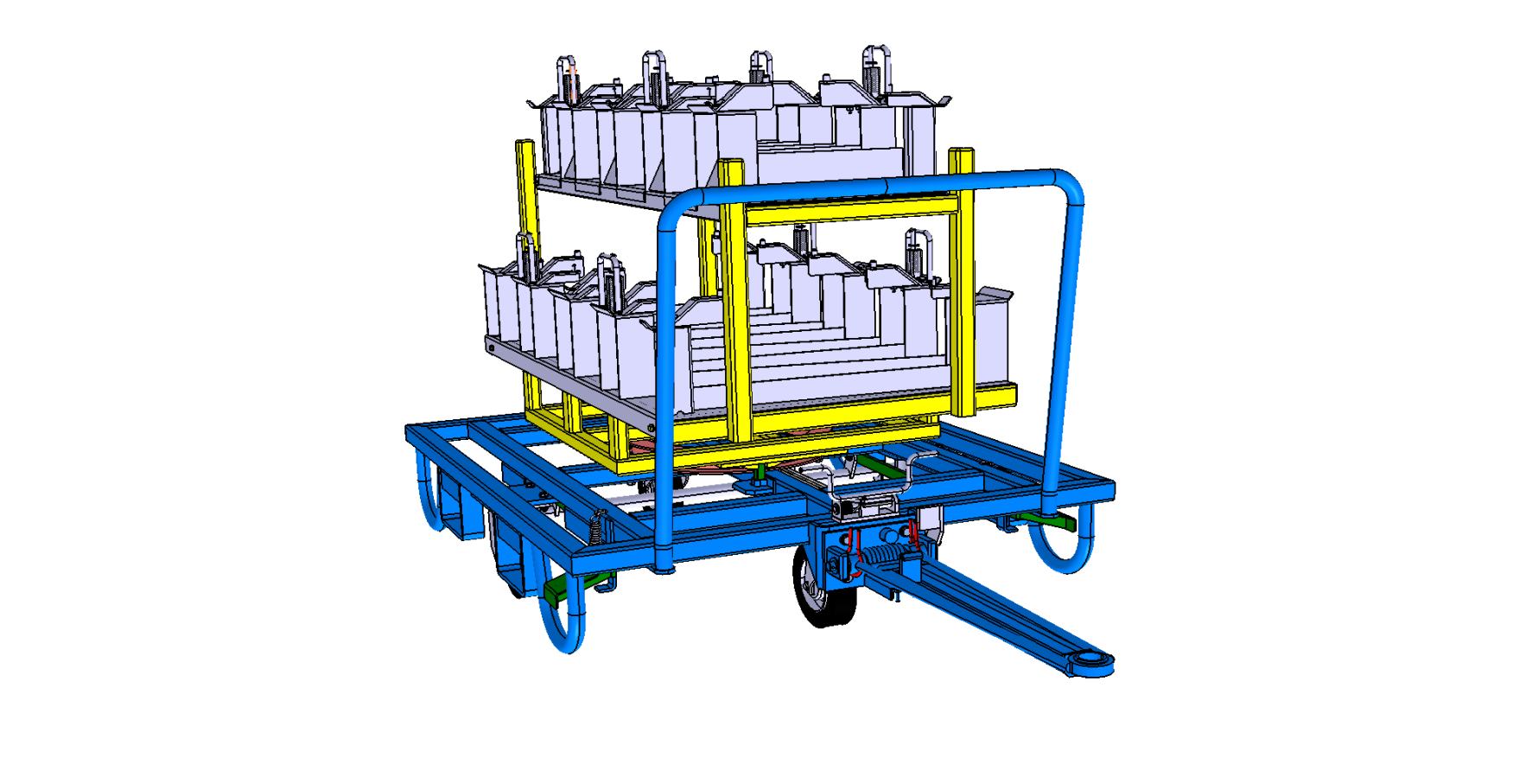
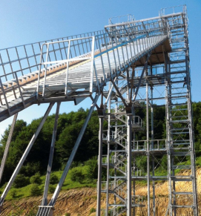
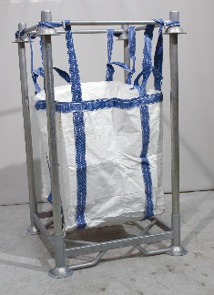
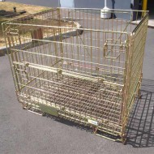

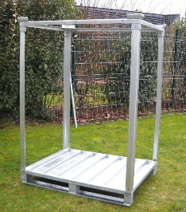
Manufacturer
A maufactu
CONSTRUCTION :
Infrastructures, équipments…
NUCLEAR :
Special containers for waste collection in the framework of dismantling,
LOGISTIC
Manufacturing of specifiq containers and storage solutions storage

Slide 7

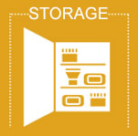


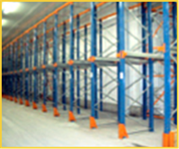
E-shop
PALLETS
BIG BAGS
SHELVING
CANTILEVERS
SKEEP CONTAINERS
TRANSPORT TROLLET TROLLEY
WIRE CONTAINERS
PLASTICS BINS
MANURACKS
MANUBAGS
TROLLEY
LIFTING TABLES
STEEL CONTAINERS
PALLETS COLLARD
WIRE DECKING
PROTECTIONS
ROLL
PALLET TRUCK

Slide 8



E-shop
LIFTING BROOM
HOIST
WORSHOP TABLES
CABLE COVER
CARTONS
PROTECTIVE MATERIAL
CLAMPS
LIFTING BEAMS
DRAWERS CABINETS
STORAGE CABINETS
PAPER
CUTTING SYSTEM
SLING
ACCESSORIES
SIGNALISATION
PROTECT. PERSONNES
LABEL HOLDER
PACKAGING TABLE
TOOLS HOLDERS
MATTERS

Slide 9



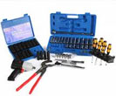



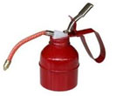
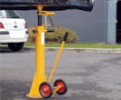
E-shop
SPILL PALLETS
DRUMS CABINETS
ROLLS – PADS
ABSORBENTS SOCKS
PROTECT. RAYONNAGES
PROTECT. ENTREPÔTS
HANDS TOOLS
POWER TOOL
SECURITY STORAGE
SPILL DECK
DRAIN BLOCKER
SEWAGE FILTER
CONTRÔLE D’ACCÈS
RALENTISSEURS
ÉLECTRICITY - LED
CLEANING PRODUCTS
DRUM RACKING SYSTEM
ACCESSORIES
MOBILE RESPONSE KIT
HOSES FILTER
SIGNALISATIONS
COFFRES FORTS
GREASING EQUIPMENT
TRUCKS ACCESSOIRIES

Slide 10




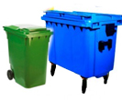
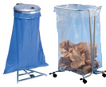
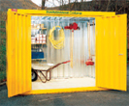


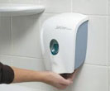
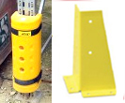
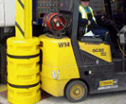
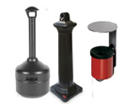

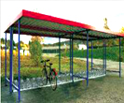
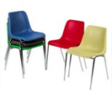
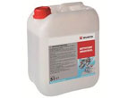
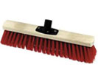
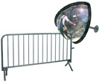
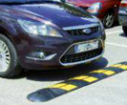
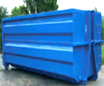
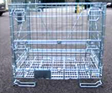


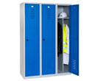
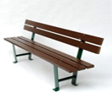
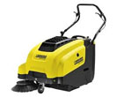
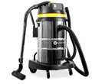
E-shop
CONTENEURS EXTÉRIEURS
DÉCORATIONS
ESSUYAGE INDUSTRIEL
WHEELED BINS
SACKHOLDERS
OUTDOOR CONTAINERS
OUTSIDE FURNITURE
INDUSTRIAL WIPERS
LIQUID SOAP
SHELVING PROTECTION
WAREHOUSE PROTECTION
PRODUITS D’ENTRETIEN
ABRIS À VÉLOS
MOBILIER INTÉRIEUR
BROSSERIE
CLEANING PRODUCT
ASHTRAYS
WASTE BINS
INTERIORS FURNISHING
BROOMS AND BRUSHES
ACESS CONTROL
SPEED BUMPS
CYCLE SHELTERS
VESTIAIRES INDUSTRIELS
BANCS
ELECTRICAL GOODS
SIGNAL
SAFES
WASTE CONTAINERS
DIDICATED CONTAINERS
INDUSTRIAL LOCKER
BENCHES
FLOOR SWEEPERS

Slide 11



Services
I
Industrial remolding
Maintenance and repair
Audit
EXPERTISE
ON-SITE INSTALLATION
S.A.V.
Our technicians move to evaluate with you needs and they direct you to the best solution among or standard or custumized offer,
Storage facilicity
Space optimization
Protective equipment
We propose the maintenance of your equipments ( repairs , maintenance….) to ensure your investments life time.
Containers
Dock equipments
Floor markings
Storage equipment
Our installation technicians are able to assemble and dismantling your infrastructures.
Shelving
Plateforms/Mezzanins
- Mesh bulkhead

Slide 12
Rental
The rental
Management of fleet
We control physical flows and we join services to the good functionning of flows.
Discover the advantages of the rental and lease with an option to buy. We take care of everything !
Pallet position
Handling equipment
Containers
YOU DELIVERED YOUR CUSTOMER
TAP SENDS BACK THE MATERIAL
TAP GETS BACK THE DELIVERED MATERIAL
TAP CLEANS AND REPAIR THE MATERIAL
TAP DELIVERS YOU THE MATERIAL
1
}
1
Our rental offers allows you to have an equipment without investment
5
2
2
The equipment is available immediatly
3
You keep your financial independance
Only one partner!
Rental advantages
4
The equipment is not recorded in the mobilizations
Monthly payments are parts of cost and they are deducted from the profits
4
3
5
6
VAT is not apply
7
You can stop anytime you wish

Slide 13



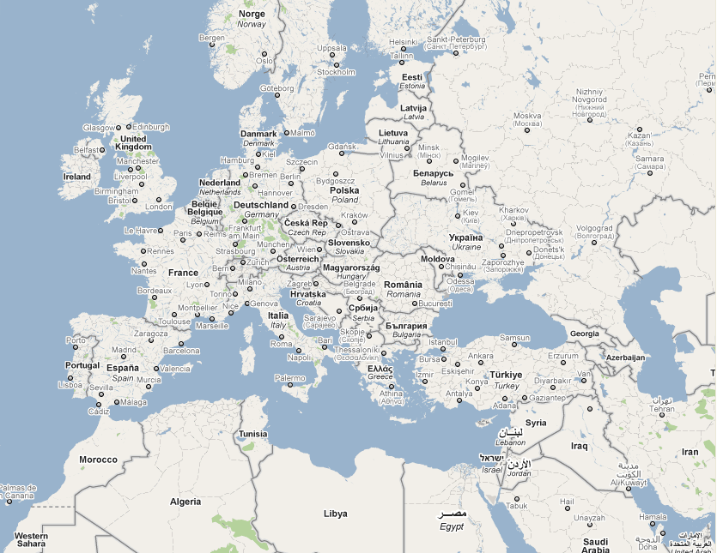


Proximity
Metal Production, Poznan
TAP france,
Tours
Commercial activities
Factories
TAP france,
plaI sI r
Logistic
Design office
Installation and maintenance
mathiaut,
ST Broing les moines
TAP UKRAINE, ROVNO
BELLEVRET,
bALANOD
TAP BALKAN, bELGRADE
TAP france,
St VALLI ER
2016
TAP > 300 employees
Benefits : 35 M €
TAP maroc, Casablanca
TAP IBERICA, BARCELONE

Slide 14
Contact us
ADRESS
TAP France
91 Avenue Sainte Apolline
78370 PLAISIR
CONTACT
Tél : 01 30 56 63 88
Fax: 01 30 56 63 87
Email: infos@tap-france.com
Web: tap-france.com
WEB
tapfrance.info
mathiaut.fr
Tap-shop.fr
bellevret.fr

