Slide 1
Start signing – build bridges
Johanna, Steiner
Lingvano
Austria
"Methods for teaching sign language
and fostering signing
communities"
Thursday, February 22, 2024, 01:40 pm – 02:40 pm CET
Notes:
Start signing – build bridges; Johanna, Steiner; Lingvano, Austria, Methods for teaching sign language and fostering signing communities
#ZeroCon24
Thursday, February 22, 2024, 01:40 pm – 02:40 pm CET

Slide 2
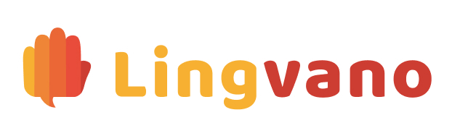
About
2018: Deaf co-founded
2019: ÖGS = Austrian Sign Language
2020: App version
2021: ASL = American Sign Language
2022: BSL = British Sign Language
2023: 1,5 Mio. users
100% self-funded
Notes:
About Lingvano and the milestones each year since having been Deaf co-founded in 2018. So far there are three sign languages being offered and Lingvano is completely self-funded.

Slide 3
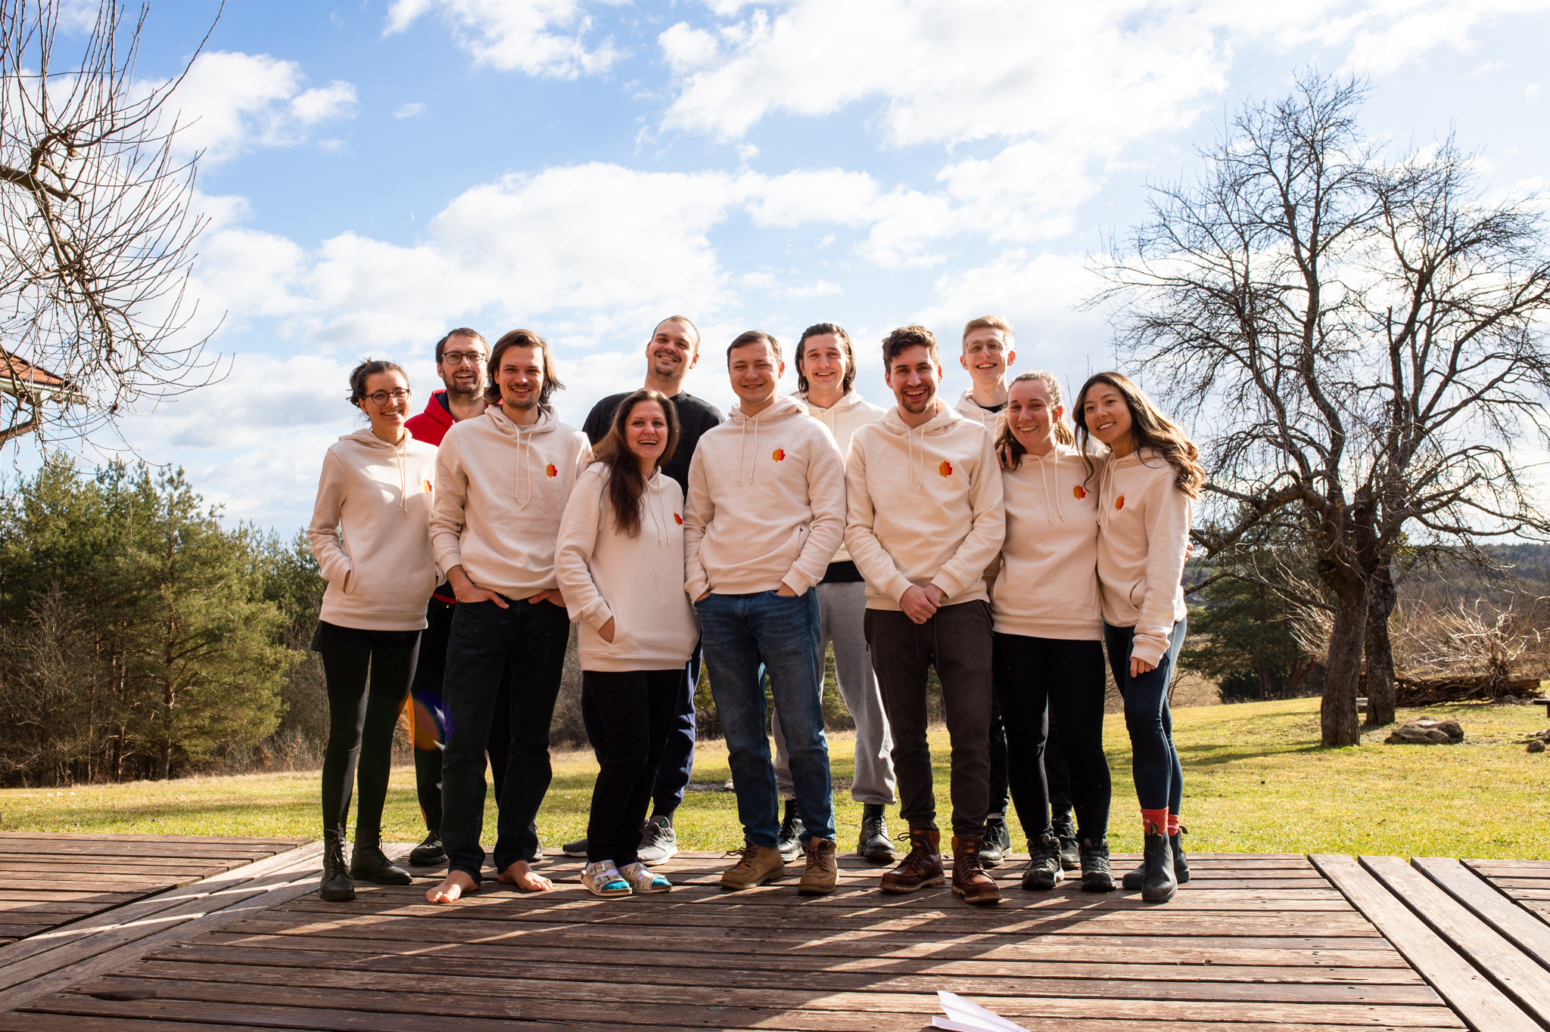
The team
Deaf, hard of hearing and hearing (¼ D/HoH)
All teachers are Deaf Native Signers
Qualified job opportunities for people with disabilities
1/3 female developers
International, multilingual team
Notes:
Presenting numbers concerning the team, pointing out the percentages of Deaf/Hard of Hearing and female employees, highlighting the international and multilingual workforce although it is not represented in the group picture.

Slide 4
Our aim
Facilitate communication to achieve more accessibility for Deaf people
Build bridges between the Deaf and the hearing to make the world a more inclusive place
How can this be achieved?
More people know how to sign = improved quality of living for Deaf people
We offer a fun, easy and flexible way to learn sign languages
Learn anytime, anywhere, for as long as you like
Notes:
Our aim is to build bridges between the Deaf and the hearing world to facilitate a better quality of living for Deaf people. This can be achieved through enabling more people in an accessible, flexible and fun way to learn sign language.

Slide 5
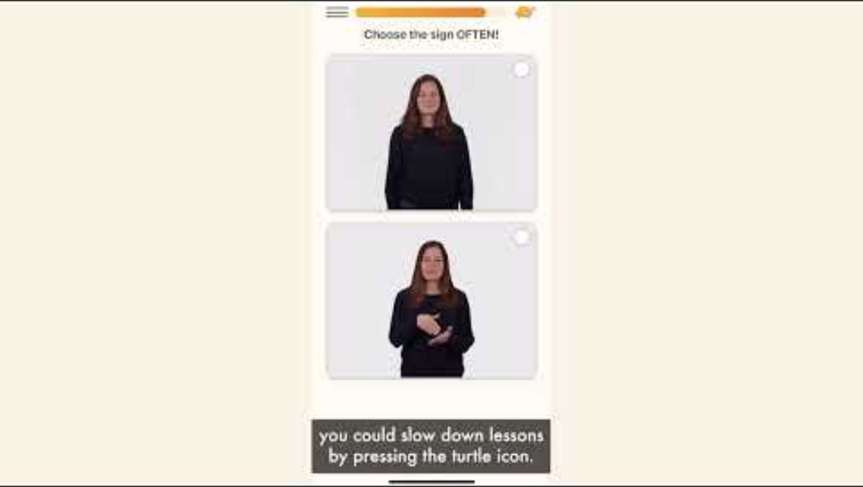
The product
Notes:
Es wird ein Produktvideo mit Aufnahmen aus der App gezeigt. Das Video ist untertitelt und mit einer Sprachaufnahme versehen.
The video shows a product demo of sampled screen recordings, including subtitles, voicing and elevator music.

Slide 6
What stands out?
Great user engagement
Fun and easy to learn
Great progress with investing only 10 minutes a day
Gamification
Course, 3 Trainers, Dictionary
Significant grow: 2 mio. users
US-Apple store ranking: in the Top 3 for months
Notes:
Lingvano stands out for great user engagement and a fun and easy way to learn sign languages. People make a great progress with investing only 10 minutes a day. This can be achieved with elements like gamification and different trainers.

Slide 7
Outlook
Reach out to even more people and support them in their sign language learning journey
Additional BSL content
Subsequently add more sign languages
Expand our B2B program
Continue our ambition to make the world a more inclusive place
Notes:
The next steps are going to be: attracting even more users, add more content for BSL, add new sign languages and expand the B2B program. All of these measurements will lead to a more inclusive place.

