Slide 1
Inclusive Sports and Quality Education
Dr. Daniela Bas
Founder DB SustainABILITY Advisory Boutique Int.(SAB)
www.danielabas-sab.com
Wednesday, 21 February 2024
15:20-16:20
Notes:
Please add your notes here.
Title; First name, last name of speaker(s); Name of Organization, Name of Country, Name of Session (as written in Agenda)
#ZeroCon24
Day and Time of Session

Slide 2
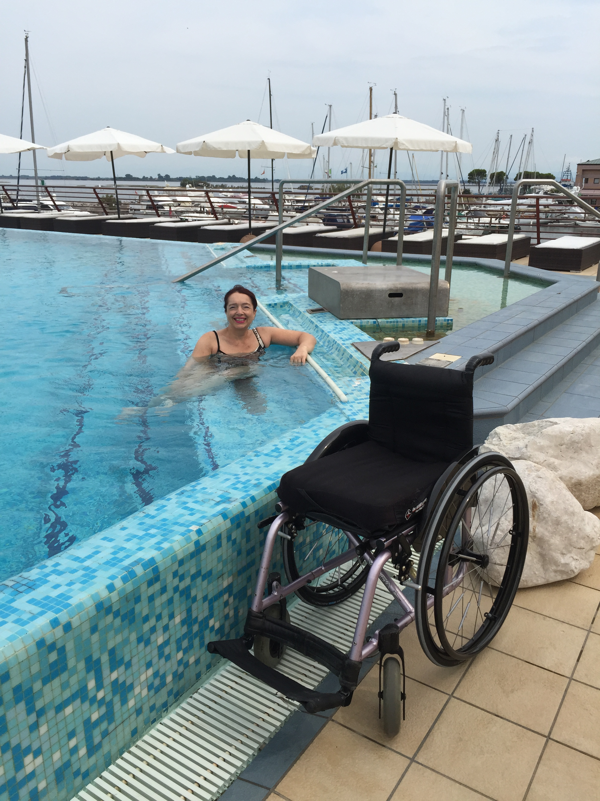
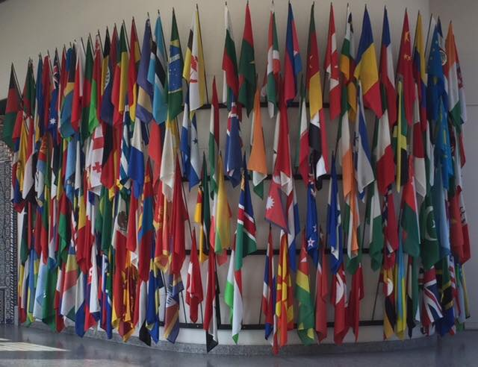
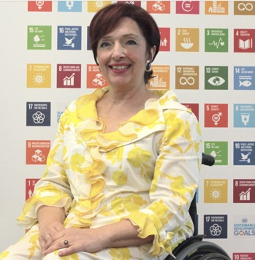
Zero Project Conference 2024
Policy framework and definition sport
“Sport” as a generic term, comprising sport for all, physical play, recreation, dance, organized, casual, competitive, traditional and indigenous sports and games in their diverse forms”
(Kazan Plan of Action 2017)

Slide 3
Zero Project Conference 2024
Sport and quality education for the fashion industry worldwide

Slide 4
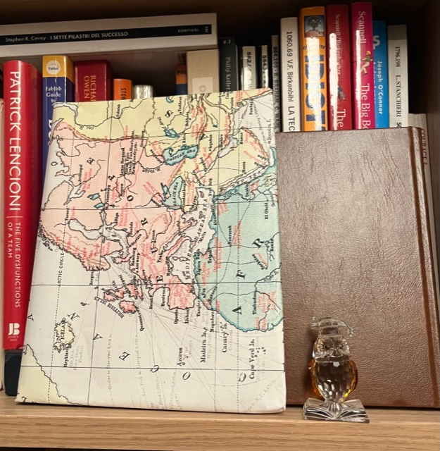
Zero Project Conference 2024
Sport and quality education and STEAM

Slide 5
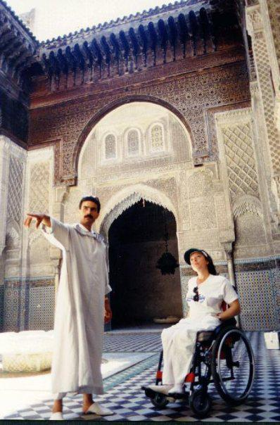
Zero Project Conference 2024
Sport and quality education for the travel industry

Slide 6
Zero Project Conference 2024
The 2030 Agenda for Sustainable Development and driving SDGs:
SDG4 (Quality Education) is enhanced by providing diverse learners equal access
SDG8 (Decent Work) skilled, inclusive workforce
SDG10 (Reduced Inequalities) by breaking down educational barriers, reducing disparities.
SDG17 (Partnerships) quality education formal and informal and long life education requires collaborative efforts among governments, NGOs, the private sector, academia, communities and persons with disabilities.

Slide 7
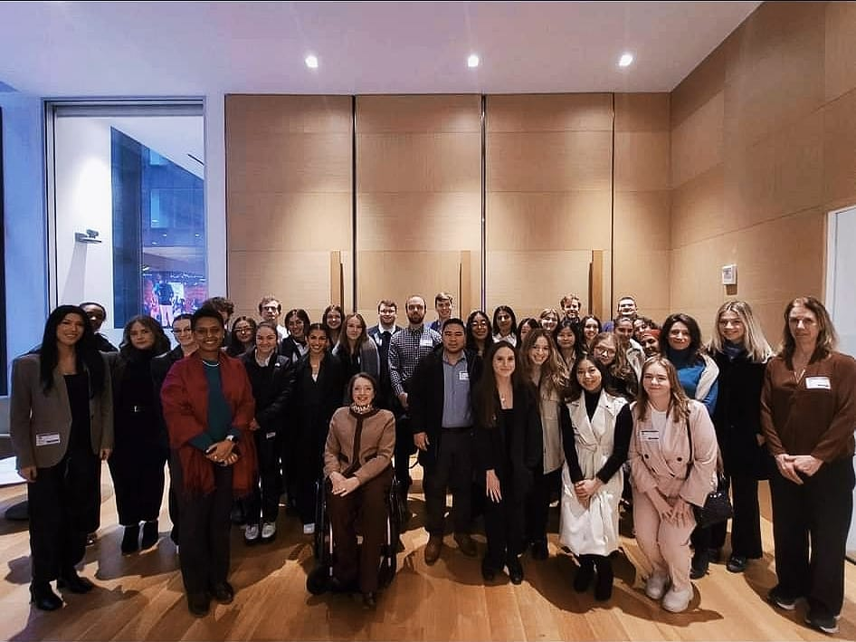
Zero Project Conference 2024
Call for action
Support initiatives that bridge the gaps between sports, education, fashion, travel, and sustainability, fostering an inclusive society that leaves no one behind.
Encourage ongoing efforts to break barriers and build a world where everyone has equal access to sport through quality education and opportunities at school and in the public and private sector where also media play a key role.

Slide 8

THANK YOU
For more information
db@danielabas-sab.com
www.danielabas-sab.com
Or in LINKEDIN
Notes:
Sample Slide: presenting three points on our project and the relationship to this year’s theme of the Zero Project Conference. Point 1; Point 2; Point 3 connect together in this way.

