Slide 1



GROW TOGETHER
SUPPORTING START-UPS:
THE SLOVENE ENTERPRISE FUND'S ROLE
January 2024

Slide 2
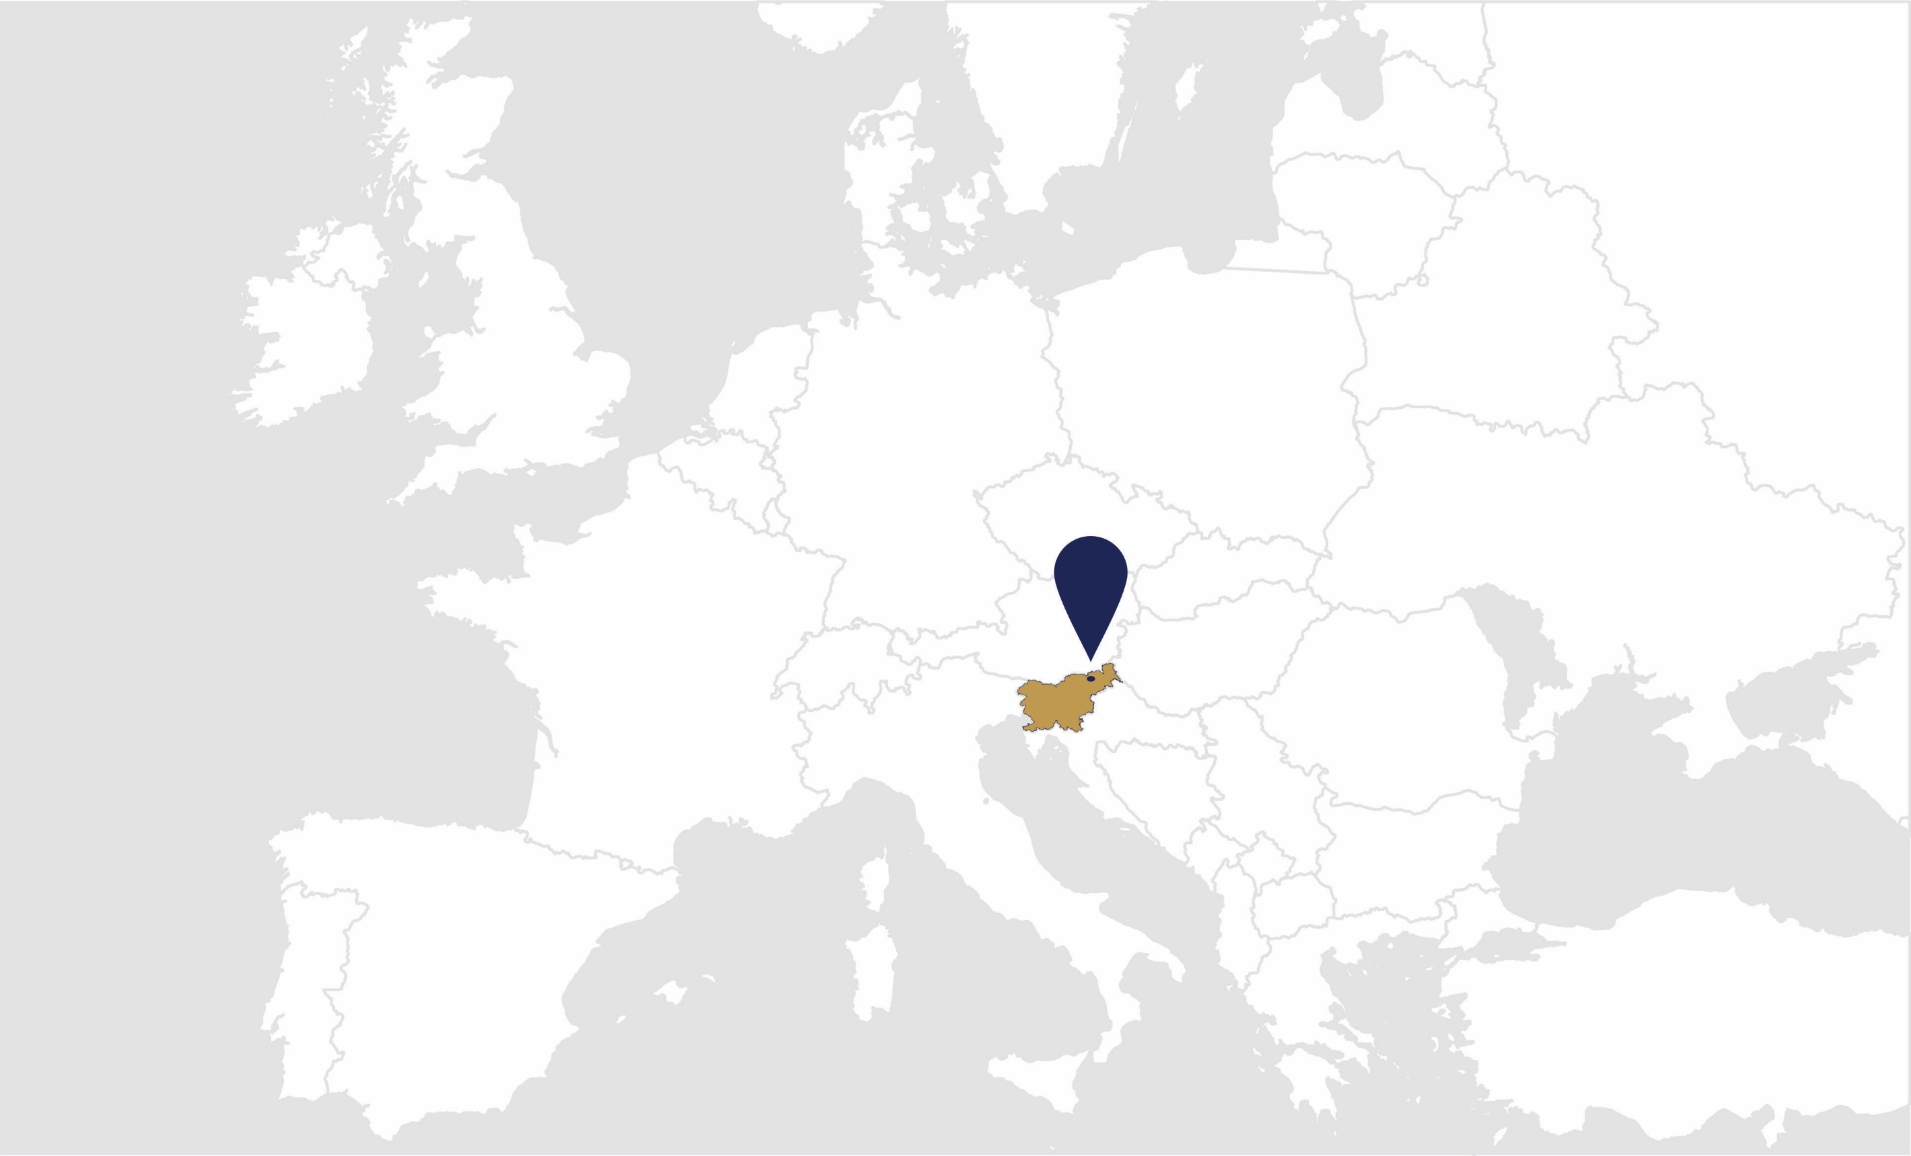

a leading public
financial fund
for the support of
SMEs, start-ups, and scale-ups

Slide 3

31 YEARS
on the market
895,34 M EUR
the value of active portfolio
14.511
active contracts in portfolio
ABOUT SEF:
STRATEGIC ROLE:
STRATEGIC VISION:
support SMEs, start-ups and scale-ups
using effective financial and non-financial ('soft‘) incentives to bridge financing gaps and skills shortages
maintain our position as the leading, recognized, and respected national public fund for supporting SMEs, startups, and scale-ups, following the examples of world-best practices.
61.1% guarantees
29.7% credits
2.5% special incentives
6.8% other

Slide 4
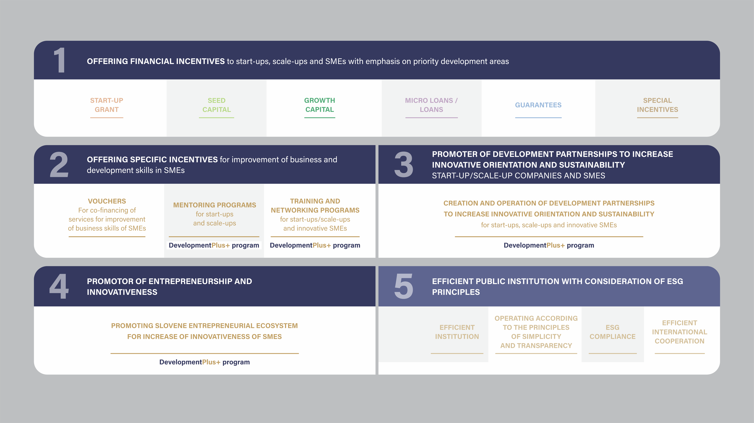
OPERATIONAL ROLES

Slide 5
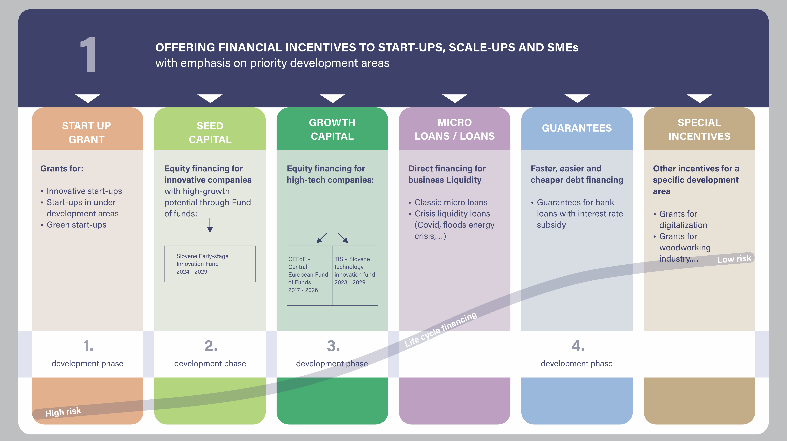


Slide 6
1 call for proposals each year
P2
INCENTIVES FOR INNOVATIVE START-UPS
non-repayable financing (grant) for innovative start-ups in their earliest stages
co-financing the development of their minimum viable product (MVP) and the launch of their innovative product/service on the market
Funding Amount
Beneficiaries and eligibily criteria
up to 72.000 EUR grant per start-up
100 % aid intensity
micro and small enterprises
registered in Slovenia
registered as limited liability company
‚younger‘ than approx. 14 months
at least one employee at the time of signing the funding contract
Funding Period
Payment in 3 tranches over 2,5 years:
1. tranche: 12.000 EUR
2. tranche: 21.000 EUR
3. tranche: 39.000 EUR
30 supported start-ups
each year

Slide 7

2
OFFERING SPECIFIC INCENTIVES FOR THE IMPROVEMENT
OF BUSINESS AND DEVELOPMENT SKILLS IN SMEs
VOUCHERS
For co-financing services aimed at improving business skills
MENTORING PROGRAM
for start-ups
and scale-ups
TRAINING AND NETWORKING PROGRAMS
for start -ups, scale-ups and innovative SMEs
Simple and easily accessible grants of small-value for SMEs
of max. 60 % co-financing
or up to 9.999,99 EUR
Voucher for LCA
Voucher for digitalization
Voucher for internationalization
Voucher for intellectual property
Voucher for quality certificates
Voucher for status transformation of companies
Voucher for ownership transfer
Voucher for prototype development for start-ups
More than 150 experienced mentors and experts
List of mentors on SEF web page
Pre-incubation, incubation and horizontal accelerator programs
Investment accelerator programe
Promotional activities
Networking
Workshops, trainings, seminars
Expert counseling
Study and work visits, group visits to conferences

Slide 8
3
PROMOTER OF DEVELOPMENT PARTNERSHIPS TO
INCREASE INNOVATIVE ORIENTATION AND SUSTAINABILITY
START-UP/SCALE-UP COMPANIES AND SMEs
CREATION AND OPERATION OF DEVELOPMENT PARTNERSHIPS TO INCREASE
INNOVATIVE ORIENTATION AND SUSTAINABILITY
of start-ups, scale-ups and SMEs
Development partnerships – accelerator programs
Vertical accelerators
Cross-border accelerators
Hardware
Web 3.0
Health-tech
Hydrogen value chain
USA
Austria
Israel
Dubai
Hardware
International biotechnology cluster 2023/25 (UNIDO)
Strengthening regional and global innovation ecosystems of industry 4.0 in
Western Balkans in 2023/25 (UNIDO)
Digital innovation of cultural heritage in Montenegro 2023/25 (UNIDO)
Partnership for sustainable development in hydrogen industry in CEE region in 2023/25 (UNIDO)

Slide 9
4
PROMOTOR OF ENTREPRENEURSHIP AND INNOVATIVENESS
PROMOTING SLOVENIAN ENTREPRENEURIAL ECOSYSTEM FOR INCREASE OF INNOVATIVENESS OF SMEs
Promoting start-ups/scale-ups and SMEs
International entrepreneurship conference
National competition for the most prospective start-up
Venture capital investors meet-ups
Registry of innovative start-ups
Events, round tables, press conferences, web pages, e-news, press releases, advertising etc.
Other promotional/technical support
Specialized digital platforms and tools for skills improvement and/or networking
ESG self-assesment tool
Application preparation tools (business tools, depreciation schedules etc.)

Slide 10


CONTACT US
Slovene Enterprise Fund
Ulica kneza Koclja 22, 2000 Maribor
Phone: + 386 234 12 60
E-mail: info@podjetniskisklad.si
Website: www.podjetniskisklad.si

