Slide 1
EU support to algae-sector developments
Felix Leinemann
Head of Unit Blue Economy Sectors,
Aquaculture and Maritime Spatial Planning
DG MARE – European Commission
20 September 2024

Slide 2
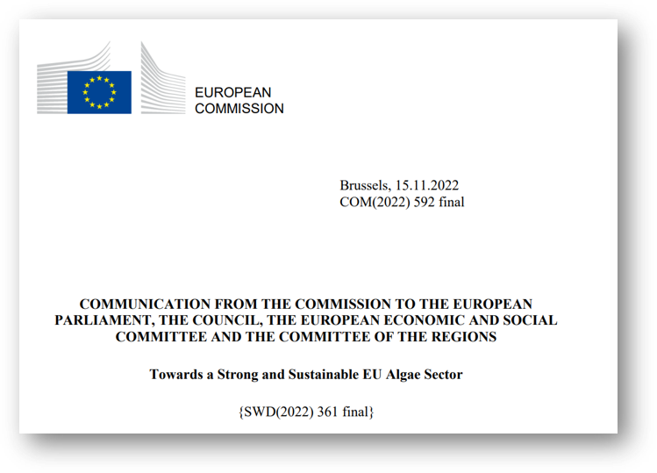
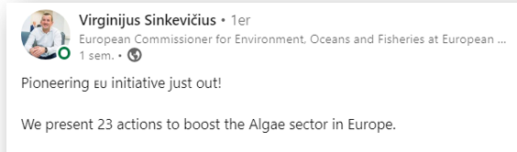
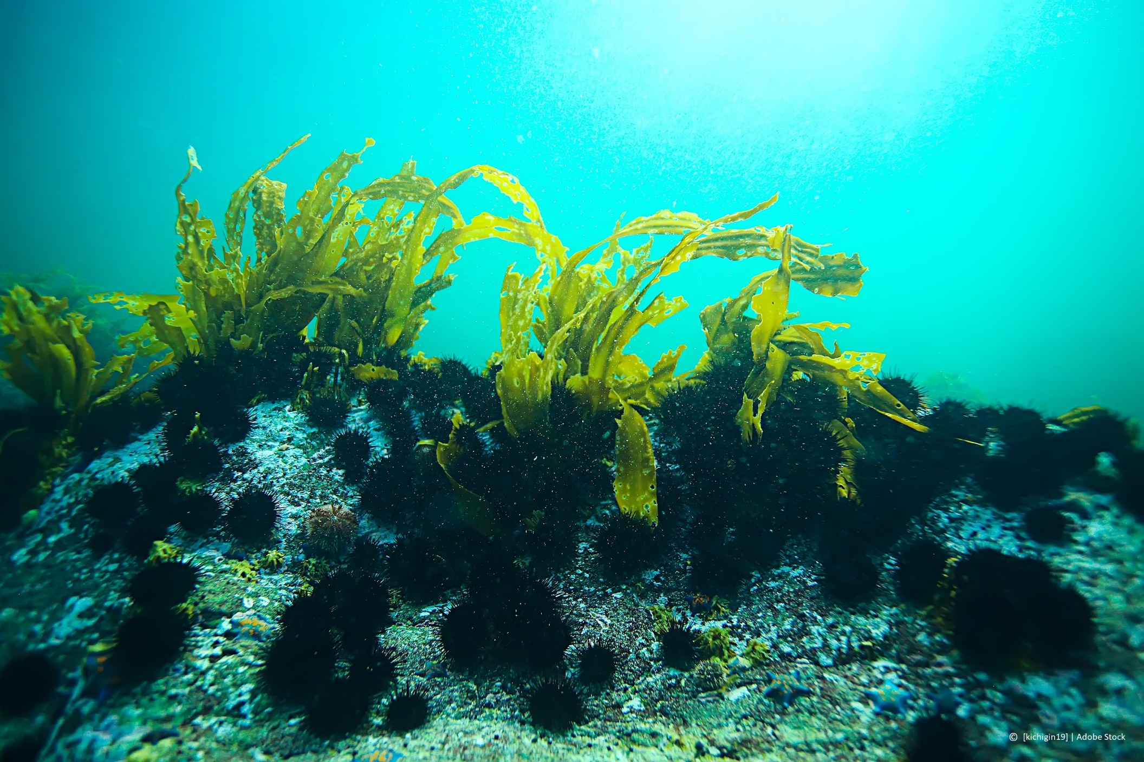
The EU Algae Initiative – Adopted November 2022
Notes:
The EU Algae initiative was adopted 15 November 2022. With the aim to unlock the algae potential in Europe by increasing sustainable production, ensuring safe consumption and boosting innovative use of algae and algae-based products.
This also to help to achieve the objectives of the European Green Deal, and the transition to a green, circular self-sufficient and carbon neutral EU. The Algae sector, as part of the EU Blue Bioeconomy, has a unique opportunity to contribute to climate action through decarbonisation and ocean regeneration actions.

Slide 3
Implementation of the EU Algae Initiative
  Implementation of the Initiative is ongoing at full speed
  (23 actions covering 4 broad action areas):
  Improving the governance framework and the legislation;
  Improving the business environment;
  Closing knowledge, research, technological and innovation gaps;
  Increasing social awareness & market acceptance of algae in the EU
Notes:
With the EU Algae initiative, the Commission approaches the EU algae sector in a more holistic way than ever before. The initiative identifies 23 actions aimed at:
Improving the governance framework and the legislation;
Improving the business environment;
Closing knowledge, research, technological and innovation gaps;
Increasing social awareness and market acceptance of algae in the EU.
The European Commission is currently working on the implementation of these 23 actions, in close collaboration with all the relevant stakeholders (Member States authorities, other EU services, industry, scientific institutions, academia, NGOs, etc.).

Slide 4
Action area 1: Improving the governance framework and legislation

Slide 5
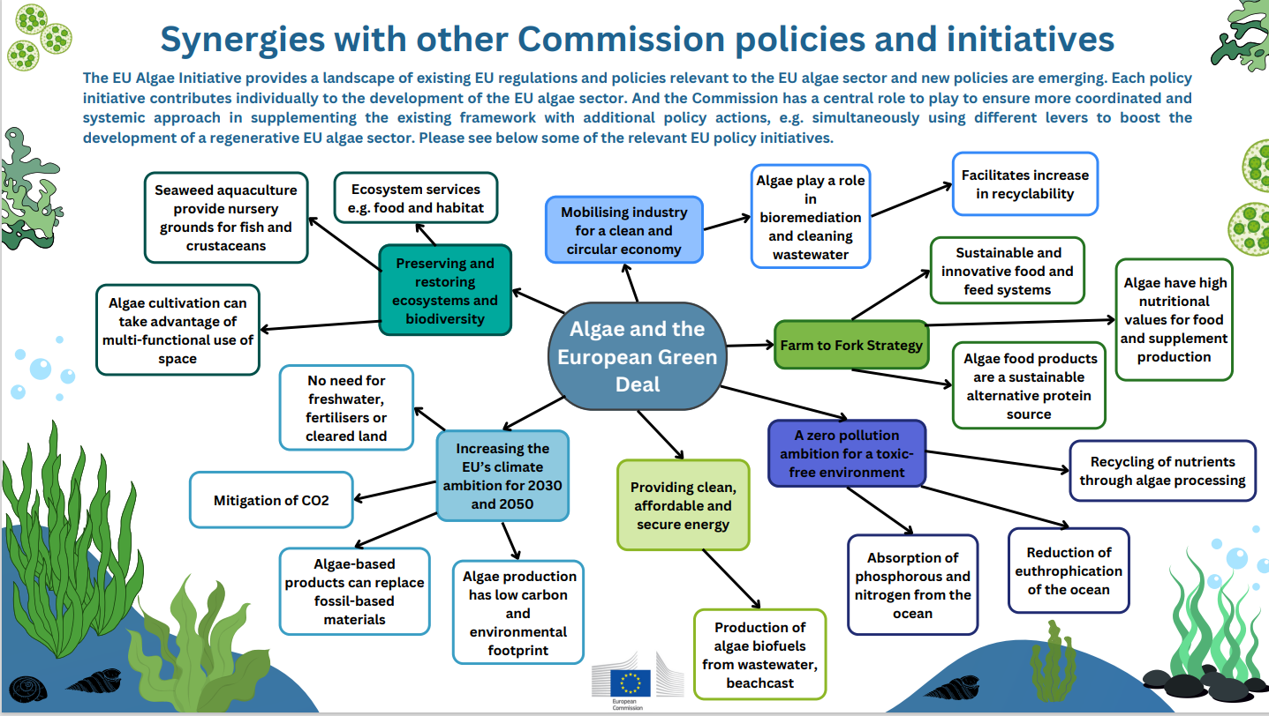
Notes:
The EU Algae Initiative is not an isolated policy initiative. It contributes to several flagship initiatives of the EU Green Deal (e.g. restoring and preserving ecosystems, Farm to Fork, circular economy).
The initaitive has links with various EU policy and legal initiatives, for instance
Water framework directive (contribute to cleaner marine waters),
Nitrates directive (nitrates removal by seaweed at sea),
Green claims directive (to ensure algae sector provides correct green claims of algae products),
sustainable carbon cycles communication (to explore role of blue carbon in carbon cycles)
etc

Slide 6
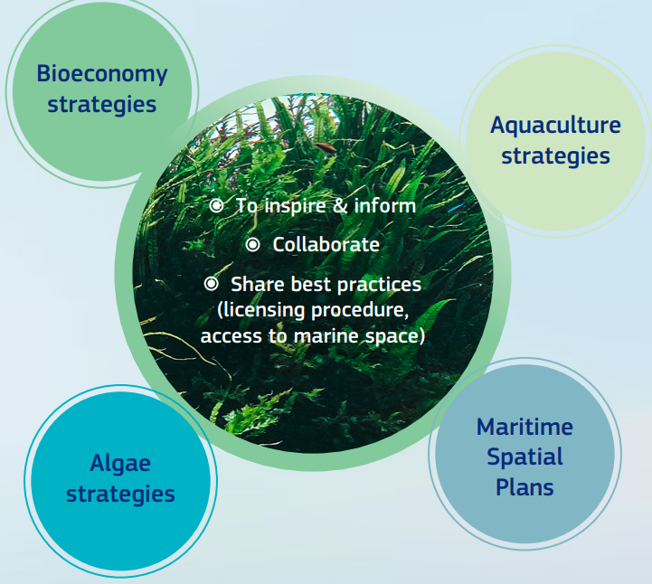
Working together with EU national authorities
Notes:
The Commission regularly meets with EU national authorities to encourage and inspire them to streamline allocation of licences and maritime space at sea for algae cultivation as well as to include algae cultivation into their Maritime Spatial Plans, Multiannual National Strategic Aquaculture Plans and into their European Maritime, Fisheries and Aquaculture Fund (EMFAF) programmes.

Slide 7
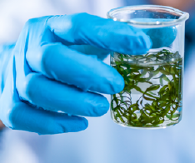
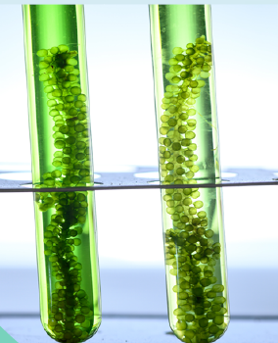
Other ongoing actions
Actions 3 and 4: development of algae industry standards with DG ENER & DG GROW
Action 5: assessment of the market potential, efficiency and safety of algae-based materials when used in fertilising products with DG GROW
Action 11: facilitation of the sea basin and macroregional cooperation by promoting innovative interregional partnership with DG MARE A3
Notes:
DG MARE is also working closely with other DGs on specific actions, such as Actions 3 and 4: development of algae industry standards with DG ENER & DG GROW. Action 5: assessment of the market potential, efficiency and safety of algae-based materials when used in fertilising products with DG GROW. Action 11: facilitation of the sea basin and macroregional cooperation by promoting innovative interregional partnership with DG MARE A.

Slide 8
Action area 2: Improving the business environment

Slide 9
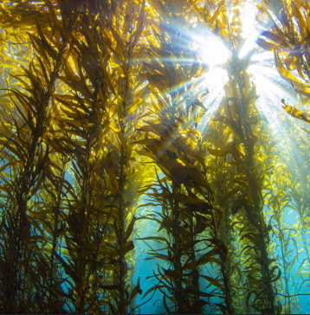

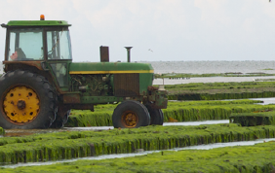
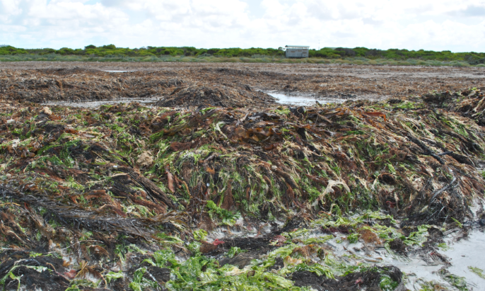
Algae Industry Study
Algae Industry Study (kicked off January 2024 – 18 months) – will implement 7 actions e.g. on algae-based feed, nutrients recycling, bioremediation, blue carbon, on extent of kelp forests and the market potential of beachcast algae in the EU etc.
Notes:
An algae industry study has kicked off 15 January 2024. The study deliverables will contribute to the implementation of 7 actions of the Initiative e.g.
to gather knowledge and promote use of algae as fish feed, fertilizers, and waste-water cleaning as well as
gain better knowledge of algae as blue carbon sinks and
market potential of beach cast algae.

Slide 10

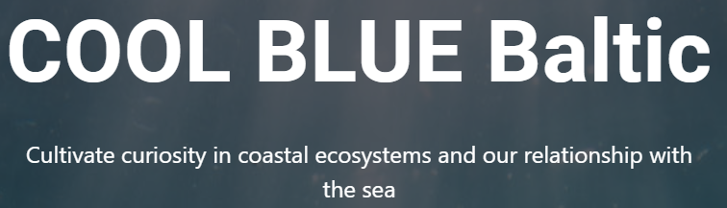
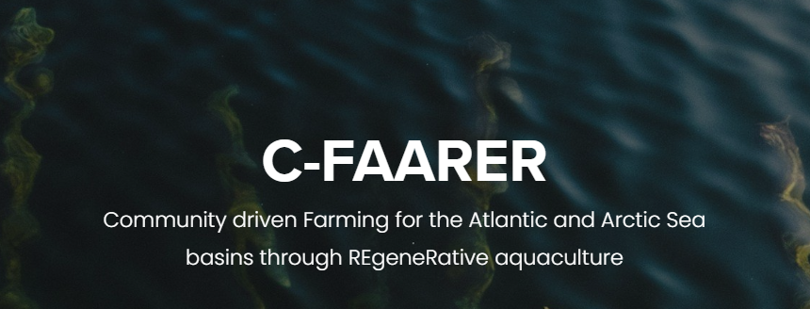
Action 9: Funding pilot projects to support reorientation of fishers’ careers to regenerative ocean farming
To promote diversification from fishing towards regenerative ocean farming 3 projects launched in 2023: (1) COmmunity Ocean farms and Local Business cLUstErs (Cool Blue); (2) Community-driven Farming for the Atlantic and Arctic sea basins through REgeneRative aquaculture (C-Faarer) and (3) EMFAF Flagship for the Baltic Sea “COmmunity Ocean farms and Local Business cLUstErs in the BALTIC sea” (Cool Blue Baltic).
Notes:
As we know well, fishers are facing huge challenges to mainatin their livelihoods due to declining fishing stocks, climate change, coastal ecosystems degradation and external challenges like rising fuel pices .
The Algae initiative aims to explore the ground for providing opportunities to fishers (and local communities) to have a new or additional activity at sea using their own boat, experience, marketing channels etc. Such activities include regenerative ocean farming or coastal marine ecosystem (fish habitats) restoration.
As you can see on the slide, there are already 2 projects that have been launched to implement the Algae initative and to test the idea with local communities and fishers. We encourage national authorities to plan and support such projects from EMFAF and other national funds.

Slide 11

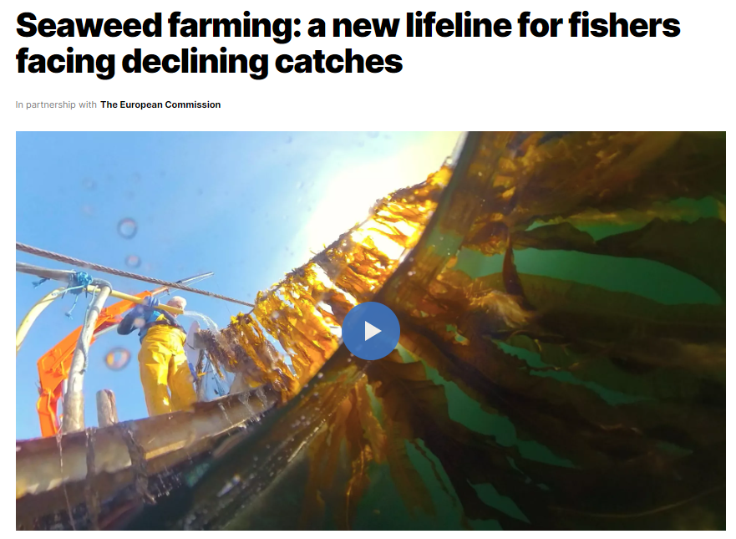
ocean
https://www.euronews.com/green/2024/05/28/fishers-turn-to-seaweed-farming

Slide 12
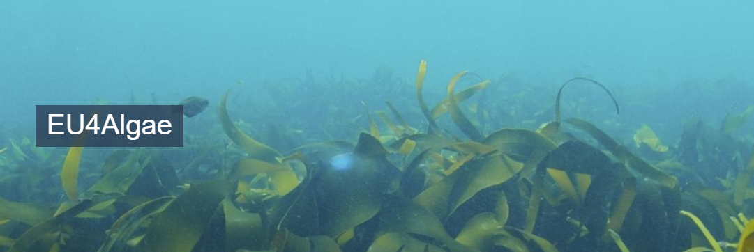
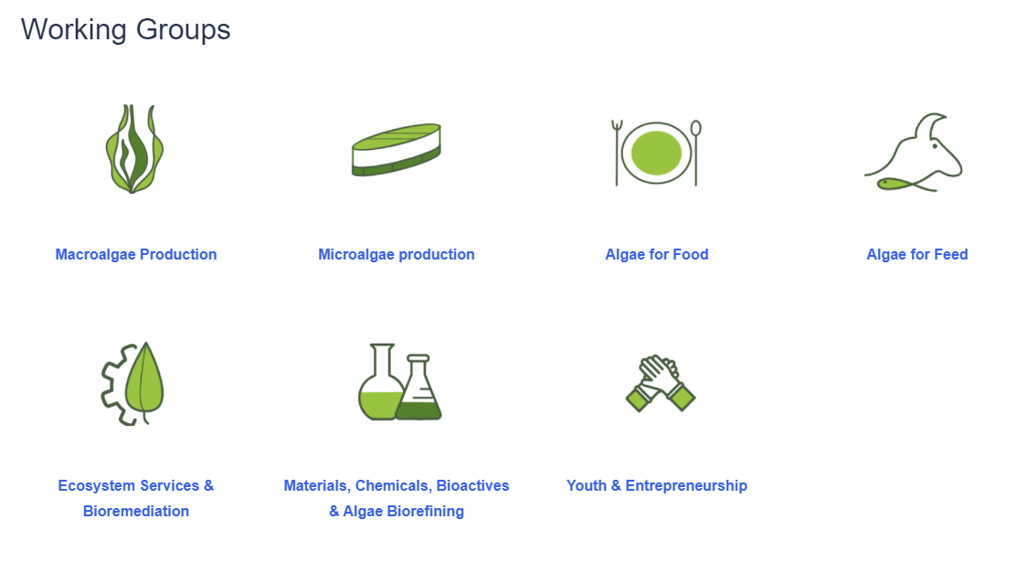
European Algae Stakeholder Platform – EU4Algae
984 registered members from Europe, and beyond
Share business-related information, access funding calls and events, collaborative space for algae stakeholders, share best practices
7 thematic Working Groups with working plans, qualified chairs from algae sector – deliver on actions defined bottom up and solving specific problems algae sector faces
Next EU4Algae contract
Will kick off in January 2025
2+2 years contract
Will include: New Algae Farmers Toolkit and organizing 2nd EU Algae Awareness Summit
Notes:
The EU4Algae has been set up as a stakeholder Platform and can already be considered a success story with more than 1000 registered members and many useful deliverables to be used by entire EU algae sector.
The main purpose of the platform is to Share business-related information, access funding calls and events, collaborative space for algae stakeholders, share best practices
They have 7 active working groups, operating bottom up that are led by leading EU algae sector professionals.

Slide 13

Algae as novel food
The novel-food status of the majority of algae species has been considered one of the major bottlenecks in the EU that slows down algae sector developments
2021 JRC report “Algae as food and food supplements in Europe”, a process performed by the Commission (DG SANTE) and EU national health authorities, allowed to add 30 new algae species to the EU food catalogue as “non-novel”

Slide 14
Action area 3:
Closing knowledge, research, technological and innovation gaps

Slide 15
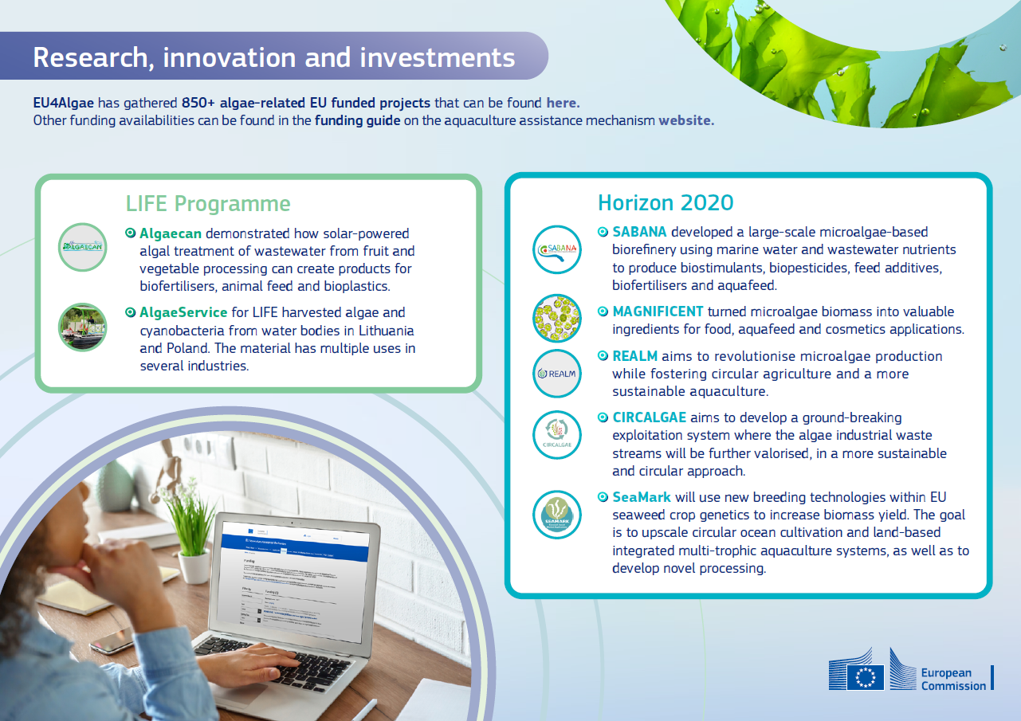
Notes:
As regards funding, the European Commission makes sure that algae are adequately covered in various EU funding instruments, including EMFAF managed directly by the Commission⁶, Horizon Europe⁷ (notably through the EU Mission: Restore our Ocean and Waters⁸), the Circular Bio-Based Europe Joint Undertaking, EIT Food, EIT Climate-KIC. EU4Algae facilitates access to algae related funding opportunities by placing them regularly on the EU4Algae website.

Slide 16
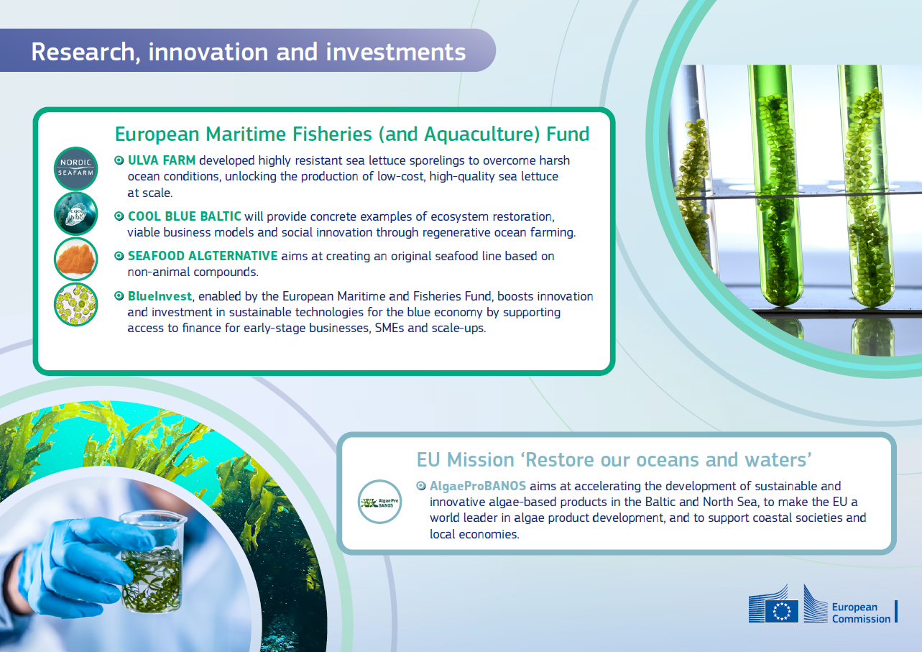

Slide 17
Other ongoing actions
Actions 17, 18, 19: integrating further algae-related research and innovation needs into Horizon Europe with DG RTD

Slide 18
Action 4: Increasing social awareness and market acceptance of algae in the EU

Slide 19
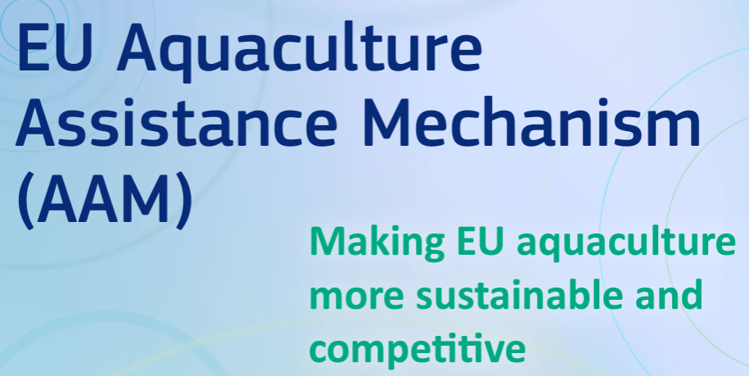
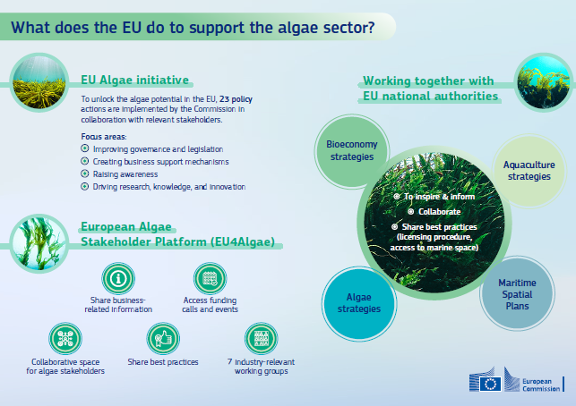
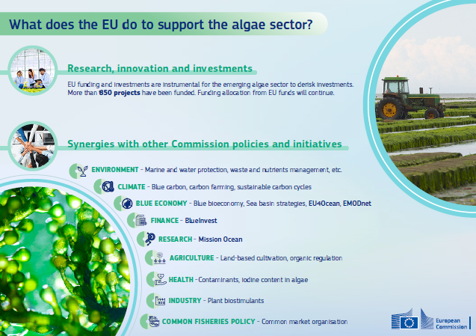
EU Open Method of Coordination on aquaculture
DG MARE regularly meets MS authorities to facilitate governance, share good practices etc.
In line with Action 12, algae sector knowledge has been already integrated into the Aquaculture Assistance Mechanism (AAM) website + infographic on “How the EU supports the algae sector” was published online.

Slide 20
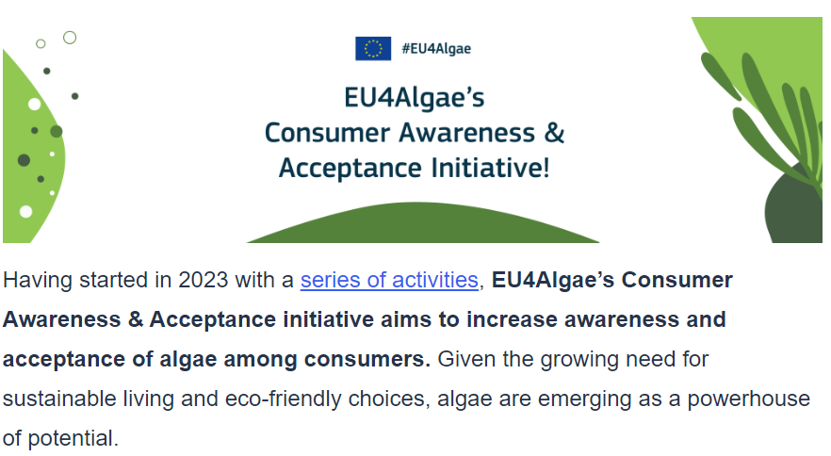
Other ongoing actions
Action 21-A: perform a consumer behaviour and preference analysis of the perception of algae-based products with EU4Algae and MARE A4
Action 23: promote awareness-raising actions about blue bioeconomy with EU4Algae

Slide 21
Closing Remarks
EU Algae Initiative – a set of well-advancing coordinated actions to unlock algae potential in the EU
MS authorities support to algae sector is crucial to unlock algae sector’s potential in EU e.g. by improving governance, access to space
EU4Algae – a continuous EU flagship project for algae sector, one-stop-shop for industry, contributes to the implementation of the EU Algae Initiative
Investments + research/innovation funding – instrumental for emerging sector to derisk investments
European Commission is here to help: assistance mechanisms, funds, guidelines, events etc
Notes:
To conclude, I would like to emphasize main features of the continuous EU support to the algae sector.
EU Algae initiative is a coordinated EU strategy to support algae sector developements via 23 actions
Algae sector developments would be much slower and less effective without a support of Member States authorities, so authorities are encouraged to recognize sector’s potential and provide a broad support to it.
EU4Algae is already a success story but lets make together EU4Algae a cornerstone for unlocking algae sector potential in the EU
Funding is crucial to derisk investments, fund projects ideas, develop cultivation and production. Commission will further work to integrate algae sector related funding into various EU funding streams
And finally, Commission will ensure its continuous support and help to the sector via various EU tools, mechanisms or policy initiatives

