Slide 1

Reverse Carnot cycle heat pumps
SESAM
TECHNOLOGY
SRL BERCENI
The heat pump with the highest
energy and exergy efficiency

Slide 2
The most state-of-the-art heat pumps
Disadvantages
- operates in subcritical mode, following a reverse Rankine cycle, and use phase change refrigerants, which can be expensive or toxic
-the vapor pressure at the compressor outlet is much higher than the condensation temperature and leads to a heat transfer process with large temperature differences
- at the entrance to the evaporator, an isenthalpic expansion of the refrigerant occurs
These reduce the COP and the energy efficiency

Slide 3
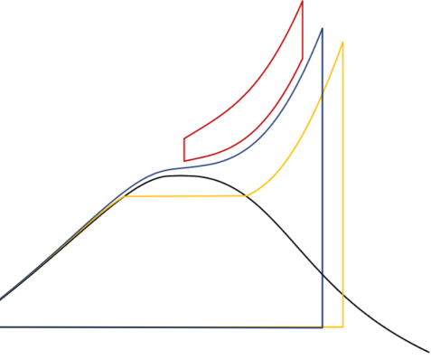
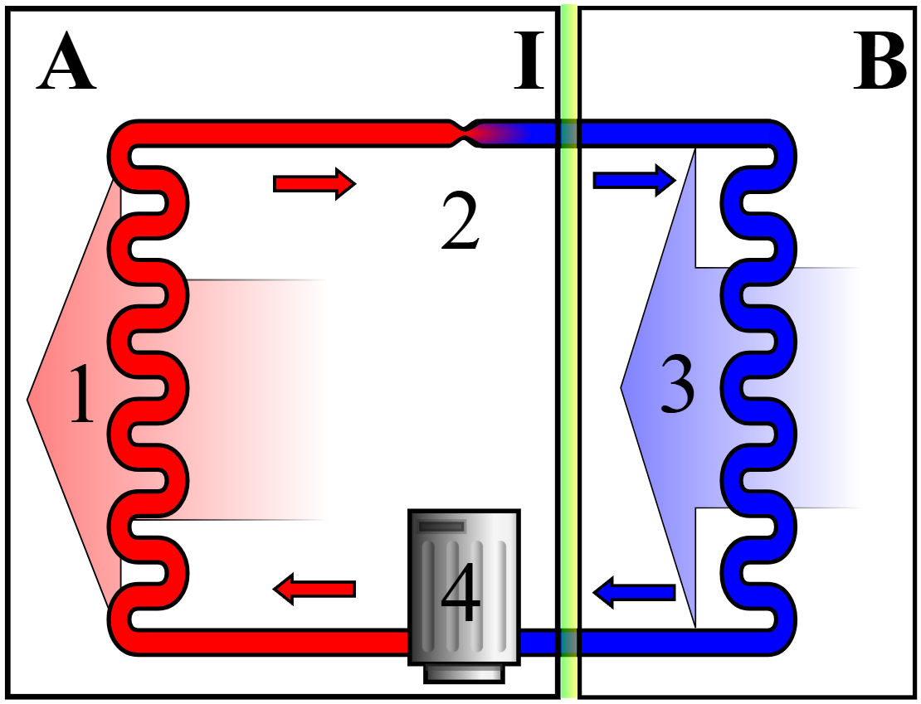
Fig. 1A : HP with PCM
Supracritic
Transcritic
Subcritic

Slide 4
The isothermalizer is the device that can eliminate these disadvantages:
both the compression and the expansion of the working gas take place at a constant temperature (by changing in real time the piston speed), therefore the principle of minimum entropy generation is satisfied (with the achievement of the maximum exergy efficiency corresponding to the respective difference between the temperature of the gas and that of its ambient environment).
due to the fact that no phase changes occur, the use of exergy-consuming expansion valves is not necessary. The absence of condensation/evaporation processes is compensated by the introduction of the deformable thermal sponge which maintains its large heat transfer surface throughout the isothermal transformation.

Slide 5
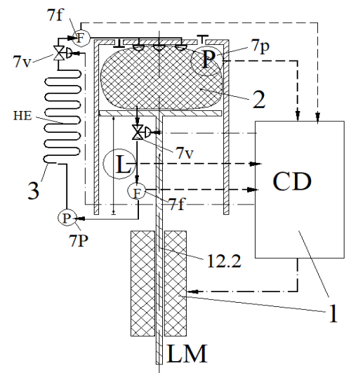
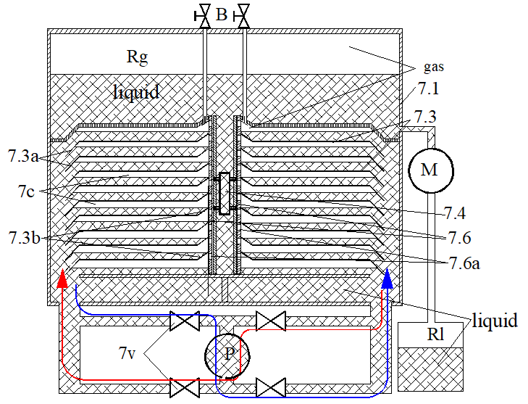
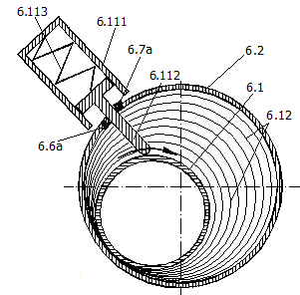
THE ISOTHERMALIZER
1. CD: calculates and imposes the isothermal speed
2: thermal sponge. Ensures high thermal transfer speed and high power density
3: cooling system with heat transfer fluid. Ensures heat transfer to the tank
SOLID PISTON LIQUID PISTON ROTARY PISTON

Slide 6
Other advantages of isothermalizers, which recommend them for the construction of heat pumps:
- they can operate with any substance that maintains its gaseous state throughout the entire working range, consequently gases such as helium, oxygen, nitrogen, argon, neon, carbon dioxide, etc. can be used, cheap, non-toxic, non-flammable natural refrigerants, without harmful effects on the atmospheric environment
- they maintain their energy and exergy efficiency even at very high temperature differences between the gas and the casing
- the speed of the processes is easily controlled by the control processor provided, by appropriately modifying the isothermal speeds, also maintaining control over the value of energy efficiency and optimal power (the equivalent of the Curzon-Ahlborn efficiency)
- they can be made in a wide range of constructive and dimensional configurations: with solid, liquid, or gaseous piston, rotary, cylindrical, or parallelepipedal, etc.

Slide 7
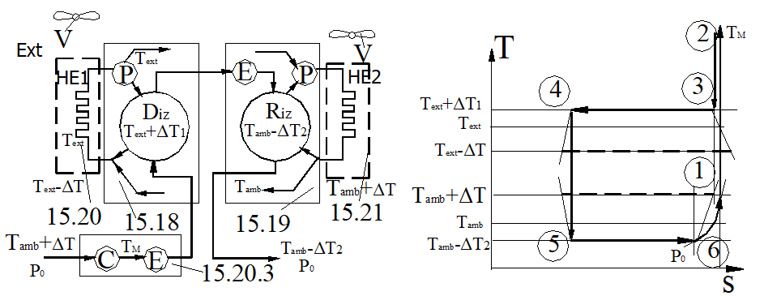
Reverse Carnot cycle heat pump
Fig.1B

Slide 8
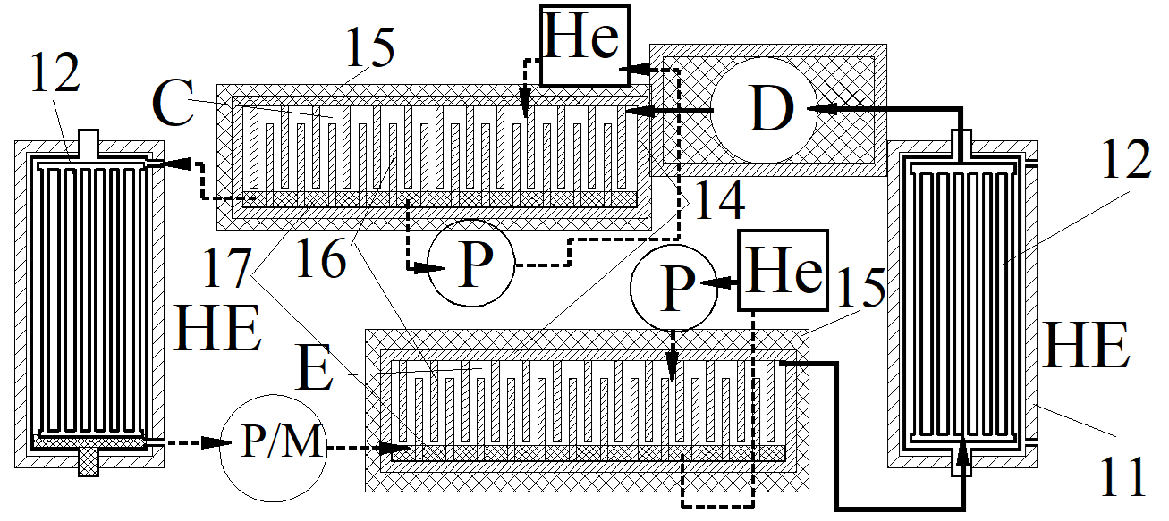
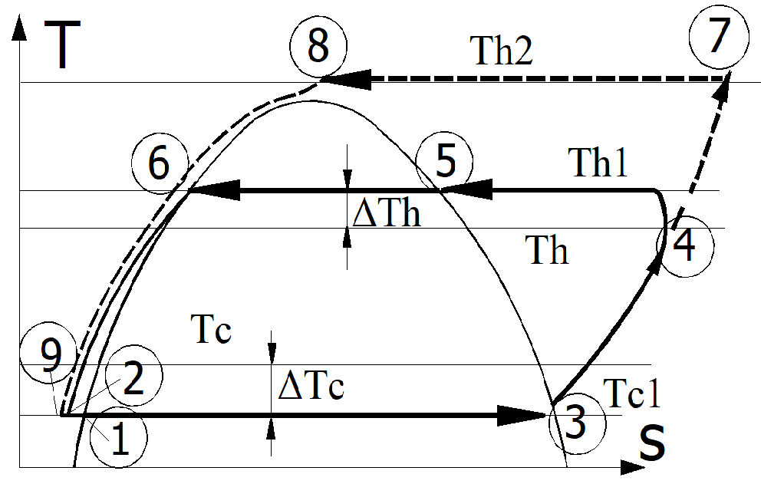
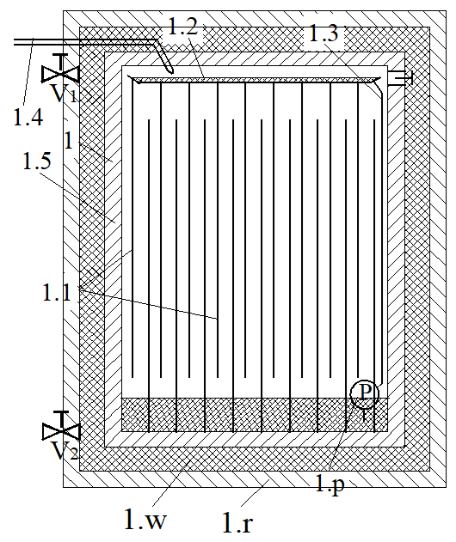
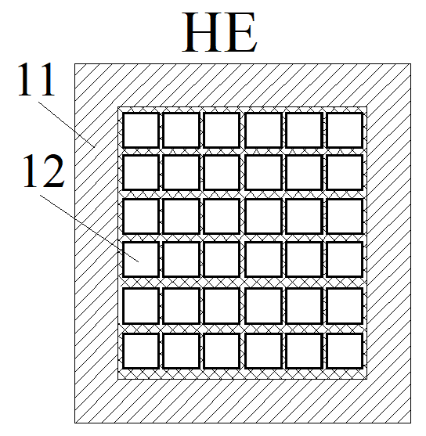
PHASE CHANGE HEAT PUMP
Block diagram T-s diagram
condenser
heat excheanger

Slide 9
Thank you
SESAM
TECHNOLOGY
SRL BERCENI
Comuna BERCENI
județul ILFOV
ROMANIA
Arpi Torok
arpi.torok@sesamtechnology.eu

