Slide 1
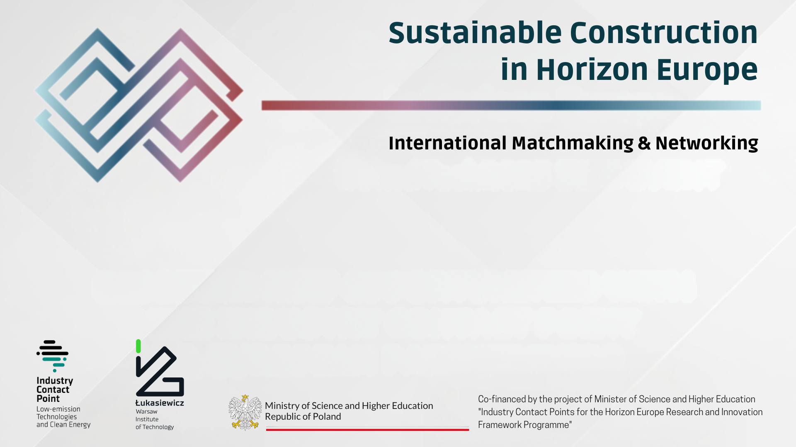
SUSTAINABLE CONSTRUCTION - MODERN TRENDS OR NECESSITY?
INNOVATION AND R&D FUNDING IN THE EUROPEAN CONSTRUCTION OF THE FUTURE
28 October 2025 – Warsaw, Poland

Slide 2
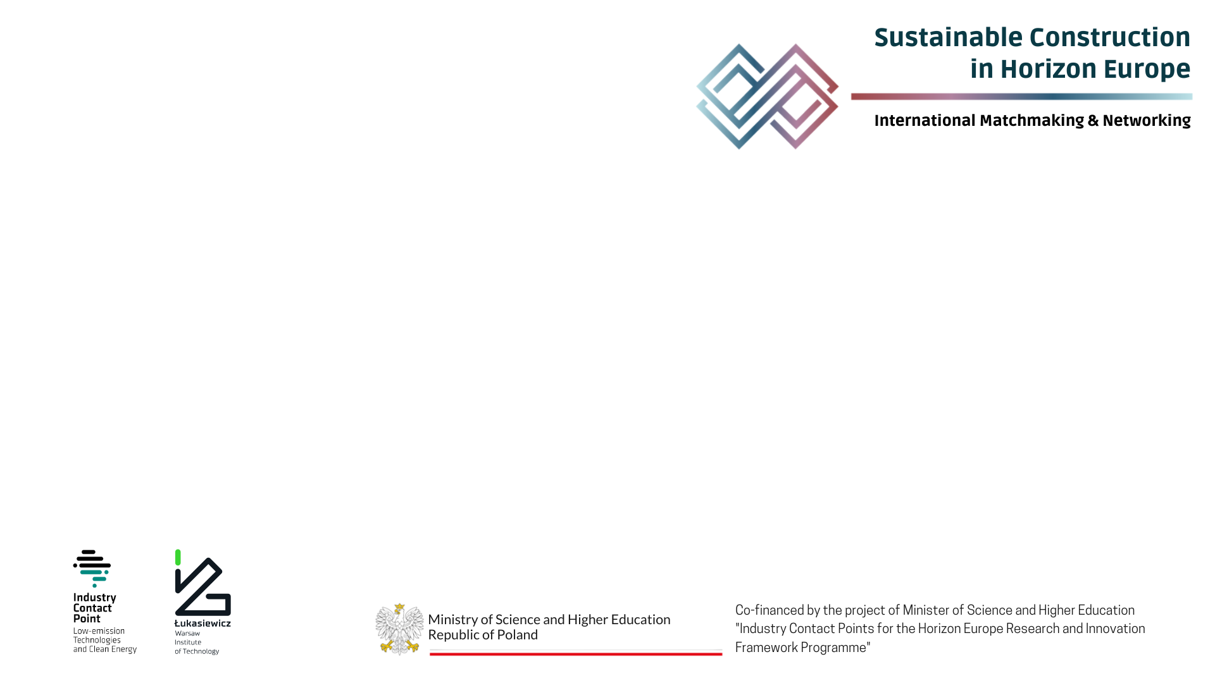
Project idea
Maximum 3 slides (timing: 4-5 min)
Outline of the presentation:
  Call number(s) / topic(s)
    Horizon-CL5-2026-02-D4-01 - On-site innovative robotic and automated solutions and techniques for more sustainable and less disruptive building renovation and construction
    Horizon-CL5-2026-02-D4-02 - Smarter buildings as part of the energy system for increased efficiency and flexibility
    Horizon-CL5-2026-02-D4-03 - Innovative pathways for low carbon and climate resilient building stock and built environment
    Horizon-CL5-2026-02-D4-04 – Innovative approaches for the deployment of Positive Energy Districts
    Horizon-CL5-2026-02-D4-05 - Optimal combination of low embodied carbon construction products, technical building systems and circularity principles for climate neutral buildings
  Main contact(s)
  Name and subject of the project idea(s)
  Main objectives, innovative aspects
  Expected results, expected impacts
  Demo building identified, if any
  Identified and missing partners

Slide 3
Expression of interest to join a consortium
Maximum 3 slides (timing: 3-4 min)
Outline of the presentation:
  Call number(s) / topic(s)
  Main contact(s)
  Areas of expertise - (if any) scientific/technical/experimental assets available
  Contributions proposed

