Slide 1
Enabling Beyond
Singapore: An Inclusive City
May Gee LEE
SG Enable
Singapore
Champions of Inclusive Spaces
5 March 2025 12:00

Slide 2

About
Set up by Ministry of Social and Family Development (MSF) in 2013
Focal agency for disability and inclusion in Singapore
Company Limited by Guarantee
(Not-for-Profit) | Charity | Institution of Public Character (IPC)
Notes:
SG Enable
Set up by Ministry of Social and Family Development (MSF) in 2013
Focal agency for disability and inclusion in Singapore

Slide 3
Focal Agency For Disability & Inclusion
Disability & Caregiver Support
Training & Consultancy
Community Integration
Hiring & Employment
Accessibility & Assistive Technology
Social Innovation
Notes:
There are six key pillars of work for SG Enable, namely: disability and caregiver support, training and consultancy, community integration, hiring and employment, accessibility and assistive technology, and social innovation. Some are dedicated workstream e.g. hiring and employment, while other such as accessibility & AT are enablers which cut across different workstream throughout the organisation.

Slide 4
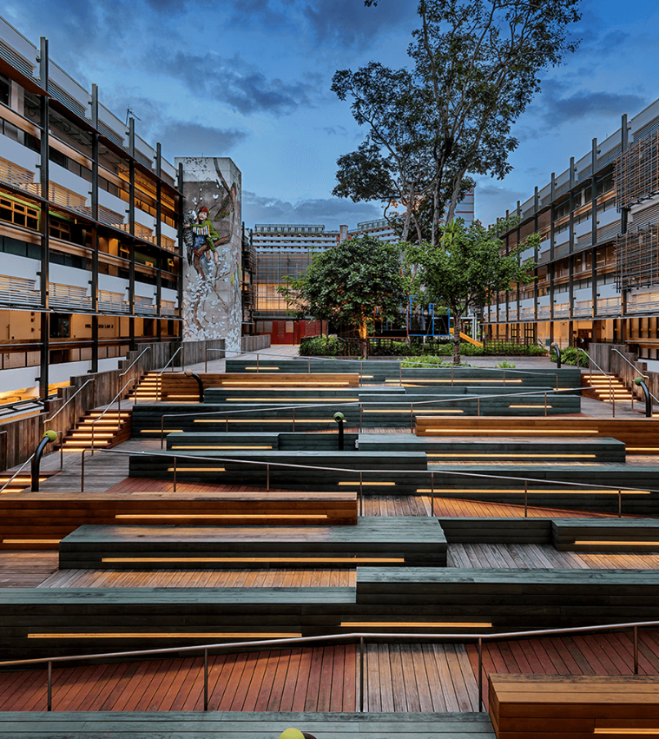

Living the Ethos of Inclusion Through
Enabling Village
Integrated First Stop
  A first-stop gateway that provides persons with disabilities and caregivers with greater opportunities to integrate in learn, work and play settings.
Inclusive Infrastructure & Initiatives
  A showcase of how universal design, assistive technology, social innovation initiatives can enable persons with disabilities to lead fulfilling lives.
4P Partnerships
  A space where People, Public, Private and Philanthropic organisations come together to build an inclusive community and catalyse innovative solutions that mitigate post-18 disability needs.
  Barrier Free Access
Notes:
Through the Enabling Village (EV), we demonstrate the ethos of inclusion through 4P (People, Public, Private, Philanthropic) partnership and show visitors how inclusive infrastructure and initiatives can enable persons with disabilities. As an integrate first stop for disability matters, we hope EV will provide persons with disabilities with the opportunities to work, learn, live and play independently.

Slide 5
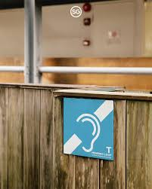
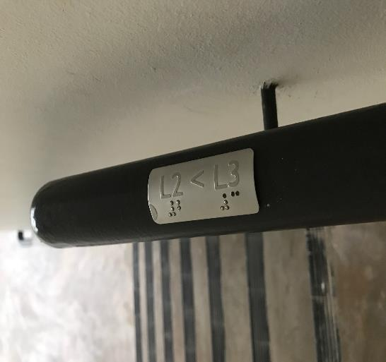
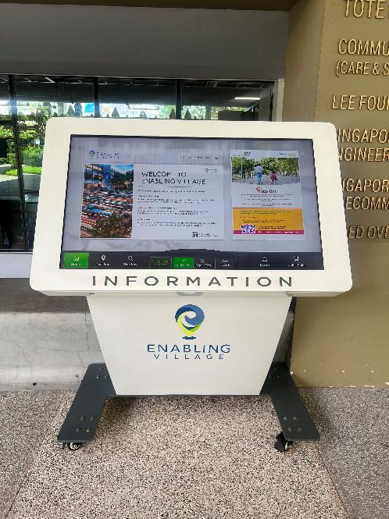
Universal Design @ Enabling Village
  Information kiosk with lowered display for wheelchair users, and option to adjust the contrast and the size of text displayed.
  Braille lettering on stairways indicate floor levels
  Hearing Loop to stream audio during movie screenings
Notes:
Enabling Village is universally designed, providing barrier free access to persons with physical disabilities (including a lowered information kiosk as shown on this slide), and other features such as braille lettering on stairways and hearing loop system to allow persons who are hard-of-hearing to hear announcements etc. better.

Slide 6






Awards for Enabling Village
Notes:
The Enabling Village has won both local and international awards, and it is not just for universal design but also for sustainability, and Social Outcomes.

Slide 7
Next Phase of Enabling Village
Enabling Village is envisioned to be the Beacon of Disability Inclusion in Singapore and beyond. With its 4-storey extension scheduled to be ready in 2025, Enabling Village is innovating a new work-life model of commerce, caregiving, and user experience for disability inclusion to showcase what can be when we come together to build dreams and enable lives for a stronger and better Singapore.
Current EV
Inclusive Community Space with focus on Employment & Training
EV Extension
Inclusive Community Space with focus on addressing Post-School Cliff Effects & Future Care Planning
Notes:
Enabling Village is building an extension which will be ready in 2025, with a focus on providing services addressing post-school cliff effects and to better equip caregivers with future care planning knowledge. With the continual focus on employment and training with the current set up, Enabling Village seeks to be the Beacon of Disability Inclusion going forward.

Slide 8
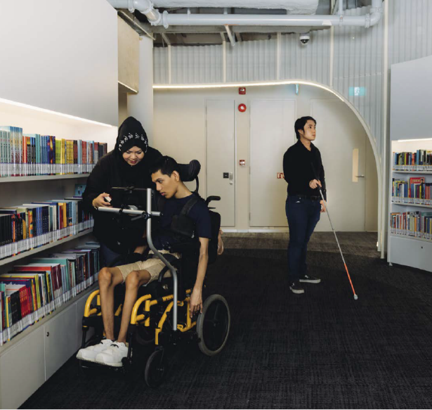
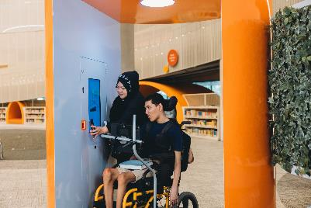
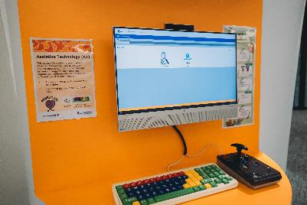
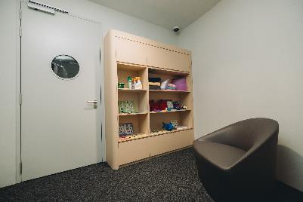
Punggol Regional Library: Opening a new chapter on accessibility in public libraries
Singapore’s first library with a comprehensive range of services meticulously designed with and for persons with disabilities.
Accessible membership for persons with disabilities confers additional privileges e.g. longer loan period and free reservation of items.
Accessible Collection
Borrow-n-Go System
Catalogue stations with assistive technology
Calm Pods
Notes:
SG Enable works with partners on our inclusion journey. One such partner is the Punggol Regional Library, Singapore’s first library with comprehensive services designed for persons with disabilities. Features include an accessible collection of book, a Borrow-n-Go system for easy checking out of books, a catalogue station with assistive technology to aid persons with disabilities in searching online for books, and calm pods, to soothe those who need a quiet place to address their sensory needs.

Slide 9
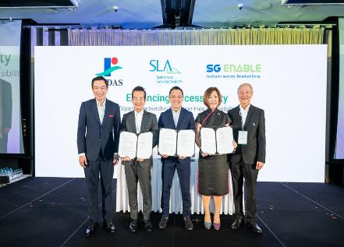
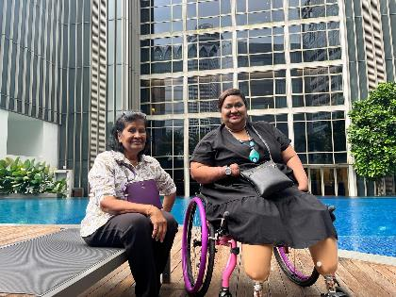
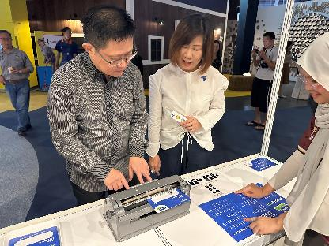
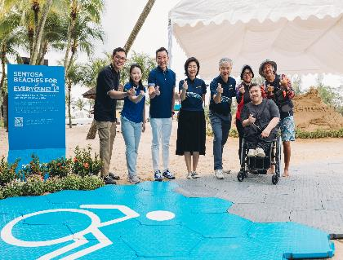
Building Inclusive Spaces… Together.
Advancing barrier-free access routes and scale inclusive infrastructure across Singapore (Singapore Land Authority & REDAS)
Inclusive stays: improving service standards and accessibility of Ascott’s serviced apartments
Making learning experiences at Science Centre more accessible
Accessible beach: First inclusive beach track at Sentosa which allows wheelchair-users to access the water’s edge
Notes:
SG Enable also works with partners across other domains to build an inclusive society. With government agencies such as the Singapore Land Authority, Science Centre, and Sentosa and private sector operators such as Ascott, we synergise efforts to enhance accessibility, both physical and digital, to enhance the independence of persons with disabilities.

Slide 10
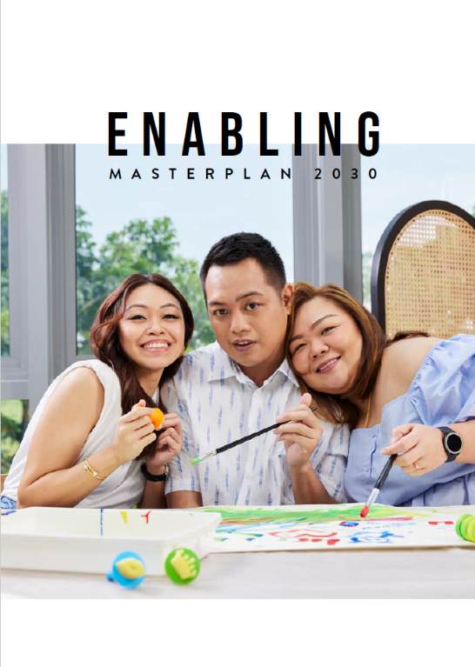
Inclusive Society. Enabled Lives.
Enabling Masterplan 2030 seeks to paint a picture of what we hope Singapore will be as an inclusive society in 2030
Focus areas include:
Communications
Transport
Public spaces
Healthcare
Public, private and people sectors come together to enable access and empower persons with disabilities to work, learn, live and play independently.
Notes:
Singapore’s goals for inclusion are largely encapsulated in the Enabling Masterplan 2030, which details the targets that we hope to achieve by 2030. Some focus areas include comms, transport, public space and healthcare.

