Slide 1



WEDO: WOMEN ENTREPRENEURS WITH DISABILITIES ALLIANCE
FROM INVISIBILITY TO VISIBILITY

Slide 2


Introduction to WEDO
Fostering an Inclusive Entrepreneurship Environment for Women with Disabilities Globally
Enable Economic Independence and Address Gaps in Employment & LFPR
Change Community Mindsets & Build meaningful narratives About Women with Disabilities
Ensure a more inclusive and diverse entrepreneurship ecosystem
“If you get it right for women with disabilities, you will get it right for all women”

Slide 3

WEDO: Unlocking Potential through Entrepreneurship
Globally, entrepreneurship is a catalyst for transformative economic and social development. Despite a robust ecosystem, women with disabilities encounter unique challenges, remaining on the margins of this impactful narrative.
Economic Independence:
Enables financial independence, breaking the cycle of poverty
Inclusive Participation:
Helps overcome barriers, allowing active contribution to development
Dignified Livelihoods:
Provides independence, addressing spatial and mobility constraints.
Global Impact:
Encouraging entrepreneurship creates a global impact, fostering diversity and inclusion.
Marginalization:
Women with disabilities globally face heightened violence and limited access to services.
Financial Struggles:
Many encounter severe financial hardships, hindering access to essentials.
Poverty Disparities:
Women with disabilities worldwide experience higher unemployment and lower wages.
ENTREPRENEURSHIP AS A SOLUTION
THE CHALLENGES

Slide 4
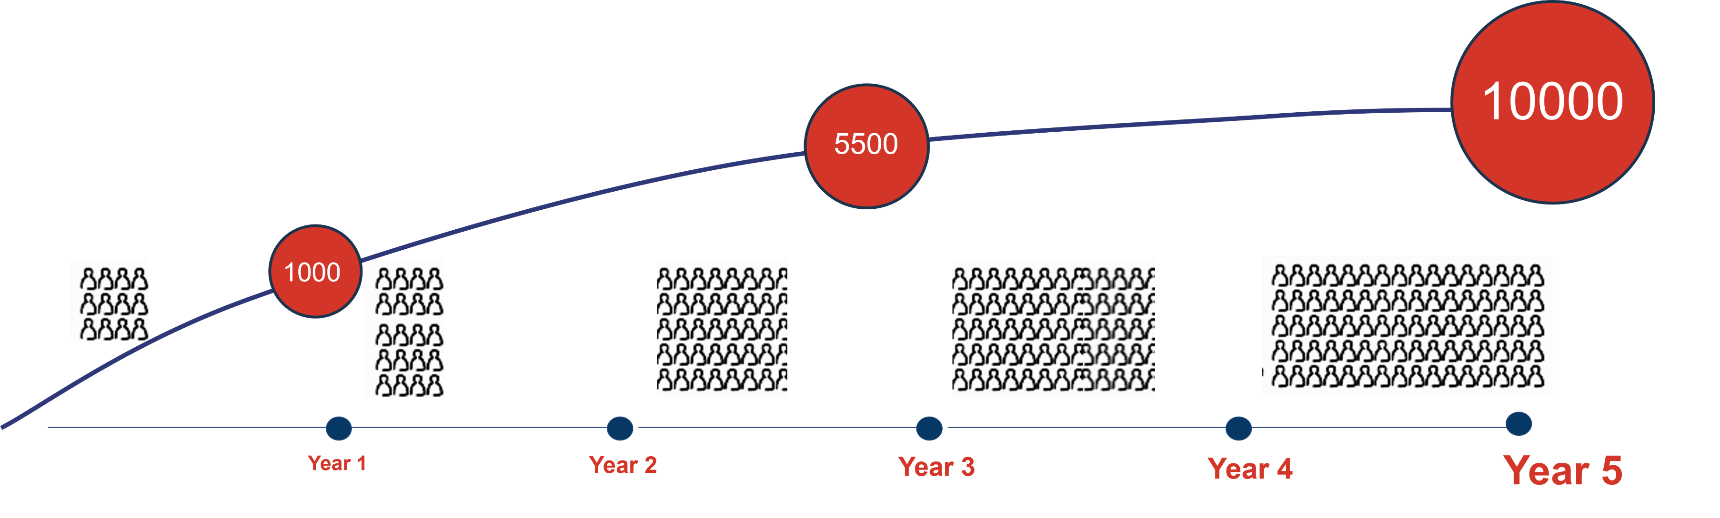
INDIA PROGRAM
Empower 10,000 women entrepreneurs with disabilities in 5 years through strategic alliances, policy changes, knowledge dissemination, community building, and inclusive entrepreneurship programmes, with a key focus on impacting 1.1 million households through mindset change campaigns
10
Policy Changes +Schemes
400
Alliance Partners
20
Knowledge Products
20
Media Campaigns
20
Convenings
1000
Community members
80% of existing programmes adapted for Inclusivity

Slide 5


MOVE WOMEN WITH DISABILITIES
FROM INVISIBLE TO VISIBLE
Document /publicize their
inspirational stories

Slide 6


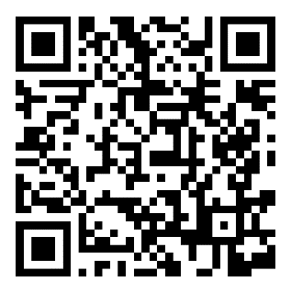

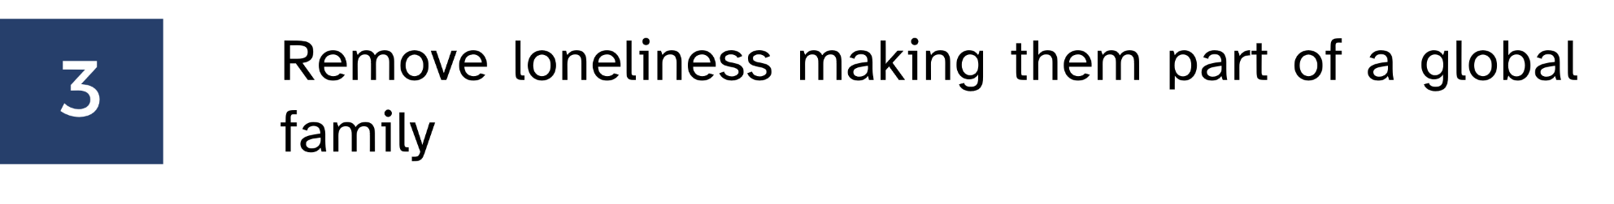


WEDO Initiative 2
How to participate in the challenge
OR
.
CONTACT: WEDO@YOUTH4JOBS.ORG

