Slide 1
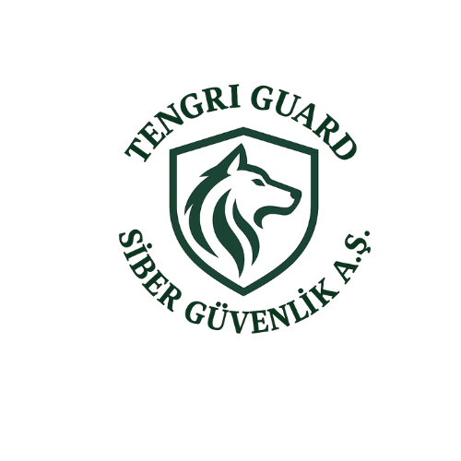

Slide 2
Who Are We ?
Tengri Guard Cyber Security Inc. is a technology company that offers innovative and effective solutions in the field of cyber intelligence. In today’s world, where digital security is becoming increasingly critical, we operate with the aim of ensuring that individuals and organizations are protected against cyber threats at the highest level.
Our mission is to provide high-standard solutions that add value to the cybersecurity ecosystem and to ensure a reliable digital environment for our customers. Our vision is to become a globally competitive brand that develops innovative technologies and is recognized as a reference in the industry.

Slide 3

Problems

Slide 4
Problems
Because it is difficult for organizations to detect data that has leaked onto platforms such as the Dark Web and Telegram, threat visibility remains low, and critical data circulates unnoticed for long periods of time.
The fact that collected intelligence data is raw and complex causes IT teams to spend hours on manual analysis, making it difficult to quickly distinguish real risks.
Data breaches originating from supplier companies often remain invisible, leaving organizations exposed to cascading security risks.
Managing processes such as log management, penetration testing, code analysis, and data intelligence through separate systems both increases costs and makes it difficult for organizations to establish an integrated security structure.
Since security cameras do not operate in integration with official crime databases such as law enforcement red/orange/black lists, the passage of individuals who may pose potential threats cannot be detected at an early stage.
The requirement of AI-supported cameras by existing competitor solutions forces organizations into high hardware costs, making physical security solutions inaccessible.
The inability to match images obtained from cameras with criminal databases in real time eliminates preparedness and rapid response capabilities in the face of potential terrorism or organized crime threats.

Slide 5

Product / Project Portfolio

Slide 6

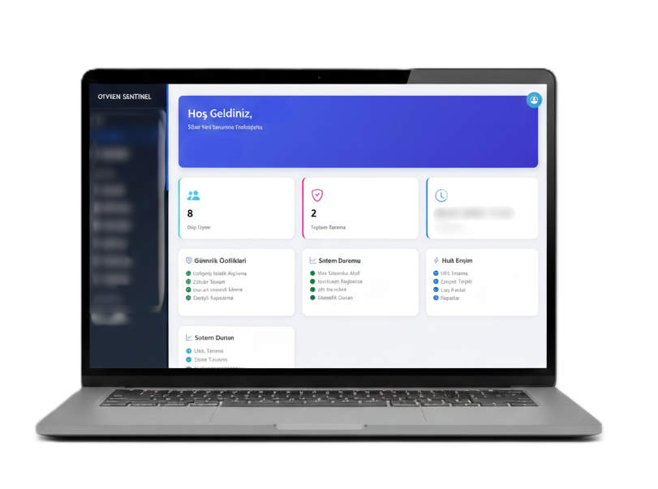
OTYKEN SENTINEL
Data Intelligence:
A data mining infrastructure that automatically scans, collects, and analyzes data leaked from customers or their suppliers across environments such as the Dark Web, Telegram, and similar platforms.
Checker System:
A system that processes collected raw data by separating actively used information from passive data, providing clean and contextualized data presentation that enables organizations to take rapid action.
Web Pentest Automation & Artificial Intelligence:
An AI-supported web application security testing solution that operates according to up-to-date attack techniques, performs automated vulnerability scanning, and continuously learns.
Code Scanning Artificial Intelligence:
An AI-based code review system that analyzes software projects during the development phase to detect potential security vulnerabilities at an early stage.
Cybersecurity Awareness Trainings:
Training and awareness modules designed to raise employee awareness against social engineering and other types of threats.
Additional Security Tools Within the Platform:
An integrated security ecosystem where auxiliary security tools such as scam lists, antivirus scanning bots, and similar solutions are accessible from a single panel.

Slide 7
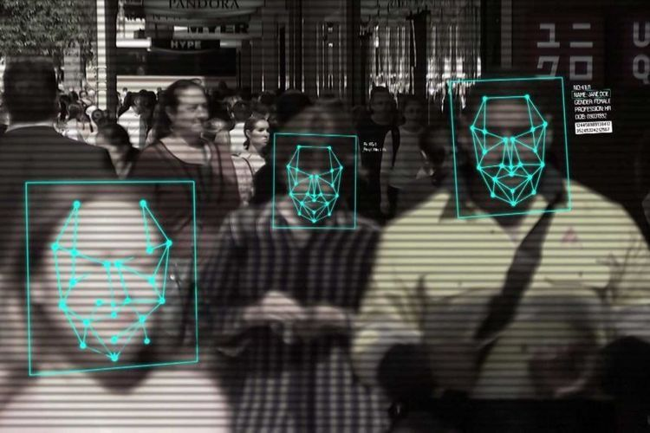
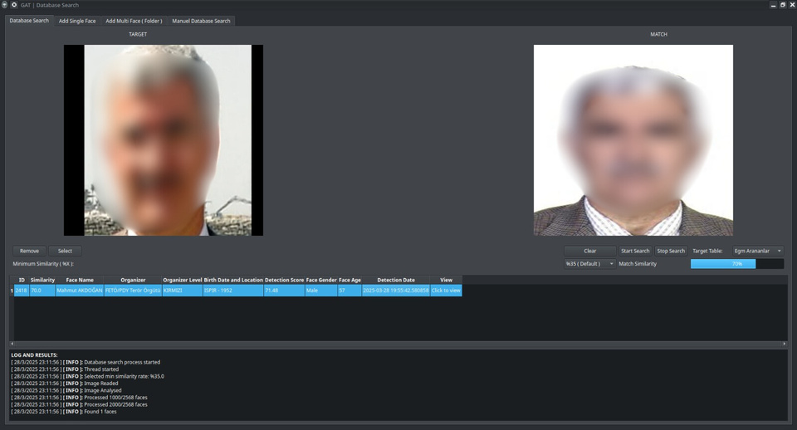
Smart Security Camera Solutions (GAT)
Real-time matching with official criminal lists:
Automatically compares camera footage with red, orange, and other criminal lists published by law enforcement authorities.
Early detection of physical threats:
Generates instant alerts when risky or wanted individuals pass through the camera’s field of view, enabling rapid and early intervention.
Low-cost and easily integrable solution:
Enhances the security level of organizations without requiring any optical (camera) replacement.
Pre-identification of potential threats:
In addition to official criminal lists, individuals or profiles associated with terrorism and organized crime are identified in advance by adding images from traditional and social media sources to the database, enabling the early detection of persons who may pose potential risks.

Slide 8

Growth Strategy and Roadmap

Slide 9
Category | Goals (0–6 Months)
Product & Technology | • Completion of all 4 core GAT modules • Sentinel Checker Engine V2 • Logo-based brand-protection Lite • Edge Box standardization • First 3 pilots (public + private sector)
Sales & Business Development | • Announcement of the Teknopark Istanbul reference • 5 new pilots: 2 public + 3 private sector • Distributor / integrator mapping • Fast quotation – fast deployment model
Organization & Human Resources | • 1 CV/ML engineer • 1 backend / DevOps engineer • 1 project / sales manager • Preparation of ISO 27001 requirement set • KVKK compliance documents
Finance & Operations | • Product cost (COGS) calculation • 6-month cash flow plan • Annual license + pilot package pricing
Brand & Marketing | • Product-focused redesign of the website • PR: “First sale to Teknopark Istanbul” • LinkedIn corporate content strategy • Corporate pitch deck v1

Slide 10
Category | Goals (6–18 Mounth)
Product & Technology (GAT) | • Multi-camera Re-ID Pro • Access Control integration • Weapon / suspicious behavior analytics • Low-quality face enhancement • Threat Graph Intelligence Lite
Product & Technology (Sentinel) | • Full Brand Protection • Supply Chain Scoring Engine • Autonomous Threat Agent • SIEM Connectors
Sales & Growth | • 20 new enterprise customers • 5 authorized partners within Turkey • Initial entry into the Gulf region + Azerbaijan • Preparation for public tenders • Entry into the defense ecosystem
Organization | • Technical team of 10+ people • Sales team of 4+ people • Establishment of SLA / support teams • Addition of a Pilot & Deployment Manager
Certification | • Full-scope ISO 27001 • CE / FCC certification for Edge Box • Public sector compliance tests
Finance | • ARR target: 0.45–0.75 M $ • 65%+ net product margin • Preparation for Seed / Pre-A investment round

Slide 11
Category | Goals (18–36 Mounth)
GAT Product Expansion | • Citywide Re-ID (city-wide person tracking) • Drone camera integration • Acoustic weapon detection integration • National facial pool for terrorism / organized crime • Chain of custody evidence system • Real-time threat score engine
Sentinel Product Expansion | • Global Threat Intelligence Pool • AI Auto-pentest & patch recommendation engine • Red Team Simulation AI • Enterprise Threat Graph • SOC management module
International Expansion | • Entry into Gulf, Europe, and Asia markets • Sales to 10+ countries • GDPR + NATO STANAG compliance • International solution partners
Organization | • Technical team of 40+ people • Global sales teams • R&D center + Edge Box production line • International support offices
Finance & Strategic Objectives | • 3M$+ annual recurring revenue (ARR) • Series A investment round • Prime contractor status in government projects • Establishment of a patent portfolio

Slide 12

Competitive Analysis

Slide 13
MODULE / FEATURE | OTYKEN Sentinel | Recorded Future | CrowdStrike Falcon Intel | Digital Shadows | SOCRadar | U.S.T.A.
Dark Web / Deep Web / Telegram Leak Scanning | ✓ | ✓ | ✓ | ✓ | ✓ | ✓
Stealer Log Analysis | ✓ | ✓ | △ (ED-based) | ✓ | ✓ | ✓
Checker System (Active/Passive separation + data cleansing) | ✓ | – | – | – | – | –
AI Web Pentest Automation | ✓ | – | – | – | – | –
AI Code Scanning (DevSecOps) | ✓ | – | – | – | – | –
Vulnerability Intelligence / CVE Tracking | ✓ | ✓ | ✓ | △ | ✓ | △
Supplier / Supply Chain Risk Monitoring | ✓ | △ | – | ✓ | ✓ | –
Domain Management (WHOIS, expire, DNS) | ✓ | △ | – | ✓ | ✓ | –
Phishing / Scam Domain Detection | ✓ | ✓ | ✓ | ✓ | ✓ | ✓
Brand Impersonation – Logo Detection (Visual AI) | △ (partial) | – | – | ✓ | ✓ | ✓
Brand Impersonation – Social Media Fake Account Detection | – | – | – | ✓ | ✓ | ✓
Brand Impersonation – Fake Mobile Application Detection (App Store) | – | – | – | ✓ | ✓ | △
Attack Surface Management (ASM) | – | △ | – | ✓ | ✓ | –
Threat Actor / APT Intelligence (MITRE ATT&CK) | – | ✓ | ✓ | △ | ✓ | ✓
Identity Intelligence / Exposure | ✓ | ✓ | ✓ | ✓ | ✓ | ✓
Fraud Intelligence | – | △ | – | △ | △ | ✓ (Strong local presence)
Antivirus Scanning Bot | ✓ | – | – | – | – | –
Cybersecurity Awareness Trainings | ✓ | – | – | – | – | –
VIP / Executive Protection | ✓ | ✓ | ✓ | ✓ | ✓ | ✓
AI Agent / Autonomous Threat Intelligence | – | – | – | – | ✓ (Agentic TI) | –
SOC / SIEM Integration | ✓ | ✓ | ✓ | ✓ | ✓ | ✓
Local Market Focus (Turkey) | ✓ | – | – | – | ✓ | ✓

Slide 14

Investment Requirement and Budget Allocation

Slide 15
Area | % | Amount
R&D & Product Development | %40 | 120.000$
Team & Human Resources | %30 | 90.000$
Sales & Marketing & Pilots | %15 | 45.000$
Certification & Legal | %8 | 25.000$
Operations & Reserve | %7 | 20.000$
TOTAL | %100 | 300.000$

Slide 16
 | Amount | Description
GAT – Multi-Camera Re-ID Pro | 30.000$ | City-level scalable Re-ID layer
GAT – Behavioral Analytics (weapon, bag, anomaly) | 20.000$ | CV models + dataset acquisition
Sentinel – Full Brand Protection | 25.000$ | Social media, app store, and domain hunting
Sentinel – Autonomous Threat Agent | 25.000$ | AI threat hunting infrastructure
Edge Box optimization | 20.000$ | Hardware cost + software optimization
1 Computer Vision Engineer | 30.000$ | 12-month salary + additional benefits and expenses
1 Backend / DevOps Developer | 25.000$ | Pipeline + API + security layer
1 Sales Engineer | 20.000$ | Enterprise sales + pilot management
1 OSINT / Threat Analyst (part-time) | 15.000$ | GAT + Sentinel dataset expansion
5 pilot deployments (public + private) | 20.000$ | Edge Box + deployment + personnel
PR + Brand launch | 10.000$ | Teknopark Istanbul reference + media
Domestic security fairs | 5.000$ | SEDEC, SAHA EXPO
Sales funnel tools | 10.000$ | CRM, quotation systems, demo infrastructure
ISO 27001 certification | 10.000$ | Mandatory for GAT + Sentinel
CE / FCC (Edge box) | 7.500$ | For hardware sales
KVKK + contracts + data processing | 7.500$ | Legal consultancy
Operational reserve | 15.000$ | 3–4 months of critical expenses
Server & infrastructure expenses | 5.000$ | GPU servers + cloud services
We are allocating 40% of the $300,000 investment to strengthening the technical capabilities of our products. For GAT, multi-camera Re-ID, behavioral analytics, and risk scoring will be developed; for Sentinel, full brand protection and the AI threat agent module will be implemented. 30% will be used to expand the critical technical and sales teams. 15% has been allocated to sales and pilot deployments. We plan to rapidly grow our reference journey, which started with Teknopark Istanbul, across both the public and private sectors. 8% will be allocated to certifications (ISO 27001, CE/FCC), and 7% will be retained as an operational reserve. This investment will make us the market leader in Turkey within 18 months and position us to expand into the Gulf and European markets within 36 months.

