Slide 1


Biotech Innovation Hub
Argentina

Slide 2
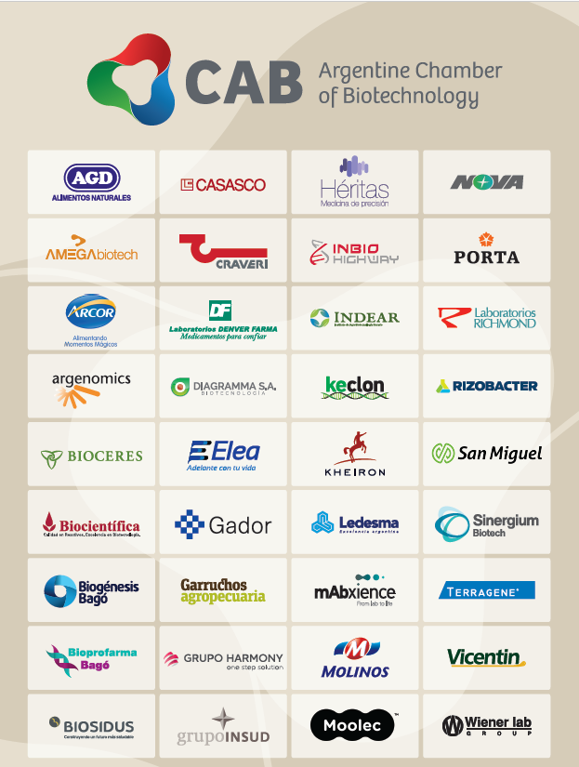
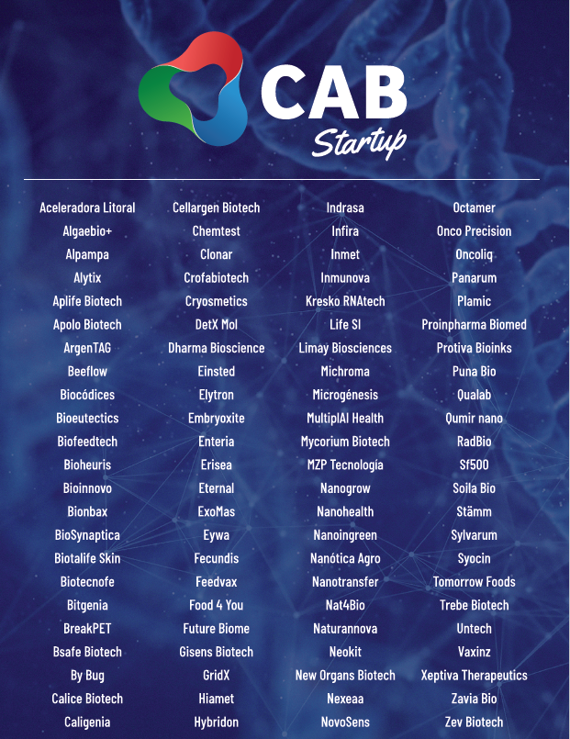
The Argentine Chamber of Biotechnology
140 Companies
3 Accelerators

Slide 3





Biotec recent dynamics in Argentina (2022)
+1300 MM USD Biotech Sales
216 MM USD Biotech Exports
6,9% R+D/Sales
+20.000 jobs
+2000 scientists doing R+D in the private sector
Source: 1st Argentine Census of Bio and Nano Companies (2023).

Slide 4
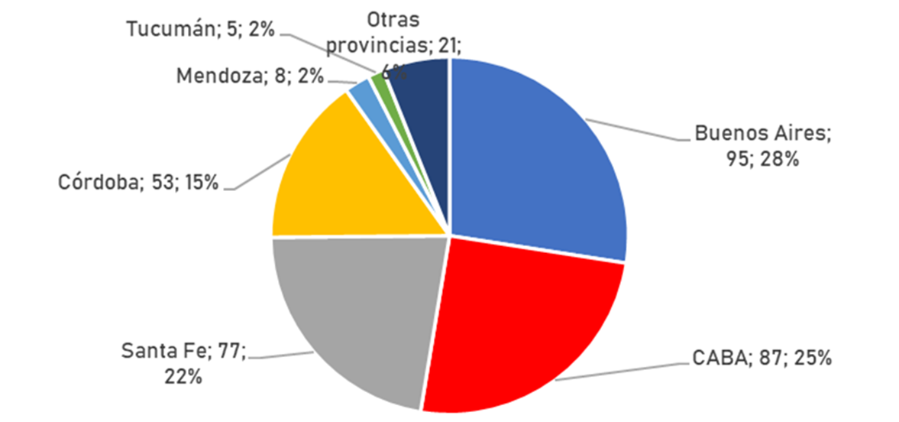
Geographical distribution of the identified biotechnology companies
340
Biotech
Companies
Identified
146
Biotech
Companies
created since 2015
Other provinces: Misiones (4), Entre Rios (4), Salta (2), Santiago del Estero (2), Chaco (2), Chubut (1), Formosa (1), Jujuy (1), La Rioja (1), San Luis (1) and Tierra del Fuego (1).
Source: 1st Argentine Census of Bio and Nano Companies (2023).

Slide 5
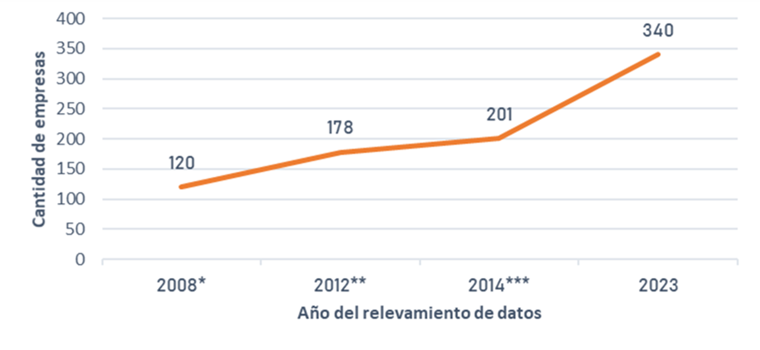
Evolution of the number of biotechnology companies in Argentina
*Anlló et al (2011), **MINCyT (2014), ***MINCyT (2016)
Source: 1st Argentine Census of Bio and Nano Companies (2023).

Slide 6
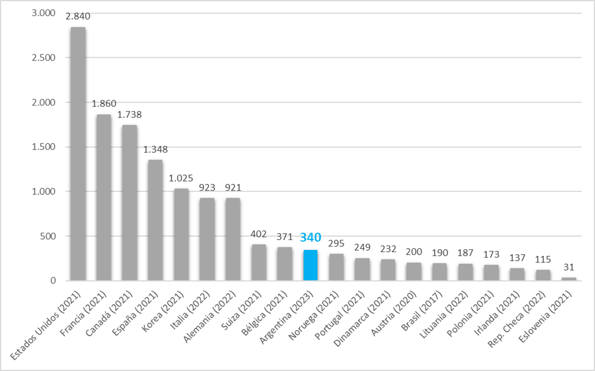
Argentina in the international context
#10 in number of biotech firms
340 biotec startups
4 bio company builders
Source: 1st Argentine Census of Bio and Nano Companies (2023).

Slide 7
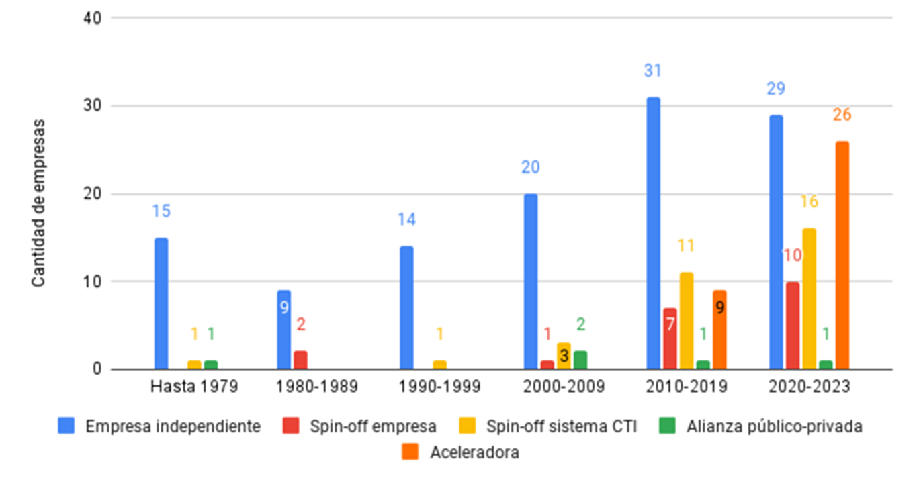
Origin of biotechnology companies, by year of foundation
Source: OECD (2023)
Source: 1st Argentine Census of Bio and Nano Companies (2023).

Slide 8
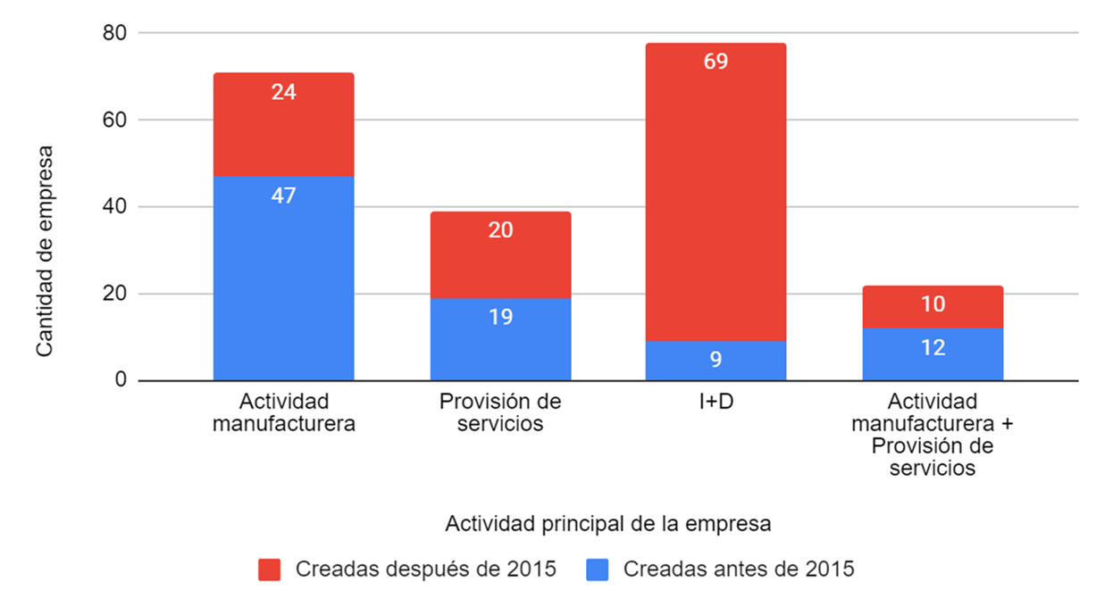
Production and technological profile of biotech companies
Source: 1st Argentine Census of Bio and Nano Companies (2023).

Slide 9
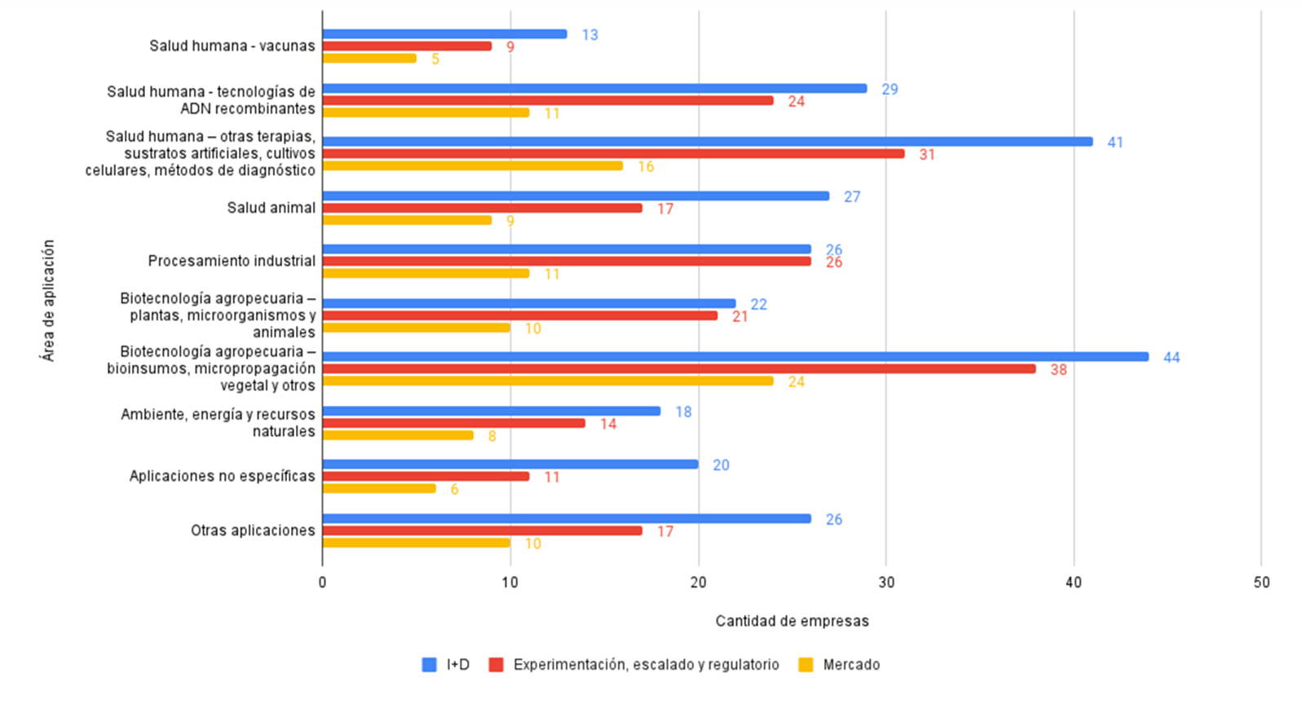
Areas of application of biotechnology companies, by stage of development
Source: 1st Argentine Census of Bio and Nano Companies (2023).

Slide 10

Ministry of Science, Technology and Innovation (MINCyT) + National Agency of Research,, Technological Development and Innovation
The Argentine Biotechnology Ecosystem: a public-private long-term alliance for development
National Scientific and Technical Research Council (CONICET)
Ministry of Economy
Biotec Sector
R+D Capabilities
Biotec Promotion policy
Regulatory Agencies
Federal Governments + National Investment Council (CFI)
Market development
Global connection
Company builders and venture capital
Ministry of Foreign Affairs & Argentine Agency on Investment & Trade

Slide 11
www.cabiotec.com.ar

