Slide 1
OPTEL’S TRACEABILITY SOLUTIONS FOR METAL & MINERALS
v2023

Slide 2




YEARS OF EXPERTISE in traceability and vision systems
GLOBAL PRESENCE
Presence
in more than
30 COUNTRIES
700+
EMPLOYEES
worldwide
TRACEABILITY SYSTEMS
installed worldwide
Notes:
Optel Group is a privately owned company founded over 33 years ago by three College graduates who wanted to have an Impact. Optel started applying our solutions in the Pharmaceutical Industry and have since diversified our business into Food and Beverage, Medical Device, Agrochemical, Metals and Minerals, CPG, Fashion and Clothing, Residual Materials etc…
Optel Group are member of the WEF (World Economic Forum), WBCSD (World Business Council for Sustainable Development), UN GC (United Nations Global Compact), GBA (Global Business Alliance), GBA (Global Battery Alliance), GS1 and many other international organizations to be at the center of the movement. Optel Group are a B-Corp Certified entity.
5 Facilities on 4 continents….Presence in more than 30 countries…6000+ systems installed worldwide…… 25 BILLION products tracked each year. 500,000 Producers connects through the ISC with our Control Tower and ISC technology.

Slide 3








SOME OF OPTEL PARTNERS

Slide 4

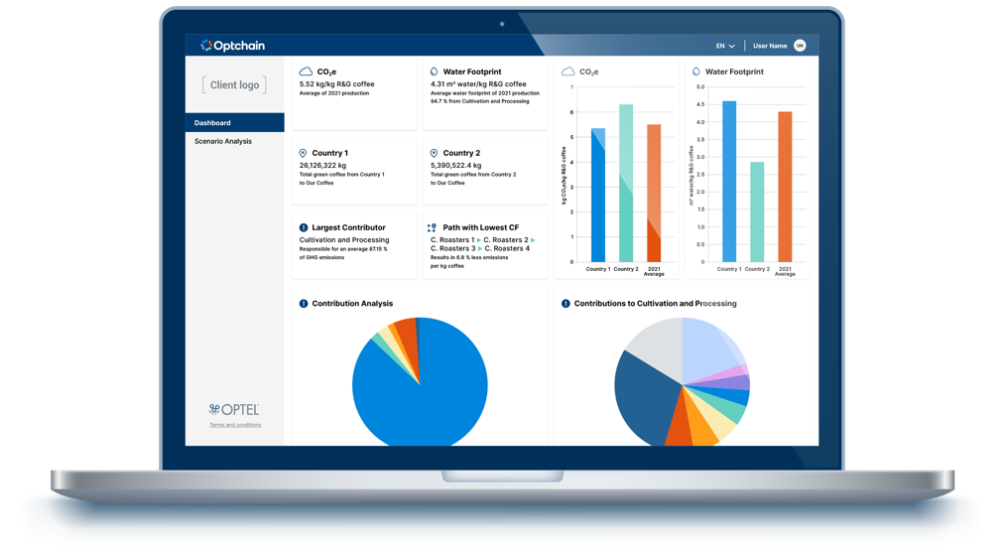
YOUR SUPPLY CHAIN CONTROL TOWER
FOR PERFORMANCE, SUSTAINABILITY
AND COMPLIANCE

Slide 5
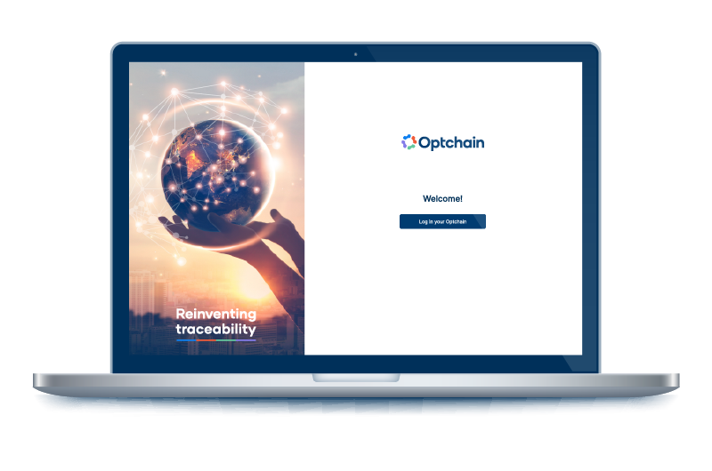
EMPOWER DATA ON YOUR SUPPLY CHAINS
DATA CAPTURE
DATA RETENTION
BUSINESS INTELLIGENCE
Web or Native Application
(Smartphone, Tablet, Computer)
Reports
(Regulatory, ESG, CSR)
Web File Loader
(CSV, Excel, Google Sheet)
Alarms and Alerts
Enterprise Data
(ERP, EAM, MES, GS1 EPCIS, EDI (ANSI), iDoc)
Supply Chain Visibility and Transparency
OptchainTM Web Platform
Emission Factors, I/O, Audits, Consumption Data (Energy, Fuel)
Supplier Assessment
Complete data integrity from trusted contributors and secure platform with user access control
Real-time data consolidation
State-of-the art data segregation
Multiple data-entry methods
Operations Data: OT, SCADA, IoT (Meter Readings, GPS, Humidity, Temperature)
Simulation, Predictive Analytics and Decision Support
Logistics Partner
Integration
Product Passport
Inspection Point
on Production Line
Performance and Benchmarking
RFID Portals
Carbon Footprint
Databases
(LCA Data, Satellite Imagery)
Audit Results

Slide 6




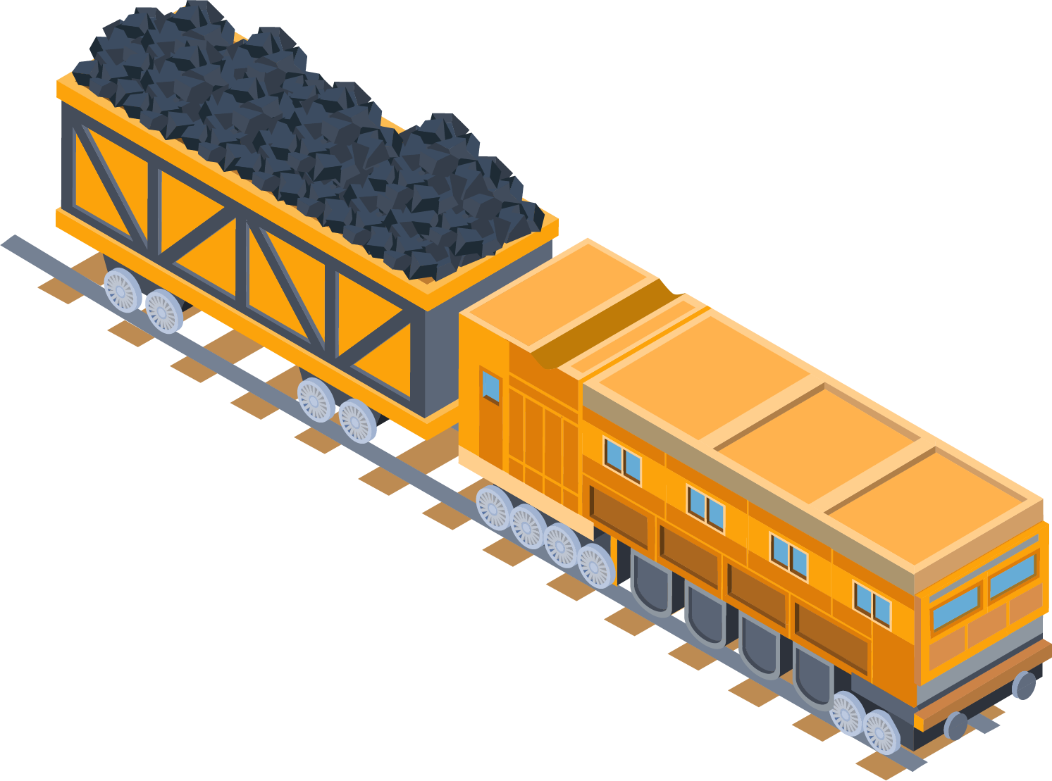



DATA CAPTURE
Enterprise softwares
(MES, ERP, PLC, WMS, DRP)
APIs (EPCIS, EDI, iDoc)
Internet of Things (GPS, RFID, NFC, Smart Labels)
File upload (Excel, CSV, Google)
Manual entry
Mobile/Web application
Supplier onboarding tool

Slide 7

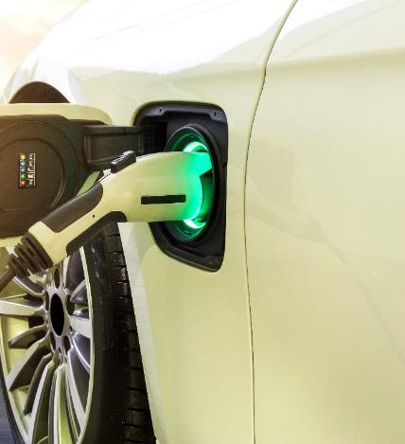

V-TRACE - AN INTEGRATED SOLUTION DEVELOPED
BY TWO GLOBAL LEADERS
V-TRACE, a verified traceability digital solution co-developed by Bureau Veritas and OPTEL, to monitor and control the lithium batteries supply chain, by seamlessly combining verified sustainability performance assessments and point-to-point verified traceability tracking with specialized auditors
GLOBAL LEADER IN SUPPLY CHAIN ASSURANCE, SUSTAINABILITY AUDITS, AND TECHNICAL QUALITY AUDITS
GLOBAL LEADER IN
SUPPLY CHAIN TRACK & TRACE
PLATFORMS AND SOLUTIONS
SUPPLY CHAIN ASSURANCE
TRACK & TRACE PLATFORM

Slide 8



Use Case
V-TRACE, a verified traceability solution co-developed by Bureau Veritas and OPTEL, allow to monitor and control the batteries supply chain, by seamlessly combining verified sustainability performance assessments and point-to-point traceability.
Allow to better understand the supply chain with data you can trust
Control tower providing sustainability, risk management and compliance of the entire supply chain
Give the manufacturer a tool to make more informed decisions on how to reduce its carbon footprint
SUSTAINABILITY
Example of results
of Optchain™ solution
V-TRACE:
Gigafactory
Assured
Traceability

Slide 9



Use Case
Since 2020, Optel is providing the traceability system that allows the Canadian Aluminium industry to certify the origin of the metal crossing the US border, providing full transparency throughout the value chain. The platform connects 3 companies and 10 manufacturing facilities.
Help support & respect trade agreements
Block insertion of non-Canadian aluminium in Canada-U.S. trade
Leverage Canadian “green alu” competitiveness
COMPLIANCE
Example of results
of Optchain™ solution
Canadian
Aluminium Traceability

Slide 10
THANK YOU FOR YOUR INTEREST!
LEARN MORE AT OPTELGROUP.COM
Ken Fallu, Global Head of Strategy, Mining and Batteries
ken.fallu@optelgroup.com

